Slide 1

DATA MINING PROJECT : SEM 1

Slide 2
WhatsApp Chat Analyzer
A Comprehensive Analysis of Your Chat Data

Slide 3
TEAM MEMBER
Shreyash.v.patil
MOHD Zaid
Rohan Biturwar
Prn. 20230804016
Prn. 20230804002
Prn. 20230804013

Slide 4
Table of contents
User Selection and Basic Statistics
Introduction
BLOCK DIAGRAM
Conclusion
Data Processing
Timeline Analysis
Most Common Words and Emoji Analysis

Slide 5
Introduction
WhatsApp has become an integral part of our daily communication, serving as a hub for personal and professional interactions.
Analyzing WhatsApp chat data can provide valuable insights into our communication patterns, language usage, and social dynamics.
This presentation introduces the WhatsApp Chat Analyzer, a tool that enables comprehensive analysis of your WhatsApp chat data.

Slide 6
Data Processing
The WhatsApp Chat Analyzer begins by preprocessing the chat data file, extracting relevant information like sender, message content, timestamps, and media attachments.
It cleans and normalizes the text, removing irrelevant characters, emojis, and punctuation.
This preprocessed data serves as the foundation for further analysis and insights.

Slide 7
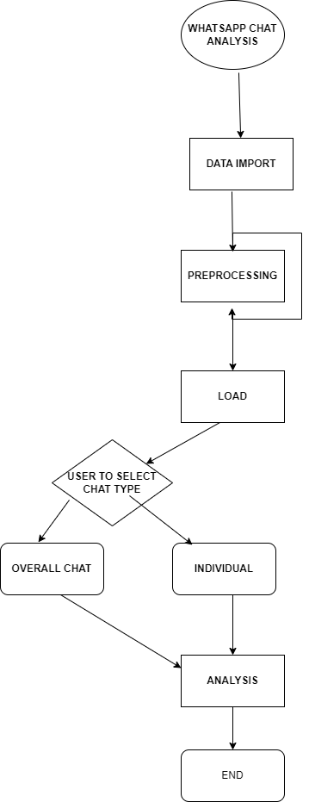
BLOCK DIAGRAM

Slide 8
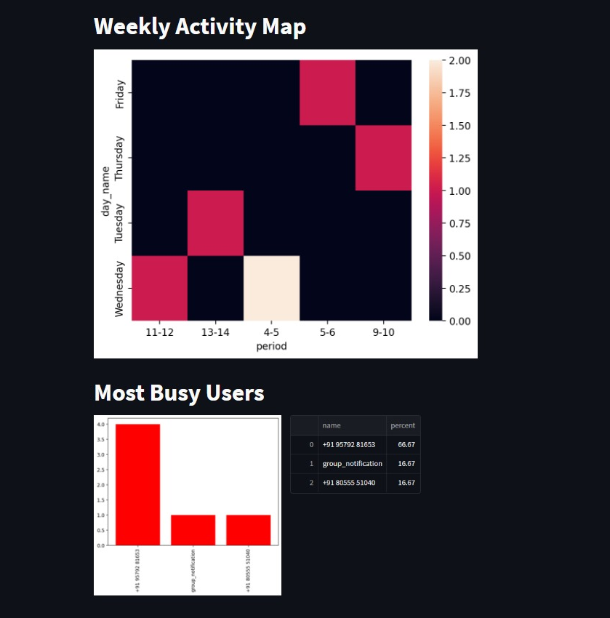
Timeline Analysis
The WhatsApp Chat Analyzer generates monthly and daily timelines to visualize message activity over time.
These timelines reveal patterns in communication trends, identifying periods of increased or decreased activity.
Understanding these patterns can provide insights into individual communication styles and group dynamics.

Slide 9
User Selection and Basic Statistics
The tool allows users to select a specific user for analysis or view overall chat statistics.
For individual user analysis, it provides basic statistics like the total number of messages, words, media messages, and links shared.
This initial overview sets the stage for deeper exploration of the chat data.

Slide 10
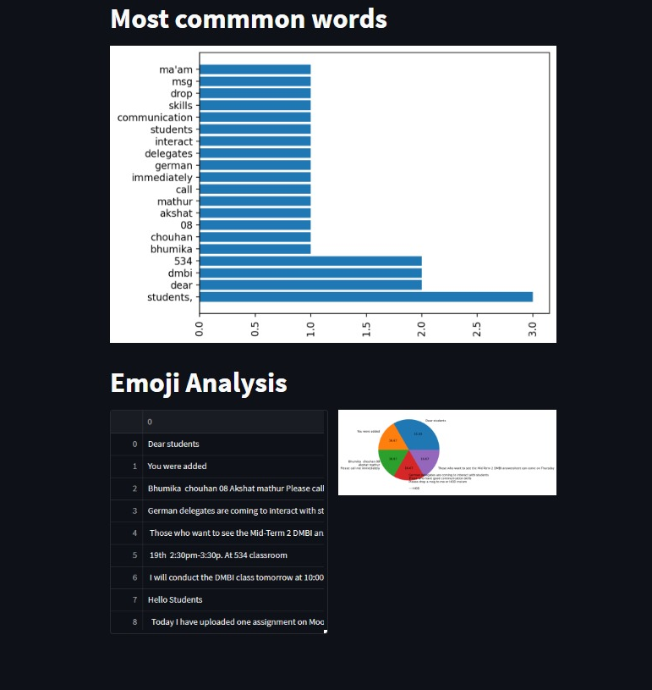
Most Common Words and Emoji Analysis
The WhatsApp Chat Analyzer identifies and displays the most common words used by the selected user.
This analysis can reveal the user's thematic preferences and interests, providing insights into their personality and communication style.
The tool also counts and displays the most frequently used emojis by the selected user, along with a pie chart visualization.
Emoji analysis can provide additional context about the user's emotional tone and communication style

Slide 11
Conclusions
Conclusion 1
Conclusion 2
The WhatsApp Chat Analyzer is a comprehensive tool that empowers users to gain valuable insights from their WhatsApp chat data.
By analyzing message patterns, word usage, and emoji usage, the tool provides a deeper understanding of communication habits, social dynamics, and individual communication styles.
Conclusion 3
The tool can be used for personal reflection, self-improvement, and understanding group dynamics.

