Slide 1
SHREE SAMARTH KRUPA GYM
BY
Rushikesh Tambe 8045
Shreyash Thombare 8073
Rajesh bongane 8074
Manthan shinde 8026

Slide 2
INTRODUCTION -
In the modern era, where everything is becoming digitized, the need for online systems to manage day-to-day operations in various industries is growing rapidly. The fitness industry is no exception. Gyms and fitness centers require efficient systems to manage their memberships, schedules, trainers, and client engagement. Manual processes are time-consuming, prone to errors, and lack the convenience that customers expect today. To address these challenges, we have developed the "SHREE SAMARTH KRUPA GYM Website", a complete web-based gym management system. technologies like used HTML, CSS, JavaScript, PHP, and MySQL

Slide 3
SCOPE -
Personal Fitness & Health
Professional Training & Sports Performance
Fitness Industry & Business Opportunities
Nutrition & Lifestyle Coaching
Community & Social Engagement
Manage booking
Client acquesion
Billing process management

Slide 4
OBJECTIVES -
Improving Physical Fitness – Enhancing strength, endurance, flexibility, and overall cardiovascular health.
Building Muscle Mass – Gaining muscle through weight training and resistance exercises.
Losing Weight – Burning calories and reducing body fat through exercise and diet
To allow new users to register and existing members to log in securely.

Slide 5
Hardware and Software chart
Hardware Software
Computer/laptop HTML, CSS, javascript
Senser(for database) PHP(Backend)
Internet Router MySQL(Database)
Mobile Devices Web Browser
Storage Operating system

Slide 6
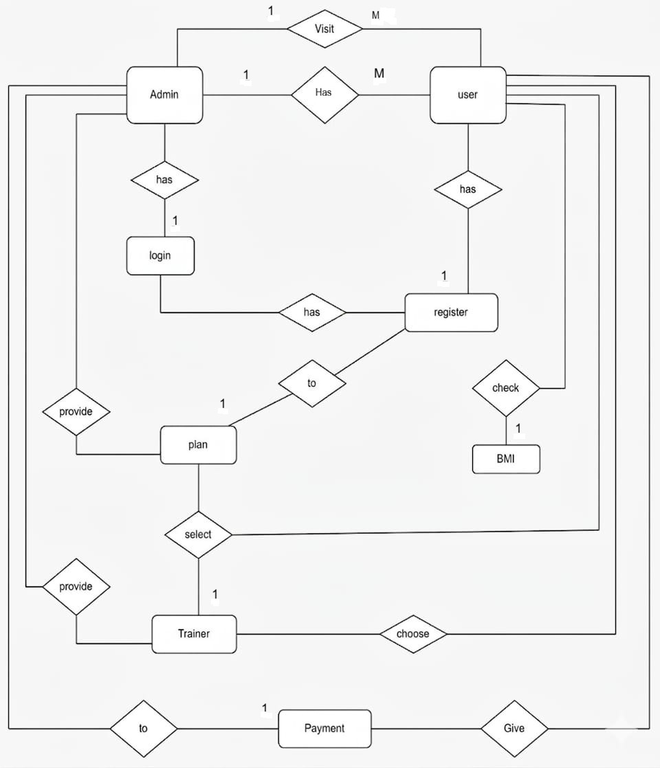
E-R Diagram

Slide 7
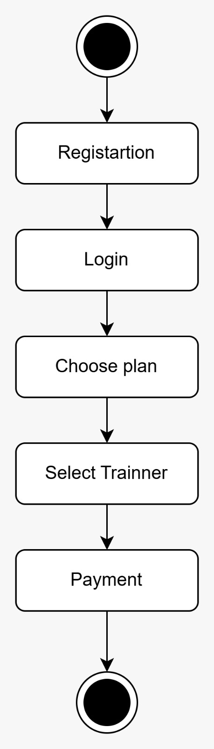
Activity diagram

Slide 8
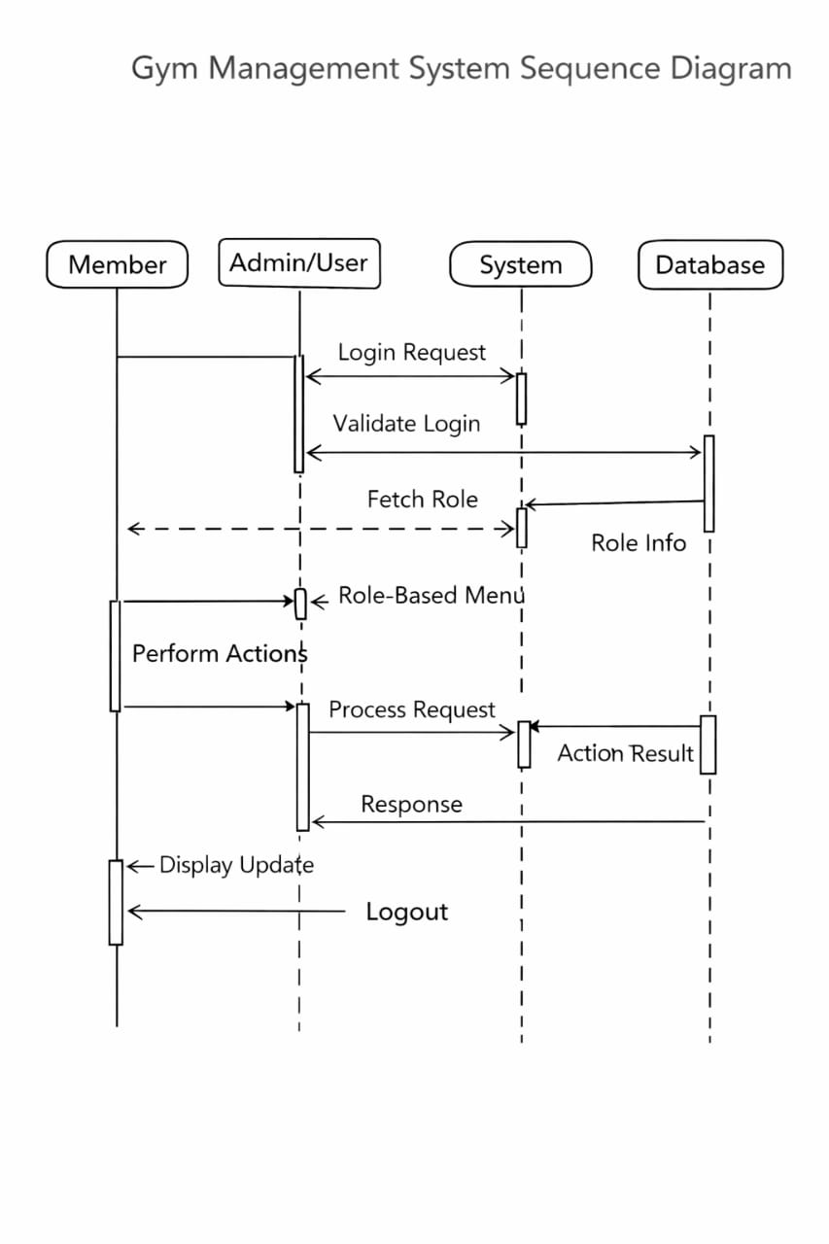
Sequence diagram

Slide 9
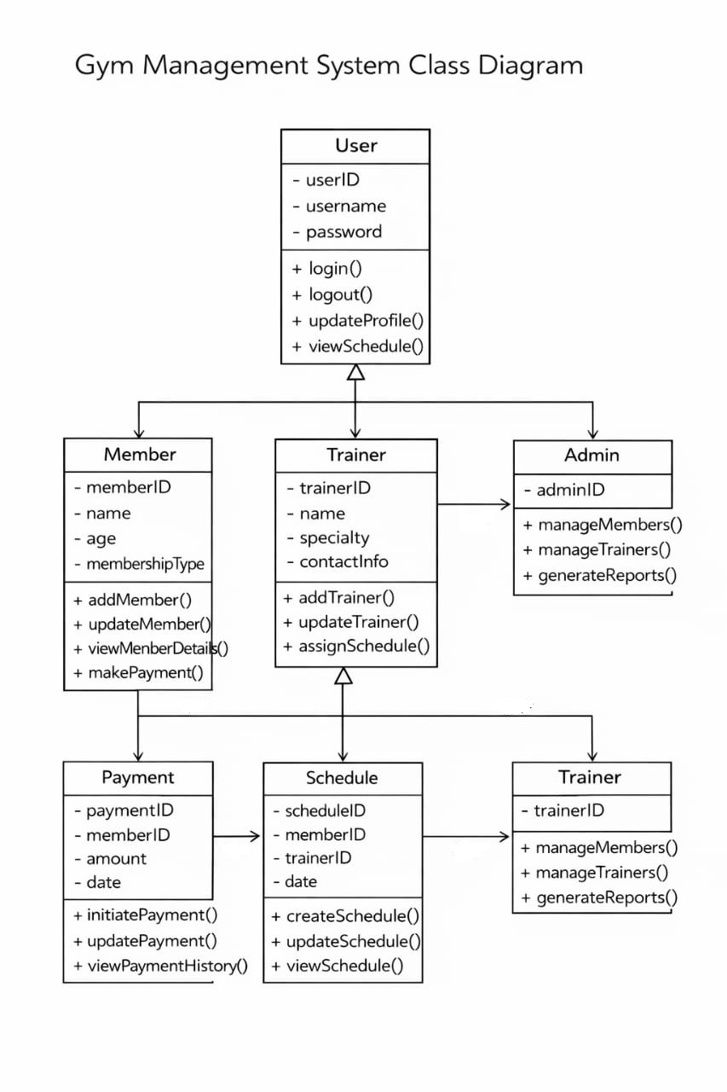
Class diagram

Slide 10
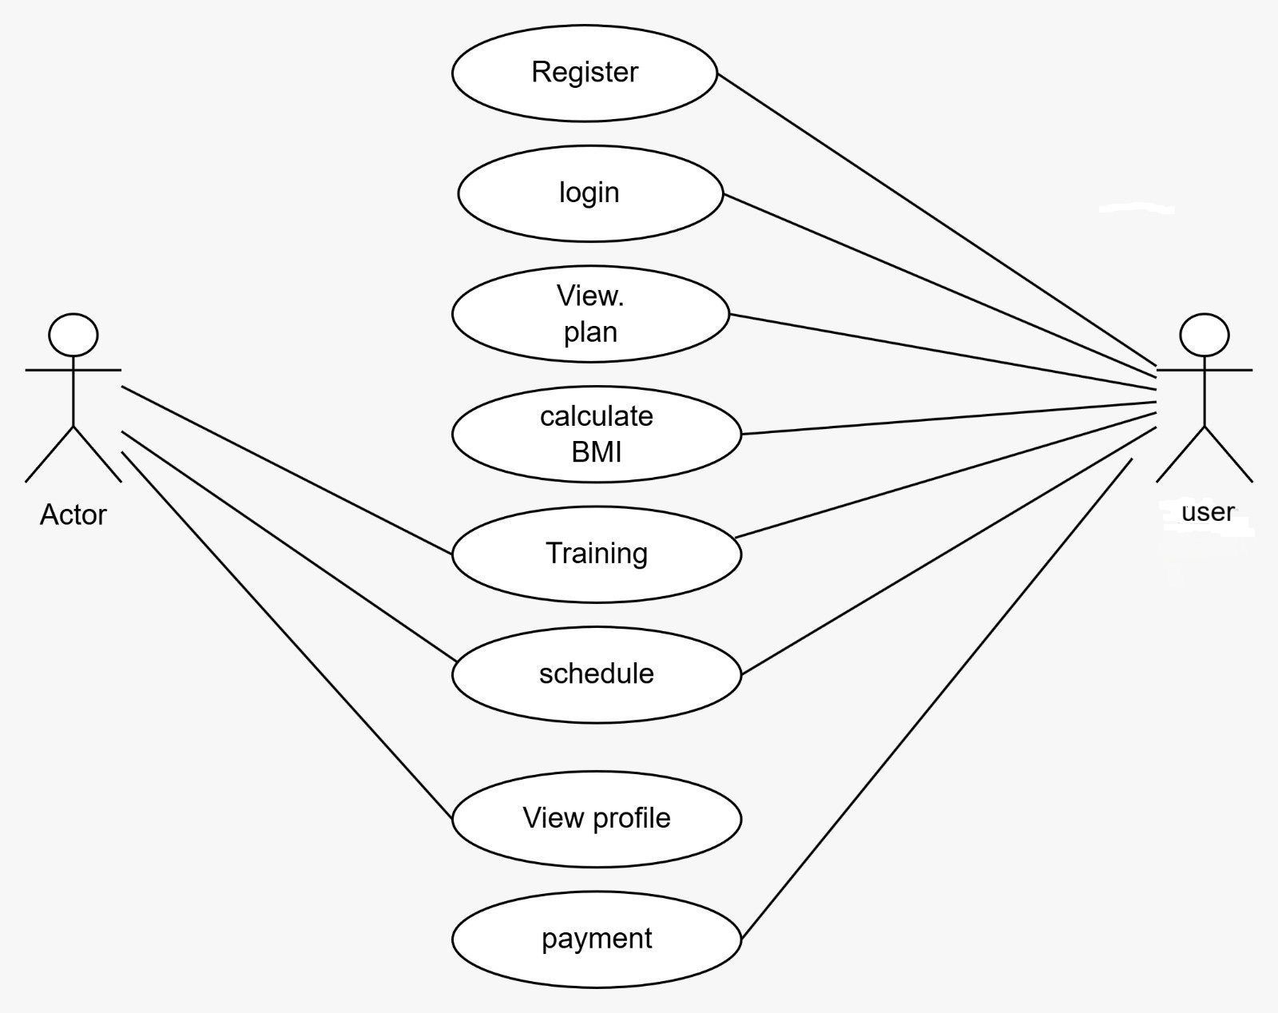
Use-case diagram

Slide 11
ADVANTAGES -
Cost-Effective Development
Interactive User Experience
Real-Time Updates
Easy Maintenance and Updates
Easy to use Personalized Support
User-Friendly Interface:
Online Membership Management

Slide 12
DISAVANTAGES -
Limited Backend Functionality
Security Concerns
Browser Compatibility Issues
Limited Functionality
Technical Maintenance

Slide 13
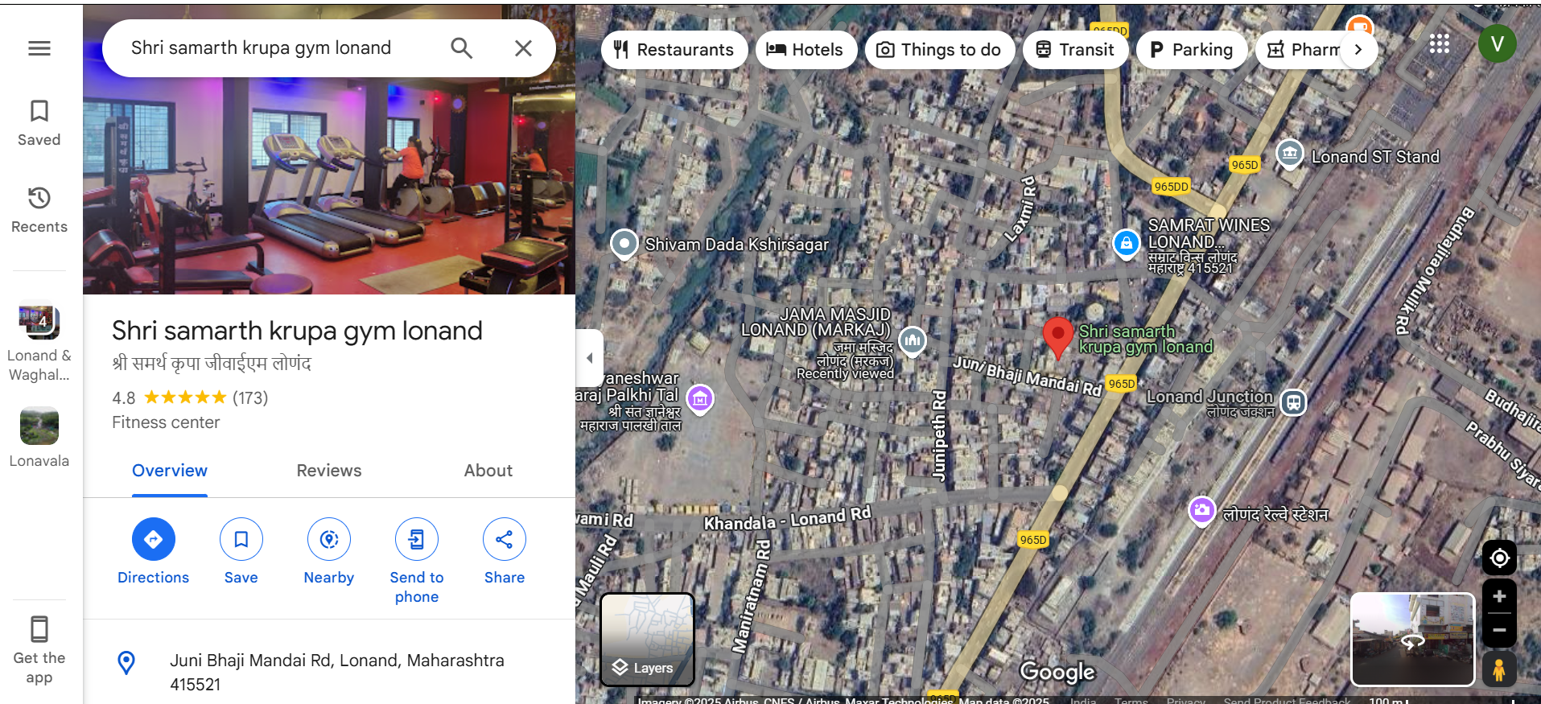
ADDRESS DEATILS

Slide 14
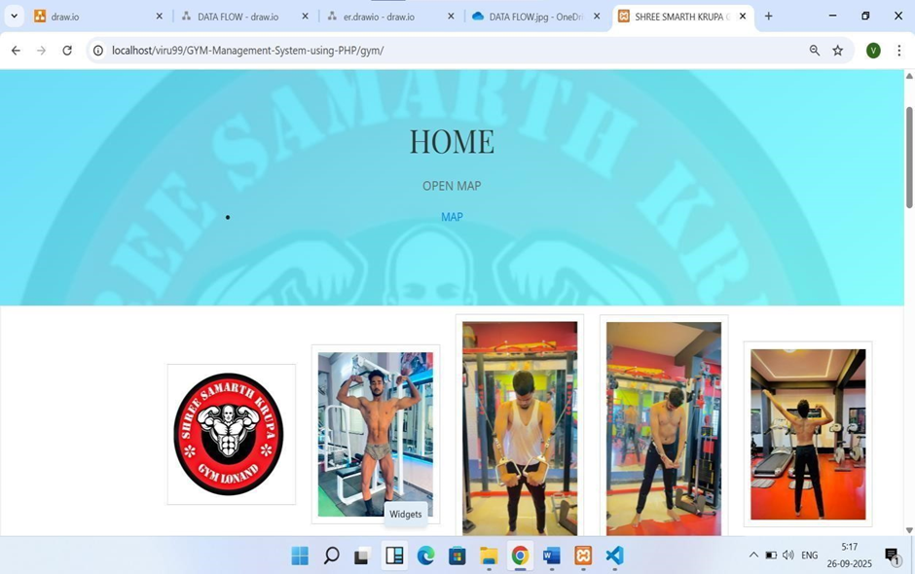
HOME PAGE

Slide 15
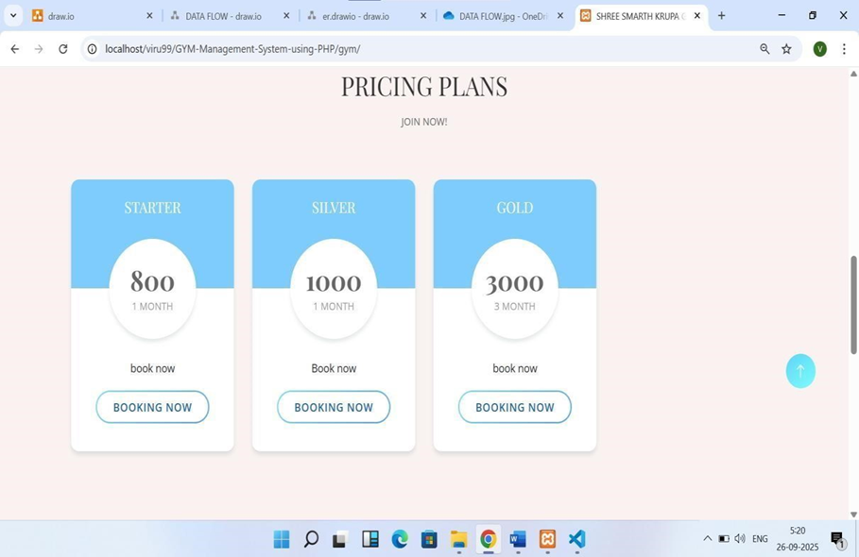
PLAN DISCRIPTION

Slide 16
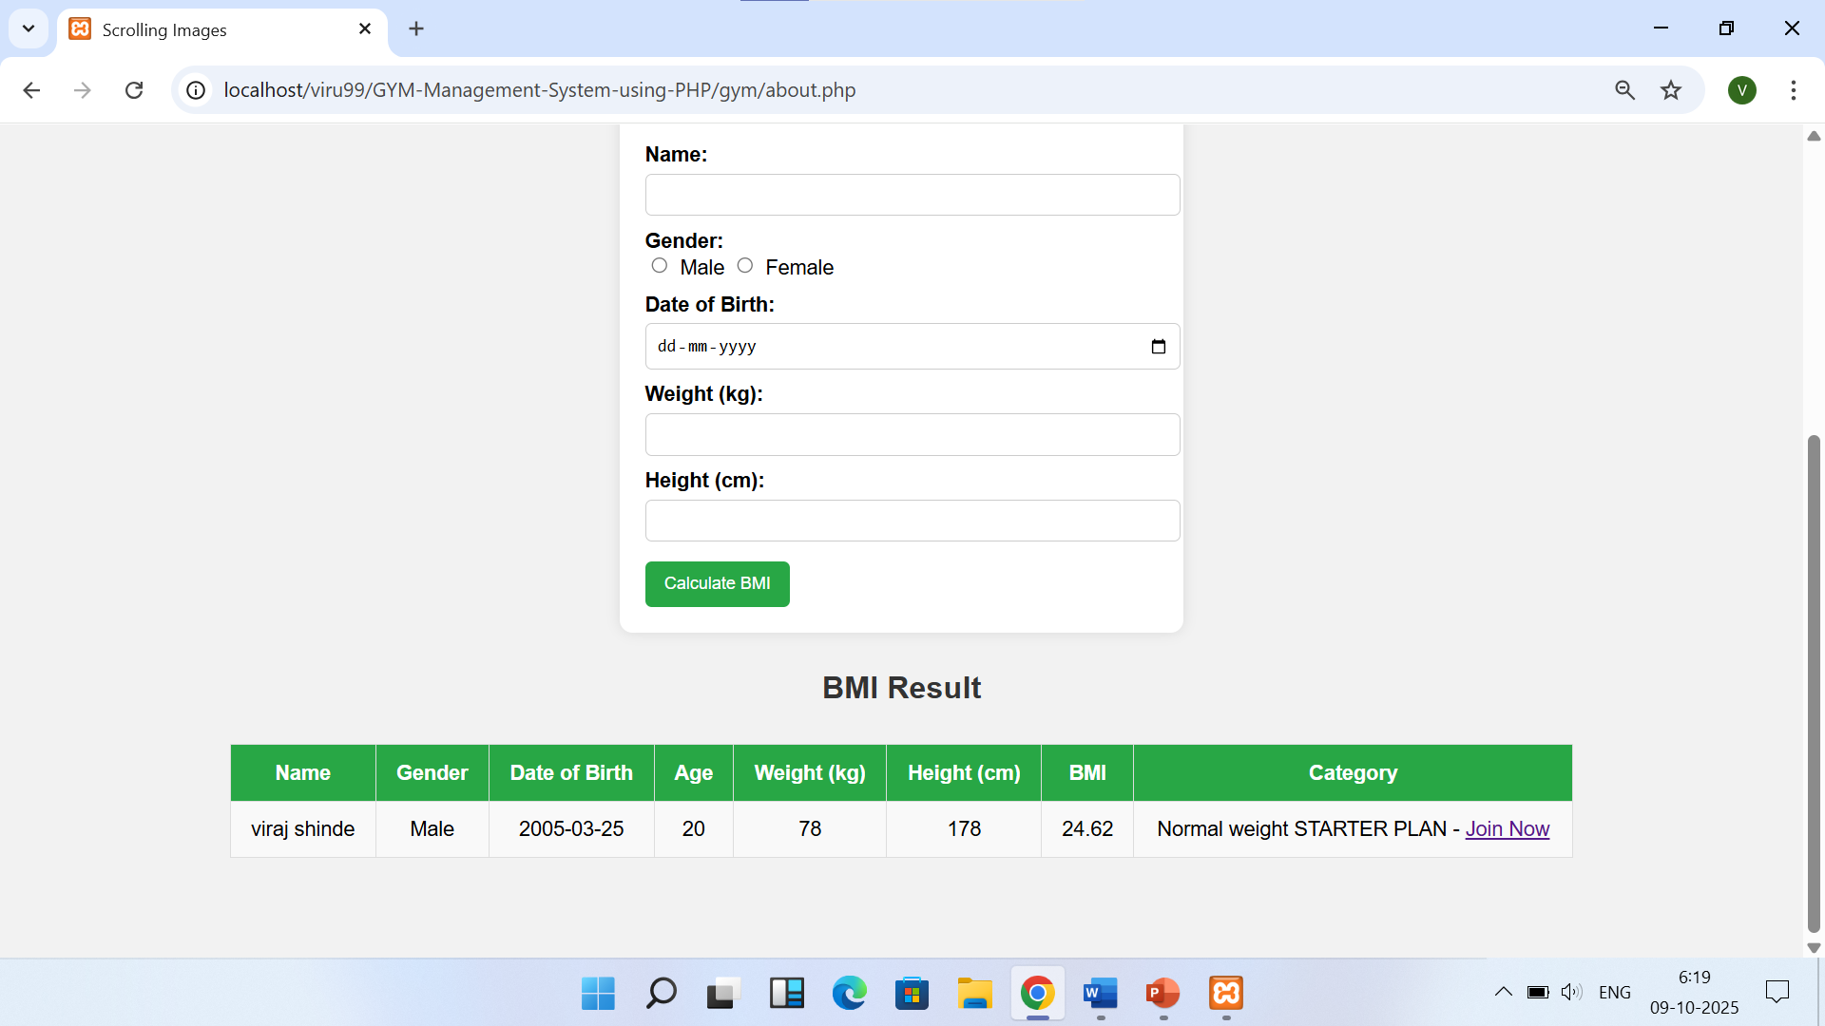
BODY MASS INDEX

Slide 17
THANK YOU

