Slide 1
TRENDS IN EDUCATION EQUITY: ACCESS TO RESOURCES AND OUTCOMES
By ~ Shreyash Singh – RA2211027010159 K Raghava Raju – RA2211027010195 G Prajasree – RA2211031010158

Slide 2
Introduction to Education Equity:
Definition: Education equity refers to the fairness in access to educational resources, opportunities, and outcomes.
Goal: To ensure all students have equal opportunities to succeed regardless of socioeconomic background, gender, or geography.
Importance: Understanding trends in resource allocation and outcomes helps policymakers address gaps and create a more equitable system.

Slide 3
Data Sources & Visualization:
Data Sources: Collected from 195 countries over 6 decades (1971-2024).
Education-related indicators: Attendance rates, funding, and student outcomes, sexes(males and females), mode of education(primary or secondary)
Visualization Methods: Bar charts, maps, tree maps, pie charts, and matrix charts using Power BI.

Slide 4
Global Trends in Education Resources (1971–2024):
Key Data Trends:
- Countries like China, India, the United States, and Indonesia show significant educational investments.
- Data tracked from years such as 1971, 1974, 1982, 1988, and 2011.
Chart Type:
- Line or bar graph showcasing funding over time.

Slide 5
Comparative Analysis of Countries:
Countries Analyzed: China, India, Brazil, Russian Federation, Japan.
Indicators: Educational attendance, financial investment in education.
Findings: China shows sharp increases in educational investments, while other countries exhibit disparities in rural vs. urban access.

Slide 6
Outcomes Based on Educational Investments:
Impact of increased funding on attendance and literacy rates.
Disparities in outcomes based on gender and region (e.g., rural vs. urban).
Predictions for 2024 based on past trends.

Slide 7
Geographic Disparities in Education Access:
Regional differences in access to education.
Sub-Saharan Africa: Continued challenges.
East Asia & Pacific: Large improvements in educational funding.

Slide 8
Tools Used in Analysis:
Power BI: Used for tracking trends in education equity.
Tree maps, funnel charts, and matrix views used to analyze data.
Map data: Visualized geographic disparities in educational access.

Slide 9
Future Predictions and Goals:
Predictions for 2024:
- Continued increase in educational funding in developing countries.
- Gender parity and rural-urban gaps expected to narrow.
Goal: Bridge the gaps in educational resources and outcomes.

Slide 10
Conclusion:
Education equity trends show improvements, but disparities remain.
Effective policy-making requires understanding resource allocation and its outcomes.
Call to Action: Focus on equitable distribution of educational resources.

Slide 11
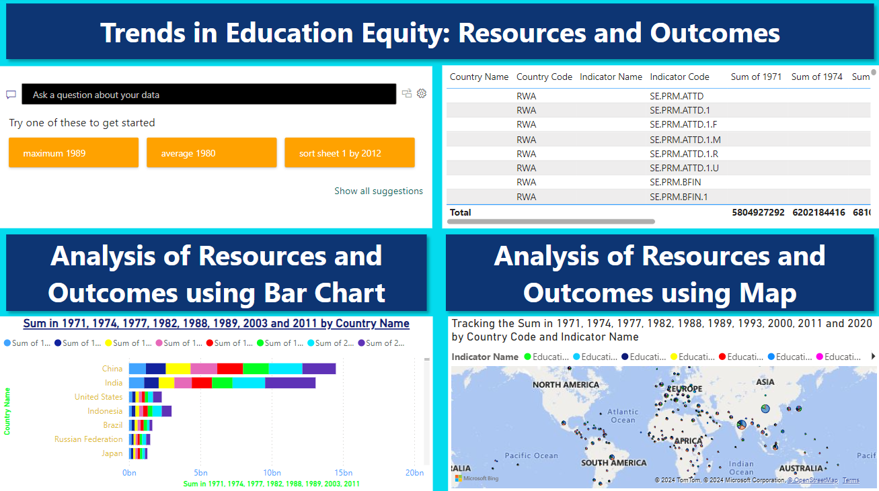

Slide 12
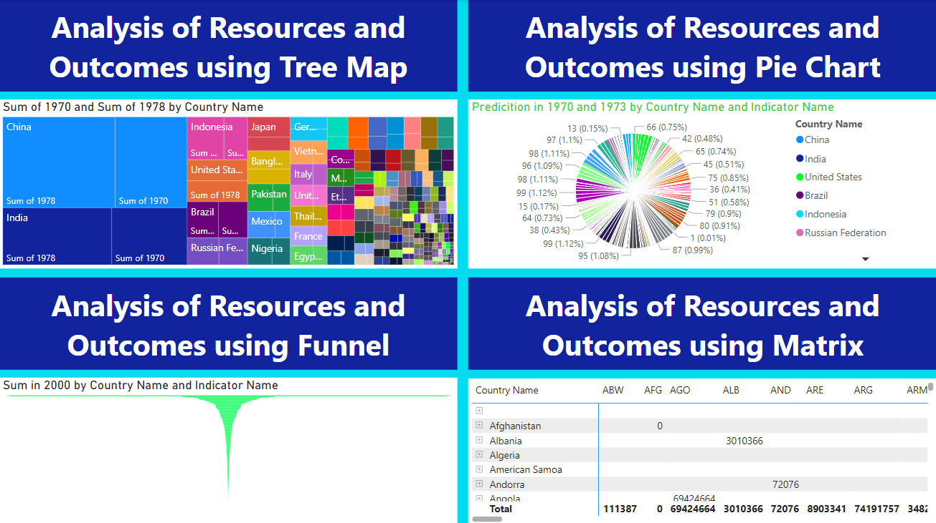

Slide 13
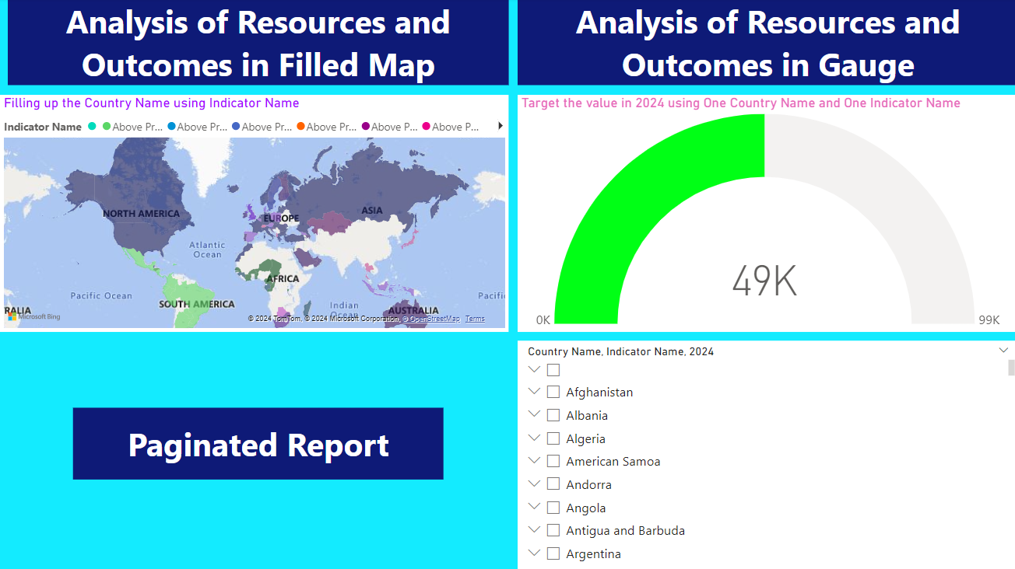

Slide 14
THANK YOU

