Slide 1
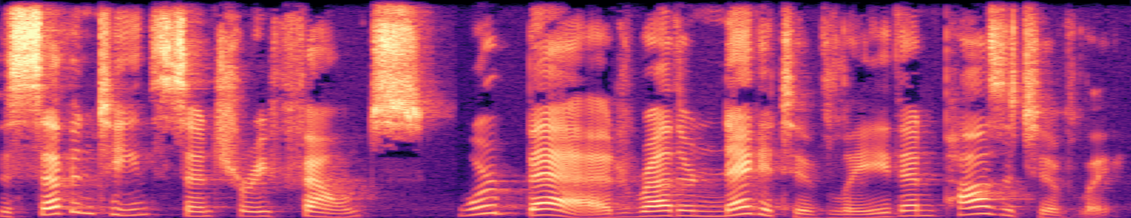
UE24CS352A · MACHINE LEARNING · MINI-PROJECT #20
Colatron
Reproducing & Extending End-to-End Text-to-Speech
Team 23 · PES University, Section H
Shriram Chandrasekar (PES2UG24CS495) · Shreyash Yadwad (PES2UG24CS493)
Reference: Wang, Yang & Li, “End-to-End Text to Speech Synthesis”, CS229 Project Report, Stanford, Autumn 2018
Notes:
Colatron: we reproduce the three models of Wang, Yang & Li's CS229 project (2018) and extend it with DCTTS. Team 23 — Shriram Chandrasekar and Shreyash Yadwad.

Slide 2
Text in, waveform out — no hand-built front-end
1
Part 1 — Reproduce
2
Part 2 — Extend
The paper’s three models: per-timestep SVR, flattened-output MLP, LSTM seq2seq with attention
Same data, preprocessing and Griffin-Lim vocoding
Reported-vs-Ours table with a reason for every gap
DCTTS: convolutional Text2Mel + SSRN with guided-attention loss
Chosen to attack the paper’s main failure mode: attention drift → repeated words
Not used by the paper; same data, split and metrics
CONSTRAINTS
CPU-only
Time-boxed training
All seeds = 42
Every number traceable to code that ran
Notes:
Goal: map text straight to a waveform. Part 1 reproduces the three models; Part 2 adds DCTTS, a model the paper did not use, aimed at its main failure mode. Everything ran on CPU with seed 42 and time-boxed training.

Slide 3
The reference paper: Colatron (CS229, 2018)
LJ Speech · single speaker · trained on ~200 sentences
TEXT
AUDIO
MODEL
OUTPUT
CMU map:
phonemes | letters
Pre-emphasis
+ STFT (1025 bins)
SVR · NN ·
Seq2Seq
Griffin-Lim
→ .wav
HUMAN MOS (10 Stanford raters, Table 2)
1.0
1.7
2.5
!
Key finding
Seq2Seq sounds like speech but repeats words and leaves sentences incomplete
Cause: the attention alignment drifts
SVR: disjoint words · NN: random phoneme mix
SVR
NN
Seq2Seq
Tacotron’s 3.82 cited for context only
Notes:
The paper's pipeline: CMU phoneme/letter mapping, pre-emphasis and a 1025-bin STFT, one of three models, and Griffin-Lim to get audio. Human MOS ranks SVR 1.0 < NN 1.7 < Seq2Seq 2.5. Its key failure: seq2seq repeats words because attention drifts — that motivates our extension.

Slide 4
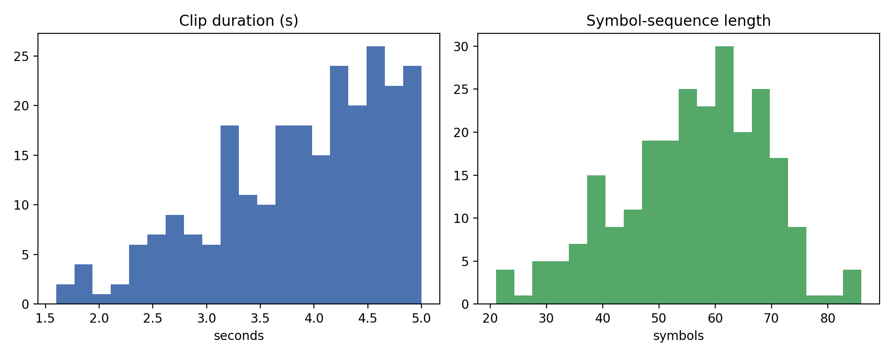
Data & preprocessing pipeline
200 / 25 / 25
1.5–5.0 s
42
train / dev / test
clip band
seed
LJ Speech 1.1, streamed from the HuggingFace parquet mirror (no 2.6 GB tar)
Clip band keeps CPU zero-padding tractable — the same memory wall the authors report
Text: each word → CMU phonemes or letters (p = 0.5) → symbol IDs → padded
Inversion: Griffin-Lim (60 iters, power 1.5) + de-emphasis, shared by every model
Clip durations and symbol-sequence lengths across all 250 clips
AUDIO FRONT-END — TAKEN FROM THE AUTHORS’ CODE
sr
n_fft
hop
20 kHz
2048 (1025 bins)
250 (12.5 ms)
win
pre-emphasis
log-dB norm.
1000 (50 ms)
0.97
scaled to [0, 1]
Notes:
Fixed 200/25/25 split with seed 42, clips limited to 1.5–5 s so padding fits on CPU — the paper never says which 200 sentences it used. Audio parameters are copied from the authors' released code, and every model shares the same Griffin-Lim inversion.

Slide 5
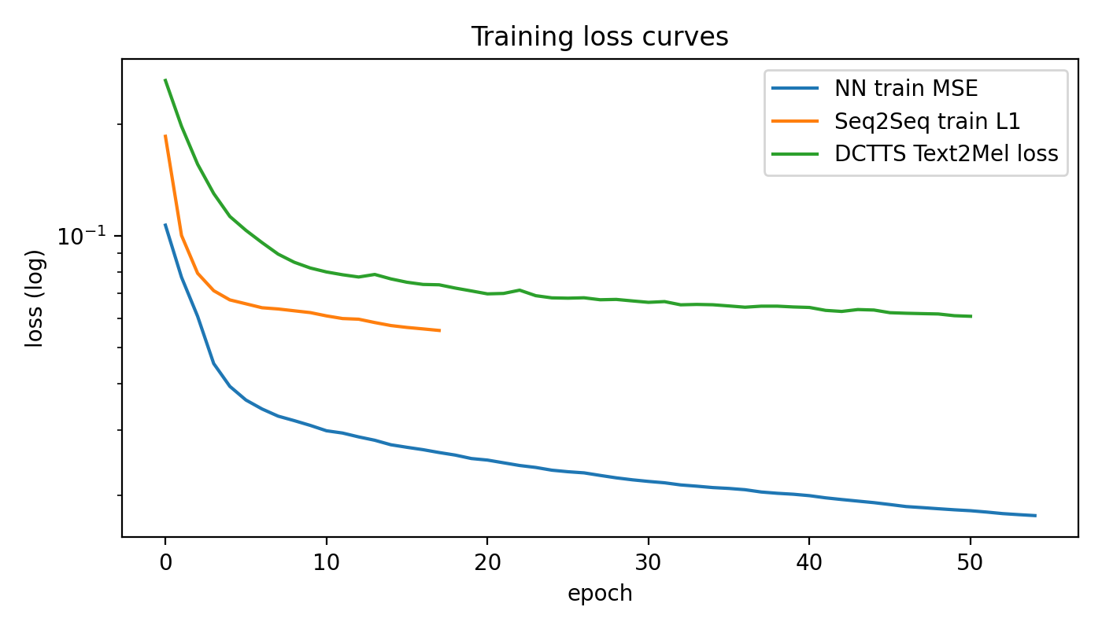
The three reproduced models
1
SVR (polynomial)
One regressor per output frame; predicts the top-16 PCA components of the spectrum (C = 1, ε = 0.2, as in the authors’ code)
2
Simple NN
Authors’ MLP: raw symbol IDs → 2 × Dense(width = input, ReLU) → Dense(T × 1025, sigmoid); Adam, MSE, batch 10
Training losses (log scale); runs are time-boxed with checkpoints
3
Seq2Seq + attention
CPU deviations: SVR fits PCA components instead of 1025 bins; Seq2Seq latent 512 → 256; linear-kernel SVR iteration-capped
BiLSTM encoder → LSTM decoder with Bahdanau attention; teacher forcing; autoregressive stop at 1.2 × longest train target
Notes:
SVR: one regressor per frame on PCA-compressed spectra. NN: exactly the authors' MLP. Seq2Seq: BiLSTM encoder, LSTM decoder, Bahdanau attention, latent cut to 256 for CPU. The loss plot shows all runs converging inside their time boxes.

Slide 6
Evaluation — honest about MOS
OBJECTIVE · 25 HELD-OUT TEST CLIPS
PERCEPTUAL
MOS needs human raters — it can’t be fully automated
MCD
↓ better
Mel-cepstral distortion, aligned with DTW
UTMOS (neural predicted MOS) — our primary automated column
Optional small human test — reported only if collected (paper used n = 10 raters)
CER / WER
↓ better
Whisper ASR transcribes our audio — a direct proxy for repeated or missing words
4.34 ground truth 3.01 GT + Griffin-Lim
Spectrogram L1
↓ better
UTMOS references: Griffin-Lim alone caps quality at 3.01
Frame-wise distance to the ground-truth spectrogram
Notes:
We can't run a full MOS study, so UTMOS — a neural MOS predictor — stands in, and a small human test is reported only if collected. Note the references: real audio scores 4.34, but passing it through Griffin-Lim drops it to 3.01, so that's the ceiling for every model here. CER/WER from Whisper directly measures repeated or missing words.

Slide 7
Reported vs ours
Model | Reported MOS (paper) | UTMOS ↑ | MCD ↓ | CER ↓ | WER ↓ | spec L1 ↓
Ground truth (ref) | — | 4.34 | 0.05 | 0.040 | 0.052 | —
GT + Griffin-Lim (vocoder ceiling, ref) | — | 3.01 | 23.16 | 0.041 | 0.055 | —
SVR (poly) | 1.0 | 1.31 | 42.41 | 0.834 | 0.985 | 0.161
SVR (linear) | — | 1.30 | 53.03 | 0.891 | 0.993 | 0.213
Simple NN | 1.7 | 1.39 | 40.99 | 0.934 | 0.996 | 0.157
Seq2Seq + attention | 2.5 | 1.63 | 51.34 | 0.929 | 0.996 | 0.169
DCTTS (extension) | — | 1.44 | 51.44 | 0.915 | 1.000 | 0.189
RANKING CHECK
Paper (human MOS): SVR 1.0 < NN 1.7 < Seq2Seq 2.5
Ours (UTMOS): SVR 1.31 < NN 1.39 < Seq2Seq 1.63
✓
Notes:
All objective metrics on the 25 test clips. Absolute UTMOS values are low for every model — remember the Griffin-Lim ceiling is 3.01 — but the ordering SVR < NN < Seq2Seq matches the paper's human MOS. DCTTS, highlighted, lands between NN and Seq2Seq on UTMOS.

Slide 8
Extension: DCTTS with guided attention
Tachibana et al., 2018 — fully convolutional, two networks
WHY THIS MODEL
+ guided-attention loss
1
Targets the failure
Text2Mel
Forces a near-diagonal alignment — drift is what the paper blames for repeated words
Conv text encoder + audio encoder/decoder → mel spectrogram (80)
2
Fast on small data
Convolutions train far faster than RNNs on CPU with 200 clips
SSRN
Channel-expanding 80 → 1025 bins (mel & linear share the hop)
3
New to this paper
It cites only Tacotron, Char2Wav and Deep Voice 3 — not DCTTS
Griffin-Lim
4
Fair comparison
Same inversion as every other model
Same data, split and metrics; channels reduced for the CPU budget
Notes:
DCTTS has two convolutional networks: Text2Mel predicts a mel spectrogram, SSRN expands it to the full 1025-bin spectrum. The guided-attention loss penalises attention far from the diagonal, which is exactly the failure the paper reports. It also trains much faster than an RNN on CPU. Same data, split and metrics as the reproduction.

Slide 9
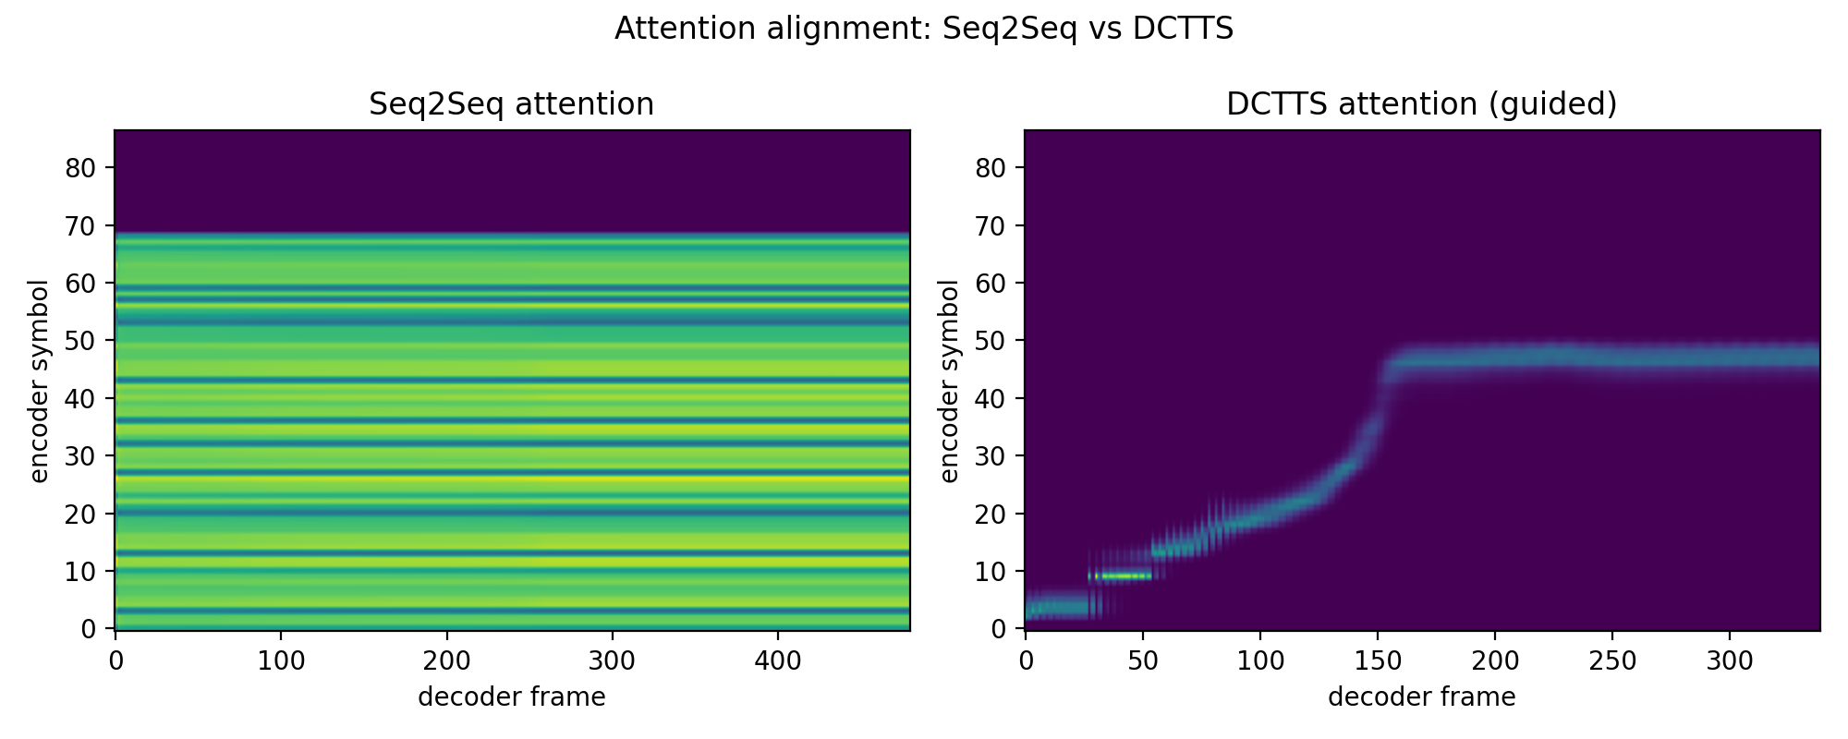
Attention: Seq2Seq vs DCTTS
Seq2Seq: uniform horizontal bands — every frame attends to the same symbols, so there is no alignment
DCTTS: monotonic, near-diagonal path over the first ~155 frames, then a plateau
Notes:
This is the key figure. Left: seq2seq attention is a set of horizontal bands — each decoder frame looks at the same mixture of symbols, so it never walks through the text; that's the mechanism behind repeated words. Right: DCTTS with guided attention moves monotonically through the symbols. The mechanism is fixed.

Slide 10
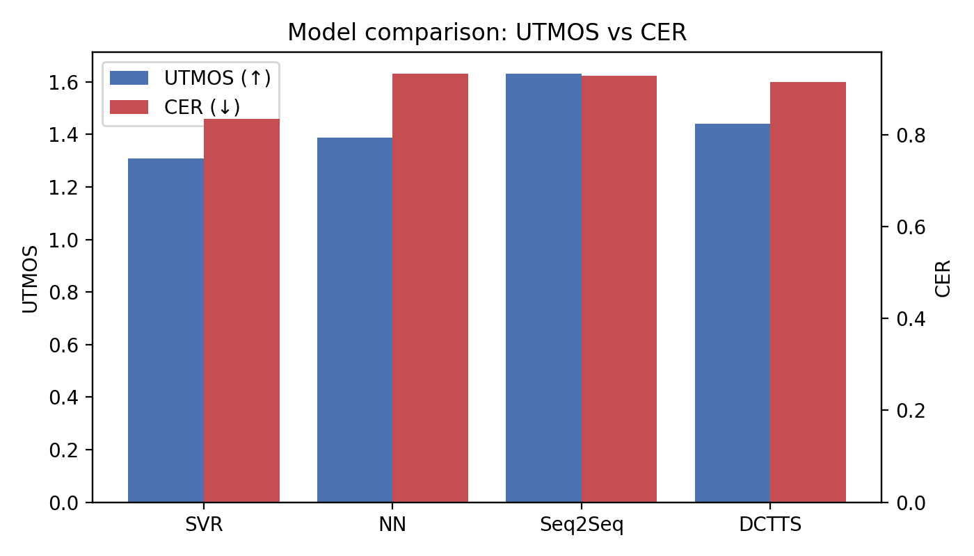
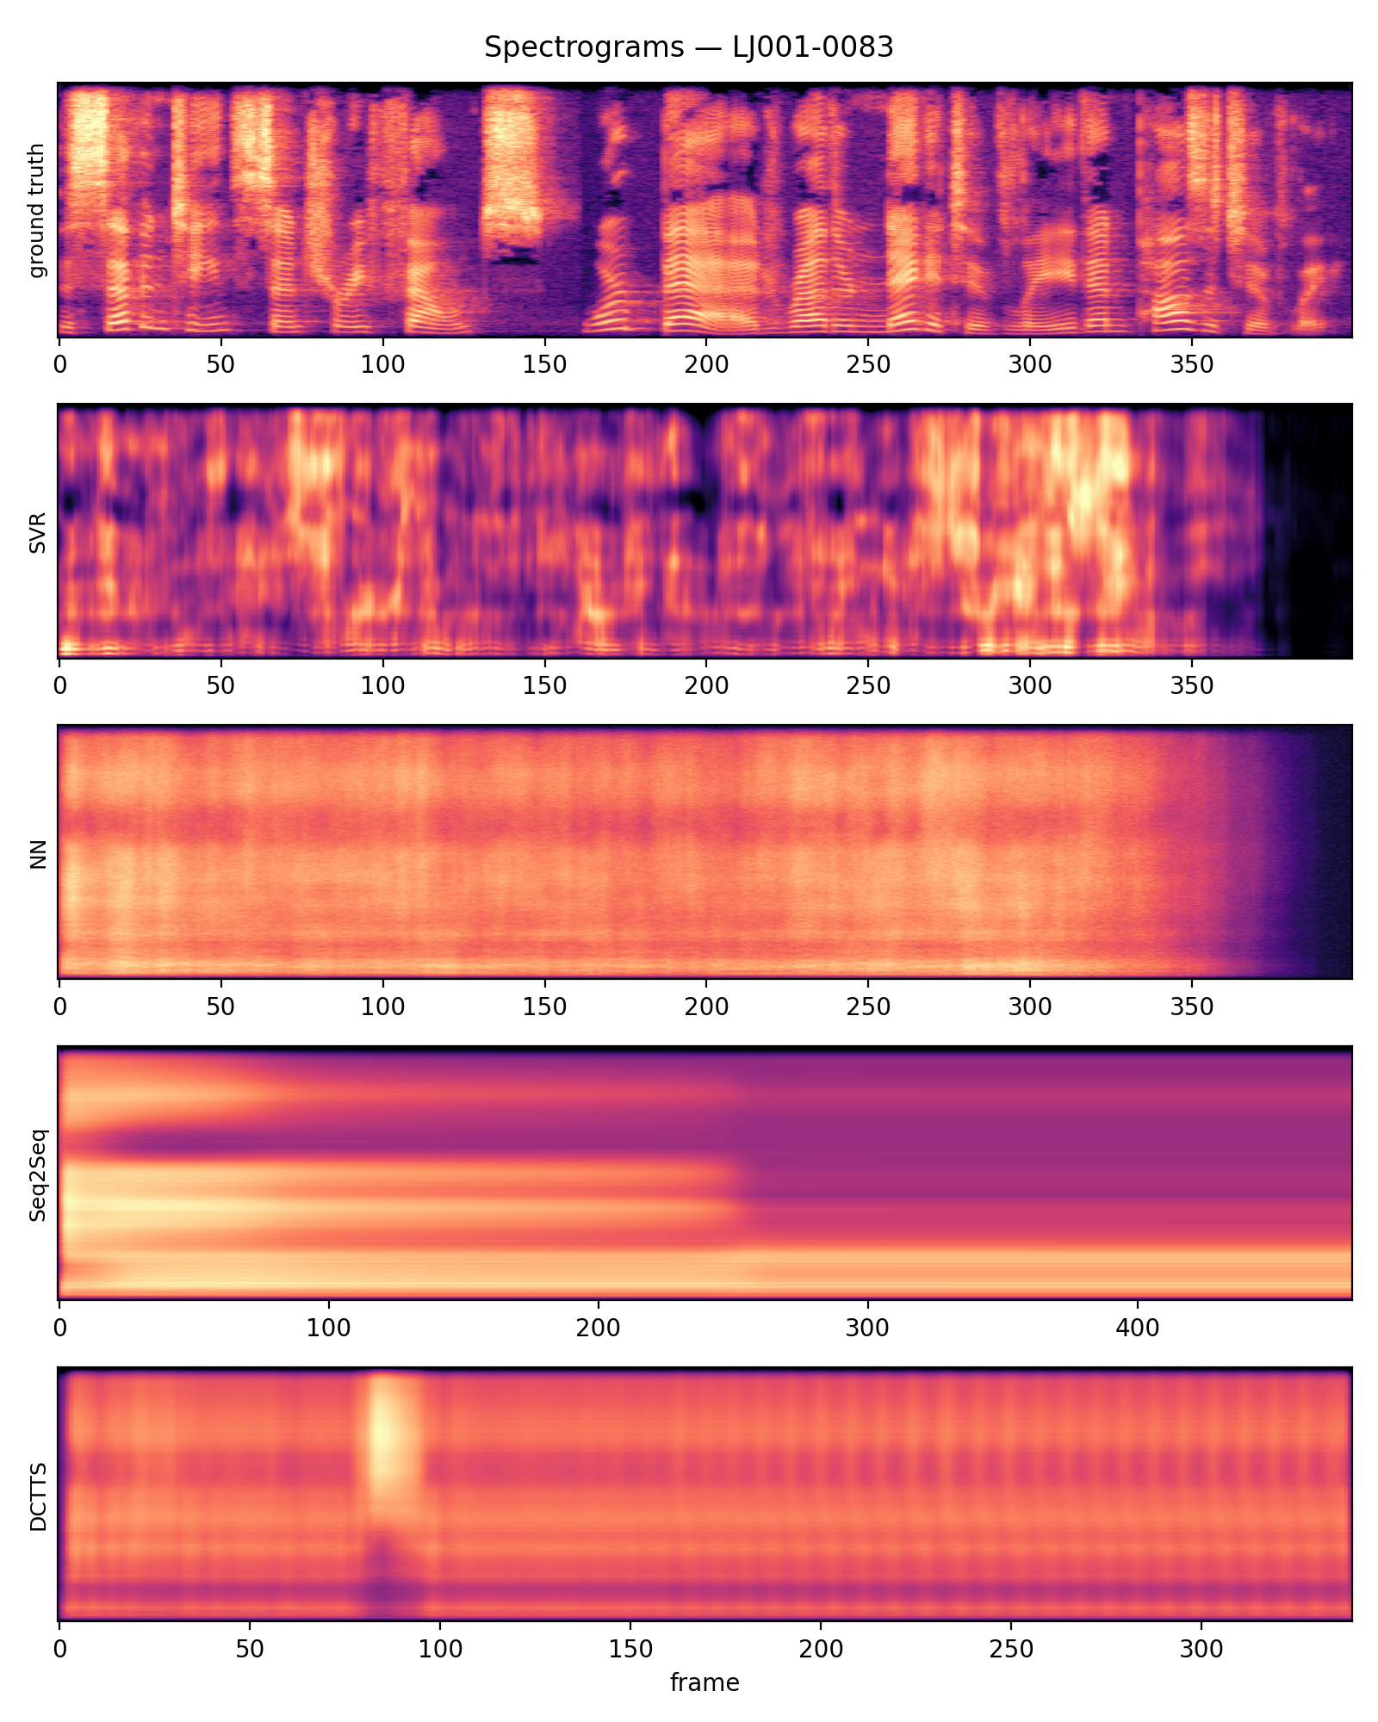
Final comparison
DCTTS vs Seq2Seq — paired Wilcoxon signed-rank, 25 utterances
UTMOS 1.441 vs 1.633
CER 0.915 vs 0.929
W = 71.0, p = 0.0125
W = 91.0, p = 0.3945
DCTTS significantly lower
No significant difference
Spectrograms, test clip LJ001-0083
Notes:
Bars: blue is UTMOS (higher is better), red is CER (lower is better). Seq2Seq has the best UTMOS. Paired test against Seq2Seq: DCTTS UTMOS is significantly lower (p = 0.0125) and CER is statistically the same (p = 0.3945). The spectrograms show why absolute scores are low — none of the models recovers the harmonic structure of the ground truth.

Slide 11
Conclusions & future work
200 sentences is the binding constraint, not the model.
What worked
Honest verdict
Why numbers differ
UTMOS recovers the paper’s ranking: SVR 1.31 < NN 1.39 < Seq2Seq 1.63
DCTTS fixes the mechanism: far more diagonal, monotonic attention
No perceptual gain on this budget: UTMOS significantly lower (p = 0.0125)
CER statistically tied (p = 0.3945)
Better alignment helps alignment, not naturalness
MOS ≈ UTMOS, not 10 human raters
A different 200-sentence subset
Griffin-Lim caps quality (GT + GL: 3.01)
Models shrunk and time-boxed on CPU
Future work: more training data · a neural vocoder (HiFi-GAN) · full-size models on GPU
Notes:
Three points. One: our automated proxy reproduces the paper's ranking. Two: DCTTS fixes the alignment mechanism, but on 200 clips and a CPU budget it doesn't sound better — UTMOS is significantly lower and CER is tied. Three: our numbers differ from the paper for four stated reasons. The takeaway matches the paper's own conclusion: data is the binding constraint. Next steps: more data, a neural vocoder like HiFi-GAN, full-size models on GPU.

Slide 12
Thank you — questions?
LIVE DEMO
REPOSITORY
python main.py --demo "..."
src/ audio, text, dataset, models, evaluation
data/splits/ fixed 200/25/25 lists
Synthesises one sentence with all 4 models in under 60 s on CPU
results/ metrics, tables, audio, figures
python main.py --all
docs/ paper spec, write-up, slides
reference/ paper PDFs + authors’ code
Full pipeline: data → train → synth → eval → tables → figures
checkpoints/ weights for --demo
Team 23 · Shriram Chandrasekar (PES2UG24CS495) · Shreyash Yadwad (PES2UG24CS493)
Notes:
Happy to run the demo live: one command synthesises a sentence with all four models in under a minute on CPU. Everything in the deck regenerates from python main.py --all.

