Slide 1

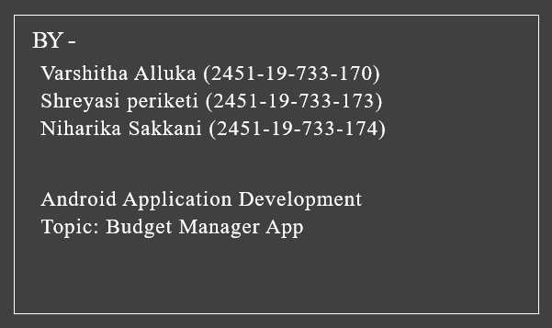
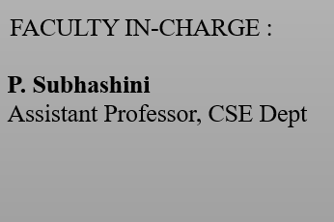
Title: BUDGET MANAGER ANDROID APP

Slide 2

CONTENTS
Abstract
Problem Statement
Scope of the project
Hardware & Software requirements
UML diagrams
Implementation
Results/Outputs
Conclusions & Future Enhancements
References/Bibliography

Slide 3
ABSTRACT
Android is the best mobile operating system platform for developing apps. There are many financial-related apps available on the app store but this application is unique with the best features. The budget management presented in the application can also be used to help enterprises to improve and optimize business processes and then achieve better control of business processes.
The budget Manager App helps manage personal budgets. After adding your budgets, simply record your day-to-day transactions. You can then view how close your spending is to your budget. Budget Manager helps you keep track of your spending, and keep your data as your own. The application requires very few permissions and never attempts to access the Internet. There is an option to back up your cards to local storage. From there you can send the backup somewhere safe.

Slide 4
PROBLEM STATEMENT
Budget management is the total budget of an individual in all aspects and the various stages of economic activities for the future of a certain period of time. It is the most important part of integrated management, which is the combination of objectives management, ratio management, and responsibility management.
As an internal allocation of resources, Budget Management’s biggest advantage is achieving maximum efficiency in any changing circumstances. Through the planning, organization, control, coordination, and integration functions, the accurate allocation of resources is achieved. And this Android application is designed for that purpose.
These days, more and more people are concerned about Budget Management in their lives because it is a powerful tool for the allocation of money to important events, for investing and buying personal stuff. Having an app like this helps us to describe the future allocation of money and the development of our careers and life. Many people have some ideas about budget management.
However, their actual operations are manually oriented and less efficient. But when used in the form of an Android application, it is more efficient through notifications, reminders, and a fun activity.

Slide 5
SCOPE OF THE PROJECT
In this system, the user can make budgets, transactions, and track expenses by selecting the user’s list of expenses and budgets based on their preferences of expense type.
There can be any number of budgets and there is no limit to the number of budgets made. All the information related to a transaction is fetched directly by touching the expenses icon.
The Plan considered our total number of money added so that it can calculate our spending + time at which a particular transaction is made.
The final budgets are sorted and shown on the Budgets icon. The user can thus utilize the android app to make the proper Budget Management.
The App will also give information about Import/Export from specific files from the file system.

Slide 6
HARDWARE & SOFTWARE REQUIREMENTS
For Application development, the Hardware Requirements are:
Processor: Intel
RAM: 8000 MB
Space on disk: minimum 1000 MB
Device: Laptop or PC
I3 processor system or higher
4 GB RAM or higher
100 GB ROM or higher
Minimum space to execute: None (online) or Work Station file size.
Android Phone (6.0 or above).
For Application development, the Software Requirements are:
Laptop or PC version: Windows 7 or higher that has good internet.
Network: Wi-Fi Internet or Cellular Network.
Dependencies: Android Studio.
Programming Language: Java

Slide 7
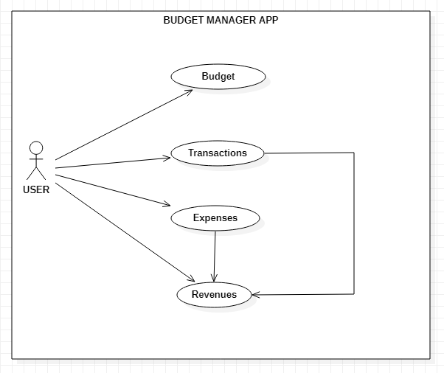
UML DIAGRAMS (CLASS & USE-CASE)
Use Case diagram

Slide 8
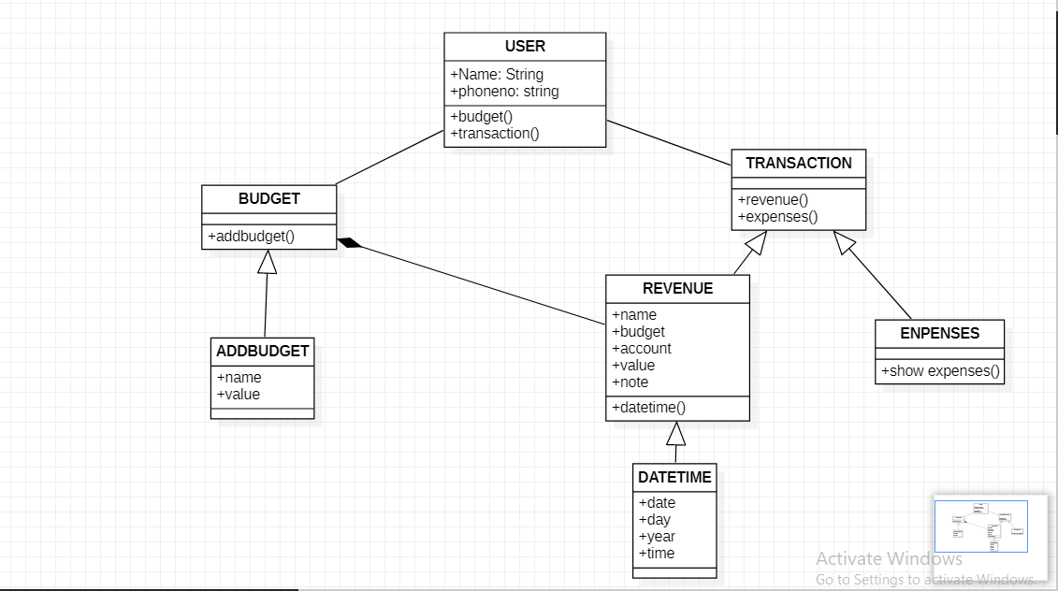
Class Diagram

Slide 9
IMPLEMENTATION
The Android application has various features which include managing the budget by tracking our spending. We can create as many budgets as we would like to track, each with our maximum monthly spending. To create a budget, we installed the "budgets" icon on the main screen. We have to click the plus sign in the menu to add as many budgets as we wish.
After creating the budget, transactions can be added that apply to budgets. To create a transaction, touch "Transactions" from the main screen. Select the expenses or revenues tab and click on the plus sign in the menu. Touching a budget will show all transactions for that budget.
By default, the budgets show the current month’s spending. To change the time window, touch the calendar icon in the menu.
Budget and transactions can be backed-up. To export or import data, Import/Export icon is created in the menu on the main page.
Above all, this Android application is completely free, ad-free, and open-source. All details are made in an easy-to-navigate and understandable way so that the app’s efficiency is always high. The design is straightforward and simple. It does not require an internet connection to use the Budget Manager App.

Slide 10
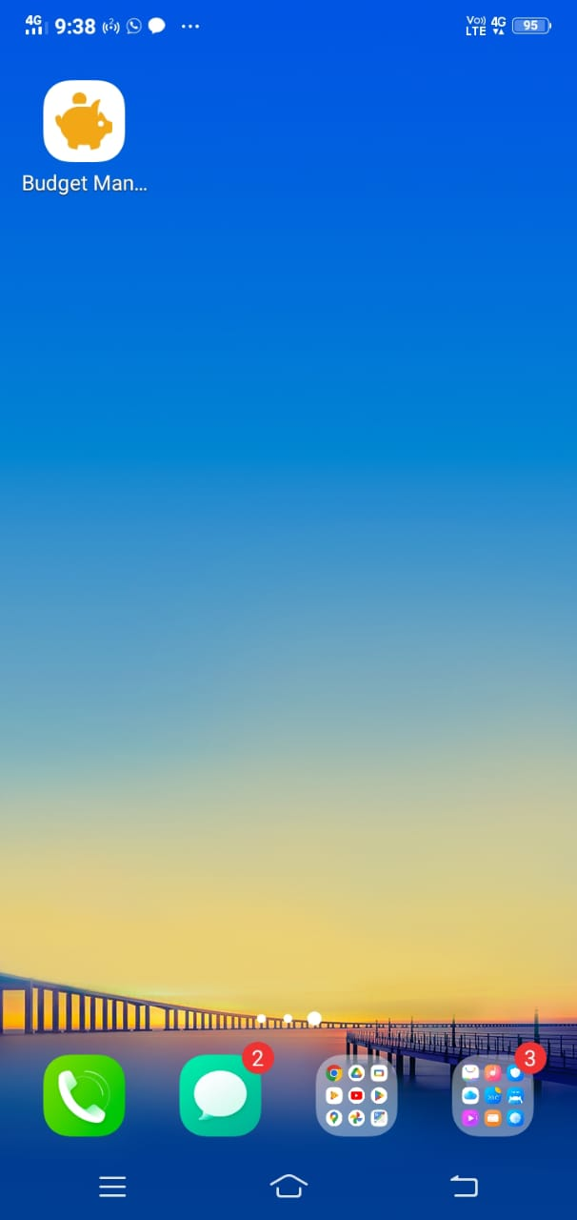
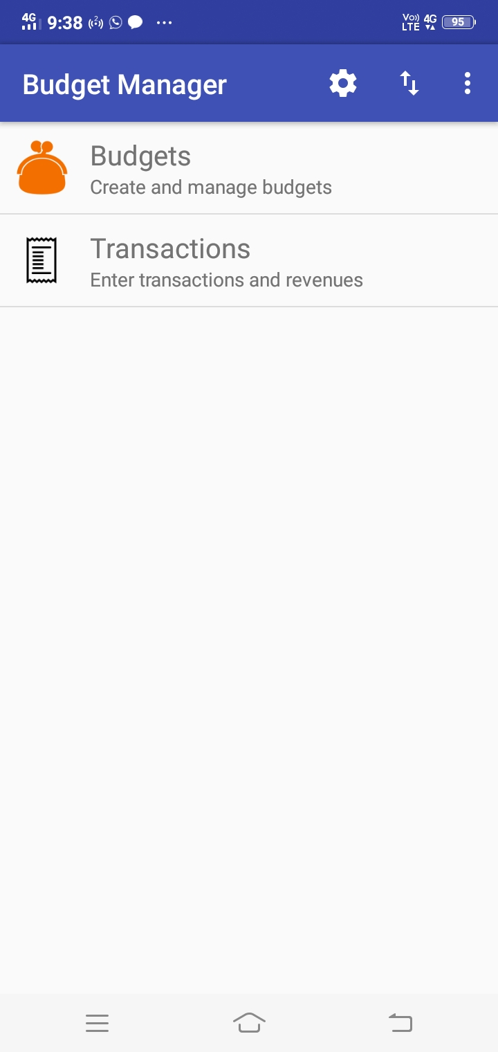
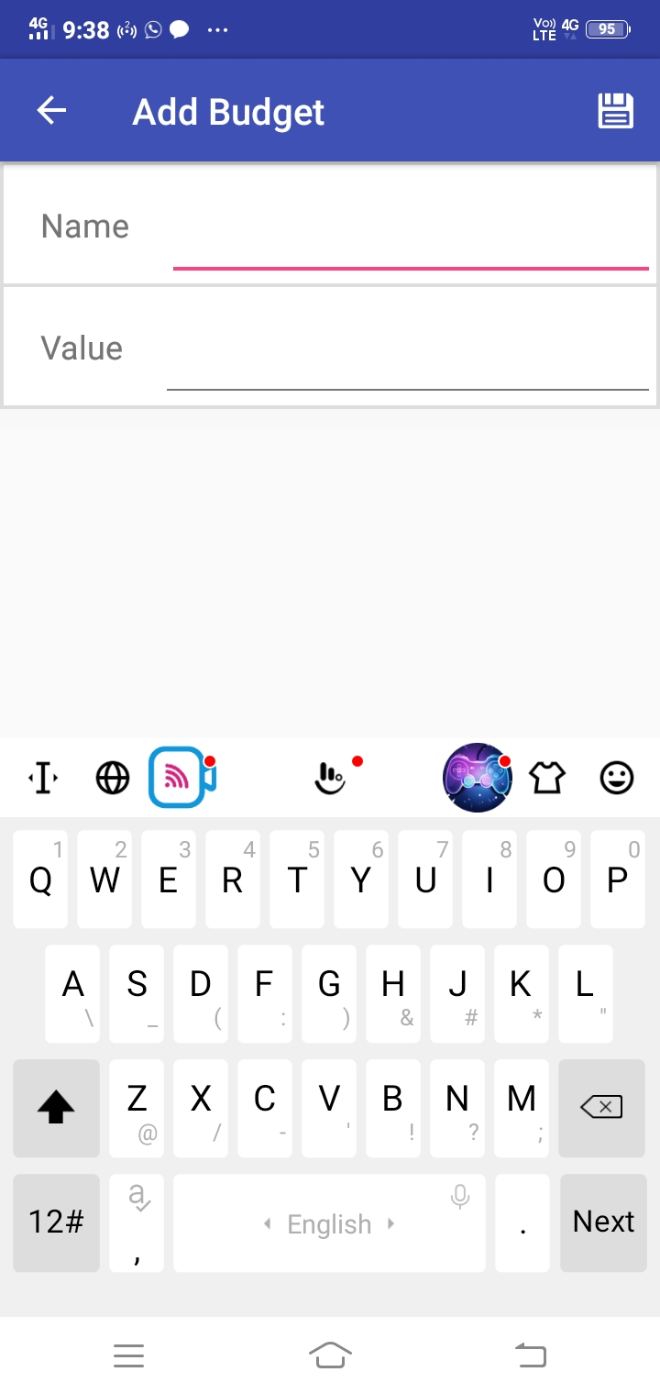

Slide 11
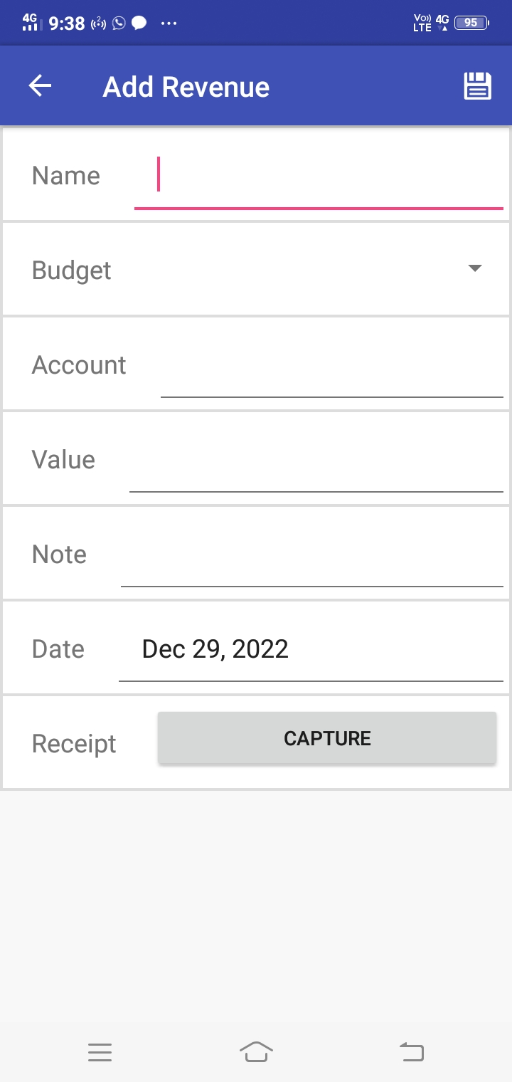
After creating the budget, transactions can be added that apply to budgets. To create a transaction, touch "Transactions" from the main screen. Select the expenses or revenues tab and click on the plus sign in the menu. Touching a budget will show all transactions for that budget.
By default, the budgets show the current month’s spending. To change the time window, touch the calendar icon in the menu.
Budget and transactions can be backed-up. To export or import data, Import/Export icon is created in the menu on the main page.

Slide 12
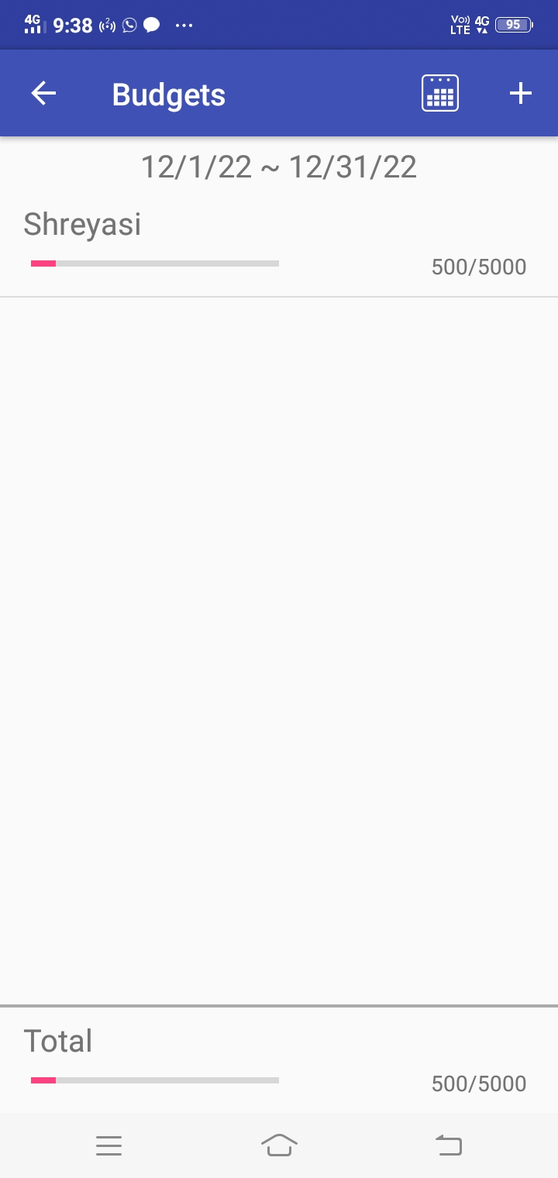
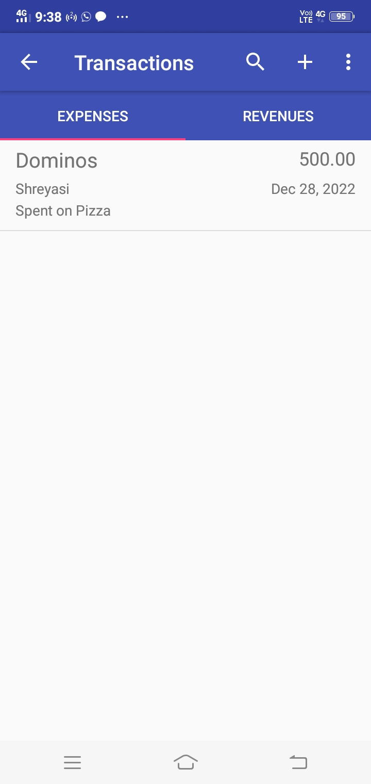
RESULTS / OUTPUTS

Slide 13
CONCLUSIONS & FUTURE ENHANCEMENTS
It is relatively simple for building the application system by utilizing daily expenses and designing in such a way that the transactions and the money we spend are controlled. The flow of the android application has been created in an efficient way which also increased the flexibility of the user schedules.
In the future, the application of the system can even help enterprises to improve and optimize business processes and then achieve better control of business processes. Such a system will be an advantage in improving operational efficiency and reducing costs.

Slide 14
BIBLIOGRAPHY
https://sci-hub.se/https://ieeexplore.ieee.org/document/5384723
https://github.com/projectworldsofficial/Budget-Manager-Android-App/blob/master/app-debug.apk

