Slide 1
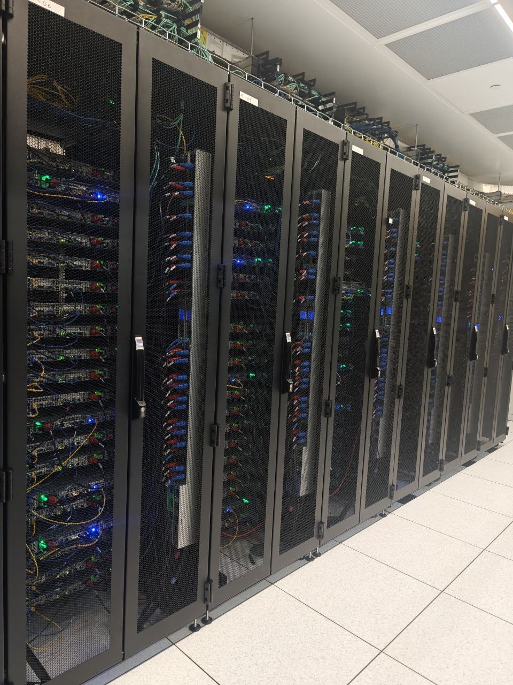

ThermoSentinel
An unified platform powered by Edge Fog Cloud environmental monitoring system for data centers: detecting heat, humidity, airflow loss, pressure and smoke before they become disasters.
Fog & Edge Computing.
Notes:
Good afternoon everyone, I am Sai Shreyas Gubbi Harish and now I will be presenting on my ThermoSentinel Project which is basically a unified Platform Powered by Edge Fog Cloud environmental monitoring system especially for data centers: which detects heat, humidity, airflow loss, pressure and smoke before they turn into a big disasters.

Slide 2
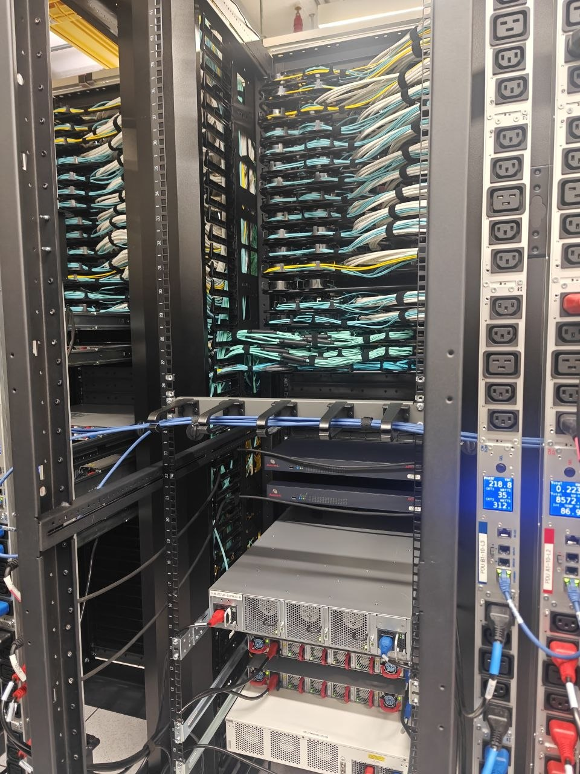
Why ThermoSentinel?
THE PROBLEM
Modern data centers operate at the edge of their thermal envelope. Heat buildup, humidity swings, airflow disruption, pressure drops and smoke events can cascade into full scale outages within minutes.
💸 Operational Cost
📉 Reputational Risk
Unplanned thermal outages carry massive direct costs from hardware damage to emergency response and SLA penalties.
Downtime erodes customer trust and operator credibility, with long term consequences that outlast the incident itself.
🎯 The Goal
Detect environmental anomalies early, surface risk in real time and empower operators to act before failure occurs.
Notes:
The main problem is the environmental issues in data centers escalate very quickly. Even a small rise in temperature or a unmonitored changes can damage servers and lead to downtime, huge operational cost and time to setup whole system again.

Slide 3

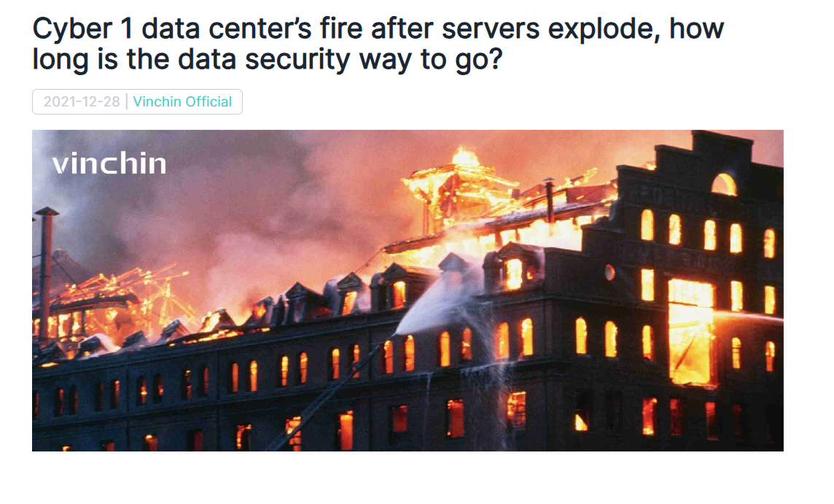
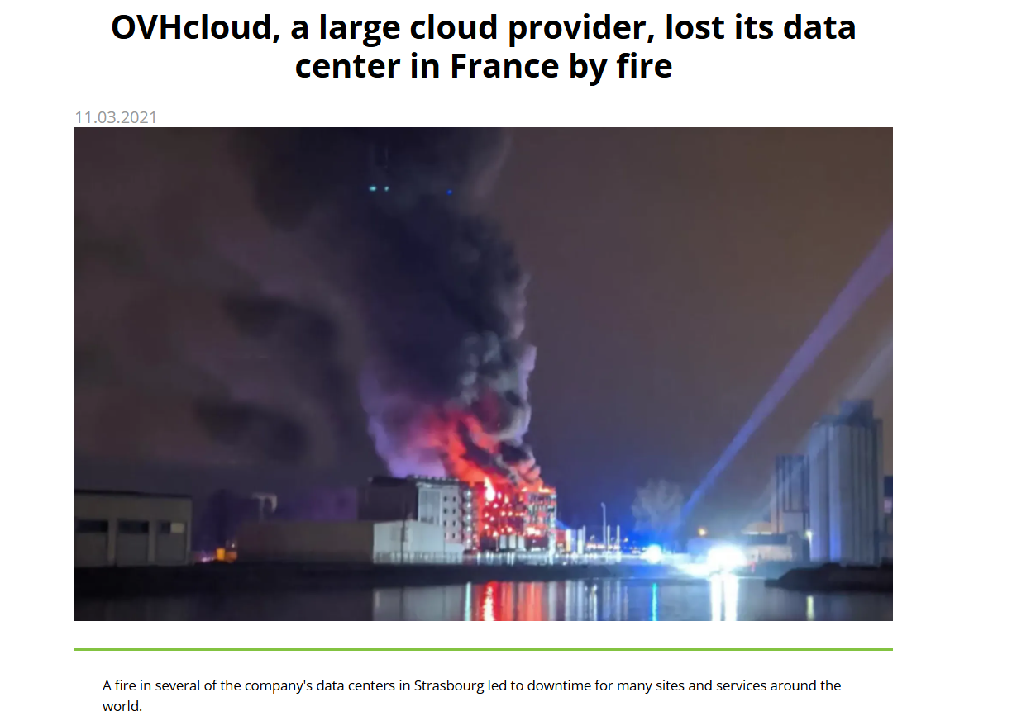
Notes:
These are some of the real world datacenter breakdown which you can see on this slide.

Slide 4
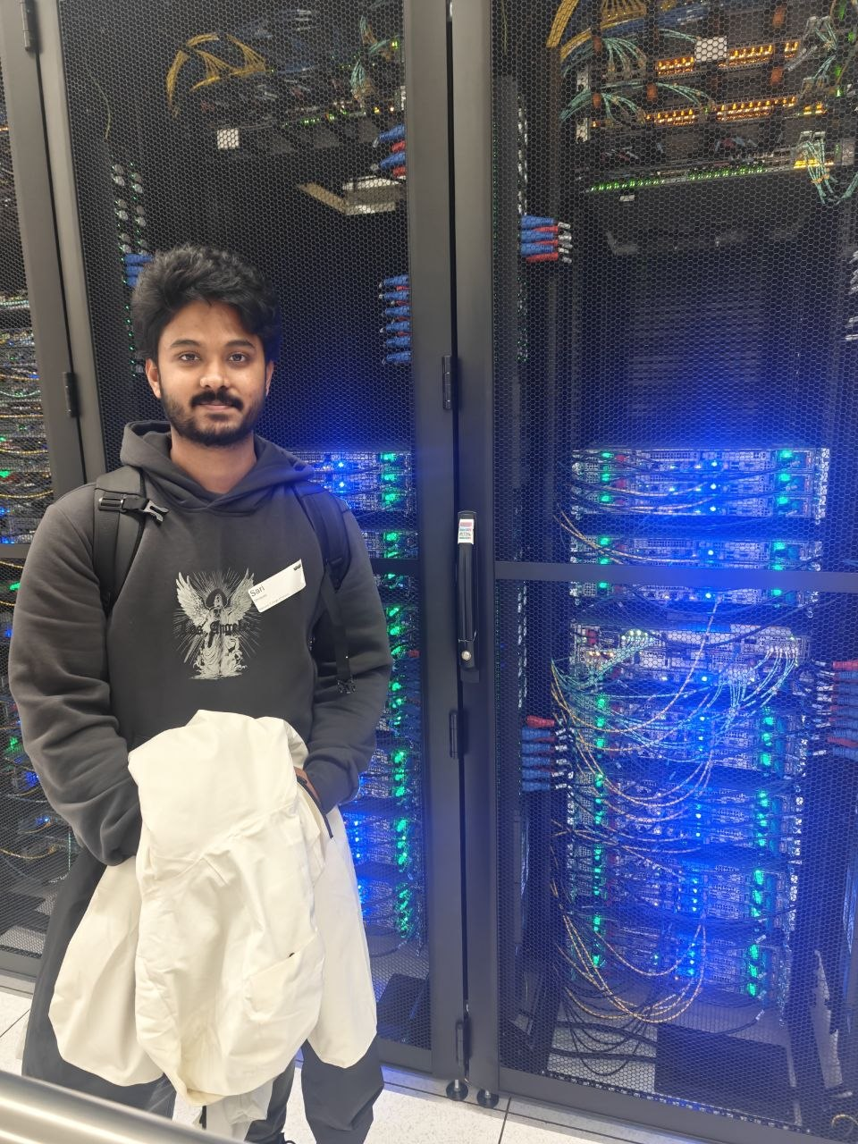
Project Objectives
ThermoSentinel is designed to continuously monitor the data hall, surface anomalies early and reduce risk of costly downtime across every rack facility.
1
2
Safe Environmental Envelope
Edge → Fog → Cloud Pipeline
Maintain temperature, humidity, airflow and pressure within safe operating thresholds across all monitored racks.
Build a three tier real time data pipeline from sensor edge nodes through a local fog gateway to cloud storage and APIs.
3
Live Dashboard & Alerting
Deliver a unified dashboard with live trends, per-rack status views, threshold alerts and dynamic risk scoring.
Notes:
So my objectives were: • To Build a full pipeline from sensors → to→ cloud. • Provide a dashboard with live metrics, rack views and alerts. • Showing trends, risk scoring
• And make the system deployed using serverless scalable cloud components because as you can all these pictures were taken during my visit to Susquehanna Datacenter last month located near Connolly which actually helped me come up with this solution.

Slide 5
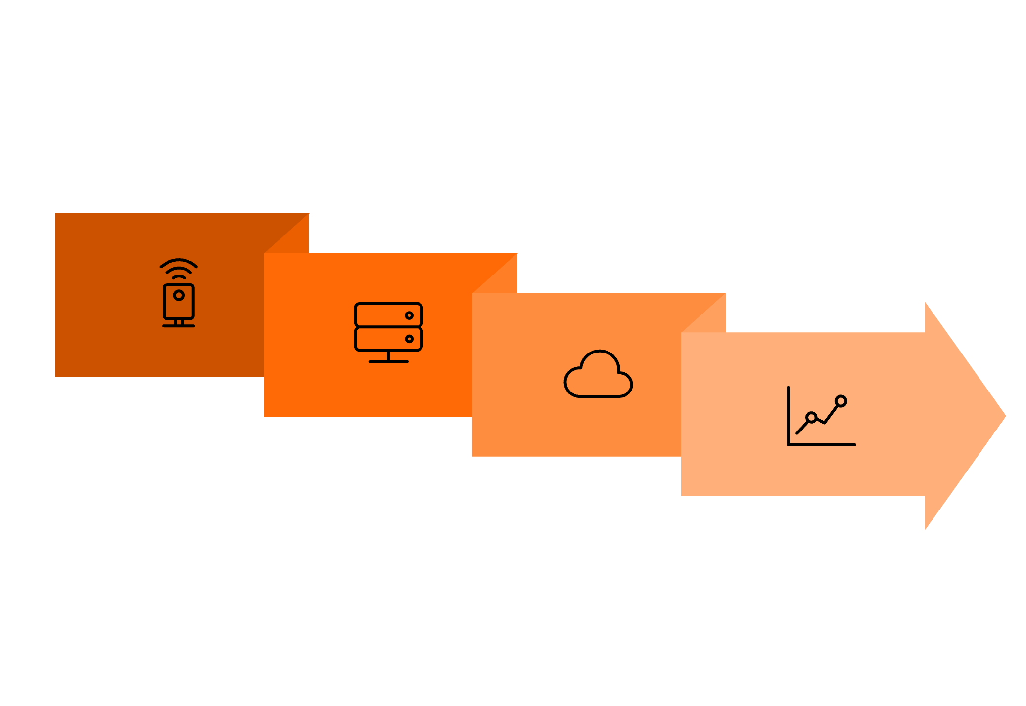
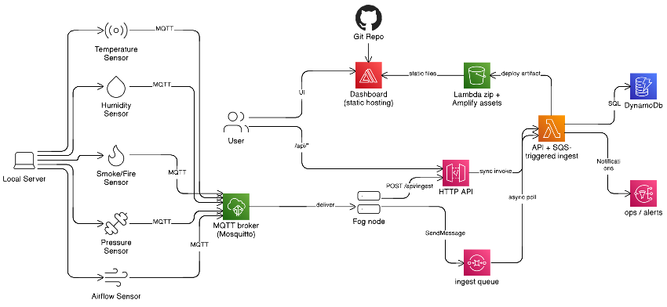
SYSTEM ARCHITECTURE
Edge → Fog → Cloud
Three tiers follow established fog/edge practice each layer has a distinct role in the data pipeline, from raw sensor readings to cloud stored metrics and live visualization.
Fog Node
Dashboard
Edge Sensors
Cloud Backend
The fog node acts as a resilience buffer if cloud connectivity is lost, it continues to store and validate data locally, ensuring no readings are dropped during transient outages.
Application Link: https://main.dx55a7yx23a8.amplifyapp.com/
Notes:
The architecture follows the classic edge → fog → cloud model.
Now lets go through the application first,
So, Sensors generate readings through randomly produced data logic running on my local PC. Passed through MQTT on AWS IOT Core. Then fog node validates and batches them. Uses SQS to send it to the cloud layer which uses API Gateway, Lambda, DynamoDB and SNS. The dashboard is hosted on AWS Amplify from the github repo.
This build keeps the system scalable, low‑cost and resilient

Slide 6
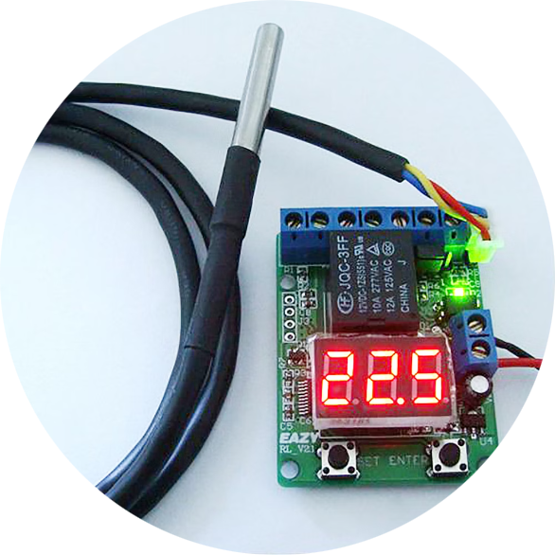
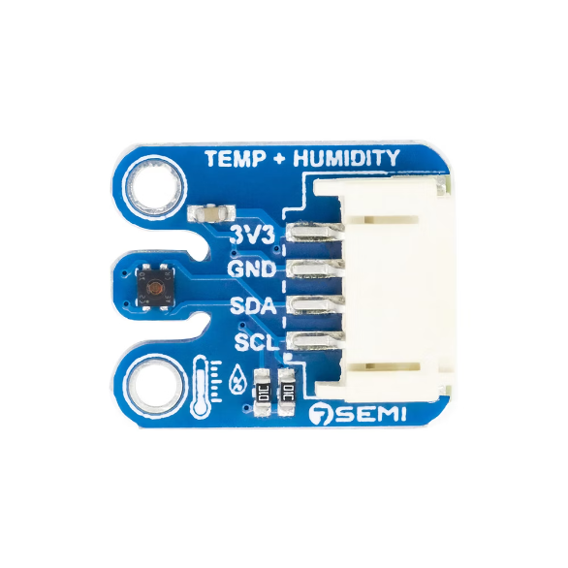
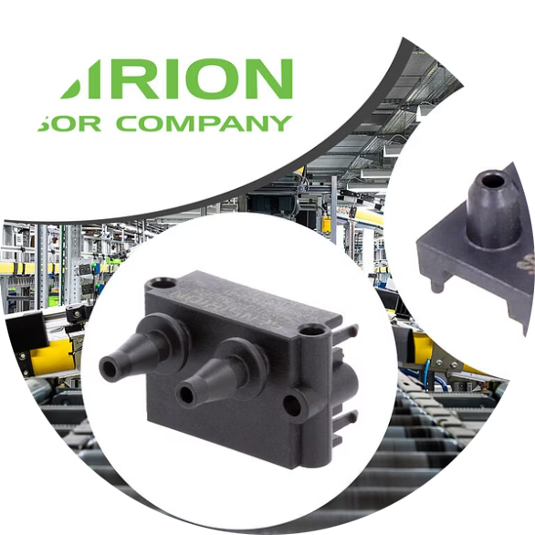
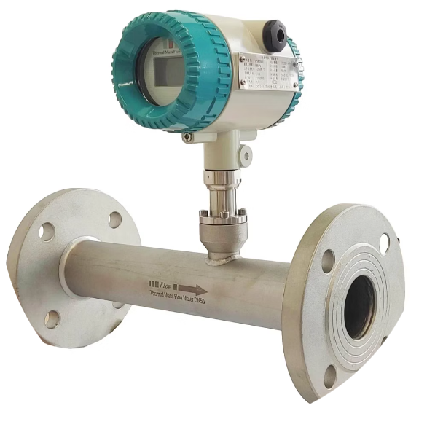
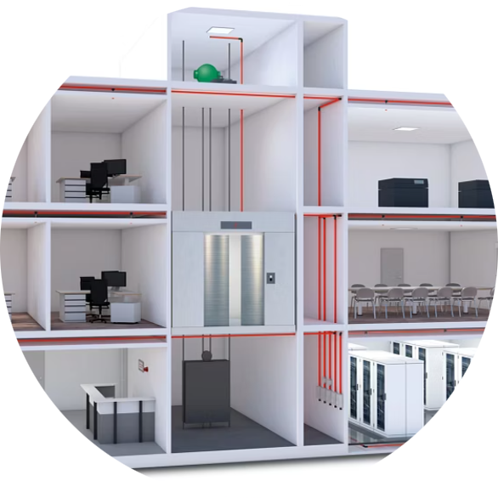
Sensor Suite Real World DC Hardware
ThermoSentinel uses industry-grade sensors that mirror actual data center deployments, covering all five critical environmental dimensions.
Temperature
Humidity
Pressure
DS18B20 Waterproof Probe precise 1Wire digital readings per rack unit.
ENS210 Wireless Humidity Sensor relative humidity with ±3.5% RH accuracy.
Sensirion SDP810-500PA differential pressure monitoring for airflow containment.
🌡️ Temperature
18°C – 25°C (Optimal) ⬇️ Low → Condensation risk ⬆️ High → Overheating
💧 Humidity
40% – 60% RH ⬇️ Low → Static electricity ⬆️ High → Condensation
🌬️ Airflow
1.0 – 3.0 m/s ⬇️ Low → Heat buildup ⬆️ High → Inefficient cooling
🔥 Smoke/Fire
0 (Normal) ⬆️ Any detection → Fire hazard 🚨
🌪️ Pressure (Differential)
5 – 20 Pa (Typical) ⬇️ Low → Poor airflow / leakage ⬆️ High → Airflow imbalance
Airflow
Smoke / Fire
SFM3400-33-D Flow Sensor volumetric air measurement at rack exhaust points.
TITANUS RACK·SENS early warning aspirating smoke detection for enclosed racks.
Notes:
To model this real data center setup, I have considered reference of these five types of sensors:
• DS18B20 for temperature • ENS210 for humidity • SDP810‑500PA for pressure • SFM3400‑33‑D for airflow • TITANUS RACK·SENS for smoke and fire
These sensors represent what real facilities actually use for environmental monitoring at edge level.

Slide 7
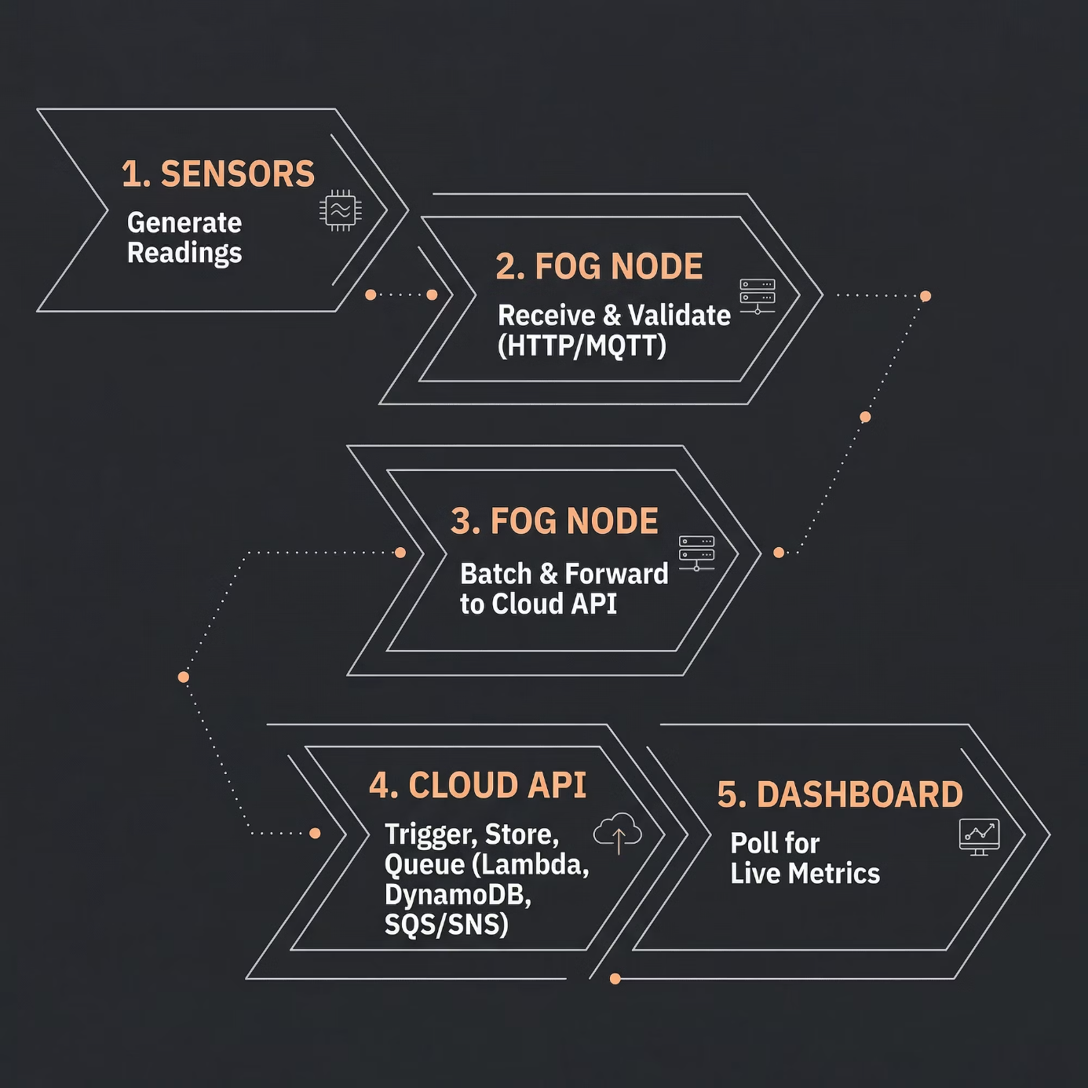

FOG LAYER
Fog Node: Local Gateway
The Advantech UNO-1372G industrial IoT gateway sits between the sensor edge and the cloud, acting as the critical local intelligence layer.
Alternative demo hardware: NVIDIA Jetson Orin Nano or Raspberry Pi 5.
Buffering & Batching
Protocol Translation
Local Filtering
Aggregates high frequency sensor reads into efficient cloud bound payloads.
Normalizes MQTT and HTTP inputs into a unified REST API contract.
Discards noise and validates data before transmission, reducing cloud ingestion costs.
Notes:
For the fog layer, I have selected the Advantech UNO‑1372G, which is an industrial IoT gateway.
It can ingest multiple sensor types, buffer data, filter it and send it to the cloud. It’s rugged and commonly used in industrial environments.

Slide 8
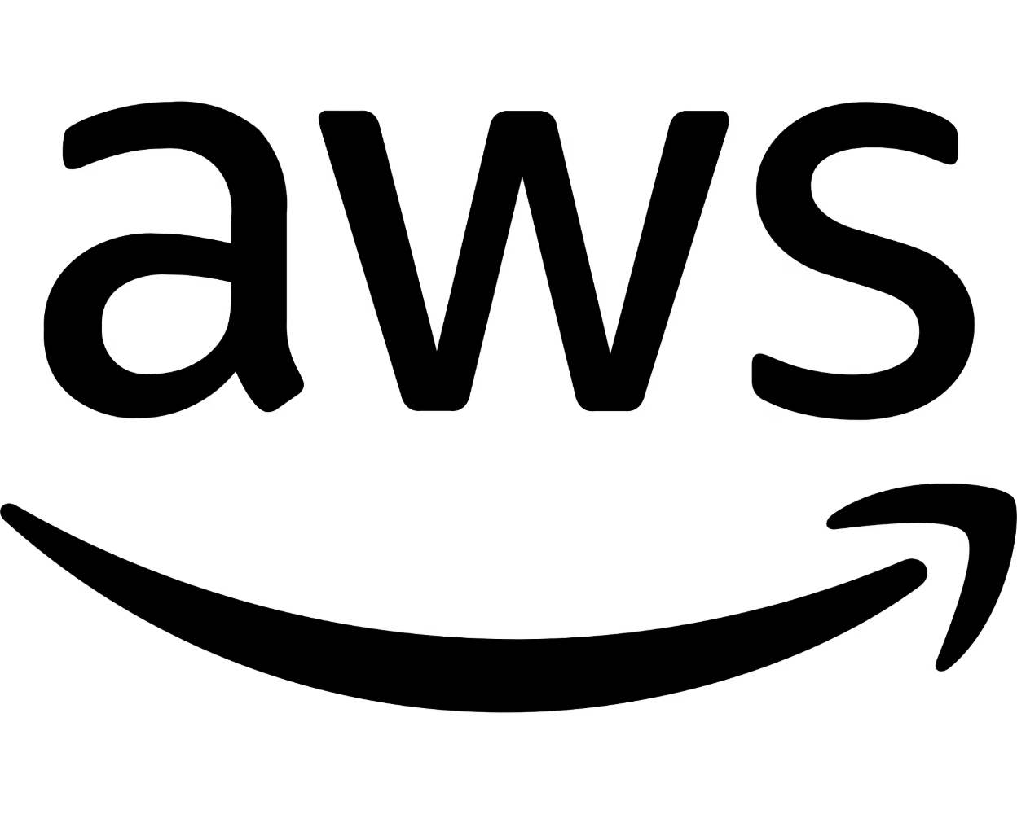
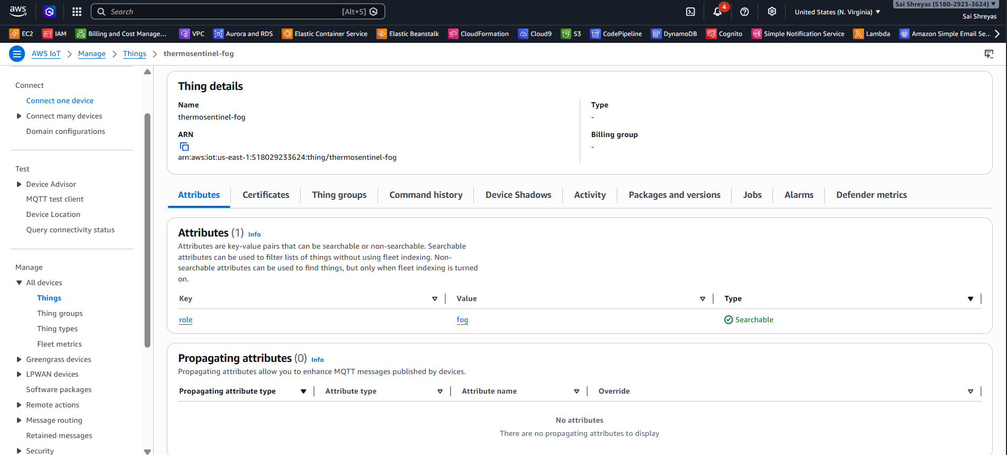
Scalable design in Smart Iconic Vault
Serverless API: OCR processing on AWS Lambda and API Gateway scales automatically with traffic spikes.
Asynchronous Workload: Amazon SQS decouples API calls from background OCR tasks, ensuring front-end responsiveness.
Managed Data Storage: DynamoDB provide scalable object storage and NoSQL database capabilities without manual sharding.
Stateless Architecture: Lambda functions remain stateless and DynamoDB for durable state, enabling robust horizontal scaling.
Notes:
For scalability, im using API Gateway and Lambda, so api scales automatically with demand. Using SQS to handle higher user requests from background processing
Storing results in DynamoDB giving managed storage without manual scaling

Slide 9
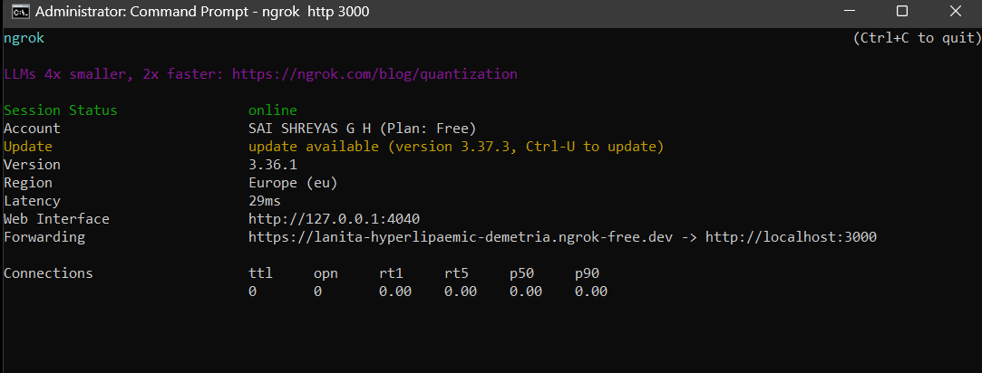
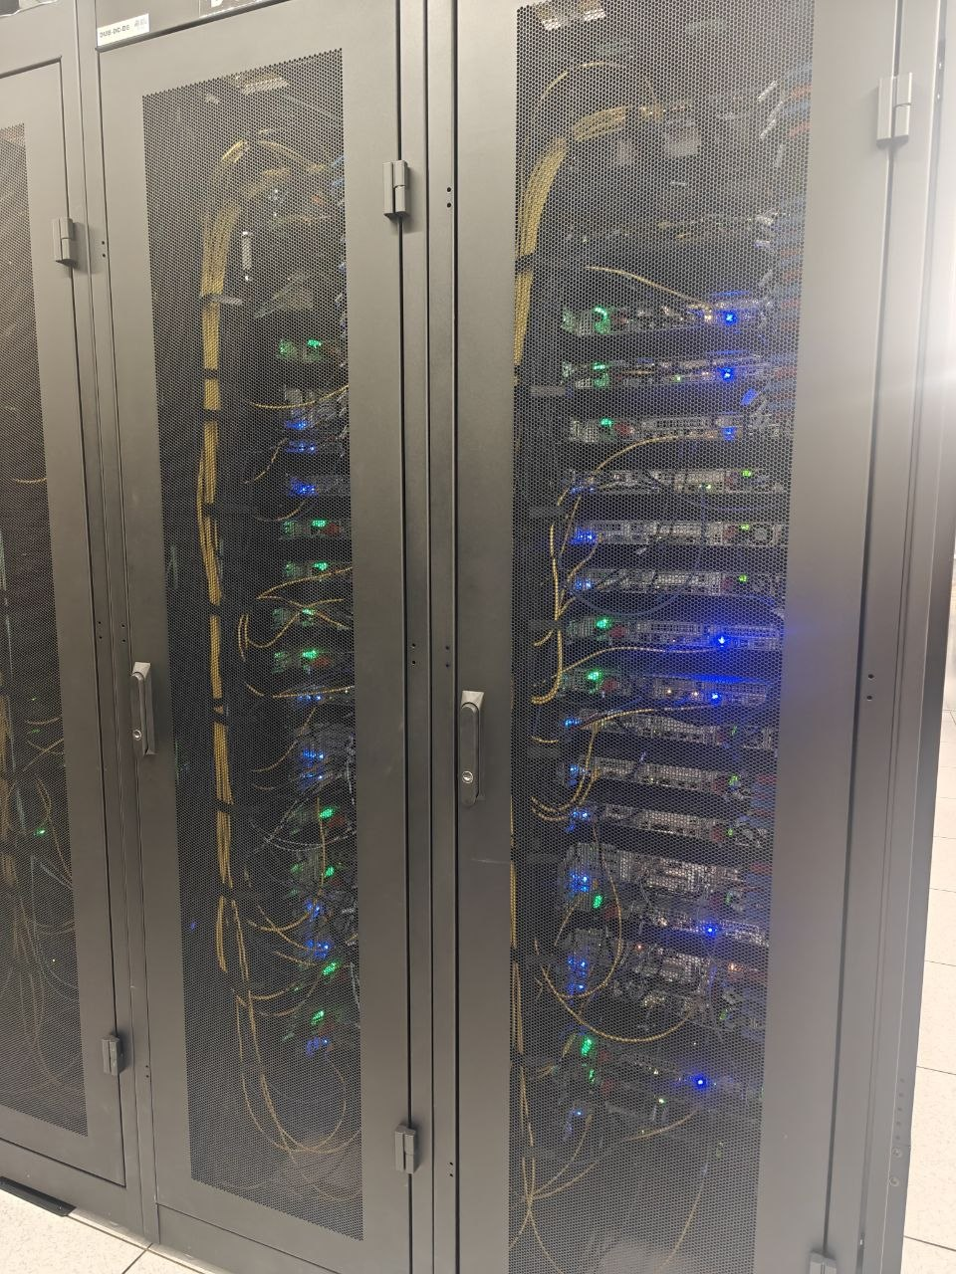
Hardest Challenge & Solution
The Challenge
Integrating the local server running sensors data pipeline with the cloud API and add to statically exported Amplify.
Key Issues
Amplify doesn’t allow any http-based URL’s but local host runs on port 3000 and is http based.
The Solution
Using ngrok to provide the https version of the localhost and acts as live server which made easy for this integration.
Notes:
The hardest part of the project was Integrating the local server running sensors data pipeline with the cloud API and add to statically exported Amplify
I faced issues because Amplify doesn’t allow any http-based URL’s but local host runs on port 3000 and is http based.
I solved this by Using ngrok to provide the https version of the localhost and acts as live server which made easy for this integration.
This made the system stable in both local and cloud modes.

Slide 10
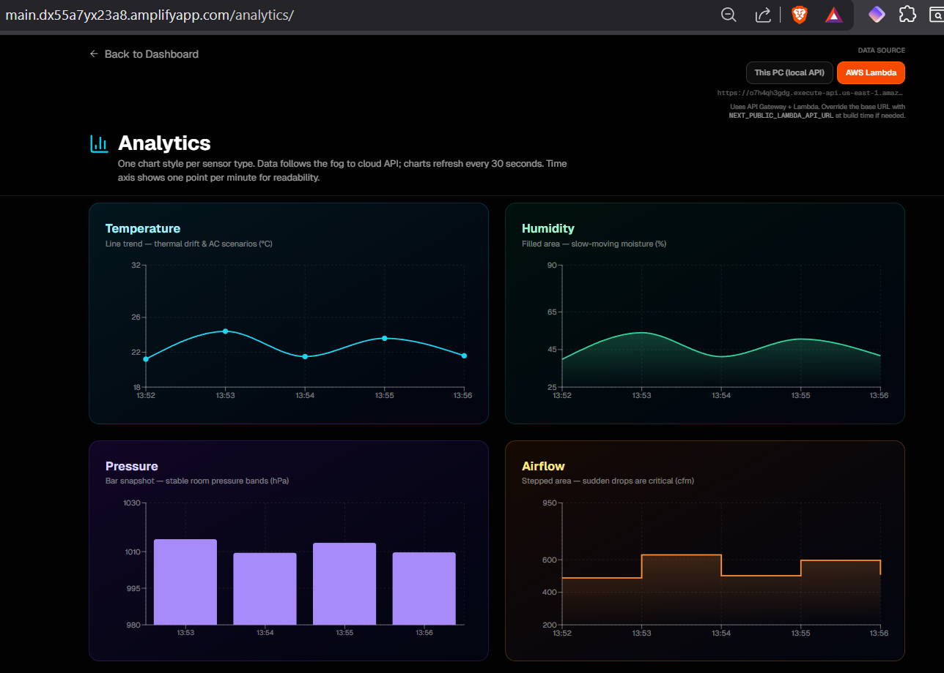
Demonstration Highlights
The live dashboard gives operators a complete, real time view of data hall health
from individual rack readings to facility wide risk scores.
Rack-Level Status
Per-rack indicators: Normal / Warning / Critical with color coded severity.
Scenario Toggles
Simulate AC failure, humidity spike, airflow loss and smoke events on demand.
Risk Scoring
Dynamic composite risk score instantly highlights the highest severity rack hotspots.
Future Scope
Expanded Sensor Network: Add more sensors for finer‑grained monitoring.
Sensor‑Triggered Actions: Real‑time automatic adjustments based on sensor readings.
AI‑Driven Predictions & Recommendations : Early anomaly detection using patterns from historical sensor data and Automatic suggestions for preventive actions during emergencies.
Automated DC Health Checks: Scheduled system wide scans to ensure optimal environment.
Notes:
As we saw few of the key features were: • Rack level status: Normal, Warning or Critical • Scenario toggles like AC failure, humidity spike, airflow loss and smoke events • And a risk score that updates automatically
This shows how operators can detect issues before they become disasters. Talking about Future scope, adding on more sesnors and expanding the coverage and triggered based automation tasks and Ai driven prediction and recommendations to ensure optimal environment.

Slide 11
Results & System Behavior
ThermoSentinel delivered a stable, end to end pipeline validated in both local fog only and full cloud connected modes.
30s
5
Dashboard Refresh
Sensor Dimensions
Live charts update every 30 seconds across all sensor dimensions.
Temperature, humidity, pressure, airflow and smoke monitored simultaneously.
3
0
Architecture Tiers
Data Dropped
Edge, fog, and cloud operating as a validated, production grade pipeline.
Fog buffering ensures zero reading loss during transient cloud connectivity gaps.
Fog batching demonstrably reduces bandwidth consumption and cloud ingestion latency, validating the three tier architecture's efficiency advantage over direct sensor to cloud approaches.
Notes:
The final webapp shows a complete end to end flow.
Charts refresh every 30 seconds. Rack views update instantly. Risk scoring highlights hotspots. And fog batching demonstrates bandwidth and latency trade offs.
Overall, the system performs reliably and is easy to scalable and extend.

Slide 12
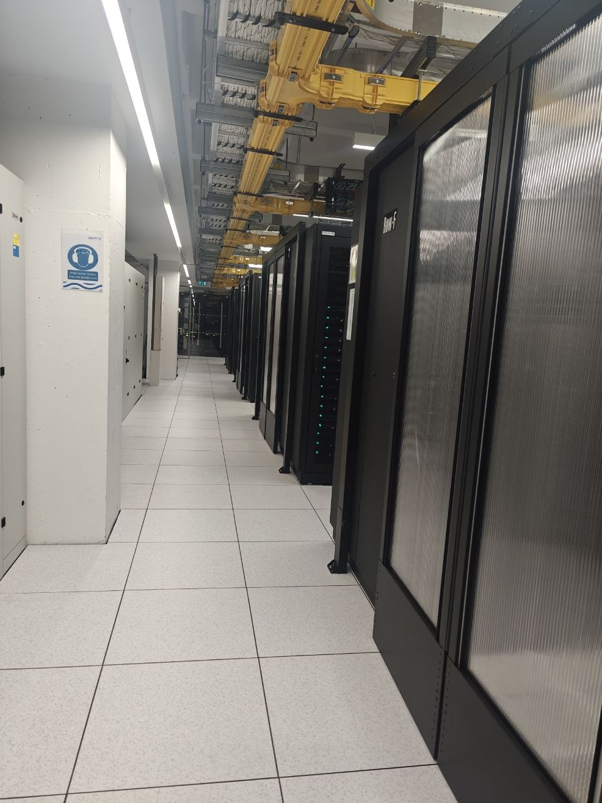
THANK YOU.
Notes:
So To conclude:
ThermoSentinel demonstrates a full edge–fog–cloud monitoring model. It reduces the risk of thermal incidents and operational cost. The serverless backend and static UI make it scalable and affordable.
Thank you.

