Slide 1

DAYANANDA SAGAR ACADEMY OF TECHNOLOGY AND
MANAGEMENT
Department of Electronics and Communication Engineering
“BRAIN-CONTROLLED HOME AUTOMATION”
Submitted by
AMOGAVARSHA N.R (1DT19EC003)
DEEPAK BP (1DT19EC017)
BUPHIN HEGDE (1DT19EC011)
SAI SHREYAS G H(1DT19EC025)
Under the Guidance of
Miss SINDHU K
(Assistant. Professor, Dept. of ECE)

Slide 2
Contents
Introduction
Literature Survey
Problem Statement
Objectives
Proposed Methodology
Block diagrams
Outcomes
Applications
Advantages
Conclusion

Slide 3
I INTRODUCTION
Brain computer interface or mind machine interface is a computer-based system that acquires brain signals, analyzes them, and translates them into commands that are relayed to an output device to carry out a desired action .
A BCI is a computer-based system that acquires brain signals, analyzes them, and translates the minto commands that are relayed to an output device to carry out a desired action. Thus, BCIs do not use the brain's normal output pathways of peripheral nerves and muscles.
The Brain-Computer Interface (BCI) is one of the communication channel used to make an interaction between the human brain and a digital computer.
BCI which monitors EEG waves from the Brain. EEG –Electroencephalography which monitors an Electrical property of the Brain along with the Scalp (Non-invasive). The Neuro sky Mind wave mobile / Brain Sense measures intentionally directed EMG activity (blink strength).
3A brain-computer interface (BCI) is a new communication channel between the human brain and a digital computer. The ambitious goal of a BCI is finally the restoration of movements, communication and environmental control for handicapped people Arduino is an open-source hardware.
Arduino UNO is a micro controller board based on theATmega328P. It has 14 digital input/output pins (of which 6 can be used as PWM outputs), 6analog inputs, a 16 MHz ceramic resonator, a USB connection, a power jack, an ICSP header and a reset button.
Arduino consists of both a physical programmable circuit board (often referred to as a microcontroller) and a piece of software, or IDE (Integrated Development Environment) that runs on your computer. arduinio is used to read data from sensors and produce output corresponding to it.

Slide 4
II LITERATURE SURVEY
Mayo Clin Proc. 2012 Mar; 87(3):
“The advance of functional neuro imaging techniques with high spatiotemporal resolution now provides potential new methods for recording brain signals to control a BCI. Magnetoencephalography (MEG) measures mainly the magnetic fields generated by electrical currents moving along pyramidal cell axons.”
Sonam, Yashpal Singh Paper ID : IJERTCONV3IS10102 Volume & Issue :
“ A brain computer interface (BCI) is a proficient result in the research field of human-computer synergy”
Advanced EEG Monitor Ergonomic Issues in Brain-Computer Interface Technologies:
Current Status, Challenges, and Future Direction View this Special Issue Volume 2019 Hyun Jae Baek ,1 Min Hye Chang ,2 Jeong Heo ,3 andKwangSuk Park 4
Academic Editor: Pietro Aricò 4
“Technological advancements have greatly simplified the measurement and assessment of bio-potential signals, particularly electrocardiograms. However, the sites for EEG electrodes are mostly covered with hair, and EEG signals are weaker than those used in other bio-potential measurement tools, which makes the use of dry electrodes in EEG difficult. Most dry EEG electrodes make signal measurements by penetrating the outermost layer of the skin, the stratumcorneum, using microelectromechanical or carbon nanotube (CNT) techniques [25–28]”

Slide 5
III PROBLEM STATEMENT
Movement related disabilities have a negative effect on the people who suffer from them, since, it reduces the ability to do tasks on their own.
In many cases, very simple tasks such as turning on a television, alight bulb and other devices of daily use, become difficult to do without the help of another person.
The use of home automation devices has increased the quality of life for many individuals by providing them the ability to control home devices such as light bulbs, fans, garage doors, and thermostats.

Slide 6
IV OBJECTIVES:
Allow an independent performance of people with difficulties or motor disabilities (but with an intact intellectual activity) into their home, and to improve their keepers services helping the tasks accomplishment by an automation an access of the house´s present devices through a Brain Computer Interface.
Brain Computer Interface (BCI) has given the opportunity to not only take advantage of advancements in home automation technology but also improve the overall quality of life for individuals who are suffering from speech and motion related conditions.
BCI is a method of communication with a computer using the electroencephalogram(EEG)signals obtained from the user's brain activity. Considering EEG signals are independent of the normal pathways of the nerves and muscles, EEG signals can be used to implement a home automation system.

Slide 7
V PROPOSED METHODOLOGY
The proposed system provides people with disabilities an easy way to control electronic devices by using EEG signals generated when the user blinks. The blinks of the user is detected by the EEG and such information is transmitted to the computer that executes a BCI application with filters and classifies the raw blink signals.
Once understood the command that the user wants to execute the BCI applications sends the command to the IoT devices through the communication server. Using the proposed system, the user can have the control of IoT devices (such as SmartTV, Lightbulbs and Fans)without being close or having physical interaction.
In order to achieve this, we have used the brain sense a Mind Wave NeuroSky ®based commercial device. It is affordable, portable and wireless, that senses and delivers to the computer the electroencephalographic signals produced in the frontal lobe and the levels of Attention, Relaxation and Blinking to the computer.
In order to determine the efficiency of the obtained signals a Test Software was designed, which verified the operation´s device with different persons. We concluded that the easiest way to control the Attention levels of attention is concentrating in a certain point, and the way to control the Relaxation levels is by closing the eyes.
As a second step we developed a software that takes the signal from the EEG(Electro Encephalo Graphy) sensor, processes it and sends signals via USB to an Arduino board which is associated with electronics that complies the different tasks.
The user chooses the action by managing the Attention levels. When they are higher than a particular threshold value, the action is executed.
In order to disable this action, the user must lower the threshold level and over-come it again. This is the simplest and fastest way to handle but it brings with several problems: if the user concentrates for any other reason and this signal exceeds the threshold, it causes the activation of an involuntary action. To solve this problem, we use a three variables combination that can become independent of each other thru training properly.
These variables are Attention, Meditation and Blink. When you comply three simultaneous previously established conditions, the action is executed, and when they return to fulfill the conditions the action is deactivated. The software also has the feature of personalizing its conditions, so it can be best for any user, even a novice one.

Slide 8
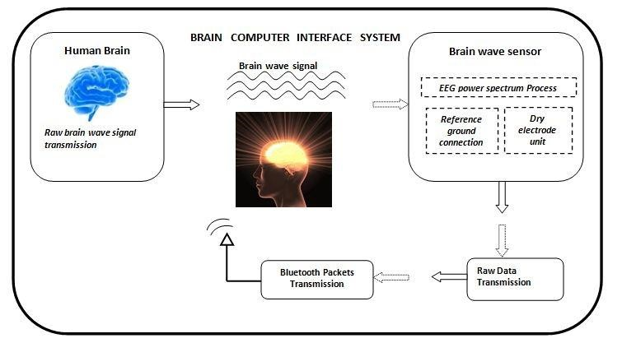
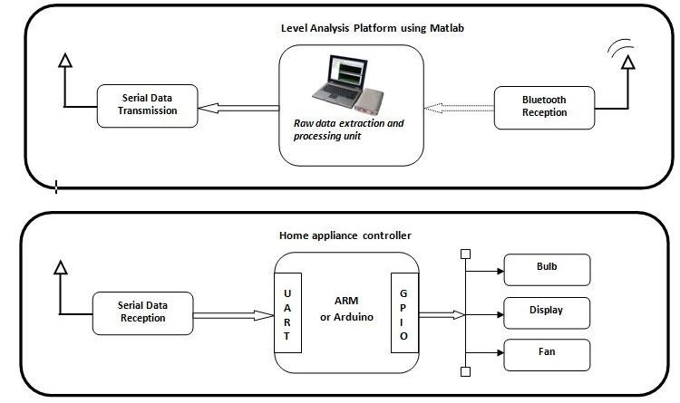
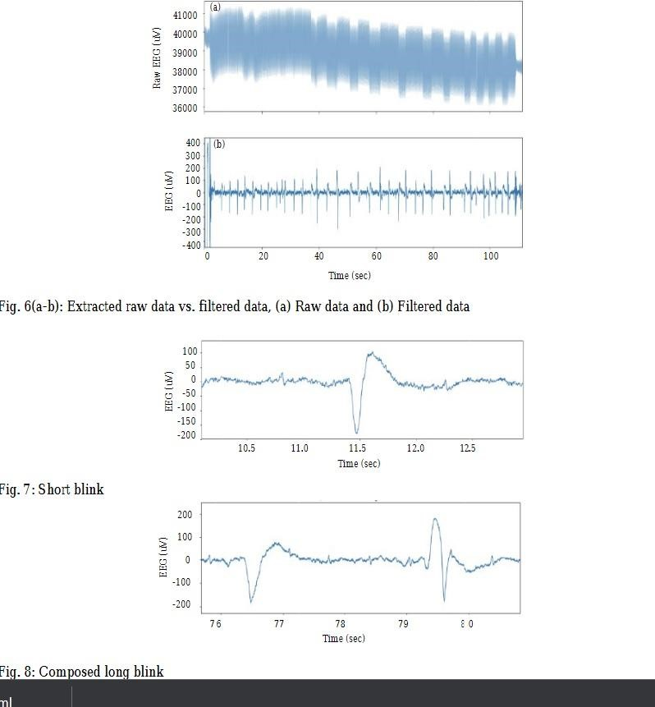
VI BLOCK DIAGRAMS
Brain computer Interface System
Level Analysis Platform Using MatLab
Graphs

Slide 9
VII OUTCOMES :
A home automation system which is controlled by brain signals
home appliances like fan, light, motor,fan,etc., which are controlled using brain signals

Slide 10
VIII Applications
To automate home
Control home appliances using brain signals
For paralyzed people
For specially abled people

Slide 11
IX Advantages :
Allows paralyzed people to live independent life.
Less physical work .
Since it uses only brain signals and doesn't involve voice or physical commands, it has wide range of applications.

Slide 12
X Conclusion :
We have built a home automation system using BCI, which receives EEG signals and process it to check attention level.which is then transferred to Arduino through which IOT devices are controlled.

Slide 13
THANK YOU

