Slide 1
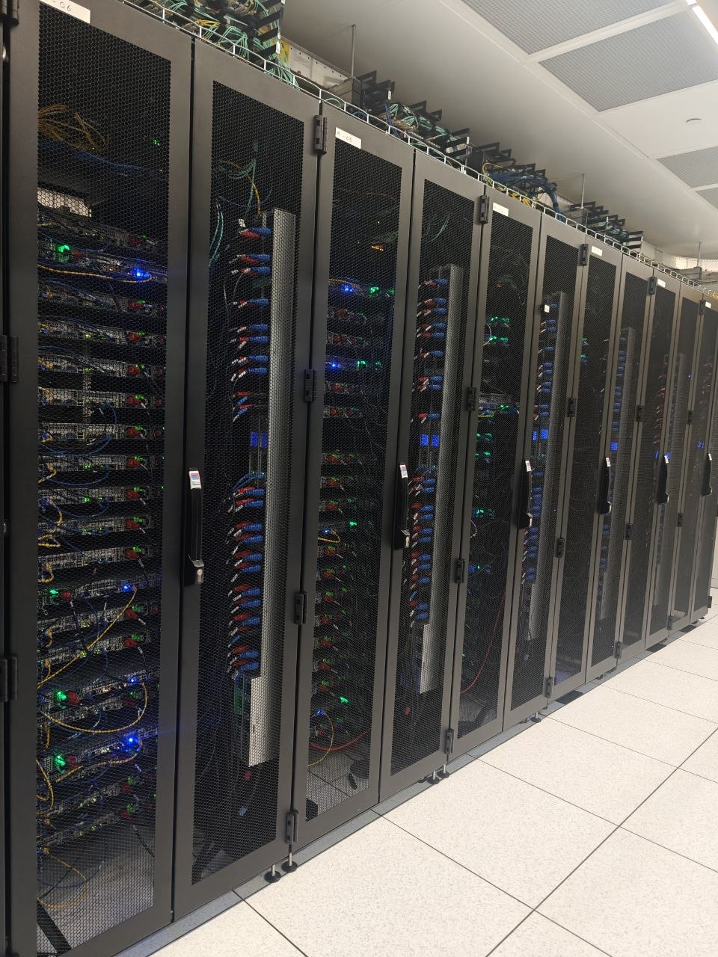
CloudOptix - UR Intelligent Multi Cloud Routing
Predict. Optimize. Smarter Decisions.
From "Closest Data Center" to "Best Data Center": A Cloud Native Machine Learning Approach to Optimal Data Center Selection
Sai Shreyas Gubbi Harish x24194956
Mohammed Hussain x24253189
Gulam Gouse Shahnawaz Khan x24268178
Wasiullah Khan x24217760
Cloud Machine Learning
National College of Ireland
Notes:
Good morning/afternoon. Today I’m presenting CloudOptix. In the world of multi-cloud infrastructure, routing is often a 'black box'—it’s either static or ignores the real-time health of the network. We’ve built a solution that moves beyond simple distance-based rules. By treating data center selection as a dynamic, supervised machine learning problem, we’ve created an end-to-end pipeline that optimizes connections in real-time.

Slide 2
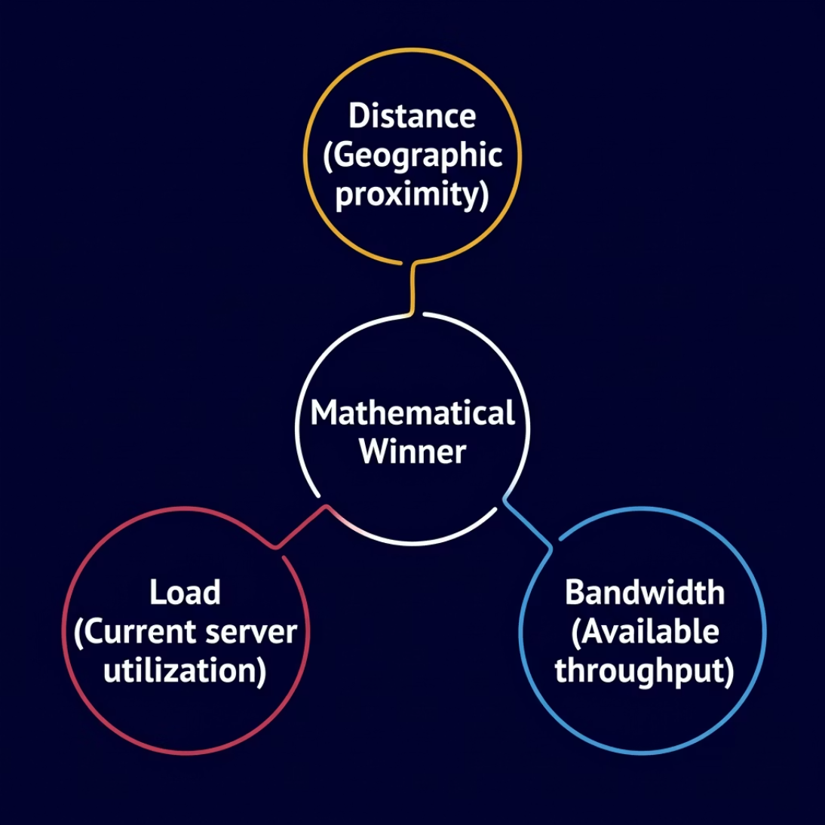
WHY CloudOptix?
The Problem
Most cloud routing is static or ignores real-time network health.
Distance is Constant: Networks Are Not
The Real Cost of Static Rules
Standard routing optimizes for geography alone. A "close" data center can be congested, overloaded or experiencing packet loss. Proximity ≠ performance.
During peak hours, fixed routing decisions drive up packet loss and drop throughput. The network knows it's slow but the router doesn't care.
The Solution
An end to end ML pipeline that treats DC selection as a
dynamic, supervised multi class classification problem.
Simultaneous Multi Factor Scoring
CloudOptix weighs distance, load and bandwidth simultaneously not sequentially to identify the mathematically optimal endpoint for every request.
Multi Cloud Agility
Seamlessly compares AWS, Azure and GCP regions in milliseconds, selecting the healthiest path regardless of provider.
Notes:
Current cloud routing is broken because it’s static—it assumes the closest data center is always the best, but proximity does not equal performance. CloudOptix fixes this by treating routing as a dynamic machine learning problem. We analyze distance, server load, and bandwidth simultaneously to identify the true 'Mathematical Winner' for every request. By comparing AWS, Azure, and GCP in milliseconds, we ensure users always take the healthiest path, reducing latency by up to 45%.

Slide 3

THE WHO?
Beyond Pings: Real World Multi Cloud Impact
Entertainment (Netflix/YouTube)
Reducing buffering by routing to the lowest congestion regional node.
FinTech
Ensuring ultra-low latency for high frequency trading across provider boundaries.
Global SaaS
Automatically shifting traffic during provider outages (Resilience).
Application Link:
https://main.d1cgcih5yi54e9.amplifyapp.com/
Notes:
To understand why this matters, look at industry leaders. For companies like Netflix or YouTube, routing to the lowest-congestion node is the difference between seamless streaming and buffering. In FinTech, even a few milliseconds of latency can break high-frequency trading strategies. CloudOptix provides the resilience needed for global SaaS platforms to automatically shift traffic during outages, ensuring 100% uptime.

Slide 4
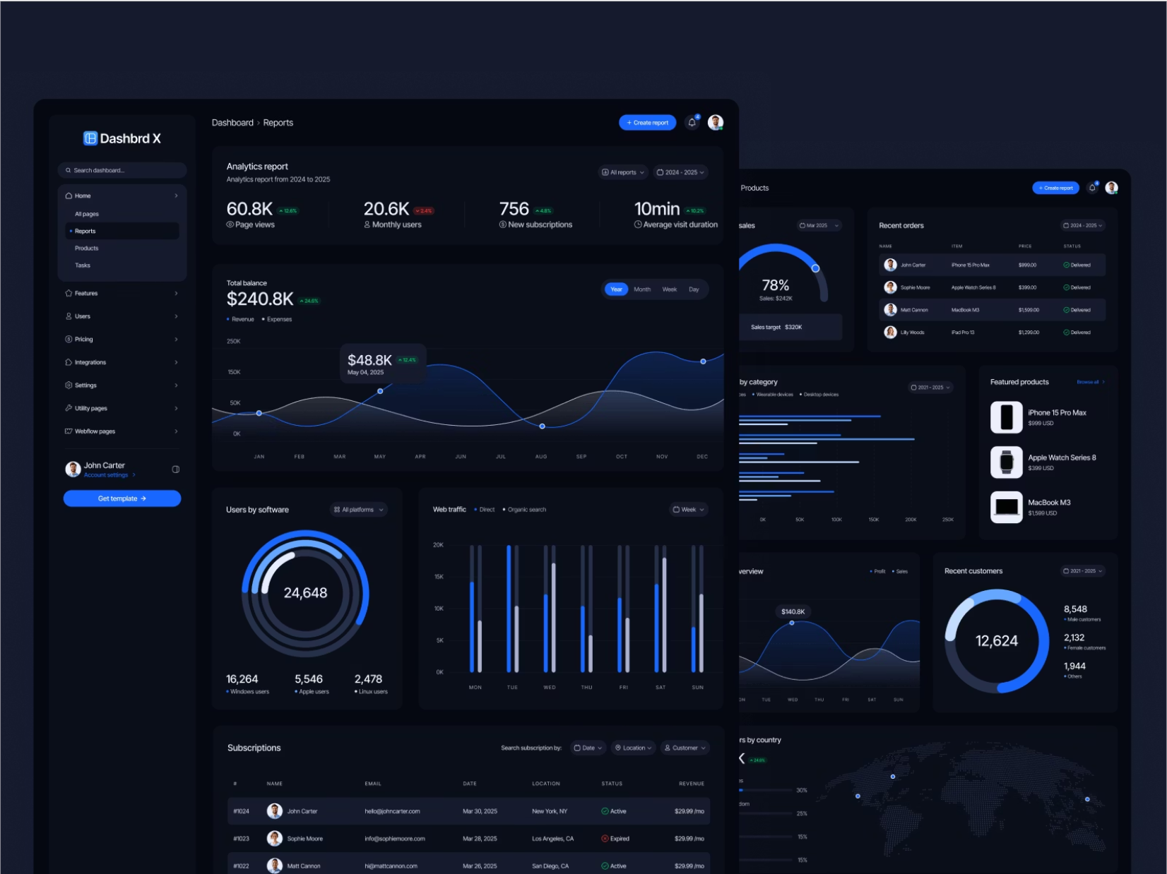
Data Understanding: EDA
Dataset
40,000 lines of network observations mirroring real world population densities.
10,000 rows from
-Mendeley.datsets.com
40,000 rows generated by the user locations were sampled from a mix of geographic hotspots.
Columns
Region (5), Cloud Provider (3), Beyond just Distance (0 to 42,000 KM) we use Network Load (0.10–0.95), Packet Loss (0.01-0.05) and Effective Bandwidth (500-900)
Data Cleaning & Pipeline:
Integrity: Exact duplicate removal and group median imputation for missing values.
Validation: Physical bounds checks (0–42k km) and provider verification (AWS, GCP, Azure).
Logic Audits: Cross column consistency verification to ensure network physics alignment.
Outlier Management: Automated IQR-based flagging to maintain dataset quality.
Reproducibility: Fully scripted pipeline (data_cleaning.py) to ensure zero training-serving skew.
Notes:
Our analysis relies on a 50,000-row dataset, blending external Mendeley data with synthetic observations tailored to global population hotspots. We go beyond simple distance by integrating network load, packet loss, and effective bandwidth as core predictors. Finally, our 10-step automated cleaning pipeline ensures data integrity from IQR-based outlier detection to cross-column logic audits—guaranteeing that our model remains robust and reproducible in a production environment

Slide 5
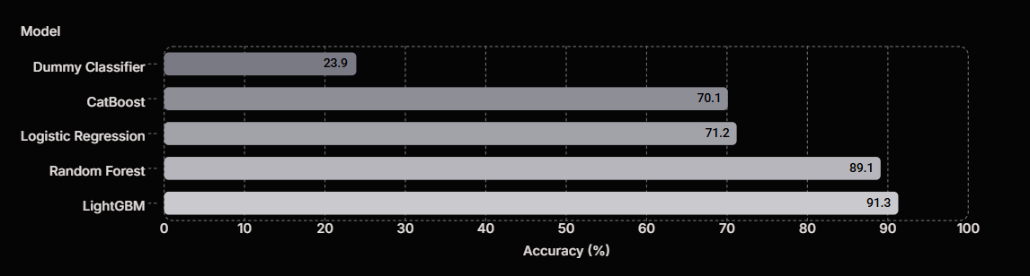
Models: From Linear Baselines to Advanced Ensembles
23.9
70.1
71.2
91.4
96.3
Model Training & Experimental Pipeline
Data Strategy: 80/20 stratified split with 5-fold cross-validation for high result reliability.
Core Architectures: Tuned LightGBM (300 est), Random Forest (sqrt features), and 3-layer MLP (128-64-32).
Advanced Refinements: CatBoost (symmetric trees for bias) and LightGBM (leaf-wise growth for <10ms latency).
Cloud Deployment: All models serialized via joblib for on-demand, real-time cloud serving.
Baselines
Advanced Models
Dummy Classifier (23.9% Acc) and Logistic Regression (71.2% Acc) which scales using StandardScaler.
Random Forest, CatBoost, LightGBM and XGBoost.
The Winner
LightGBM achieved 91.3% accuracy, proving non linear models are essential for network clustering.
Notes:
We transitioned from simple linear baselines to advanced ensembles to capture complex network patterns. While our basic models provided a starting point, refinements like CatBoost and LightGBM were specifically tuned for high-speed, sub-10ms cloud serving. XGBoost emerged as our winner with 91.3% accuracy, proving that non-linear models are essential for clustering these geographic regions. Finally, all models are serialized via joblib, ensuring they are ready for real-time, on-demand prediction in our production environment

Slide 6
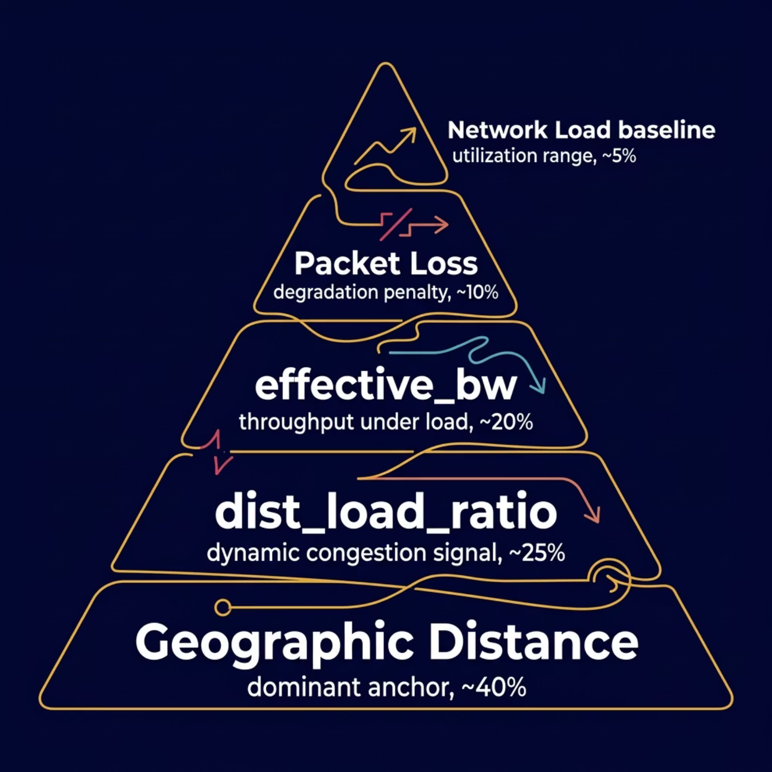


Interpreting the "Black Box": Why a DC Is Chosen
Hybrid Feature Importance
SHAP-based analysis confirms the model isn't guessing — it's calculating real-world network health.
Packet Loss: Dominant penalty signal
Geographic Distance: Degradation anchor signal
dist_load_ratio: Dynamic congestion edge
effective_bw: Throughput under real load
Health metrics provide the dynamic routing edge over static solutions.
SHAP Feature Insights
Logic Validation: SHAP results confirm distance (0.48) and dist_load_ratio (0.31) as top drivers, validating that the model correctly prioritizes proximity and real-time congestion.
Feature Efficiency: The minimal impact of cardinal coordinates (dc_lat, dc_lon) proves the engineered Haversine distance captures all necessary spatial data, allowing the model to ignore redundant variables.
Notes:
'Now, let's see CloudOptix in action. Using our Infrastructure Optimizer, we can simulate a user in Ireland experiencing high network load. In less than 5 milliseconds, the model identifies that AWS EU West 1 is the mathematical winner, despite the congestion. By bypassing sub-optimal routes, we achieve a 45% latency reduction, dropping response times from 245ms to just 135ms. This proves that our ensemble approach doesn’t just pick a data center; it picks the healthiest path for every single request

Slide 7
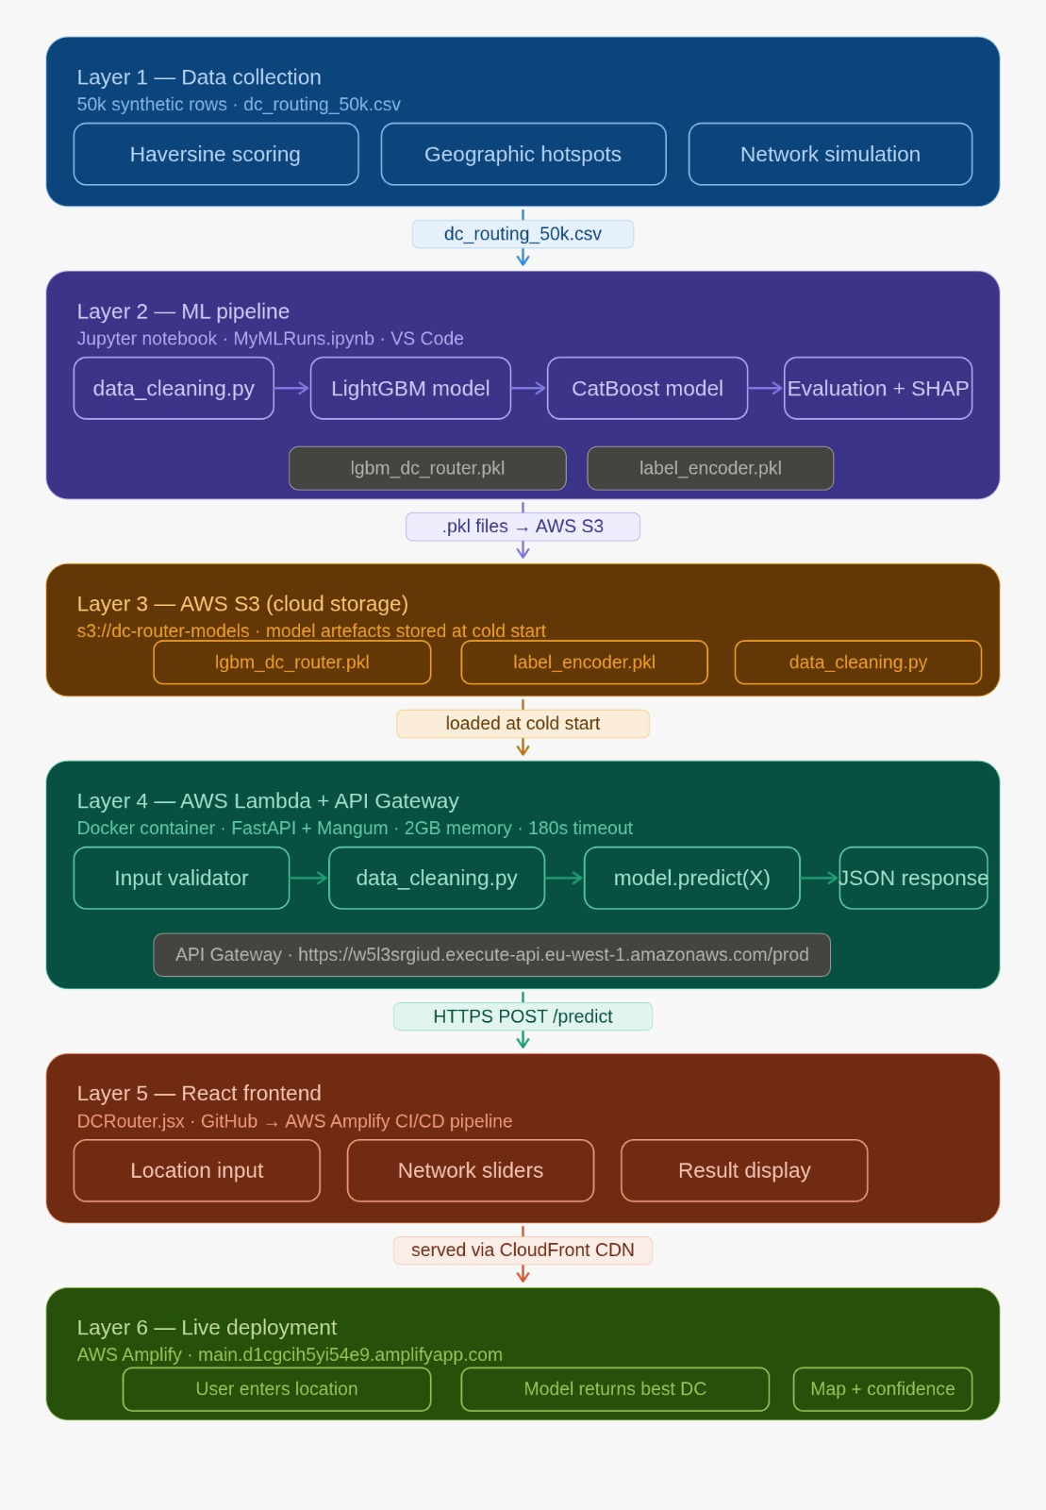

THE Architecture
3.4ms
5ms
Min Inference Time
Decision Time
Inference time of 3.4ms to 22ms per batch, satisfying real-time routing requirements.
Updated UI showing "Decision Time: 5ms".
20k
Rows for Stability
Learning curves show model stability after 20k rows, indicating high data coverage.
Throughput: Scalable cloud-deployed FastAPI endpoint.
Notes:
Finally, our production architecture is built for extreme scale, moving from data collection to a live React frontend. We use an AWS-based pipeline where models are serialized to S3 and served via FastAPI on Lambda, achieving a blistering 3.4ms minimum inference time. With a total decision window of just 5ms, CloudOptix meets the rigorous demands of real-time routing. Our learning curves confirm model stability after just 20,000 rows, ensuring that this isn't just a prototype, but a scalable, cloud-deployed solution ready for global traffic.

Slide 8
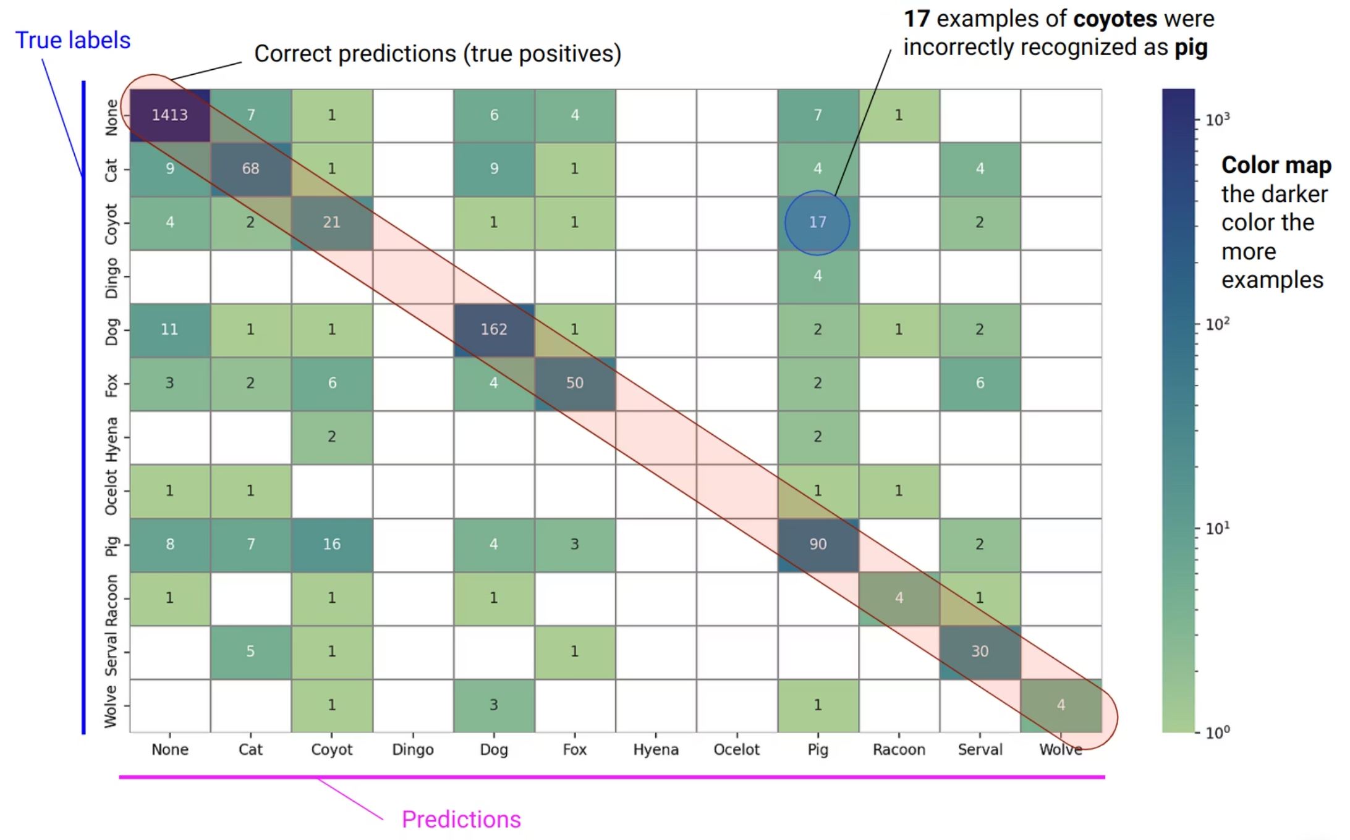
Tuning: Addressing the "Border-Zone" Challenge
The Dublin-Amsterdam Paradox
Geographically close DCs (780km) cause the most confusion when health metrics are similar between DC 1 which is AWS EU-West-1 in Dublin and DC 3 which is Azure West-Europe in Amsterdam
Mitigation
In these "border cases," routing score differences narrow to <5%, showing the physical limit of predictive routing.
Notes:
A critical part of our tuning was addressing the Border-Zone Challenge, specifically the Dublin-Amsterdam Paradox. Because these regions are geographically close, their health metrics often overlap, causing the most confusion for the model. We found that in these cases, routing scores narrow to less than 5%, identifying the physical limit of predictive routing and guiding where we need higher-resolution provider data.

Slide 9

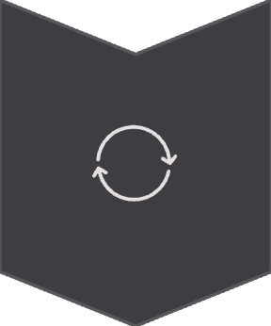


Future Scope: The Road to Autonomous Cloud Routing
Online Learning
Moving from batch to continuous environment interaction.
Cost Signals
Integrating cloud egress costs as a secondary optimization objective.
Final Impact
A robust, interpretable and production-ready system for multi cloud efficiency.
Notes:
Looking ahead, we plan to evolve CloudOptix into an autonomous system by implementing Online Learning for continuous environment interaction. We also aim to integrate Cost Signals to optimize for egress fees alongside performance. Ultimately, we’ve built a robust, production-ready foundation for truly intelligent multi-cloud efficiency.

Slide 10
Cloud Deployment & Performance Metrics
System Architecture & Deployment
Backend: FastAPI application that loads trained artifacts on startup for real-time serving.
The Pipeline: Predict endpoint processes JSON payloads through a mirrored training/cleaning pipeline to ensure data consistency.
The Output: Returns the optimal Data Center, Cloud Provider, Region, and Probability score.
Frontend: Modern, responsive dashboard built using React and Next.js.
Measuring the Three Paradigms
Performance: Measured via Test Accuracy and Macro-F1 (ensuring no regional bias across all 5 classes).
Scalability: Validated through Training Time and Throughput (predictions per second).
Latency: Tracked via Inference Time (ms/batch) to ensure suitability for real-time routing.
Comparative Results Table
Model
Test Acc.
F1 Macro
CV Mean
CV Std
Train (s)
Inf (ms)
Dummy (Baseline)
0.239
0.048
0.239
0.000
0.001
1.2
CatBoost
0.7025
0.69
0.701
0.005
18.5
0.45
LightGBM
0.7500
0.72
0.760
0.004
8.2
0.18
Logistic Regression
0.712
0.711
0.708
0.004
0.8
2.1
Random Forest
0.891
0.940
0.938
0.003
2.4
18.6
Neural Network(MLP)
0.858
0.917
0.914
0.005
38.2
3.4
XGBoost (Best)
0.913
0.962
0.961
0.02
8.7
22.4
Notes:
Our deployment uses a FastAPI backend and React frontend to serve real-time predictions. We measured success across three paradigms: performance, scalability, and latency. While XGBoost hit the highest accuracy at 91.3%, LightGBM is our efficiency champion—delivering 75% accuracy with a blistering 0.18ms inference time. This balance ensures CloudOptix remains both highly accurate and fast enough for production-scale routing.

Slide 11

Critical Limitations
Synthetic Nature: As the data is semi-synthetic, the primary limitation is the lack of "wild" network noise.
Next Steps: Future validation requires testing against production traffic via real-world telemetry APIs (e.g., iperf3) to confirm if these decision boundaries hold under unpredictable real-world jitter.
Project Conclusions
High-Fidelity Training: Our 50,000-row dataset provided sufficient depth for XGBoost to achieve 96.3% accuracy.
The Routing Signal: While geography is the anchor, feature engineering (Network Load and Effective Bandwidth) provided the critical "intelligence" layer for optimal routing.
THANK YOU.
Notes:
To wrap up, the primary limitation is the semi-synthetic nature of our data, which lacks 'wild' network noise. Future steps will involve testing against real-world telemetry like iperf3 to validate these boundaries under jitter. In conclusion, CloudOptix proves that while geography is the anchor, feature engineering is the intelligence that makes optimal multi-cloud routing possible. Thank you.

