Slide 1


IBS – Integrated Banking Services
IBS is an Indian banking and financial services company, & is India’s largest private sector lender by assets. It is the largest bank in India by market capitalisation as of February 2016.
Loan Management Services
Team:
Chetan Kohli
Devyansh Goyal
Divyam Batta
Shreya Sinha
Yuvraj Kalra

Slide 2


Requirements (Customer)
Home Loan
Education Loan
Apply Loan
Personal Loan
Pay EMI
Vehicle Loan
Apply Pre-closure
View Details

Slide 3

Requirements (Admin)
Approve Loan
Approve Pre-Closure

Slide 4
In-Scope
Loan Selection: type, amount and tenure.
EMI calculation.
Loan verification documents upload by customer.
Download and verification of documents by bank representative.
Pre-closure application by customer.
Approval/Denial of loan by Bank representative.
Approval/Denial of pre-closure by Bank representative.

Slide 5
Assumptions
Customer is already registered with the bank
Loan minimum and maximum limits are defined by the bank
Interest rates are fixed based upon the bank’s policy
EMI cycle is assumed to be monthly
Pre closure conditions to be defined by the bank

Slide 6
OUT OF SCOPE
Credit Scores.
New Customer Registration.
Mailing of receipts and Message Updates.
Auto Deduction of EMI Amount for Active Loans.

Slide 7


Apply Loan
Applicant Details
Pulls details for approval
Oracle
View Loan Details
Loan Approved
Customer
Interface
Admin
Interface

Slide 8
Pay EMI
Loan Number
EMI Details
Pays EMI
Updated Loan History
Customer
Interface
Oracle

Slide 9
Apply Pre-closure
Applies pre-closure
Pulls details for approval
(Loan Number)
Oracle
Updated Loan Details
Pre-closure Approved
Customer-UI
Admin-UI

Slide 10
View Loan History
User ID
All loans corresponding to User ID
Customer
Interface
Oracle

Slide 11
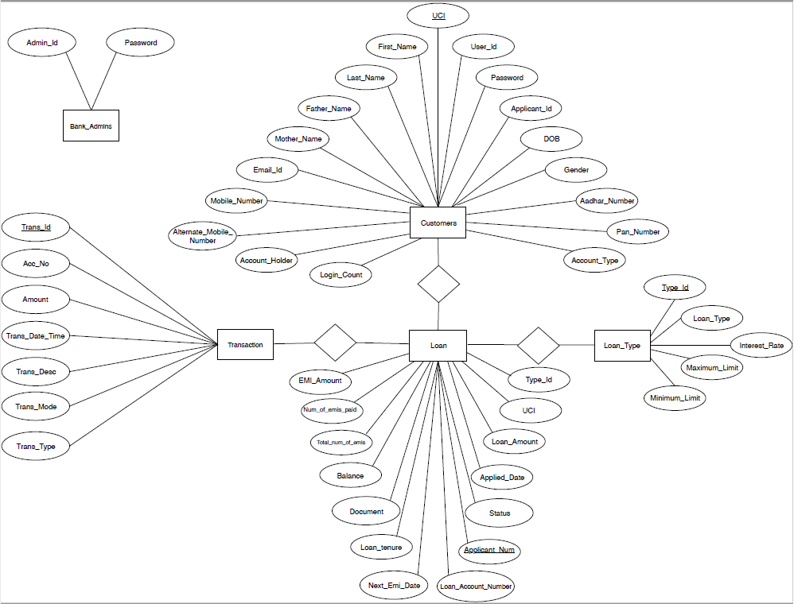
ER Diagram

Slide 12
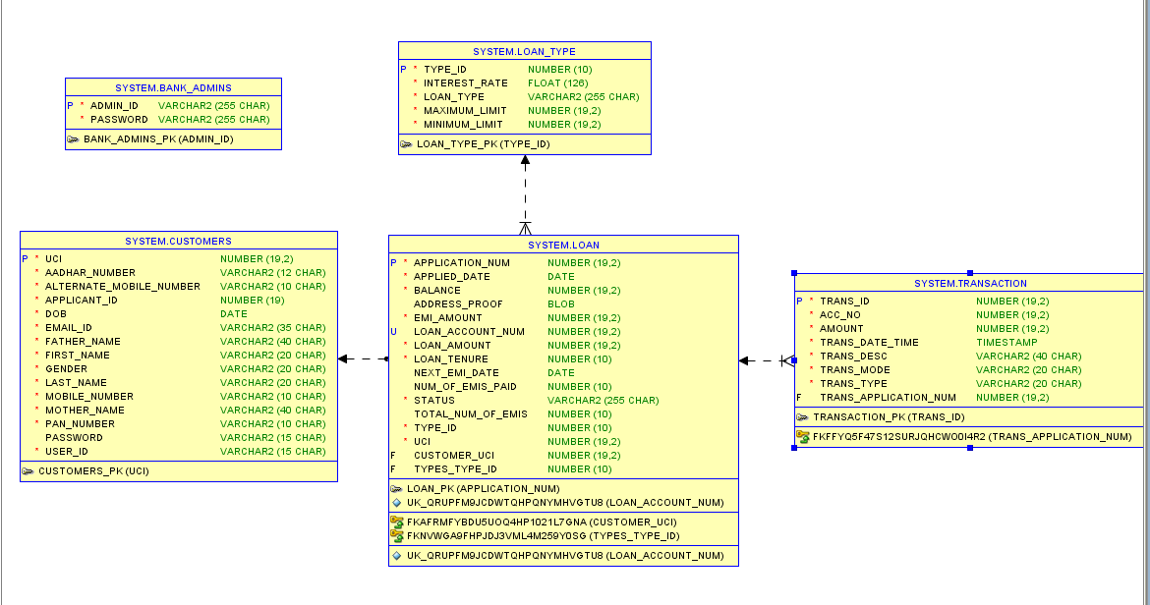
Schema Diagram

Slide 13
Demo Code
Login as an existing customer or admin?
------------------------
1 EXISTING_CUSTOMER
2 BANK_ADMIN
3 VISITOR
4 EXIT
Logging in as Customer
Welcome Page
1
Login with your Registered UserID
UserID:
ykalra
Password:
lol123
Welcome Yuvraj Kalra
--------------------
Please select one of the following to proceed further :
--------------------
1. APPLY_LOAN
2. PAY_EMI
3. APPLY_PRECLOSURE
4. VIEW_HISTORY
5. LOG_OUT

Slide 14
Demo Code
1
Menu
--------------------
Choice
--------------------
1 HOME_LOAN
2 EDUCATION_LOAN
3 PERSONAL_LOAN
4 VEHICLE_LOAN
5 GO_BACK
Apply Home Loan
Choice
1
-----------------------------------------
Loan Type: Home Loan
Interest Rate: 8.5
Maximum Loan Amount: 200000000
Minimum Loan Amount: 100000
Enter Loan Amount:
120000
Enter Loan Tenure (Months):
** Tenure should be in multiples of 6 months **
12
Monthly EMI: 10466.43
Apply Loan

Slide 15
Demo Code
Please upload any address proof in pdf format
Enter the file path:
C:\Users\dbatta\Desktop\sample.pdf
1010
Menu
--------------------
Choice
--------------------
1 HOME_LOAN
2 EDUCATION_LOAN
3 PERSONAL_LOAN
4 VEHICLE_LOAN
5 GO_BACK
Uploading Verification documents

Slide 16
Demo Code
Login as an existing customer or admin?
------------------------
1 EXISTING_CUSTOMER
2 BANK_ADMIN
3 VISITOR
4 EXIT
Logging in as Admin
Welcome Page
2
Login with your Registered UserID
UserID:
admin1
Password:
pass1
Menu
--------------------
Choice
--------------------
1 VERIFY_LOAN
2 VERIFY_PRECLOSURE
3 LOG_OUT

Slide 17
Demo Code
Choice
1
Following are the loans pending for verification:
1002 Yuvraj Home Loan
1007 Yuvraj Home Loan
1008 Yuvraj Home Loan
1009 Yuvraj Home Loan
1010 Yuvraj HomeLoan
Enter the applicant number of the loan you want to verify:
1010
Selecting Loan for approval
Enter the applicant number of the loan you want to verify:
1010
******
Application No.: 1010
Name of customer: Yuvraj Kalra
Loan Amount: 120000
LoanTenure: 12
EMI Amount: INR 10466.43
Document for Application Number 1010 has been downloaded in the 'Downloads Folder'.
******
Do you want to approve the loan?
1. Yes
2. No
Verify Loan

Slide 18
Demo Code
Do you want to approve the loan?
1. Yes
2. No
1
Loan Approved!
Loan number for the loan: 2019101010
Menu
--------------------
Choice
--------------------
1 VERIFY_LOAN
2 VERIFY_PRECLOSURE
3 LOG_OUT
Verify Loan

Slide 19
Demo Code
1
Login with your Registered UserID
UserID:
ykalra
Password:
lol123
Welcome Yuvraj Kalra
--------------------
Please select one of the following to proceed further :
--------------------
1. APPLY_LOAN
2. PAY_EMI
3. APPLY_PRECLOSURE
4. VIEW_HISTORY
5. LOG_OUT
Logging in as Customer

Slide 20
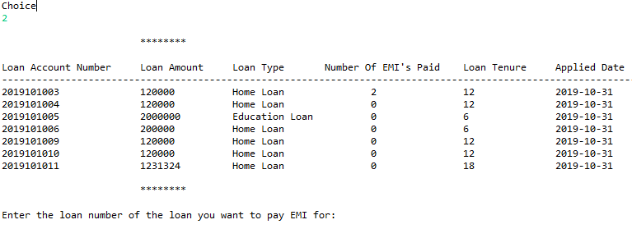
Demo Code
Select Pay Emi, List of loans

Slide 21
Demo Code
Enter the loan number of the loan you want to pay EMI for:
2019101018
********
Loan Number:2019101018
Loan Type:Home Loan
Total Number of EMI's to be paid:12
Number of EMI's already paid:1
Balance Amount to be paid:110352.15
EMI to be paid:10466.43
********
Do you want to pay EMI:
1. Yes
2. No
1
Transaction Successful!
********
Transaction Id:52
Transaction Account Number:2019101018
Transaction Amount:10466.43
Transaction Date :2019-10-31T14:26:39.876
********
Receipt has been generated.
Save the receipt for future references!
********
Balance has been updated.
New balance: INR 100638.49
Next EMI Date:2020-01-30
Number of EMIs left:10
Thankyou!

Slide 22
Enhancements From Previous Sprint
Visitor portal: View types of loans, minimum/maximum loan limits, calculate EMI values.
Login as an existing customer or admin?
------------------------
1 EXISTING_CUSTOMER
2 BANK_ADMIN
3 VISITOR
4 EXIT
3
Menu
--------------------
Choice
--------------------
1 HOME_LOAN
2 EDUCATION_LOAN
3 PERSONAL_LOAN
4 VEHICLE_LOAN
5 GO_BACK
Choice
2
-----------------------------------------
Loan Type: Education Loan
Interest Rate:11.35
Maximum Loan Amount:5000000
Minimum Loan Amount:50000
Enter Loan Amount:
120000
Enter Loan Tenure (Months):
** Tenure should be in multiples of 6 months **
12
Monthly EMI: INR 10625.44
Do you want to apply for this loan
1. Yes
2. No
1
******Login Portal******
Login with your Registered Customer UserID!

Slide 23
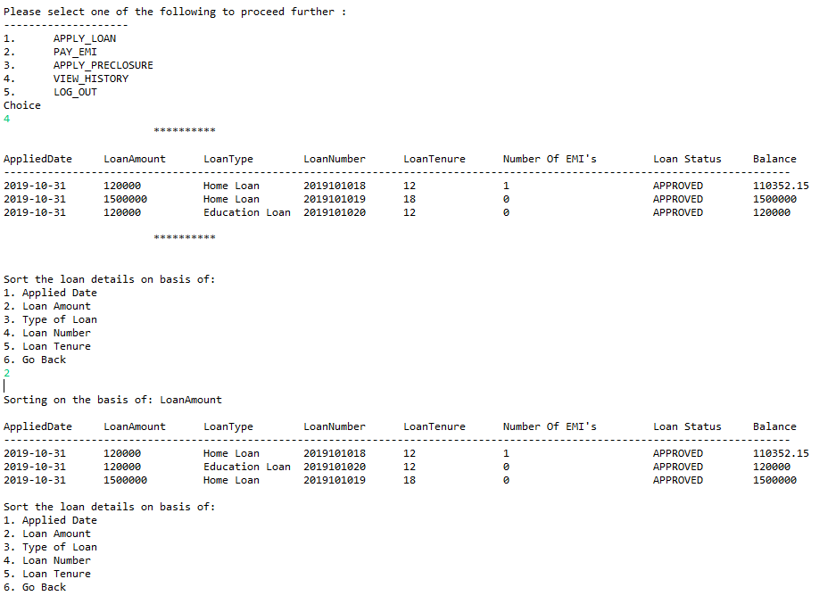
Enhancements From Previous Sprint
Sorting of Loans: Loans can be sorted according to multiple fields as per user request while viewing loan details

Slide 24
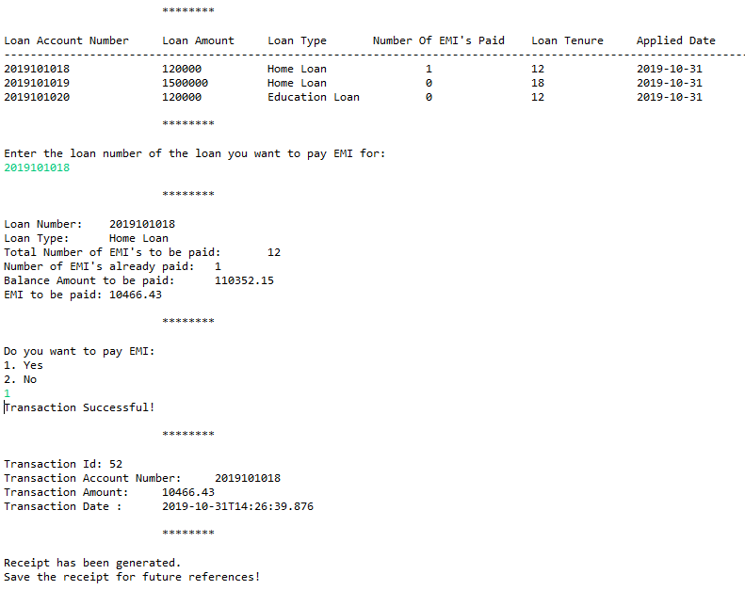
Enhancements From Previous Sprint
Generation of receipts: Transaction receipts while payment of EMI is generated and available to the customer. Contains Transaction ID, Date/time, Transaction Amount, Transaction Type/Mode.

Slide 25
Enhancements From Previous Sprint
Login Portals: Both customer and admin need to login with registered Login ID and password for using the application.
Login as an existing customer or admin?
------------------------
1 EXISTING_CUSTOMER
2 BANK_ADMIN
3 VISITOR
4 EXIT
1
******Login Portal******
Login with your Registered Customer UserID!
UserID:
ykalra
Password:
lol123
----------------------------------------------------------------
Welcome Yuvraj Kalra
Login as an existing customer or admin?
------------------------
1 EXISTING_CUSTOMER
2 BANK_ADMIN
3 VISITOR
4 EXIT
2
******Admin Login Portal******
Login with your Registered Admin UserID
UserID:
admin1
Password:
pass1
Menu
--------------------
Choice
--------------------
1 VERIFY_LOAN
2 VERIFY_PRECLOSURE
3 LOG_OUT

