Slide 1
Automatic Tagging
Text Analytics
Sagar Kelkar: PRN - 18030142015
Shreyasi Patwardhan: PRN - 18030142025

Slide 2

What is Automatic Tagging?
Automatic Tagging has various ways to add part-of-speech tags.
We will see that the tag of a word depends on the word and its context within a sentence.
For this reason, we will be working with data at the level of sentences rather than words.

Slide 3
Ways to do Automatic Tagging
Default Tagging
The Regular expression Tagging
The Lookup Tagging

Slide 4


The Default Tagger
The simplest possible tagger assigns the same tag to each token.
In order to get the best result, we tag each word with the most likely tag.
This method performs rather poorly.
On a typical corpus, it will tag only about an eighth of the tokens correctly.

Slide 5
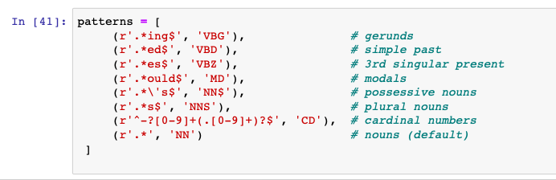
The Regular Expressions Tagger
The regular expression tagger assigns tags to tokens on the basis of matching patterns.
For instance, we might guess that any word ending in ed is the past participle of a verb, and any word ending with ’s' is a possessive noun.
We can express these as a list of regular expressions:

Slide 6
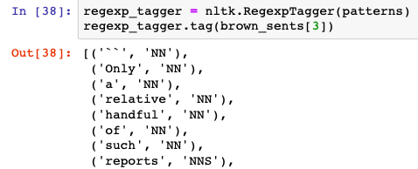

The Regular Expressions Tagger
Note that these are processed in order, and the first one that matches is applied.
Now we can set up a tagger and use it to tag a sentence.
Now its right about a fifth of the time.

Slide 7
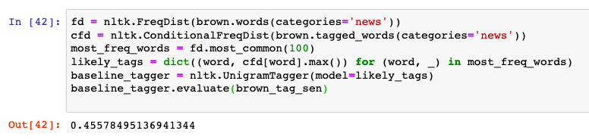
The LookUp Tagger
A lot of high-frequency words do not have the ‘NN’ tag.
Let's find the hundred most frequent words and store their most likely tag.
We can then use this information as the model for a "lookup tagger”.
It should come as no surprise by now that simply knowing the tags for the 100 most frequent words enables us to tag a large fraction of tokens correctly (nearly half in fact).

Slide 8
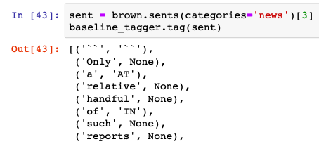
The LookUp Tagger
Many words have been assigned a tag of None, because they were not among the 100 most frequent words.
In these cases we would like to assign the default tag of NN.
In other words, we want to use the lookup table first, and if it is unable to assign a tag, then use the default tagger, a process known as backoff .
We do this by specifying one tagger as a parameter to the other, as shown below.
Now the lookup tagger will only store word-tag pairs for words other than nouns, and whenever it cannot assign a tag to a word it will invoke the default tagger.

Slide 9
Conclusion
In the above examples, you will have noticed an emphasis on accuracy scores.
In fact, evaluating the performance of such tools is a central theme in NLP.
Recall the processing, any errors in the output of one module are greatly multiplied in the downstream modules.
We evaluate the performance of a tagger relative to the tags a human expert would assign.
Since we don't usually have access to an expert and impartial human judge, we make do instead with gold standard test data.
This is a corpus which has been manually annotated and which is accepted as a standard against which the guesses of an automatic system are assessed.
The tagger is regarded as being correct if the tag it guesses for a given word is the same as the gold standard tag.
Of course, the humans who designed and carried out the original gold standard annotation were only human.

Slide 10
THANK YOU

