Slide 1
UE24CS352A / MACHINE LEARNING MINI-PROJECT
Detecting & Predicting Earthquake
Ground Motion Directionality Patterns
Using machine learning to model how shaking orientation changes between nearby sites.
TEAM DETAILS
Shreyas K M – PES1UG24AM402
Dhruvanth U – PES1UG24AM362
Reference study / Alan Poulos & Rodrigo Silva-Lopez
John A. Blume Earthquake Engineering Center • Stanford University
01

Slide 2
01 / ENGINEERING MOTIVATION
The assumption misses spatial coherence
Ground-motion orientation influences how infrastructure experiences earthquake demand.
CODE ASSUMPTION
OBSERVED BEHAVIOUR
ENGINEERING CONSEQUENCE
Orientations across stations are often treated as uniformly and independently distributed.
For shallow crustal events, nearby stations can exhibit correlated orientations.
Independent sampling can understate simultaneous shaking risk for distributed assets.
Project target
Estimate the acute angular difference Δθ ∈ [0°, 90°] between two sites recording the same earthquake.
RotD100: the orientation associated with maximum horizontal spectral acceleration.
02

Slide 3
02 / DATA FOUNDATION
From earthquake records to paired observations
A pairwise dataset makes spatial dependence measurable.
PEER NGA-West2
Engineering filter
Pair construction
Learning table
Ground-motion records
→
Shallow crustal
Mw ≥ 5.0
→
Same event
d ≤ 5 km
→
5,300 site pairs
5,300
71
21
80 / 10 / 10
pairwise instances
initial attributes
selected features
train / val / test
Target: Δθ = min(|θᵢ − θⱼ|, 180° − |θᵢ − θⱼ|)
Data note: the 5,300-pair NGA-West2 set is produced by src/data_generator.py, calibrated to the reference study.
03

Slide 4
03 / FEATURE ENGINEERING
Reduce 71 attributes to a focused 21
Stepwise backward–forward selection with Ridge regression.
1) BACKWARD RANKING
2) FORWARD SELECTION
3) FINAL SUBSET
Remove one feature at a time and measure the validation R² drop. Larger drops imply greater contribution.
Add features in ranked order until validation performance peaks.
Retain 21 predictive attributes while limiting redundancy and collinearity.
Dominant drivers
Inter-site distance d
Δθ rises as sites move farther apart
Other selected variables include hypocenter depth, rupture dimensions and fault geometry.
Average PGA
Higher PGA (> 0.15g) lowers Δθ
04

Slide 5
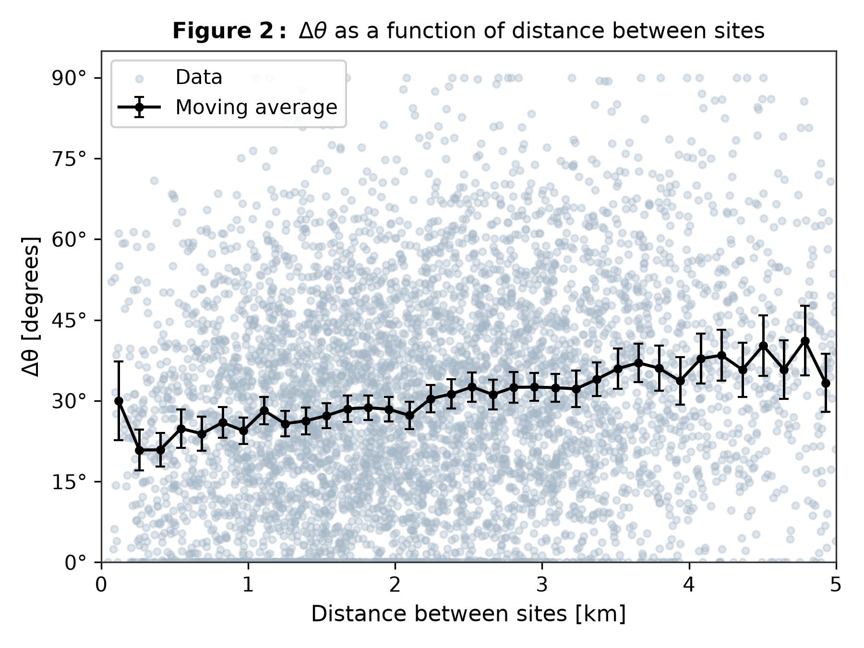
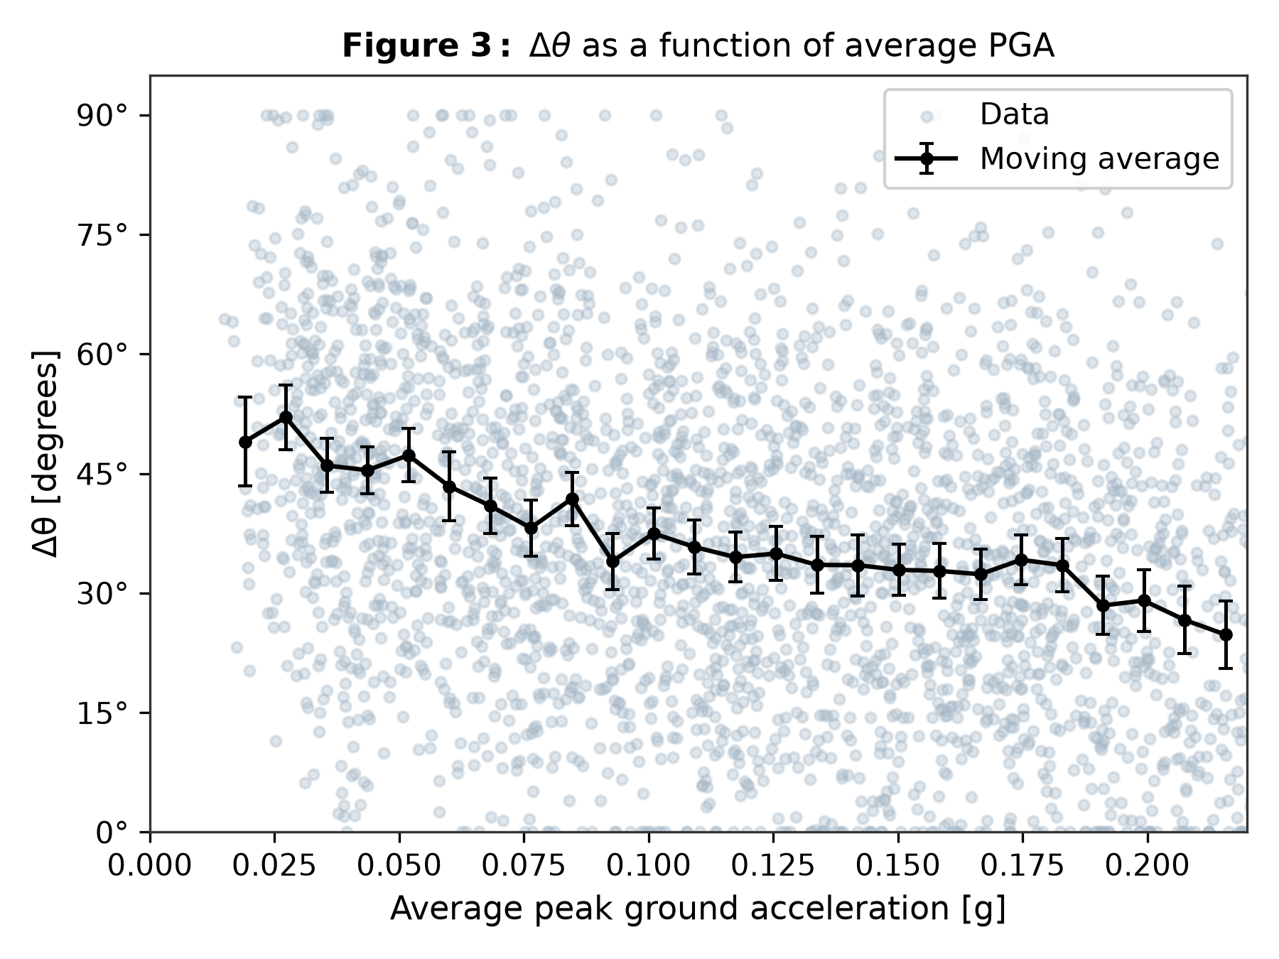
04 / EXPLORATORY ANALYSIS
Two physical variables reveal clear mean trends
Raw observations are highly scattered; moving averages expose the conditional pattern.
FIGURE 2 / Δθ generally rises with site separation.
FIGURE 3 / Δθ tends to fall as average PGA increases.
05

Slide 6
05 / MODELING STRATEGY
Compare a simple baseline with three ML models
All multivariate models use the same 21 selected features.
MODEL
INPUTS
LEARNING IDEA
ROLE
Benchmark OLS
Distance d only
Univariate linear fit
Reference baseline
Ridge Regression
21 features
Linear model + L₂ penalty
Regularized benchmark
Deep Neural Network
21 features
MLP • ReLU • Adam
Nonlinear learner
Gradient Boosting
21 features
Boosted decision trees
Tree-based comparison
Ridge α = 1.5 • MLP: ReLU + Adam, L₂ weight decay • Hyperparameters tuned on validation data
06

Slide 7
06 / RESULTS
A linear model matches complex models on test data
Held-out test set of 530 site pairs. Boosted trees overfit: train R² 0.751 vs. test 0.325.
Model | Inputs | Train R² | Test R² | Test MAE (°) | Test RMSE (°)
Benchmark OLS | Distance d | 0.038 | 0.051 | 16.43 | 19.95
Ridge | 21 features | 0.349 | 0.350 | 13.35 | 16.52
MLP | 21 features | 0.381 | 0.328 | 13.56 | 16.79
Boosted trees | 21 features | 0.751 | 0.325 | 13.71 | 16.83
R²: 0.051 → 0.350
MAE: 16.43° → 13.35°
Trees R²: 0.751 → 0.325
Ridge vs distance-only baseline
3.08° lower error than baseline
Train → test: clear overfitting
07

Slide 8
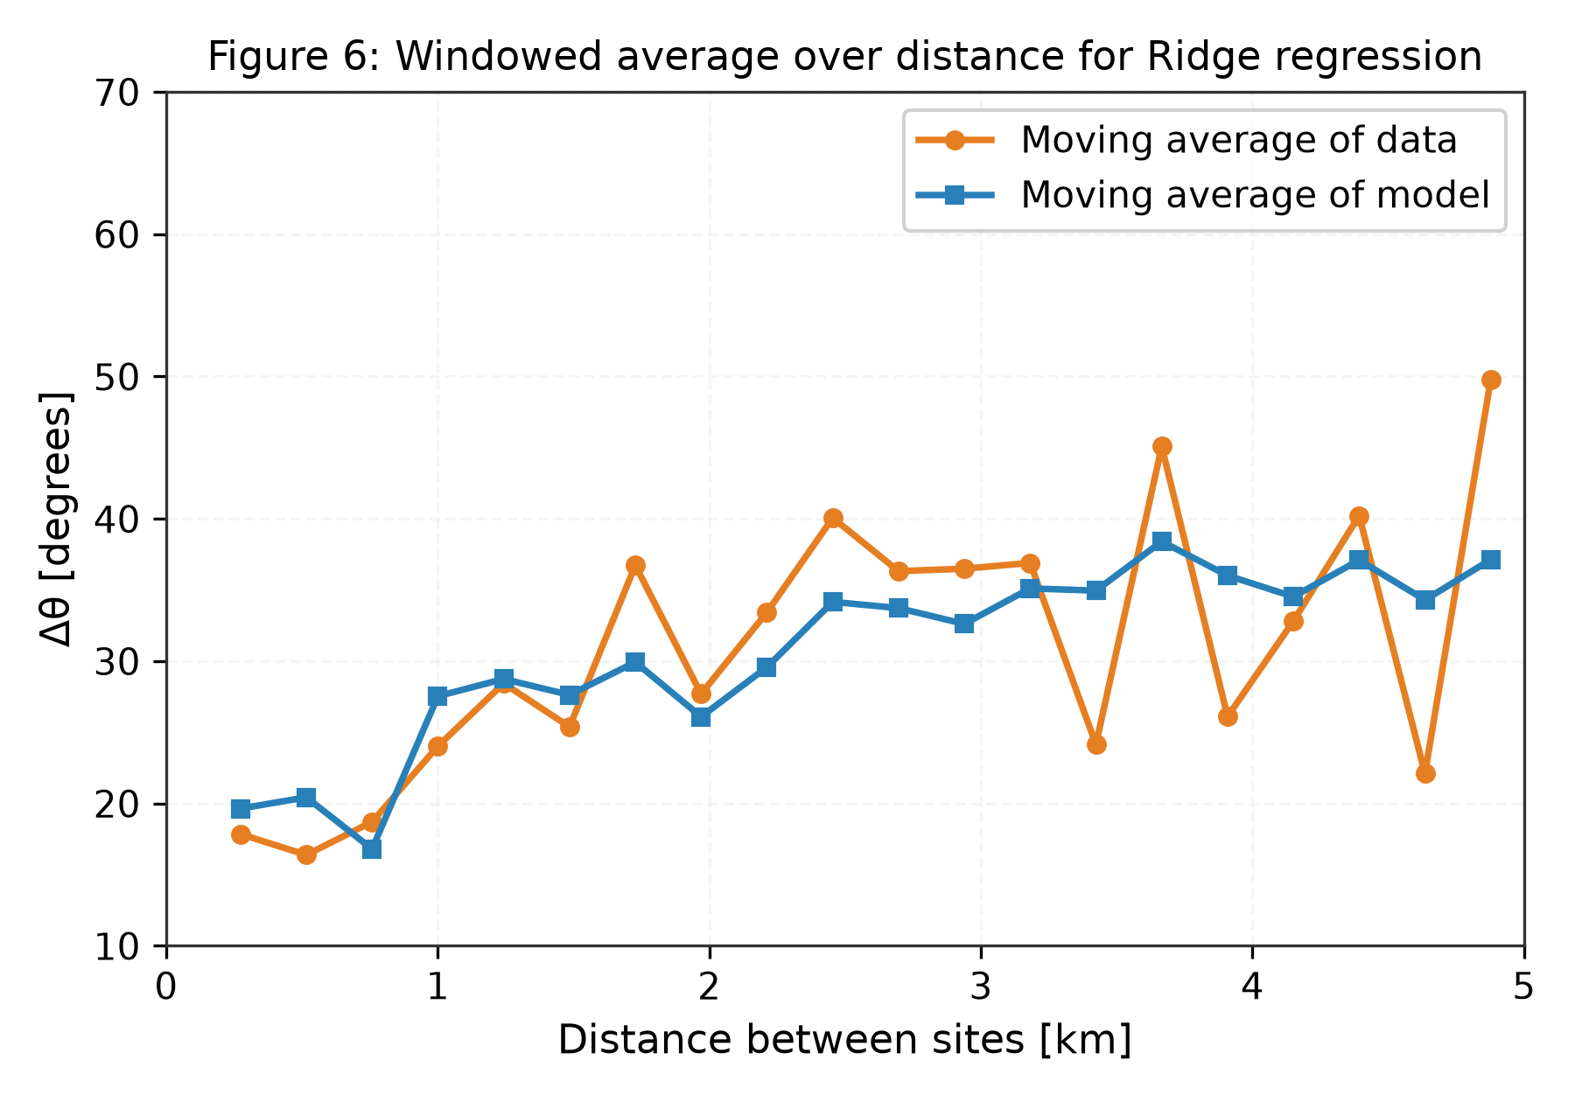
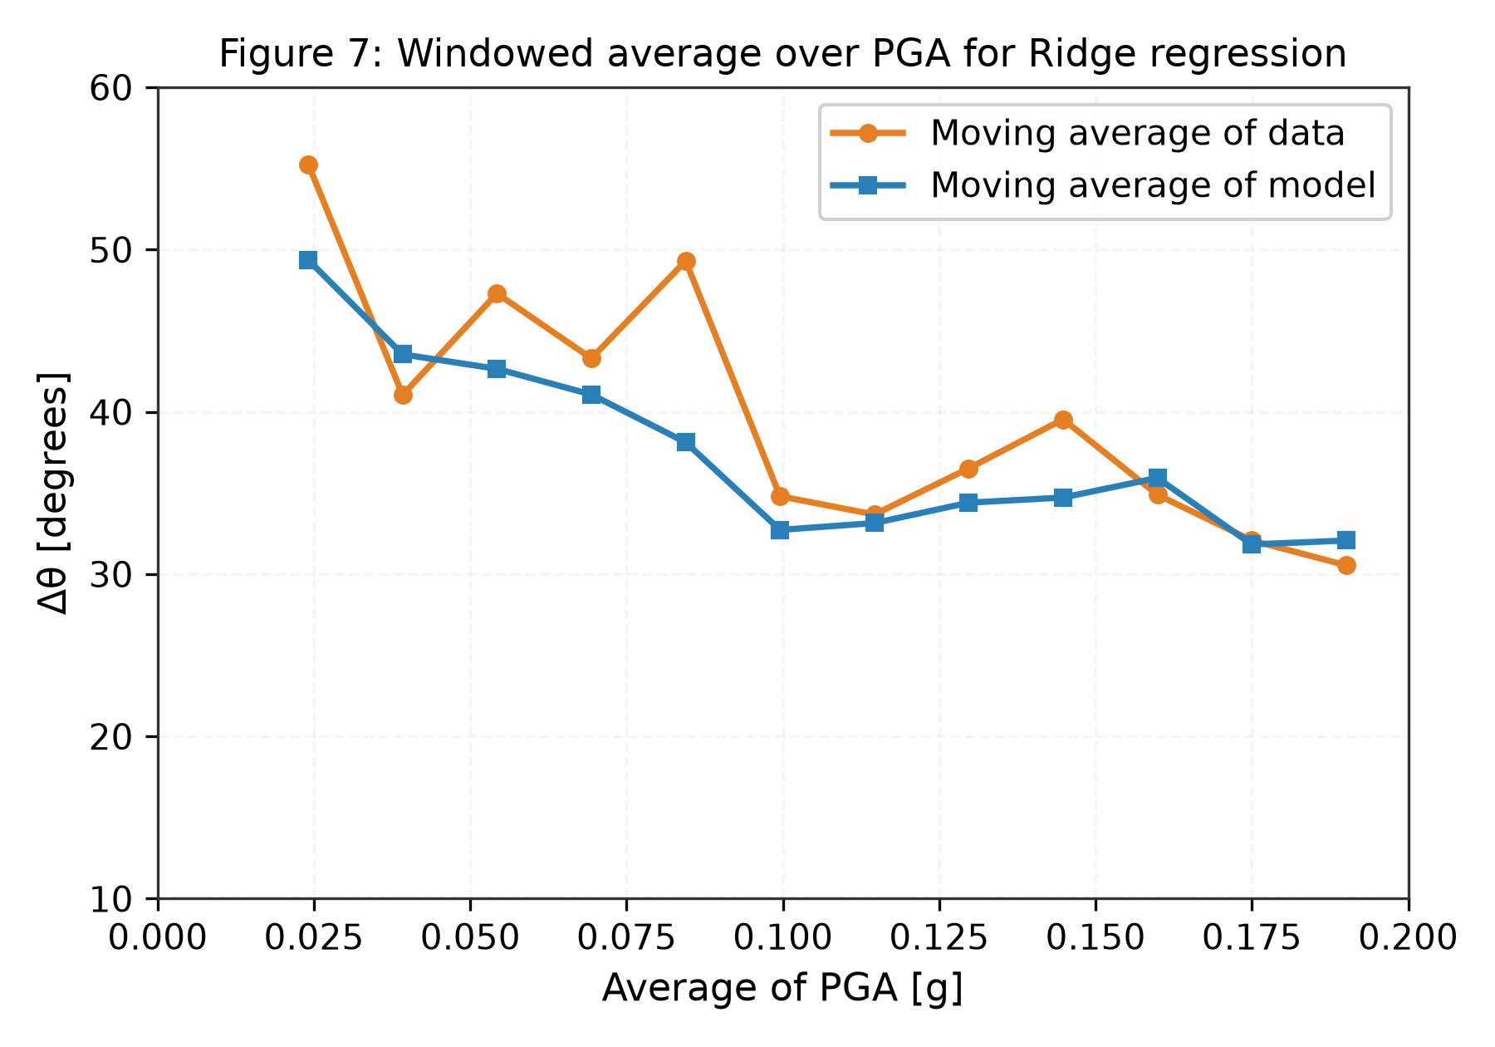
07 / MODEL BEHAVIOUR
Predictions recover the average physical trend
Windowed averages compare empirical Δθ with the Ridge model across feature bins.
FIGURE 6 / Moving averages over distance.
FIGURE 7 / Moving averages over PGA.
08

Slide 9
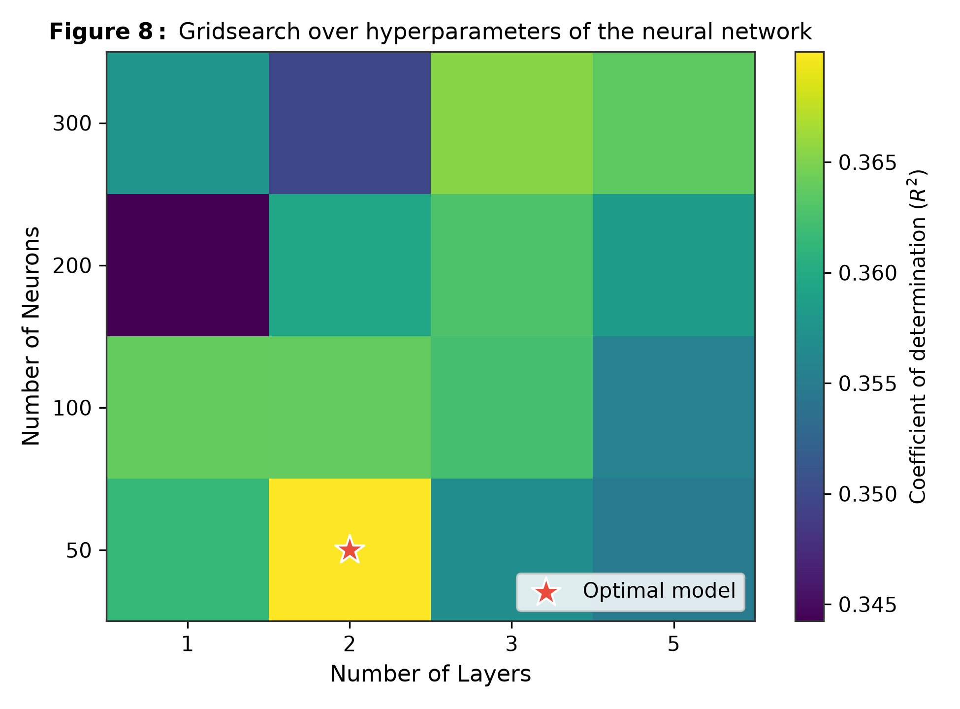
08 / ARCHITECTURE TUNING
A compact MLP was selected through grid search
Validation R² across hidden-layer depth and neuron count.
SEARCH SPACE
1–5 hidden layers • 50–300 neurons
OPTIMIZATION
ReLU activations • Adam • L₂ weight decay α = 0.1
TEST OUTCOME
Test R² = 0.328 • MAE = 13.56°
Every configuration lands within about 0.02 R², so the ceiling comes from the data, not the architecture.
09

Slide 10
09 / INTERPRETATION
Why does test R² plateau near 0.35?
The remaining error is not necessarily a failure of the learning algorithm.
OBSERVABLE INPUTS
UNOBSERVED PHYSICS
MODEL IMPLICATION
Magnitude, geometry, site properties, PGA and inter-site separation describe only part of the wavefield.
3D subsurface heterogeneity, velocity variations and micro-topography introduce irreducible variability.
A single point estimate cannot explain every pair, even when the conditional mean is learned well.
The practical signal is the conditional mean: E[Δθ | x]
High aleatoric uncertainty limits pointwise R², while the moving-average curves show that the model reconstructs the expected trend across distance and PGA.
10

Slide 11
10 / IMPLEMENTATION & DEMO
From raw data to live predictions
A modular Python pipeline with a single command-line entry point.
PIPELINE
TRAIN & EVALUATE
LIVE DEMO
Generate data, preprocess and split, then select the 21 features with backward–forward Ridge ranking.
Grid-search tuning and saved models, then publication figures 2–12 and the metrics table.
Interactive inference of Δθ for near-field, mid-range and far-field site pairs.
python main.py --pipeline • --train • --evaluate • --predict • --demo
Deliverables: two-page academic write-up (PDF) and this slide deck. Pure Python 3, cross-platform.
11

Slide 12
11 / TAKEAWAYS
Learning directionality adds value to hazard analysis
A compact summary of what the experiments support.
01 / PHYSICS
02 / PERFORMANCE
03 / INTERPRETATION
Distance and average PGA are the leading drivers of orientation correlation.
Ridge matches or slightly beats the MLP and boosted trees, so a simple model suffices.
Models capture mean trends despite high uncertainty in individual site-pair outcomes.
Next research steps
• Probabilistic / heteroscedastic models to estimate both conditional mean and variance.
• Extend pairwise estimates toward joint spatial simulation for multi-site infrastructure analysis.
12

Slide 13
12 / REFERENCES
References
Reference & project materials
• Poulos, A. & Silva-Lopez, R. “Detecting and predicting earthquake ground motion directionality patterns using machine learning tools.” John A. Blume Earthquake Engineering Center, Stanford University.
• PEER NGA-West2 ground-motion database, Pacific Earthquake Engineering Research Center.
• UE24CS352A Machine Learning Mini-Project: write-up, codebase and supplied figures.
Thank you
13

