Slide 1
Data Visualization:
Team 6: DEBARATI, Dhwanil, Nischal, Poonam, Sanjeev and Shreyas

Slide 2
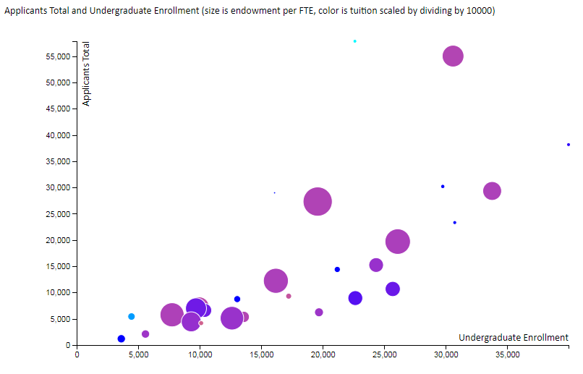
Linear positive relationship seen between Applicants total, Undergraduate Enrolment and Tuition. No particular pattern found for Endowment per FTE.
Source: Screenshot from chrome browser, plot made using d3

Slide 3
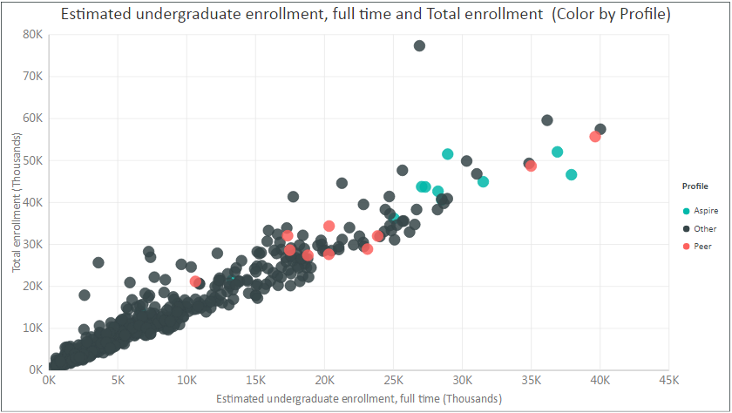
Linear positive relationship seen between undergraduate enrollment, Full time and Total enrollment with higher value of both for Aspire and peer profile
Source: Screenshot from Power BI

Slide 4
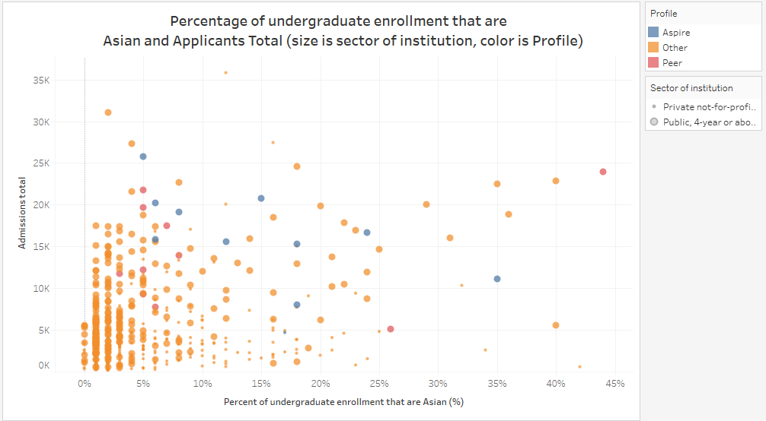
Most of other profile colleges have lower % of undergraduate enrollment that are Asian and Applicants Total. Aspire profile has higher lower minimum of Applicants Total and Percentage of undergraduate enrollment that are Asian in comparison to others
Source: Screenshot from Tableau

Slide 5
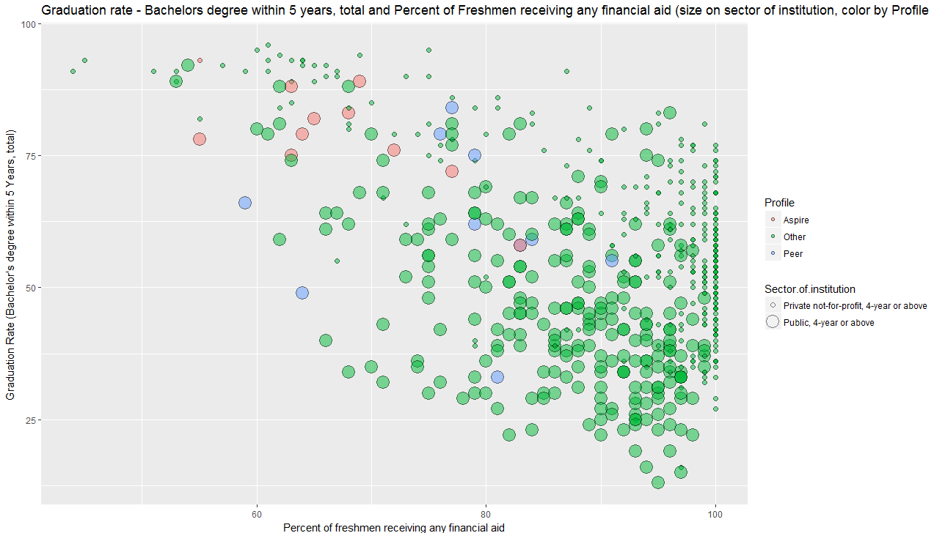
A pattern is seen of decrease in Graduation rate with increase in Percent of freshmen receiving any financial aid. Aspire and Peer profile have lower financial aid and also there is lot of variation between public and private sector of institution with respect to Graduation rate
Source: Screenshot from Rstudio

Slide 6
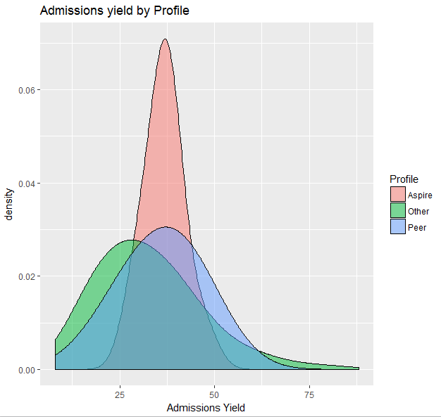
Density of Admission Yield for Aspire is seen to be of higher density and peak around an admission yield around 40 with less variations.
Source: DV screenshot from RStudio

Slide 7
Recommendations for UTD
Admission yield density is higher for aspire with less variation and if we optimize the admission yield then we are able to impact the total enrollment and number of admission (i.e. % of admitted). Therefore suggestion would be to increase marketing activities to invite more applications with targeted focus.
Linear positive relationship seen between Applicants total, Undergraduate Enrolment and Tuition. Total enrollment as seen increases if with increase the estimated undergraduate, full time enrollment. Therefore it would be interesting to do marketing for estimated undergraduate enrollment, full time enrollment.
Admission total and number of percentage of Asian is higher in Aspire, therefore we can target the campaigns towards Asian.
It is seen that bachelor within 5 years for aspire is higher with less % of financial aid therefore if we decrease the % of financial aid it can lead to quality of application and also increase the Bachelor’s within 5 years. . Also there is lot of variation between public and private sector of institution with respect to Graduation rate
Recommendation based on external sources
The great out-of-state migration: There is an upward trend in the number of students migrating out of their home states, not only that the number of out-of-state freshman has evidently doubled. This has been aided by not only by the lure of independence but also student exchange and reciprocity programs. Universities, to gain from this inference, can offer other benefits to the in-state students and tie-up with other universities for the reciprocity program. Establishing a partnership with peer university or aspire university to attract more talent and run programs can be helpful to increase the profile.
Learnings from the University of Alabama: For a university to be among the top players, it needs to excel not only in academics but also in other nice areas like the Greek life and sports. Apart from major attractions such as excellent faculty and academic resources, the university “oomph” factor also contributes to the decision-making process of the applicant.
Increase in state-based and alumni-generated funding can help in providing better facilities to the enrolled students. Universities should be more caring towards their students and not just look at the numbers, in this incredibly competitive landscape of higher education
Private Institutions recover their cost of operations through fees and Public Intuitions recover their fees through dorms and in food consumption. Therefore it could be said that over a period of time it could be difficult for Public to offer financial aids and they may resort to increase in their marketing or attracting talent through recruiter and other initiatives.
Source: https://mobile.nytimes.com/2016/11/06/education/edlife/survival-strategies-for-public-universities.html?referer=https://www.nytimes.com/interactive/2016/08/26/us/college-student-migration.html
Increase Admission Yield with Marketing activities
Targeted campaigns on Undergraduate that are Asian
Decrease % of any financial aid
Bachelors within 5 years increases, higher applicants total and total enrollment.
A shift towards Aspire profile

Slide 8
Thank You!

