Slide 1
Shreyas, Tanish, and Seth
Lawn Sweeper
Notes:
Seth

Slide 2
Problem Statement
Reports indicate that American homeowners spend long hours each fall removing leaves from their yards. The significant time required to complete leaf removal causes physical strain, with 42,000 people sustaining recurring neck, shoulder, and back injuries as a result per year.
Don’t let raking leaves become a pain in the neck, back or spine. Luminis Health. (n.d.). https://www.luminishealth.org/en/blog/dont-let-raking-leaves-become-a-pain-in-the-neck-back-or-spine?
Notes:
Seth

Slide 3
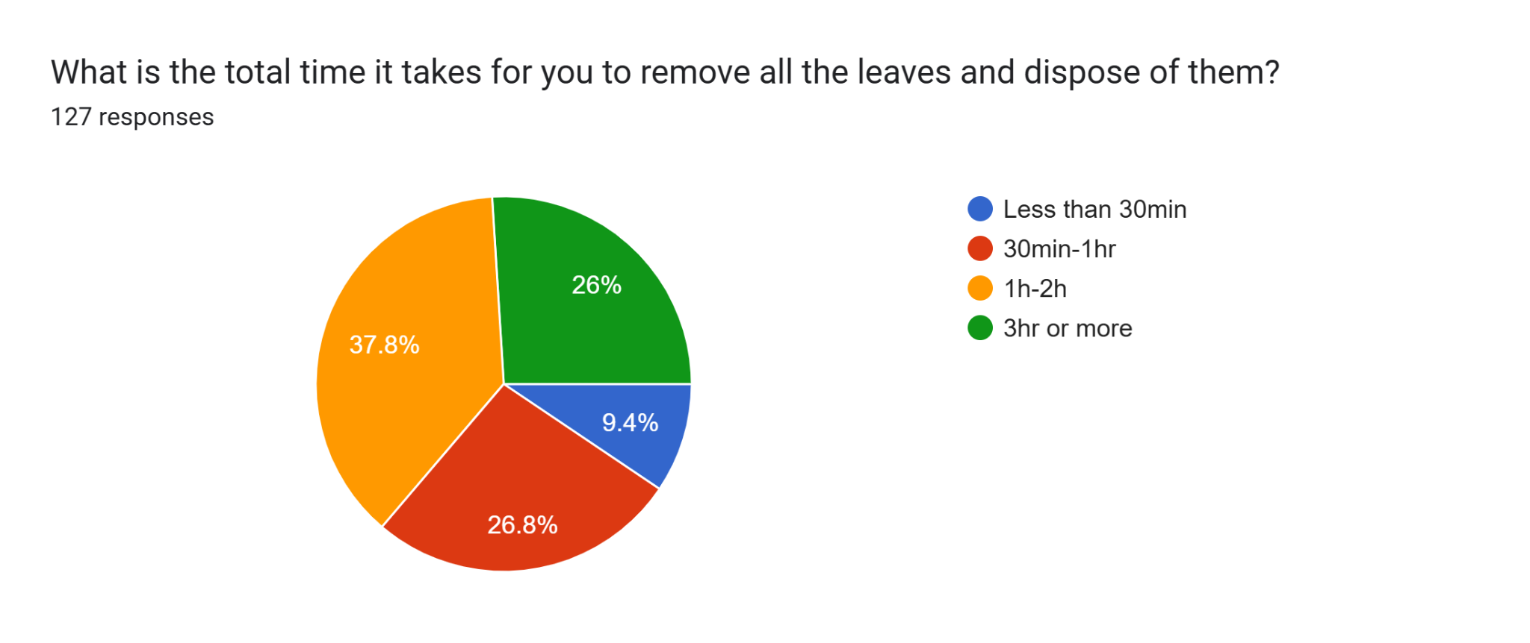
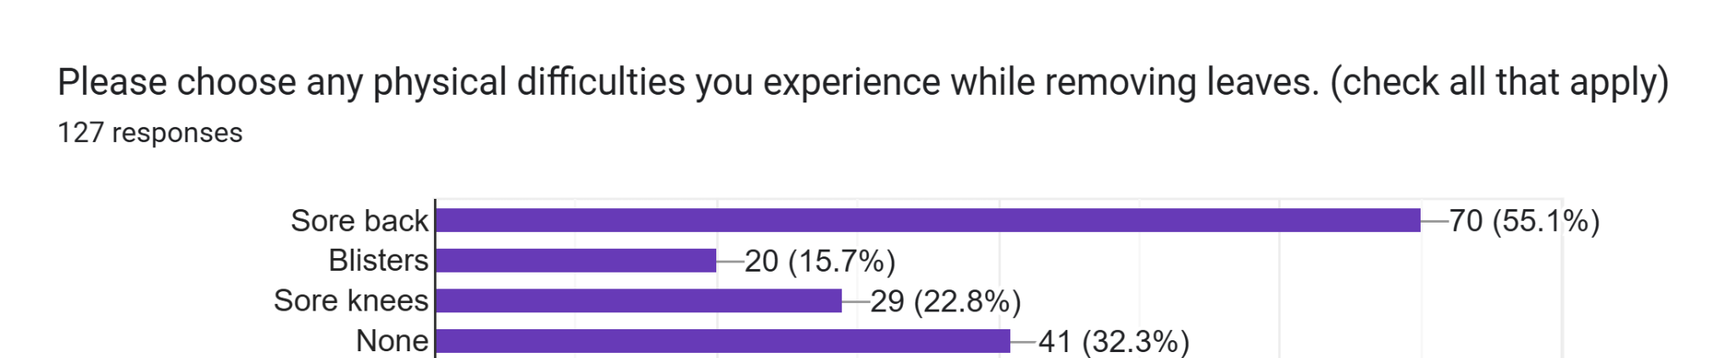
Survey Data
Notes:
Shreyas

Slide 4
Solution Requirements
Efficiency
Leaf Disposal
Natural Conditions
Ergonomics
Storage
Durability
Operating Environment
Maintenance
9. Target Cost
10. Noise Level
11. Battery Replacement
12. Battery Life
13. Compactation
14. Autonomous Operations
15. Safety Precautions
16. Battery Per Runtime
Notes:
Shreyas

Slide 5
Solution Requirements
Efficiency
Shall pick up 15 gallons of leave in under 30 minutes
Leaf Disposal
The machine shall pick up leaves and store it directly into a leaf bag
Natural Conditions
The machine shall operate with resistance to conditions like dust, moisture, and uneven terrain
Ergonomics
Any human interference shall minimize awkward lifting positions and not exceed 20 pounds.
Storage
Machine shall store 30 gallons of leaves with a weight capacity of 50 lbs
Notes:
Shreyas

Slide 6
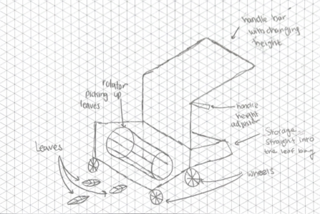
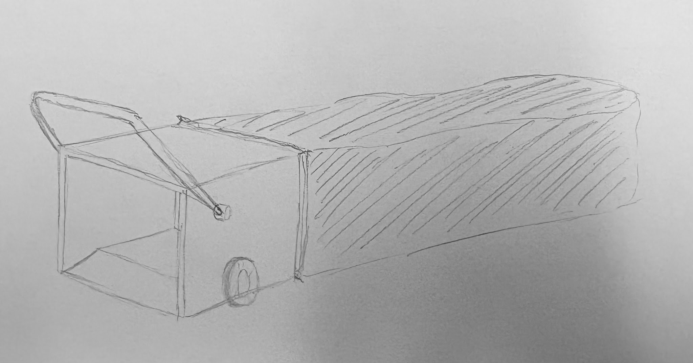
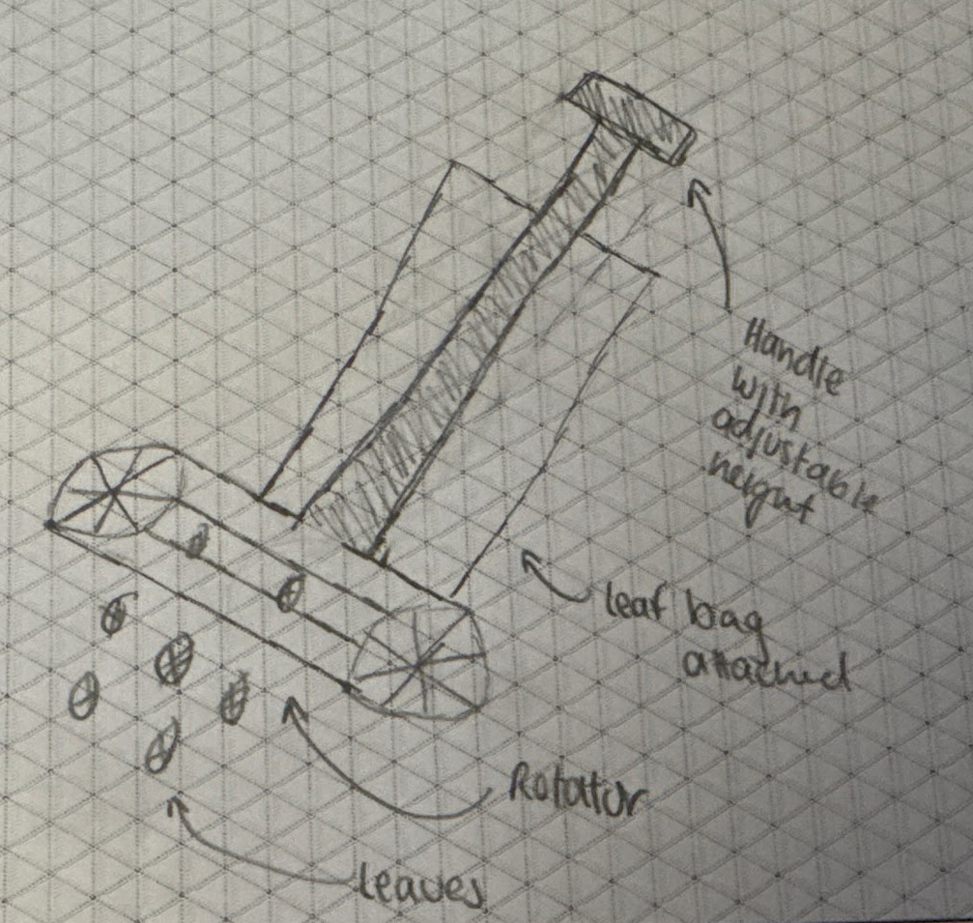
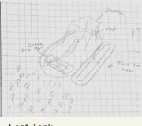
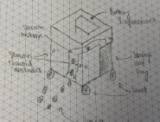
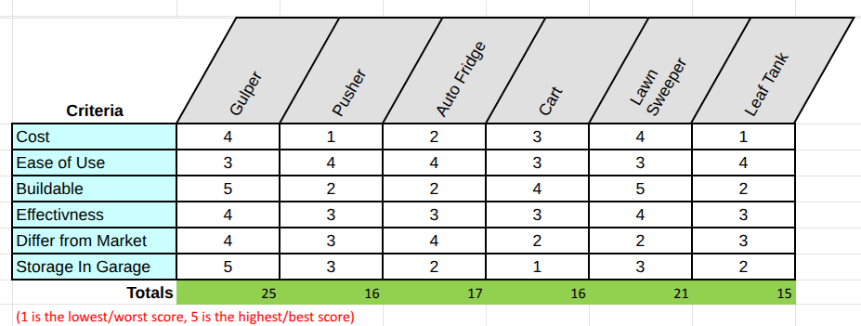
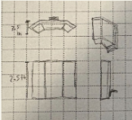
Picking a Design
Notes:
Seth

Slide 7
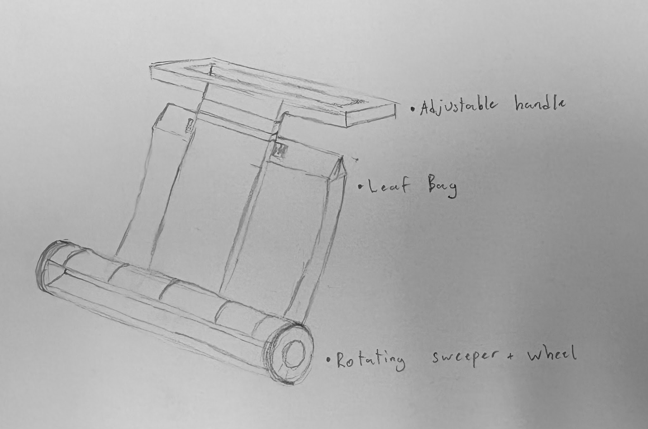
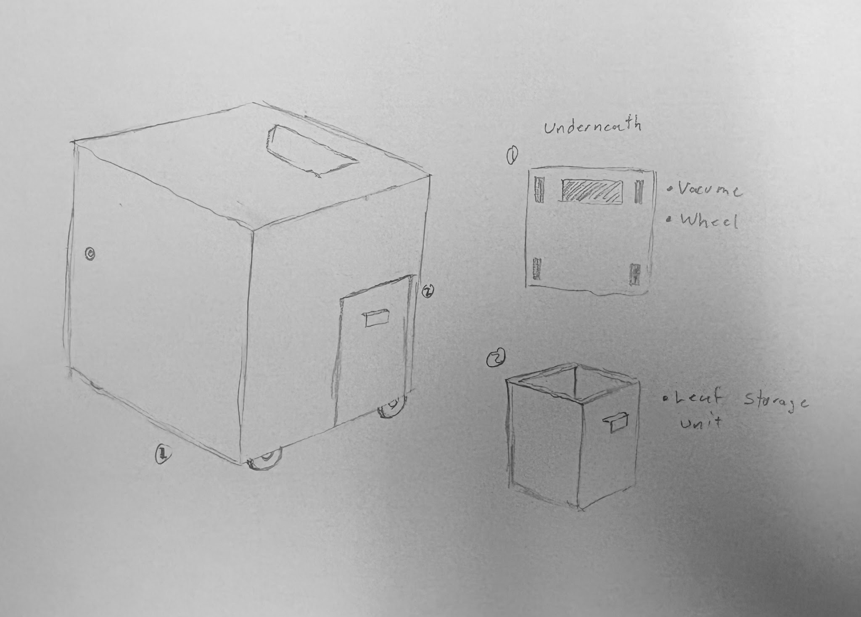
Choosing a Design
Leaf Gulper:
-Manual
-Pull motion
-Uses an incline to scoop leaves into removable bag
Lawn Sweeper:
-Manual
-Push motion
-Rotating wheel and axle to pull leaves into removable bag
Auto Fridge:
-Autonomous
-Battery, motor, and vacuum to transfer leaves to a waste compartment
Notes:
Seth

Slide 8
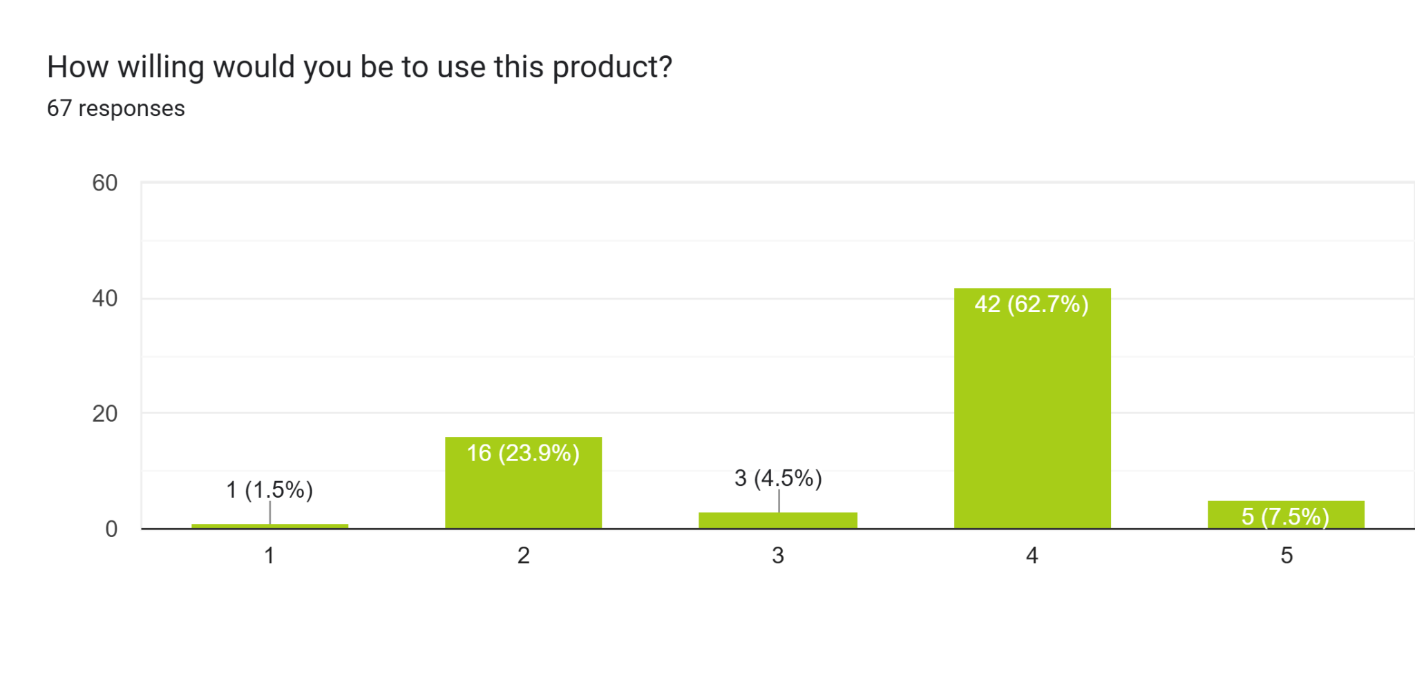
Choosing a Design
Lawn Sweeper Average: 3.52
Gulper Average: 3.39
Notes:
Shreyas

Slide 9
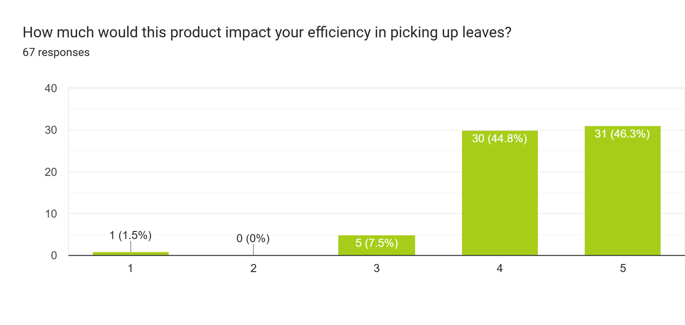
Choosing a Design
Lawn Sweeper Average: 4.41
Gulper Average: 3.95
Notes:
Shreyas

Slide 10
The Lawn Sweeper
Preferred by Stakeholders
Meets Constraints
Additional Benefits
Mechanical Design
Most willing to use
Most efficiency impacting
Leaf storage straight into leaf bag
Leaf Bag storage -> >30 Gallons
Minimizes human interference
Compact in size
Takes up minimal space in garage
Notes:
Seth

Slide 11
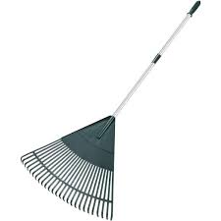
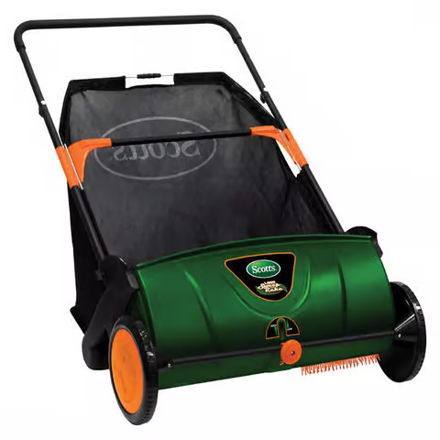
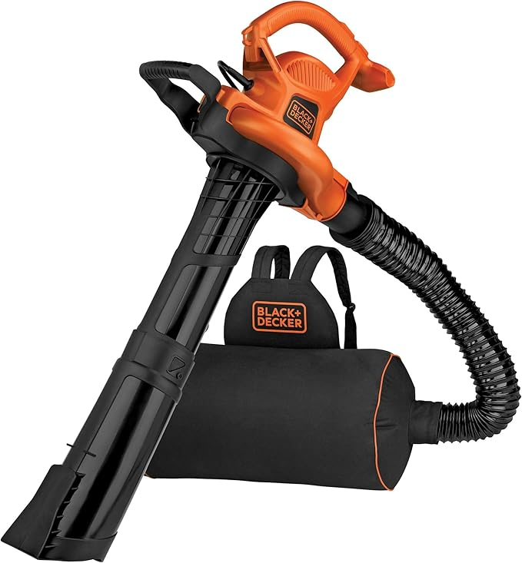
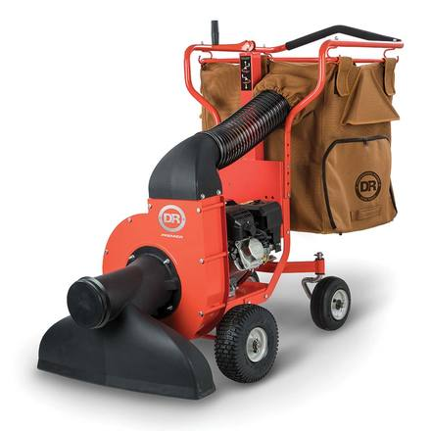
Market Competition
Mechanical Design (like the Lawn Sweeper)
Designs with electrical/fuel components
$15-$30
$179.99
$229.99
$1,599.99
Notes:
Shreyas

Slide 12


Design Viability
Target Market:
Homeowners
Suburban/Rural
Aged 30-70
Manufacturing:
Estimated Cost of Production: ~$100
Estimated Retail Price: ~$149.99
Estimated Profits: ~$49.99
Notes:
Seth

Slide 13
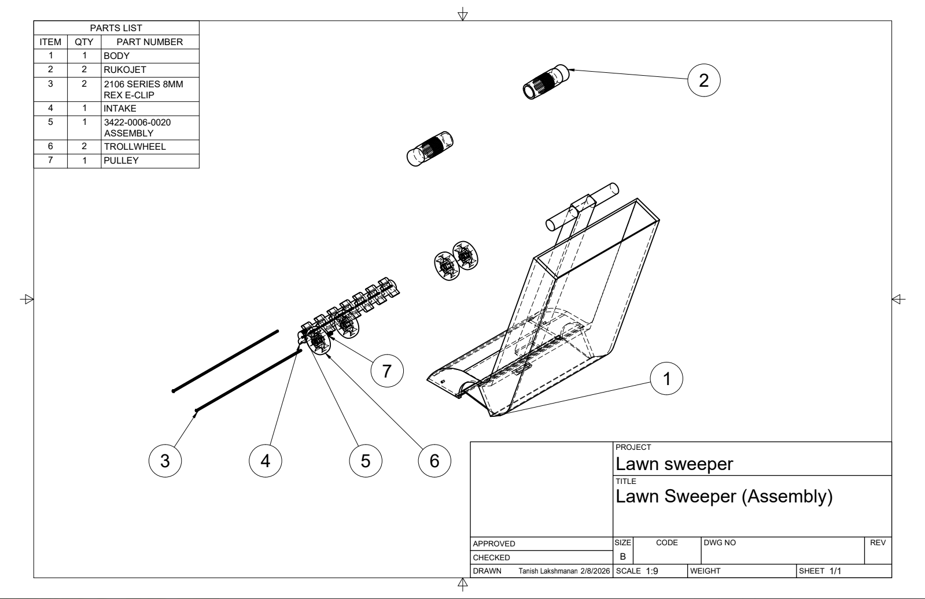
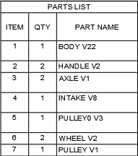
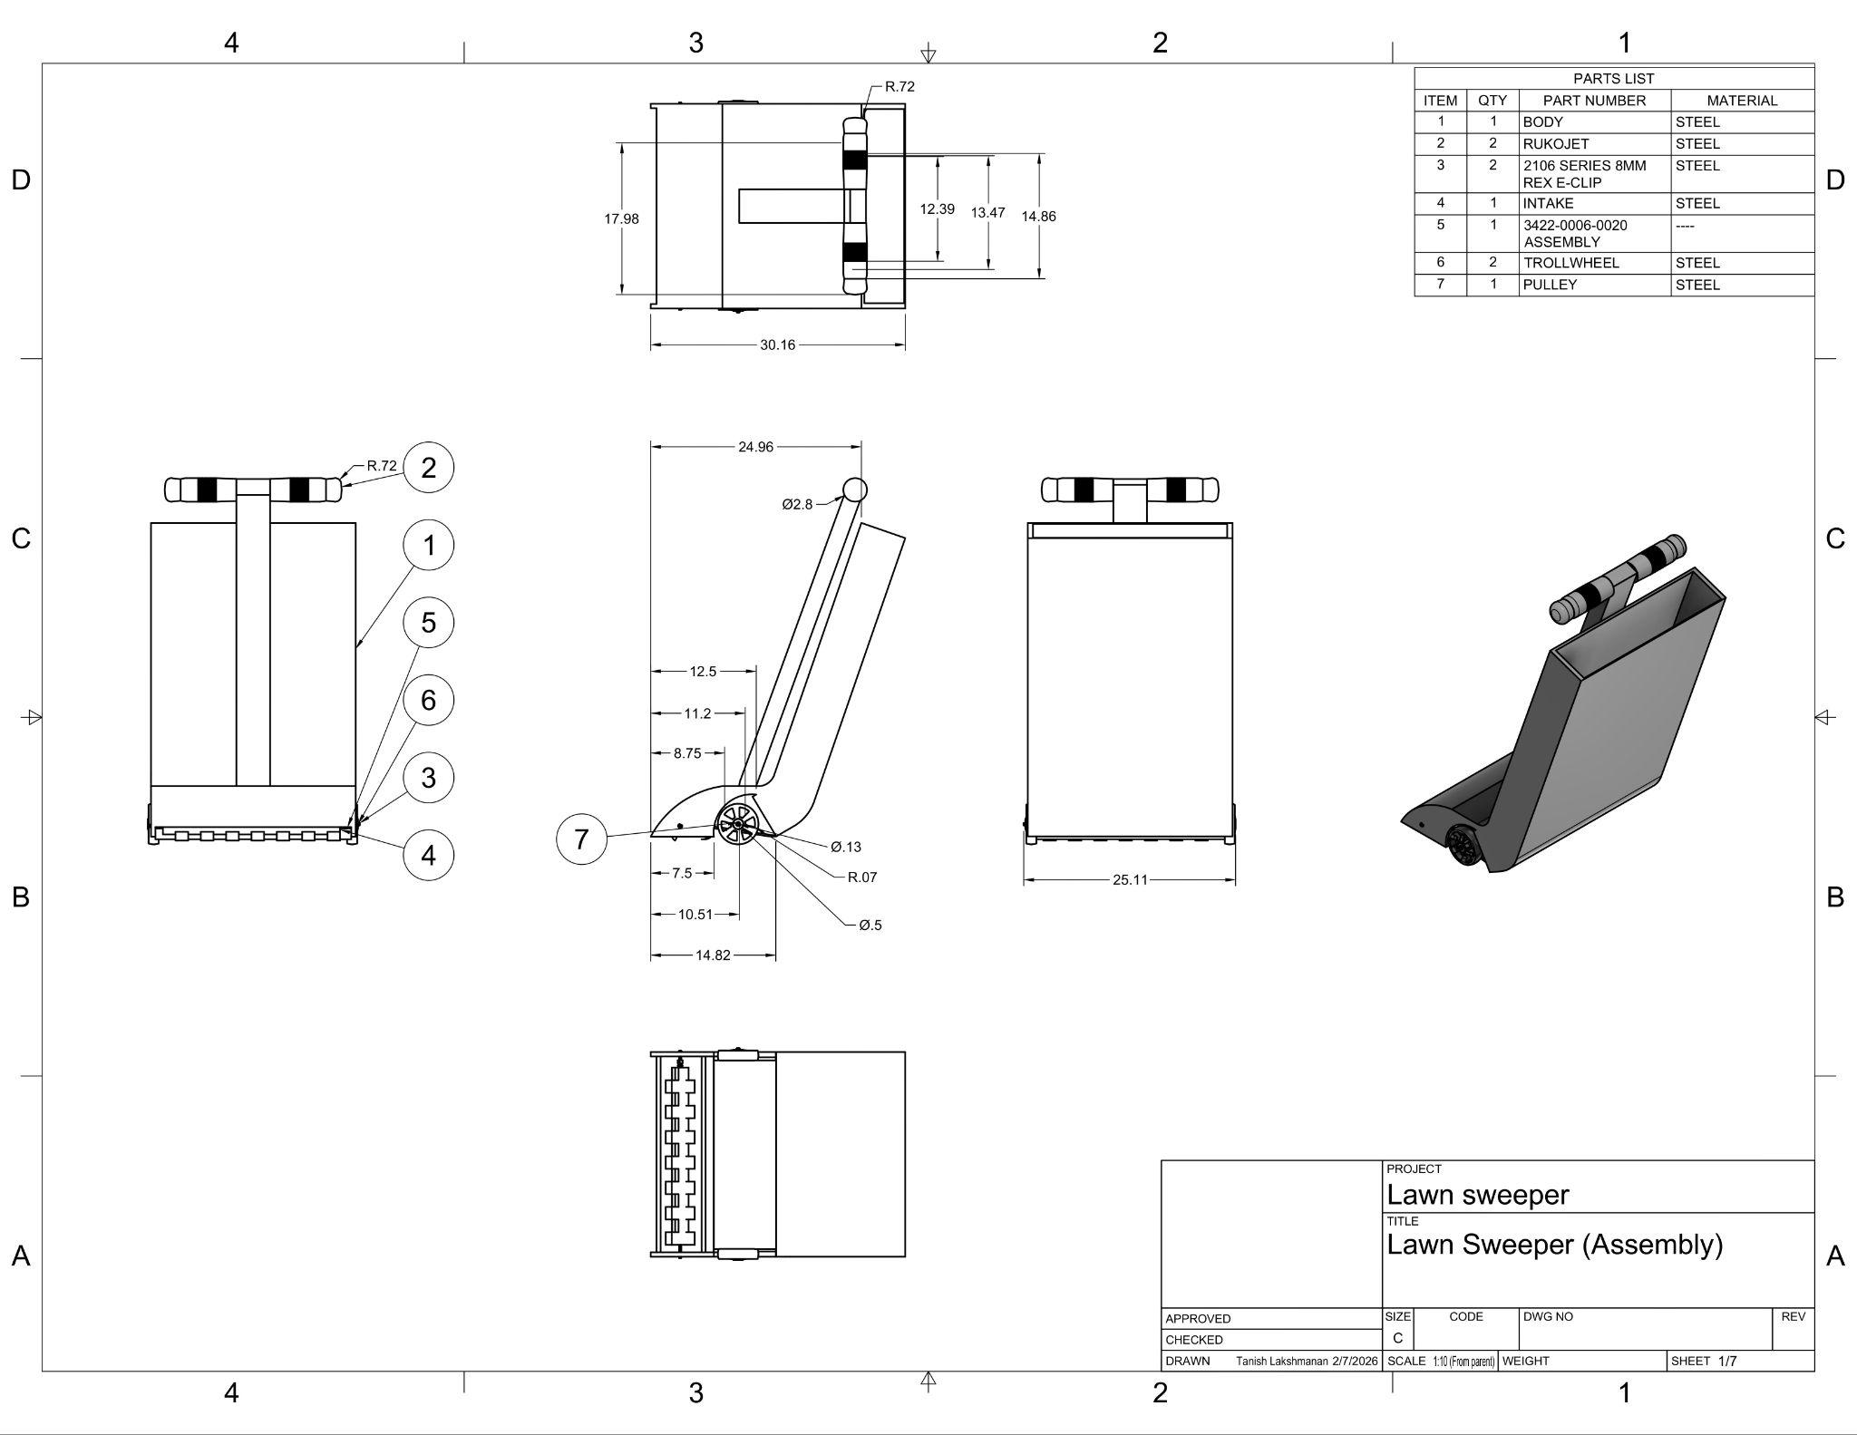
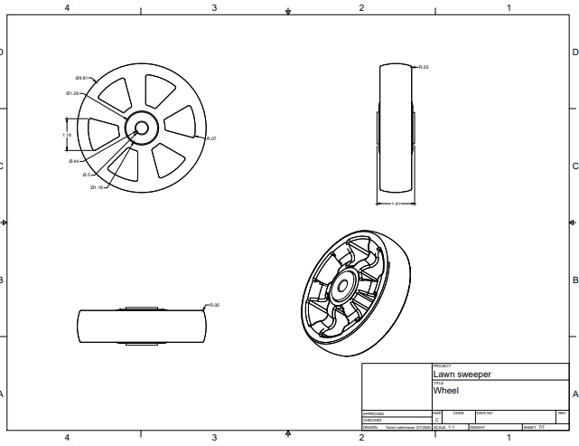
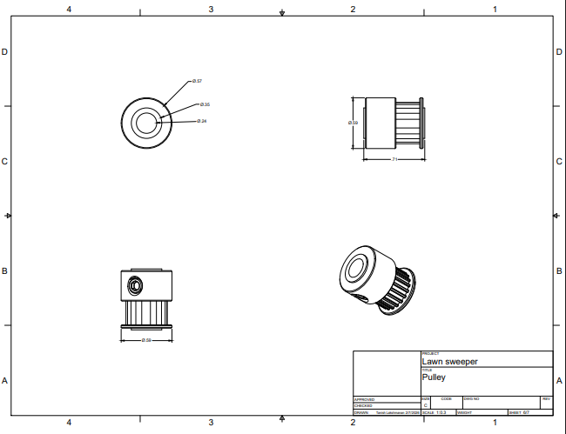
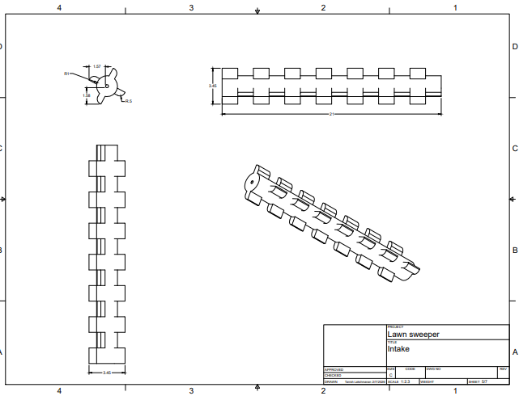
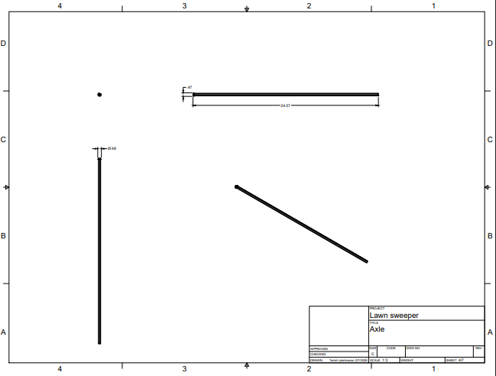
CAD Drawings
Notes:
Seth

Slide 14
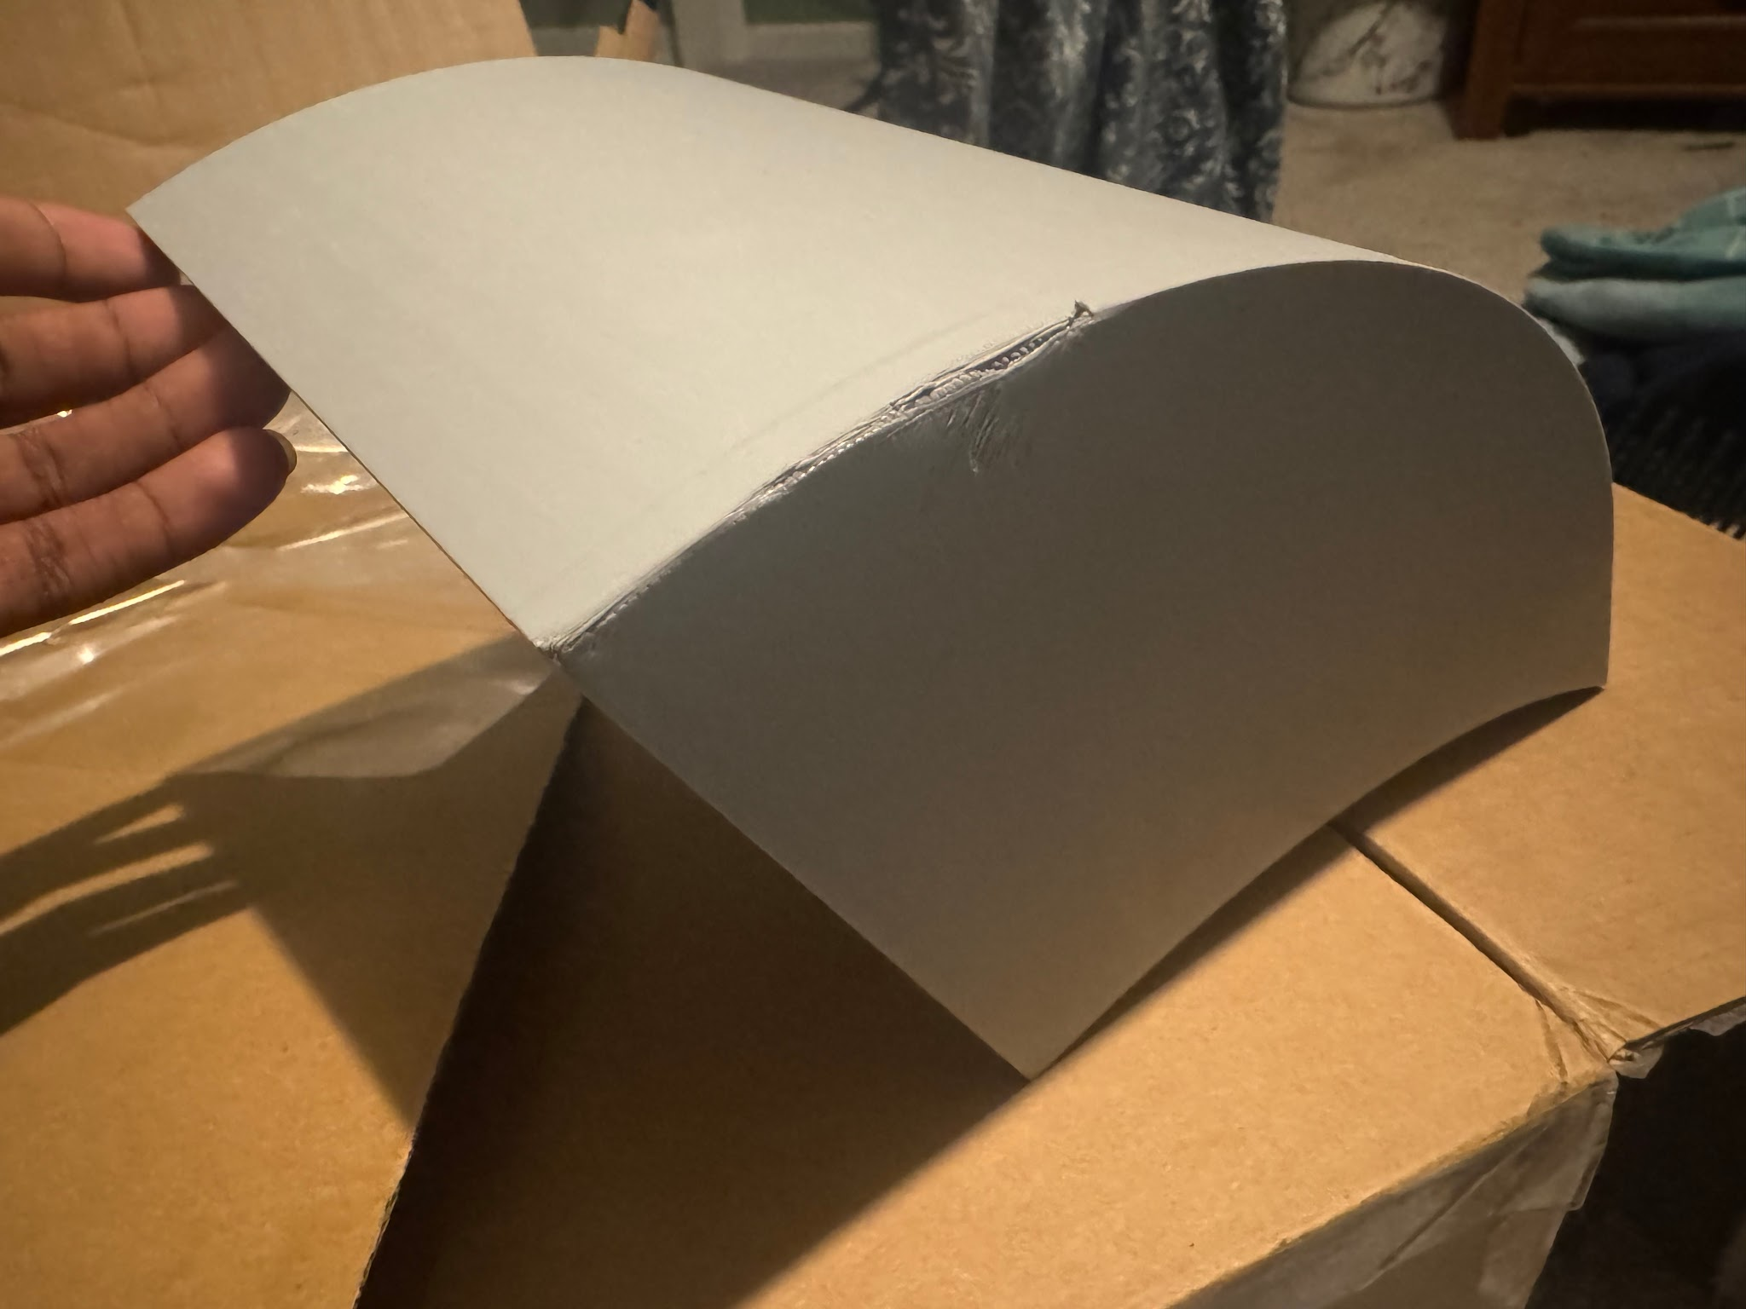
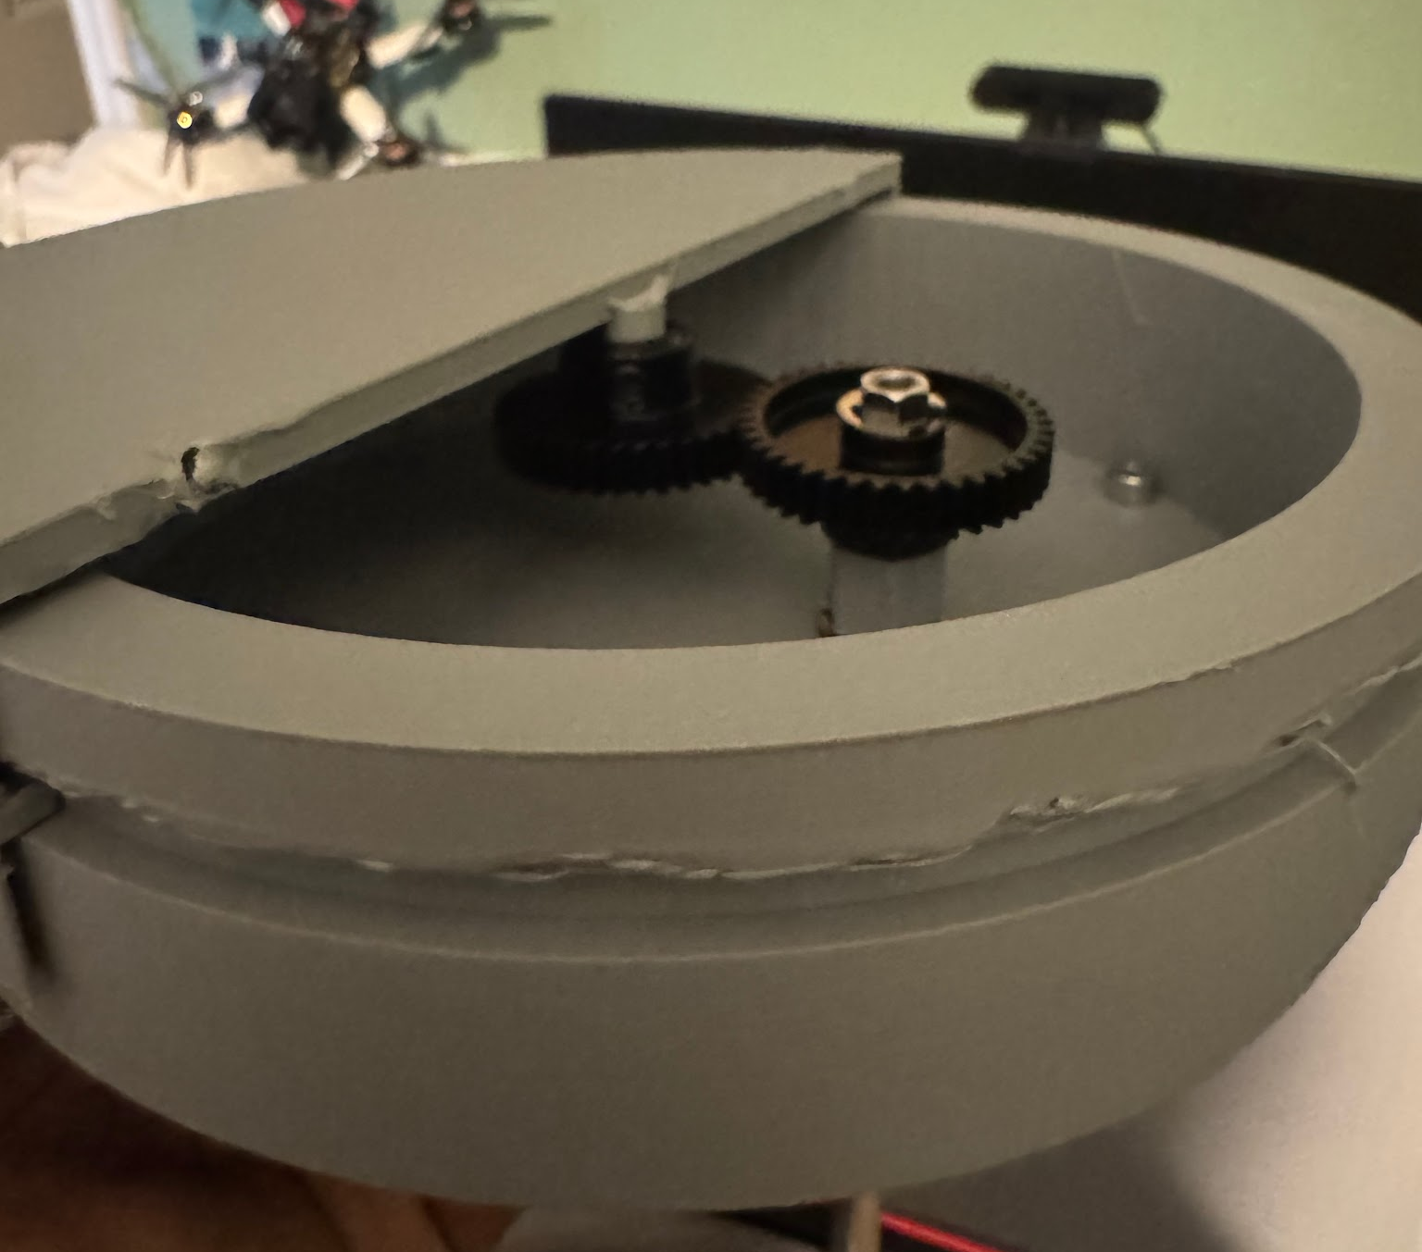
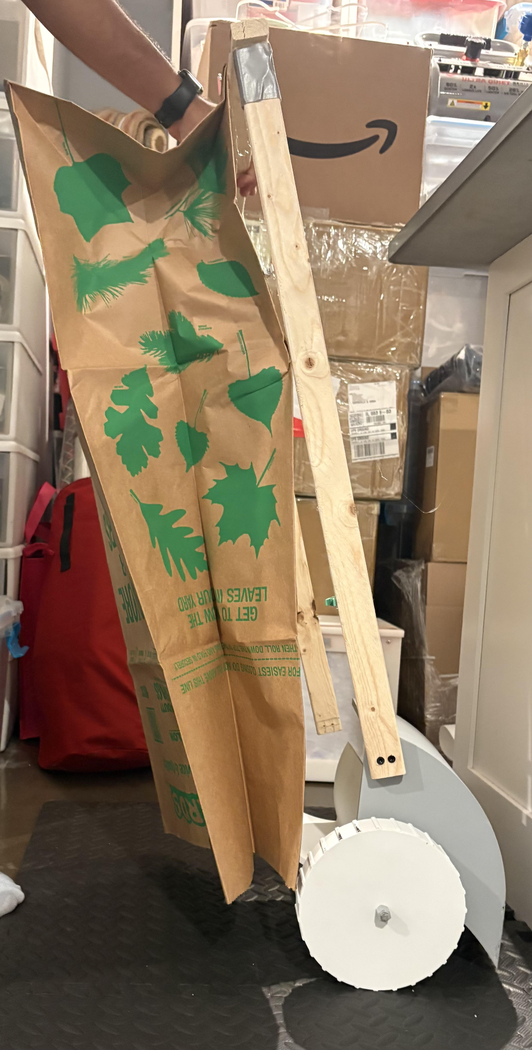
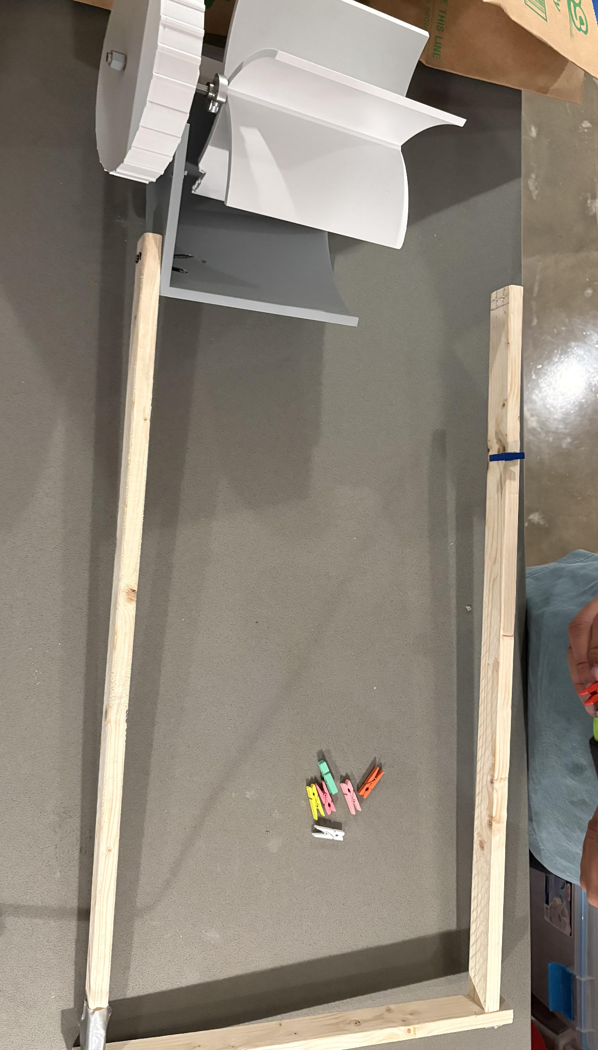
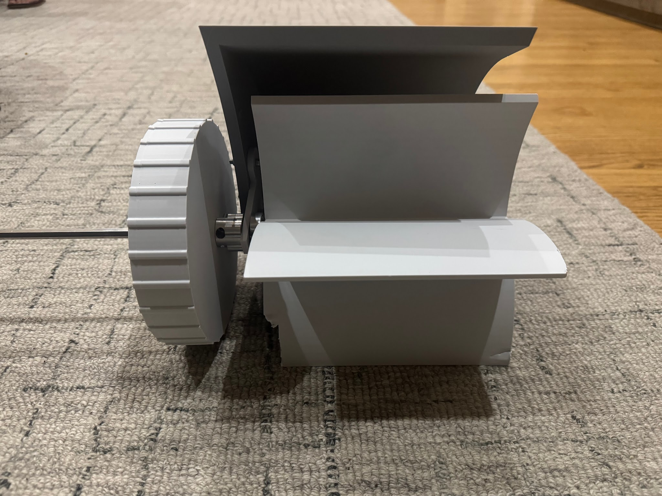
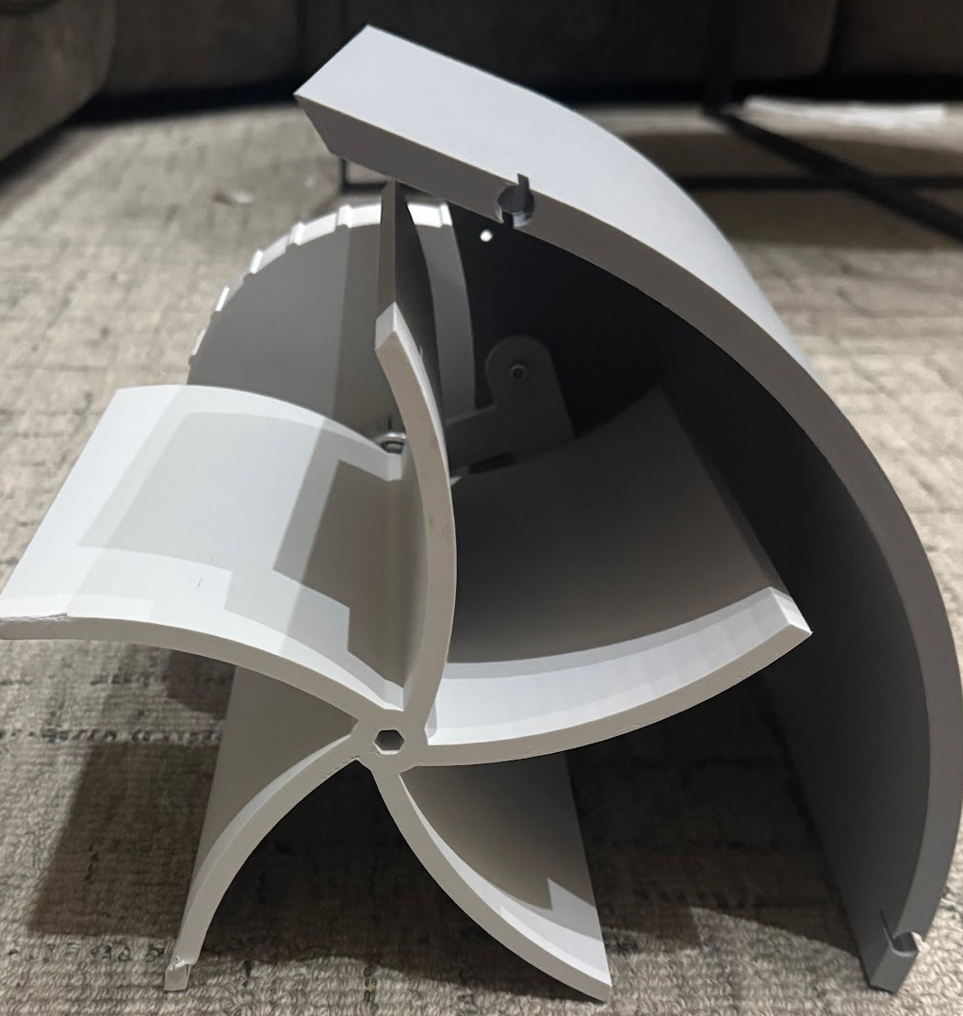
Construction
Notes:
Shreyas

Slide 15
Test #1: Efficiency
Test # | Mass Leaves(lb) | Volume Collected (gal): .03 lb/gal | Time (min) | Efficiency (gal/hr)
1 | 1.45 | 4.83 | 10 | 29.0
2 | 1.6 | 5.33 | 10 | 32.0
3 | 1.35 | 4.50 | 10 | 27.0
4 | 1.50 | 5.00 | 10 | 28.0
Average Volume: 4.91 Gallons
Average Efficiency: 29 Gallons
Takeaways:
Claw positioning is pushing leaves instead of lifting
Material of claw too weak
Notes:
Seth

Slide 16
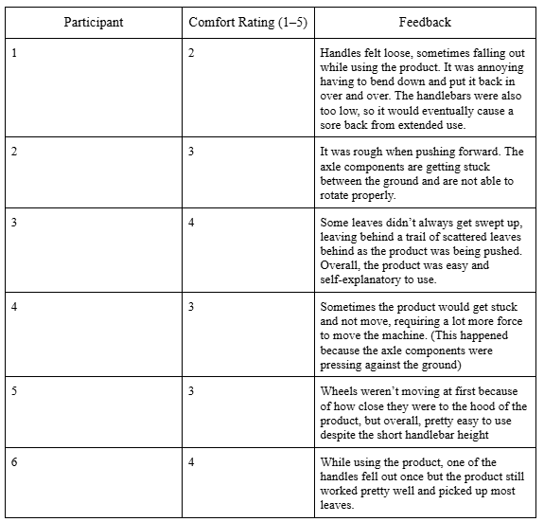
Test #2: Ergonomics
Average Rating: 3.17/5
Takeaways:
Handles were not stable enough
Handlebar height is not comfortable for all heights
Intake claw component built to large, causing recurring pauses in use
Notes:
Shreyas

Slide 17
Test #3: Natural Conditions
Condition | Total Leaves | Leaves Collected | % Collected | Notes
Dry | 50 | 28 | 56 | Was able to pick up dry leaves with moderate consistency, but still needed to dig deeper into the ground to pick up everything.
Wet | 50 | 16 | 32 | Cannot pick up wet leaves very well. They mostly just stick to the intake or slide off and stay on the ground. So it should dig into the ground more
Debris | 50 | 38 | 76 | Crumpled up the paper to simulate bigger debris, and it was able to capture them with ease.
Dry Leaves: Pass
Wet Leaves: Fail
Debris: Pass
Takeaways:
Product appropriate for dry leaves & debris
Wet leaves caused problems
Notes:
Shreyas

Slide 18
Going Forward
The design needs:
Stronger Material for body of the product
Redesign the process of the leaves entering the bag
Adjustable handlebars
Notes:
Seth

Slide 19
Thank you!
Questions?
Notes:
Seth

