Slide 1

Leaf Removal Preliminary Design Review
Shreyas Mathur, Tanish Lakshmanan, Seth Jones

Slide 2
Problem Statement
Reports indicate that American homeowners spend long hours each fall removing leaves from their yards, with 42,000 sustaining recurring neck, shoulder, and back injuries as a result per year. The significant time required to complete leaf removal not only causes physical strain but also reduces time available for other tasks.
1. Don’t let raking leaves become a pain in the neck, back or spine. Luminis Health. (n.d.). https://www.luminishealth.org/en/blog/dont-let-raking-leaves-become-a-pain-in-the-neck-back-or-spine?
Notes:
Shreyas

Slide 3
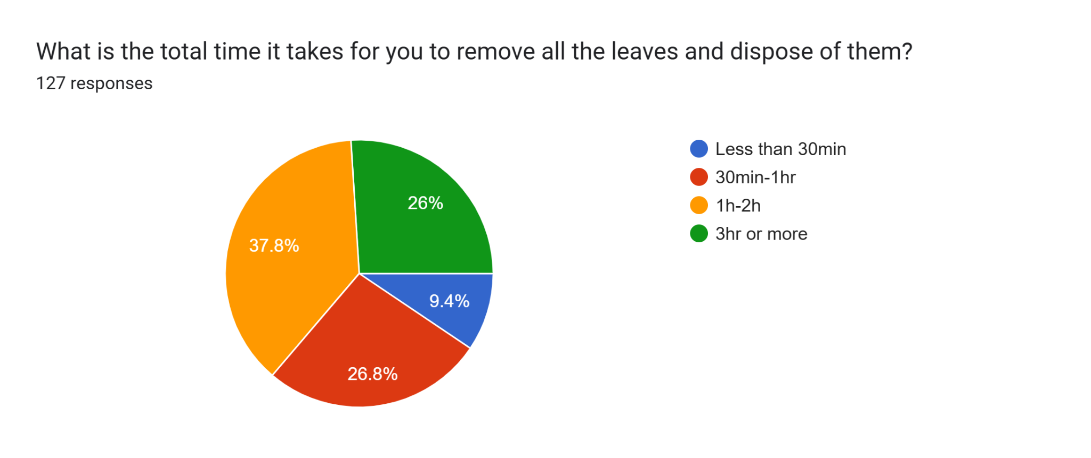
Problem Justification: Survey
Notes:
Seth

Slide 4
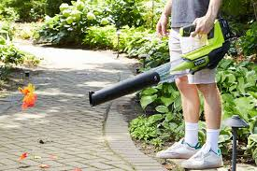
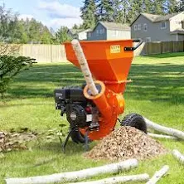
Problem Justification: Statistics
In the US more than 4,000 people are visiting the emergency room after being injured by leaf blowers, mulchers and grinders₂.
42,000 American homeowners annually sustain recurring neck, shoulder, and back injuries picking up leaves₃
2. New.York.Injury.Lawyer. (2019, October 10). Autumn Injuries related to leaves raking and how to prevent them. New York Personal Injury Attorneys Blog. https://www.newyorkpersonalinjuryattorneysblog.com/autumn-injuries-related-to-leaves-raking-and-how-to-prevent-them/
3. 11. Don’t let raking leaves become a pain in the neck, back or spine. Luminis Health. (n.d.). https://www.luminishealth.org/en/blog/dont-let-raking-leaves-become-a-pain-in-the-neck-back-or-spine?
‌
Notes:
Seth

Slide 5
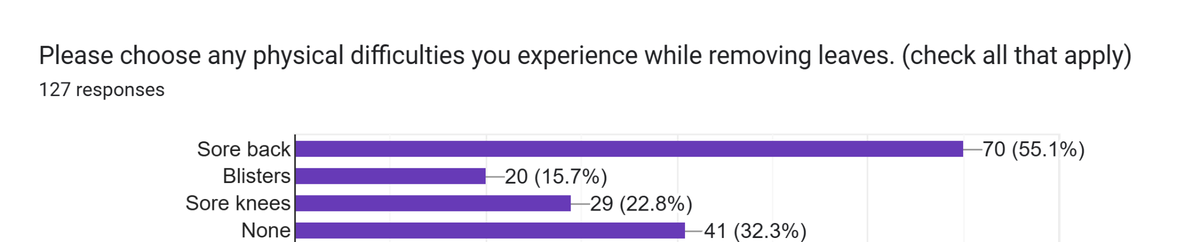
Problem Justification: Survey
Notes:
Seth

Slide 6
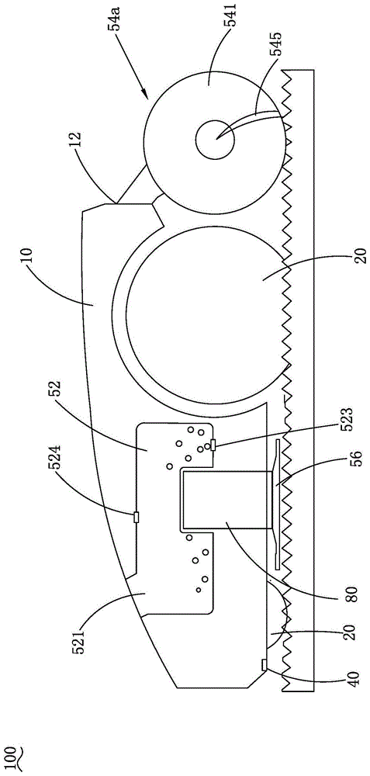
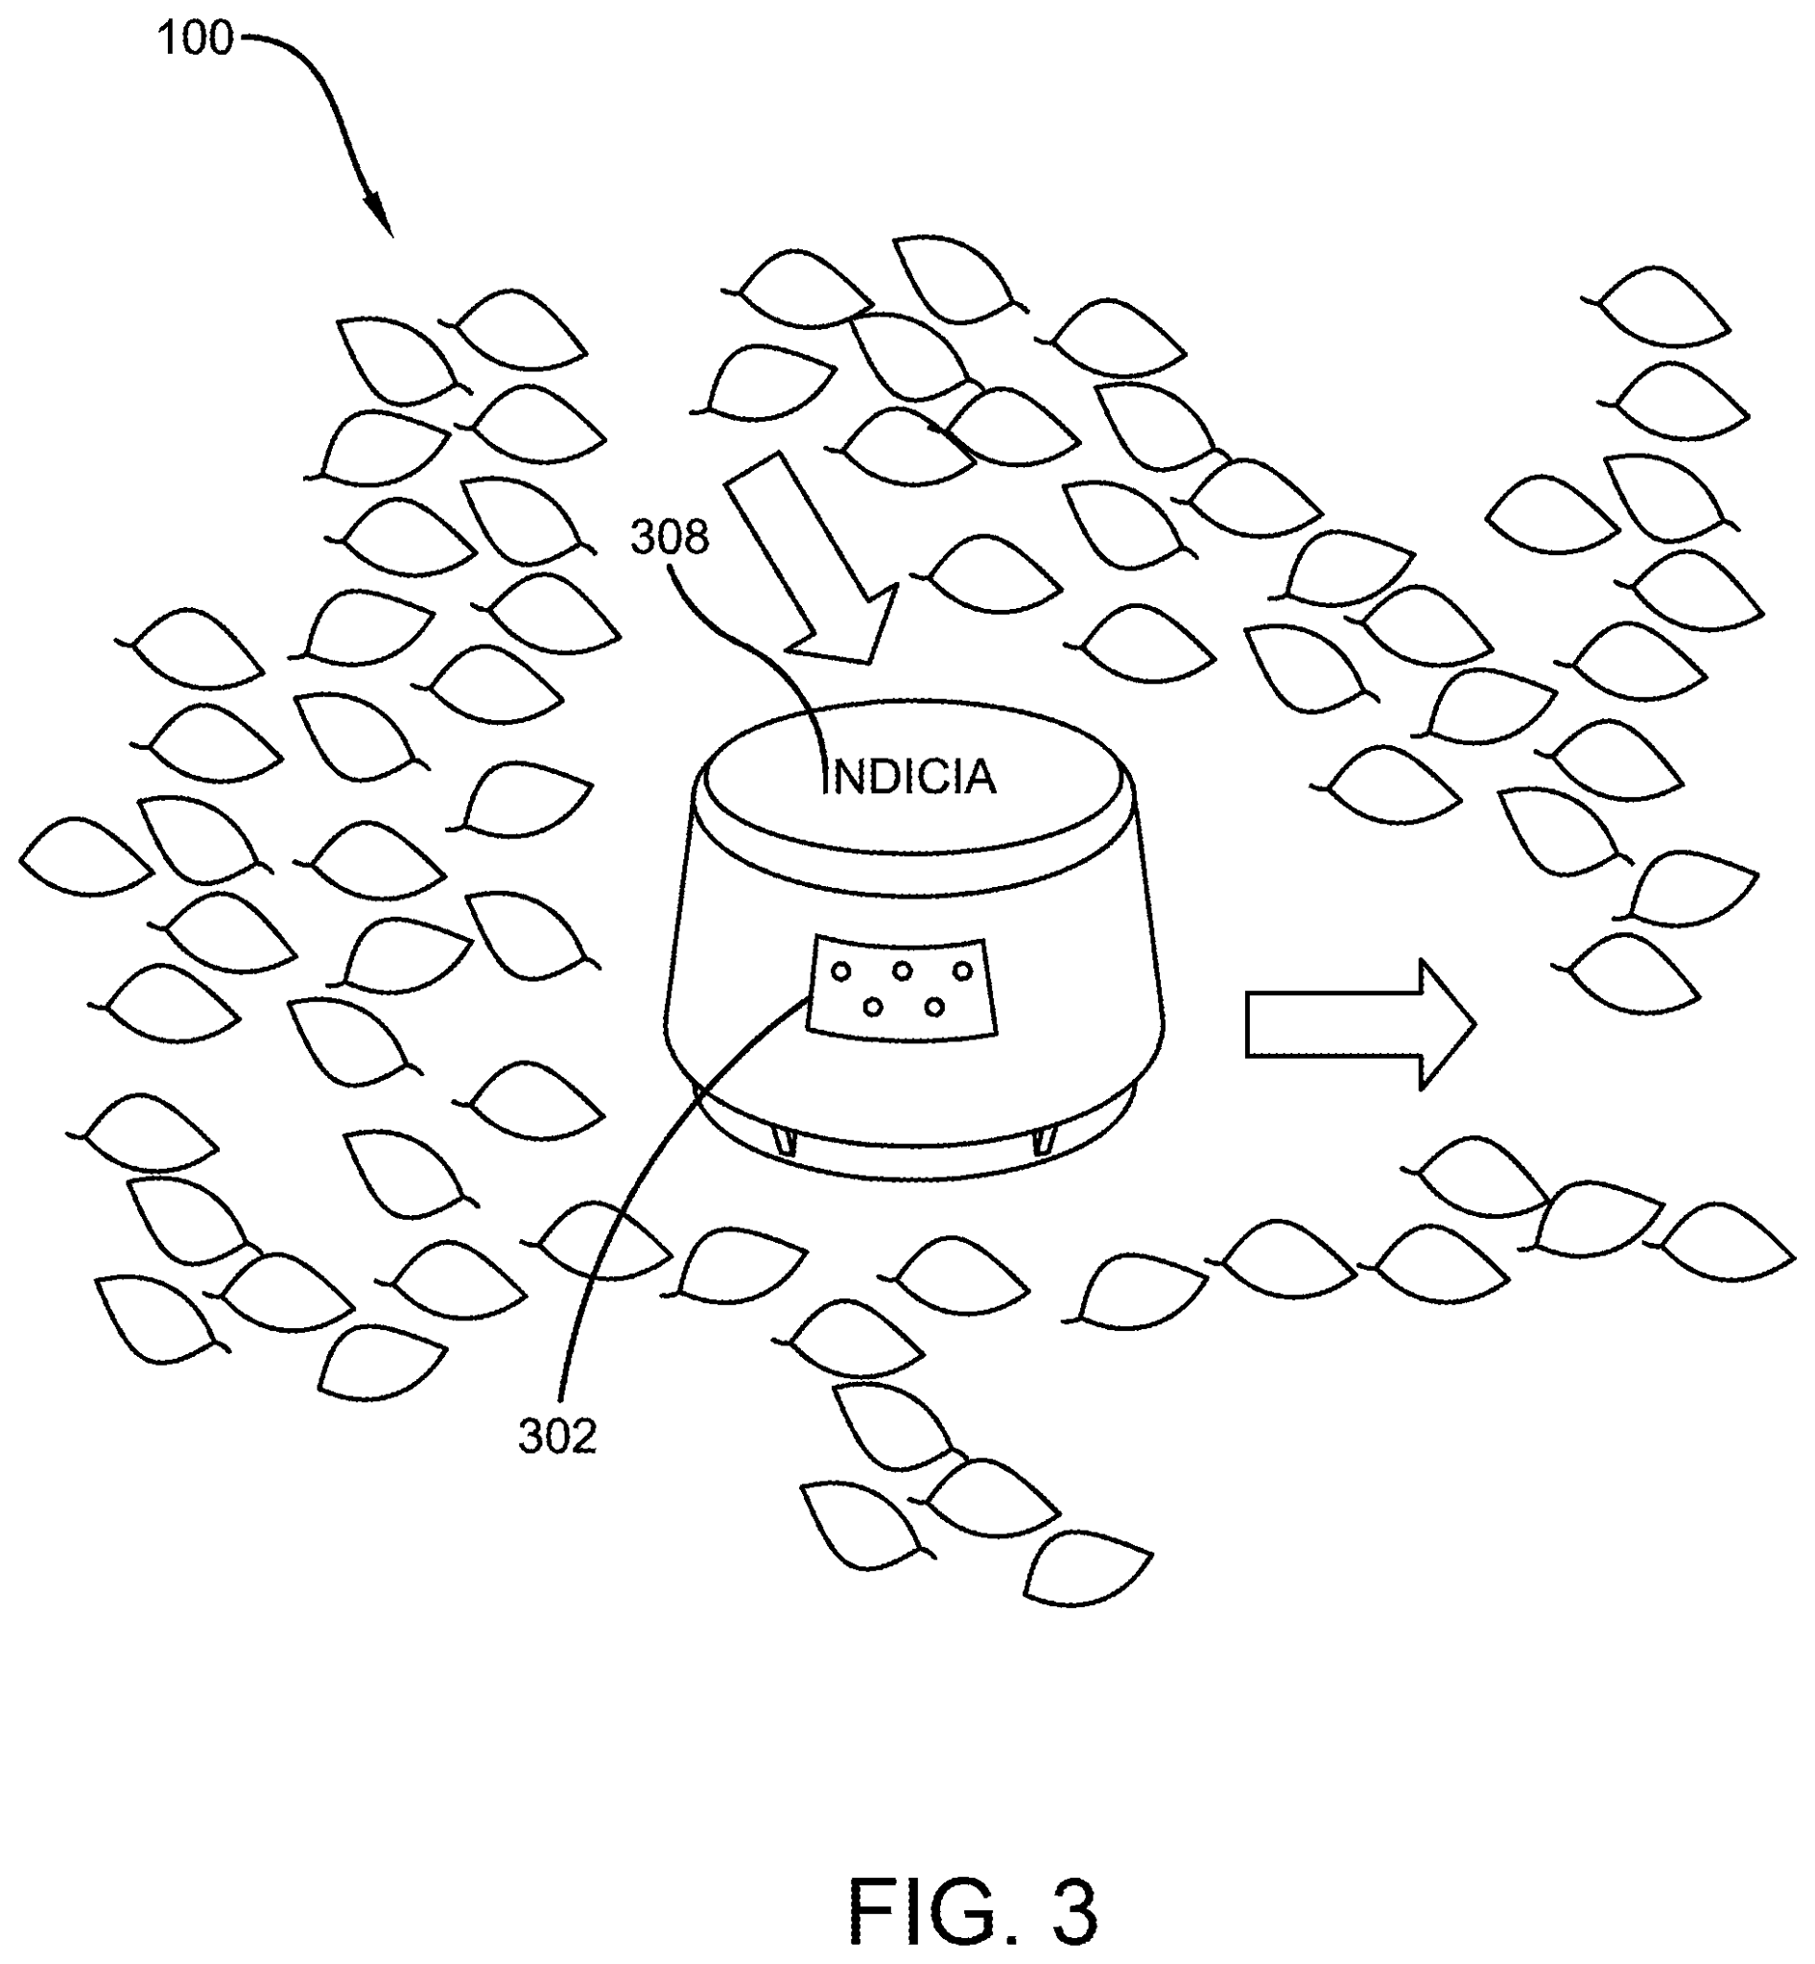
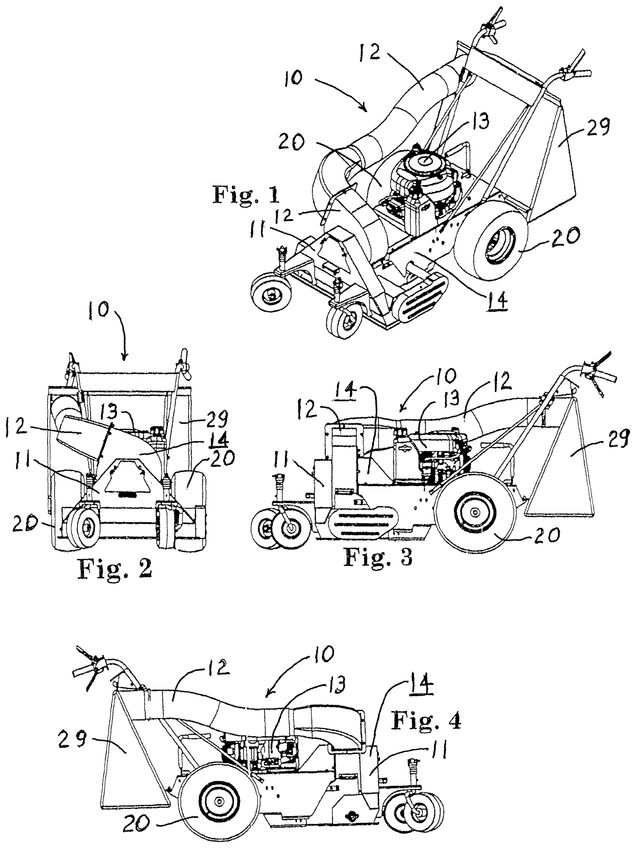
Current and Past Solutions: Patents
A Roomba-style yard robot
Adaptable to different yards
Limited leaf capacity
Expensive
Leaf collector and dock
Automated cleaning
Requires fixed power and water source
Mower style system
Uses suction and blades
Volume reduction
Complex and expensive
CN206538723U - Suction and blowing device - Google Patents. (2016, April 6). Google.com. https://patents.google.com/patent/CN206538723U/en?q=(leaf+removal)&oq=leaf+removal &page=1
Techtronic Cordless GP. (2024). Lawn maintenance system having an autonomous lawn mower and a docking station (U.S. Patent Application No. US20240081201A1 https://patents.google.com/patent/US20240081201A1
Diaz del Castillo, D. A. (2014). Autonomous and remote control all purpose machine. U.S. Patent Application No. US20140121881A1.https://patents.google.com/patent/US20230154321A1/en
Notes:
Tanish

Slide 7
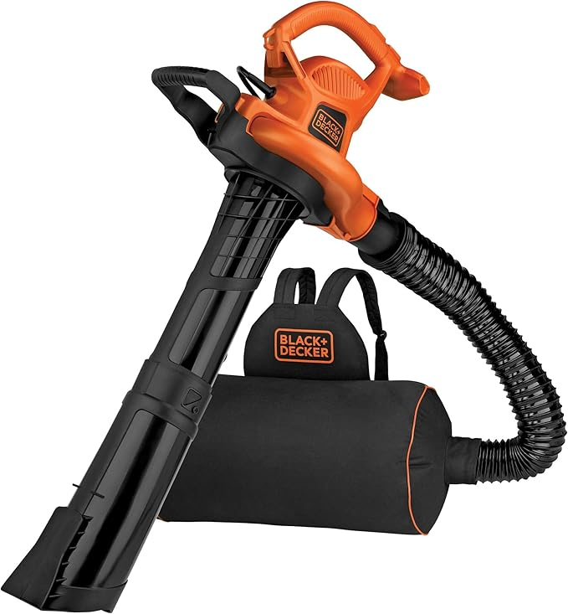
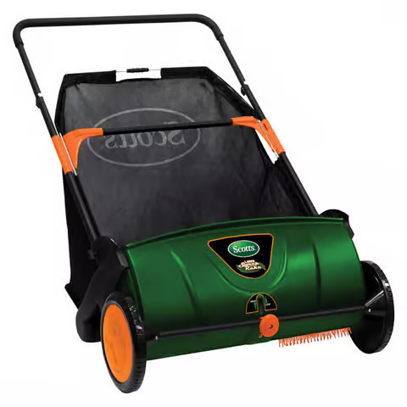
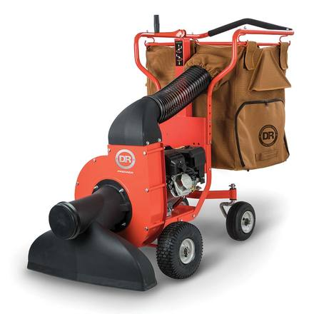
Current and Past Solutions: Products
Combines leaf blowing and vacuuming
Backpack storage
Full bag places strain
Push-powered
Requires physical effort and heavy bag lifting
Expensive for the product
High-power vacuum
Shredding
Large storage capacity
Very expensive and heavy collection bag
Amazon. (n.d.). BLACK+DECKER BEBL7000 Blower/Mulcher [Product page]. Amazon. https://www.amazon.com/BLACK-DECKER-BEBL7000-Blower-Mulcher/dp/B07253C39S/ref=sr_1_10
DR Power Equipment. (n.d.). DR Leaf and Lawn Vacuum – Walk-Behind (WL33206DMN). Retrieved December 9, 2025, from https://www.drpower.com/Power-Equipment/Leaf-Blowers-%26-Vacuums
Ace Hardware. (n.d.). Scotts Lawn Sweeper (Item # 7821416). Retrieved December 9, 2025, from https://www.acehardware.com/departments/lawn-and-garden/lawn-mowers/grass-catchers/7821416?
Notes:
Tanish

Slide 8
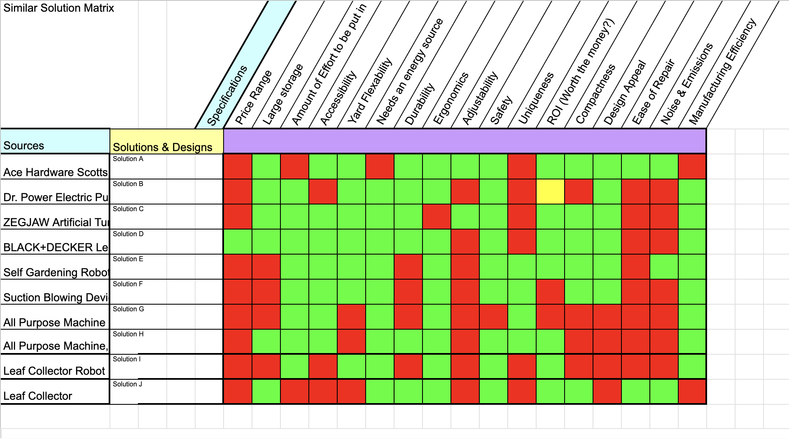
Solution Requirements
Notes:
Seth

Slide 9
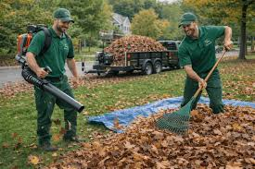
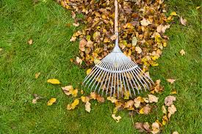
Primary Stakeholders
Homeowners
Landscaping service providers
https://www.walmart.com/ip/Greenworks-80V-580-Cfm-at-145-Mph-Brushless-Leaf-Blower-with-2-5-Ah-Battery-Charger
Hulley, L. (2024). The Impact of Dust in Electronics. Bulgin.com. https://blog.bulgin.com/blog/the-impact-of-dust-in-electronics
Notes:
Tanish

Slide 10
Solution Requirements
Efficiency
Leaf Disposal
Natural Conditions
Ergonomics
Storage
Battery Replacement
Compaction
Battery Per Runtime
9. Target Cost
10. Noise Level
11. Durability
12. Battery Life
13. Operating Environment
14. Autonomous Operations
15. Safety Precautions
16. Maintenance
DeBruin, I. (2025, August 23). How Long Does a Fall Yard Clean-Up Take? - LambtonLawn LTD Blogs. LambtonLawn LTD Blogs. https://lambtonlawn.com/blog/how-long-does-a-fall-yard-clean-up-take/
Wasson, S. (2022, August 23). The Average Yard Size by State and City. Today’s Homeowner. https://todayshomeowner.com/lawn-garden/guides/average-yard-size/
Minnesota Equipment. (2023, July 12). How Old Is Too Old for a Lawn Mower? - Minnesota Equipment. Minnesota Equipment.
Fall Temperature Averages for Each USA State - Current Results. (n.d.). Www.currentresults.com. https://www.currentresults.com/Weather/US/average-state-temperatures-in-fall.php
Notes:
Shreyas

Slide 11
Solution Requirements
Efficiency
Shall pick up 15 gallons of leave in under 30 minutes
Leaf Disposal
The machine shall pick up leaves and store it directly into a leaf bag
Natural Conditions
The machine shall operate with resistance to conditions like dust, moisture, and uneven terrain
Ergonomics
Any human interference shall minimize awkward lifting positions and not exceed 20 pounds.
Storage
Machine shall store 30 gallons of leaves with a weight capacity of 50 lbs
Notes:
Shreyas

Slide 12
Solution Picking Process
Brainstorming 45 Ideas
Top 6 Ideas
Group Discussion
Decision Matrix
Final Design
Stakeholder Survey
Top 3 Ideas
Notes:
Tanish

Slide 13
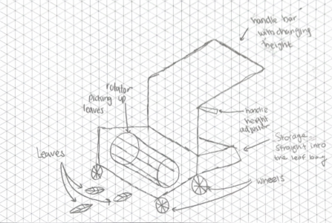
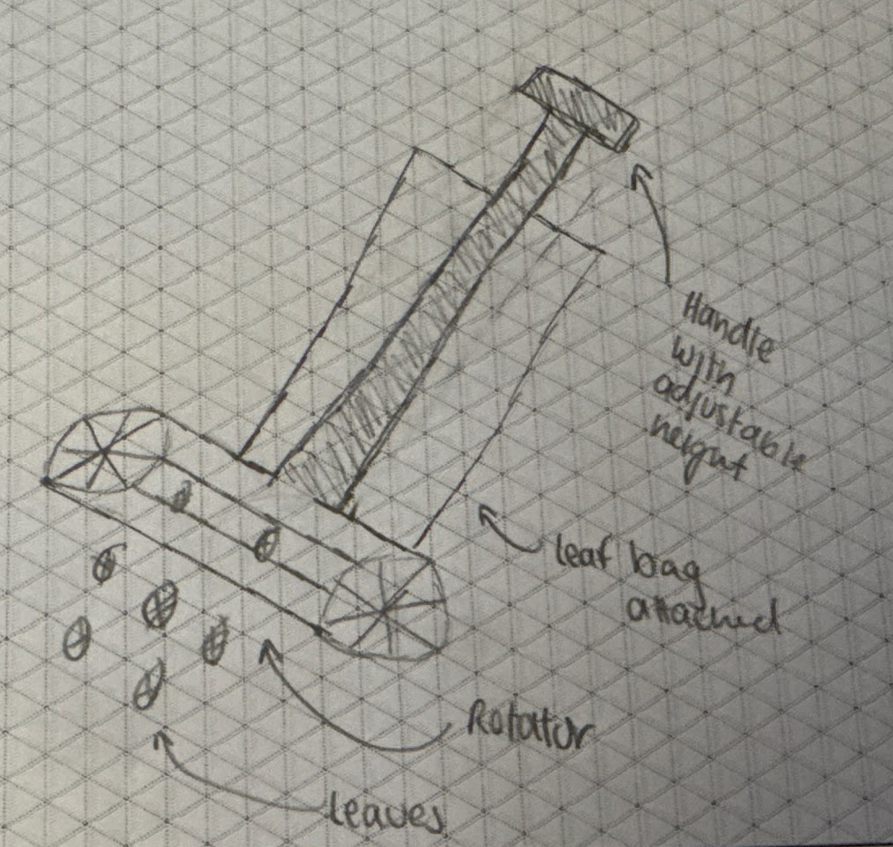
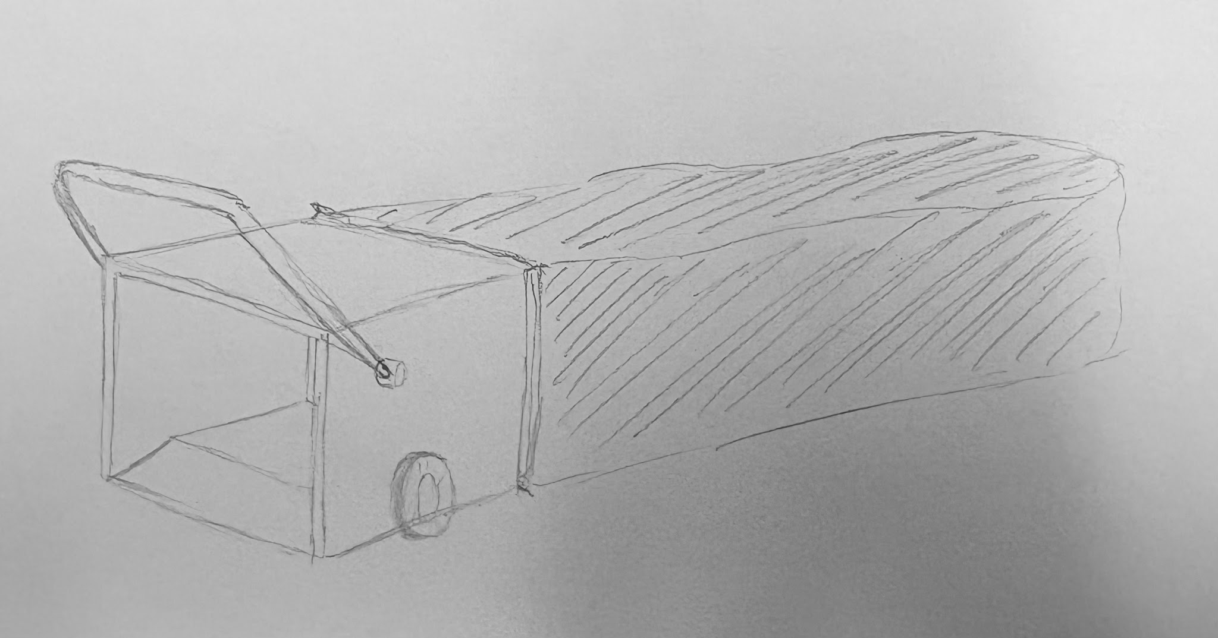
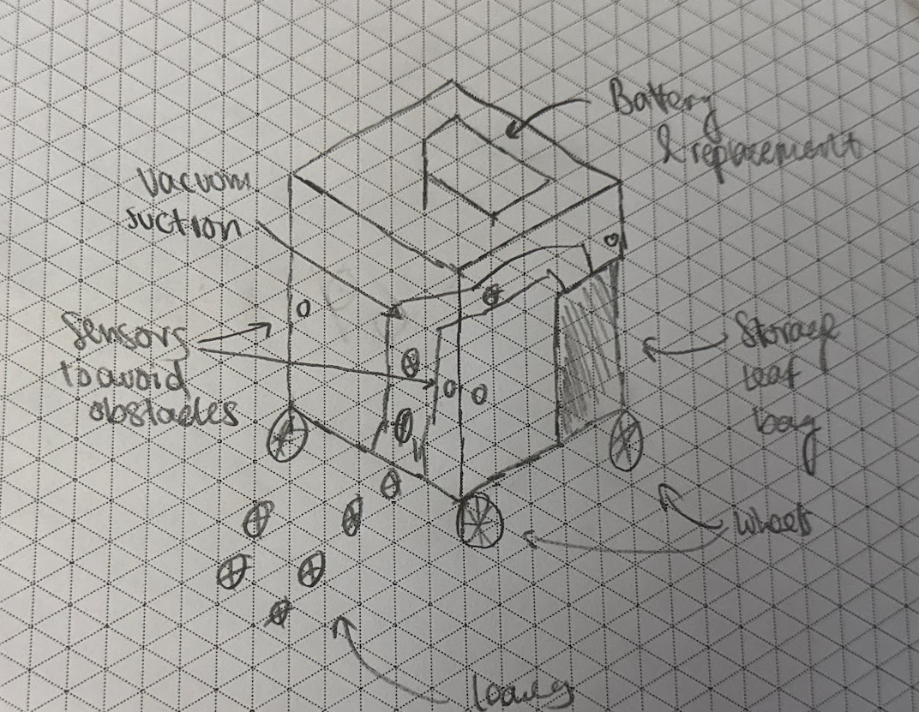
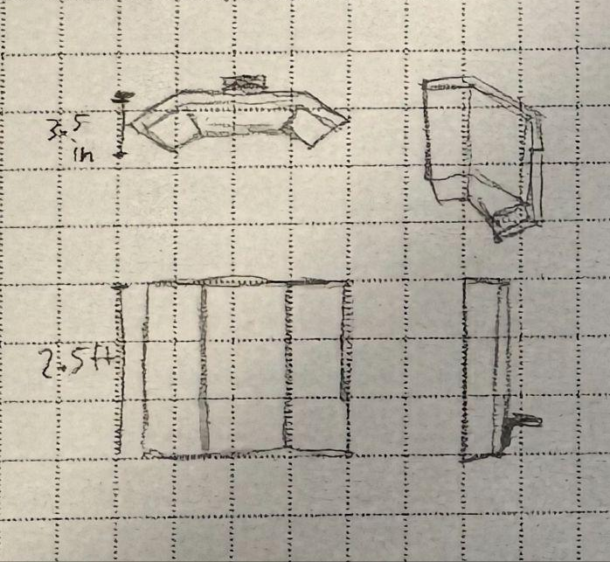
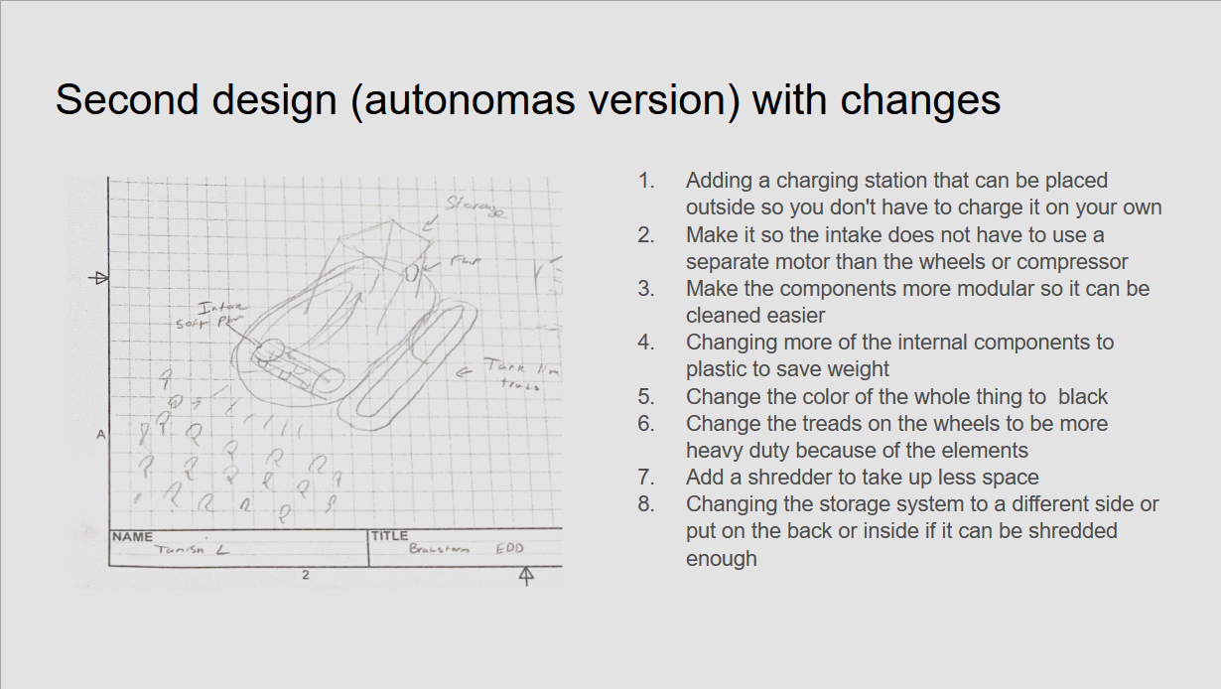
Cart Pusher Gulper Lawn Sweeper
Auto Fridge Auto Pusher Leaf Tank
Notes:
Shreyas

Slide 14
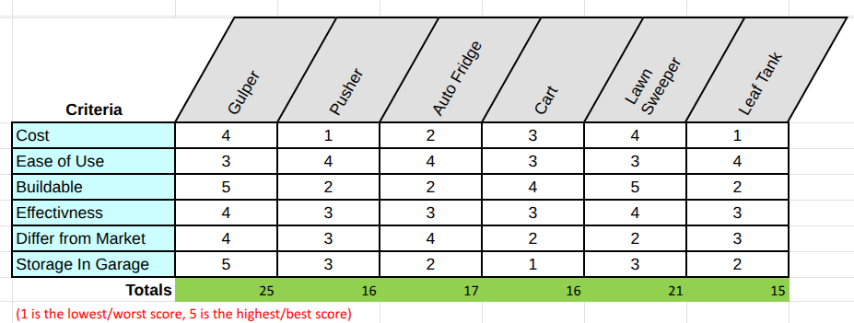
Notes:
Seth

Slide 15
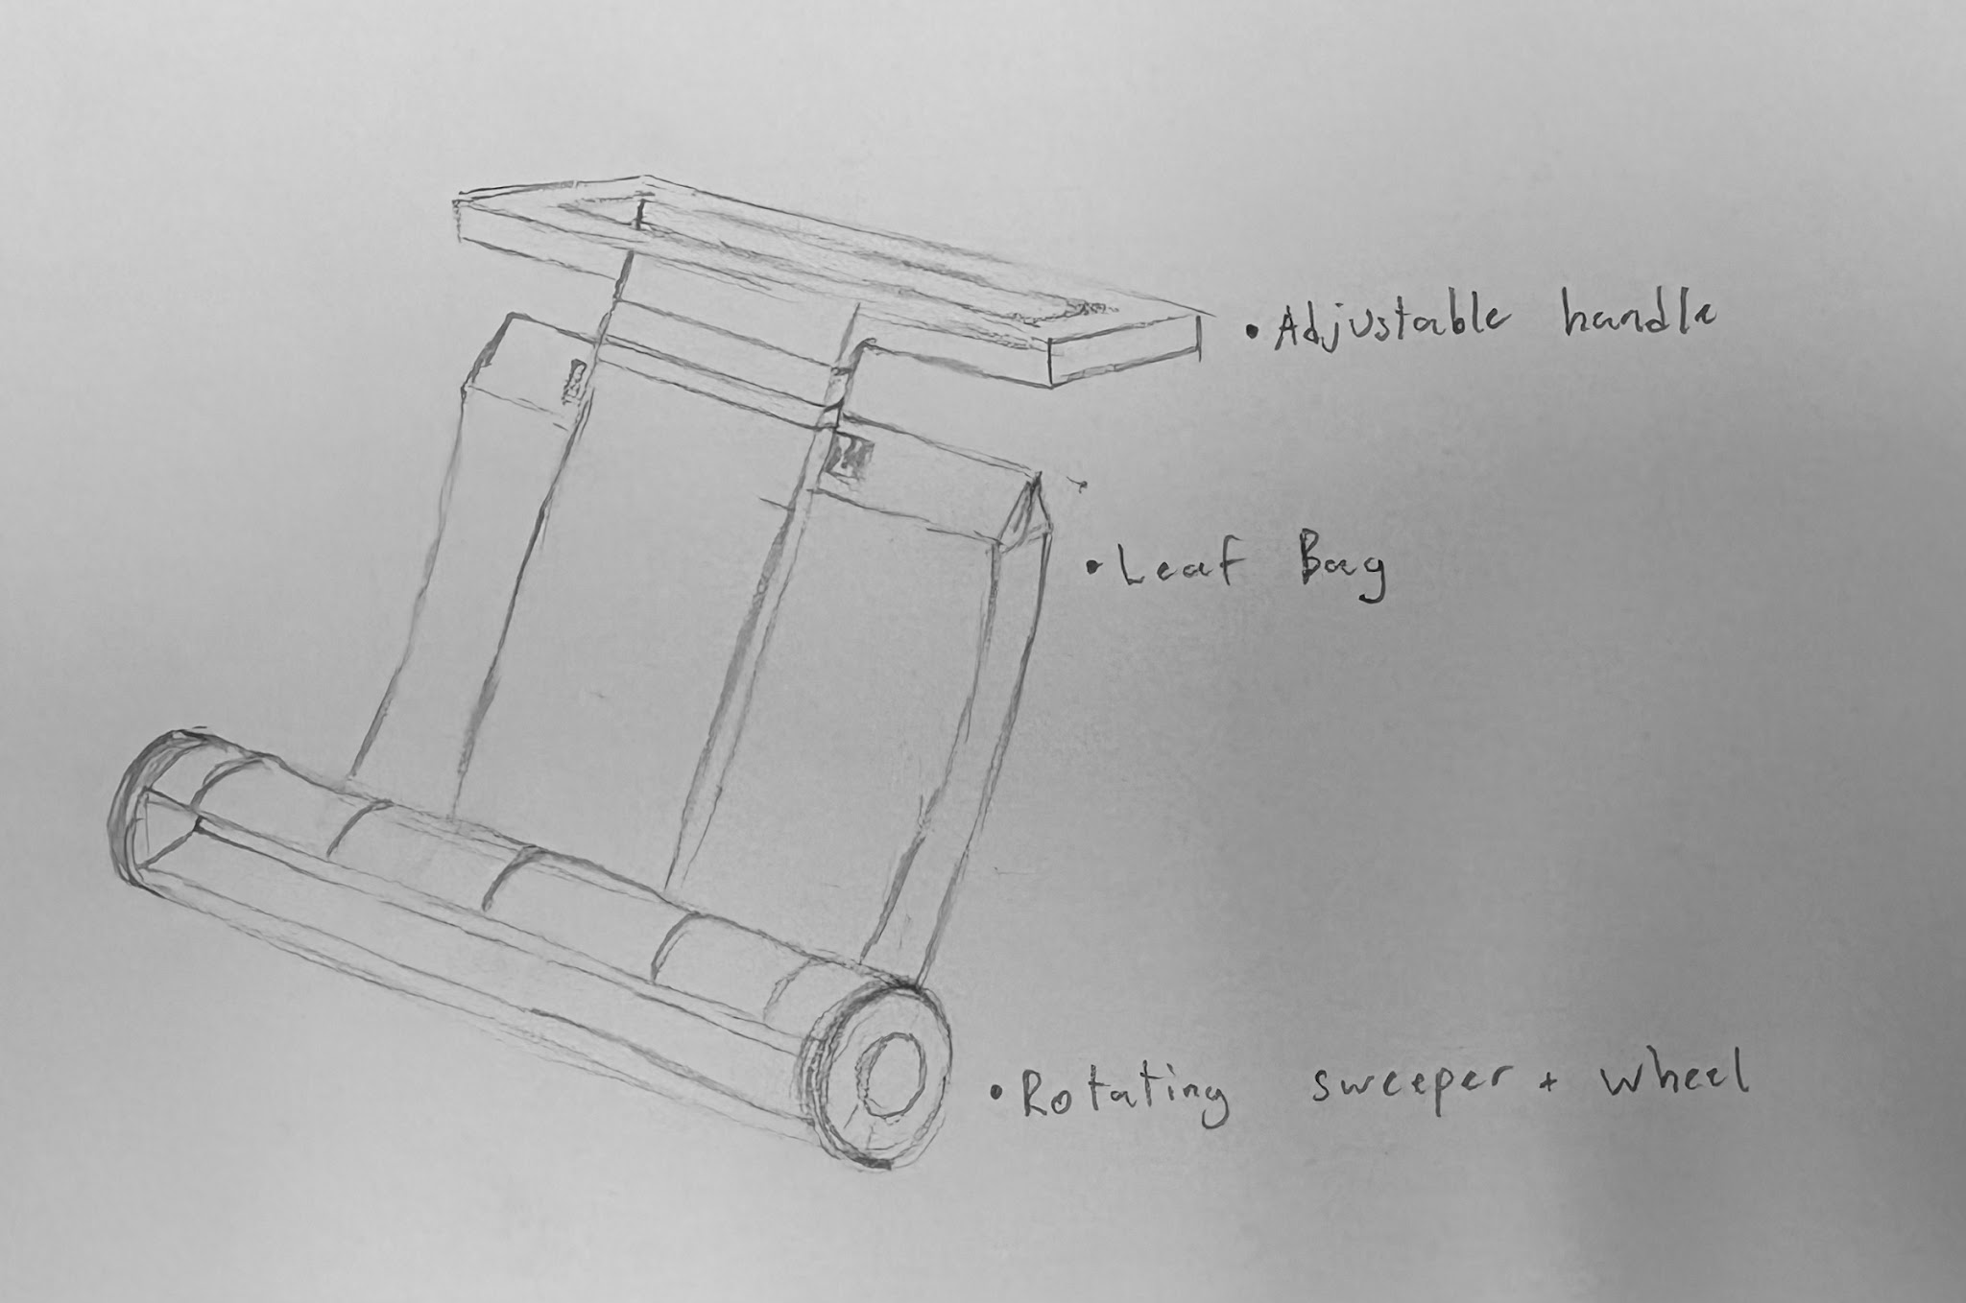
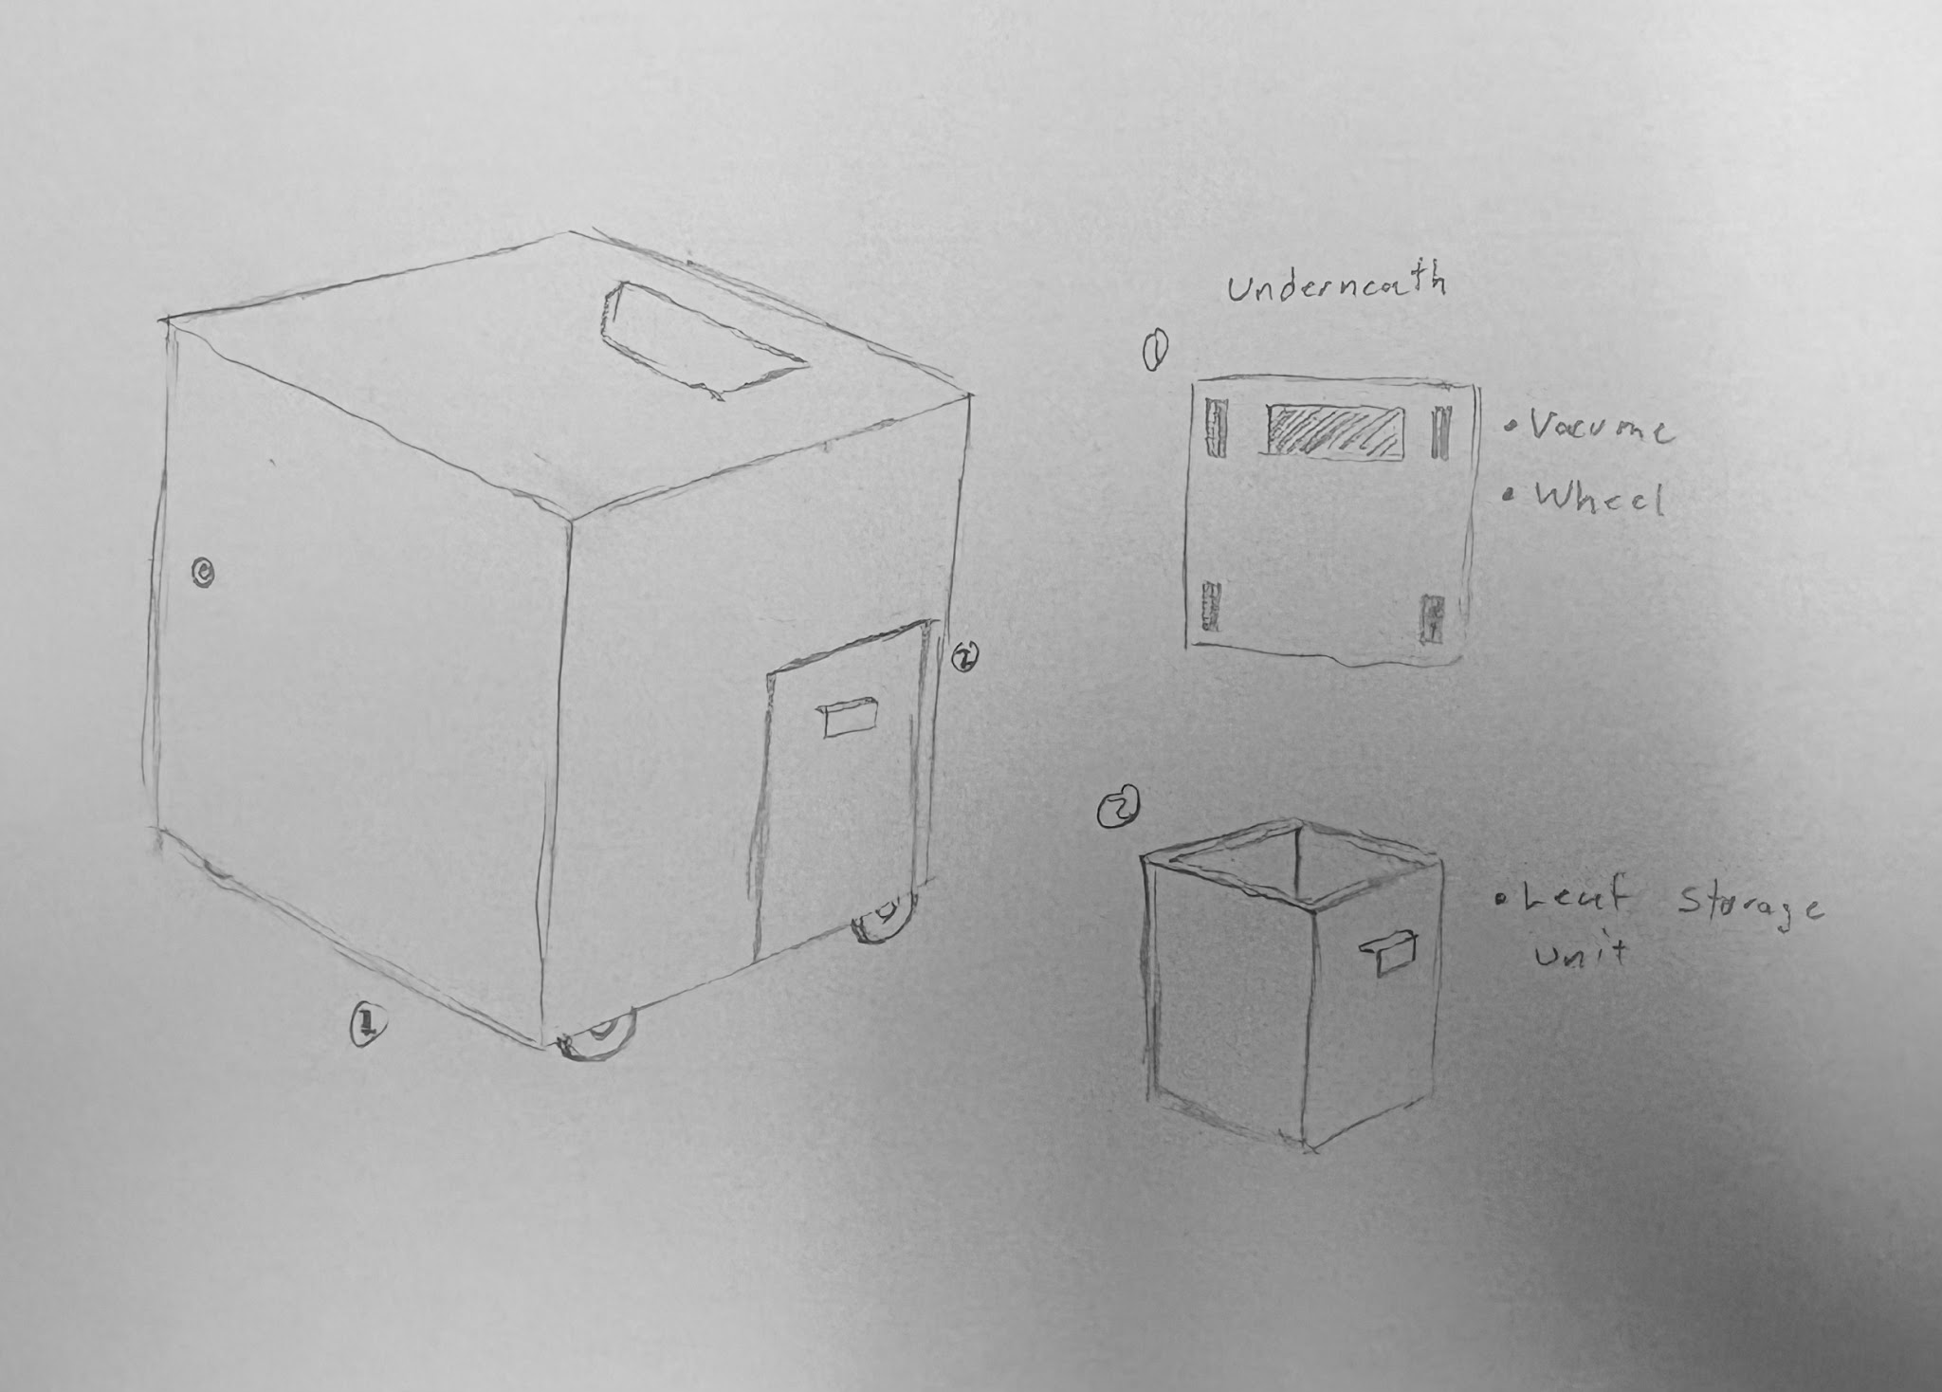
Top 3 Designs
Leaf Gulper:
-Manual
-Pull motion
-Uses an incline to scoop leaves into removable bag
Lawn Sweeper:
-Manual
-Push motion
-Rotating wheel and axle to pull leaves into removable bag
Auto Fridge:
-Autonomous
-Battery, motor, and vacuum to transfer leaves to a waste compartment
Notes:
Seth

Slide 16
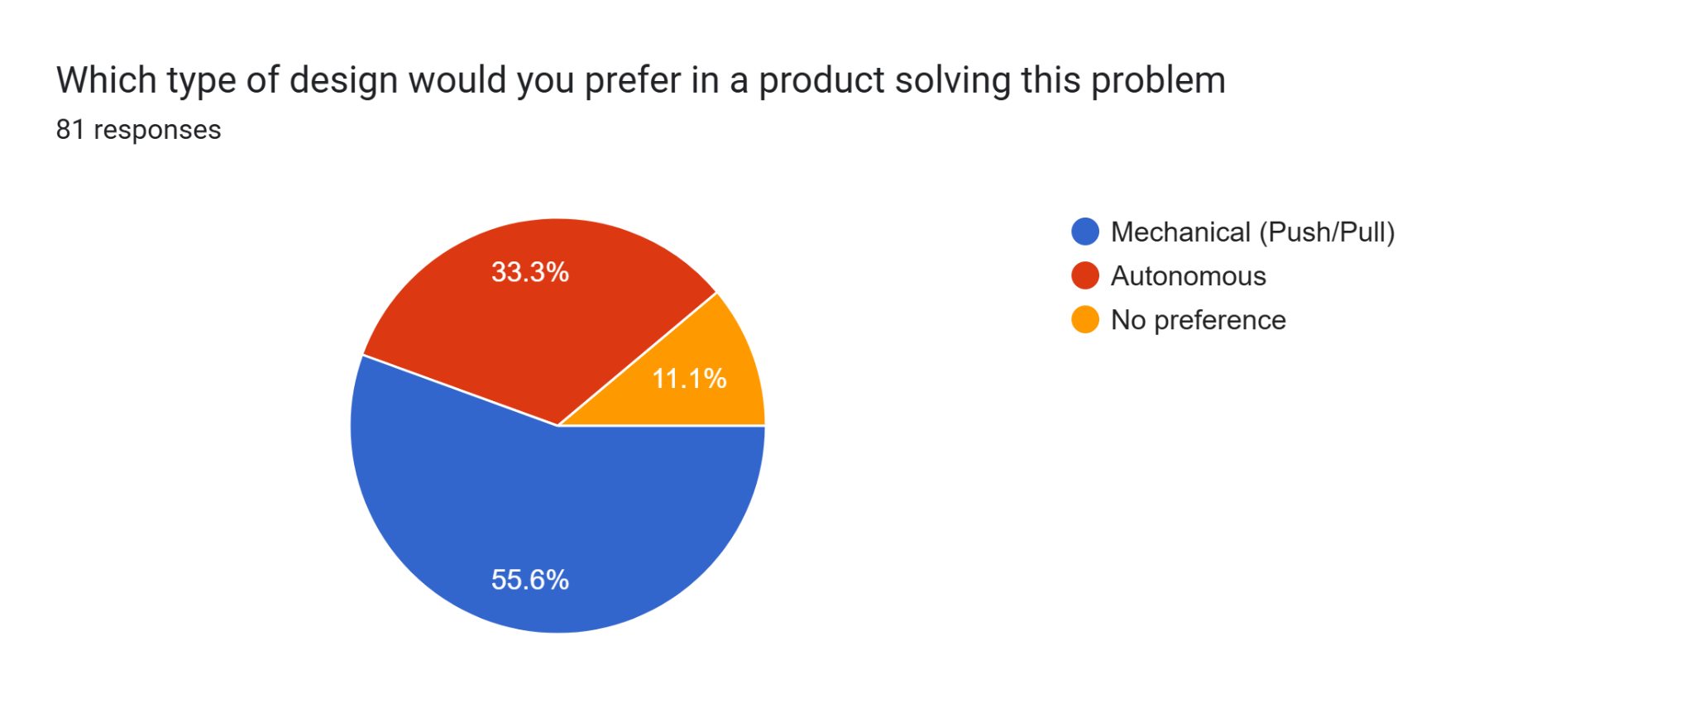
Product Design Survey
Notes:
Shreyas

Slide 17
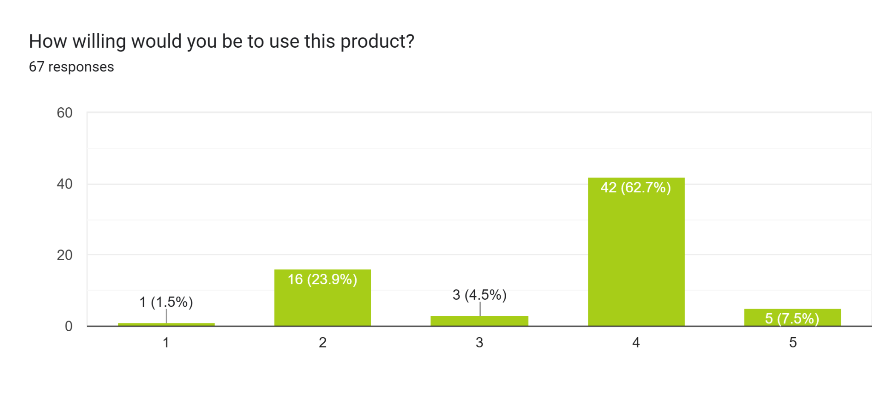
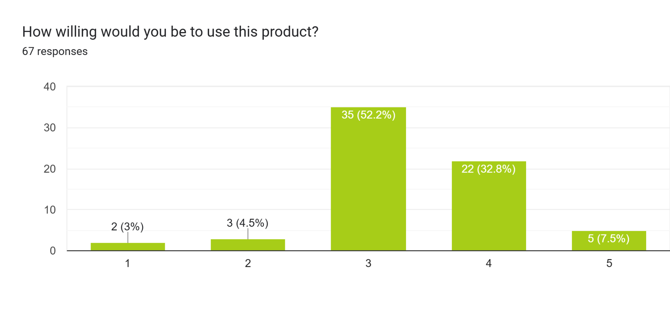
Product Design Survey
AVG= 3.52
AVG= 3.39
Notes:
Shreyas

Slide 18
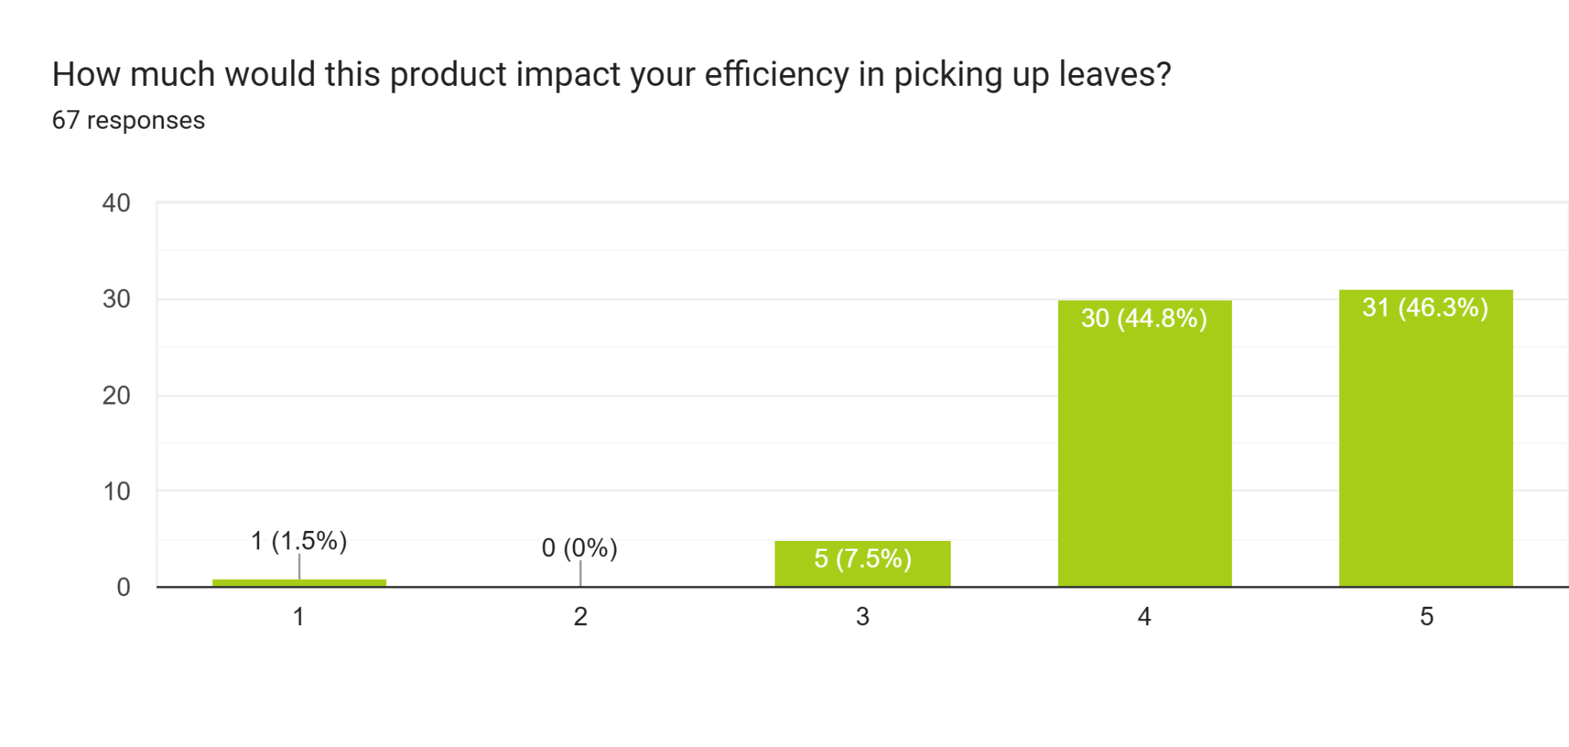
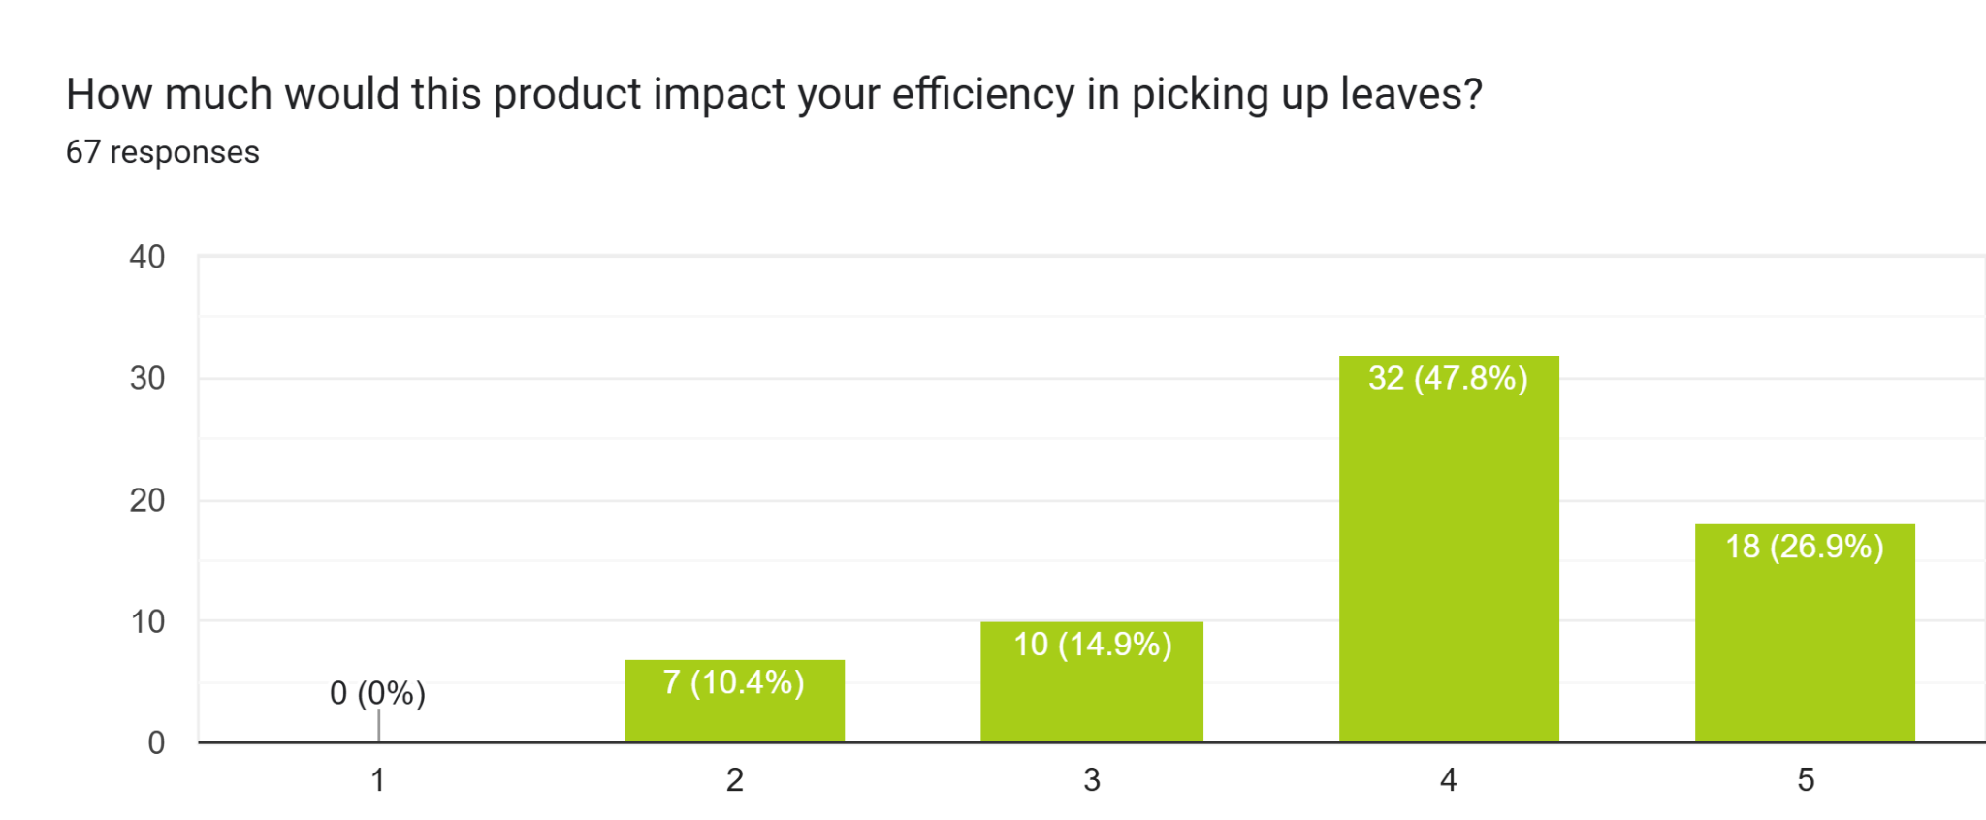
Product Design Survey
AVG= 4.41
AVG= 3.95
Notes:
Shreyas

Slide 19
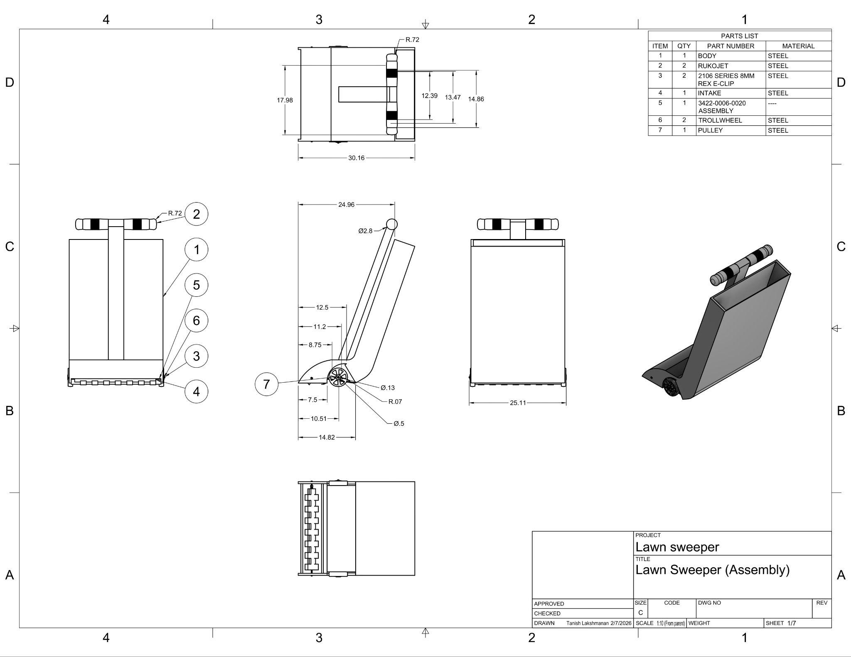
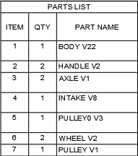
The Lawn Sweeper
Matches highest stakeholder willingness
Mechanical designed as preferred by stakeholders
Notes:
Shreyas/Tanish

Slide 20
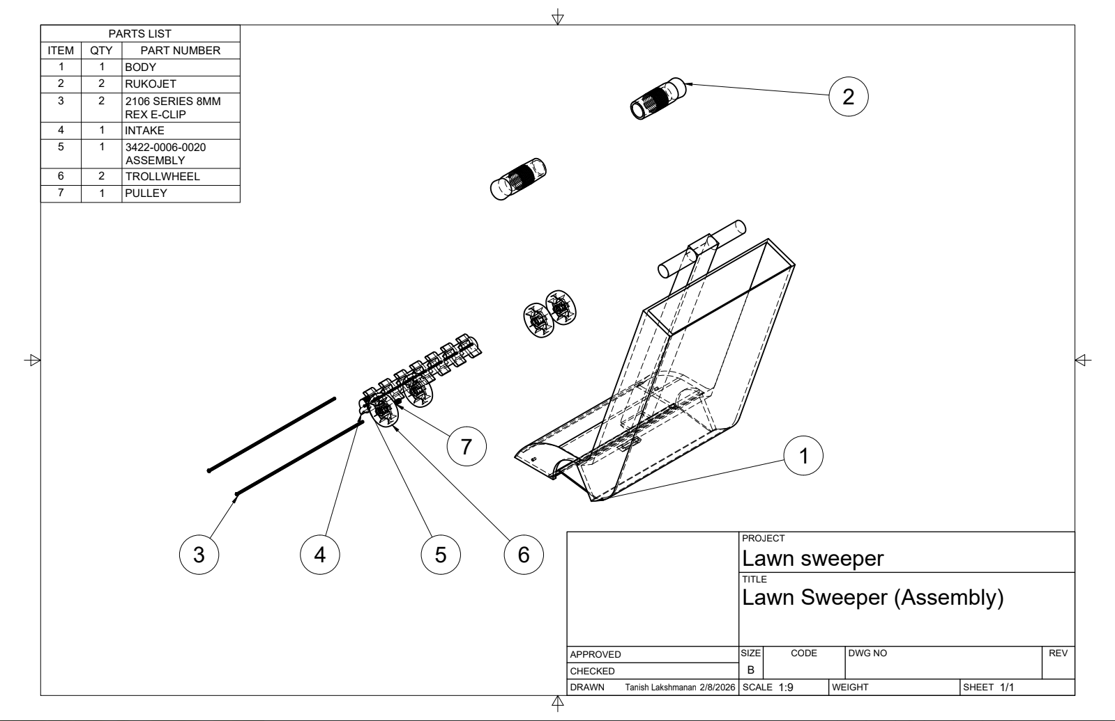
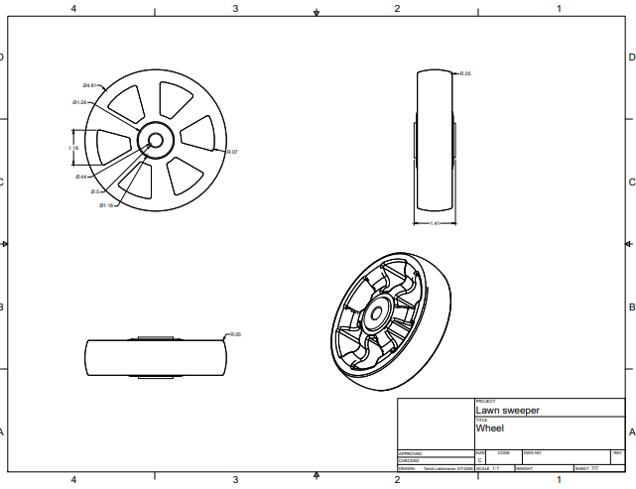
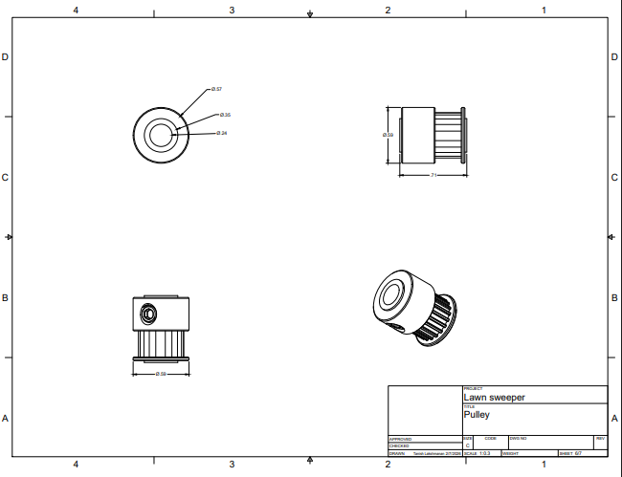
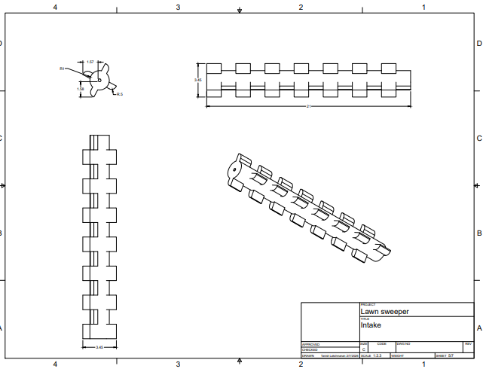
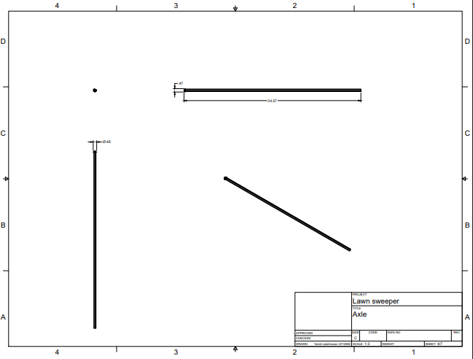
Notes:
Tanish- say what the entire machine is and how it works going through all of its parts (should be 1-2 min according to tegtmeyer on friday)

Slide 21
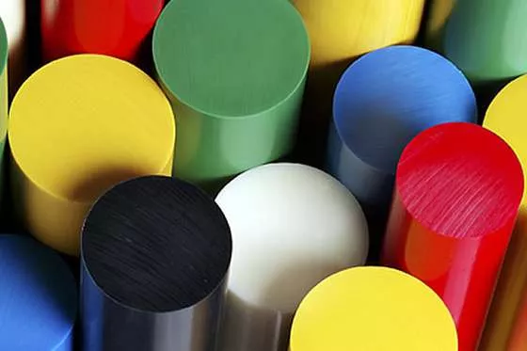
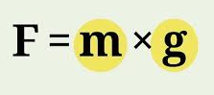
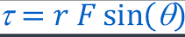
STEM Applications
Wheel and Axle
Forces/Energy
Materials
Intake blades, frame, and handle from plastic to minimize weight and maintain strength
Axle/ Rotating Shaft aluminum
Torque
Push Force
Force from weight of the leaves
Only human mechanical energy used
Notes:
Tanish

Slide 22
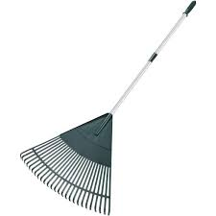
Market Competition
Mechanical Design (like the Lawn Sweeper)
Designs with electrical/fuel components
$15-$30
$179.99
$229.99
$1,599.99
Notes:
Shreyas

Slide 23



Design Viability
Target Market:
Homeowners
Suburban/Rural
Aged 30-70
Manufacturing:
Estimated Cost of Production: ~$100
Estimated Retail Price: ~$149.99
Estimated Profits: ~$49.99
Distribution
Hardware Stores (Lowes, Home Depot)
Online Marketplaces
Lawn and Garden Retailers
Notes:
Seth

Slide 24
Thank You For Listening!
Questions?

