Slide 1

Efficient Leaf Removal Project Proposal
Shreyas Mathur, Tanish Lakshmanan, Seth Jones

Slide 2
Problem Statement
Reports indicate that 42,000 American homeowners annually sustain recurring neck, shoulder, and back injuries while picking up and disposing of leaves in their yards₁. This task also consumes significant time, making it difficult to perform regularly, causing it to be delayed or avoided, leaving leaves accumulate on lawns, smothering grass and blocking the sunlight necessary for healthy growth.
11. Don’t let raking leaves become a pain in the neck, back or spine. Luminis Health. (n.d.). https://www.luminishealth.org/en/blog/dont-let-raking-leaves-become-a-pain-in-the-neck-back-or-spine?

Slide 3
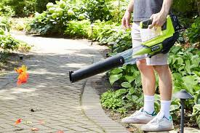
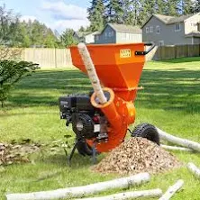
Problem Justification: Statistics
In the US more than 4,000 people are visiting the emergency room after being injured by leaf blowers, mulchers and grinders₂.
42,000 American homeowners annually sustain recurring neck, shoulder, and back injuries picking up leaves₃
2. New.York.Injury.Lawyer. (2019, October 10). Autumn Injuries related to leaves raking and how to prevent them. New York Personal Injury Attorneys Blog. https://www.newyorkpersonalinjuryattorneysblog.com/autumn-injuries-related-to-leaves-raking-and-how-to-prevent-them/
3. 11. Don’t let raking leaves become a pain in the neck, back or spine. Luminis Health. (n.d.). https://www.luminishealth.org/en/blog/dont-let-raking-leaves-become-a-pain-in-the-neck-back-or-spine?
‌

Slide 4
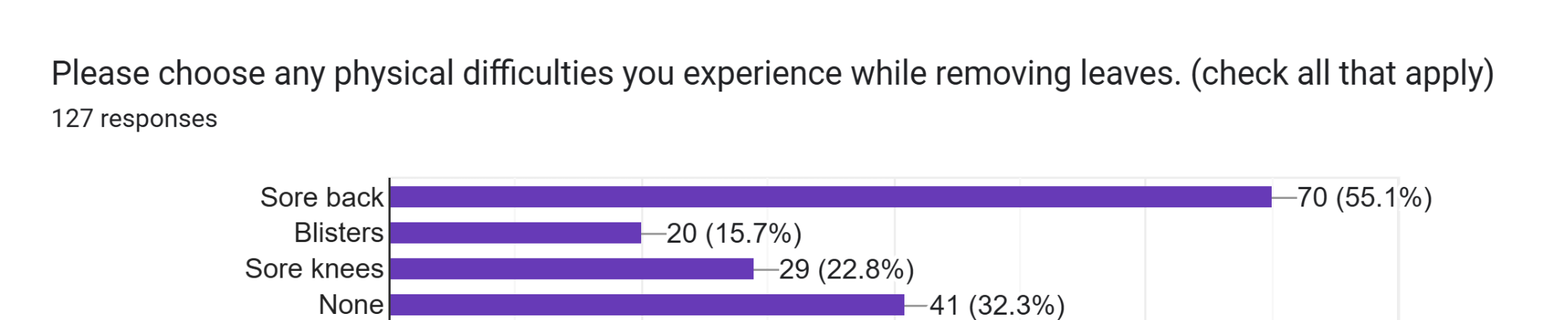
Problem Justification: Survey

Slide 5
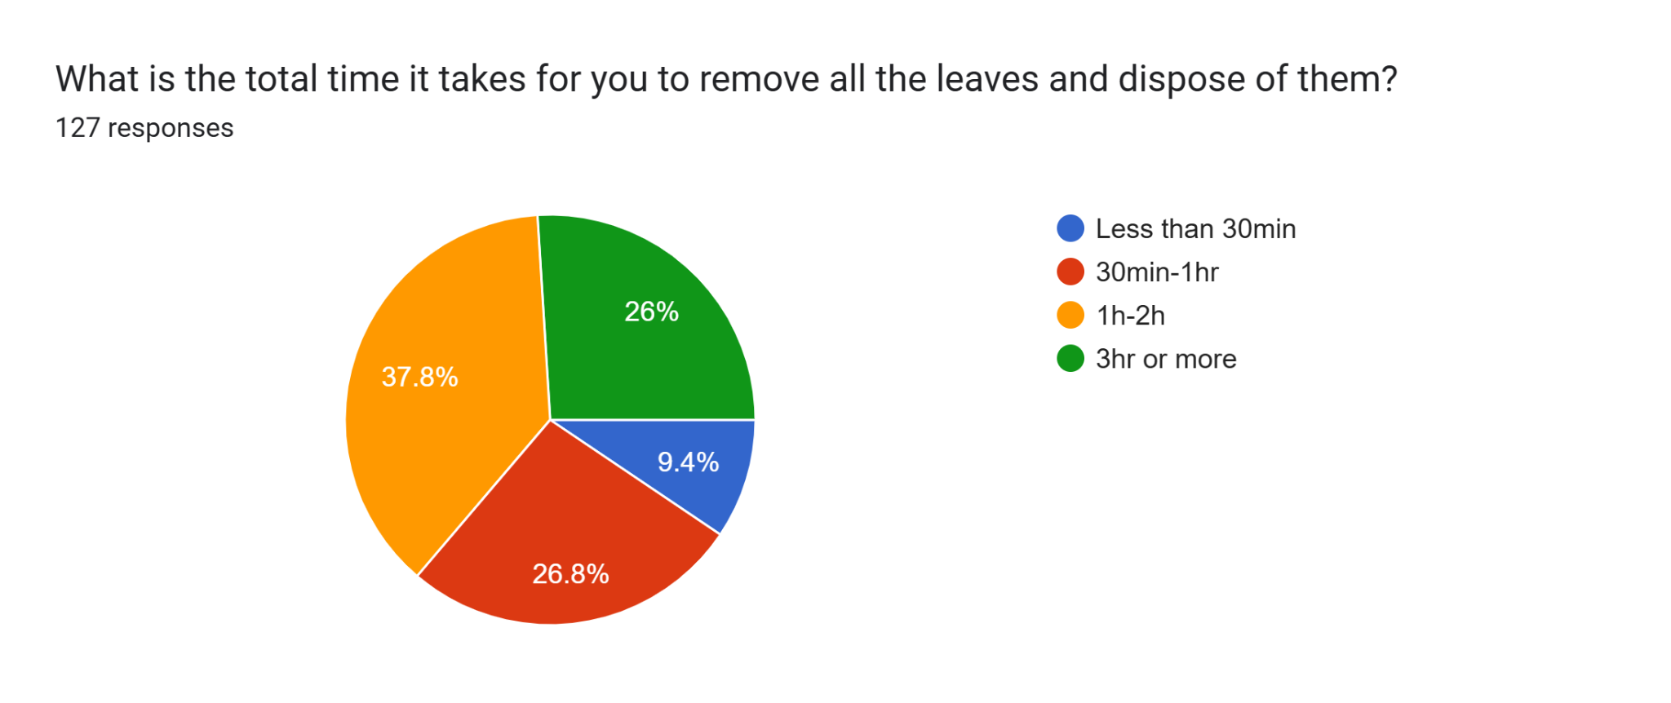
Problem Justification: Survey

Slide 6
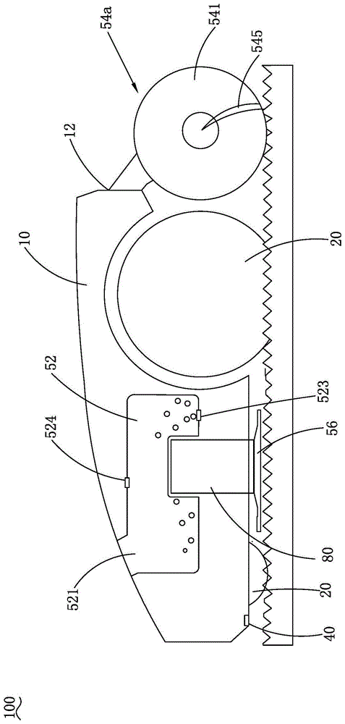
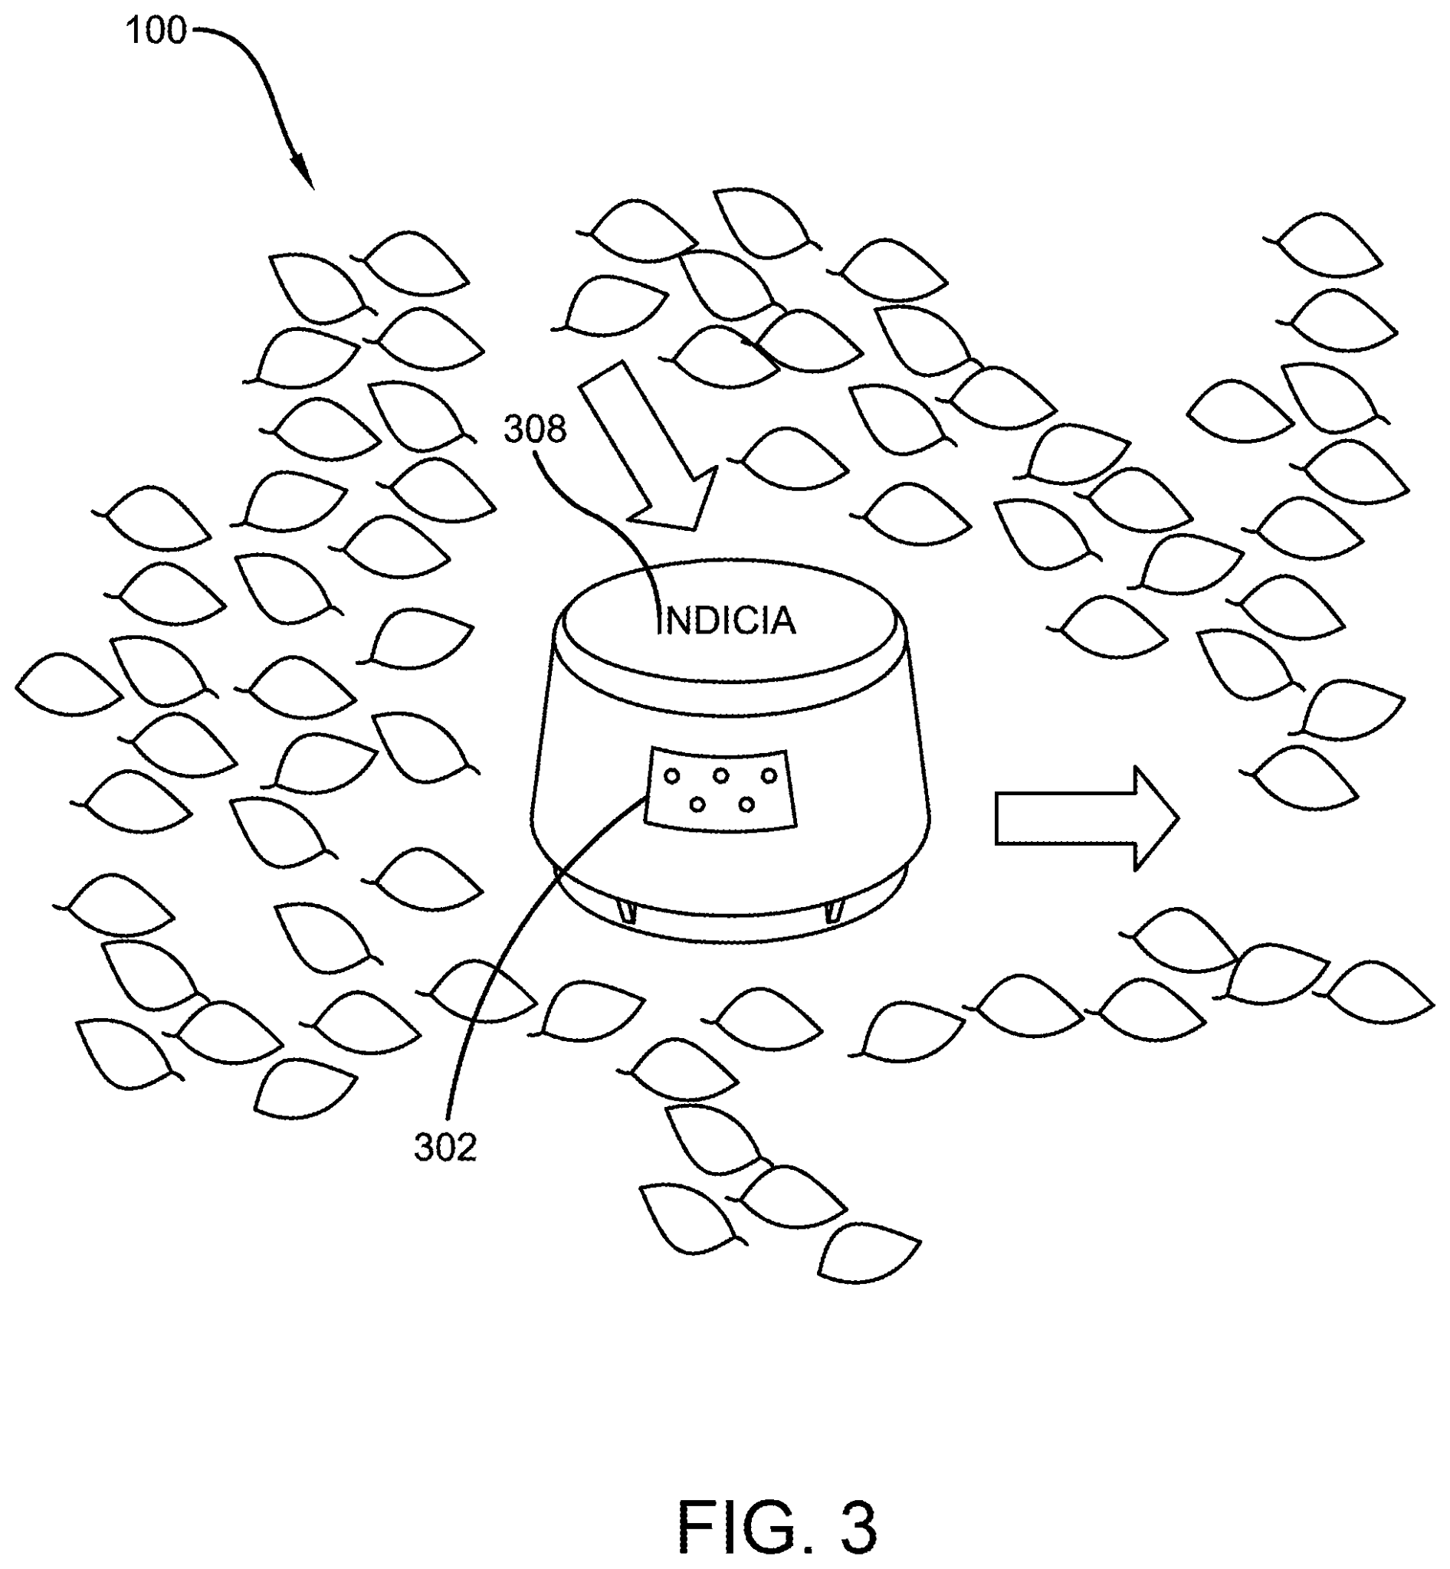
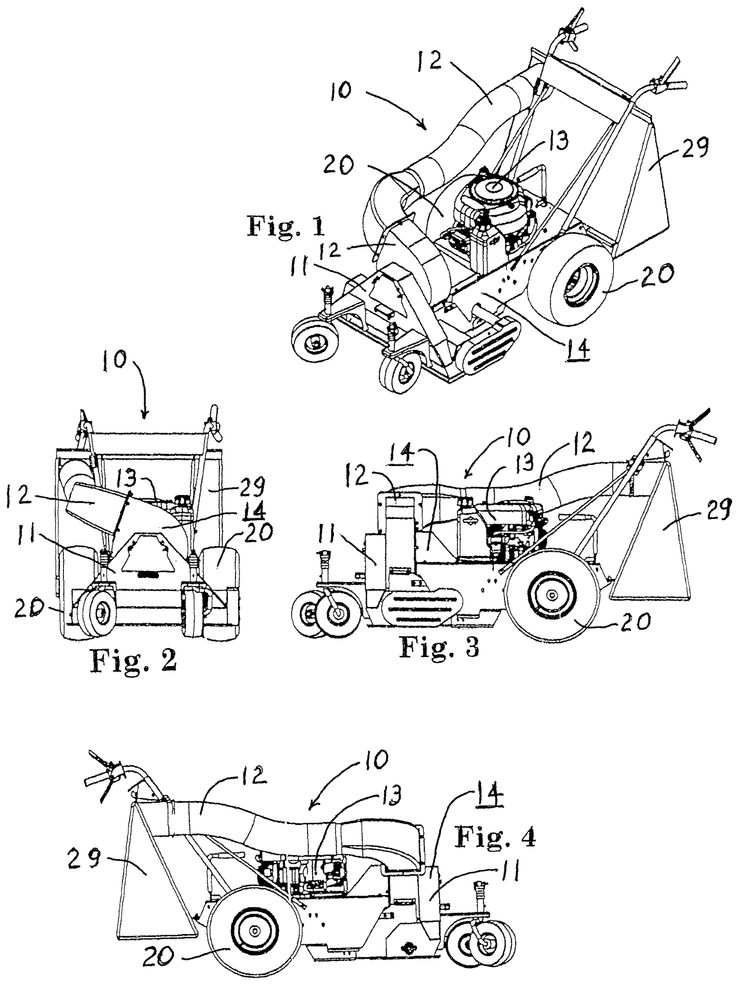
Current and Past Solutions: Patents
A Roomba-style yard robot
Adaptable to different yards using boundary signals.
Limited leaf capacity
Expensive
Leaf collector and dock
Automated cleaning
Requires fixed power and water source
Mower style system
Uses suction and blades
Volume reduction
Complex and expensive
CN206538723U - Suction and blowing device - Google Patents. (2016, April 6). Google.com. https://patents.google.com/patent/CN206538723U/en?q=(leaf+removal)&oq=leaf+removal &page=1
Techtronic Cordless GP. (2024). Lawn maintenance system having an autonomous lawn mower and a docking station (U.S. Patent Application No. US20240081201A1 https://patents.google.com/patent/US20240081201A1
Diaz del Castillo, D. A. (2014). Autonomous and remote control all purpose machine. U.S. Patent Application No. US20140121881A1.https://patents.google.com/patent/US20230154321A1/en

Slide 7
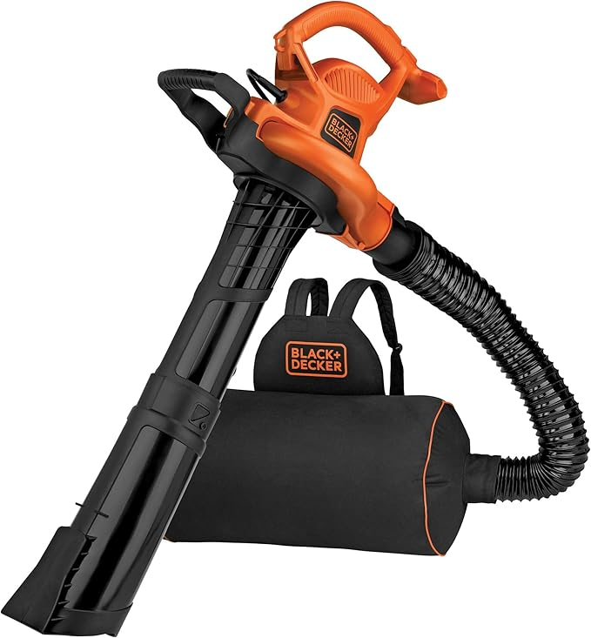
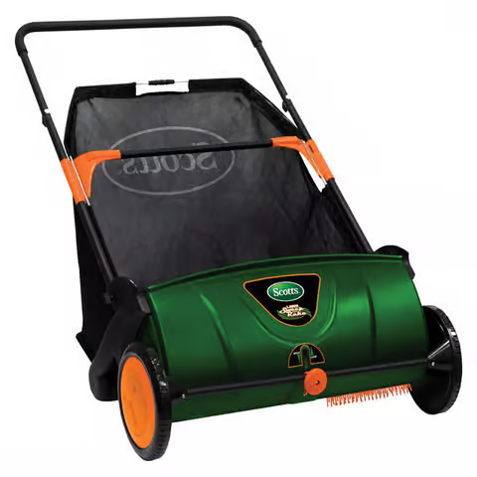
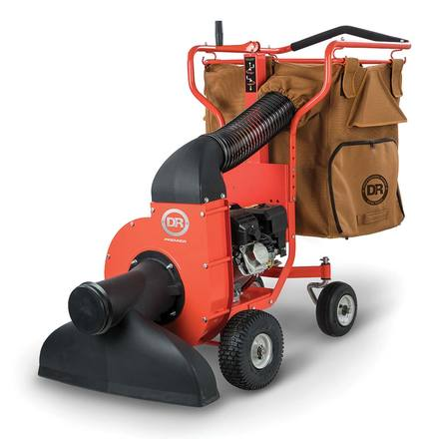
Current and Past Solutions: Products
Push-powered mechanical leaf collection
Requires physical effort and heavy bag lifting
Combines leaf blowing and vacuuming functions
Backpack storage improves mobility
Full bag places strain on the user
High-power vacuum with built-in leaf shredding
Large storage capacity
Very expensive and heavy collection bag
Amazon. (n.d.). BLACK+DECKER BEBL7000 Blower/Mulcher [Product page]. Amazon. https://www.amazon.com/BLACK-DECKER-BEBL7000-Blower-Mulcher/dp/B07253C39S/ref=sr_1_10
DR Power Equipment. (n.d.). DR Leaf and Lawn Vacuum – Walk-Behind (WL33206DMN). Retrieved December 9, 2025, from https://www.drpower.com/Power-Equipment/Leaf-Blowers-%26-Vacuums
Ace Hardware. (n.d.). Scotts Lawn Sweeper (Item # 7821416). Retrieved December 9, 2025, from https://www.acehardware.com/departments/lawn-and-garden/lawn-mowers/grass-catchers/7821416?

Slide 8
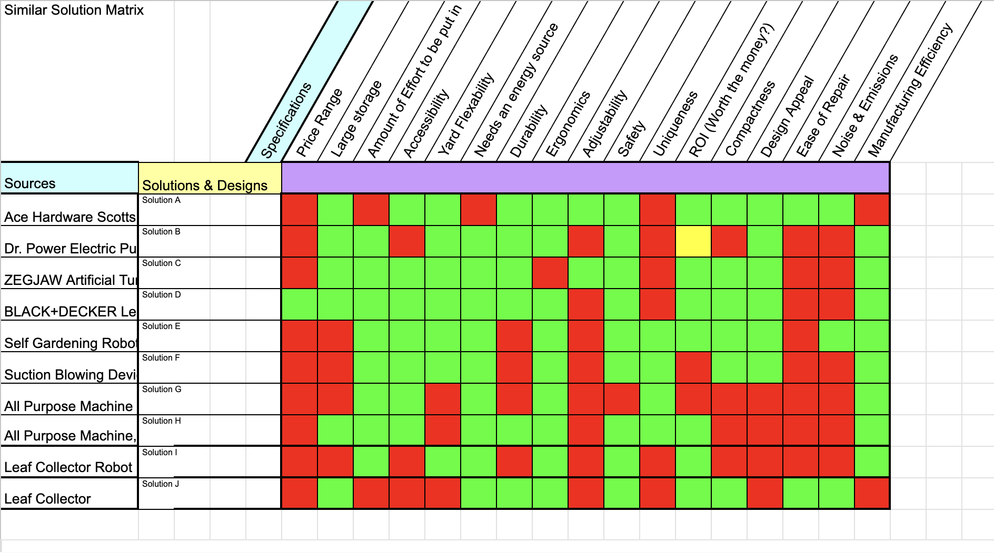
Solution Requirements
From the past solutions, a similar solution matrix was created to identify what characteristics each product had, and what they lacked in comparison.

Slide 9
Primary Stakeholders
Homeowners who take regular care of their lawn
Older individuals with physical limitations
Landscaping service providers
Homeowners Association
https://www.walmart.com/ip/Greenworks-80V-580-Cfm-at-145-Mph-Brushless-Leaf-Blower-with-2-5-Ah-Battery-Charger
Hulley, L. (2024). The Impact of Dust in Electronics. Bulgin.com. https://blog.bulgin.com/blog/the-impact-of-dust-in-electronics

Slide 10
Expert Review & Feedback
Dr. Howard Greene
Director of STEM Education and Outreach at The Ohio State University
Must run to clear a 5000 sq. ft lawn
Must have enough storage to hold a 30 gallon leaf bag
Must be able to automatically dump contents
Mr. Ray Derer
Team Lead in Mechanical Design at Caterpillar Inc.
-”All of these solutions also require the user to empty the machine into a yard waste bag or burn pile”

Slide 11
Solution Requirements
1. Autonomous Operation
2. Efficiency
3. Leaf Disposal
4. Battery Life
5. Storage
6. Battery Replacement
7. Compaction
8. Battery Per Runtime
9. Target Cost
10. Noise Level
11. Durability
12. Ergonomics
13. Operating Environment
14. Natural Conditions
15. Safety Precautions
16. Maintenance
DeBruin, I. (2025, August 23). How Long Does a Fall Yard Clean-Up Take? - LambtonLawn LTD Blogs. LambtonLawn LTD Blogs. https://lambtonlawn.com/blog/how-long-does-a-fall-yard-clean-up-take/
Wasson, S. (2022, August 23). The Average Yard Size by State and City. Today’s Homeowner. https://todayshomeowner.com/lawn-garden/guides/average-yard-size/
Minnesota Equipment. (2023, July 12). How Old Is Too Old for a Lawn Mower? - Minnesota Equipment. Minnesota Equipment.
Fall Temperature Averages for Each USA State - Current Results. (n.d.). Www.currentresults.com. https://www.currentresults.com/Weather/US/average-state-temperatures-in-fall.php

Slide 12
Solution Requirements
Autonomous Operation
Machine shall fully autonomous once set up
Efficiency
Shall pick up leaves from a 2,500 sq. ft. lawn under 60 minutes
Leaf Disposal
The machine shall autonomously pick up and dispose of leaves in its own storage unit
Battery Life
The machines battery life shall last 120 minutes
Storage
Machine shall store 30 gallons of leaves with a weight capacity of 50 lbs

Slide 13
Thank You
Questions?

