Slide 1
Final Project Demonstration
Knowledge Management
UE17CS342
Project Title : Democratizing the economic system of a nation
Project Guide : Dr. Jayashree
Project Team : Sushanth, Nithish, Shreyas, Amrutanshu

Slide 2
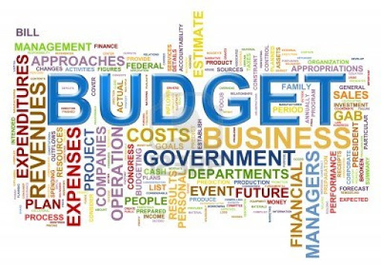
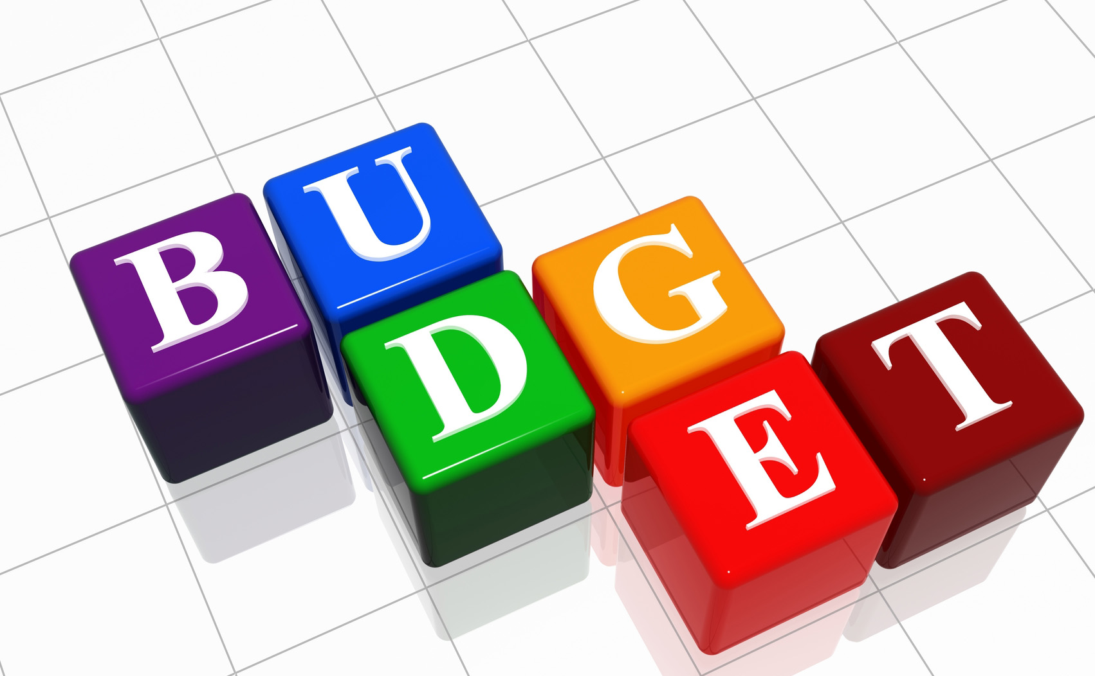

Introduction

Slide 3
Project Abstract and Scope
Every year in a country there is an annual financial budget which lays a roadmap of the income and the expenditures the government announces before its people.
Basically it’s a plan by the government on how it intends to spend the revenue generated by its population for that financial year.
In most of the countries across the world this is a decision which is completely taken by the government and people have no say in it. Similarly in INDIA the same method is followed but in most of the countries it is a constitutional obligation to present the annual budget before its people.
In this project we will consider a hypothetical country which also allows its people to give suggestions and input on which and what sectors they wish to invest the budget.

Slide 4
Project Idea contd..
So in this hypothetical country the annual financial budget is formulated based on its people’s suggestions and by consulting the government experts in the respective sectors.
Throughout this project we will consider this hypothetical country as our basis for the Knowledge management project.
The whole idea behind this project is that we collect data from the citizens of the country which is essentially tacit knowledge and convert it into a form of online documentation , process the raw data , analyze it using business intelligence techniques and finally give the government our documented data which is essentially explicit knowledge.

Slide 5
Design and Implementation
We firstly collect the data from the citizens of the country through a website which allows only permanent citizens of the country to login and fill in the form.
The website consists of many features designed and developed using CSS and advanced web frameworks technologies. An individual citizen can log into the website using his/her unique citizen id.
The website basically allows individual citizens to fill in their options of choice on which sectors they intend to invest the budget and it informs the user (citizen) on the possible consequences which may occur after choosing an option.
This unique feature makes it possible for even an ordinary user to make an informed choice before submitting the form, hence enabling better inputs.
The website also displays the previous financial year’s budget to make the citizen aware of the nation’s development in the past.

Slide 6
Implementation contd..
The data/response from the user which is input through the website is stored on a server-side database for us to process and analyze it.
The database we use here is the MySQL database and along with it we have designed the webpage using PHP, JavaScript , CSS etc.
The data which is input is then analyzed using tools such as Power BI and python plots for graphical representations.

Slide 7
Assumptions
The country chosen here is a hypothetical country , so we have assumed that only permanent citizens of the country can login to the website through their unique citizen id.
Also it is assumed that the country has only 50 citizens and the age group of the citizens should also be input before filling in their choices.
The motive behind receiving ages of citizens is that it helps the data scientist and subject experts analyze the responses better.
It is also assumed that the suggestions given by the population will be made into actual financial budget only after considering the final views of the subject experts and measuring the feasibility .
Final budget will therefore be a document which strikes the right balance between respecting people’s aspirations and the opinion of the government experts in each sector.
Hence this helps the government in making the right financial budget after considering all the pros and cons involved in it.
Notes:
7

Slide 8
User friendly aspect
The website also intends to be user-friendly in the sense that for some citizen who is very new to this system and is unaware of how to go about filling his choices there is a link that directs the user to the last year’s budget and the sector-wise allocation.
Here the citizen can get a clear insight of the amount of budget that was allocated to each sector and how the nation benefitted from it.
It also shows the limitations the budget had about each sector and hence he will be able to make a wise choice while filling in the options.
This feature thus is one of the most striking features which makes it possible for even an ordinary citizen do the right pickings.
Notes:
8

Slide 9
Project Ananlysis
The analysis is done using python plots and online business intelligence tools like Power BI. The data is firstly processed , analyzed and then it’s represented graphically.
The analysis shows that the previous year the education sector was prosperous, but the agriculture sector suffered. As a result the country and its population also witnessed a slight food crisis, it also made the farming community face long term negative consequences.
Also the health and the defense sector were equally funded which neither were detrimental nor at the same time they did not add to the development.
Notes:
9

Slide 10
Project Analysis contd..
We also found that since most of the budget was focused more on the education sector since a major chunk of the nation’s population lie in the age group of 15 - 25.
This age group is essentially the youth and hence they wished that more budget was allocated to the education sector.
But its important to note that a good budget is the one which strikes the right balance among all sector based on the country’s requirements and needs.
Hence by looking into the positives and the negatives of the previous financial budget , it makes it possible even for an ordinary citizen to make a better choice.
Notes:
10

Slide 11
Conclusion
After the data is collected and analyzed in the form of explicit knowledge it is given to the government experts to make them aware of the aspirations of the countrymen.
This is further scrutinized by the government and its subject experts in presenting the final annual financial budget.
Hence by doing this we are democratizing the whole economic setup of the nation and making the population of the country have a say in the annual budget.
At the end of the day, a country which respects the aspirations of its people not only proves to be democratic but also become a matter of pride and respect to its people.
Notes:
11

Slide 12
Thank You

