Slide 1
MACHINE LEARNING PROJECT PES UNIVERSITY SAQLAIN PASHA PES1201701539 SECTION E MD FAIZAN SIDDIQUI PES1201701740 SECTION E SHREYAS MAVANOOR PES1201700837 SECTION E

Slide 2
Problem Statement
A problem that lends itself to the application of machine learning is classifying matched sources in the Galax (Galaxy Evolution Explorer) and SDSS (Sloan Digital Sky Survey) catalogs into stars and quasars based on color-color plots. The problem is daunting because stars and quasars are still inextricably mixed elsewhere in the color-color plots and no clear linear/non-linear boundary separates the two entities. Diversity and volume of samples add to the complexity of the problem. We explore the efficacy of neural network-based classification techniques indiscriminating between stars and quasars using GALEX and SDSS photometric data. Both sources have compact optical morphology but are very different in nature and are at very different distances. We have used those objects with associated spectroscopic information as our training-set and built neural network and ensemble classifiers that appropriately classify photometric samples without associated spectroscopic labels. Catalogs comprising of samples labelled using our classifiers can be further used in studies of photometric sources. The design of a novel Generative Adversarial Network (GAN) based classifier is proposed in the paper to tackle the classification problem. To evaluate the correctness of the classifiers, we report the accuracy and other performance metrics and find reasonably satisfactory range of 91-100 % .

Slide 3
Getting good accuracy from imbalanced dataset:
We separate the given dataset into separate classes and perform imputation on it to make it balanced and accordingly get good accuracy .
We have used SMOTE, Decision tree classifier , train_test_split etc in our imputation and classification.
SMOTE is abbreviation of synthetic minority oversampling technique. It is oversampling method to solve
imbalance in a given dataset. It balances the class distribution by increasing minority class examples, by
replicating them. SMOTE synthesizes new minority instances between existing minority instances.
Decision tree: It is one of the machine learning technique which have bias towards majority class and
neglects minority class. This method is more applicable to the data having very lesser recall. It is a tree like
structure ,in which each branch represents outcome of the test date set and each leaf node represents class
label. To implement decision tree we have used CART(classification and regression trees) algorithm.
We have used train_test_split (from sklearn.model_selection) with test_size as 0.3.

Slide 4
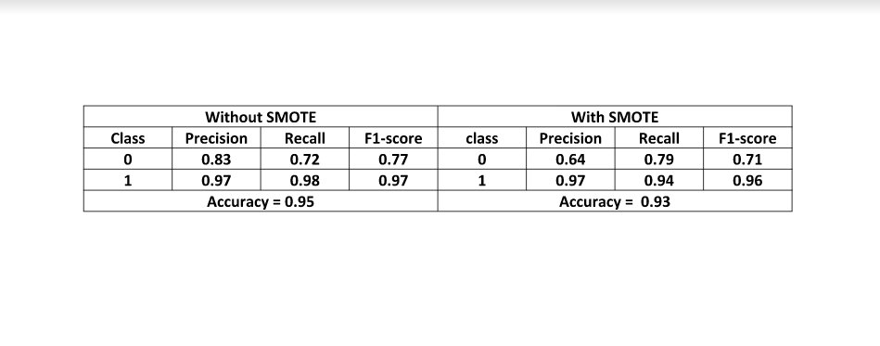
Conclusion

Slide 5
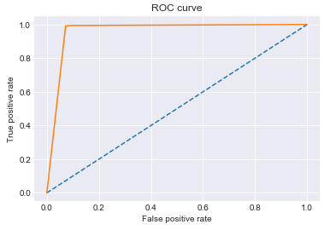
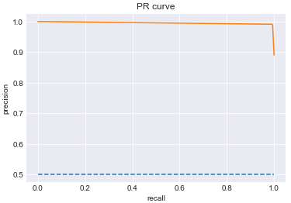
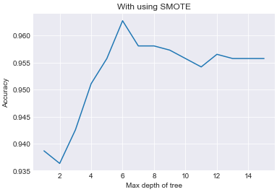
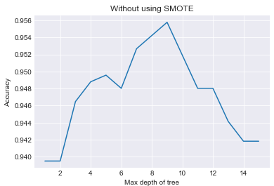
Visualisations

