Slide 1

USER-guide Multi-Moment Analysis (MMA) Tool BueP Status: 2016-09-23

Slide 2
What is MMA?
MMA is a statistical method for determining the proportion of time spent by workers in various defined categories of activities.
This user guide gives the step by step representation of “How to use the BueP MMA web application”.
2
Electrical Drives | BueP/BPS-IE | 201609-23
© Robert Bosch GmbH 2016. All rights reserved, also regarding any disposal, exploitation, reproduction, editing, distribution, as well as in the event of applications for industrial property rights.
Notes:
It permits e.g. quick analysis, recognition and enhancement of job responsibilities, tasks, performance competencies and organizational work flows.

Slide 3
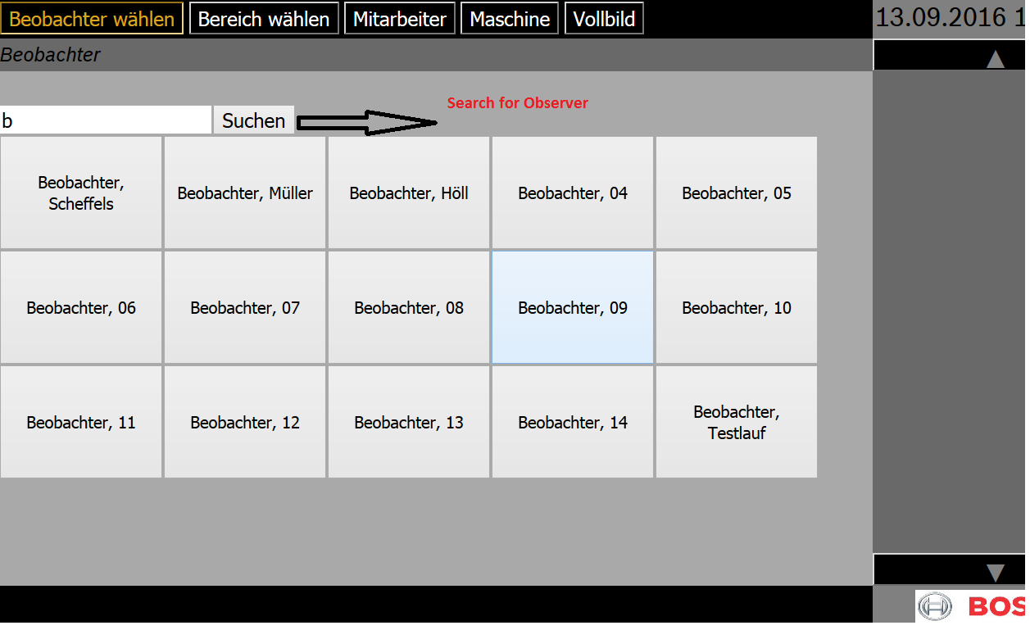
Observer (Beobachter)
This window shows the list of available observer
Please select the proper observer
3
Electrical Drives | BueP/BPS-IE | 201609-23
© Robert Bosch GmbH 2016. All rights reserved, also regarding any disposal, exploitation, reproduction, editing, distribution, as well as in the event of applications for industrial property rights.

Slide 4
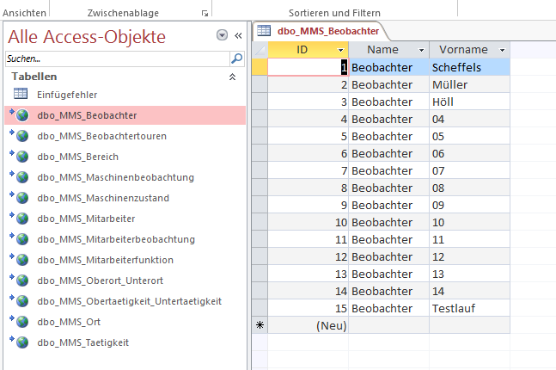
Observer - Data table
Here is the data table for observer
Every observer has unique ID
One can edit the observer list from data table. Database access is necessary
According to the list of observer it displays the list of observer buttons
4
Electrical Drives | BueP/BPS-IE | 201609-23
© Robert Bosch GmbH 2016. All rights reserved, also regarding any disposal, exploitation, reproduction, editing, distribution, as well as in the event of applications for industrial property rights.

Slide 5
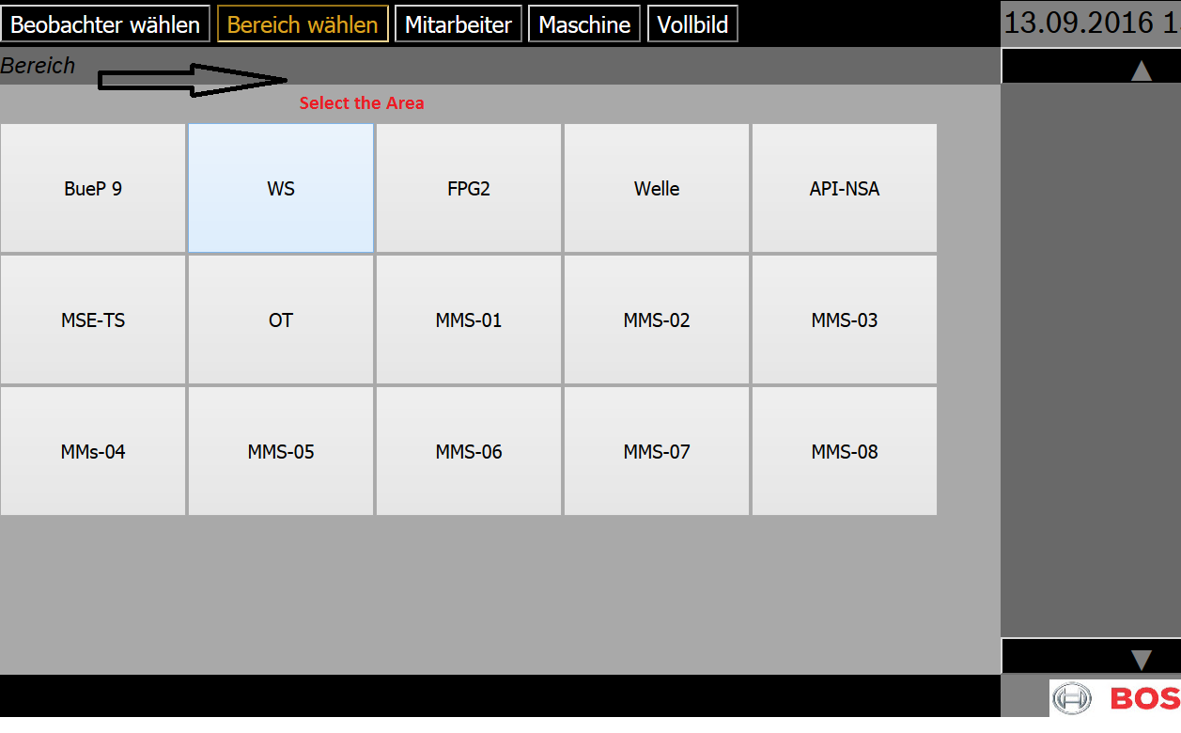
Area (Bereich)
Please select the proper area
It’s very important to select the proper area. Because the list of employees and machines will be generated according to the selected area
5
Electrical Drives | BueP/BPS-IE | 201609-23
© Robert Bosch GmbH 2016. All rights reserved, also regarding any disposal, exploitation, reproduction, editing, distribution, as well as in the event of applications for industrial property rights.

Slide 6
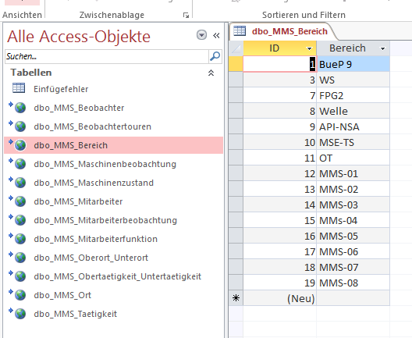
Area – Data table
Here is the data table for list of different areas (e.g. window lift area )
One can edit the areas from database
Database access is necessary
Every area has it’s unique ID in database
6
Electrical Drives | BueP/BPS-IE | 201609-23
© Robert Bosch GmbH 2016. All rights reserved, also regarding any disposal, exploitation, reproduction, editing, distribution, as well as in the event of applications for industrial property rights.

Slide 7
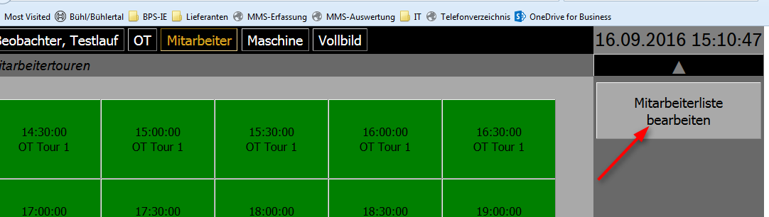
Employee(Mitarbeiter)- Time Slot
This window shows the available
time slot
By the current time it indicates the current time slot for the observer
Completed time slots are shown by green color
7
Electrical Drives | BueP/BPS-IE | 201609-23
© Robert Bosch GmbH 2016. All rights reserved, also regarding any disposal, exploitation, reproduction, editing, distribution, as well as in the event of applications for industrial property rights.

Slide 8
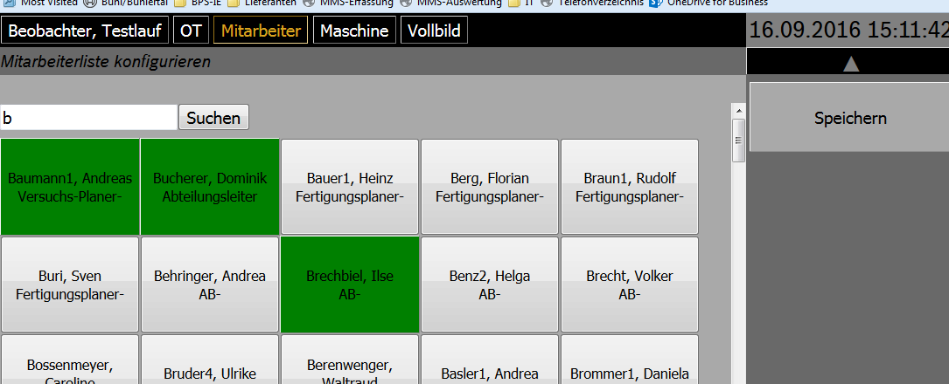
Employees – List
After that it will show the list of employees with work title
Select only those employees, who work on that day.
8
Electrical Drives | BueP/BPS-IE | 201609-23
© Robert Bosch GmbH 2016. All rights reserved, also regarding any disposal, exploitation, reproduction, editing, distribution, as well as in the event of applications for industrial property rights.

Slide 9
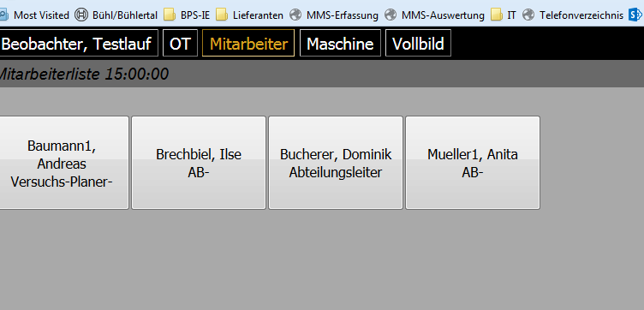
Employees - Selected
After selecting the employees. It will give the list of all available employees
Once observer click on the button of particular employee, it shows the list of activities
9
Electrical Drives | BueP/BPS-IE | 201609-23
© Robert Bosch GmbH 2016. All rights reserved, also regarding any disposal, exploitation, reproduction, editing, distribution, as well as in the event of applications for industrial property rights.

Slide 10
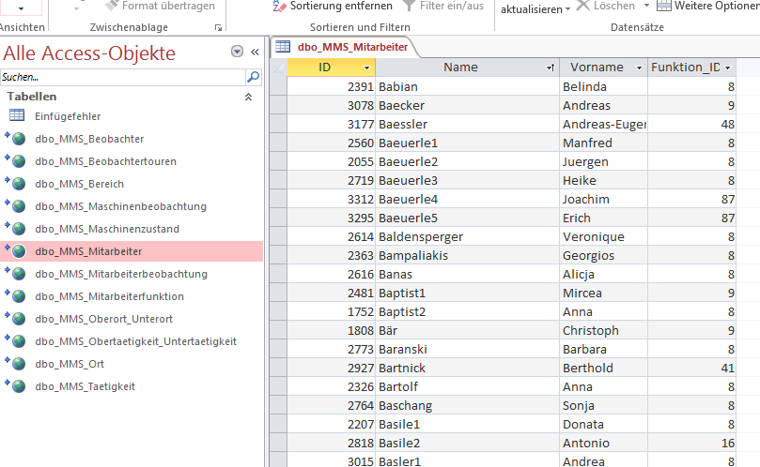
Employee – Data table
This data table shows the list of employees with unique ID and with function ID
10
Electrical Drives | BueP/BPS-IE | 201609-23
© Robert Bosch GmbH 2016. All rights reserved, also regarding any disposal, exploitation, reproduction, editing, distribution, as well as in the event of applications for industrial property rights.

Slide 11
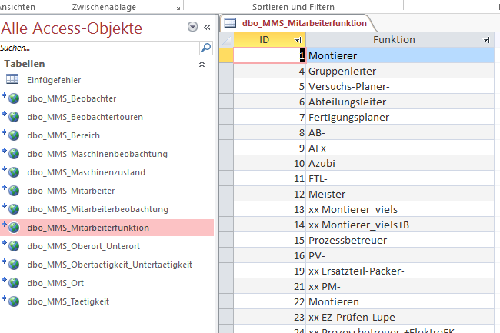
Employee – Functions data table
This table shows the functions of employee with function ID
Different functions have their unique ID
11
Electrical Drives | BueP/BPS-IE | 201609-23
© Robert Bosch GmbH 2016. All rights reserved, also regarding any disposal, exploitation, reproduction, editing, distribution, as well as in the event of applications for industrial property rights.

Slide 12
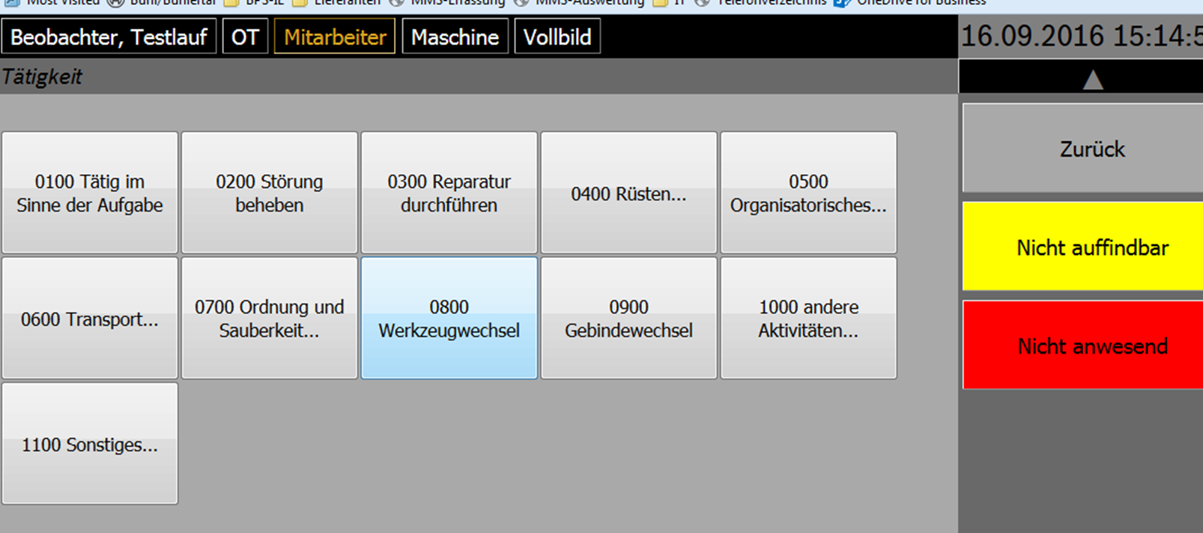
Employee – Activities
This window shows the activity information of employee with two other options:
1.Nicht auffindbar (Not traceable)
2.Nicht anwesend (Not present)
Observer can select the activity done by employee
12
Electrical Drives | BueP/BPS-IE | 201609-23
© Robert Bosch GmbH 2016. All rights reserved, also regarding any disposal, exploitation, reproduction, editing, distribution, as well as in the event of applications for industrial property rights.

Slide 13
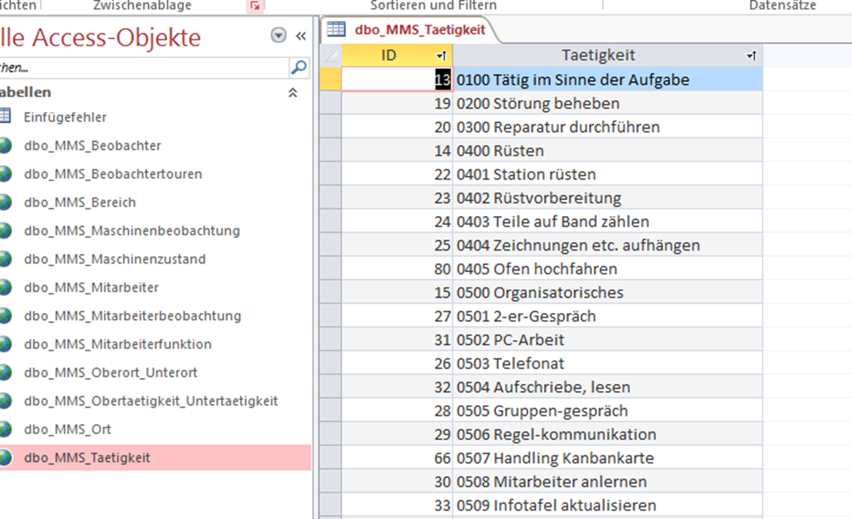
Employee – Activities data table
This table shows the information about different activities done by employee with respective ID
13
Electrical Drives | BueP/BPS-IE | 201609-23
© Robert Bosch GmbH 2016. All rights reserved, also regarding any disposal, exploitation, reproduction, editing, distribution, as well as in the event of applications for industrial property rights.

Slide 14
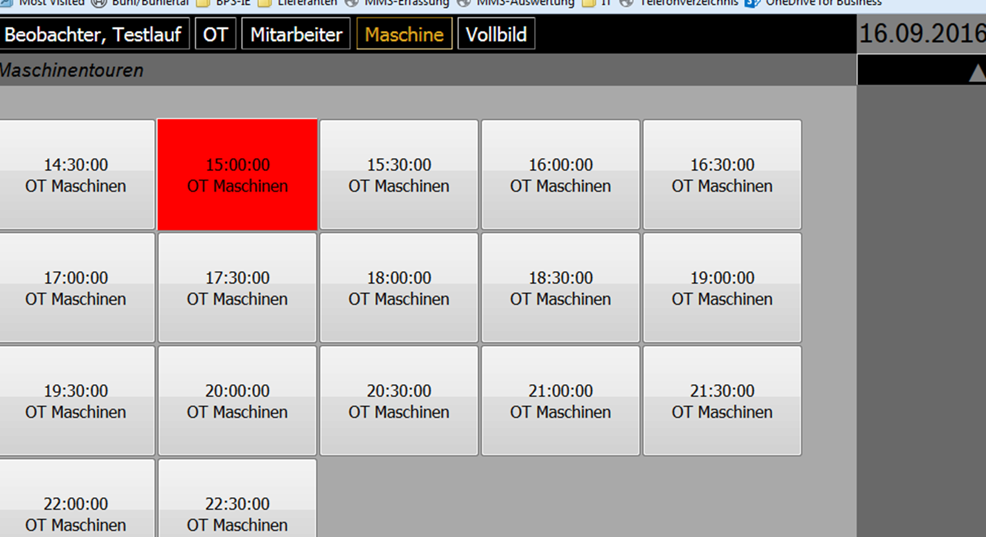
Machine
Here are the different time slots for machine list.
Once the selection of time slot is done, it shows the list of machines .
14
Electrical Drives | BueP/BPS-IE | 201609-23
© Robert Bosch GmbH 2016. All rights reserved, also regarding any disposal, exploitation, reproduction, editing, distribution, as well as in the event of applications for industrial property rights.

Slide 15
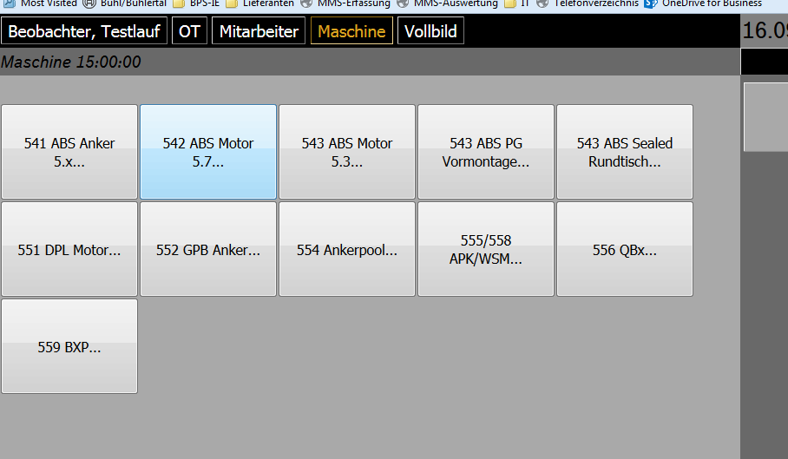
Machine - Lines
This window shows the list of machine lines at particular place
After selecting the proper machine line, it shows the list of machines on that line
15
Electrical Drives | BueP/BPS-IE | 201609-23
© Robert Bosch GmbH 2016. All rights reserved, also regarding any disposal, exploitation, reproduction, editing, distribution, as well as in the event of applications for industrial property rights.

Slide 16
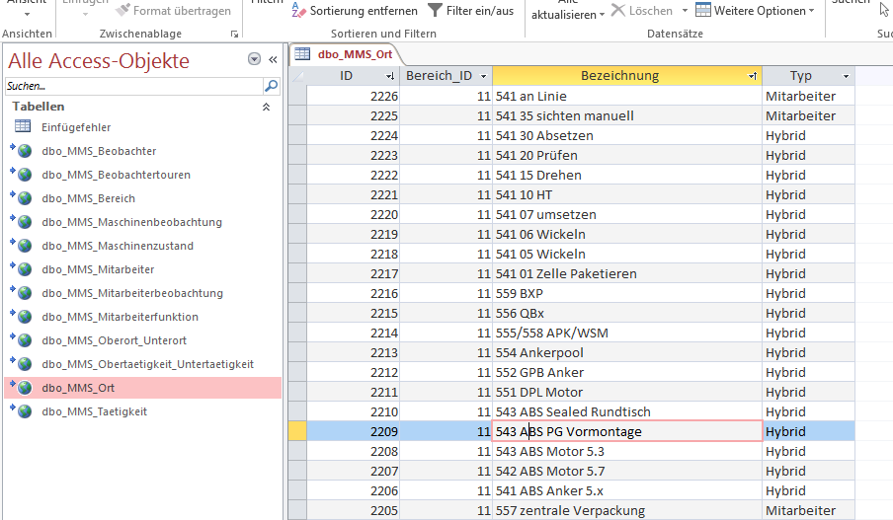
Machine – Lines data table
This table shows the list of machine lines with respective ID with type and place
16
Electrical Drives | BueP/BPS-IE | 201609-23
© Robert Bosch GmbH 2016. All rights reserved, also regarding any disposal, exploitation, reproduction, editing, distribution, as well as in the event of applications for industrial property rights.

Slide 17
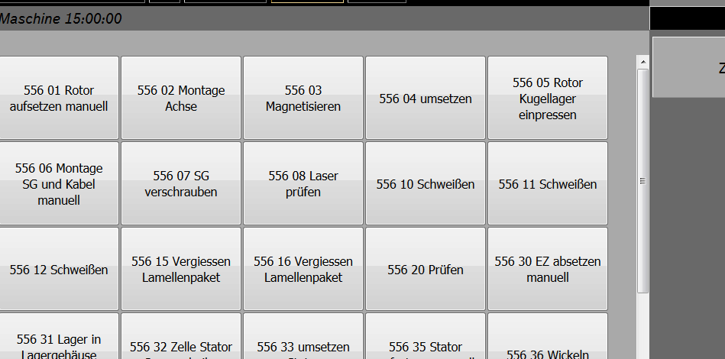
Machines – List
This is the list of machines in the machine line. After selecting the particular machine the list of states of machine will be generated
17
Electrical Drives | BueP/BPS-IE | 201609-23
© Robert Bosch GmbH 2016. All rights reserved, also regarding any disposal, exploitation, reproduction, editing, distribution, as well as in the event of applications for industrial property rights.

Slide 18
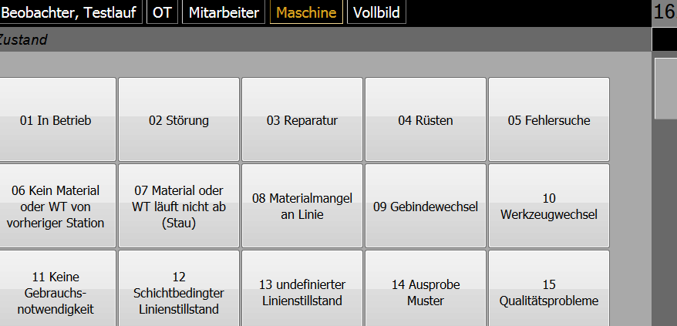
Machine – States list
This shows the list of states of machine
Observer have to select the current state of machine
18
Electrical Drives | BueP/BPS-IE | 201609-23
© Robert Bosch GmbH 2016. All rights reserved, also regarding any disposal, exploitation, reproduction, editing, distribution, as well as in the event of applications for industrial property rights.

Slide 19
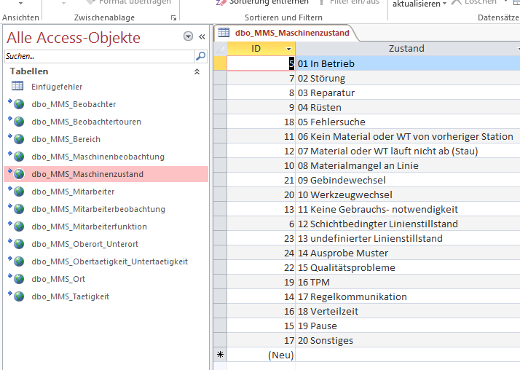
Machine – State data table
This data table shows the list of states of machine with ID
Every state has it’s unique ID
19
Electrical Drives | BueP/BPS-IE | 201609-23
© Robert Bosch GmbH 2016. All rights reserved, also regarding any disposal, exploitation, reproduction, editing, distribution, as well as in the event of applications for industrial property rights.

Slide 20
Machines - Tree structure
The respective ID of place , machine line (Oberort) & machine (Unterort) are saved in the database
Place(Ort)
Machine Line 1
(Oberort)
Machine Line2
(Oberort)
Machine 1
(Unterort)
Machine 2
(Unterort)
Machine 3
(Unterort)
Machine 4
(Unterort)
20
Electrical Drives | BueP/BPS-IE | 201609-23
© Robert Bosch GmbH 2016. All rights reserved, also regarding any disposal, exploitation, reproduction, editing, distribution, as well as in the event of applications for industrial property rights.

Slide 21
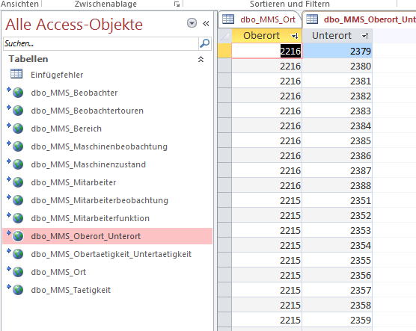
Machines - Tree structure data table
This data table contains the two layers of machine tree structure
This two layers are saved with respective ID in database
21
Electrical Drives | BueP/BPS-IE | 201609-23
© Robert Bosch GmbH 2016. All rights reserved, also regarding any disposal, exploitation, reproduction, editing, distribution, as well as in the event of applications for industrial property rights.

Slide 22
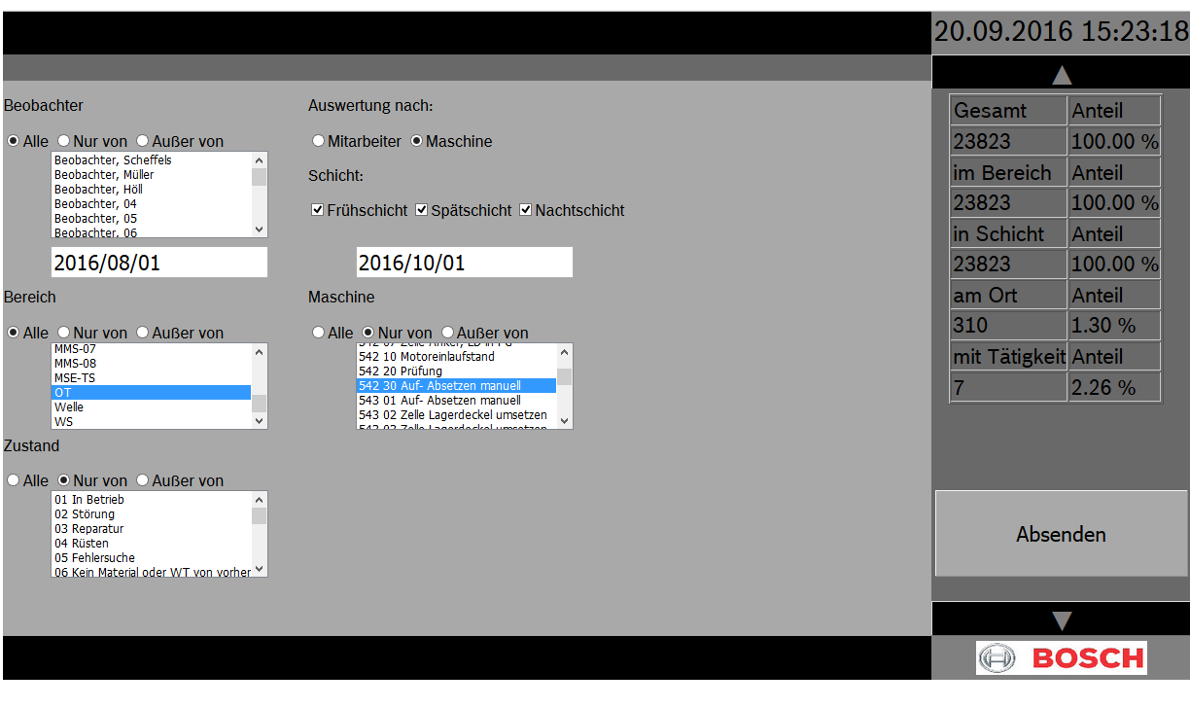
Analysis of data
This is a window for analysis of selected data
Here we can select the different parameters of data to get the analysis
After selecting proper data the analysis is shown on the right side of the window
22
Electrical Drives | BueP/BPS-IE | 201609-23
© Robert Bosch GmbH 2016. All rights reserved, also regarding any disposal, exploitation, reproduction, editing, distribution, as well as in the event of applications for industrial property rights.

