Slide 1
UNIVERSITY PROJECT PRESENTATION
Machine Failure Analysis Platform
A Predictive Maintenance & Industrial Monitoring System built on the AI4I 2020 Dataset
Subal V R
github.com/subal-v-r/Machine-Failure-Analysis

Slide 2
THE CHALLENGE
Problem Statement
Unplanned machine breakdowns disrupt production, increase costs, and create safety risks — yet most maintenance today is still reactive, acting only after a failure occurs.
1
Reactive maintenance is costly
2
No unified monitoring view
Machines are run until failure, resulting in unplanned downtime, urgent repairs, and production loss.
Sensor readings, failure history, and maintenance records are typically scattered across disconnected tools.
3
Multiple failure modes
4
No structured maintenance workflow
Heat Dissipation, Power, Overstrain, Tool Wear, and Random failures each need distinct monitoring signals.
Without a system to log, assign, and track work orders, maintenance response stays informal and inconsistent.
MACHINE FAILURE ANALYSIS PLATFORM
2

Slide 3
GOALS
Project Objectives
1
Build a centralized platform to monitor machine health using the AI4I 2020 dataset.
2
Provide interactive analytics to understand failure patterns and sensor behavior.
3
Enable machine-level exploration of live sensor readings and health status.
4
Integrate an AI Assistant to support maintenance decision-making.
5
Digitize the maintenance workflow — from work order creation to closure.
6
Support preventive maintenance scheduling to reduce unplanned downtime.
7
Secure the platform with authenticated, role-based access for Admin and Employee users.
MACHINE FAILURE ANALYSIS PLATFORM
3

Slide 4
OUR APPROACH
Proposed Solution
A single, secure, web-based platform that unifies monitoring, analytics, AI-assisted diagnosis, and maintenance operations for industrial machines.
Monitoring Dashboard
Data Analytics & Machine Explorer
AI Assistant
Live KPIs and failure/machine-type overview across the entire fleet.
Correlation, distribution, and failure-mode analysis, plus per-machine drill-down.
AI-generated maintenance insights grounded in each machine's live sensor context.
Maintenance Workflow
Secure Access
Centralized Dataset
Work order creation, tracking, and preventive maintenance scheduling.
Username/password authentication with Admin and Employee roles.
Built entirely on the AI4I 2020 Predictive Maintenance dataset.
MACHINE FAILURE ANALYSIS PLATFORM
4

Slide 5
HOW IT WORKS
System Architecture & Workflow
AI4I 2020
Dataset
Authentication
Layer
Application
Backend
Dashboard &
Analytics UI
Maintenance
Workflow
Source data: 10,000 machine records with sensor readings and failure labels.
Login validates user credentials and assigns Admin / Employee access.
Processes machine data, computes health status, and manages work orders.
Presents monitoring, analytics, Machine Explorer, and AI Assistant to users.
Work orders and preventive maintenance actions are logged and tracked.
Data flows from the dataset through authentication into the backend, which powers the dashboard, analytics, AI Assistant, and maintenance workflow modules seen by the end user.
Admin
Employee
Full access — dashboard, analytics, AI Assistant, and maintenance workflow management.
Session-based access to monitoring, analytics, and maintenance workflow features.
MACHINE FAILURE ANALYSIS PLATFORM
5

Slide 6
UNDER THE HOOD
Technology Stack
Data Layer
AI4I 2020 Predictive Maintenance Dataset — 10,000 records, 14 features, powering all analytics and monitoring.
Application Layer
Backend logic that serves machine data, computes health status, and manages authentication and work orders.
Presentation Layer
Interactive web dashboard — monitoring views, analytics charts, Machine Explorer, and maintenance forms.
AI Layer
AI Assistant module that generates maintenance insights using live machine sensor context.
MACHINE FAILURE ANALYSIS PLATFORM
6

Slide 7
SECURE ACCESS
Login & Authentication
Access to the platform is protected by username/password authentication, with session-based access and role separation between Admin and Employee users.
Sign In
Admin
Full platform access, including maintenance workflow management and system-wide analytics.
Username
Employee
Password
Access to monitoring, analytics, and maintenance workflow within a secure session.
Sign In
Session-Based Protection
Once signed in, the session identifies the active user throughout the platform — shown as "Signed in as: Admin" — and restricts pages until a valid login is completed.
Signed in as: Admin
MACHINE FAILURE ANALYSIS PLATFORM
7

Slide 8
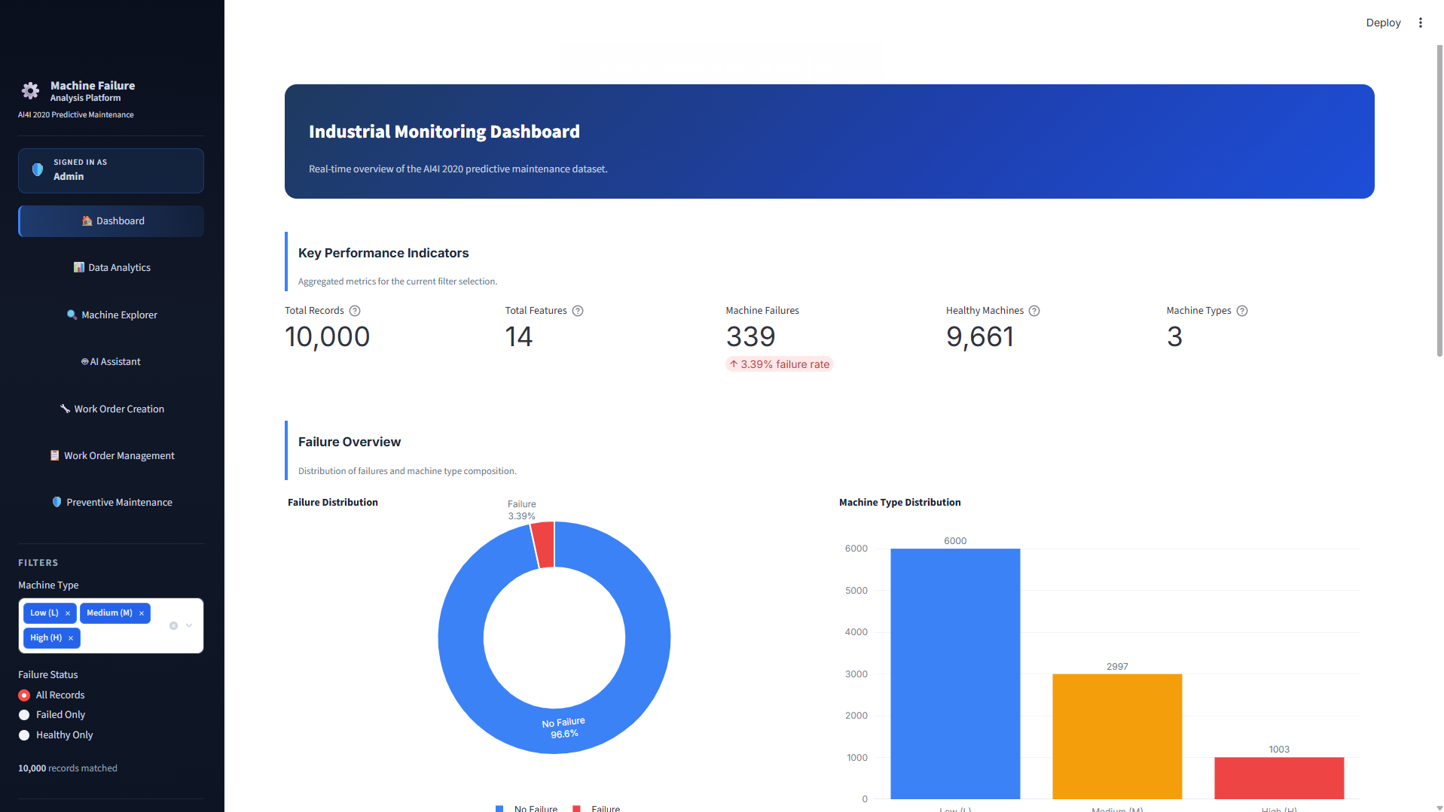
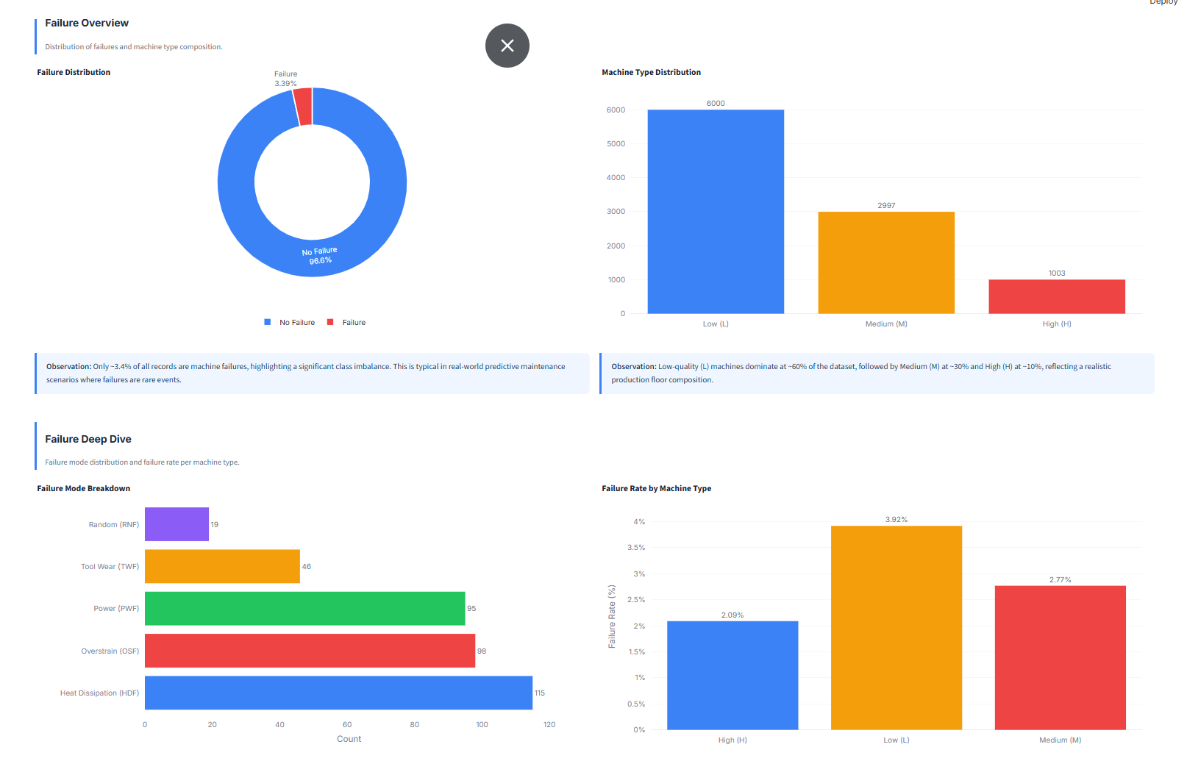
MODULE — MONITORING
Industrial Monitoring Dashboard
A real-time overview of the AI4I 2020 dataset — key performance indicators, failure distribution, and machine-type composition.
MACHINE FAILURE ANALYSIS PLATFORM
8

Slide 9
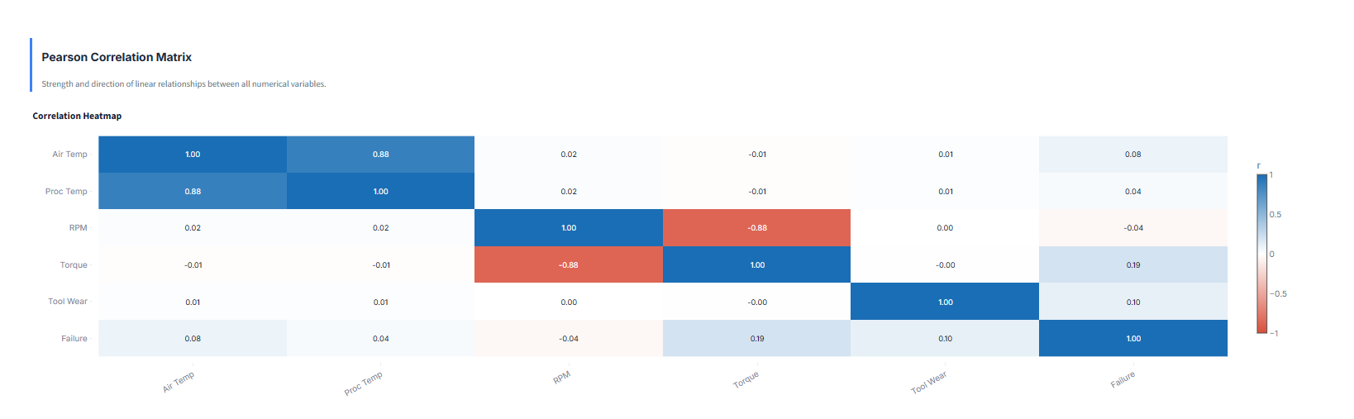
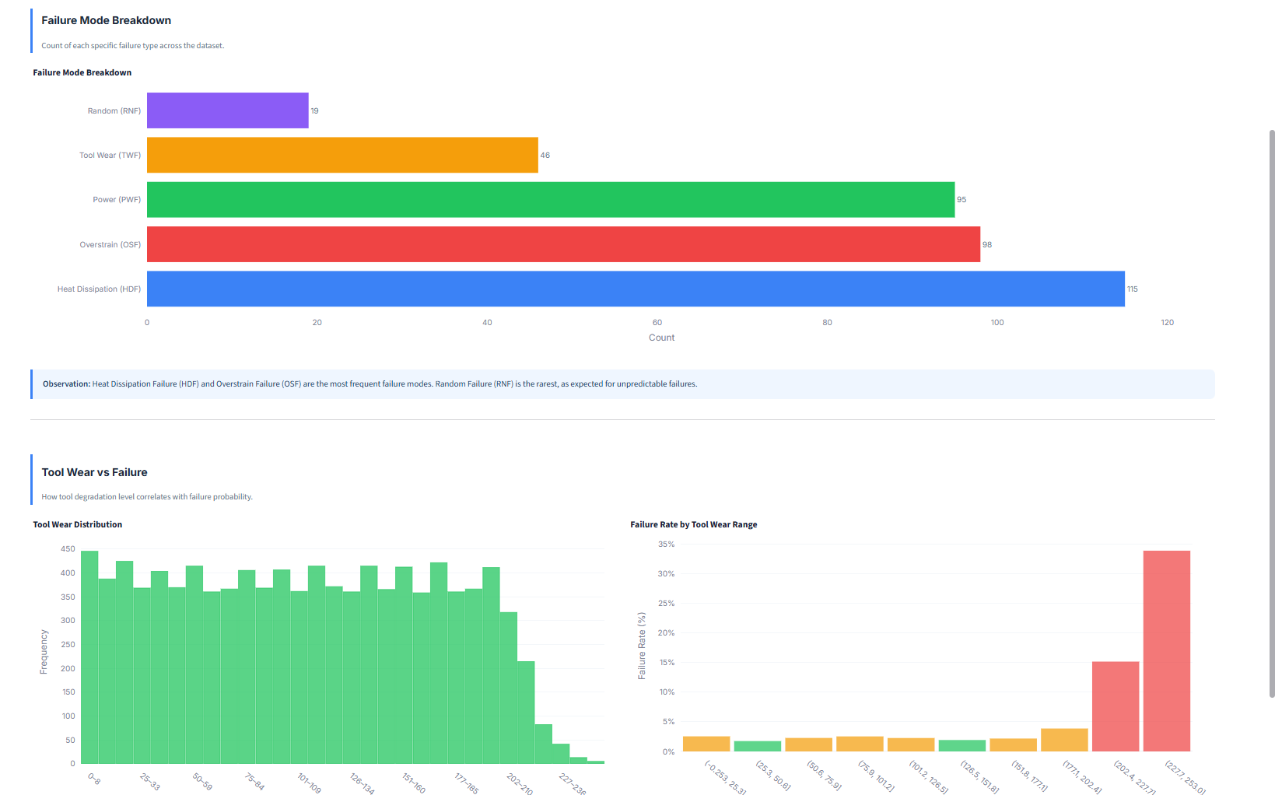
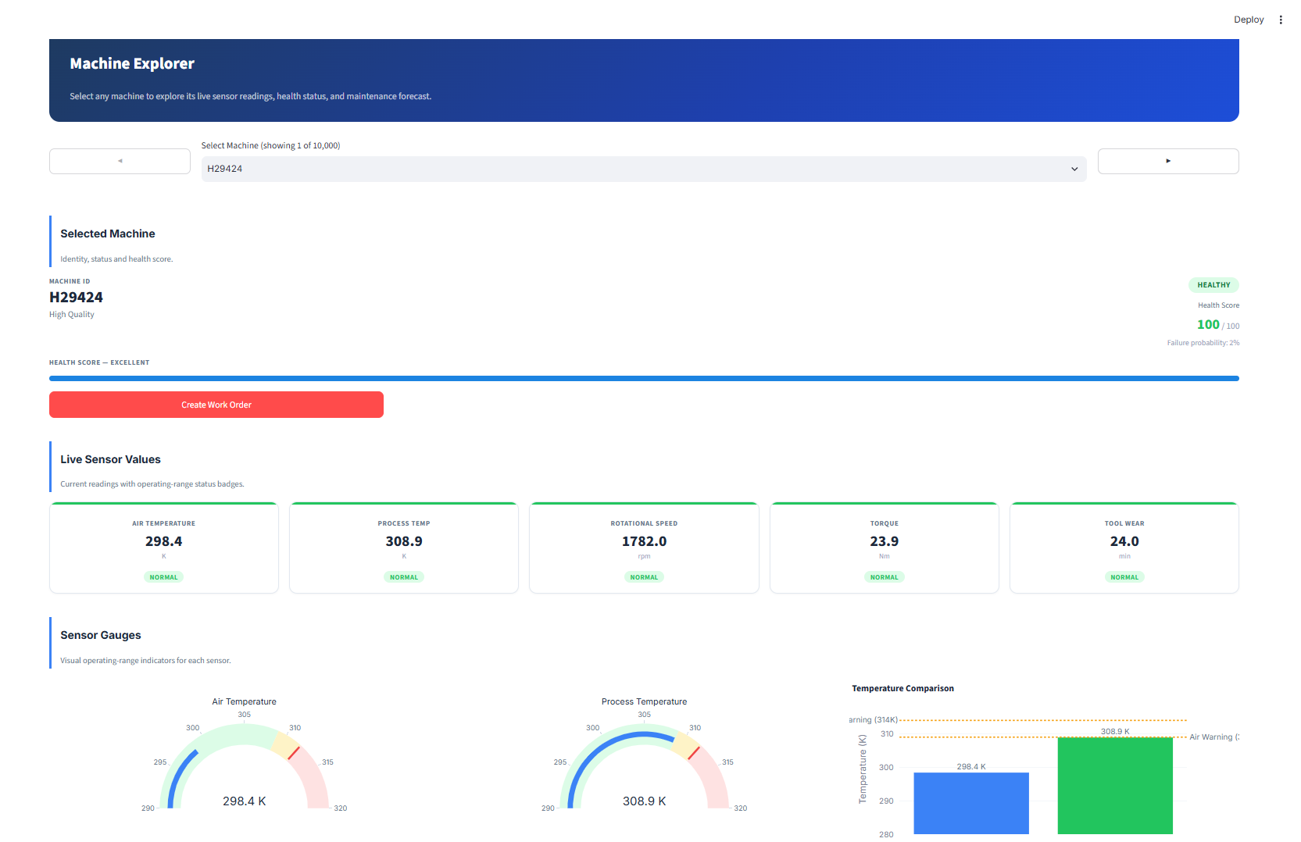
MODULE — ANALYTICS & EXPLORATION
Data Analytics & Machine Explorer
Correlation and distribution analysis across sensors, plus a per-machine explorer for live health and sensor status.
MACHINE FAILURE ANALYSIS PLATFORM
9

Slide 10
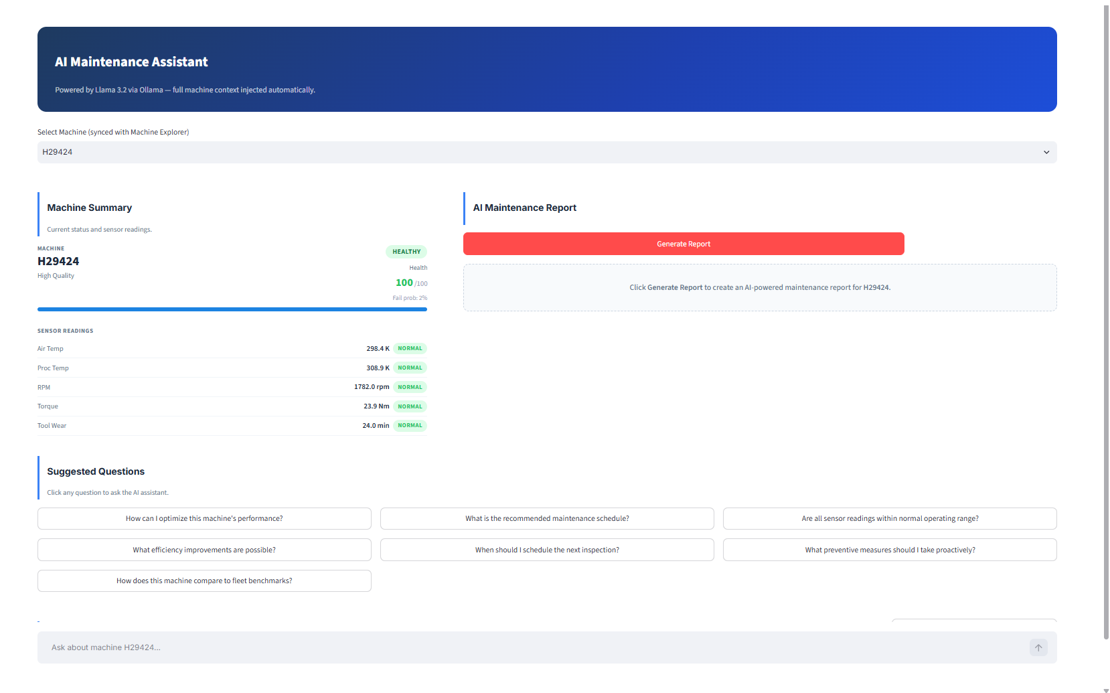
MODULE — AI ASSISTANT
AI-Assisted Maintenance Insights
The AI Assistant uses each machine's live sensor context to help generate maintenance insights and answer technician questions.
MACHINE FAILURE ANALYSIS PLATFORM
10

Slide 11
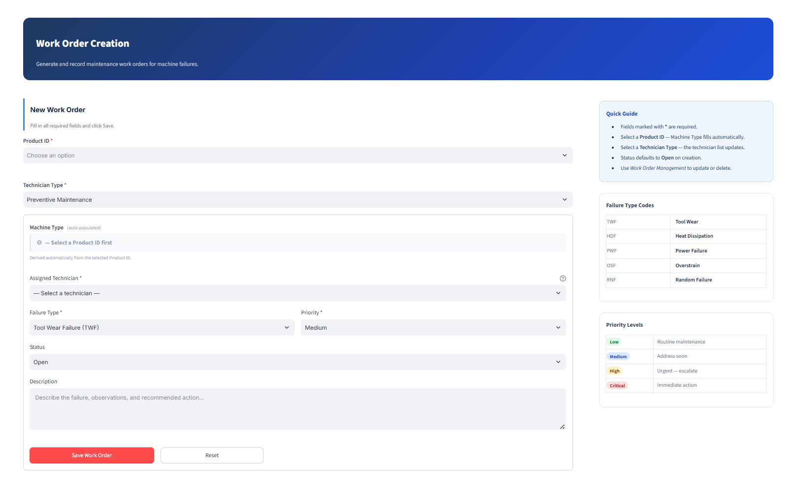
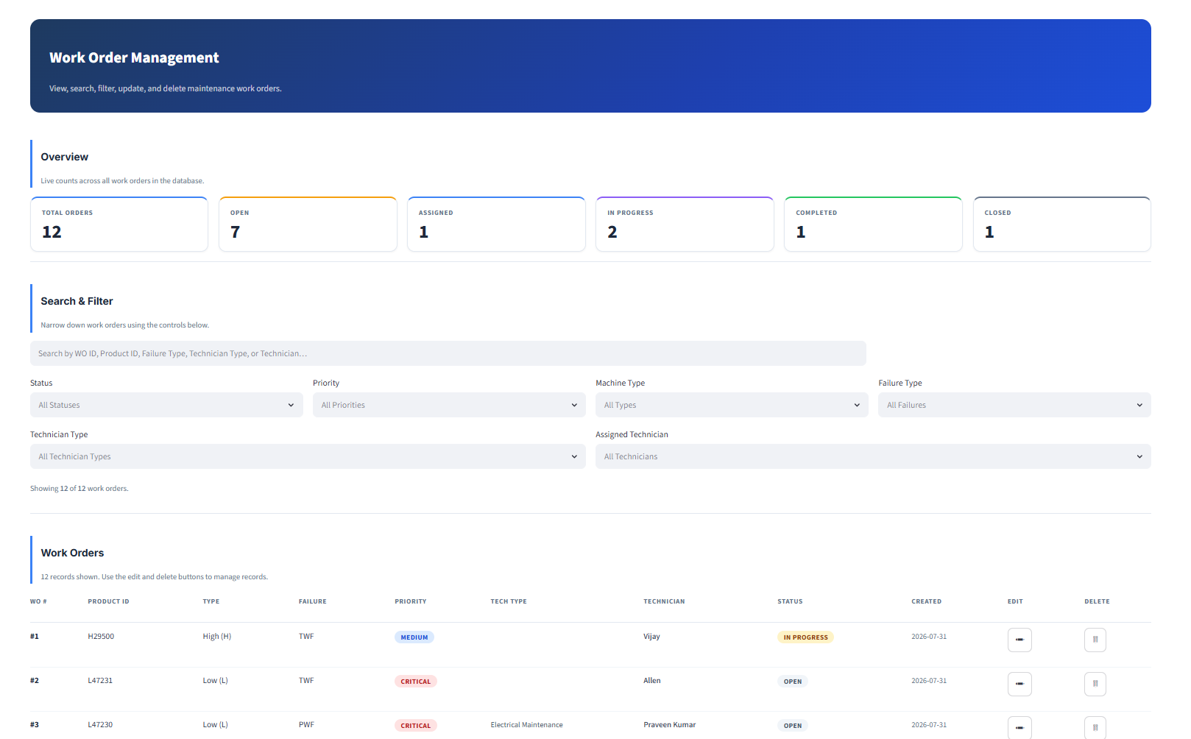
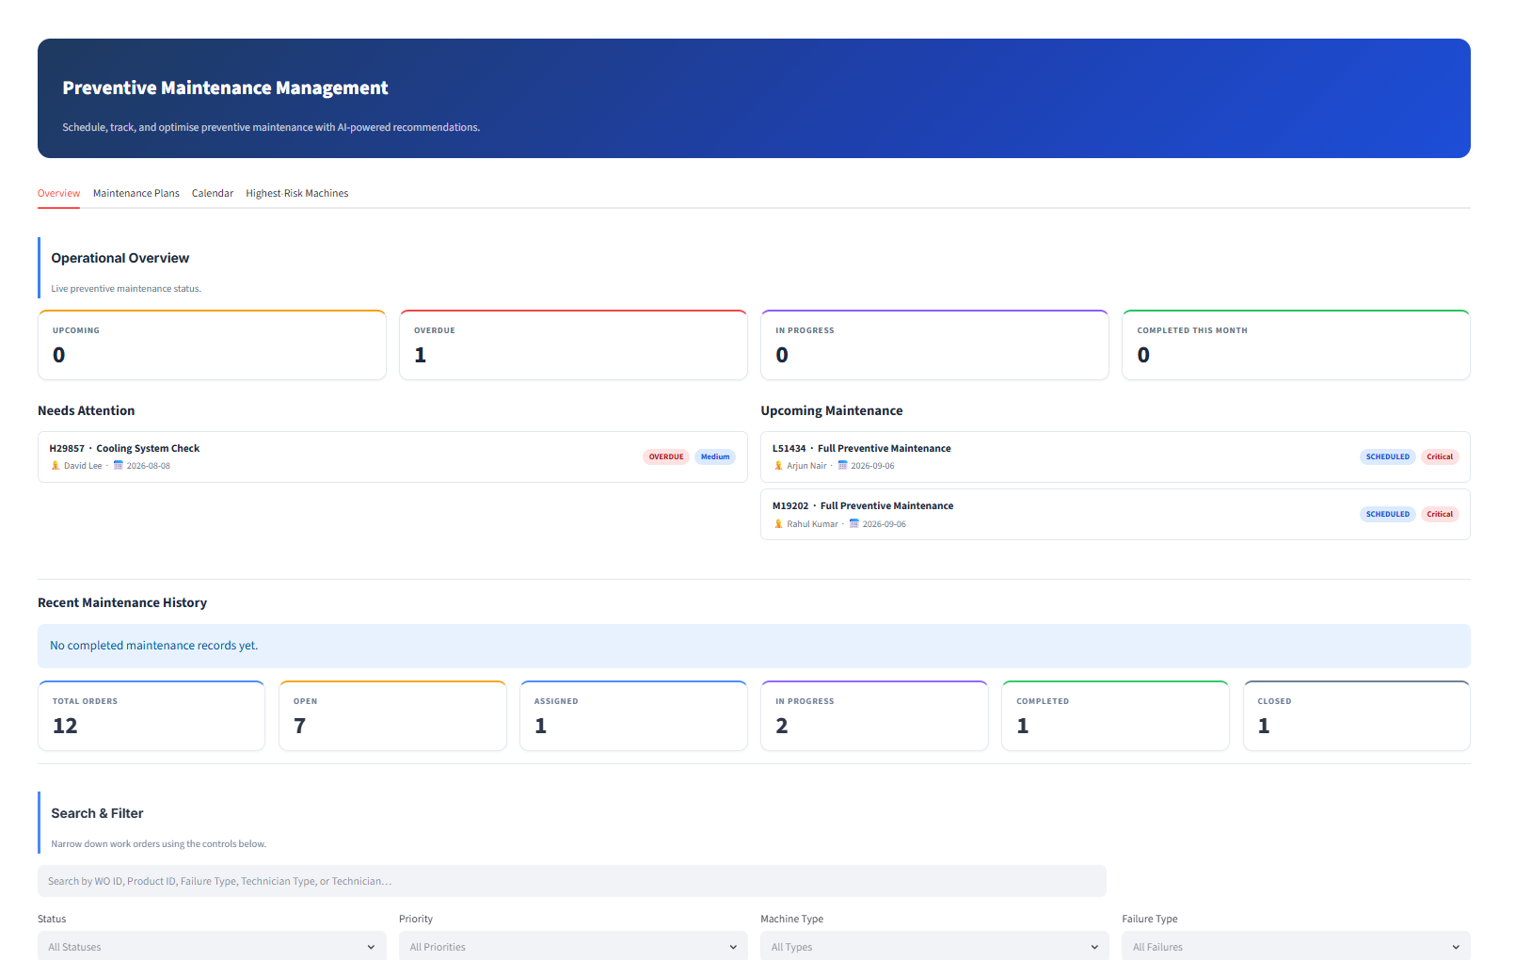
MODULE — MAINTENANCE OPERATIONS
Maintenance Workflow
Work Order Creation, Work Order Management, and Preventive Maintenance form a connected maintenance workflow.
Work Order Creation
Work Order Management
Preventive Maintenance
MACHINE FAILURE ANALYSIS PLATFORM
11

Slide 12
VALUE DELIVERED
Key Features & Benefits
Unified Monitoring
Deep Analytics
Machine-Level Insight
AI-Assisted Diagnosis
Single dashboard view of machine health, failures, and fleet composition.
Correlation and distribution analysis to understand failure drivers.
Explore live sensor readings and health status per machine.
AI Assistant supports maintenance decisions with contextual insights.
Structured Workflow
Preventive Scheduling
Secure Role-Based Access
Centralized Data Source
Work orders move from creation to tracking in one system.
Plan maintenance ahead of failure with a dedicated module.
Admin and Employee roles with session-based protection.
Built entirely on the AI4I 2020 dataset for consistency.
MACHINE FAILURE ANALYSIS PLATFORM
12

Slide 13
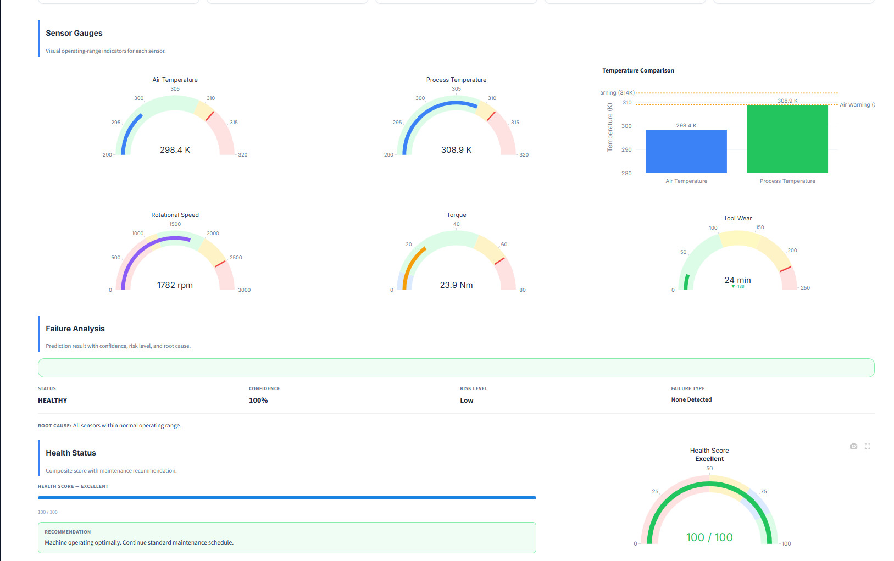
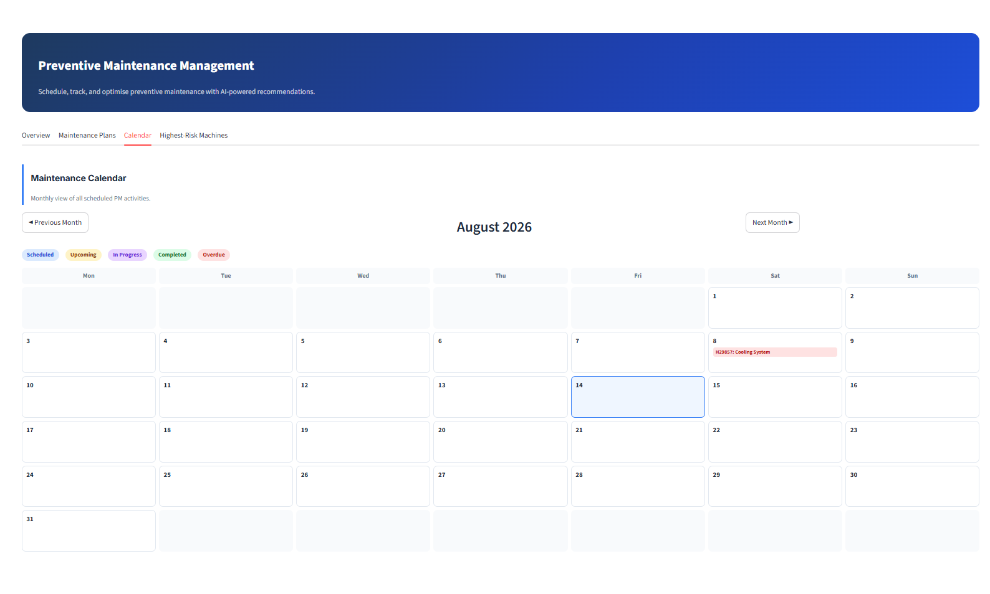
LIVE WALKTHROUGH
Results / Application Demonstration
A snapshot of the platform in action — from monitoring to analytics to maintenance operations.
Monitoring Dashboard
Machine Explorer — Health Status
Preventive Maintenance Calendar
MACHINE FAILURE ANALYSIS PLATFORM
13

Slide 14
WHAT'S NEXT
Future Enhancements
Predictive ML Model
Automated Alerts
Introduce a trained machine-learning model for automated failure prediction.
Notify technicians when a machine's health status requires attention.
Extended Role Management
Historical Trend Reports
Add finer-grained permissions beyond Admin and Employee.
Longer-term reporting on machine health and maintenance history.
Mobile Access
Cloud Deployment
Extend the platform for on-the-floor technician access.
Move the platform to cloud infrastructure for wider accessibility.
MACHINE FAILURE ANALYSIS PLATFORM
14

Slide 15
CONCLUSION
A complete, connected predictive-maintenance platform.
The Machine Failure Analysis Platform brings together industrial monitoring, data analytics, AI-assisted insight, and maintenance workflow management into one secure system — built on the AI4I 2020 Predictive Maintenance dataset — moving maintenance from reactive to proactive.
Monitoring
Analytics
AI Assistant
Workflow
Live fleet-wide visibility
Data-driven failure insight
Context-aware guidance
Structured maintenance ops
Secured throughout by username/password authentication and role-based, session-protected access for Admin and Employee users.
MACHINE FAILURE ANALYSIS PLATFORM
15

Slide 16
Thank You
Questions & Discussion
Machine Failure Analysis Platform — AI4I 2020 Predictive Maintenance
Subal V R
github.com/subal-v-r/Machine-Failure-Analysis

