Slide 1

Operating Systems
Processes
(Ch 4.1)
Department of ISE,PESIT

Slide 2
Processes
“A program in execution”
Modern computers allow several at once
“pseudoparallelism”
A
A
B
C
A
Program
Counter
B
B
Conceptual View
C
C
Time
Department of ISE,PESIT

Slide 3
Processes
“A program in execution”
main() {
...
}
A() {
…
}
main() {
...
}
A() {
…
}
Heap
Stack
A
main
“more” than a program: ls, tcsh
“less” than a program: gcc blah.c
(cpp, cc1, cc2, ln …)
“A sequential stream of execution in it’s own address space”
Department of ISE,PESIT

Slide 4
Process States
Consider:
cat /etc/passwd | grep claypool
Exit
New
Running
Dispatch
I/O Wait
Interrupt
Ready
Waiting
I/O Complete
(Hey, you, show states in top!)

Slide 5
Design Technique: State Machines
Process states
Move from state to state based on events
Reactive system
Can be mechanically converted into a program
Other example:
string parsing, pre-processor

Slide 6
Unix Process Creation
System call: fork()
creates (nearly) identical copy of process
return value different for child/parent
System call: exec()
over-write with new process address space
Shell
uses fork() and exec()
simple!
(Hey, you, show demos!)

Slide 7
Process Scheduler
cat
ls
...
disk
vid
Scheduler
All services are processes
Small scheduler handles interrupts, stopping and starting processes

Slide 8
Process Control Block
Each process has a PCB
state
program counter
registers
memory management
…
OS keeps a table of PCB’s, one per process
(Hey! Simple Operating System, “system.h”)

Slide 9
Interrupt Handling
Stores program counter (hardware)
Loads new program counter (hardware)
jump to interrupt service procedure
Save PCB information (assembly)
Set up new stack (assembly)
Set “waiting” process to “ready” (C)
Scheduler (C)
Newly awakened process
Often called a context-switch
Previously running process

Slide 10
Context Switch
Pure overhead
So … fast, fast, fast
typically 1 to 1000 microseconds
Sometimes special hardware to speed up
Real-Time wants worse case
RT Linux worse case sub 20 microseconds
How to decide when to switch contexts to another process is process scheduling

Slide 11
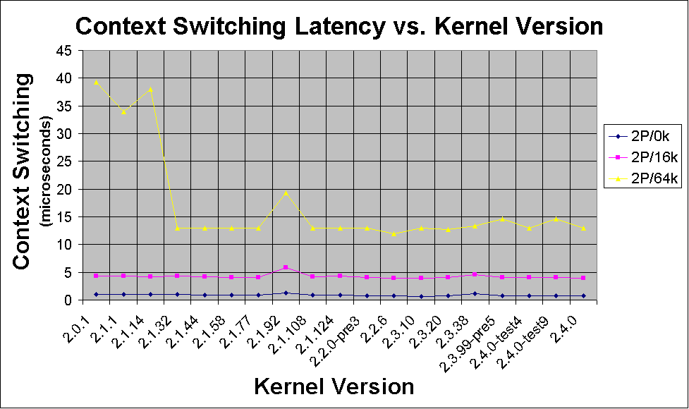
Linux Context Switch Times
Measured
with
LMBench
(http://math.nmu.edu/~benchmark/)

Slide 12
Processes in Linux
PCB is in struct task_struct
states: RUNNING, INTERRUPTIBLE, UNINTERRUPTIBLE
priority: when it runs
counter: how long it runs
Environment inherited from parent
NR_TASKS max, 2048
1/2 is max per user

Slide 13
Processes in NT/2000
States: ready, standby (first in line), running, waiting, transition, terminated
priority - when it runs
Processes are composed of threads
(revisit threads after scheduling)

