Slide 1
Weight Balanced Trees
Dsa project
Done By:
Yash Dodjea -16It149
Srinag Rao – 16IT14
Shreyas S – 16IT135
Bharath Raghunath - !6IT211

Slide 2
Introduction:
In computer science, weight-balanced binary trees (wbts) are a type of self-balancing binary search trees that can be used to implement dynamic sets, dictionaries (maps) and sequences.

Slide 3
HOW it works?
Like other self-balancing trees, wbts store bookkeeping information pertaining to balance in their nodes and perform rotations to restore balance when it is disturbed by insertion or deletion operations. specifically, each node stores the size of the subtree rooted at the node, and the sizes of left and right subtrees are kept within some factor of each other. unlike the balance information in avl trees (which store the height of subtrees) and red-black trees (which store a fictional "color" bit), the bookkeeping information in a wbt is an actually useful property for applications: the number of elements in a tree is equal to the size of its root, and the size information is exactly the information needed to implement the operations of an order statistic tree, viz., getting the n'th largest element in a set or determining an element's index in sorted order.
weight-balanced trees are popular in the functional programming community and are used to implement sets and maps in mit scheme, slib and implementations of haskell.

Slide 4
Description
A weight-balanced tree is a binary search tree that stores the sizes of subtrees in the nodes. That is, a node has fields
Key, of any ordered type
Value (optional, only for mappings)
Left, right, pointer to node
Size, of type integer.

Slide 5
By definition, the size of a leaf is zero. The size of an internal node
(size[n] = size[n.Left] + size[n.Right] + 1)
Based on the size,
Weight[n] = size[n] + 1
A node is α-weight-balanced if weight[n.Left] ≥ α·weight[n] and weight[n.Right] ≥ α·weight[n]
A < 1 – 1/1.414
Larger values of a produce a more balanced tree
On calculating the
Height is less than and equal to o(log n )

Slide 6
INSERTIOn
Suppose we already have a weight-balanced BST. Insertion begins as in basic bsts: attempt a lookup, if it fails and stops at node u (say), then add a new node as a new child of u. Now each ancestor of u may become unbalanced.
To fix this, for each node v from u to the root, in bottom-up order, we will check the balancing condition; where it is broken, we will perform a “rotation” to restore balance.
There are two cases v can be unbalanced, and they are mutually exclusive: either
Size(v.Left) + 1 > (size(v.Right) + 1) × 3
Or
(Size(v.Left) + 1) × 3 < size(v.Right) + 1

Slide 7
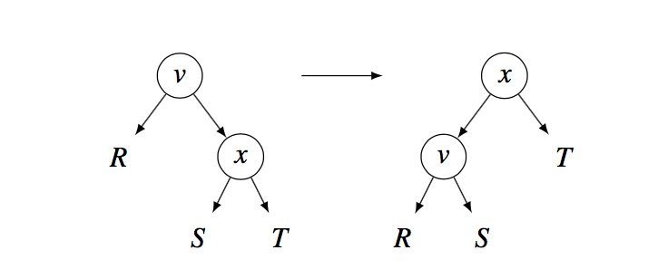
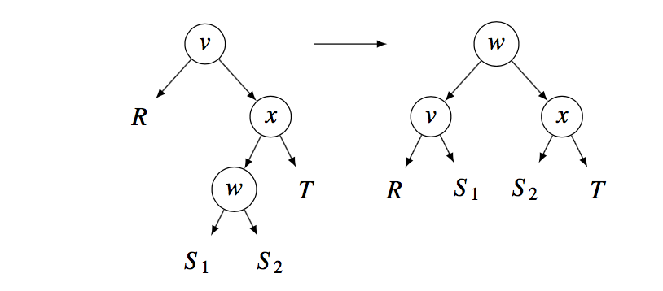
Subcase 1 “single-rotation”: this happens when
Size (x.Left) + 1 < (size( x.Right ) + 1) × 2
Subcase 2 “double-rotation” this happens when
Size ( x.Left ) + 1 ≥ (size ( x.Right ) + 1) × 2

Slide 8
DELETION
Suppose we already have a weight-balanced BST. Deletion begins as in basic bsts: perform a lookup, find the key at node v (say), then there are two cases:
1: suppose we already have a weight-balanced BST. Deletion begins as in basic bsts: perform a lookup, find the key at node v (say), then there are two cases:
2: v has two children, so replace its key by v’ ’ s successor w (say), prune w instead and promote w’’ s child, but now w’’ s ancestors may become unbalanced.
To restore balance, we check the balancing condition bottom-up and apply rotations, starting from the pruned node’s parent, ending at the root. We use the same case analysis and rotation scheme from the previous section.
The proofs that the rotations really restore balance are similar to those in the previous section, but there is a difference: this time it is the smaller subtree that had one more node before deleting, rather than the bigger subtree that had one fewer node before inserting.

Slide 9
Applications of WBT :
Kth largest element:
WBT trees are used to find the k’th largest element in a set of unordered elements.
The size attribute in a wbt tree indicates the number of elements in left , right subtree including its own node. This attribute unique to WBT tree is used to find the k ‘th largest element.
Algorithm:
We tackle this problem using recursion:
If the size of left subtree is greater than k then we know that the kth largest elemnt is in left subtree,hence we recursively call the function from the left subtree.
Else we know that it is the right subtree and we recursively call the function on the right subtree but by reducing k to number of elements we have jumped over by going further right of the tree.
If we are able to find an element with size of left subtree lesser than k by one,then we know that,this is the kth largest element.
Running time-o(logn)

Slide 10
Dictionaries:
WBT trees are used to make dictionaries ,in which there is a key,value relation,used to store information.
Operations associated with dictionaries data type allow :
The addition and removal ,modification of a pair to the collection
The lookup of a value associated with a particular key
We implement this similar to a hashmap but we use a WBT tree instead of a linked list for storing elements hashed to the same value.Although the insert in WBT hashmap is more costly than hashmap using linked list.It pays of as search is more efficient and faster in WBT tree than a linkedlist.
Hence this can be used where searches are done more often than insert.
Insert-o(nlogn)
Search-o(logn)

Slide 11
Dynamic sets :
They are used to implement dynamic sets and to perform set operations like union ,intersection in functional programming
A dynaset (short for dynamic set) is a set of data that is dynamically linked back to the database.
Instead of having the query result stored in a temporary table, where the data cannot be updated directly by the user, the dynaset allows the user to view and update the data contained in the dynaset. Thus, if a university lecturer queried all students who received a distinction in their assignment and found an error in that student's record, they would only need to update the data in the dynaset, which would automatically update the student's database record without the need for them to send a specific update query after storing the query results in a temporary table.

Slide 12
THANK YOU

