Slide 1
Team & Solution Overview
• Team: EduMiners
• Members: Shreyas S K, Vaishnavi S B
• Challenge area: Weak foundational maths in rural Karnataka government schools (grades 4–6)
• One-line solution: We combine contest scores with health and Class-10 data to find which districts are falling behind — and flag the ones where schools need the most help.
• Contact: skshreyas714@gmail.com
Evaluation: Depth of analysis | Policy relevance | Cross-dataset analysis | Innovation | Clarity of insights | Visualisation & presentation

Slide 2
Problem Statement
• Educational challenge: Rural maths is stuck — only about 53% of answers are correct, and it stays flat from grade 4 to 6. The big differences are between districts, not within them.
• Objectives: Find where the gaps are (by district, gender, and topic) and see if health and Class-10 results help explain them.
• Key questions: Which districts are weakest? What explains it? Which districts do worse than their background would suggest?
• Why it matters: Helps send limited time and money to the districts and topics that can improve the most.
Evaluation: Depth of analysis | Policy relevance | Cross-dataset analysis | Innovation | Clarity of insights | Visualisation & presentation

Slide 3
Dataset Understanding
• Dataset summary: Akshara GP Maths Contest — 1.38M students, grades 4–6, 2022–23 to 2024–25, 31 districts
• Variables: Q1–Q20 (0/1) → score; geography District, Block, Cluster, GP, Gender
• Context data: NFHS-5 (health/development) + SSLC 2025 Class-10 maths pass%
• Cleaning & assumptions: Composite GP key, dynamic competency-header detection; NFHS/SSLC links are district-level
Evaluation: Depth of analysis | Policy relevance | Cross-dataset analysis | Innovation | Clarity of insights | Visualisation & presentation

Slide 4
Analytical Approach
• Workflow: EDA (accuracy, trends, gender, competency, NFHS correlation) → diagnostic model with residual segmentation → SSLC cross-board check → dashboard
• Methods: Student-weighted district accuracy; Spearman rank correlations vs NFHS & SSLC
• Models: OLS on one standardized development index (3 collinear NFHS features)
• Validation: reproducible (seed 42); accuracy aggregated to NFHS
Evaluation: Depth of analysis | Policy relevance | Cross-dataset analysis | Innovation | Clarity of insights | Visualisation & presentation

Slide 5
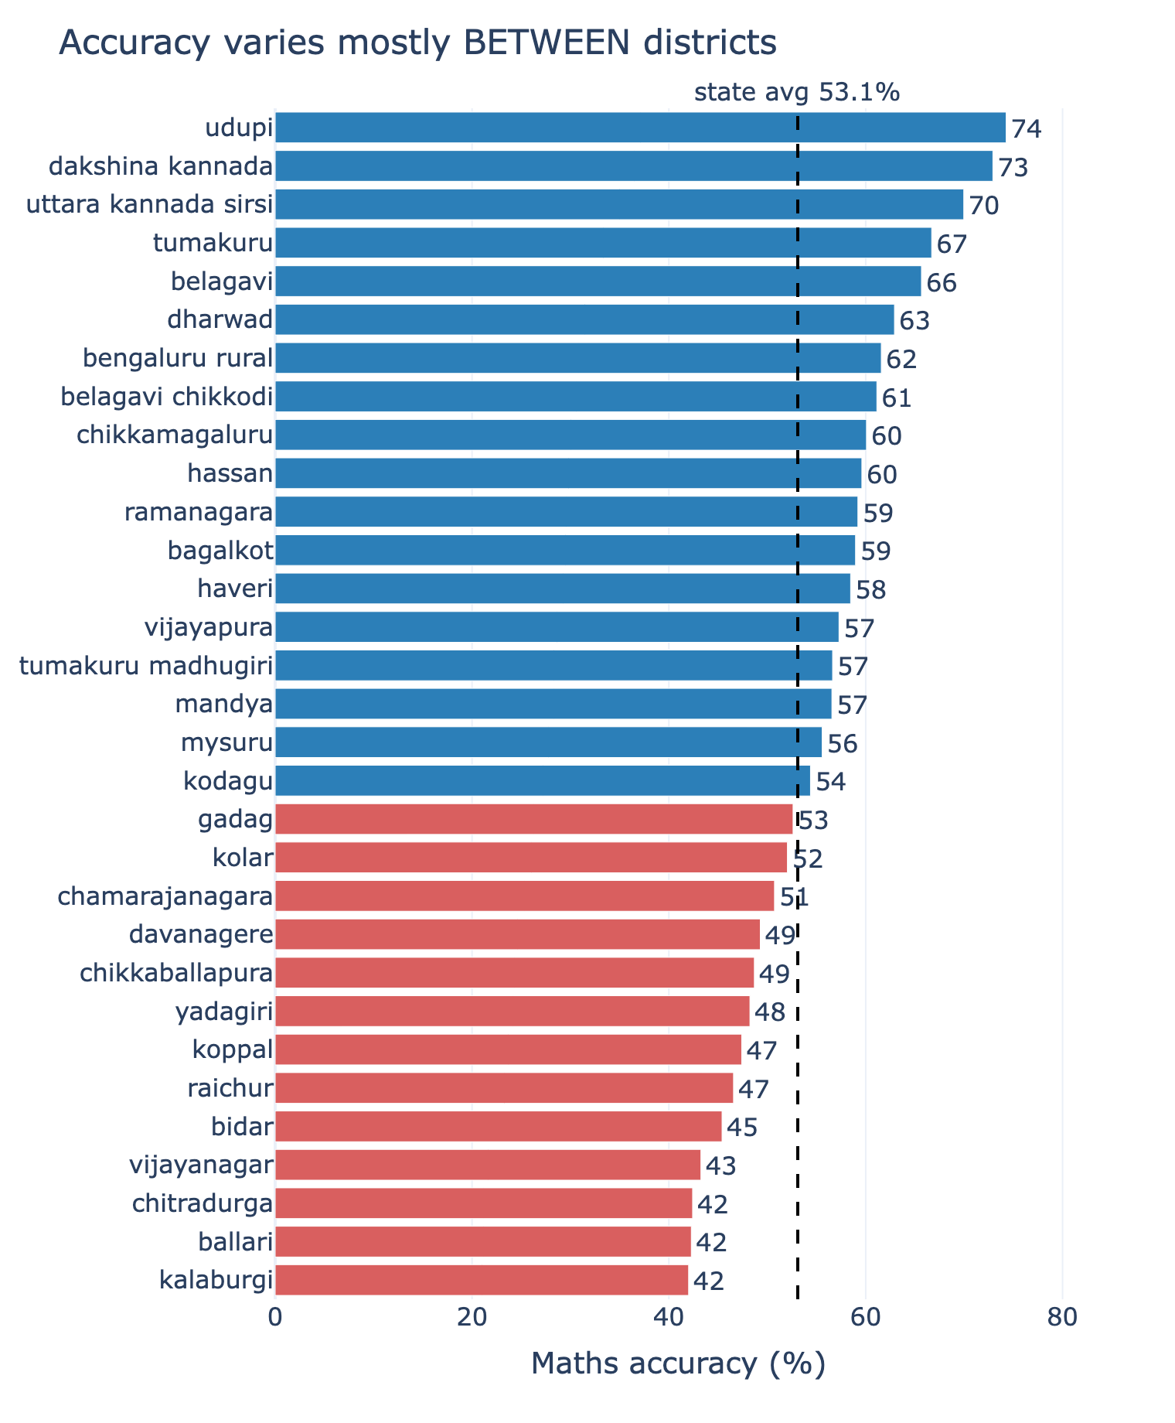
Key Insight 1
• Finding: Overall accuracy ~53%, flat across grades 4/5/6, and declining year-on-year
• Evidence: Kalyana-Karnataka belt (Kalaburgi, Raichur, Bidar, Ballari) uniformly low; Dakshina Kannada consistently high
• Interpretation: Variation is between districts, not within → a district-targeted response fits the data
Blue = above the 53.1% state average, red = below. Top vs bottom differ ~30 points: the achievement gap is mainly BETWEEN districts, not within a grade.
Evaluation: Depth of analysis | Policy relevance | Cross-dataset analysis | Innovation | Clarity of insights | Visualisation & presentation

Slide 6
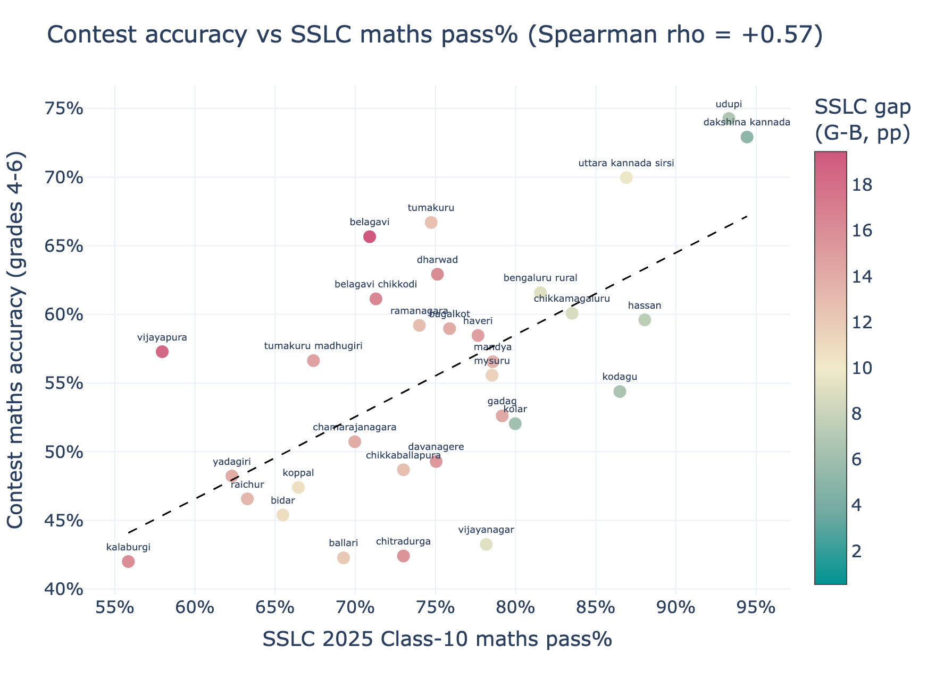
Key Insight 2
• Finding: District maths gaps are structural, they track development and persist to the Class-10 board
• Evidence: NFHS Spearman ~+0.6 (female schooling, sanitation, women's 10-yr schooling); SSLC maths pass% ρ = +0.57
• Implications: Early rural maths gaps foreshadow board outcomes ~4–6 years later in the same districts
Each dot = a district. Up-right trend (Spearman rho +0.57) means the Grade 4-6 contest agrees with the independent Class-10 board exam 4-6 years later. Colour = SSLC girls-boys gap.
Evaluation: Depth of analysis | Policy relevance | Cross-dataset analysis | Innovation | Clarity of insights | Visualisation & presentation

Slide 7
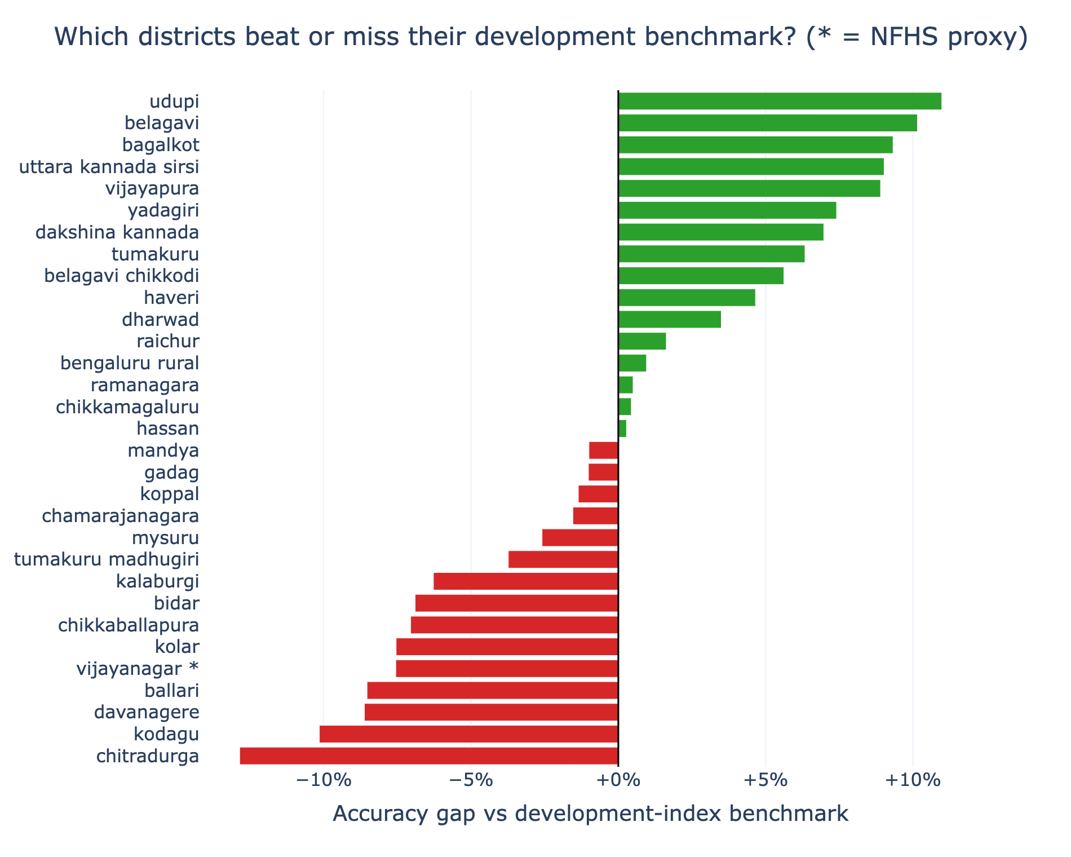
Predictive / Diagnostic Analysis
• Model: OLS of district accuracy on a standardized development index (n = 31 districts)
• Metrics: R² = 0.43; +1 SD of the development index ≈ +5.9 pp accuracy
• Inputs: female schooling (6+), household sanitation, women's 10-yr schooling -> one development index
• Under-performers (actual < predicted): chitradurga -12.8 pp, kodagu -10.1, davanagere -8.6
Gap = actual - development-predicted accuracy. Green districts beat their context; red fall short (a fair 'look here' list). * = NFHS proxy district.
Evaluation: Depth of analysis | Policy relevance | Cross-dataset analysis | Innovation | Clarity of insights | Visualisation & presentation

Slide 8
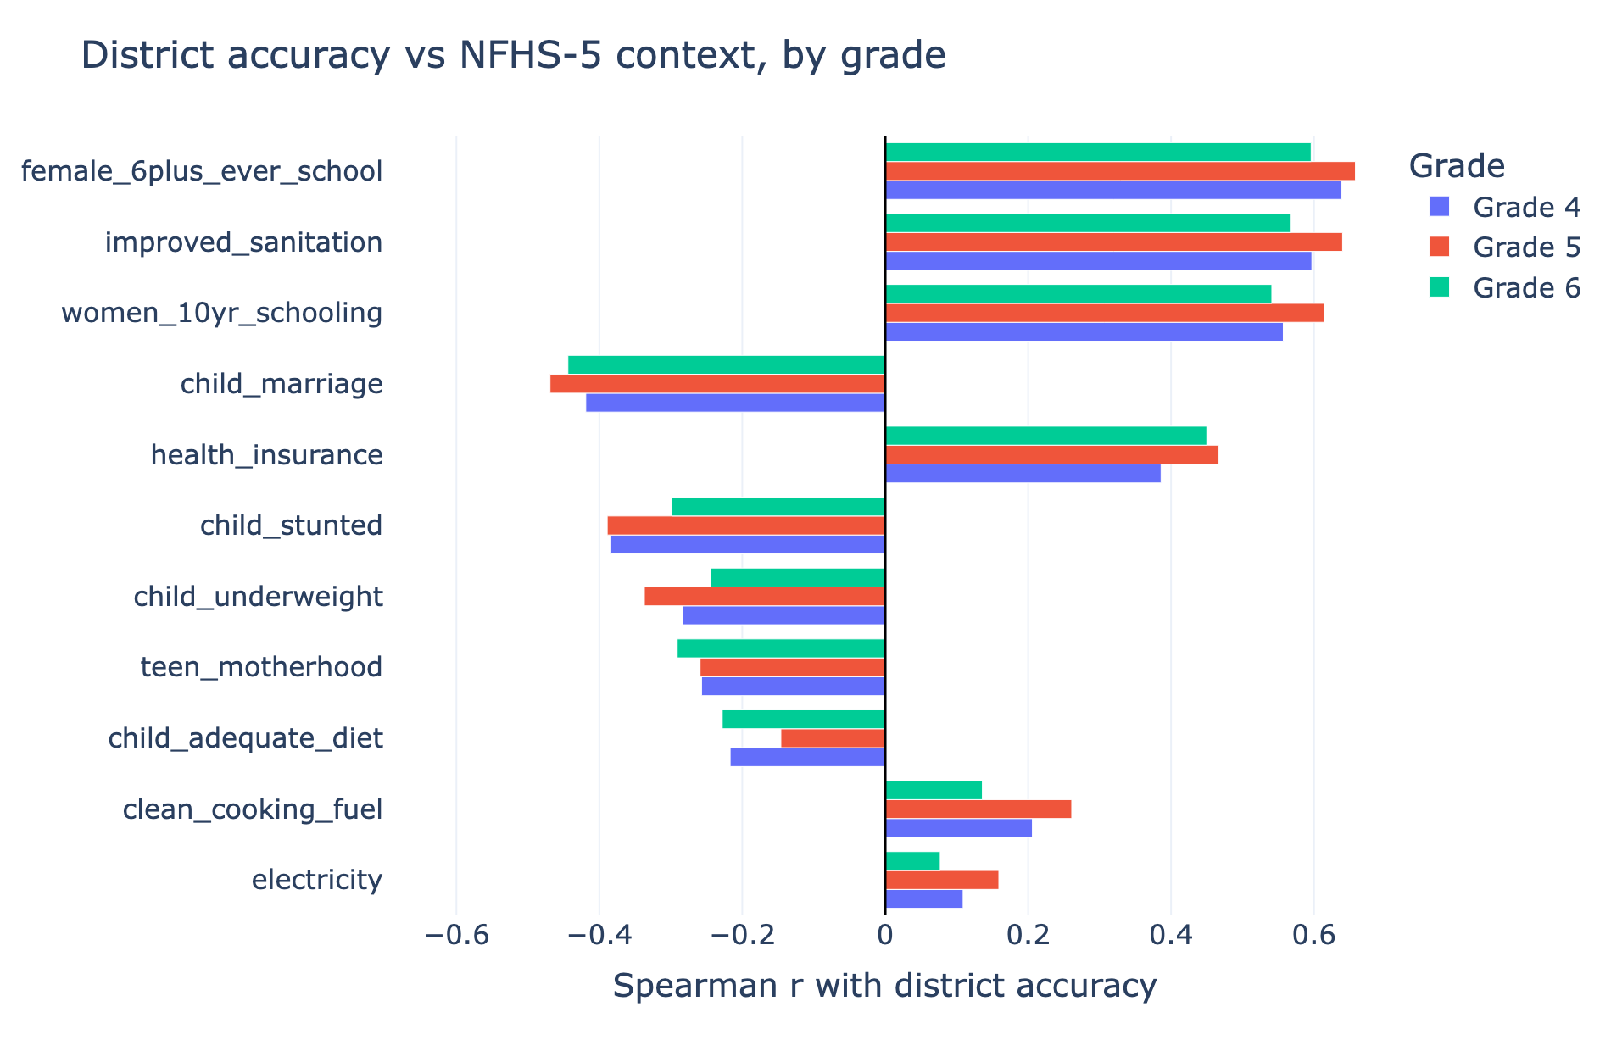
Visualization / Dashboard
• KPIs: 53.1% overall accuracy | 31 districts | SSLC ρ +0.57 | model R² 0.43
• Charts: grade/year trend, gender gap, NFHS correlation bars, SSLC scatter, district residual-gap ranking
Spearman correlation of district accuracy with each NFHS-5 indicator, by grade. Positive bars (schooling, sanitation) help; negative bars (child marriage, stunting) are headwinds.
Evaluation: Depth of analysis | Policy relevance | Cross-dataset analysis | Innovation | Clarity of insights | Visualisation & presentation

Slide 9
Recommendations and Road Map
• Priority actions: Focus school-side support on negative-residual districts (they under-perform their development context)
• Impact: Directs limited resources where health/development does not explain the gap
• Feasibility: Uses only public district data; one reproducible pipeline reruns each contest year
Evaluation: Depth of analysis | Policy relevance | Cross-dataset analysis | Innovation | Clarity of insights | Visualisation & presentation

Slide 10
Innovation & Impact
• Novelty: Contest ↔ NFHS ↔ SSLC triangulation + residual-gap targeting of districts
• Scalability: Crosswalk + pipeline are reusable for every new contest year and district
• Limitations: Ecological (district-level) inference; SSLC cohort differs ~4–6 yrs; small coastal n
• Expected impact: Sharper, evidence-based prioritisation for foundational-maths intervention
Evaluation: Depth of analysis | Policy relevance | Cross-dataset analysis | Innovation | Clarity of insights | Visualisation & presentation

Slide 11
Conclusion & Key Takeaways
• Top takeaways: Gaps are between-district & structural. development explains ~43%; the residual gap is an action list
• Next steps: Competency-level drill-down; validate priority districts on the ground
Evaluation: Depth of analysis | Policy relevance | Cross-dataset analysis | Innovation | Clarity of insights | Visualisation & presentation

