Slide 1
Group 4-Recipe Project
Team Members:
Areej Alhazmi
Jason Lill
Rajashree Maiya
Shreya Thacker

Slide 2
DTD Overview
DTD defines structure , elements and attributes of an XML document
Declared two parameter entities and an internal general entity

Slide 3
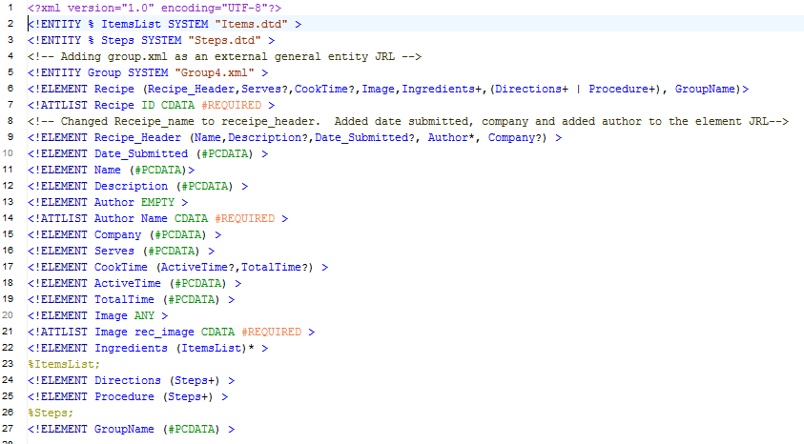
Recipe.dtd

Slide 4
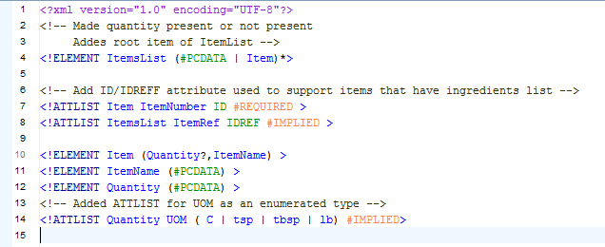
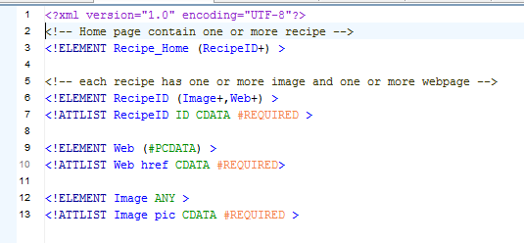
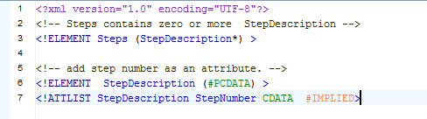
Items.dtd
Homepage.dtd
Steps.dtd

Slide 5
Home Page
Recipes:
Banana Bread
Calamari
Chicken Chimichangas

Slide 6
General Entity
Entities are used to define shortcuts to special characters
It can be declared as internal or external
It cannot be used in XML context
We have declared an Internal General Entity

Slide 7
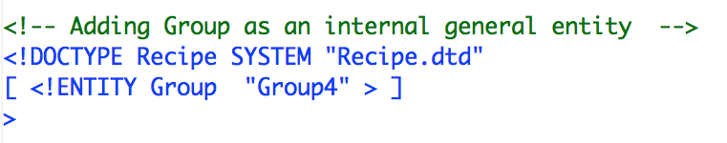
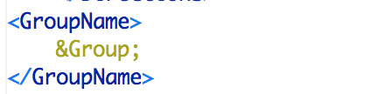
Recipe.dtd including Internal General Entity
Referencing Internal General Entity

Slide 8
Adding an Image file
The image element can refer to raster image files such as PNG, JPG, JPEG and SVG format files
Various attributes can be chosen like width, height
We have included JPG image file formats

Slide 9
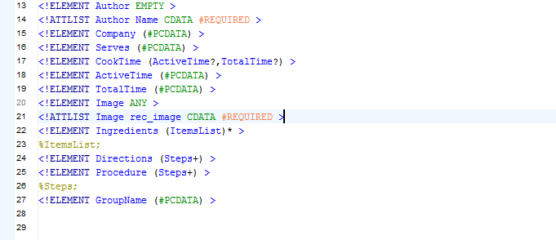
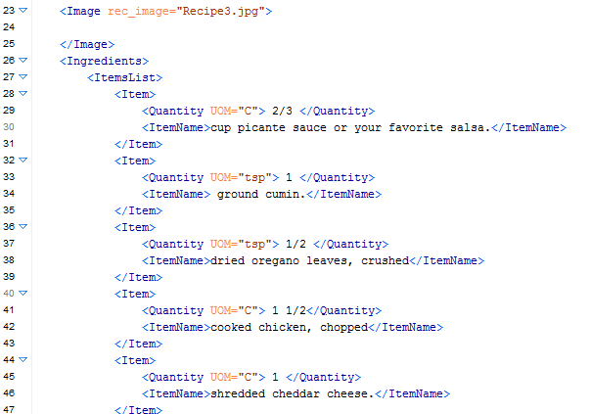
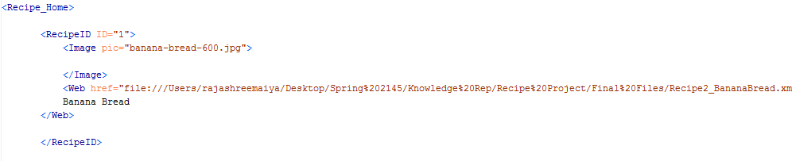
Recipe.dtd
Chicken Chimichangas.xml
Recipe.xml

Slide 10
Mixed Content
A mixed complex type element can contain attributes, elements and text

Slide 11
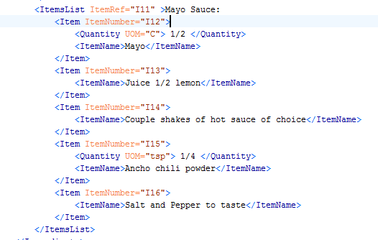
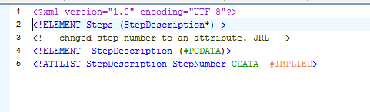
Calamari.xml
Steps.dtd

Slide 12
ID/IDREF Attributes
ID represents a unique ID name for the element
IDREF is a ID of another element
Used to show hierarchical structure of elements within a document

Slide 13
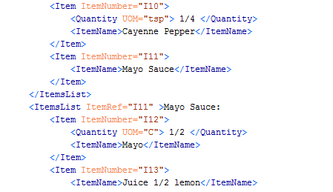
Items.dtd
Calamari.xml

Slide 14
Parameter Entities
Definition is similar to those of general entities
But these can be used only within an XML context
We have declared 2 parameter entities:
Items
Steps

Slide 15
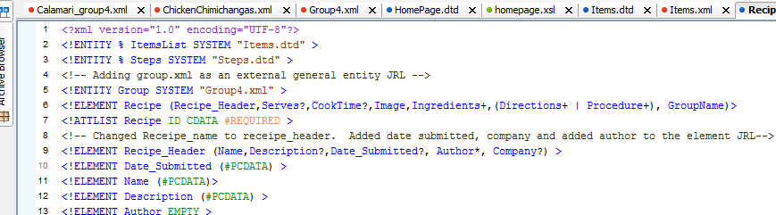
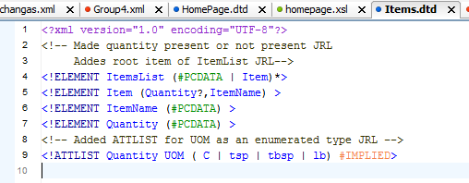
Recipe.dtd including Parameterized Entity
Items.dtd
Steps.dtd

Slide 16
Enumerated Attributes
Used when you want the attribute value to be one of a fixed set of legal values
Declared enumerated attributes for ATTLIST Quantity listing:
C, tsp, tbsp and lb

Slide 17
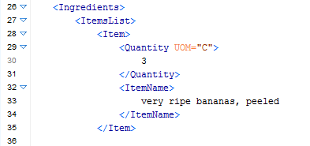
UOM as enumerated attribute in Items.dtd
Items.dtd

Slide 18
Empty Element
An element with no content is said to be empty
We have declared Author as EMPTY Element
An empty element can have attributes in them

Slide 19
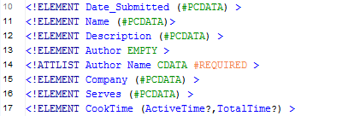
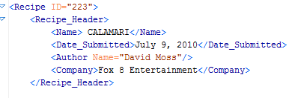
Recipe.dtd
Calamari.xml

Slide 20
Quick Demo

