Slide 1

Pastry
Team: Forever
Praveen Balireddy (2018201052)
Aman Joshi (2018201097)
Shubham Rawat (2018201098)
Harish Datla (2018201026)

Slide 2
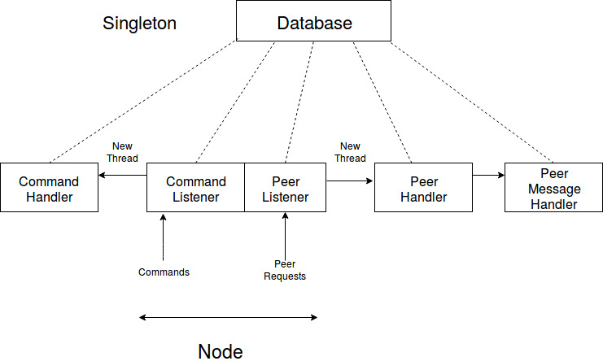
Architecture

Slide 3
Node Structure
IPv4(String)
Port(String)
Node ID(String): md5 hash value of IP+Port
Proximity(Int): Ping Time for this node
Leaf Set(Pair<Set,Set>): Set of Nodes closest to the current node in terms of NodeID
Routing Table(vector<vector>): Nodes in the ith row have i length prefix match with the current NodeID
Neighbourhood Set(Set): Set of Nodes closest to the current node in terms of Proximity
HashTable: To store Key, Value pairs locally

Slide 4
Key Classes
Database: Singleton object to store all the Node relevant data like Routing tables, etc (contains locks for mutual exclusion)
LogHandler: Singleton object to write to Log Files (LogError/LogMsg)
Printer: Print Output/Error to console
Network Interface: Interface between application and network(Write to/Read From network)

Slide 5
Message Types
Used Protocol Buffers for message serialization and de-serialization
JoinMe: Sent when a new node joins a network
Join: Routed through the network while a new node joins
RoutingUpdate: Updates sent by other nodes while joining the network
AllStateUpdate: Update sent to all the nodes in the routing tables
AddToHashTable: To add relevant key, value pairs to the Node
SetValue: Store Key Value pair
GetValue: Get Value of the given key
DeleteNode: Delete the node entry from the routing tables
Shutdown: Shutdown the pastry network

Slide 6
Routing Algorithm
Route ( Destination node):
Check if the destination node is within the range of the leafsets.
If yes then we can reach the destination in one hop.
Suppose ‘p’ is the length of the matched prefix between destination node and current node. Also let ‘i’ be the pth value in destination node id.
Check if, entry for pth row and ith column is not NULL.
If it is not NULL then route to it.
Check in the union of routing table, leaf set and neighbour set. Choose the most suitable node. Then route to it.

Slide 7
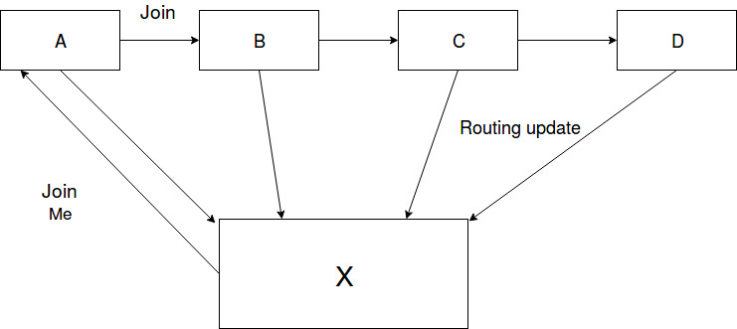
Routing Updates

Slide 8
Repair Algorithm
Leaf set Repair:
For Left Leaf set, we will ask for the leaf entries from the leftmost leaf. If we will find an entry that’s NodeId is less than ours. We will insert it in left leaf set.
If no relevant entry is found. Then the same procedure is repeated with the next node from the previously selected node.
For Right Leaf set same procedure is followed except that rightmost leaf is called first.
Neighbour set Repair:
We will ask for the neighbour set from the last neighbour of ours. If we find a new entry than we will insert it in neighbour set. Otherwise, We will repeat the same procedure with the next node from the previously selected node.

Slide 9
Repair Algorithm
Routing Table Update:
Suppose R[p][i] is the entry which is needed to be repaired. The algorithm will ask for the R[p][i] entries from nodes R[p][j] for all j!=i.
If no relevant entries are found than it will ask from next row and follows the same procedure until a relevant entry is found

Slide 10
Key Features
All the stored data is replicated at 3 different Nodes
When a new node joins, data relevant to that node is sent while routing
Lazy Repair: Fix Routing table entries if unavailable node detected while routing
Timer Repair: Check of unavailable leaf Nodes every 30 seconds
Create a replica of current Node’s data before exiting the Pastry Network
Log messages for each node

Slide 11
User Commands
port <Port>: Assigns Port to the node
port <IP> <Port>: Assigns IP and Port to the node
create: Creates pastry Node
join <IP> <Port>: Buddy Node to contact for joining the Pastry Network
put <Key> <Value>: Store the key, value pair in the network
get <key> : Fetching the value of the input key
lset: print the leaf set
nset: print the neighbourhood set
Routetable: print routing table
quit: graceful exit of the node from the pastry network
shutdown: shutdown the pastry network
hashTable: print the node’s hashtable

Slide 12


Thank You!

