Slide 1

PEAK HOUR RUSH Design Thinking for Social Innovation Course Project
GOUTAMI | 1357
SOHAIL | 1340
HARSH | 1348
RAKSHITHA | 1368
SHREYA | 1365
Under the guidance of
Manjunath Gowda Patil Sir
2022-2023, Odd Semester
CEER, KLE Technological University, Hubballi

Slide 2
Empathy
WASTAGE OF PAPER TICKETS
PEAK HOUR RUSH
FAILURE IN MAINTAINENECE IN THE SYSTEM
UPI DIGITALISATION
ISSUE RELATED TO TICKETS

Slide 3

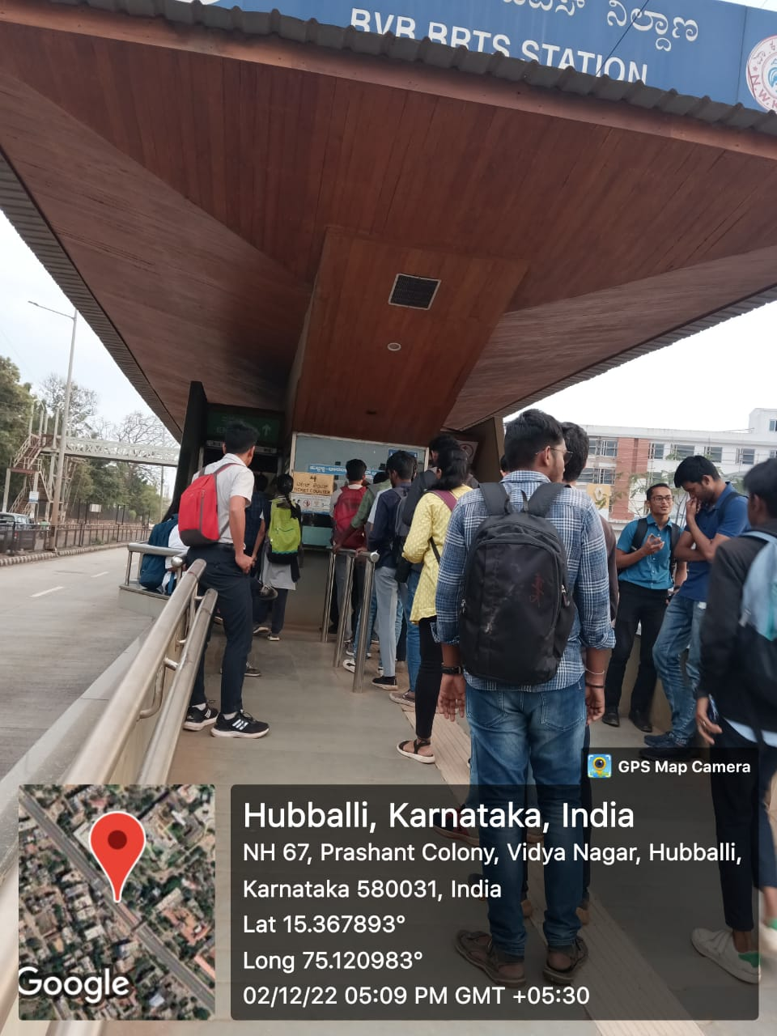
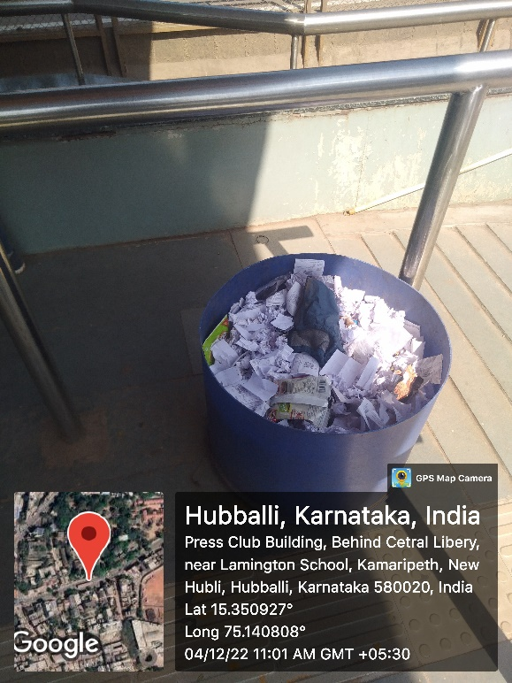
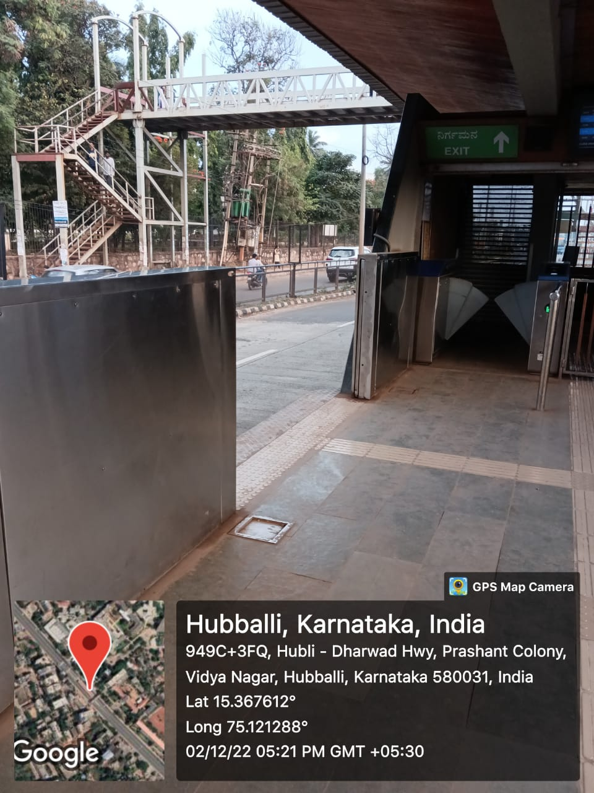
1
Que near the ticket counter
EMPATHY
Research user needs.
Wastage of the paper tickets
Lack of maintenance in the station

Slide 4
Define
USERS OF BRTS NEED TO PROPER FOLLOW PROPER RULES AND SAFETY MEASURES AT BUS STOPS TO ACCESS FACILITIES PROVIDED BY BRTS AND REACH THEIR DESTINATION ON TIME.HOWEVER DUE TO PEAK HOUR RUSH AND NO PROPER RULES AND REGULATION LEADS TO OVERCROWDING AT BUS STOPS AND BUSES WHICH MAY LEAD TO ACCIDENTS PUSHING AND PULLING INSIDE BUS MAY ALSO HARM PEOPLE IF PROPER MEASURES ARE TAKEN THIS CAN BE AVOIDED.

Slide 5

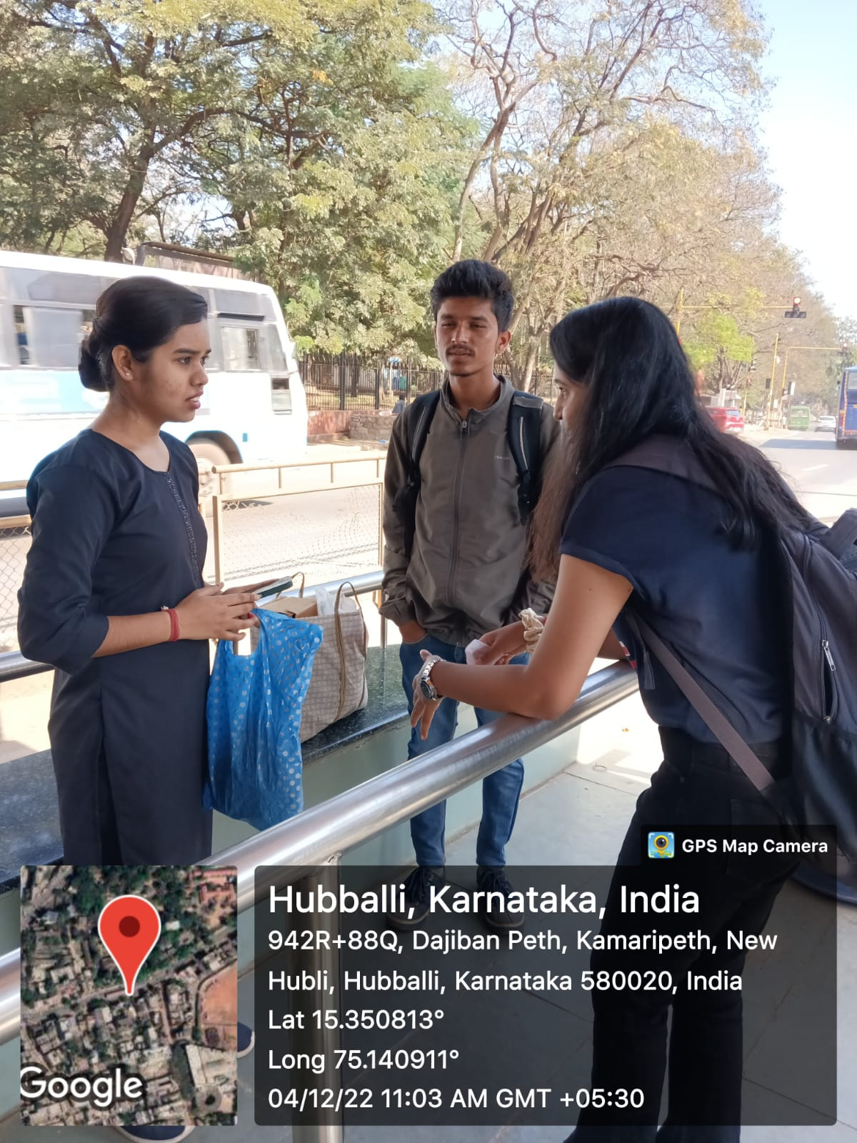
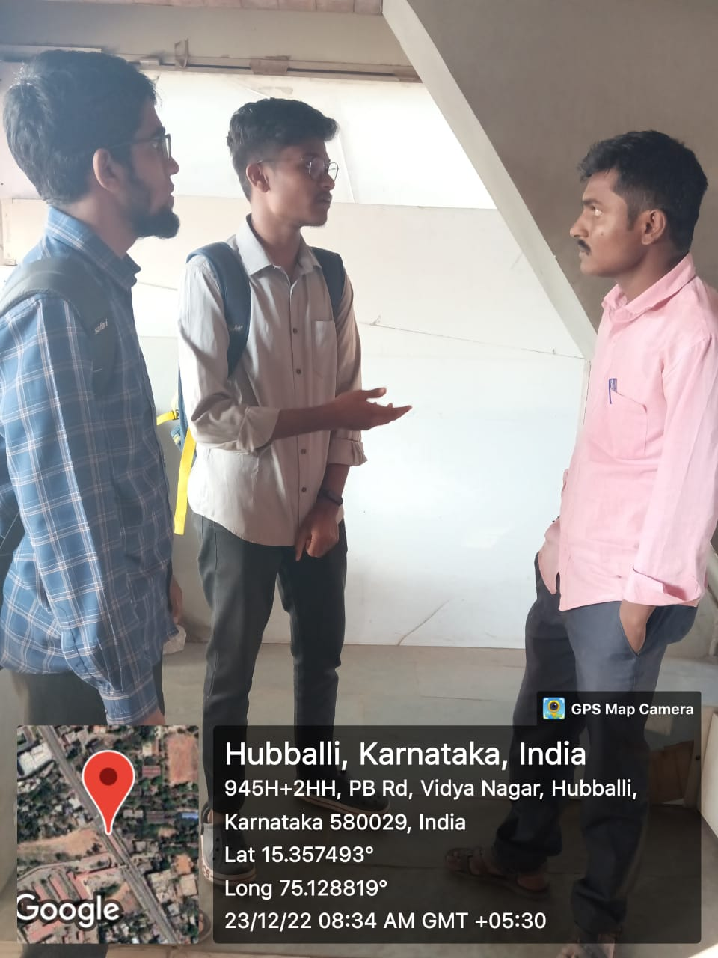
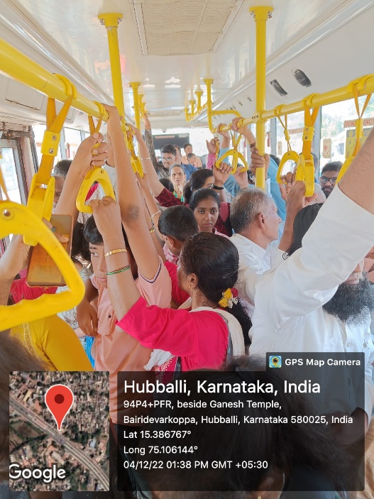
2
DEFINE
Articulate the problem.
Interaction with stake holder
Rush in the bus

Slide 6
Ideate
To avoid push and pull inside bus there must be some person limit fixed for entrering into bus.
By making separate schedule for buses during peak hours as per destination.
Website can be used to issue online payment and tickets.
Enforcement of strict rules.
Implementation of metro rails or sub urban trains.
Appointment of security staff to handle the crowd during peak hour rush.
Increase in ticket counter.
The delaying of the buses should be taken care and they should be on time .
Customized bus passenger boarding and deboarding planning should be done.
Customized bus passenger boarding and deboarding planning should be done.
To control the exit and entry a worker should be allotted.
Preference (elderly people) should be given who are in more need for travelling.

Slide 7
Ideate
FINALISED IDEA:
Extra ticket counter and tap out system for card holders.

Slide 8
IDEA FILTERING
High Impact & Low Feasibility 1)Constructing under ground metro rails or sub urban trains. 2)Extra Ticket counter 3)Increase in area of the bus stops . 4) Increase in the number of buses | High Impact & High Feasibility 1) Appointment of security staff . 2) Enforcement of strict rules and regulations . 3). Disciplined arrival timings of buses especially during peak hours. 4into the buses. 5) Online issuing of tickets To avoid push and pull there must be some person limit for entering
Low Impact & Low Feasibility 1)Preference (elderly people) should be given who are in more need for traveling. 2) Introducing separate bus services for shorter trips and longer trips. 3) customized boarding and deboarding plan 4)increase in number of seats | Low Impact & High Feasibility Introducing "No Standing "area near the doors. Specially allotted seats for senior citizens and physically challenged people. To avoid push and pull inside bus there must be some person limit fixed for entering into bus

Slide 9
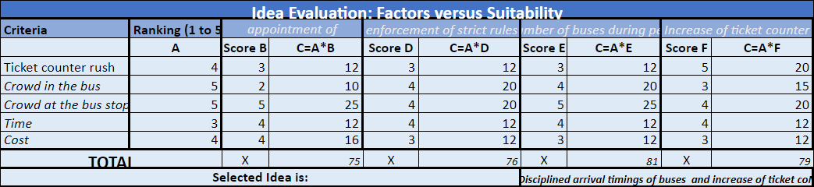
IDEA EVALUATION

Slide 10
Prototype Specification
Finalized idea: Increase in number of buses Extra ticket counter
PARAMETERS | SPECIFICATIONS
No of scenes | 10
Geo tagged photos | 2
Size of paper | A1 size paper
App used | Canva
Type of prototype | Story boarding
Language used | English
Type of content | Use of real, animated pic and text
Target group | Students senior citizens and other commuters

Slide 11

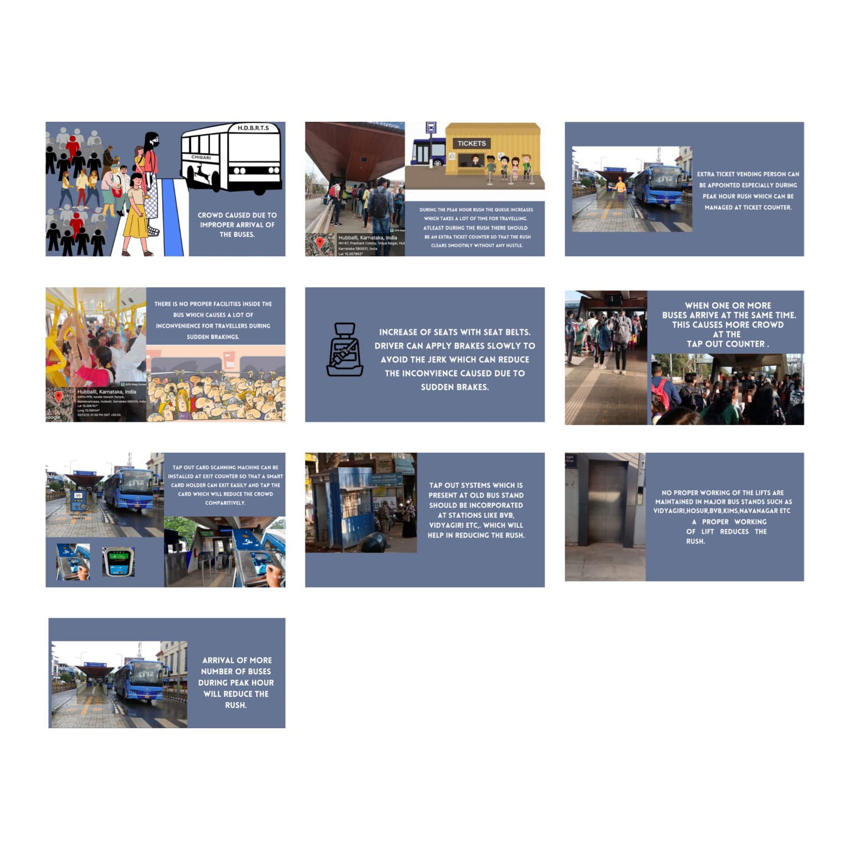
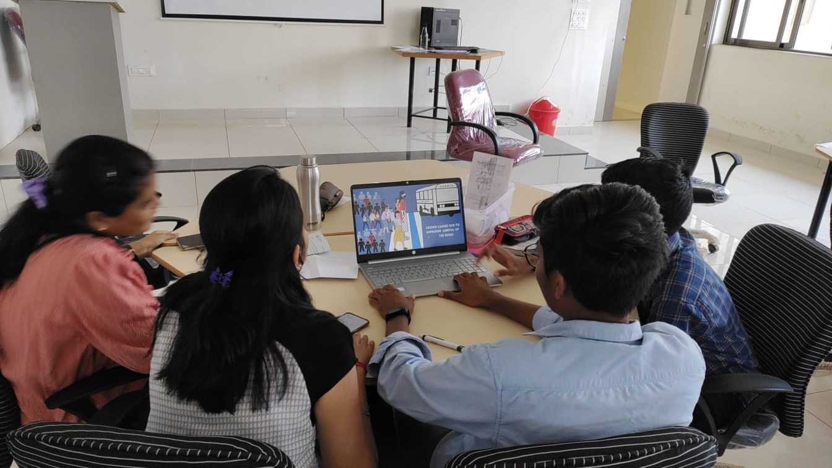
4
PROTOTYPE
Realize solutions.

Slide 12
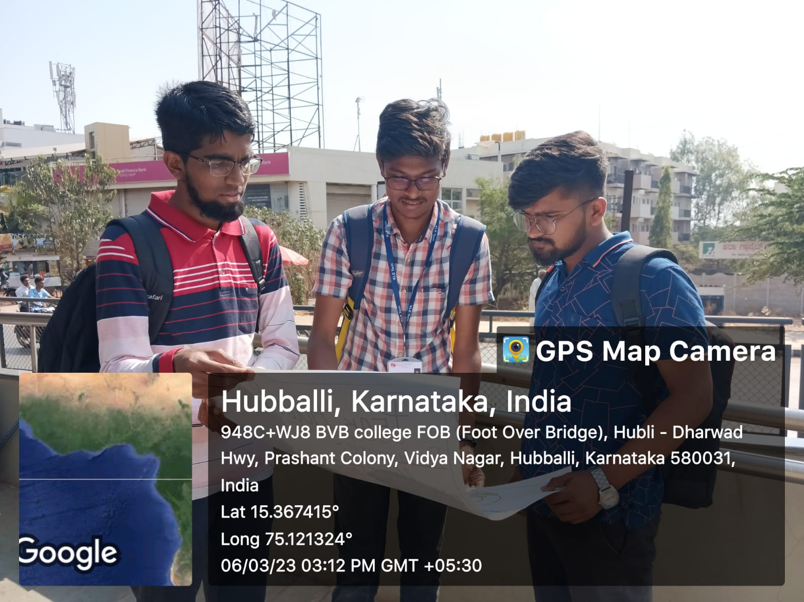
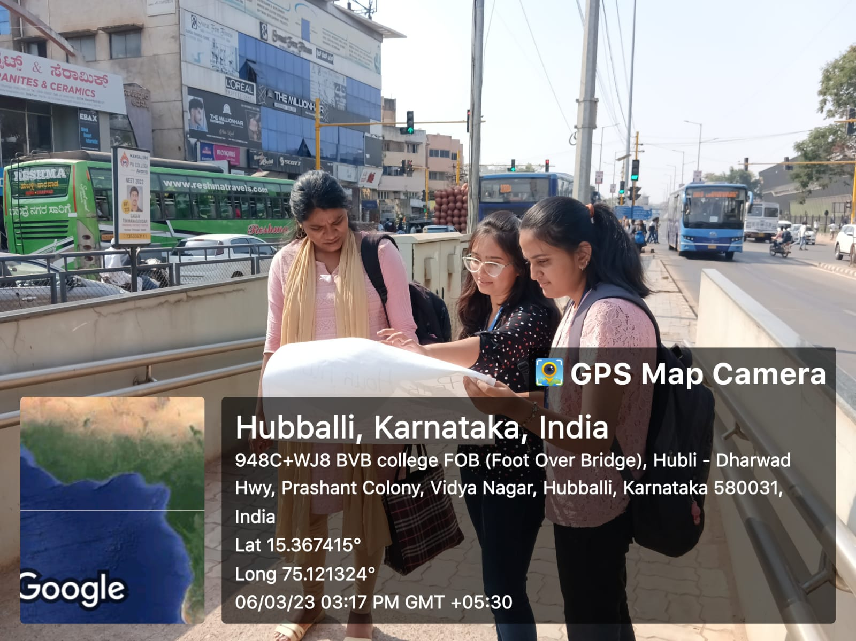
Testing

Slide 13
Learning from course project/DTSI course
A complete new experience which gave us allot of knowledge and also we learnt how to interact with the public
We learnt the process of converting an idea into a final output systematically which was a very long process .
We learnt how to find solution for a particular idea and most importantly every other person has a different opinion and solution which is unique in its own way .
Stakeholders are the key to whatever the idea we have generated so that we have to take the outcomes from them after every step of our process for a better solution.
We also learnt about the importance of a team and people working in it .
We enjoyed the thought process of this whole journey and got to know how to further identify the solutions for any given challenge .

Slide 14
THANK YOU

