Slide 1
Building Safer Cities
Addressing Natural Disasters and Security Risks
By Shreyash Srivastva

Slide 2
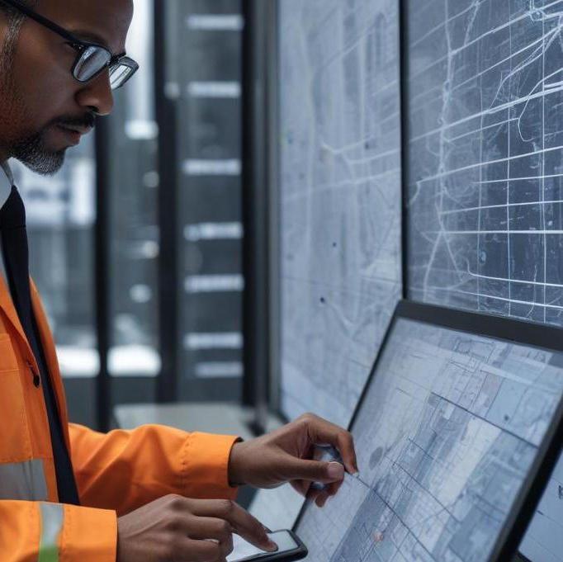
Introduction
Cities are increasingly threatened by natural disasters, security breaches, and environmental hazards. The lack of real-time monitoring systems leads to ineffective responses when crises arise. In this presentation, we explore the challenges faced by urban areas and propose solutions to strengthen infrastructure and enhance safety through innovative technologies.

Slide 3
01
Challenges

Slide 4
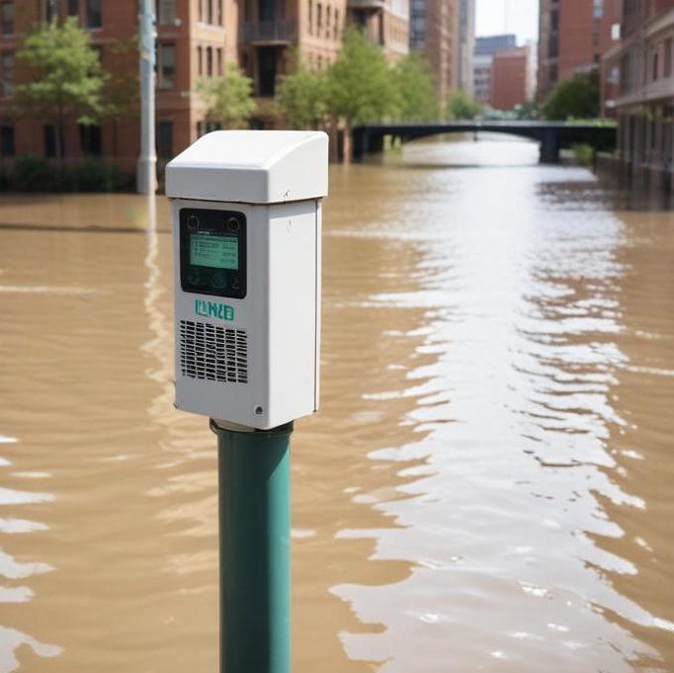
Early Detection technology
Utilizing low-cost sensors and advanced technology can enhance early detection of disasters. This includes devices like flood detectors that monitor water levels, smoke detectors for fire hazards, and air quality monitors to assess environmental threats. By adopting simple yet effective technology, cities can be alerted before conditions escalate, enabling proactive measures.

Slide 5
Fast Communication systems
Implementing efficient communication systems is critical for timely alerts to citizens and authorities during emergencies. This includes mobile applications for emergency alerts, real-time notifications about weather changes, and a network for immediate broadcasting of safety information. Rapid dissemination of information ensures that everyone is informed and can act promptly in case of imminent threats.

Slide 6
Security & Infrastructure resilience
Enhancing security and infrastructure resilience involves integrating modern technology with urban planning. This includes the establishment of reinforced structures to withstand natural disasters, installation of surveillance systems that utilize AI for threat detection, and creating community safety networks that promote communication between citizens and authorities. By improving infrastructure, cities can not only survive impacts but thrive in a safe environment.

Slide 7
02
Solutions

Slide 8
Hardware-Based Solutions
Hardware-based solutions involve tangible devices that improve safety and emergency response. These include compact flood detectors that alert residents about rising water levels, smart door alarms that enhance security by notifying homeowners of unauthorized entries, and air quality monitors that provide data on pollution levels. These low-cost devices are essential for real-time monitoring and can significantly reduce response times during emergencies.

Slide 9
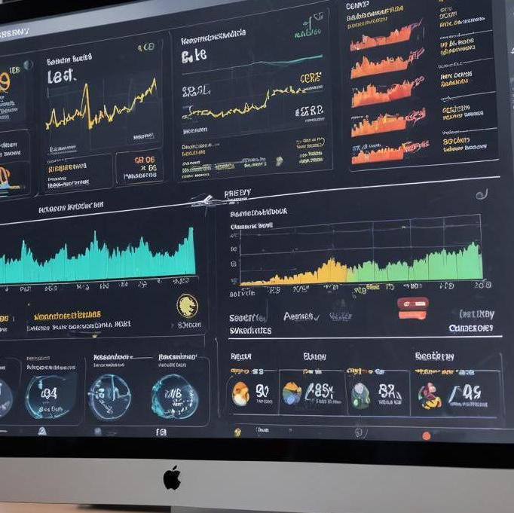
Software-Based Solutions
Software solutions focus on digital innovation to enhance safety communication and data management. This can include emergency alert apps that push notifications regarding disasters, a live city safety dashboard that aggregates real-time information concerning environmental changes, and AI-powered security notifiers that analyze surveillance footage for anomalies. These applications are crucial for timely and efficient crisis management in urban environments.

Slide 10
Automation & Response integration
Integrating automation into urban safety mechanisms can streamline response efforts during emergencies. This includes the use of chatbots that provide instant safety tips based on user location during disasters, and automated alert systems that can escalate issues to the proper authorities rapidly. The integration of automation allows for a more coordinated response, minimizing human error and ensuring critical information is disseminated quickly.

Slide 11
Conclusions
In conclusion, building safer cities requires a multi-faceted approach that combines technology with proactive strategies for disaster risk management. Implementing real-time monitoring systems, enhancing communication channels, and investing in both hardware and software solutions can significantly reduce the vulnerabilities of urban areas. By prioritizing safety and resilience, cities can better protect their citizens from the escalating threats of natural and man-made disasters.

Slide 12
Thank you!
Do you have any questions?
+91 620 421 838

