Slide 1

Extending the lotka-Volterra prey-predator system
Group 3​

Slide 2
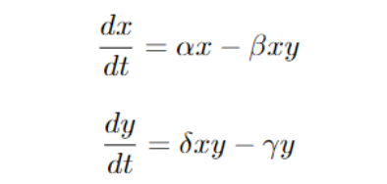
The lotka Volterra model describes a set of equations for modelling prey-predator dynamics where the populations change through time according the pair of equations:

Slide 3
The classical approach
In the classical approach, the prey are assumed to have an unlimited supply of food and reproduce exponentially, except when subjected to predation.
The rate of predation on the prey is assumed to be proportional to the rate at which the predators and the prey meet (obviously if either x or y are zero, there can be no predation).
The interpretation of the equations is simply : ”the rate of change of the prey’s population is given by its own growth rate minus the rate at which it is preyed upon”.
Similarly, the second equation represents: ”the rate of change of the predator’s population depends upon the rate at which it consumes prey, minus its intrinsic death rate”

Slide 4
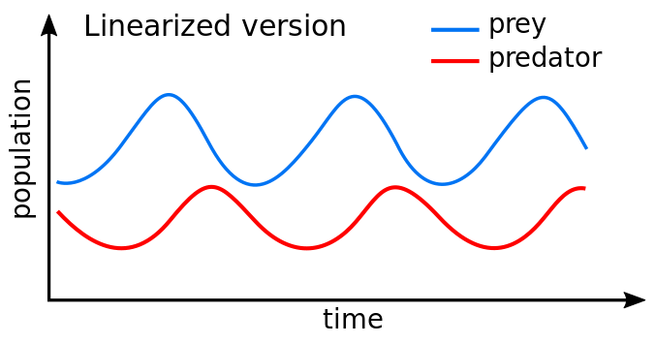
The assumptions of the initial model are the presence of unlimited food for the prey, the rate of change of population is proportional to its size, the environment cannot change in favour of one species and genetic adaptation is impossible, predators unlimited appetite, and both populations can be described by a single variable. This amounts to assuming that the populations do not have a spatial age or age distribution that contributes to the dynamics.

Slide 5
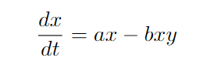
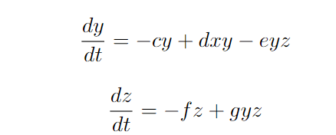
An extended generalized model with 3 species

Slide 6
New parameters and their relevance
With the addition of grass to the model, we naturally added certain energy parameters to every species in the model, while also adding conditions (for instance, when the energy level reaches 0 after a certain period of time or movement, the species dies immediately).
If a predator (wolves) attacks a prey (sheep), they also inherit that prey’s energy value, essentially prolonging their life.
This is the most significant addition to our model, since it greatly branches away from the classical Lotka-Volterra system where energy plays no role, and the only time ’death’ occurs is when a prey is attacked.
Through our agent based model, we demonstrate inferences on how the addition of energy to the Lotka-Volterra model greatly affects the model (in particular how the oscillations change, if they change at all)

Slide 7
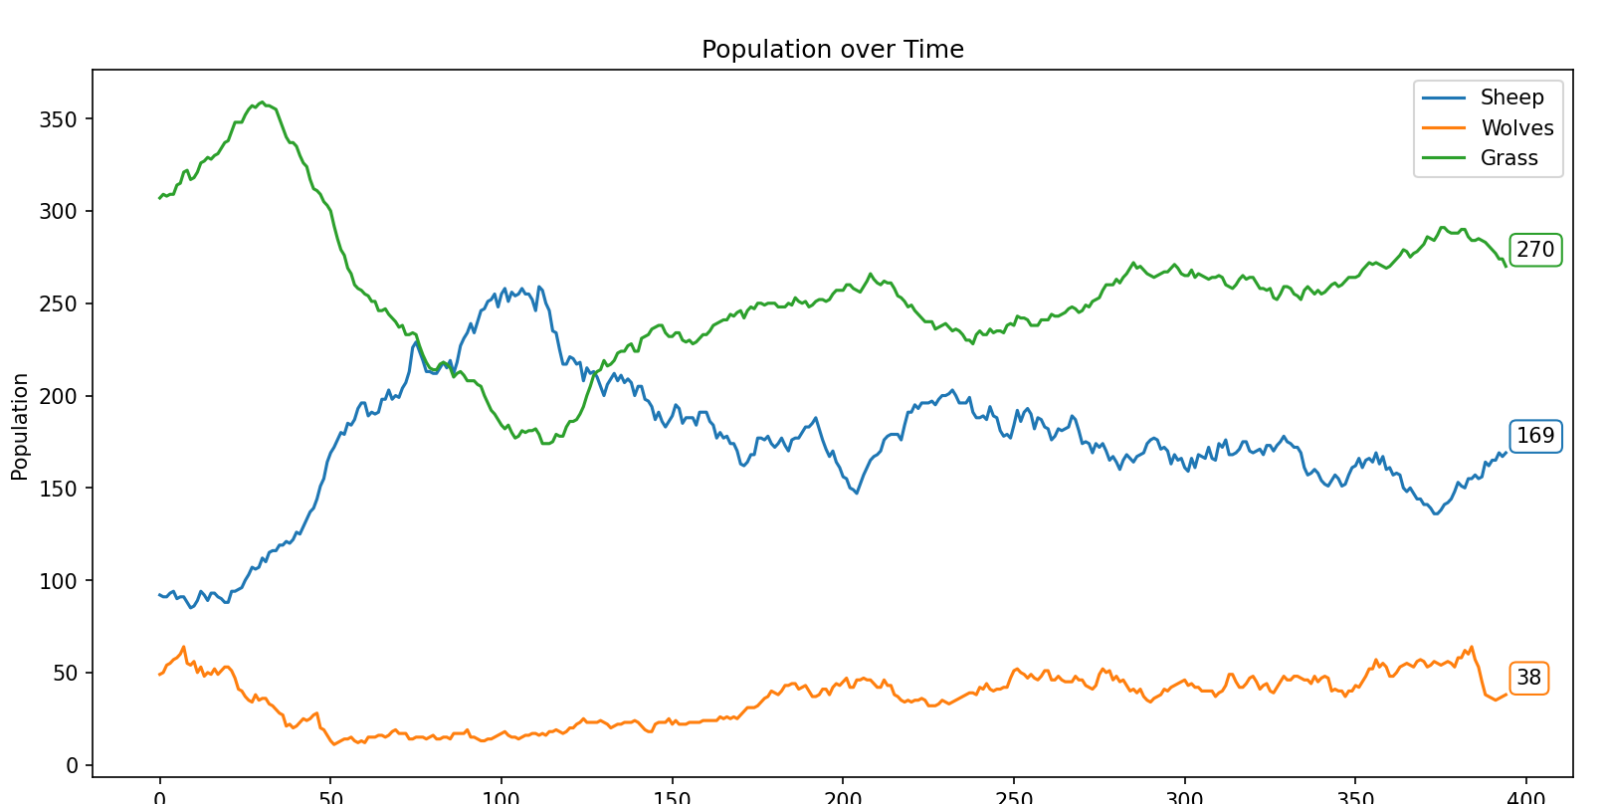

Slide 8
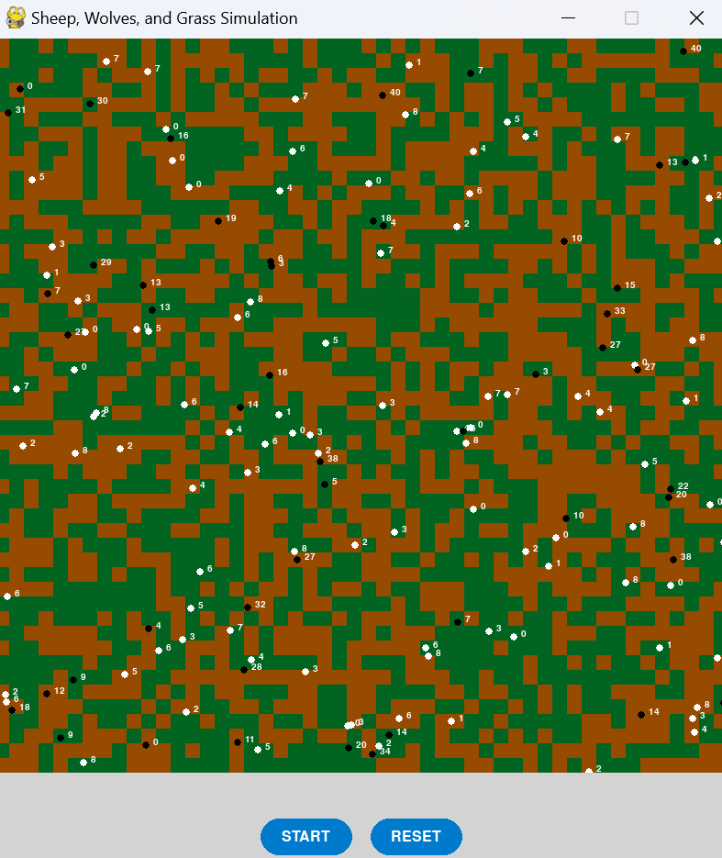

Slide 9
Spatial dynamics
The spatial distribution of resources, represented by grass patches in the grid, affects the dynamics. Grass serves as the primary food source for sheep, and its availability varies across the landscape. In areas with abundant grass, sheep populations thrive, leading to higher reproduction rates.
Conversely, scarcity of grass restricts the growth of sheep populations, impacting the carrying capacity of the system.
Secondly, the movement of animals within the spatial domain influences predator-prey interactions. Both sheep and wolves exhibit movement behaviors, seeking resources and avoiding predators. Spatial constraints affect the ability of animals to disperse, impacting encounter rates between predators and prey.
Moreover, movement patterns influence energy expenditure, influencing the survival and reproduction of individuals.

Slide 10
inferences
Compared to the classic Lotka-Volterra model, which primarily focuses on population interactions without considering energy constraints or spatial dynamics, the agent based model yields several differences.
Firstly, energy limitations introduce non-linear effects on population dynamics, influencing growth rates and stability thresholds. Organisms must balance energy intake and expenditure, leading to fluctuations in population sizes and altering the equilibrium points.
Secondly, spatial constraints introduce spatial autocorrelation and dispersal limitations, impacting population dispersal and colonization patterns. The spatial arrangement of resources and individuals modulates encounter rates and population connectivity, influencing the persistence of species within the landscape.

Slide 11
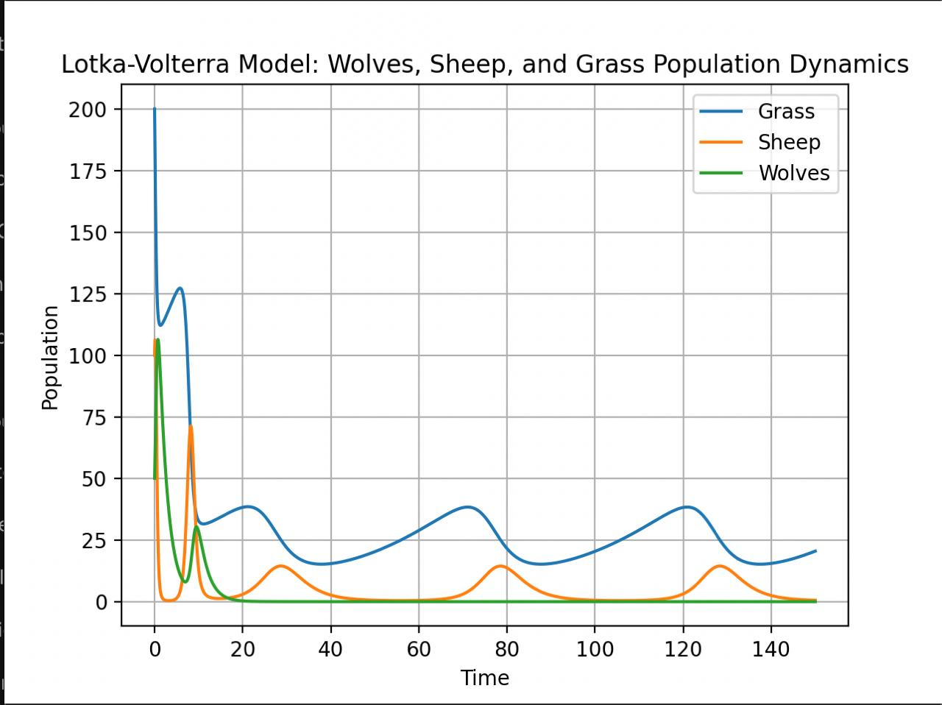

Slide 12
Thank you

