Slide 1
SaaS Product Analytics Case Study
SaaS Behavior • Revenue • Retention Analysis using SQL
Built using PostgreSQL • SQL • Excel
Prepared by: Shreya Chauhan
May 2026

Slide 2
ABSTRACT
This project analyses a simulated SaaS subscription platform dataset to study customer lifecycle behaviour across revenue, feature engagement, support interactions, retention, and churn. Using PostgreSQL and relational data modelling, the analysis explores how user activity, subscription movement, product adoption, and support experience influence business growth and long-term customer retention across the platform.
The goal of this analysis is to identify behavioural patterns such as engagement intensity, beta feature adoption, and product friction, and evaluate how these factors influence upgrades, downgrades, churn, and overall platform growth.

Slide 3
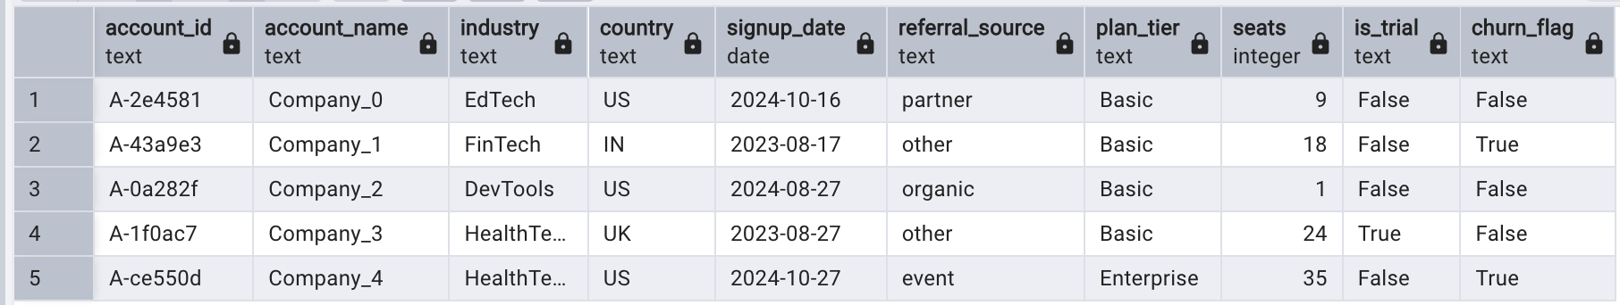
Dataset Overview
Contents of Tables
Syntax: Select * FROM tablename;
1. Accounts :
500 rows

Slide 4
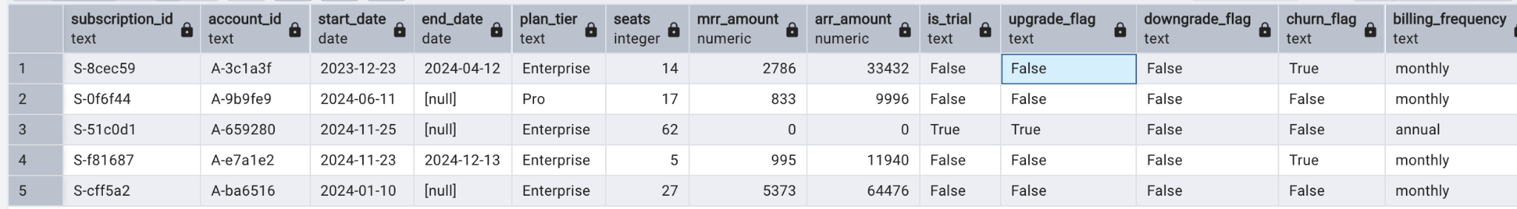
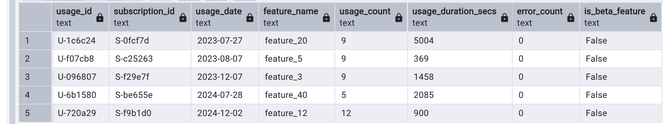
2. Subscriptions :
5000 rows
3. Feature_usage
25000 rows

Slide 5
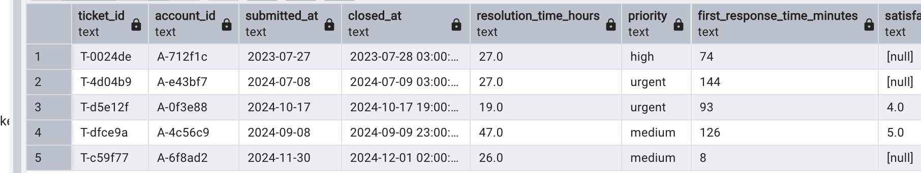
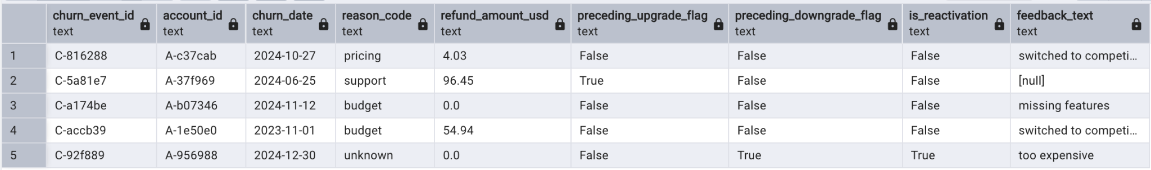
4. Support_tickets:
2000 rows
5. Churn_events
600 rows

Slide 6
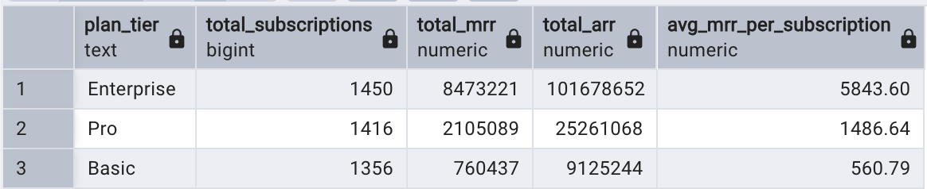
SECTION 1: REVENUE & MONETIZATION
1. Revenue Contribution by Plan Tier
Which subscription plan tiers generate the highest recurring revenue, and how does revenue distribution vary across tiers?
SELECT
plan_tier,
COUNT(DISTINCT subscription_id) AS total_subscriptions,
SUM(mrr_amount) AS total_mrr,
SUM(arr_amount) AS total_arr,
ROUND(AVG(mrr_amount), 2) AS avg_mrr_per_subscription
FROM subscriptions
WHERE is_trial = 'False'
GROUP BY plan_tier
ORDER BY total_mrr DESC;

Slide 7
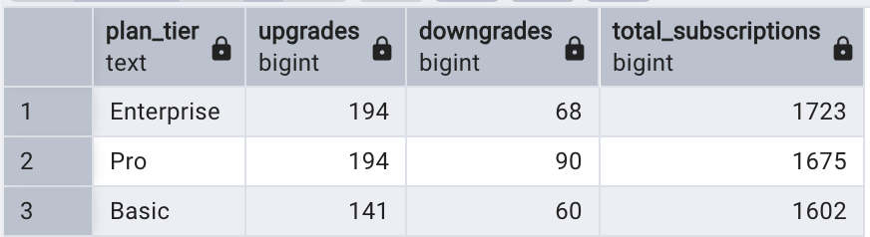
2. Subscription Tier Movement (Upgrades vs Downgrades)
How do users transition between subscription tiers through upgrades and downgrades, and what does this indicate about product growth?
SELECT
plan_tier,
SUM(CASE WHEN upgrade_flag = 'True' THEN 1 ELSE 0 END) AS upgrades,
SUM(CASE WHEN downgrade_flag = 'True' THEN 1 ELSE 0 END) AS downgrades,
COUNT(subscription_id) AS total_subscriptions
FROM subscriptions
GROUP BY plan_tier
ORDER BY upgrades DESC;
Users show a higher tendency to upgrade than downgrade, suggesting healthy upward movement
across subscription tiers and overall product adoption growth.

Slide 8
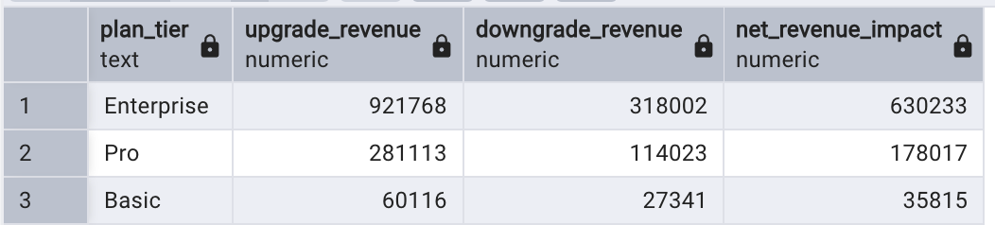
3. Revenue Impact of Upgrades and Downgrades
How do upgrades and downgrades impact net revenue across subscription tiers?
SELECT
plan_tier,
SUM(CASE WHEN upgrade_flag = 'True' THEN mrr_amount ELSE 0 END) AS upgrade_revenue,
SUM(CASE WHEN downgrade_flag = 'True' THEN mrr_amount ELSE 0 END) AS downgrade_revenue,
SUM(CASE
WHEN upgrade_flag = 'True' THEN mrr_amount
WHEN downgrade_flag = 'True' THEN -mrr_amount
ELSE 0
END) AS net_revenue_impact
FROM subscriptions
GROUP BY plan_tier
ORDER BY net_revenue_impact DESC;
Revenue impact is mainly driven by upgrades, while downgrades act as controlled leakage,
showing that expansion revenue plays a stronger role than contraction across subscription tiers.

Slide 9
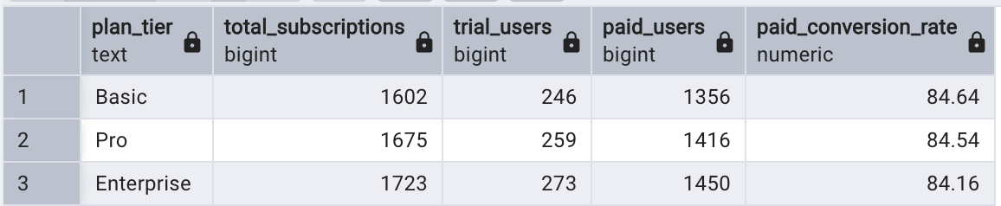
SECTION 2: CUSTOMER ACQUISITION & CONVERSION
4. Trial vs Paid Subscription Distribution
How effectively do trial users convert into paid subscriptions across different plan tiers?
SELECT
plan_tier,
COUNT(subscription_id) AS total_subscriptions,
SUM(CASE WHEN is_trial = 'True' THEN 1 ELSE 0 END) AS trial_users,
SUM(CASE WHEN is_trial = 'False' THEN 1 ELSE 0 END) AS paid_users,
ROUND(
SUM(CASE WHEN is_trial = 'False' THEN 1 ELSE 0 END) * 100.0
/ COUNT(subscription_id), 2
) AS paid_conversion_rate
FROM subscriptions
GROUP BY plan_tier
ORDER BY paid_conversion_rate DESC;
Paid conversion rates remain relatively consistent across plan tiers, suggesting that
trial-to-paid behaviour is fairly stable throughout the product ecosystem.

Slide 10
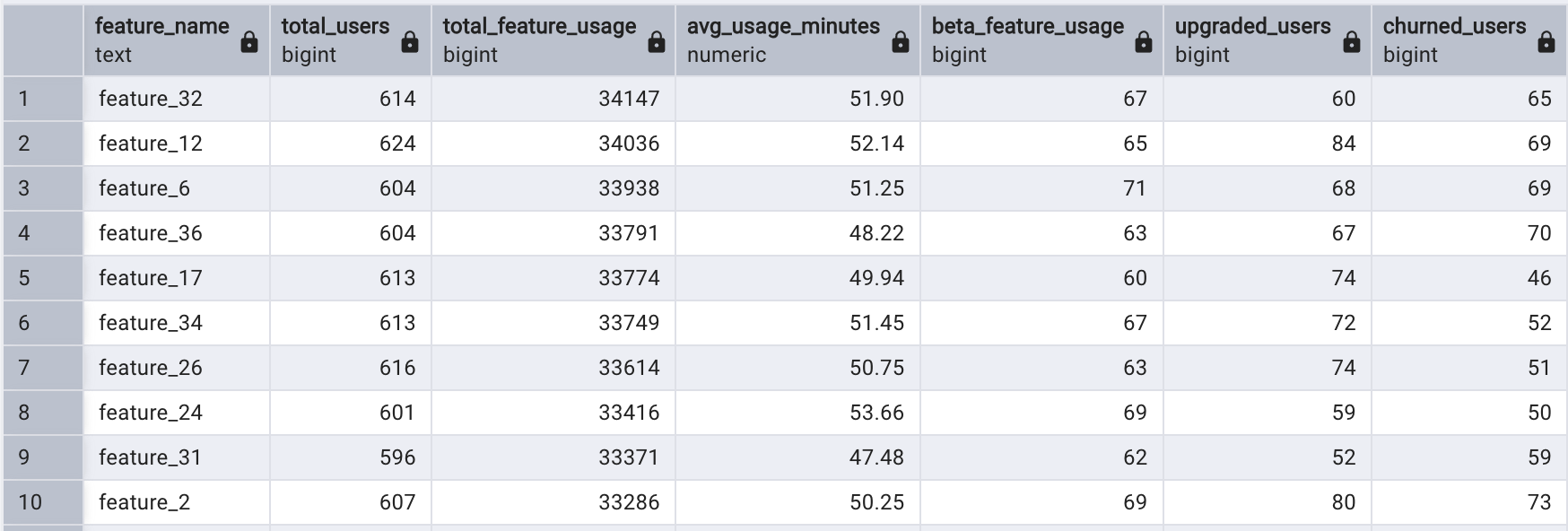
SECTION 3: PRODUCT ENGAGEMENT
5. Feature Usage Distribution
Which product features drive the highest user engagement?
SELECT
f.feature_name,
COUNT(DISTINCT f.subscription_id) AS total_users,
SUM(f.usage_count) AS total_feature_usage,
ROUND(AVG(f.usage_duration_secs) / 60.0, 2) AS avg_usage_minutes,
SUM(CASE
WHEN f.is_beta_feature = 'True' THEN 1
ELSE 0
END) AS beta_feature_usage,
SUM(CASE
WHEN s.upgrade_flag = 'True' THEN 1
ELSE 0
END) AS upgraded_users,
SUM(CASE
WHEN s.churn_flag = 'True' THEN 1
ELSE 0
END) AS churned_users
FROM feature_usage f
JOIN subscriptions s
ON f.subscription_id = s.subscription_id
GROUP BY f.feature_name
ORDER BY total_feature_usage DESC;
40 rows
Some high-usage features also show churn signals, suggesting possible gaps in usability or perceived value.

Slide 11
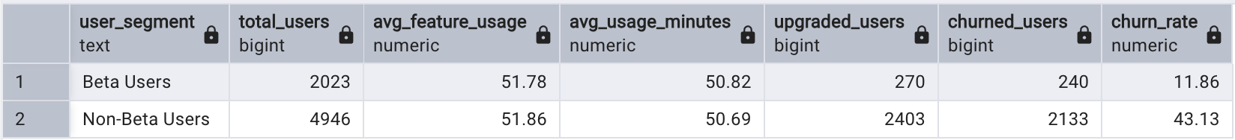
6. Beta Feature Engagement vs Non-Beta Users
“Do users who engage with beta features demonstrate stronger engagement and retention behaviour?”
SELECT
CASE
WHEN f.is_beta_feature = 'True' THEN 'Beta Users'
ELSE 'Non-Beta Users'
END AS user_segment,
COUNT(DISTINCT f.subscription_id) AS total_users,
ROUND(AVG(f.usage_count), 2) AS avg_feature_usage,
ROUND(AVG(f.usage_duration_secs) / 60, 2) AS avg_usage_minutes,
SUM(CASE
WHEN s.upgrade_flag = 'True' THEN 1
ELSE 0
END) AS upgraded_users,
SUM(CASE
WHEN s.churn_flag = 'True' THEN 1
ELSE 0
END) AS churned_users,
ROUND(
(
SUM(CASE
WHEN s.churn_flag = 'True' THEN 1
ELSE 0
END) * 100.0
) / COUNT(DISTINCT f.subscription_id),
2
) AS churn_rate
FROM feature_usage f
JOIN subscriptions s
ON f.subscription_id = s.subscription_id
GROUP BY user_segment;
Users engaging with beta features demonstrate significantly
lower churn rates and stronger upgrade behaviour compared
to non-beta users, suggesting that advanced feature
adoption is strongly associated with long-term retention
and monetization potential.

Slide 12
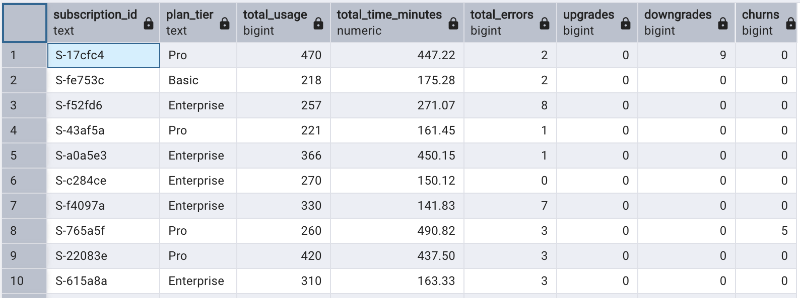
7(a). User Engagement vs Upgrade / Downgrade / Churn Behavior
“Do users who engage with beta features demonstrate stronger engagement and retention behaviour?”
SELECT
s.subscription_id,
s.plan_tier,
SUM(f.usage_count) AS total_usage,
ROUND(SUM(f.usage_duration_secs) / 60.0, 2) AS total_time_minutes,
SUM(f.error_count) AS total_errors,
SUM(CASE WHEN s.upgrade_flag = 'True' THEN 1 ELSE 0 END) AS upgrades,
SUM(CASE WHEN s.downgrade_flag = 'True' THEN 1 ELSE 0 END) AS downgrades,
SUM(CASE WHEN s.churn_flag = 'True' THEN 1 ELSE 0 END) AS churns
FROM subscriptions s
LEFT JOIN feature_usage f
ON s.subscription_id = f.subscription_id
GROUP BY s.subscription_id, s.plan_tier;
This query aggregates subscription-level behavioural signals by combining usage intensity, error patterns, and lifecycle
events like upgrade and churn to build a unified customer health profile.
5000 rows

Slide 13
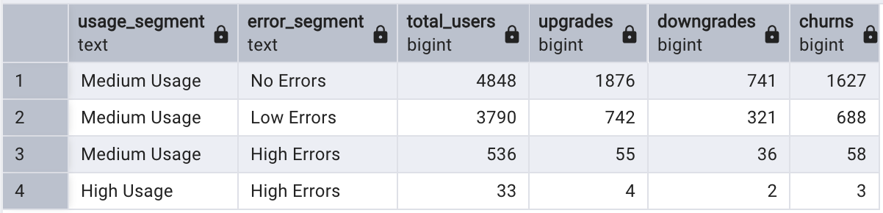
7(b). User Engagement vs Upgrade / Downgrade / Churn Behaviour
How do engagement intensity and product friction together influence customer lifecycle outcomes such as upgrades, downgrades, and churn?
SELECT
CASE
WHEN f.usage_count <= 20 THEN 'Low Usage'
WHEN f.usage_count BETWEEN 21 AND 60 THEN 'Medium Usage'
ELSE 'High Usage'
END AS usage_segment,
CASE
WHEN f.error_count = 0 THEN 'No Errors'
WHEN f.error_count BETWEEN 1 AND 3 THEN 'Low Errors'
ELSE 'High Errors'
END AS error_segment,
COUNT(DISTINCT s.subscription_id) AS total_users,
SUM(CASE WHEN s.upgrade_flag = 'True' THEN 1 ELSE 0 END) AS upgrades,
SUM(CASE WHEN s.downgrade_flag = 'True' THEN 1 ELSE 0 END) AS downgrades,
SUM(CASE WHEN s.churn_flag = 'True' THEN 1 ELSE 0 END) AS churns
FROM subscriptions s
LEFT JOIN feature_usage f
ON s.subscription_id = f.subscription_id
GROUP BY usage_segment, error_segment
ORDER BY upgrades DESC;
Higher usage intensity does not always guarantee retention; instead, the combination of usage and error patterns better explains upgrades, downgrades, and churn behavior.

Slide 14
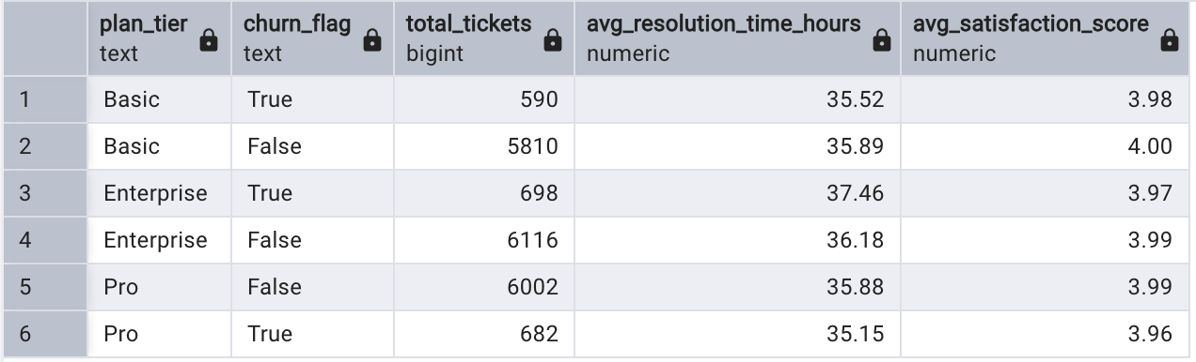
SECTION 4: CUSTOMER SUPPORT & EXPERIENCE ANALYSIS
8. Support Load & Satisfaction Across Plan Tiers and Churn Status
How does customer support usage and satisfaction vary across plan tiers and churn behavior?
SELECT
s.plan_tier,
s.churn_flag,
COUNT(st.ticket_id) AS total_tickets,
ROUND(AVG(st.resolution_time_hours::numeric), 2) AS avg_resolution_time_hours,
ROUND(AVG(st.satisfaction_score::numeric), 2) AS avg_satisfaction_score
FROM subscriptions s
LEFT JOIN support_tickets st
ON s.account_id = st.account_id
GROUP BY s.plan_tier, s.churn_flag
ORDER BY s.plan_tier;
Support experience alone may not be the primary driver of churn in this dataset. Churned and active users
show nearly identical usage and error patterns. This indicates that churn is not driven by engagement volume
or system errors, but likely by deeper factors such as perceived value, pricing sensitivity, or unmet product
expectations.

Slide 15
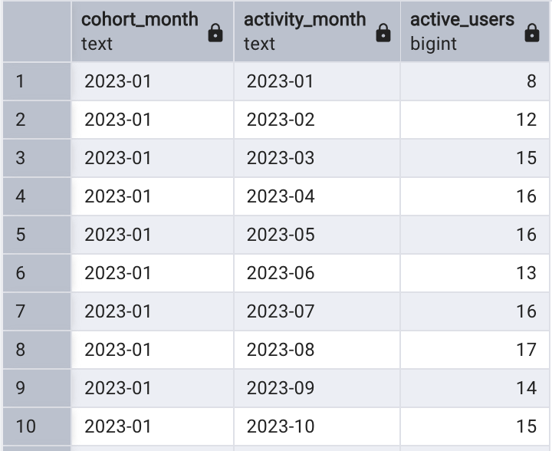
SECTION 5: RETENTION & GROWTH BEHAVIOR
9. Cohort-Based User Activity Over Time
How do user cohorts behave over time in terms of product activity and retention patterns?
WITH active_months AS (
SELECT DISTINCT
a.account_id,
TO_CHAR(DATE_TRUNC('month', a.signup_date::date), 'YYYY-MM') AS cohort_month,
TO_CHAR(DATE_TRUNC('month', f.usage_date::date), 'YYYY-MM') AS activity_month
FROM accounts a
JOIN subscriptions s
ON a.account_id = s.account_id
JOIN feature_usage f
ON s.subscription_id = f.subscription_id
WHERE f.usage_date::date >= a.signup_date::date
)
SELECT
cohort_month,
activity_month,
COUNT(DISTINCT account_id) AS active_users
FROM active_months
GROUP BY cohort_month, activity_month
ORDER BY cohort_month, activity_month;
300 rows
User activity generally increases across later activity periods, suggesting steady platform adoption and continued
engagement growth over time.

Slide 16
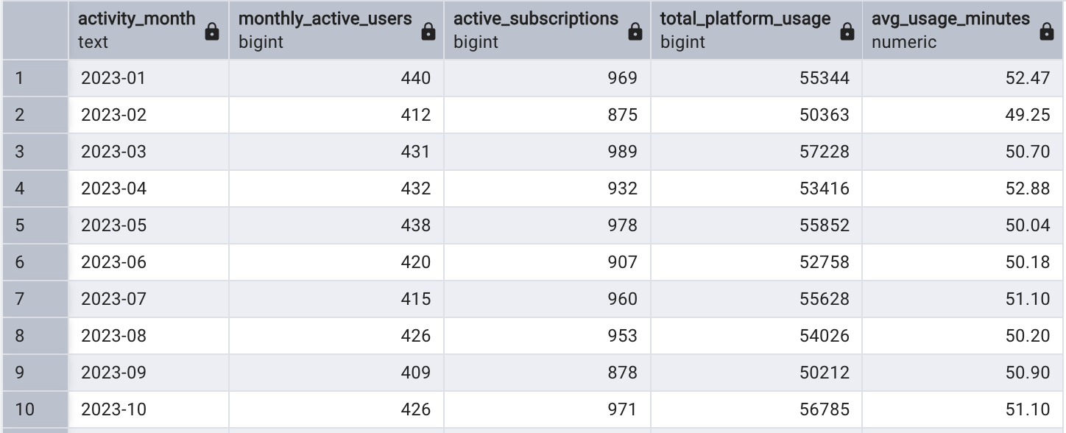
10. Monthly Active Users & Engagement Trends
How is overall platform engagement trending over time in terms of active users and usage intensity?
SELECT
TO_CHAR(DATE_TRUNC('month', f.usage_date::date), 'YYYY-MM') AS activity_month,
COUNT(DISTINCT s.account_id) AS monthly_active_users,
COUNT(DISTINCT f.subscription_id) AS active_subscriptions,
SUM(f.usage_count) AS total_platform_usage,
ROUND(AVG(f.usage_duration_secs) / 60, 2) AS avg_usage_minutes
FROM feature_usage f
JOIN subscriptions s
ON f.subscription_id = s.subscription_id
GROUP BY activity_month
24 rows
Overall engagement trends show stable active usage with fluctuations in intensity, suggesting
consistent but non-linear platform growth.

Slide 17
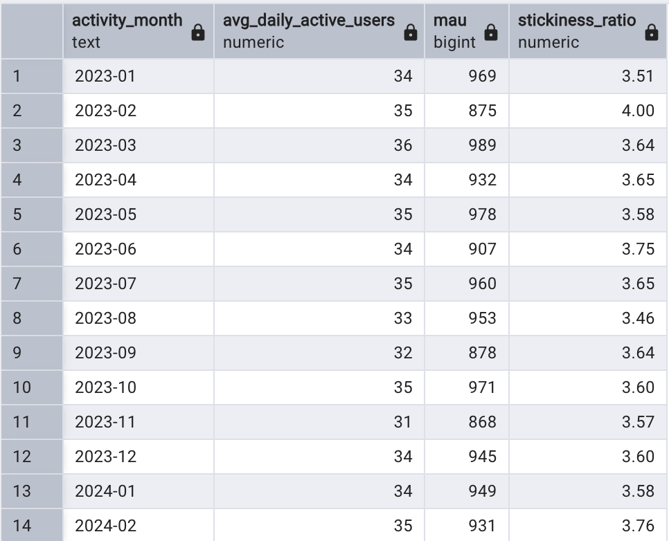
11. DAU/MAU Stickiness Ratio
How frequently do users return to the platform on a daily basis (stickiness)?
WITH daily_activity AS (
SELECT
usage_date,
COUNT(DISTINCT subscription_id) AS dau
FROM feature_usage
GROUP BY usage_date
),
monthly_activity AS (
SELECT
DATE_TRUNC('month', usage_date) AS activity_month,
COUNT(DISTINCT subscription_id) AS mau
FROM feature_usage
GROUP BY activity_month
),
monthly_dau AS (
SELECT
DATE_TRUNC('month', usage_date) AS activity_month,
AVG(dau) AS avg_daily_active_users
FROM daily_activity
GROUP BY activity_month
)
SELECT
m.activity_month,
d.avg_daily_active_users,
m.mau,
ROUND((d.avg_daily_active_users * 100.0) / m.mau, 2) AS stickiness_ratio
FROM monthly_activity m
JOIN monthly_dau d
ON m.activity_month = d.activity_month
ORDER BY m.activity_month;
Stickiness ratios indicate moderate-to-strong engagement behaviour,
showing that a meaningful portion of users return frequently
within each month.

Slide 18
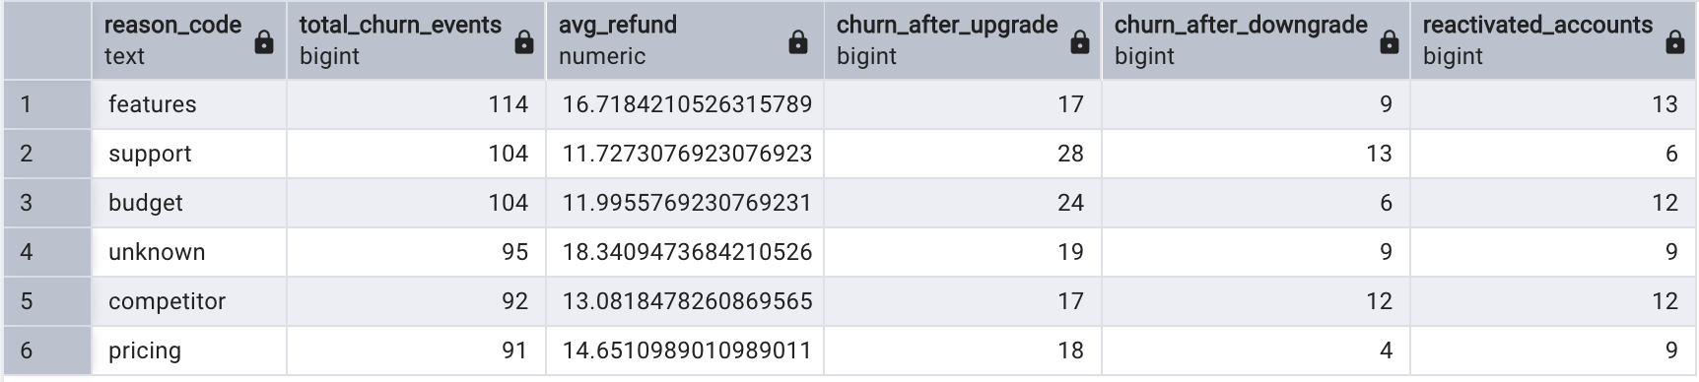
SECTION 6: CHURN ANALYSIS
12. Churn Reason Breakdown
What are the primary reasons customers churn, and how does revenue loss vary by reason?
SELECT
reason_code,
COUNT(churn_event_id) AS total_churn_events,
AVG(refund_amount_usd::numeric) AS avg_refund,
SUM(CASE WHEN preceding_upgrade_flag = 'True' THEN 1 ELSE 0 END) AS churn_after_upgrade,
SUM(CASE WHEN preceding_downgrade_flag = 'True' THEN 1 ELSE 0 END) AS churn_after_downgrade,
SUM(CASE WHEN is_reactivation = 'True' THEN 1 ELSE 0 END) AS reactivated_accounts
FROM churn_events
GROUP BY reason_code
ORDER BY total_churn_events DESC;
Churn is driven by a mix of pricing, usability, and unmet expectations, with some users even
churning after upgrades, indicating possible expectation gaps. While several churn reasons are
identifiable, a significant portion falls under “Unknown,” highlighting the limitations of churn
attribution and the need for better customer feedback capture.

Slide 19
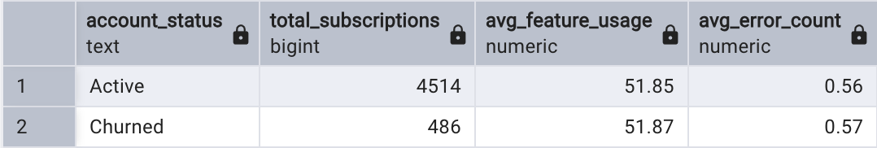
13. Churned vs Active User Behaviour Comparison
How does product engagement differ between churned and active users?
SELECT
CASE
WHEN s.churn_flag = TRUE THEN 'Churned'
ELSE 'Active'
END AS account_status,
COUNT(DISTINCT s.subscription_id) AS total_subscriptions,
AVG(f.usage_count) AS avg_feature_usage,
AVG(f.error_count) AS avg_error_count
FROM subscriptions s
LEFT JOIN feature_usage f
ON s.subscription_id = f.subscription_id
GROUP BY account_status;
Since active subscriptions make up the majority of the dataset, they naturally account for a
larger share of support interactions and product activity. Churned and active users show very
similar engagement patterns, suggesting that churn may be influenced more by perceived value,
pricing, or external factors than by raw product usage alone.

Slide 20
Key Business Insights
Enterprise plans generated the highest revenue and subscription share.
Beta feature users showed stronger retention behaviour.
Trial-to-paid conversion remained stable across plan tiers.
Support metrics alone did not strongly explain churn.
Churned and active users displayed similar engagement patterns.
Retention appears influenced by perceived value beyond raw activity levels
Tools & Skills Used
Tools
PostgreSQL
Microsoft PowerPoint
Microsoft Excel
pgAdmin
Skills
SQL Querying
Joins & Relational Modeling
Aggregations & Grouping
CASE Statements
Common Table Expressions (CTEs)
Data Cleaning & Type Casting
Cohort Analysis
DAU / MAU Stickiness Analysis
Churn Analysis
Subscription Revenue Analysis
Customer Segmentation
Behavioral Analytics
Product Usage Analysis
Retention Analysis
KPI Interpretation
Saas Metrics(ARR,MRR)

