Slide 1
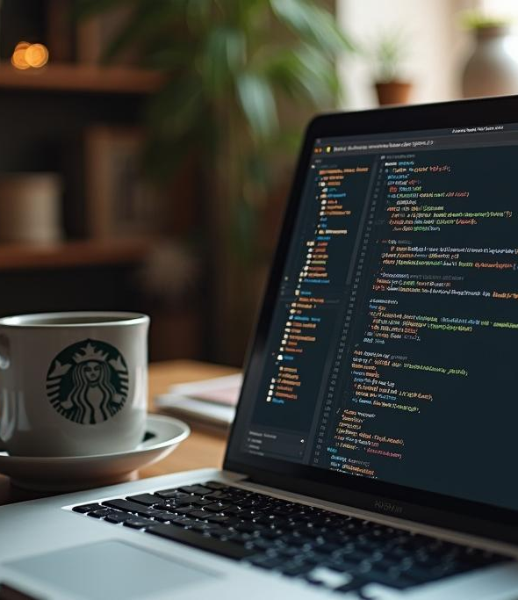
JavaScript
A Beginner’s Guide to Understanding JavaScript

Slide 2
Introduction
This presentation will introduce you to JavaScript, its roles, and its importance in web development.

Slide 3

01
What is JavaScript?

Slide 4
Overview of JavaScript as a programming language
JavaScript is a versatile programming language primarily used for creating interactive web content. It allows developers to implement complex features on web pages, enabling a dynamic experience for users. Unlike static HTML and CSS, JavaScript can respond to user events, manipulate the Document Object Model (DOM), and handle asynchronous operations, making it a key component of modern web development.

Slide 5
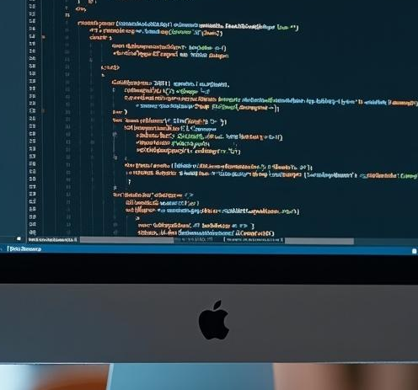
Usage in web development and its environment
JavaScript is essential for web development as it is executed in the browser, allowing real-time updates without the need to reload the web page. It works seamlessly with HTML and CSS to enhance the user interface and experience. JavaScript powers various features, including animations, form validations, and dynamic data loading from APIs, making it a cornerstone of front-end development.

Slide 6
Role of JavaScript on client-side and server-side
JavaScript plays a pivotal role on both the client-side and server-side of web development. On the client-side, it's responsible for creating interactive elements that engage users—think of dynamic forms, animations, and responsive designs. This allows websites to respond instantly to user actions without needing to refresh the page. On the server-side, JavaScript, particularly with frameworks like Node.js, helps manage backend processes including handling requests, accessing databases, and serving web content. This dual capability makes JavaScript a powerful tool in a developer's arsenal.

Slide 7

02
Basic JavaScript Concepts

Slide 8
Understanding variables: let, const, and var
In JavaScript, variables are fundamental as they allow you to store data values. There are three keywords to declare variables: 'let', 'const', and 'var'. 'let' allows you to declare variables that can be reassigned later, keeping their scope within the block they are defined. 'const' is used for variables that should remain constant and cannot be reassigned, while 'var' declares a variable globally or throughout the function. Understanding the difference between these declarations is key to effective JavaScript coding.

Slide 9

Exploring data types: strings, numbers, arrays
JavaScript has several built-in data types, with the most common being strings, numbers, and arrays. Strings are sequences of characters used for text, numbers represent numerical values, and arrays are collections of items stored in a single variable. Arrays can hold multiple values, making them super handy for organizing and managing data. Recognizing and using these data types effectively is essential for writing efficient and effective JavaScript code.

Slide 10
Introduction to functions with examples
Functions in JavaScript are reusable blocks of code that perform specific tasks. They can take input (parameters), perform operations, and return output. For example, a simple function might add two numbers and return the result. Functions can be declared in several ways—function declarations, function expressions, or arrow functions. Utilizing functions not only makes your code cleaner but also enhances its modularity and clarity, allowing for easier debugging and maintenance.

Slide 11

Conclusions
JavaScript is a vital tool in the world of web development, bridging the gap between the client-side and server-side functionalities. By understanding its basic concepts, such as variables, data types, and functions, you’ll be well-equipped to start your journey in creating interactive and dynamic web applications. Remember, practice is key—experiment with code, build small projects, and engage with the coding community to hone your skills!

Slide 12
Thank you!
Do you have any questions?
+91 620 421 838

