Slide 1
Road Accident Risk Prediction & Comparative Analysis
Naga Janaki Dwadasi (013853034)
Priyanka Kumar (013749866)
Rama Tejaswini Thotapalli (013785681)
Vaidehi Naik (012560938)

Slide 2
Introduction
Road accidents are main cause of deaths among youngsters.
In 2015, US lost 37000 individuals in car accidents, which is more than 7.2% from previous years.
The cost of fatalities and injuries will greatly affect the general people.
Reducing traffic accidents is a public safety challenge.

Slide 3
Project Scope
Problem statement
Dataset
Challenges
Increase of road accidents
Public safety
Analyse the factors increasing the accidents
Accident risk prediction
The dataset consists of 2.25 million records and 49 columns
Contains labels as the severity of the accident ranging from 0 to 4.
Employing the huge dataset.
The labels of this dataset are skewed
Lots of categorical variables.
Determining the actual factors lead to accidents.

Slide 4
Data Visualization for understanding the data distribution and features
Data cleaning, data transformation, dimensionality reduction, scaling and normalization
Accuracy score, Cross Validation, Confusion matrix
Exploratory Data Analysis
Feature selection
Preprocessing
Model selection
Evaluation
Selecting relevant features that contribute to the prediction of risk
Modeling and ensemble modeling

Slide 5
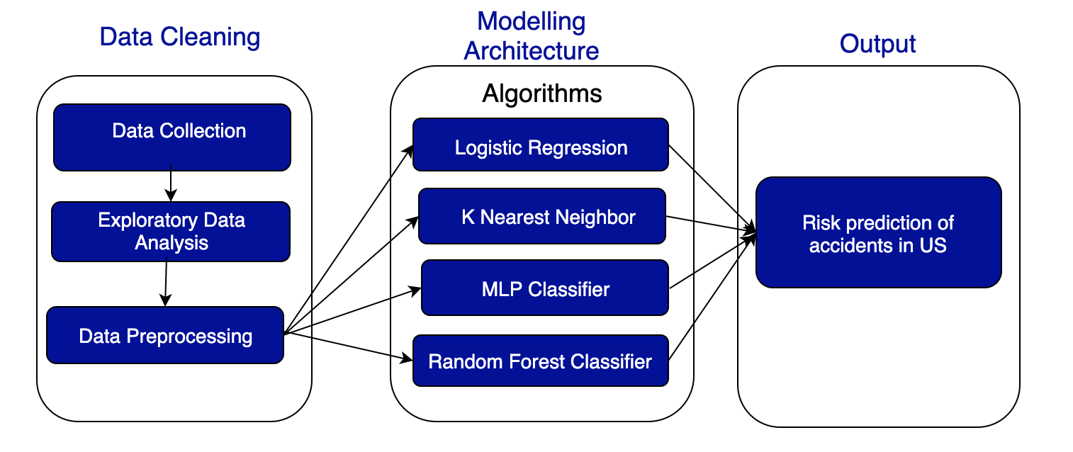
Block Diagram

Slide 6
Literature Review
Author Name | Dataset | Algorithms
Moosavi[1] | US-Accident (2.25 million) | Logistic Regression,DNN,GBC
Chang et al.[2] | Taiwan’s 1997-1998 accident Data | Negative Binomial Regression,ANN
Ren et al.[3] | Traffic accident records of Beijing in 2016 and 2017 | LSTM
Yuan et al.[4] | Motor Vehicle Crash Data + AADT + RWIS +High-Resolution Rainfall Data | Support Vector Machine (SVM), Decision Tree, Random Forest, and Deep Neural Network (DNN)
Notes:
Gradient Boosting Classifier (GBC)
AADT - Annual Average Daily Traffic
RWIS (Roadway Weather Information System) Data by Iowa Department
Moosavi DNN(a four-layer feed-forward neural network, with three hidden layers of size 512, 256, and 64, respectively. ReLU was used as the activation function of the hidden layers, and softmax was applied on the output of the last layer)

Slide 7
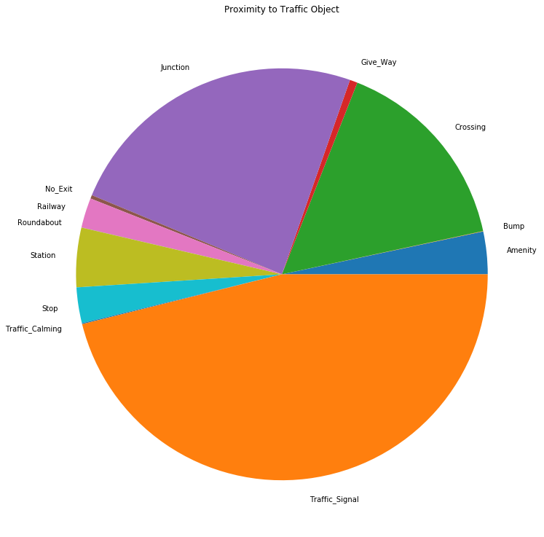
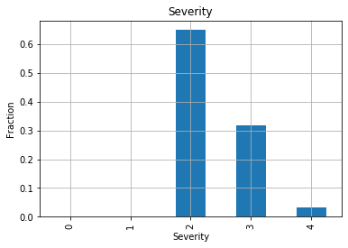
Exploratory Data Analysis
Notes:
Proximity to Traffic Objects: Pie chart that shows percentage of accidents near various traffic objects. Here most accidents happened near the traffic signals
Data distribution of accidents based on severity level

Slide 8
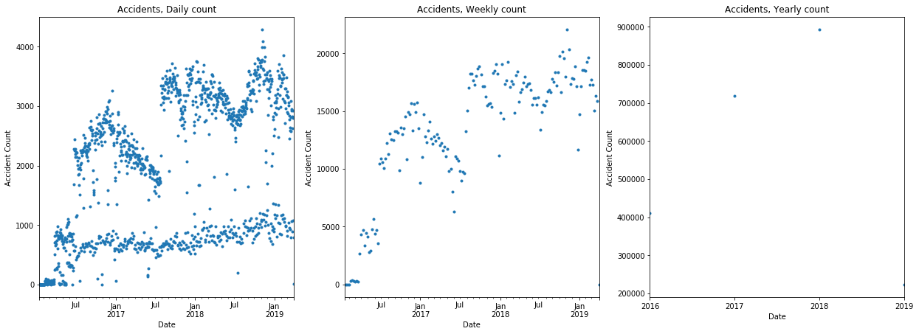
Exploratory Data Analysis
Notes:
Distribution of accidents based on daily count,weekly count and yearly count
There is some seasonal pattern, and the amount increases each year.

Slide 9
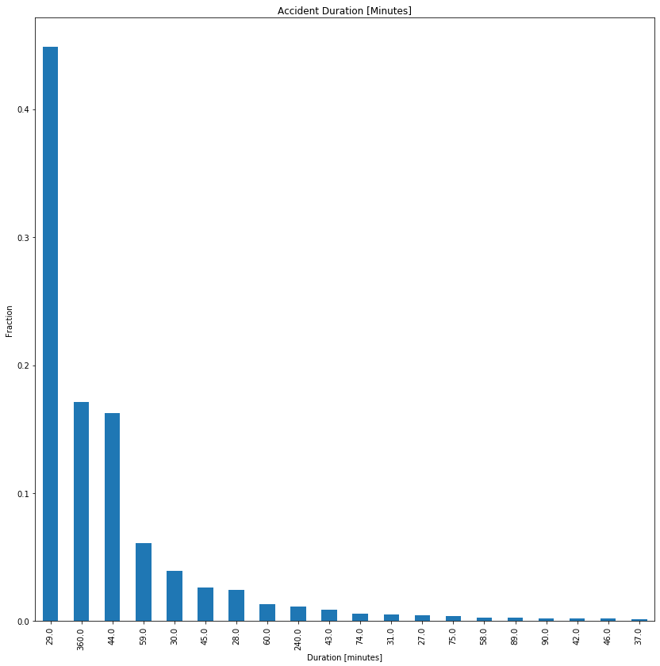
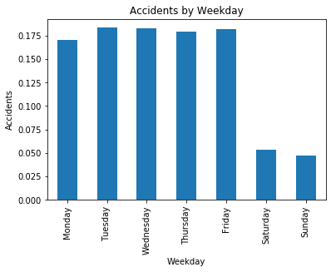
Exploratory Data Analysis
Notes:
Accident Duration(minutes) : time it took to resolve the accident rather than the accident itself¶
End time-start time
Start_TimeShows start time of the accident in local time zone.
End_TimeShows end time of the accident in local time zone.

Slide 10
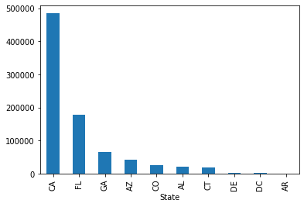
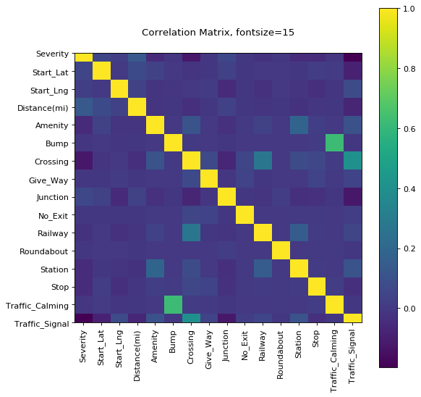
Exploratory Data Analysis
Notes:
number of accidents per states and display the top 10 states with the most accidents

Slide 11
Preprocessing
Handling null values
Label Encoding
Dimensionality reduction
Scaling & Normalization
Removed missing values for certain columns and rows
Updated with median and mode for few columns
Down sampling
Binning (in progress)
Label encoding to change categorical columns to numerical
One hot encoding for certain columns
Principal Component Analysis (PCA)
Standard scaling
Normalization
Parameter Tuning (Grid Search CV)

Slide 12
Selected Features
Start_Lat, Start_Lng, Amenity, Bump, Crossing, Give_Way, Junction, No_Exit, Railway, Roundabout, Station, Stop, Traffic_Calming, Traffic_Signal, Turning_Loop, Sunrise_Sunset

Slide 13
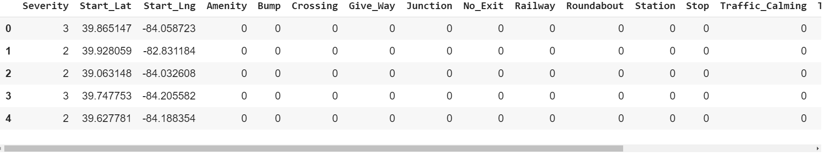
Dataset after pre-processing

Slide 14
Methodology
ALGORITHM | PARAMETERS
Logistic Regression | random_state=0, solver='lbfgs', multi_class='multinomial'
K nearest neighbour | algorithm='auto', leaf_size=30, metric='minkowski', metric_params=None, n_jobs=None, n_neighbors=10, p=2, weights='uniform'
Decision Tree | random_state = 120, criterion="entropy", max_depth=4
Neural Networks(Multi-Layer Perceptron) | solver='adam', alpha=0.0001, hidden_layer_sizes=(30, 30, 30), max_iter=200,learning_rate_init=0.001
Random Forest | n_estimators=80
Ensemble Modeling (Ada Boost) | n_estimators=200, learning_rate=0.08

Slide 15
ALGORITHM | PARAMETERS
Logistic Regression | random_state=0, solver='lbfgs', multi_class='multinomial'
K nearest neighbour | algorithm='auto', leaf_size=30, metric='minkowski', metric_params=None, n_jobs=None, n_neighbors=10, p=2, weights='uniform'
Decision Tree | random_state = 120, criterion="entropy", max_depth=4
Neural Networks(Multi-Layer Perceptron) | solver='adam', alpha=0.0001, hidden_layer_sizes=(30, 30, 30), max_iter=200,learning_rate_init=0.001
Random Forest | n_estimators=80
Ensemble Modeling (Ada Boost) | n_estimators=200, learning_rate=0.08

Slide 16
Evaluation
Accuracy Metrics: Accuracy score metrics for the test data is captured for all the models.
Cross Validation: We are doing cross validation with 5 folds.
Confusion Matrix: It is plotted to visualize the number of correct predictions in the test data.

Slide 17
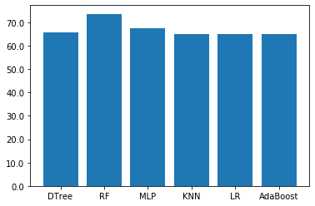
Experimental Results
Accuracy comparison graph and table between different algorithms
S.no | Algorithms | Accuracy(%)
1. | Random Forest | 73.63%
2. | MLP | 69.8%
3. | Decision Tree | 65.56%
4. | KNN | 65%
5. | Logistic Regression | 65%
6. | Adaboost | 65.12%

Slide 18
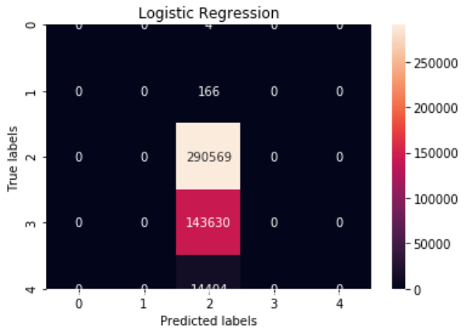
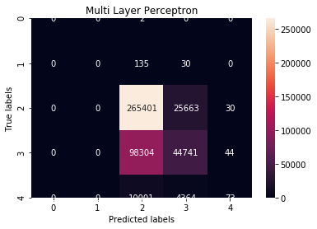
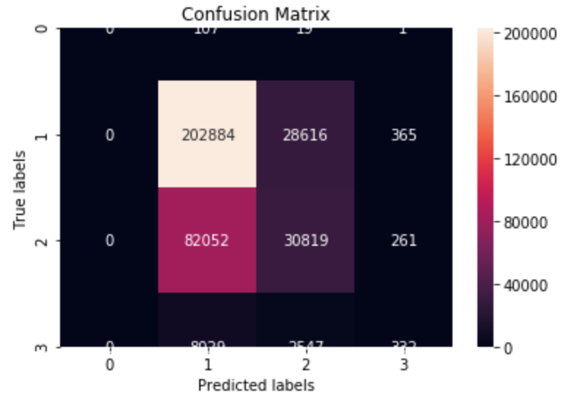
Confusion Matrix
Logistic Regression
MLP Classifier
KNN Classifier

Slide 19
Conclusion And Future Scope
The maximum accuracy score that we got is for Random Forest which is 73.63%.
Future Scope: Data augmentation can be used to create temporal data. We could use algorithms like LSTM and RNN.

Slide 20
Individual Contributions
Priyanka Kumar -
Name | Contribution
Priyanka Kumar | Data Exploration and Visualization, MLP Classifier
Rama Tejaswini Thotapalli | Data Preprocessing, K Nearest Neighbor and Ada Boost Classifier
Naga Janaki Dwadasi | Data Preprocessing, Logistic Regression and Ensemble Modeling
Vaidehi Naik | Model Evaluations, Decision Tree and Random Forest Classifier

Slide 21
References
Moosavi, Sobhan, Mohammad Hossein Samavatian, Srinivasan Parthasarathy, Radu Teodorescu, and Rajiv Ramnath. "Accident Risk Prediction based on Heterogeneous Sparse Data: New Dataset and Insights." arXiv preprint arXiv:1909.09638 (2019)
Chang, Li-Yen. "Analysis of freeway accident frequencies: negative binomial regression versus artificial neural network." Safety science 43.8 (2005): 541-557.
Ren, Honglei, You Song, Jingwen Wang, Yucheng Hu, and Jinzhi Lei. "A deep learning approach to the citywide traffic accident risk prediction." In 2018 21st International Conference on Intelligent Transportation Systems (ITSC), pp. 3346-3351. IEEE, 2018.
Yuan, Zhuoning, Xun Zhou, Tianbao Yang, James Tamerius, and Ricardo Mantilla. "Predicting traffic accidents through heterogeneous urban data: A case study." In 6th International Workshop on Urban Computing (UrbComp 2017). 2017.

Slide 22
Thank You
Q&A

