Slide 1
Domain : Cloud Computing
Technology: Python
Dual Access Control for Cloud-Based Data Storage and Sharing

Slide 2
Index
Abstract
Introduction
Literature review
Existing Method
Drawbacks
Proposed method
Advantages
Implementation
Hardware and Software Requirements
UML diagrams
Architecture
Results
Conclusion
References

Slide 3
Abstract
Cloud-based data storage service has drawn increasing interests from both academic and industry in the recent years due to its efﬁcient and low cost management. Since it provides services in an open network, it is urgent for service providers to make use of secure data storage and sharing mechanism to ensure data conﬁdentiality and service user privacy. To protect sensitive data from being compromised, the most widely used method is encryption. However, simply encrypting data (e.g., via AES) cannot fully address the practical need of data management. Besides, an effective access control over download request also needs to be considered so that Economic Denial of Sustainability (EDoS) attacks cannot be launched to hinder users from enjoying service.

Slide 4
In this paper, we consider the dual access control, in the context of cloud-based storage, in the sense that we design a control mechanism over both data access and download request without loss of security and efﬁciency. Two dual access control systems are designed in this paper, where each of them is for a distinct designed setting. The security and experimental analysis for the systems are also presented

Slide 5
Introduction
In the recent decades, cloud-based storage service has attracted considerable attention from both academia and industries. It may be widely used in many Internet-based commercial applications (e.g., Apple iCould) due to its long-list beneﬁts including access ﬂexibility and free of local data management.
Increasing number of individuals and companies nowadays prefer to outsource their data to remote cloud in such a way that they may reduce the cost of upgrading their local data management facilities/devices

Slide 6
In this paper, we propose a new mechanism, dubbed dual access control, to tackle the above aforementioned two problems. To secure data in cloud-based storage service, attribute-based encryption (ABE) [9] is one of the promising candidates that enables the conﬁdentiality of outsourced data as well as ﬁne-grained control over the outsourced data.

Slide 7
Literature review
[1] Alexandros Bakas and Antonis Michalas. Modern family: A revocable hybrid encryption scheme based on attribute-based encryption, symmetric searchable encryption and SGX. In SecureComm 2019, pages 472–486, 2019.
Secure cloud storage is considered as one of the most important issues that both businesses and end-users take into account before moving their private data to the cloud. Lately, we have seen some interesting approaches that are based either on the promising concept of Symmetric Searchable Encryption (SSE) or on the well-studied field of Attribute-Based Encryption (ABE).

Slide 8
[2] Antonis Michalas. The lord of the shares: combining attribute based encryption and searchable encryption for ﬂexible data sharing. In SAC 2019, pages 146–155, 2019
Secure cloud storage is considered one of the most important issues that both businesses and end-users are considering before moving their private data to the cloud. Lately, we have seen some interesting approaches that are based either on the promising concept of Symmetric Searchable Encryption (SSE) or on the well-studied field of Attribute-Based Encryption (ABE).

Slide 9
[3] G. Wang, C. Liu, Y. Dong, P. Han, H. Pan, and B. Fang, “Idcrypt: A multi-user searchable symmetric encryption scheme for cloud applications,” IEEE Access, vol. 6, pp. 2908–2921, 2018.
Searchable Encryption (SE) has been extensively examined by both academic and industry researchers. While many academic SE schemes show provable security, they usually expose some query information (e.g., search and access patterns) to achieve high efficiency. However, several inference attacks have exploited such leakage, e.g., a query recovery attack can convert opaque query trapdoors to their corresponding keywords based on some prior knowledge.

Slide 10
[4] Kaiping Xue, Weikeng Chen, Wei Li, Jianan Hong, and Peilin Hong. Combining data owner-side and cloud-side access control for encrypted cloud storage. IEEE Transactions on Information Forensics and Security, 2018.
People endorse the great power of cloud computing, but cannot fully trust the cloud providers to host privacy-sensitive data, due to the absence of user-to-cloud controllability. To ensure confidentiality, data owners outsource encrypted data instead of plaintexts. To share the encrypted files with other users, ciphertext-policy attribute-based encryption (CP-ABE) can be utilized to conduct fine-grained and owner-centric access control. But this does not sufficiently become secure against other attacks.

Slide 11
[5] Jianting Ning, Zhenfu Cao, Xiaolei Dong, Kaitai Liang, Hui Ma, and Lifei Wei. Auditable σ-time outsourced attribute-based encryption for access control in cloud computing. IEEE Transactions on Information Forensics and Security, 13(1):94–105, 2018..
As a sophisticated mechanism for secure fine grained access control over encrypted data, ciphertext-policy attribute-based encryption (CP-ABE) is one of the highly promising candidates for cloud computing applications. However, there exist two main long-lasting open problems of CP-ABE that may limit its wide deployment in commercial applications. One is that decryption yields expensive pairing cost which often grows with the increase of access policy size.

Slide 12
Existing method
The existing works, by using normal servers for storing and sharing data that causes un security lack of privacy. There is a chance of stole our data this is the main drawback of existing system to overcome this difficulty we can go for proposed system.
DISADVANTAGES:
Searching the stored documents takes time linear in the size of the database
It uses heavy arithmetic operations
Less security.

Slide 13
Proposed system
In proposed system, we propose a new mechanism, dubbed dual access control, to tackle the above aforementioned two problems. To secure data in cloud-based storage service, attribute-based encryption is one of the promising candidates that enables the conﬁdentiality of out sourced data as well as ﬁne-grained control over the outsourced data
ADVANTAGES:
Provides more security.
It uses simple arithmetic operations.
Storage capacity is high.

Slide 14
Implementation
1. DATA OWNER:
Register:
Data owner can Register and login with valid credentials
Upload File:
Data provider can upload the file.
View File:
Data Owner can view uploaded file once means whether the file is correctly uploaded or not.
.

Slide 15
2.User:
Register:
Data user can do registration with his details.
Login:
The user needs to register and the data stored in MySQL database.
Search a File:
Data user can search a file based on the keyword ,if file is available then user can view file and send request to KGC to download the file.
Get Key & Download
Once User Request can accept get the key to cloud provider user can download the file.

Slide 16
3. Cloud service provider:
Login:
KGC can login with his/her credentials.
View Requests:
User can send the request to download a file. KGC can accept that requests and send key to cloud provider.

Slide 17
4. Authority
Login
Internal server can login with his/her credentials.
View Users Requests Accepted by KGC:
Authority can view the accepted requests information given by KGC.

Slide 18
Hardware and Software Requirements:
H/W Configuration:
Processor - I3/Intel Processor
Hard Disk -160GB
Key Board - Standard Windows Keyboard
Mouse - Two or Three Button Mouse
Monitor - SVGA

Slide 19
S/W Configuration:
Processor - I3/Intel Processor
Hard Disk -160GB
Key Board - Standard Windows Keyboard
Mouse - Two or Three Button Mouse
Monitor - SVGA

Slide 20
UML diagrams
CLASS DIAGRAM:
In software engineering, a class diagram in the Unified Modeling Language (UML) is a type of static structure diagram that describes the structure of a system by showing the system's classes, their attributes, operations (or methods), and the relationships among the classes. It explains which class contains information.

Slide 22
USE CASE DIAGRAM:
A use case diagram in the Unified Modeling Language (UML) is a type of behavioral diagram defined by and created from a Use-case analysis. Its purpose is to present a graphical overview of the functionality provided by a system in terms of actors, their goals (represented as use cases), and any dependencies between those use cases.

Slide 23
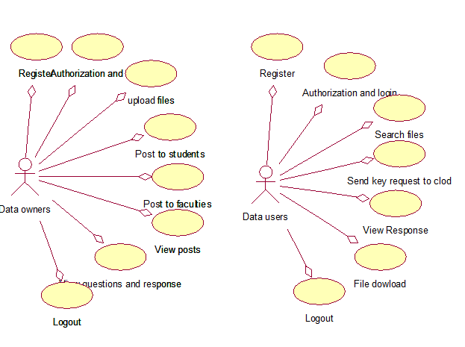
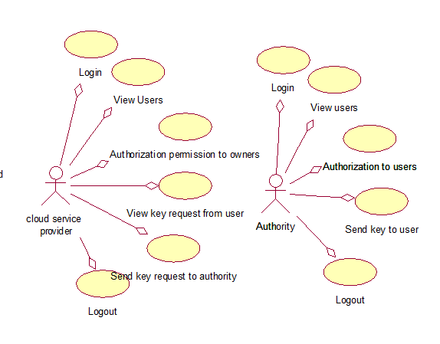

Slide 24
SEQUENCE DIAGRAM:
A sequence diagram in Unified Modeling Language (UML) is a kind of interaction diagram that shows how processes operate with one another and in what order. It is a construct of a Message Sequence Chart. Sequence diagrams are sometimes called event diagrams, event scenarios, and timing diagrams.

Slide 26
Collaboration Diagram:
In collaboration diagram the method call sequence is indicated by some numbering technique as shown below. The number indicates how the methods are called one after another. We have taken the same order management system to describe the collaboration diagram. The method calls are similar to that of a sequence diagram. But the difference is that the sequence diagram does not describe the object organization whereas the collaboration diagram shows the object organization.

Slide 27
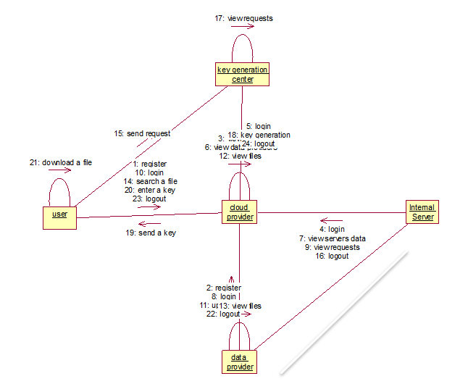

Slide 28
DEPLOYMENT DIAGRAM
Deployment diagram represents the deployment view of a system. It is related to the component diagram. Because the components are deployed using the deployment diagrams. A deployment diagram consists of nodes. Nodes are nothing but physical hardware’s used to deploy the application.

Slide 30
ACTIVITY DIAGRAM:
Activity diagrams are graphical representations of workflows of stepwise activities and actions with support for choice, iteration and concurrency. In the Unified Modelling Language, activity diagrams can be used to describe the business and operational step-by-step workflows of components in a system. An activity diagram shows the overall flow of control.

Slide 31
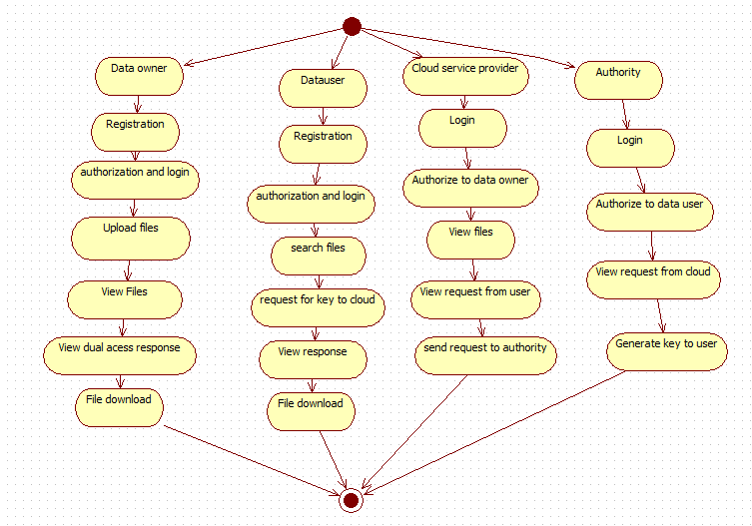

Slide 32
Component diagram,
A component diagram, also known as a UML component diagram, describes the organization and wiring of the physical components in a system. Component diagrams are often drawn to help model implementation details and double-check that every aspect of the system's required functions is covered by planned development.

Slide 34
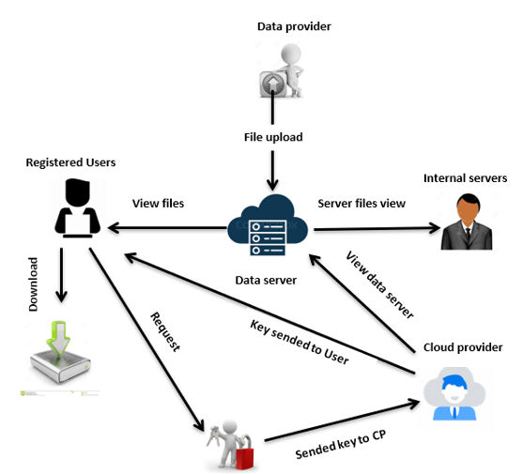
Architecture

Slide 35
Conclusion:
In this paper, we introduced the notion of SE-EPOM and formalized its security deﬁnitions. Subsequently, we designed a concrete SE-EPOM scheme in a distributed architecture with our novel subset decision mechanism and proved it satisﬁes our proposed security requirements. Besides, the scheme possesses attractive features including supporting multi-keyword search, constant size trapdoor and ciphertext, hiding search pattern and access pattern during searching, and enabling the multi-writer/multi-reader setting. Finally, the evaluation on compared schemes and our scheme shows that the overall performance of our distributed SEEPOM scheme outperforms other solutions. We leave designing a secure SE-EPOM with fewer rounds of communication between CP and IS’s as our future work.

Slide 36
References:
[1] “Forecast number of personal cloud storage consumers/users worldwide from 2014 to 2020 (in millions),” https://www.statista.com/statistics/638593/ worldwide-data-center-storage-capacity-cloud-vs-traditional/, accessed August 30, 2018.
[2] D. Boneh, G. Di Crescenzo, R. Ostrovsky, and G. Persiano, “Public key encryption with keyword search,” in International conference on the theory and applications of cryptographic techniques, 2004, pp. 506–522.
[3] J. W. Byun, H. S. Rhee, H.-A. Park, and D. H. Lee, “Off-line keyword guessing attacks on recent keyword search schemes over encrypted data,” in Workshop on Secure Data Management, 2006, pp. 75–83.

Slide 37
[4] Q. Huang and H. Li, “An efﬁcient public-key searchable encryption scheme secure against inside keyword guessing attacks,” Information Sciences, vol. 403, pp. 1–14, 2017.
[5] D. X. Song, D. Wagner, and A. Perrig, “Practical techniques for searches on encrypted data,” in Security and Privacy, 2000. S&P 2000. Proceedings. 2000 IEEE Symposium on, 2000, pp. 44–55.

Slide 38


