Slide 1

Analyzing Weather Impact on Ambulance response time
Presented by: Shrey Jain

Slide 2





Agenda
Problem Statement
Data preparation
Preliminary Assessment
Strategy for Model Construction
Expected Outcome

Slide 3

Problem Statement
What is the need for Ambulance response time during emergencies?
How do weather conditions affect Ambulance response times and by what factor?
How can this relation help us predict the response times accurately?

Slide 4

Datasets
EMS Dataset
Provided by the Fire Department of New York City (FDNY)
11863759 rows and 32 columns
Weather Dataset
Provided by the Global Historical Climatology Network
3288 rows and 34 columns
Both datasets would be joined using the Incident_dt (date) column

Slide 5

Data Preparation
The following steps would be performed on each dataset:
Quality Assessment
Cleaning
Transformation / Merging
Data Analysis
Model preparation
Evaluation

Slide 6
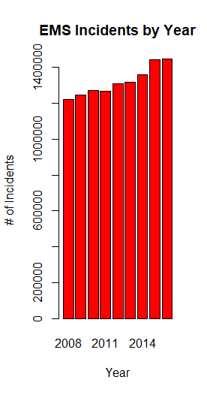
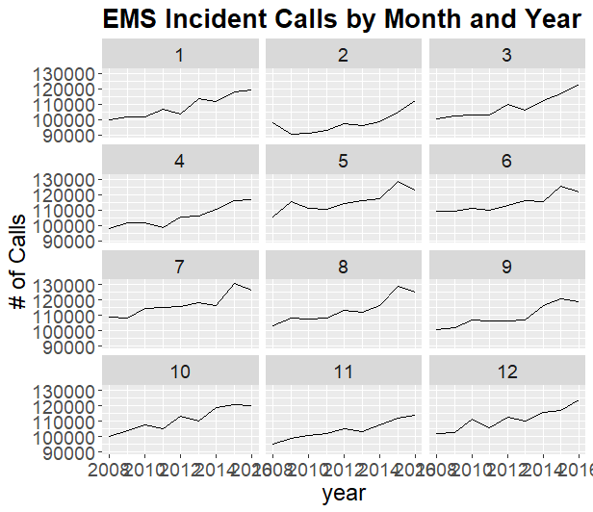
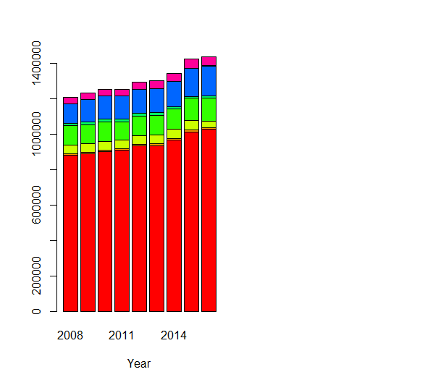
Preliminary Assessment

Slide 7
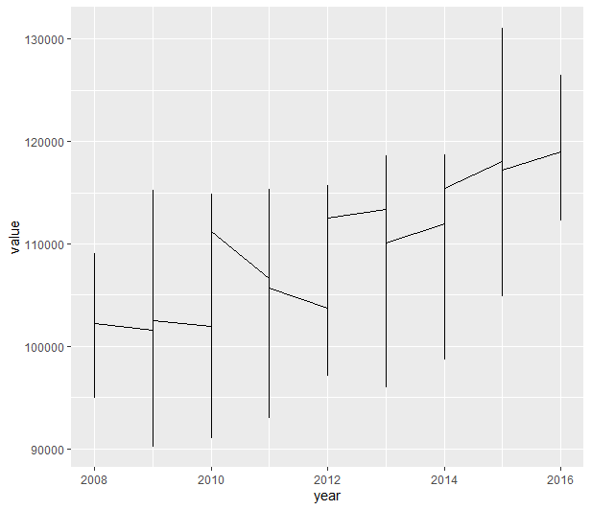
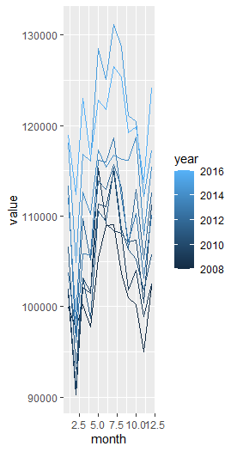
Preliminary Assessment

Slide 8

Strategy for Model Construction
Perform data pre-processing and data analysis on the combined dataset using various plots
Split the dataset for training and testing
Apply regression techniques using various models like Random Forest, KNN, SVM, Polynomial Regression, etc.
Evaluate which model fits the best
Predict response time (INCIDENT_RESPONSE_SECONDS_QY)
Uncertainties:
Weather data has less records as compared to the EMS data; hence data might not be sufficient enough for training the models

Slide 9

Expected Outcome
Find out whether weather and ambulance response time are co-related or not
If yes, understand how they are related and by what factor
Does bad weather lead to higher response time, or low?
Ultimate outcome:
Develop a high-accuracy regression model to predict response times

Slide 10

Thank you!

