Slide 1

ANT Trucks Data Analysis (Group 2)
Group Members: -Kunal Kuber Jagdale
-Shrey Sandeep Jain
-Tasfia Katha
-Jitin Naidu Kondipati
-Priyanka Shirish Laghate

Slide 2
Problem Statement
To determine and forecast risk factors for driver identification based on a variety of variables, including events, and average speed.
Analyze the dataset using different criteria, such as location, events, and risk factors, to determine who are the risky drivers.
By using the risk factor threshold, the project aims to generate a report highlighting the drivers with a risk factor greater than or equal to 7.0, allowing the fleet manager to take necessary actions to reduce the risk of accidents and ensure compliance with regulations.

Slide 3






Workflow
Aquire data
Files
import files
to HDFS
syncing tables
Creating
Tables
In hive
Populating risk factor table
data analysis in Tableau

Slide 4
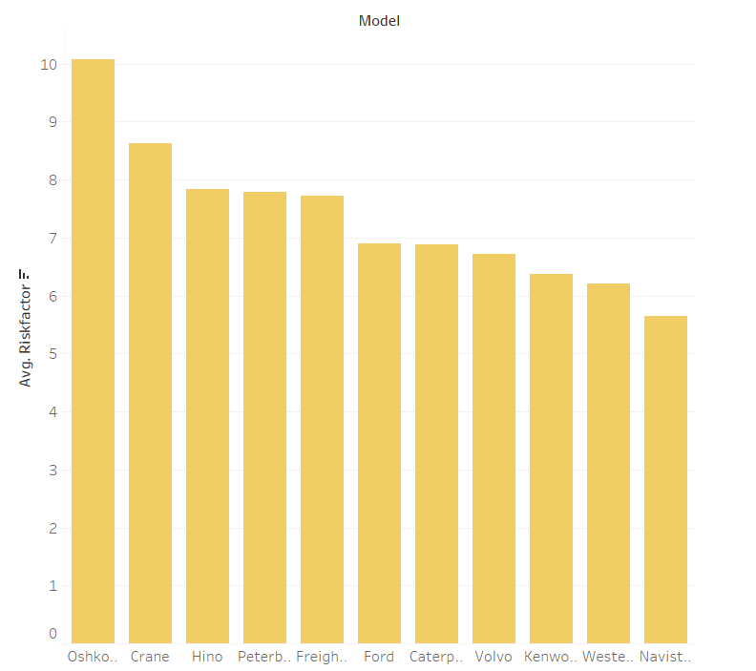
Risk Factor by Truck Model
Analysis and Insights
Models from Oshkosh, Crane, Hino, Peterbilt and Freightliner have the avg risk factor.
The average risk factor for the first 5 models is >7 with Oshkosh being the highest at 10.08.
Depending on the state of the vehicle, these models can be replaced with new ones or cross-checked for maintenance and repairs.

Slide 5
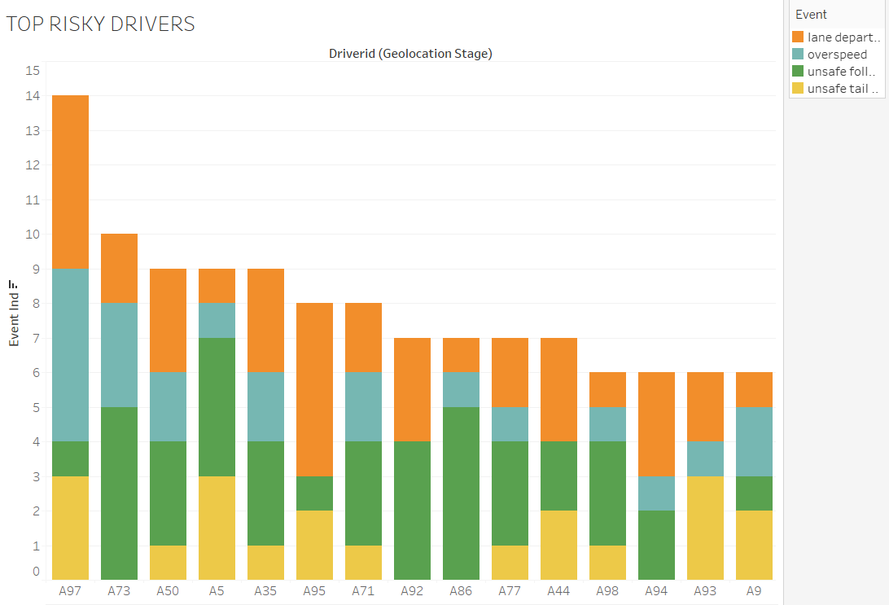
Top Risky Drivers by Events
Analysis and Insights
Observation:
Driver ID A97, A73 and A50 are the top 3 risky drivers with 14,10 and 9 risky events respectively which include over speeding, lane departure etc.
Suggestion:
In order to reduce the frequency of incidents, the company might wish to follow driving habits of the top risky drivers.
Additional training or strict rules can be imposed on such drivers to reduce risky events.

Slide 6
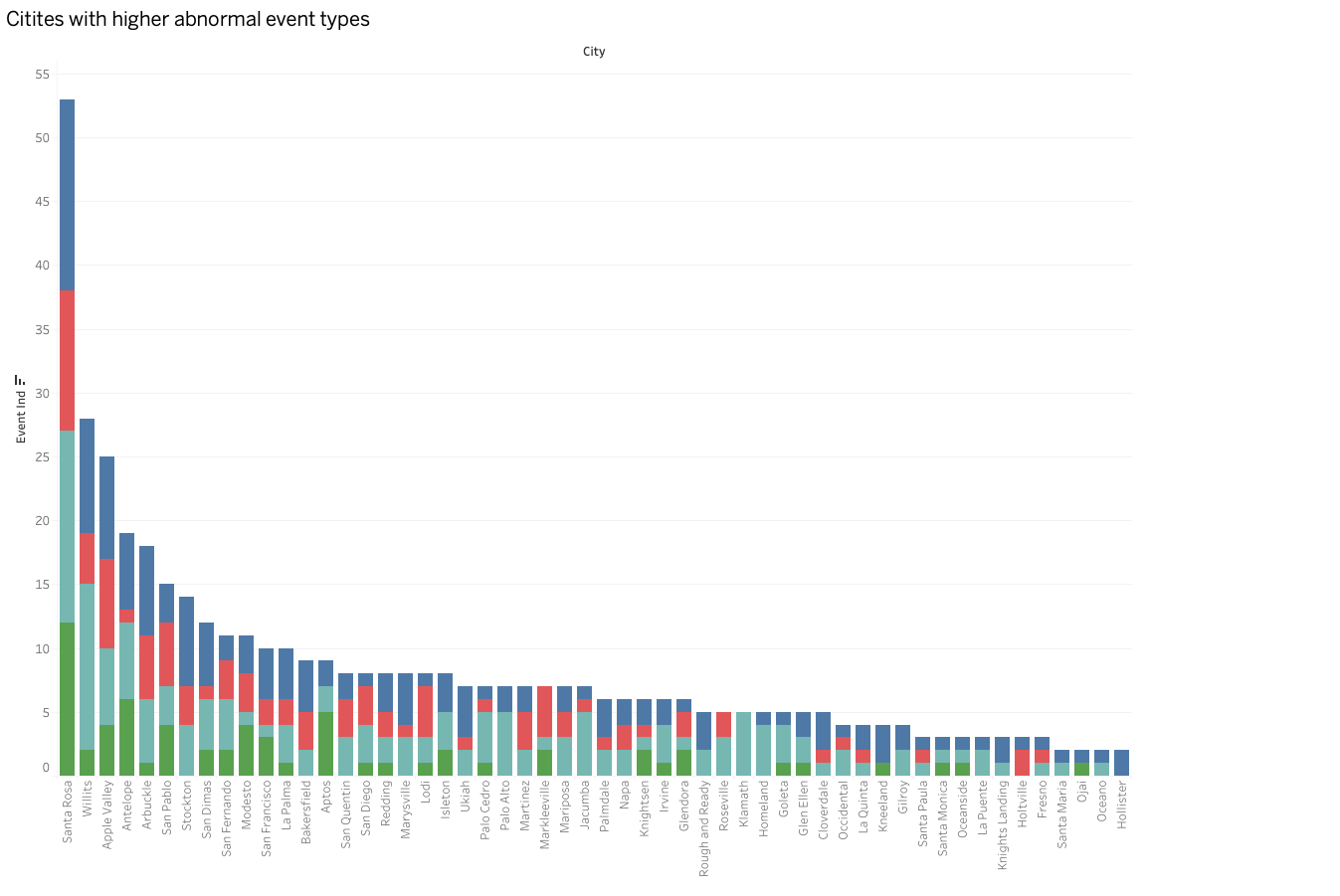
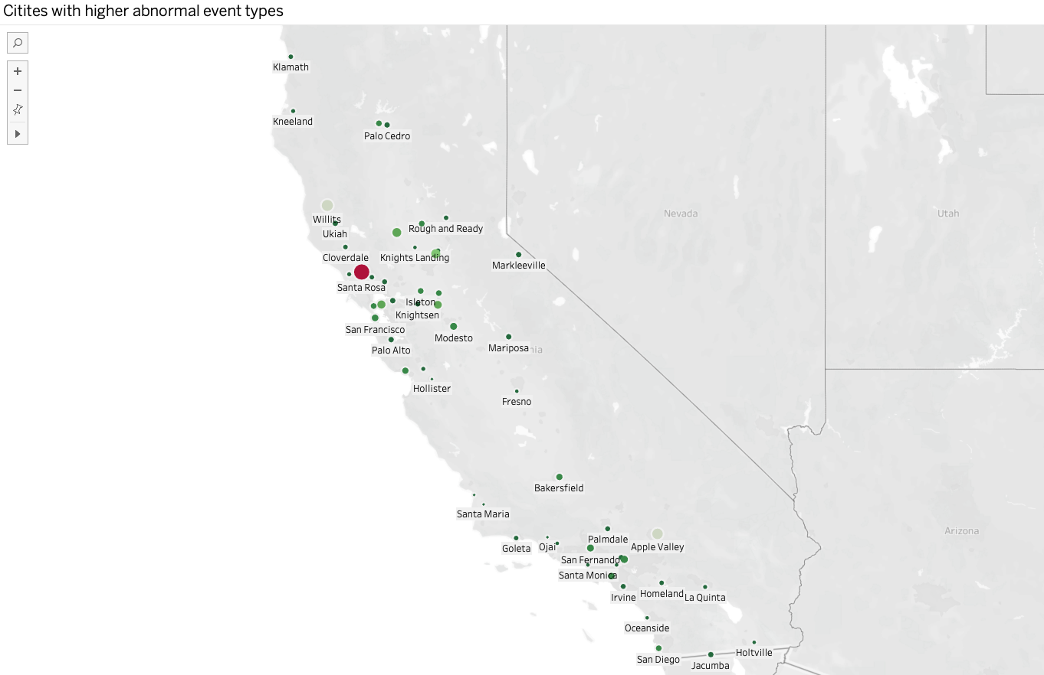
City Wise Events
Analysis and Insights
Observation:
Santa Rosa, Willits, Apple valley, Antelope, Arbuckle are the 5 cities with major risky events.
Suggestion:
It might be the case that these cities have lenient implementation on regulations so the hiring of drivers in such cities should be done more cautiously.

Slide 7
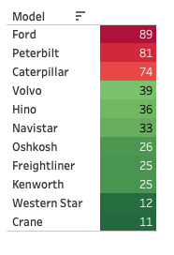
Top Risky Models by Events
Analysis and Insights
Ford, Peterbilt and Caterpillar model trucks have the highest risky events. Crane, Western Star and Kenworth have the lowest risky events.
Suggestion:
Implement additional monitoring systems in Ford, Peterbilt and Caterpillar trucks to reduce the no of risky events caused by these trucks and the drivers using them.

Slide 8
Conclusion
Each unsafe driver should be paired with an experienced driver (drivers who have driven the greatest number of miles)during the training phase as a proactive measure to mitigate risks and enhance overall safety.
The company should allow only a certain no of miles to be driven by a driver in a certain period of time.
Develop an incentive program for the driver, where the company can incentivize if a driver commits less risky events in a given quarter.
Truck drivers in high-accident regions should be watched over by a specialized team assigned by ANT. Drivers with a history of serious accidents shouldn’t be given longer trips or should be penalized.

Slide 9
Thank you

