Slide 1
Superstore-Charts
File created on: 22-Sep-24 2:26:50 AM

Slide 2


Slide 3
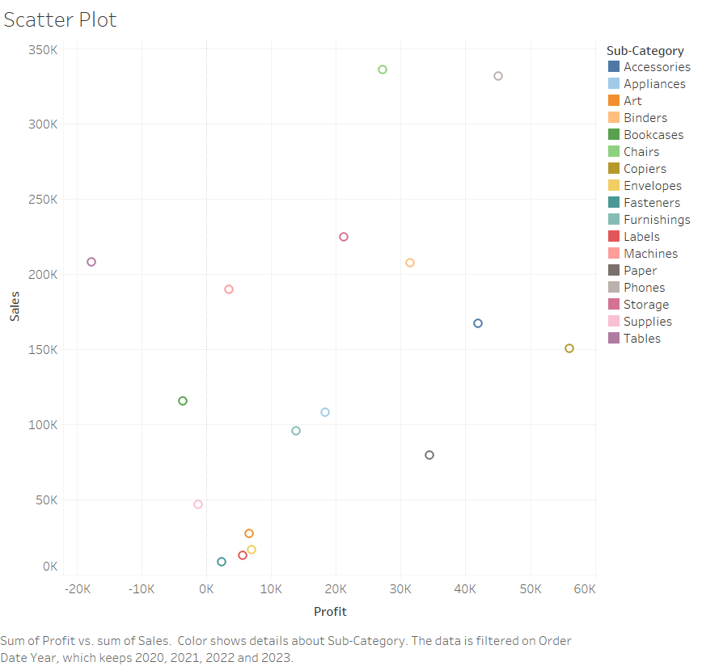

Slide 4
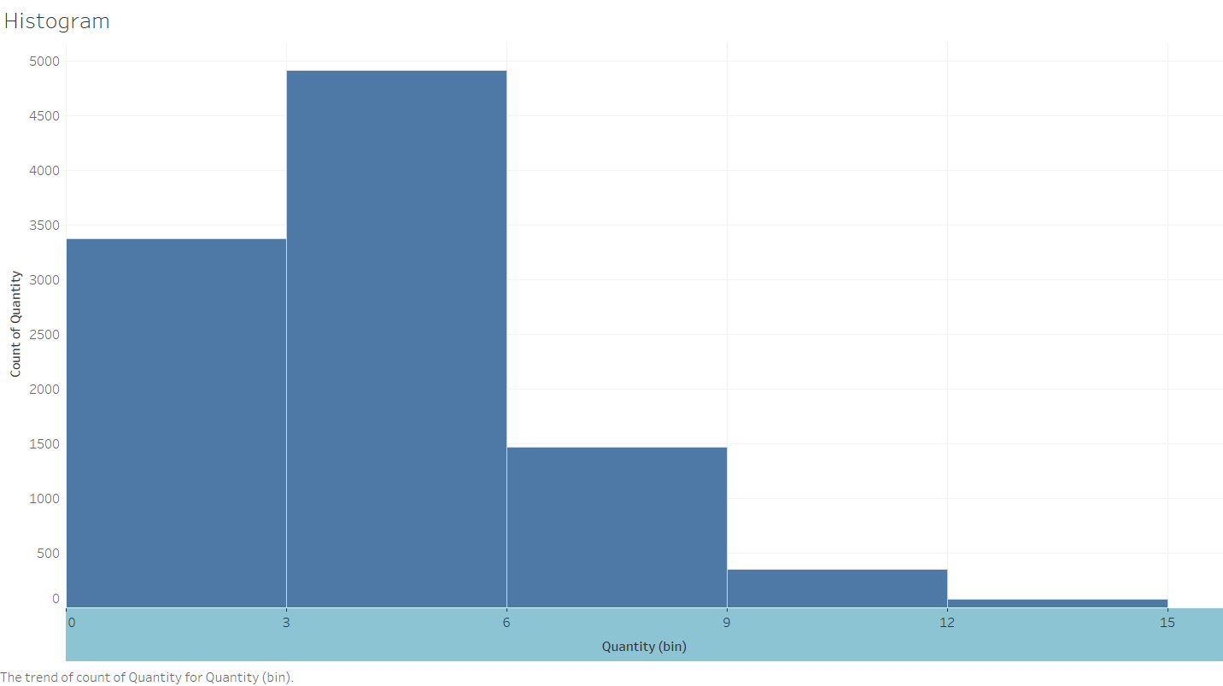

Slide 5
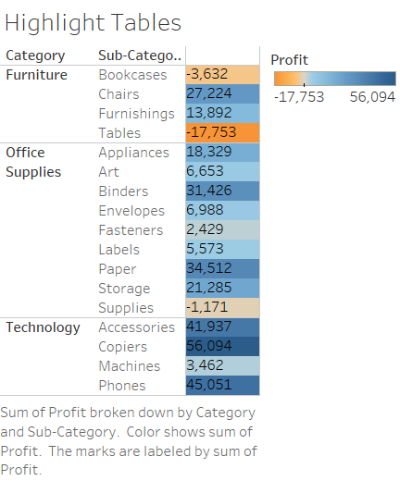

Slide 6
