Slide 1


AJAY KUMAR GARG ENGINEERING COLLEGE
INTERNSHIP ASSESSMENT
KIT-752
SUBMITTED BY DEPARTMENT YEAR
ROLL NO.
: HARI BHAJAN SINGH
: INFORMATION TECHNOLOGY
: IV
: 2000270130066
Dr. NITIN SHARMA
SUBMITTED TO :

Slide 2
Embedded Full Stack IOT Analyst
IOT
Unleashing Connectivity and Intelligence: Navigating the Embedded Full Stack IoT Landscape.

Slide 3
1. Organisation Details
Introduction to Embedded Systems
Embedded IOT
Contents
Role and responsibilities of full stack IOT
Project Work
Applications

Slide 4


Organization Details
The National Skill Development Corporation (NSDC), formed in 2008 under a Public-Private Partnership, promotes skill development in India.
The Ministry of Finance initiated this not-for-profit entity, with 49% government ownership and 51% private sector participation.
NSDC catalyzes the establishment of quality vocational institutions, providing crucial funding for scalable training initiatives.
It focuses on quality assurance, information systems and trainer academies, fostering skill development partnerships.
By funding enterprises and developing sector-specific models, NSDC acts as a catalyst, making 37 sectors appealing for private investment, aligning with the Ministry of Skill Development & Entrepreneurship's vision for a skilled workforce.
PMKVY ( Pradhan Mantri Kaushal Vikas Yojana ) : NSDC actively implements PMKVY, the flagship skill development scheme of the Government of India. PMKVY aims to enable a large number of Indian youth to take up industry- relevant skill training to help them secure a better livelihood

Slide 5
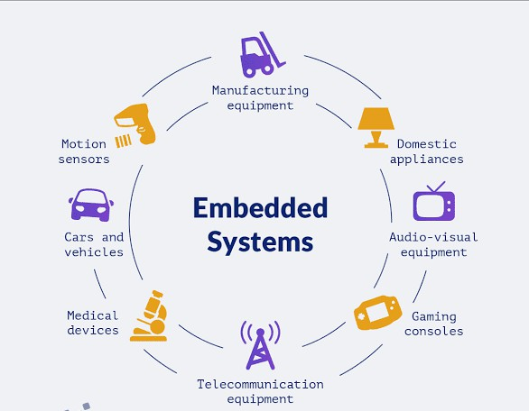
INTRODUCTION TO EMBEDDED SYSTEM
An embedded system is a specialized computing system that is dedicated to performing specific functions within a larger system.
Unlike general-purpose computers, which are designed to handle a wide range of tasks, embedded systems are typically designed to execute a specific set of functions or tasks with a focus on efficiency, reliability, and real-time performance.
Key characteristics of embedded system :-
Hardware
Software
Specific Purpose

Slide 6

Embedded IOT
What You Need to Know
Understand how the IOT works
IOT Defined
Embedded IOT Components of IOT Architecture of IOT
Networking and Protocols Used Hardwares and Softwares Used

Slide 7
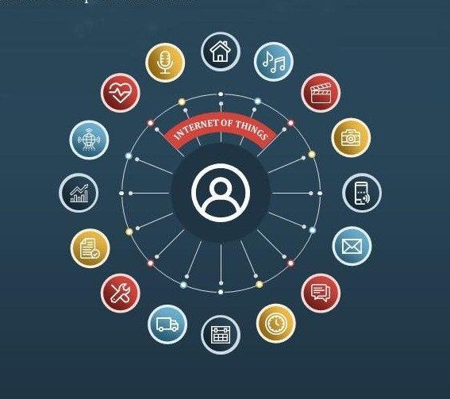
Internet Of Things
The Internet of Things (IoT) refers to the network of interconnected physical devices or "things" that communicate and exchange data over the internet.
These devices, which can include everyday objects embedded with sensors, actuators and connectivity, collect and share information to enable intelligent, automated, and often remote control.
An example of the Internet of Things (IoT) is a smart home system where various devices are connected to the internet for enhanced automation and control.

Slide 8
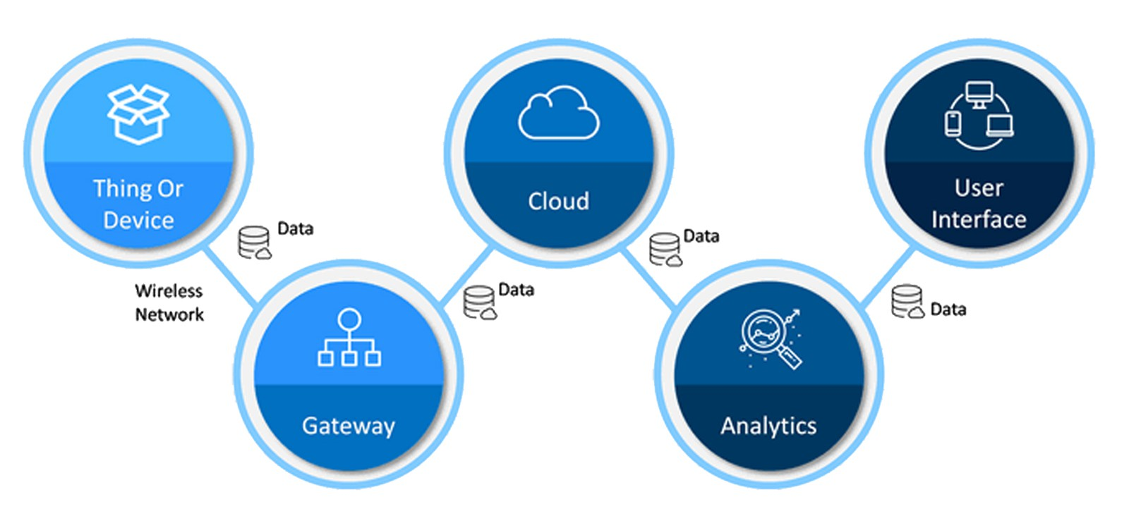
Major Components Of IOT

Slide 9
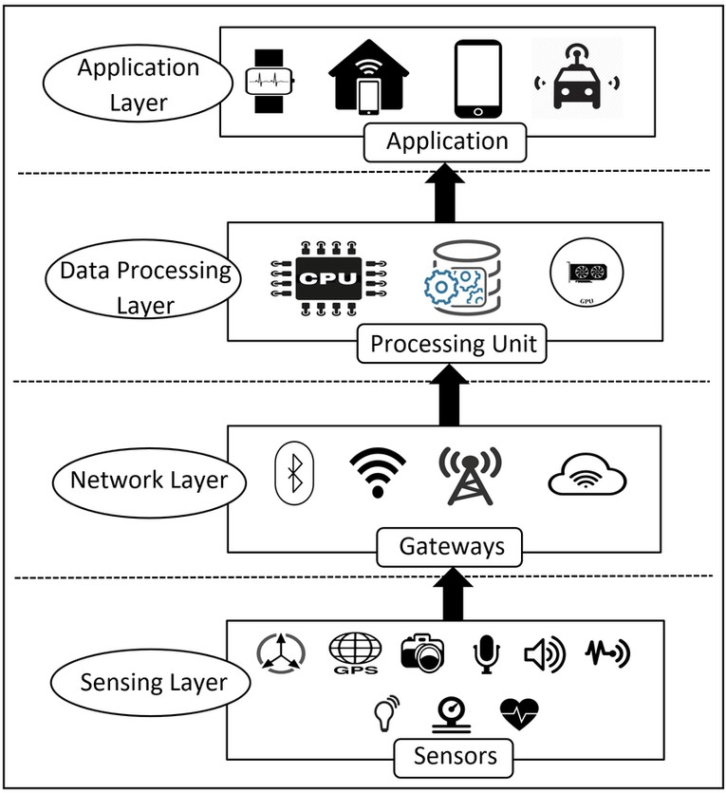
Architecture Of IOT

Slide 10
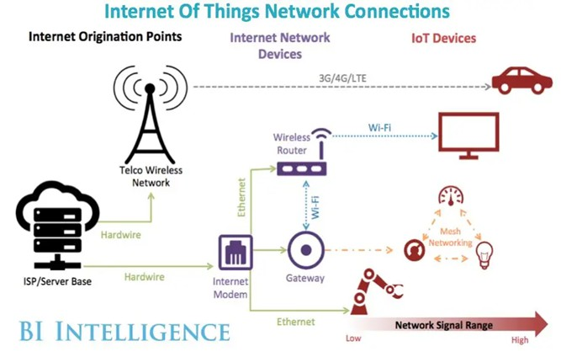
Networking In IOT

Slide 11
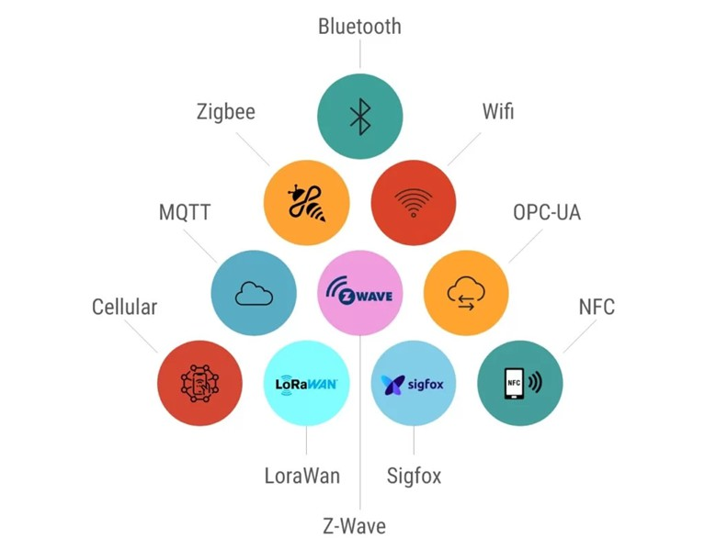
Communication Protocols
Communication protocols are the rules that enable devices to communicate and understand each other's data in interconnected systems, forming the language of the digital world. There are wireless and wired communication protocols, each with its unique characteristics.
Example:
TCP/IP HTTP SMTP USB
Bluetooth Wi-Fi Ethernet

Slide 12

Softwares Used

Slide 13



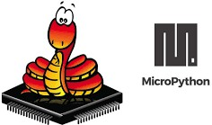



Slide 14

Hardwares Used

Slide 15
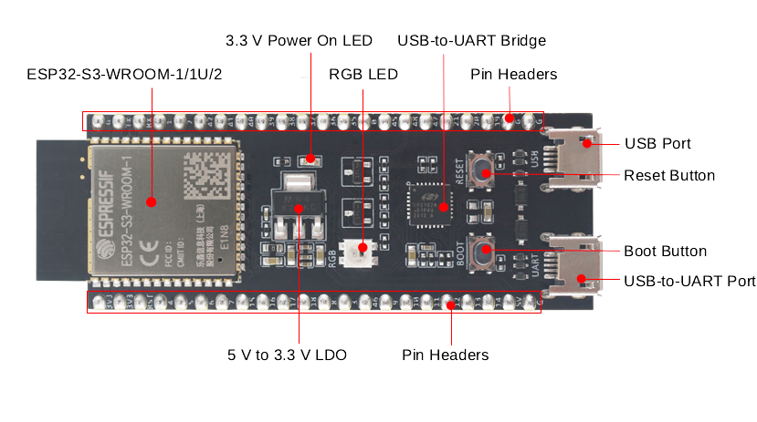
ESP32-S3

Slide 16
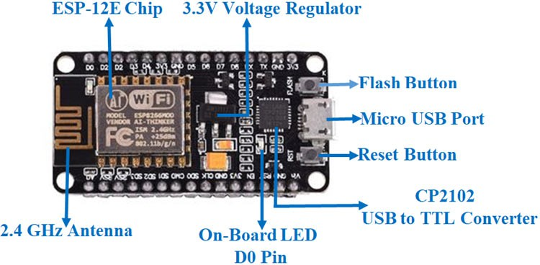
ESP8266

Slide 17
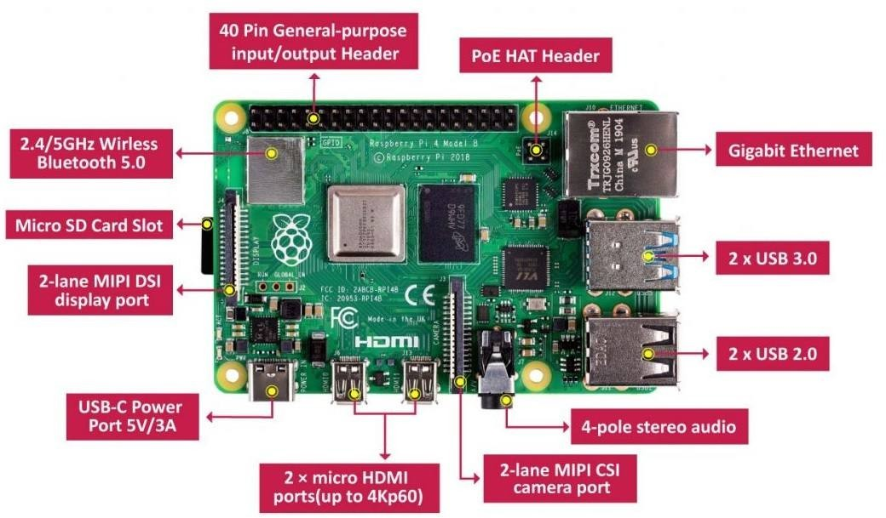
RaspBerry Pi 4

Slide 18

"Any sufficiently advanced technology is equivalent to magic."
SIR ARTHUR C. CLARKE

Slide 19
Do you have any questions?

