Slide 1

Basic Details of the team and
Problem statement
Problem statement title :- Police Feedback System
A system for ease of communication between police authorities
and general public
Team Name :- Curious Technoes
Team Leader :- Shreyansh Kulshrestha
Team Members :- Yashvardhan Singh Rathore
Aanchal Sharma

Slide 2
Solution :
1. Map integration : -
Map integration for locating and tagging the nearest or a specific police station for ease in providing feedback to the mentioned police station.
2. Account- based communication :-
An account based system to ensure their feedback can be properly responded while also ensuring that the feedbacks are genuine criticisms and not just anything. The user can choose to give the feedback anonymously.
3. Tracking of user Feedback :-
The user can track the feedback given to check whether it has been responded or not.
4. AI Chatbot :-
An AI chatbot in the app so that the user can get any information related to the police or the application. The chatbot will provide information based on the information provided to it and it’s conversation will be based on the provided information only.

Slide 3

5. Various ways to provide feedback :-
The user can provide feedback in ratings format, text format, or media format.

Slide 4
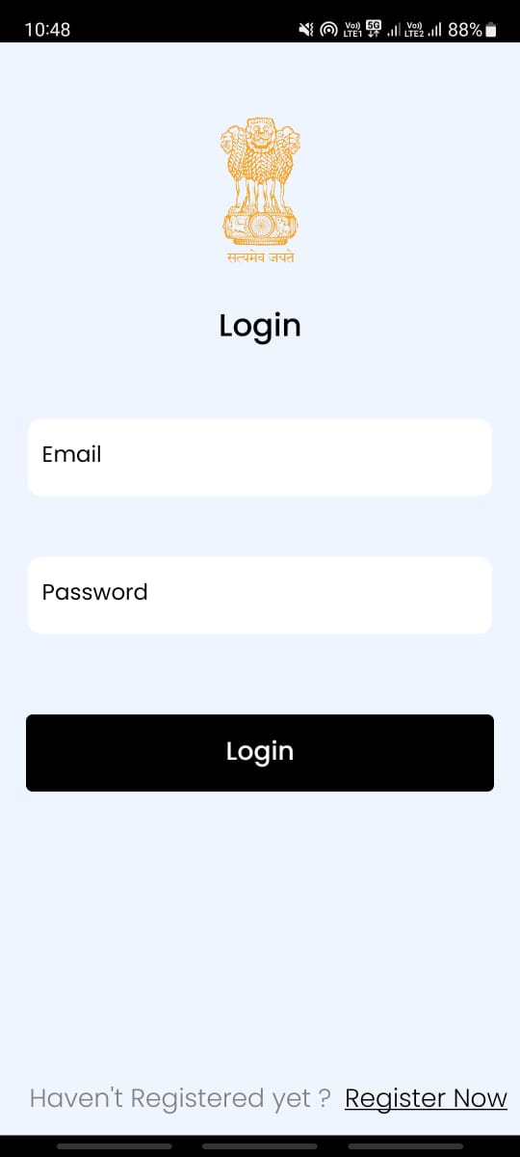
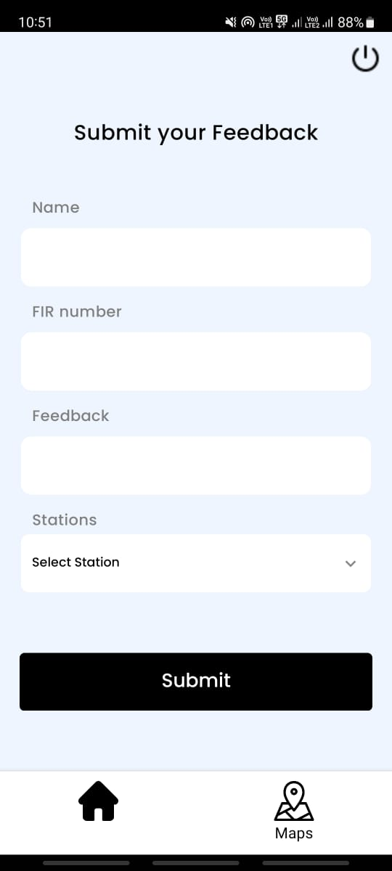
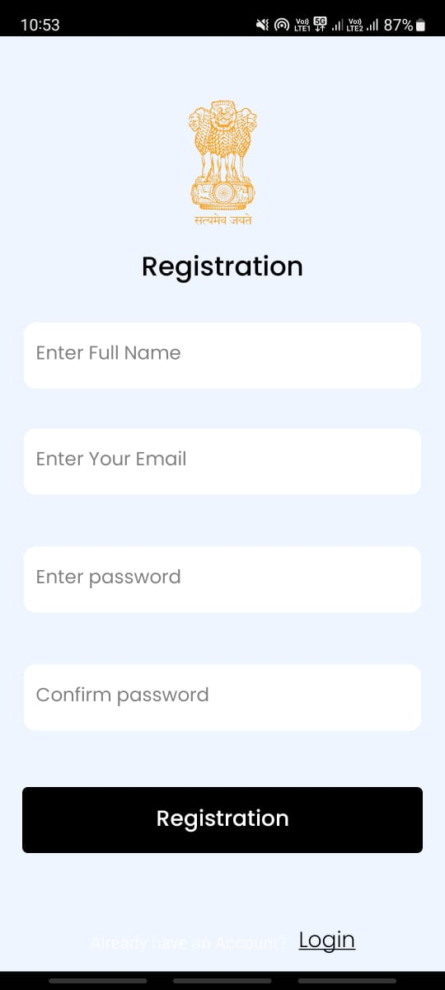
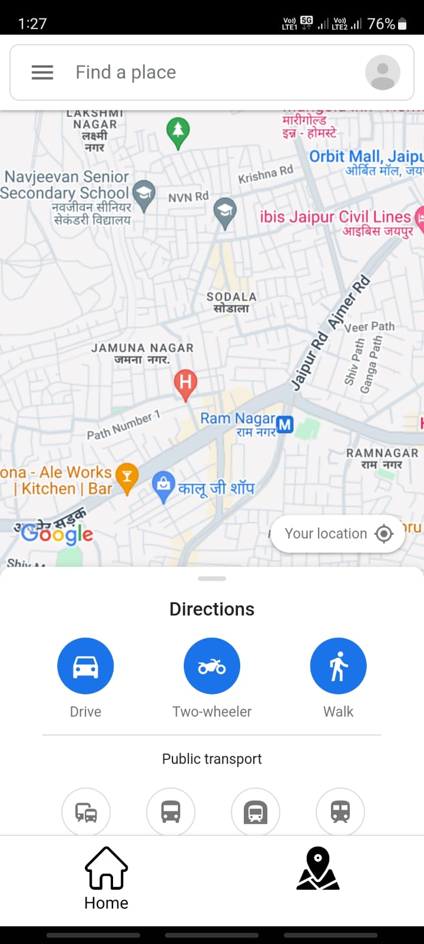
Screenshots :-
User’s Side App:

Slide 5
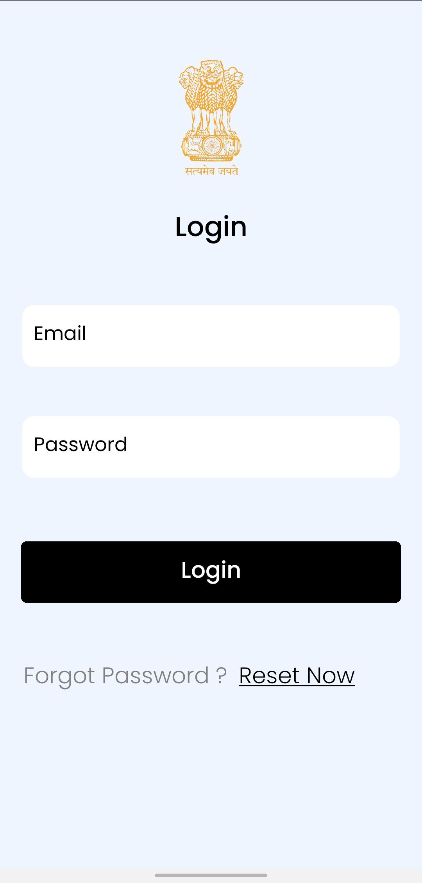
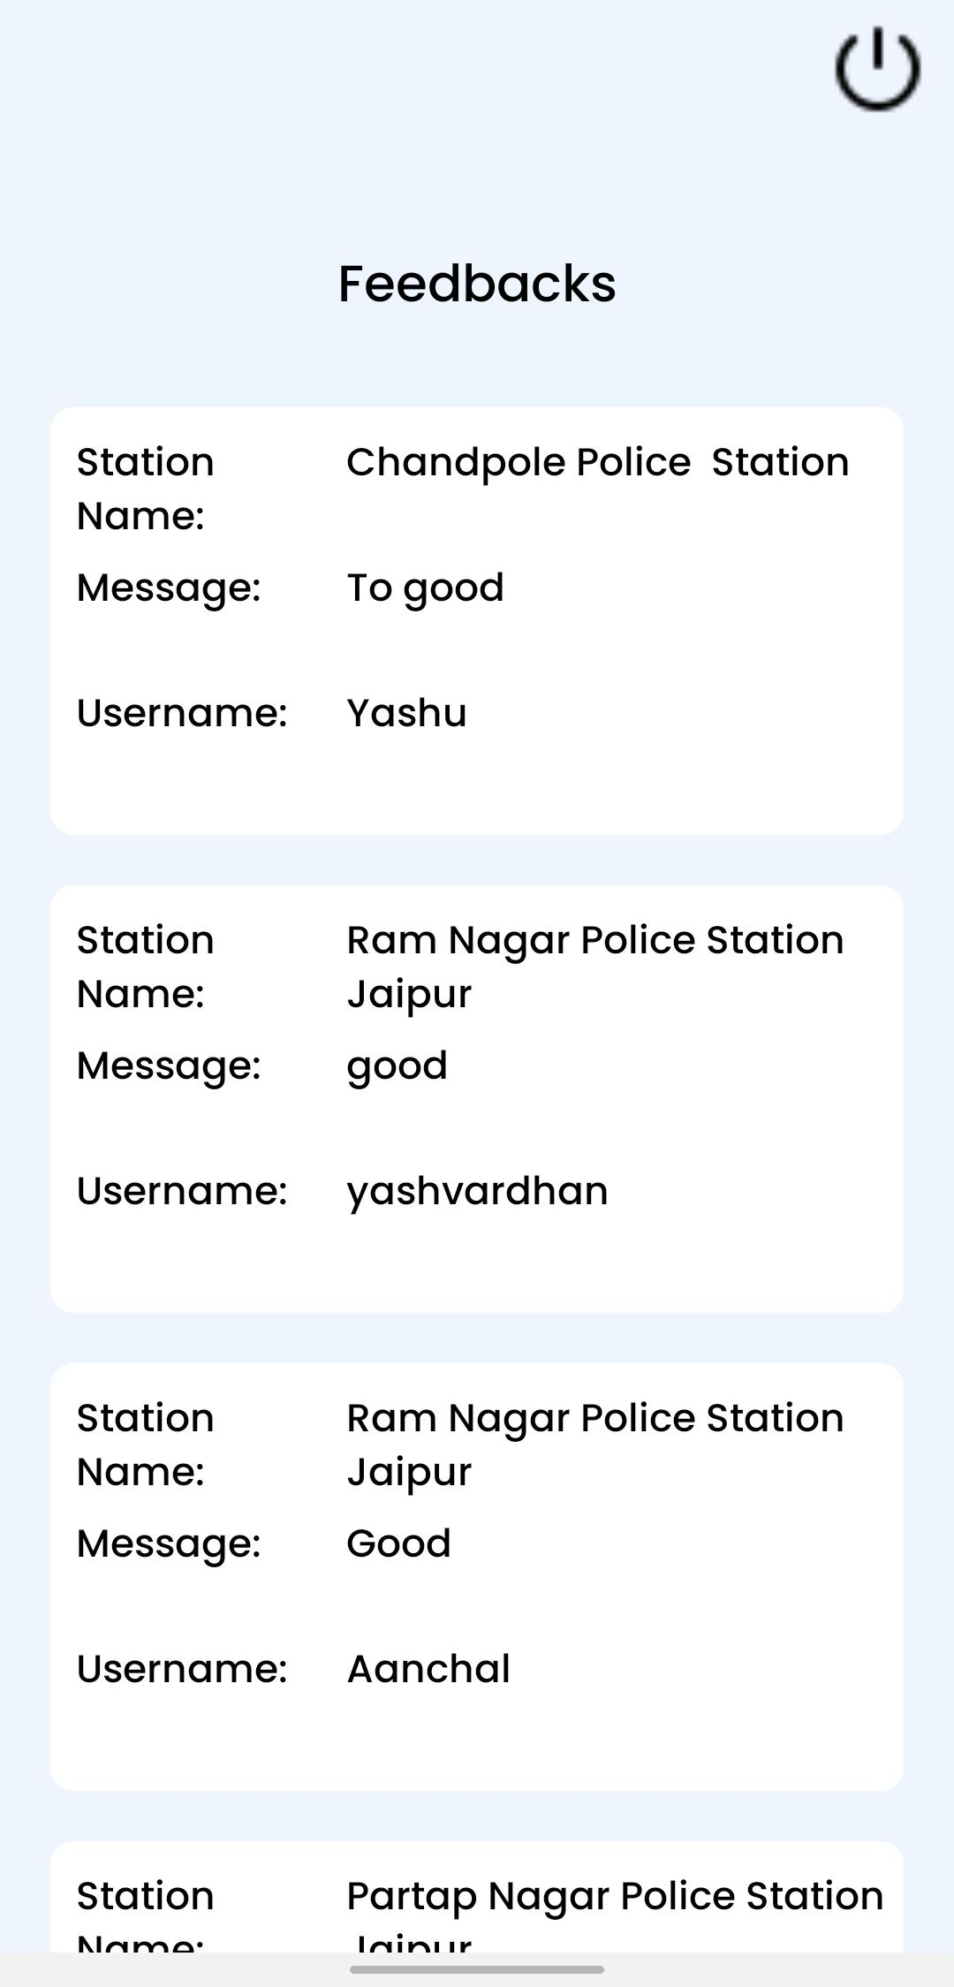
Higher Authority Side App:

Slide 6
Future Goals :
For using Google Maps more efficiently and getting the nearby police stations, we can integrate google maps API in the future.
The Higher Authority will have access, when the feedback is complete, they can remove it from the list of the feedback.
We can add filter feedback using police station name or location.
In future, by using Machine Learning we can filter user’s abuse comments written in the feedback form.

Slide 7
Team Member Details
Team Leader :
Shreyansh Kulshrestha - App Developer
Team Members :
Yashvardhan Singh Rathore - Maintaining the backend logic and system design
Aanchal Sharma – UI Designer

