Slide 1
CT PROJECT
NAME :- Shrey Mavani
Stud. Id :- 201901224
Date-14/4/2020

Slide 2
HONOR Code
We declare that → The work that we are presenting is our own work.
We have not copied the work (the code, the results, etc.) that someone else has done.
Concepts, understanding and insights we will be describing are our own.
We make this pledge truthfully. We know that violation of this solemn pledge can carry grave3 consequences.

Slide 3
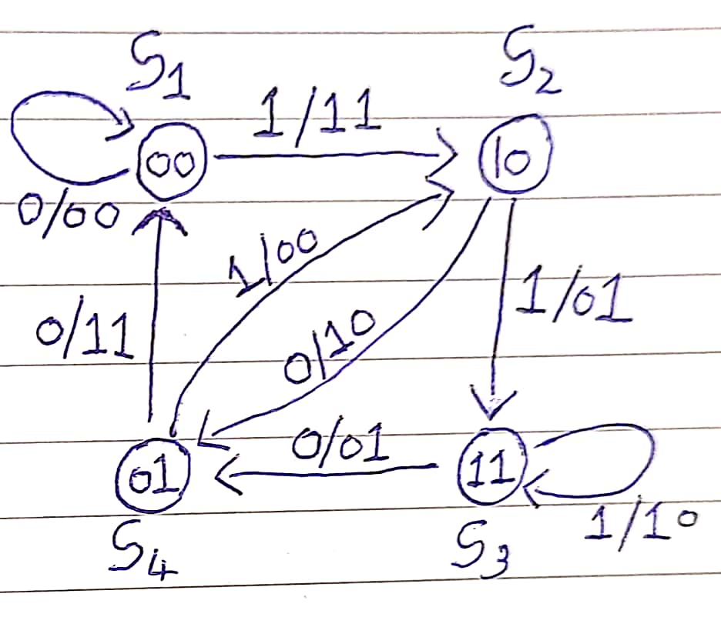
ENCODER CONCEPT
As per given G1=[1,1,1] and G2=[1,0,1] , state machine is shown in fig. Here, I have used state machine implementation.
Concept:
First of all , the program takes the user input ,after that according to the user’s input ,the program request for the other required values ( like if constraint length( K ) increases ,the program automatically asked for the required number of generator polynomials and encode the input bits accordingly.)
Hence , this program is generalized for all values of k(input length), K( constraint length) and different polynomial generators.
The complexity of encoder code is O(n).It’s complexity is varies according to the length of code.
Whole program of generator is shown in successor slide.

Slide 4
Encoder Code Snippet
Part 1
2
inp_len=input('enter number of input bits');
K=input('enter constraint length');
zer=zeros(1,K-1); % z is the matrix of zeros to be added
for i=1:inp_len
in(i)=rand <0.5;
end
enc_in=[zer,in,zer]; % enc_in is the encoded input with zeros
n=input('enter number of parity bits per window');
%n=2;
gen=zeros(n,K); % gen is a matrix which stores the generator polynomials
for i=1:n
g=input('enter generator polynomial','s');
o=char(num2cell(g));
o=reshape(str2num(o),1,[]);
for j=1:K
gen(i,j)=o(1,j);
end
end
enc_bits=zeros(1,n*(inp_len+K-1));
for i=1:inp_len+K-1
for j=1:n
for d=K:-1:1
enc_bits(1,j+(i-1)*n)=enc_in(1,K-d+i)*gen(j,d) + enc_bits(1,j+(i-1)*n);
end
enc_bits(1,n*(i-1)+j)=mod(enc_bits(1,n*(i-1)+j),2);
end
end
display(enc_bits); % enc_bits are the bits which are encoded

Slide 5
Decoder Concept
Viterbi Concept:-
1)Here, first we have calculated the difference from one state to other 2 state respectively by taking an 2-D matrix of size 8 x length of input bits named as diff_lin.For example( state 1( 0 0 ) would either go to state ( if input bit is o) or to state b(10 )( if input bit is 1)).
2)Then, it starts the tracing of path for the minimum distance by iterating it, starting the iteration from the first state of assign zero to its branch matrix and assign higher value to the rest of 3 column ( to rest of 3 state for first encoded input bit ) so it will be help to us bring the time if back-tracing of path.
3)In this iteration , program compare the sum of branch and path matrix of its two predecessor state and store minimum of them in a matrix of size 4 x (length of input bit +1) which named it as Box as shown in below given slides respectively.
4)Once ,all the iteration gets completed , (BACK-TRACING)program will find out the minimum value of this 4 path and after that it will retrace the path by comparing the sum of branch and path matrix of its two predecessor state and store the bit required for that particular way of path in a matrix which is named as rd_bits in program.
5)Finally by reversing the rd_bit matrix , we got decoded bits. It take about 3-4 min for simulation

Slide 6
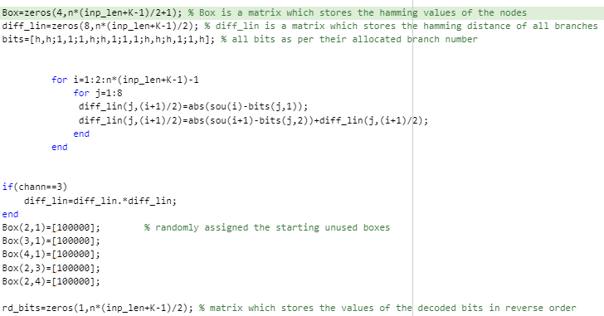
Branch Matrix Calculation Code

Slide 7
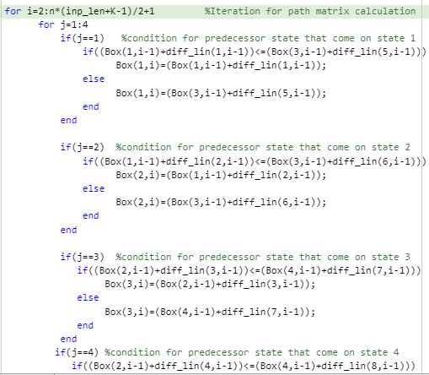
Path Matrix Calculation Code

Slide 8
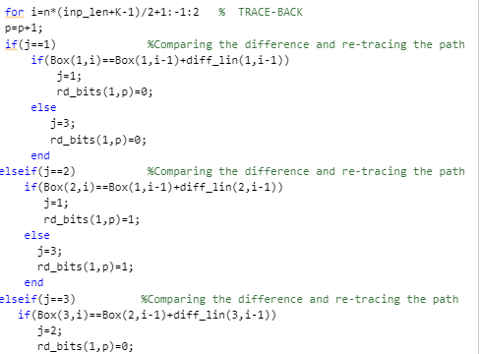
Trellis Trace-back

Slide 9
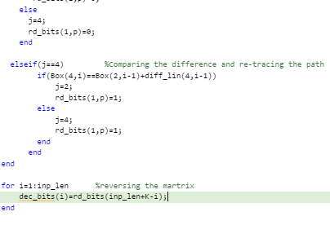
BIT DECISION CODE
I sub-parted the trellis and bit decision in to two slide so that you are able to have a look at my whole code of back-tracing and bit decision part.

Slide 10
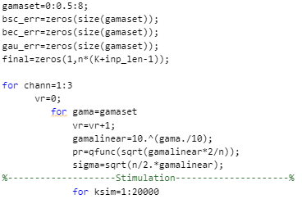
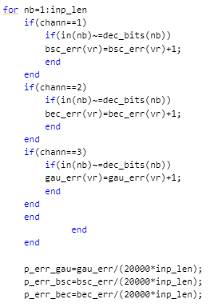
Monte Carlos Simulation Code
ITERATION PART
ERROR SUM

Slide 11
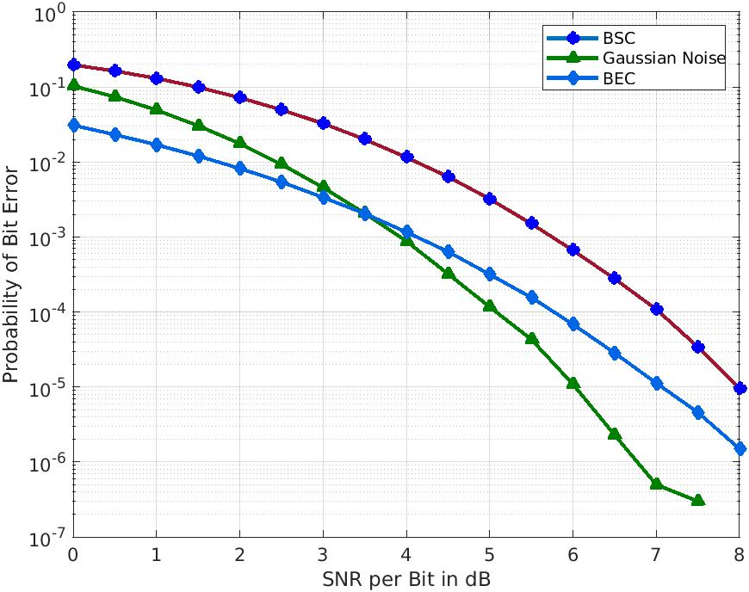
BEGINEER’S RESULT

Slide 12
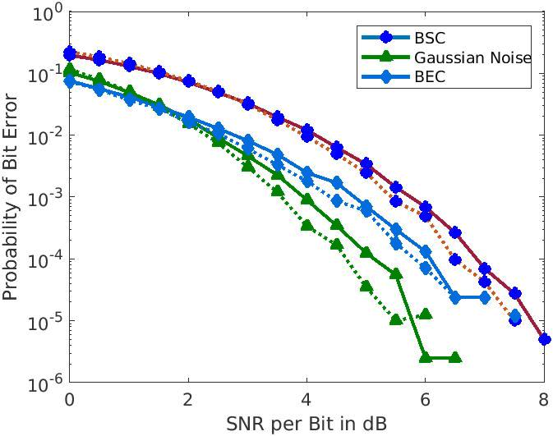
INTERMEDIATE PART 1
Continuous line is for k=3 and r=1/2 ,and Dotted line is for k=4 and r=1/2.

Slide 13
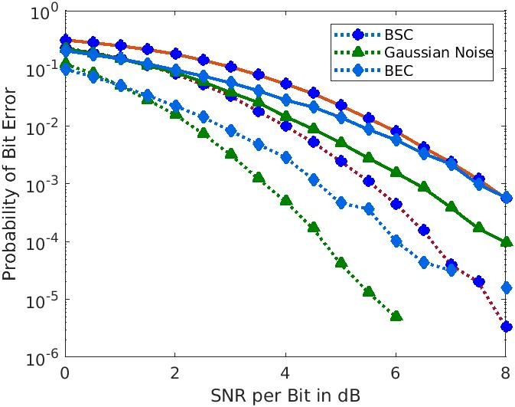
INTERMEDIATE PART 2
Continuous line is for k=4 and r=1/3 ,and Dotted line is for k=4 and r=1/2.

Slide 14
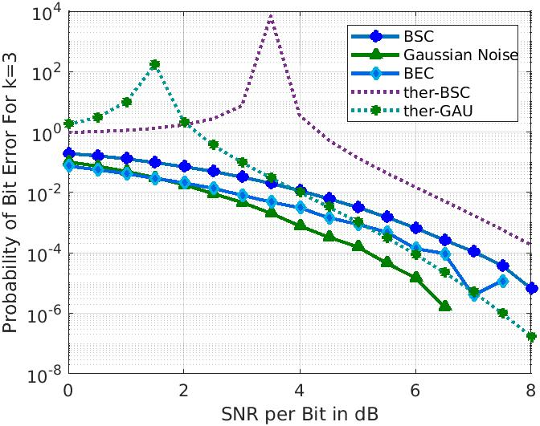
ADVANCE PART
UPPER BOUND FOR K=3 AND r=1/2

Slide 15
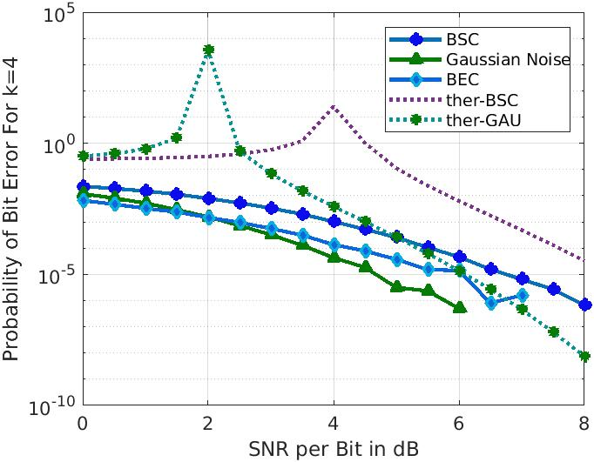
ADVANCE PART
UPPER BOUND FOR K=4 AND r=1/2

Slide 16
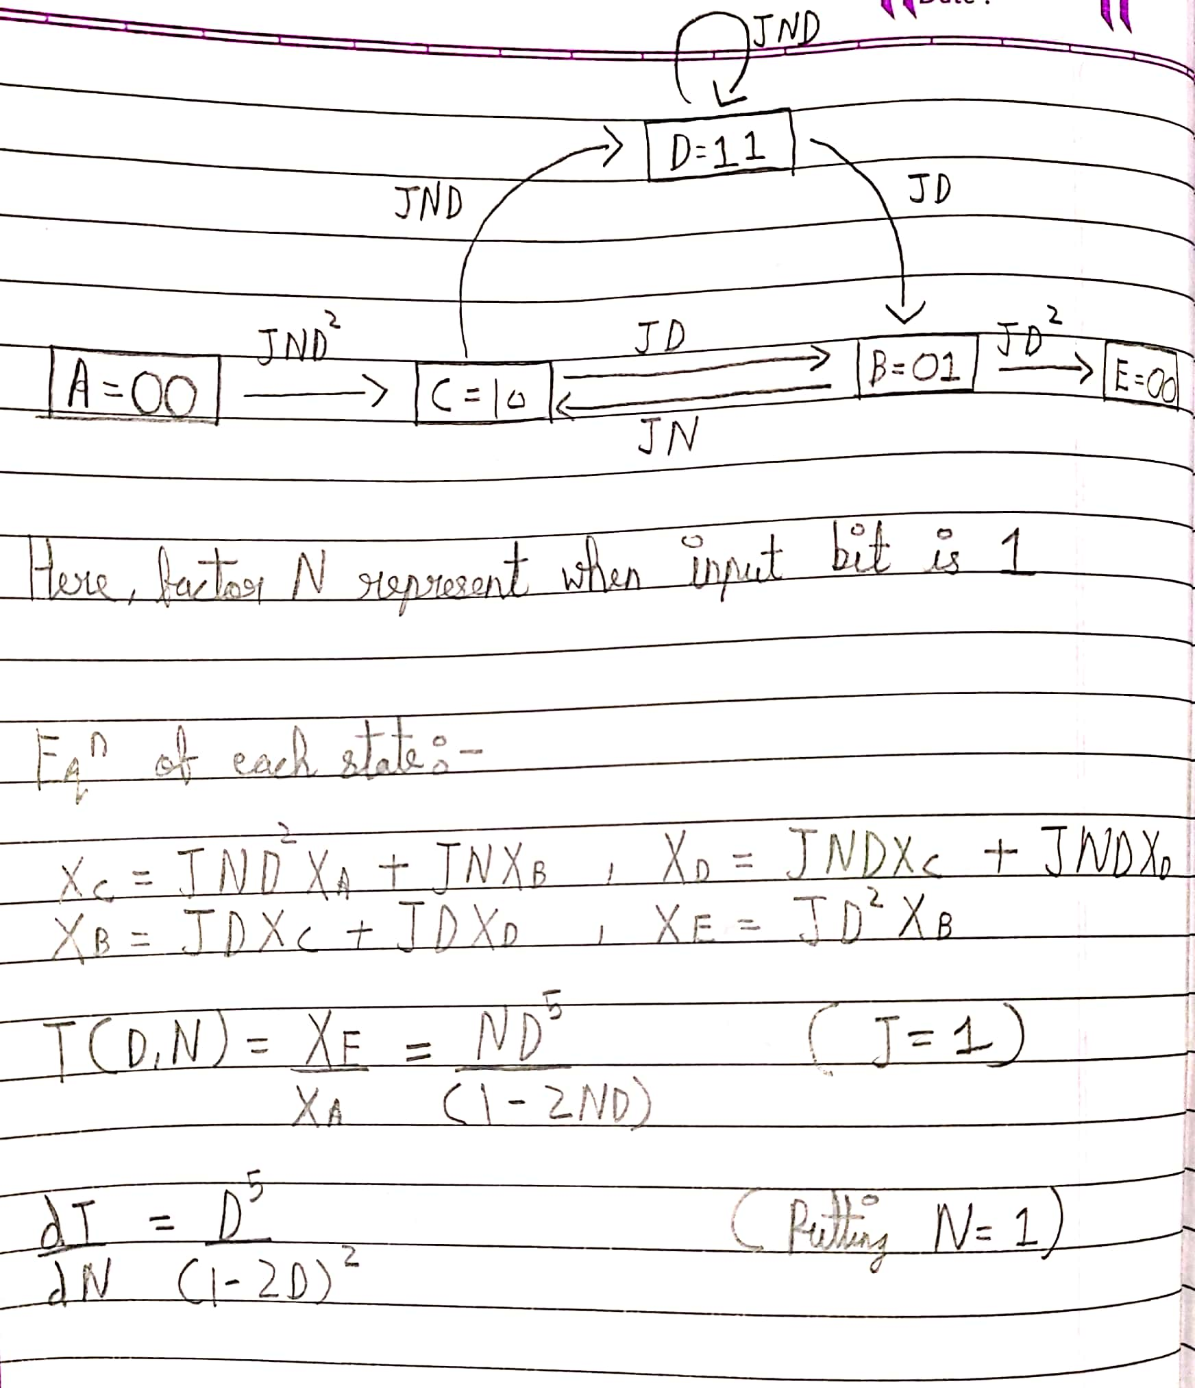
CALCULATION OF ADVANCE PART

Slide 17
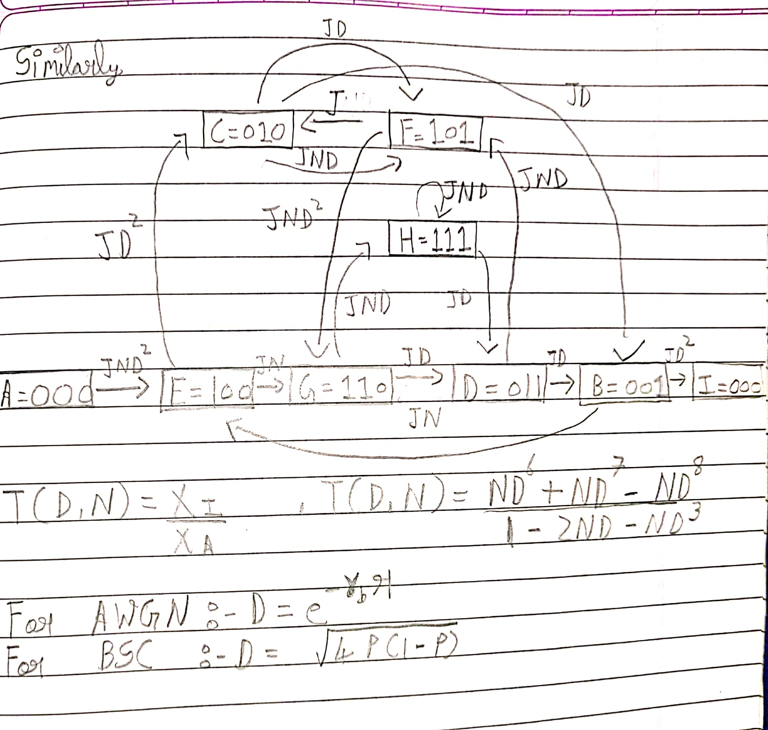
CALCULATION OF ADVANCE PART

Slide 18
SUMMARY
First difficulty that I had faced was , how to decoder BEC channel and finally after some I found out that decoder for BSC was also work for BEC channel . Other all problem were related to decoding part. Coming on to the difficulty part, there was some potential bug in my trellis implementation(trace-back part) which took long time to get discovered due to which although it worked for strings with small lengths ,it was producing high probabilities of bit errors in Monte Carlo simulations as compared to the reference values mentioned in the project manual.
The first time I ran my code for Monte Caro simulations, it took around 8 minutes for only 20000 simulations that too for one value of SNRdB. Then as mentioned by Professor in doubt forum, I used Profile function of Matlab and found out where my code was taking more time and figured out that use of inbuilt function to calculate Hamming and Eucledian distances in trellis was consuming a lot of time.
This project was moderate hard because as we only have information encoding part of this project ,we had to read the decoding part by our-self but due rich reference of source ,I didn’t face so much problem.
In my code , I have already made a universal encoder which satisfy all the different value of k , K and r. the thing that I have to add in this code is a universal decoder but I am not so sure that I can.
I though a lot on but I didn’t findout any other way to reduce the error that we have our codes.
It was of great experience and I enjoyed it a lot that was hilarious.

