Slide 1
CAPSTONE PROJECT | BAI-17
PhishGuard
Adversarially robust phishing defense using email, URL and behavioral features
ALLOW
REVIEW
BLOCK
Shrey Mehta
Roll No. TDAI045A | T.Y. B.Sc. Artificial Intelligence, Semester V
Department of Information Technology & Data Science, KES' Shroff College
Notes:
Introduce the project in one sentence: a phishing defence built and measured against an attacker who adapts, delivered as a working system. The three coloured pills are the system's three decisions and recur through the talk.

Slide 2
THE PROBLEM
Phishing is the most-reported cybercrime, and it adapts
191,561
$3.05 bn
62%
+10.1%
phishing and spoofing complaints to the FBI in 2025 - the top category
lost to business email compromise in 2025 (FBI IC3)
of breaches involve the human element (Verizon DBIR 2026)
phishing attacks, Q1 to Q2 2026: 1,069,681 in one quarter (APWG)
Detectors score well on a fixed dataset and fail when attackers change spelling, domains or style. Each edit costs the attacker almost nothing, and none changes what the message does.
India: 22,68,346 cybercrime incidents reported in 2024, +42% on 2023 (MHA, Lok Sabha Q. 432, Dec 2025)
PhishGuard | BAI-17
Sources: FBI IC3 2025 Annual Report; Verizon 2026 DBIR; APWG Phishing Activity Trends Q2 2026; Ministry of Home Affairs
2
Notes:
Why this matters: phishing is the most frequently reported crime type, and business email compromise is the most expensive per case. The Indian figure is cybercrime in general, not phishing alone. The key sentence is the one in bold: this project is about the gap between static accuracy and an adapting attacker.

Slide 3
THE GAP
The detector learns the surface; the attacker changes it
How a phishing kit is tuned
Cheap edits that change nothing the message does
1
Test the message against filters
Synonym
verify -> confirm
2
Caught? Edit it
Look-alike letter
paypal -> pаypal (Cyrillic a)
3
Try again until it gets through
Redirect
link hidden behind a trusted redirector
4
Launch the campaign
New domain
registered yesterday, valid SPF and DKIM
PhishGuard | BAI-17
3
Notes:
The attacker's loop is the whole problem. A model that learned last quarter's wording has learned exactly what the attacker is free to change. So PhishGuard adds evidence the attacker controls less: the infrastructure and, above all, the recipient's correspondence history.

Slide 4
THE APPROACH
Three feature families, weighted by attacker control
Email
URL
Behavioural
125 features
107 features
33 features
Headers, authentication, subject, body, HTML, attachment metadata, and how much obfuscation had to be undone
Structure, brand squatting, punycode, shorteners and redirects unwrapped offline, link text vs destination
First contact, prior correspondence, domain age, timing, campaign bursts, display-name reuse
Full control: they write it
High: they choose the infrastructure
Partial: they cannot fake your history
No URL is ever fetched and no attachment opened: every signal is computed offline, so the scanner cannot be used for SSRF or to tip off the attacker.
PhishGuard | BAI-17
4
Notes:
The design principle: weight evidence by attacker control. Text is free to change; infrastructure costs a little; relationship history cannot be forged without actually having corresponded with the victim.

Slide 5
THE MODEL
Four readers, one calibrated score, three decisions
Canonicalise
4 readers
Fuse + calibrate
Decide
homoglyphs, zero-width, redirects
→
rules | gradient boosting | char n-grams | word n-grams
→
stacked, isotonic, on disjoint pools
→
with abstention when readers contradict
ALLOW
score below 0.40
delivered
REVIEW
0.40 to 0.80, or readers contradict
a person decides, with the evidence
BLOCK
0.80 and above
quarantined
PhishGuard | BAI-17
5
Notes:
Three disjoint training pools, drawn by campaign, so the stacker and the calibrator see scores the members produced out of sample. The REVIEW band is the key design choice: uncertainty becomes a human decision, not a silent error.

Slide 6
INNOVATION
Threat-informed testing: 8 attack families, 6 defences
A-LEX
A-UNI
Defences, each switchable and measured
Lexical and semantic perturbation
Unicode and homoglyph obfuscation
D-NORM Text canonicalization
D-URL URL canonicalization
D-ADVTRAIN Adversarial training
D-ENSEMBLE Multi-view fusion
D-ABSTAIN Confidence banding / abstention
D-VELOCITY Campaign-burst guard
A-URL
A-STRUCT
URL obfuscation and redirection
Structural and HTML manipulation
A-HDR
A-BEH
Header and identity shaping
Behavioral and timing mimicry
A-TRUST
A-CHANNEL
Attacker: black-box, decision-based, a query budget, and every edit must keep the message a working phish.
Payload relocation onto reputable infrastructure
Out-of-band payload delivery
PhishGuard | BAI-17
35 semantic-preserving transformations; residual risk reported per family
6
Notes:
The attacker model follows industry evidence that real attackers do not compute gradients; they make cheap edits and watch what gets through. Validity checks reject any 'attack' that removes the payload or fakes the victim's history.

Slide 7
RESULTS
Clean mail: ahead of both baselines
System | Macro F1 | PR-AUC | False positives | Phishing caught
PhishGuard | 0.988 | 0.998 | 0.10% | 97.6%
Text-only model (B1) | 0.977 | 0.999 | 0.00% | 95.1%
Rule checklist (B0) | 0.895 | 0.956 | 5.49% | 84.1%
0.988
PhishGuard macro F1 (PR-AUC 0.998)
0.10%
5.5%
false positives (1 of 1038)
for the rule checklist
Held-out test set, 0.5 cut-off. The corpus is synthetic, so treat absolute accuracy as an upper bound; the comparison is what transfers.
The clean gap to the text model is 0.011. The case for the design is robustness - next two slides.
PhishGuard | BAI-17
Test set: 1938 messages, campaign-grouped split; synthetic corpus
7
Notes:
Be honest here: the corpus is synthetic, so absolute accuracy is an upper bound. The comparison is what transfers. The rule checklist's 5.5% false-positive rate is why such checklists run in tag-only mode in practice.

Slide 8
RESULTS
On hard cases, PhishGuard escalates instead of guessing
95.8%
acceptable outcomes for PhishGuard
vs 74.5% (text-only) and 61.5% (checklist)
The cost, stated: 57.8% of these deliberately ambiguous records go to a person, and 11.0% of ordinary mail. All 8 false blocks are one case: a real supplier on a 3-week-old domain.
PhishGuard | BAI-17
All three systems tuned to the same false-alarm budget first
8
Notes:
PG-HARD has 24 cases, 8 variants each. The checklist misses most hard phishing; the text model blocks half the hard legitimate mail; PhishGuard does neither by sending ambiguous cases to a person. Quote the seed range if asked: 0-1 silent deliveries and 7-8 false blocks across three seeds.

Slide 9
RESULTS
Under attack, the text model collapses; PhishGuard holds
3
43
PhishGuard, 120 queries
text-only, 120 queries
Ordinary phishing, 10 queries: 0.0% escaped PhishGuard's auto-block vs 29.3% for the text model. Attacked messages that are not blocked go to a person, not the inbox.
PhishGuard | BAI-17
Decision-based black-box attacker, semantic-preserving edits only
9
Notes:
This is the central result. The adaptive attacker knows about the abstention control and tries to make the readers agree on 'safe'. Even so, at 120 queries PhishGuard delivers 3 of 48 hard phish unwarned against 43 of 48 for the text model. The attack is not free for PhishGuard: more messages go to review instead of being auto-blocked.

Slide 10
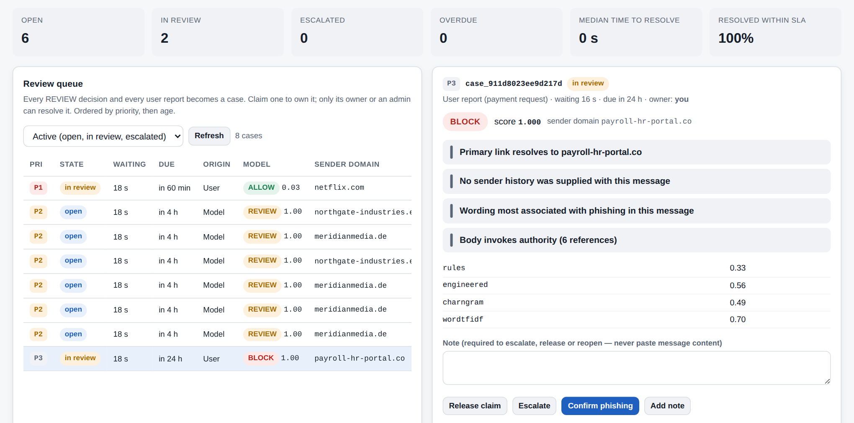
OPERATIONAL WORKFLOW
Intake, decision, human action, audit trail, monitoring
Every held message and every employee report becomes a case: owner, priority, service level (P1 1 h, P2 4 h, P3 24 h)
Only the claimant or an admin may decide it; releasing a high-risk message needs an admin and a reason
Employees report in one step and see the outcome - never a score, so the page is no scoring oracle
Every action is an audit event; no message content is stored anywhere
Real mail comes in three ways: .eml/.mbox import in the console, a read-only IMAP inbox watcher, or the API
PhishGuard | BAI-17
Object-level authorisation (OWASP API1:2023); compare-and-set state changes
10
Notes:
A REVIEW band is only a control if someone reviews. The queue makes that enforceable and measurable: overdue cases are a metric with an alert rule. Resolving a case records analyst feedback, but nothing retrains automatically - that would be a poisoning path.

Slide 11
ENGINEERING
Built like a product: tested, observable, scalable
289
30 ms
44/s
automated tests: unit, integration, security
p95 per message, with explanations (budget 150 ms)
per process; p95 234 ms with 8 requests in flight
1.97x
10/10
5 of 5
throughput with 2 server processes
acceptance gates pass; CI blocks a regression
shifted weeks caught by drift detection; 0 of 5 false alarms
PhishGuard | BAI-17
CI: lint + security rules, tests on 3 Pythons, pip-audit, CodeQL, gates, container smoke test
11
Notes:
Defects were found by the engineering process, not by luck: static analysis found a shadowed attack transform, so one attack had silently never run; review found the defence catalogue and the attack taxonomy disagreeing about which control counters which attack; contract testing found an endpoint that failed its own response schema. The load test found that threads fought over the interpreter lock; serving one request at a time per process in arrival order raised throughput under load and halved the tail.

Slide 12
RESPONSIBLE AI AND LIMITATIONS
What it does not do, and who it could hurt
Responsible-AI findings
Threats to validity
New or rebranded small businesses are the likeliest to be blocked in error (young domains)
Non-native English writing may look unusual to the text readers - measure before deploying
Human oversight must be staffed: 11% of ordinary mail goes to review
Probe and attack tools are dual-use: admin-only, audited, alerted
Synthetic corpus: absolute accuracy is an upper bound
Attacks written by the defenders: a red team is the real test
Behavioural context is simulated; public corpora have none
Calibration is measured in distribution only
PhishGuard | BAI-17
Structured by the NIST AI Risk Management Framework
12
Notes:
Say the limitations before the examiner does. The design claim - fusion with abstention is much harder to evade than a text model - is well supported. Any absolute accuracy figure on real traffic is not, and that is why the recommendation is a tag-only pilot first.

Slide 13
RECOMMENDATION
Go / no-go
Demonstrable prototype
10 of 10 gates pass; tests, security checks and load test pass; runs from the docs on a clean machine
GO
Supervised pilot, tag-only
Measure on the organisation's own mail by sender language and for new domains; staff the review queue
GO, WITH CONDITIONS
Autonomous quarantine
Needs real-mail evaluation within the false-positive budget, an independent red team, supplier-register integration and signed risk acceptance
NO-GO FOR NOW
PhishGuard | BAI-17
13
Notes:
The same three colours as the decisions: the project applies its own policy to itself. Ready to demonstrate; ready for a careful pilot; not ready to quarantine business mail on its own.

Slide 14
Thank you
ALLOW
REVIEW
BLOCK
What it adds
A detector measured against the attacker it will face, and a system that turns its own uncertainty into a human decision.
Next
Real-mail pilot (inbox watcher ready) | independent red team | DistilBERT reader under attack | supplier register | QR decoding
Questions welcome | Demo: python start.py -> http://localhost:8000 | Online: render.yaml, one click
Notes:
Close with the one-line contribution, then invite questions. Have the evaluation report and the demo running in another window.

