Slide 1
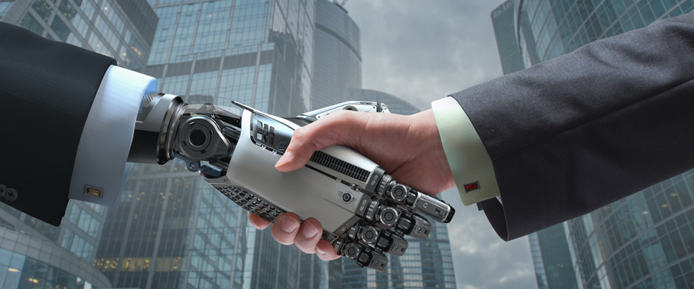
Application of Alternative Data in Credit Decisioning for Small Business Loans Project by: Shreyashi Mukhopadhyay

Slide 2

Research and Contents Credit: Moody’s Analytics www.moodysanalytics.com

Slide 3
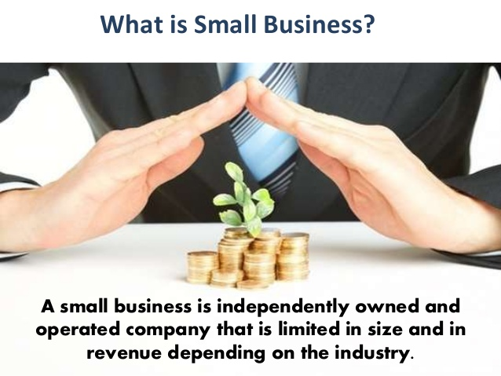
Small Business

Slide 4

Small Business Loan terms by SBA
Small Business Loan amounts:
LOAN TERMS:
Loans do not have a minimum loan amount and max out at $5 million. The average SBA loan was around $374,000 in 2015.
The SBA guarantees 85% of your loan if it’s less than $150,000 and 75% if it’s more than $150,000. However, it limits guarantees to $3.75 million.
SBA loan size | 7(a) loan paid off in under 7 years * | 7(a) loan paid off in over 7 years *
$25,000 or less | 9.50% | 10.00%
$25,001 to $50,000 | 8.50% | 9.00%
More than $50,000 | 7.50% | 8.00%
*Rates calculated with the current prime rate of 5.25%

Slide 5
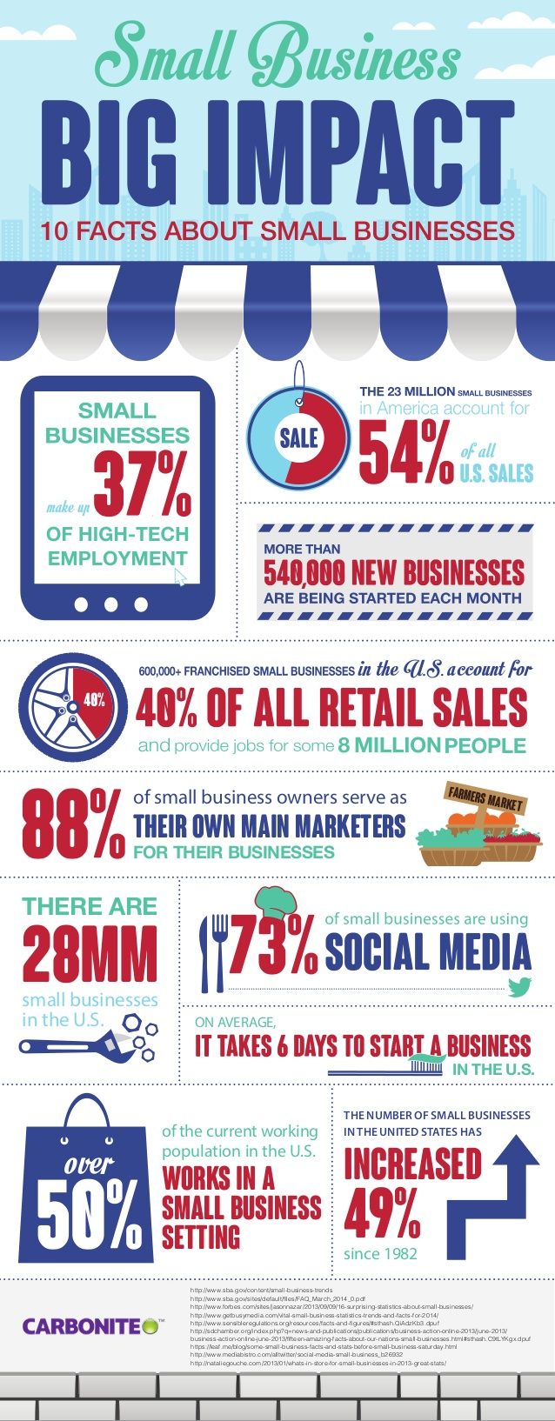
Small Businesses are the backbone of the U.S. Economy
☺ There are 28 million small businesses in the U.S. -- which outnumber corporations 1162 to 1
☺ 70% of small businesses are owned and operated by a single person
☺ Small businesses employ 57% of the country's private workforce
☺ Small businesses pay 44% of U.S. payroll
☺ 60 to 80% of all new jobs come from small businesses
☹ A small business went bankrupt every 8 minutes in 2009
☹ Only 50% of businesses survive five years -- though most (70%) hit the two-year mark

Slide 6
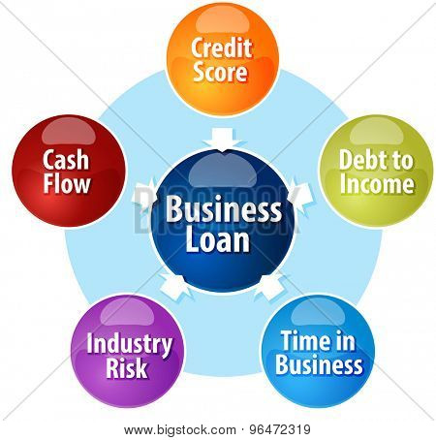
Document intensive loan process
Recent Business Bank Statements
Profit & Loss Statement
Cash Flow Forecast
Business Debt Schedule
Collateral Documentation
Business Plan

Slide 7
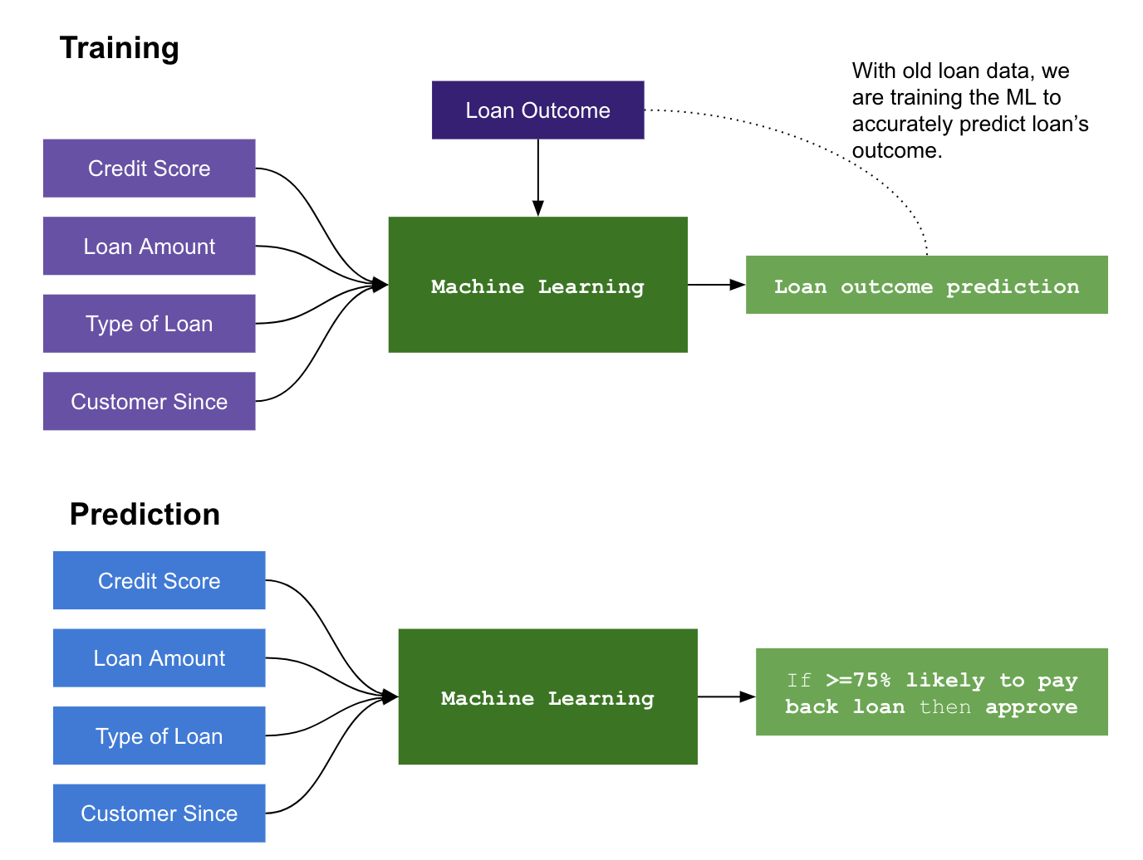
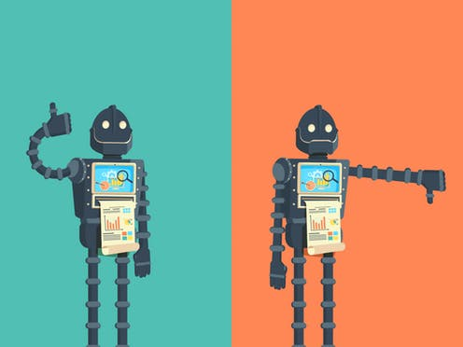
Modern AI Centric Process

Slide 8
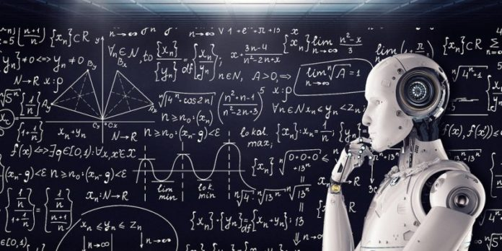
Alternative data used by an AI Algorithm
FICO Scores
Social demographics of the area
Location Score of the Business
Geospatial Methodology
Text Analytics and consumer sentiment

Slide 9



Case Study: CREDEX -- Commercial Banking Solutions

Slide 10
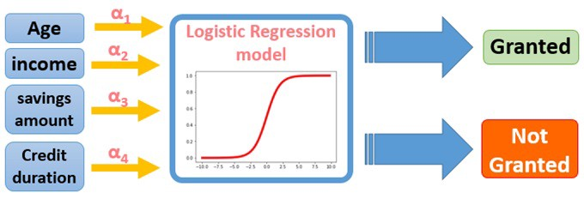

Case Study: CREDEX -- Commercial Banking Solutions

Slide 11
Tools used:
PYTHON
Beautiful Soup
HTML
JAVA SCRIPT PLOTLY
JAVA SCRIPT LEAFLET
TABLEAU
MACHINE LEARNING -- LOGISTIC REGRESSION

Slide 12


Thank you!

