Slide 1
AI and Advanced Analytics Applications in Finance
Final Project
Shreyashi Mukhopadhyay
January 16, 2023

Slide 2



Stock Trading Strategy using Algorithmic Trading
& Sentiment Analysis using Google News Headlines for Amazon(AMZN)
Data Sources:

Slide 3

Introduction:
Stock markets are characterized by their instability, changing nature, and lack of a clear pattern.
Predicting stock prices is difficult because of a variety of factors like politics, the global economy, unexpected events, and a company’s financial performance.
Investment firms are leveraging the power of Machine Learning for stock trading in a variety of ways, including forecasting market changes, researching customer habits, and examining stock price dynamics which helps them make better investment decisions and minimize financial risks.
This project aims to predict the stock trading strategy of one of the most traded Mega-Cap FAANG companies- Amazon.com (NASDAQ: AMZN) using Machine Learning and Stock News sentiment.

Slide 4
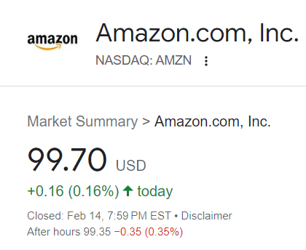
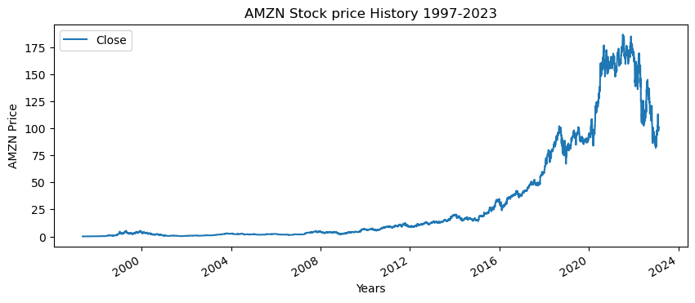
Amazon Stock Price History (1997-2023)
Data Source:

Slide 5
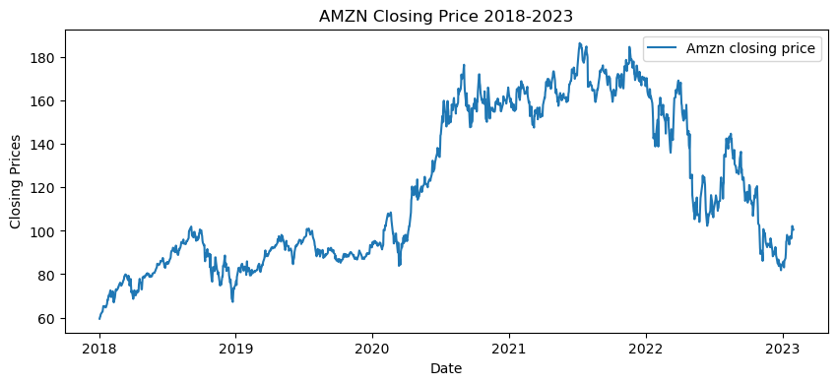
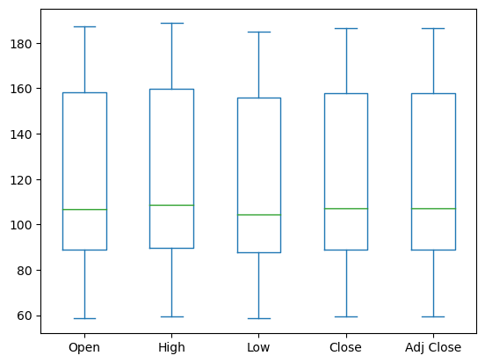

Amazon Stock Price Analysis (2018-2023)

Slide 6
Amazon Stock Technical Indicators

Slide 7
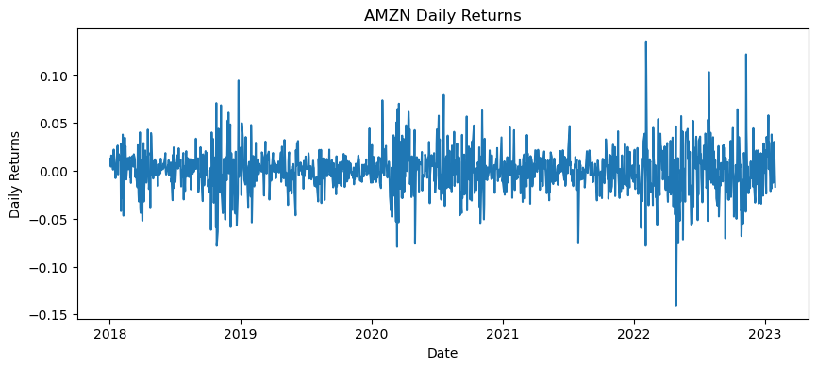
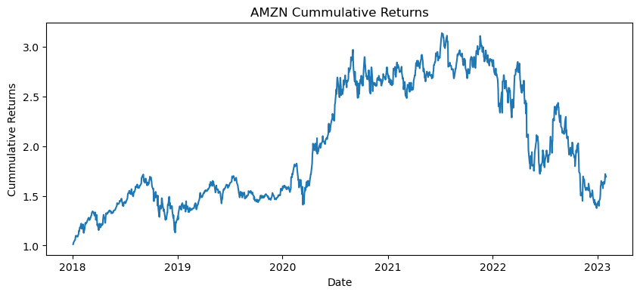
Stock Returns Analysis
Desc statistics | Open | High | Low | Close | Adj Close | Volume
count | 1278.000000 | 1278.000000 | 1278.000000 | 1278.000000 | 1278.000000 | 1.278000e+03
mean | 119.496002 | 120.941193 | 117.888139 | 119.424986 | 119.424986 | 8.640931e+07
std | 35.544385 | 35.917920 | 35.117962 | 35.473358 | 35.473358 | 4.041521e+07
min | 58.599998 | 59.500000 | 58.525501 | 59.450500 | 59.450500 | 1.762600e+07
25% | 89.003252 | 89.778753 | 87.914001 | 88.915251 | 88.915251 | 5.910318e+07
50% | 106.660000 | 108.829250 | 104.324001 | 107.021500 | 107.021500 | 7.498000e+07
75% | 158.100754 | 159.745003 | 156.024872 | 157.926624 | 157.926624 | 1.022290e+08
max | 187.199997 | 188.654007 | 184.839493 | 186.570496 | 186.570496 | 3.113460e+08

Slide 8
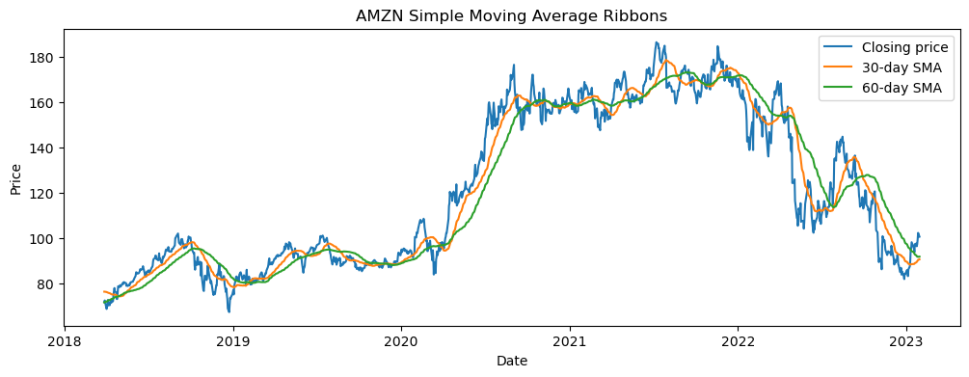
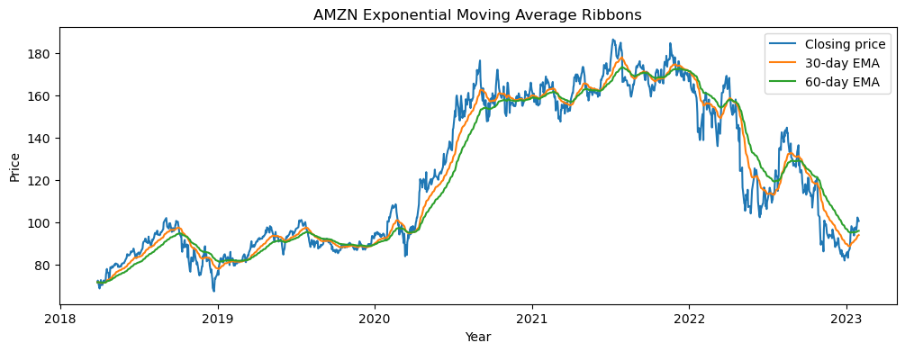
Trend Indicators
Simple Moving Averages
Exponential Moving Averages

Slide 9
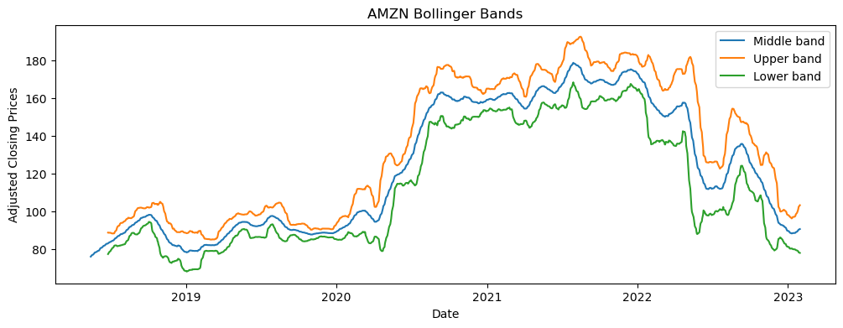
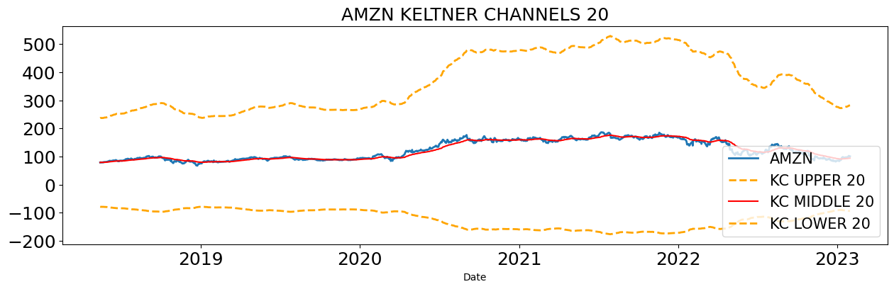
Volatility Indicators
Bollinger Bands
Keltner Channels

Slide 10
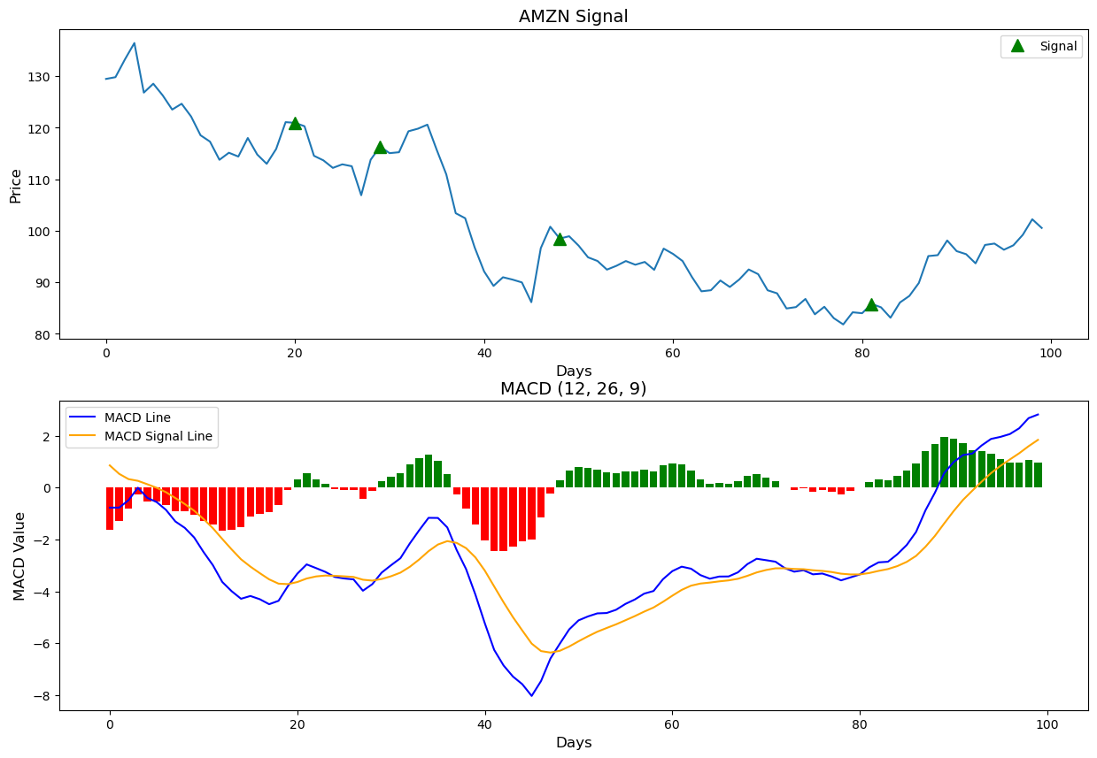
Trend Momentum Indicators -- MACD
MACD - Moving Average convergence Divergence Indicator
Moving Average Convergence Divergence (MACD) is a trend following momentum indicator that shows the relationship between two moving averages of a security’s price.
MACD triggers technical signals when it crosses above (to buy) or below (to sell) its signal line.
MACD LINE = FAST LENGTH EMA - SLOW LENGTH EMA
MACD crossing above the centerline – Uptrend
MACD crossing below the centerline – Downtrend
MACD crossing above the signal line – Buy
MACD crossing below the signal line – Sell
MACD=12-Period EMA − 26-Period EMA¶

Slide 11
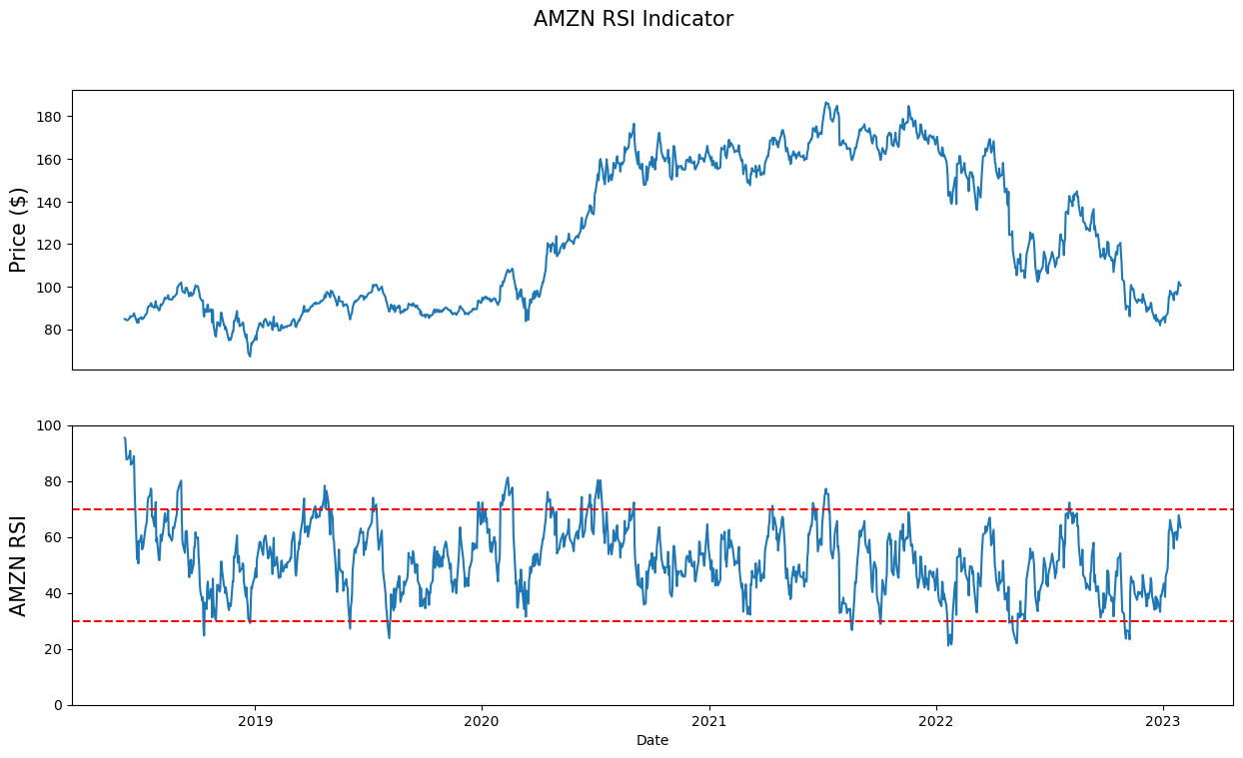
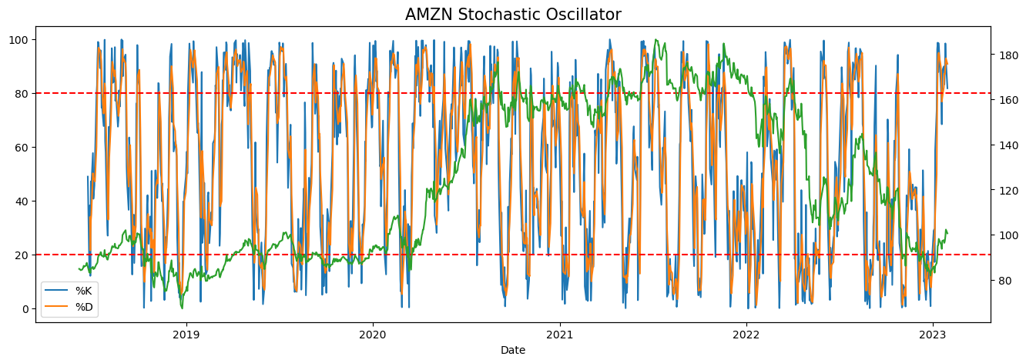
Range-bound Momentum Indicators
Relative Strength Index -- RSI
Stochastic Oscillator

Slide 12
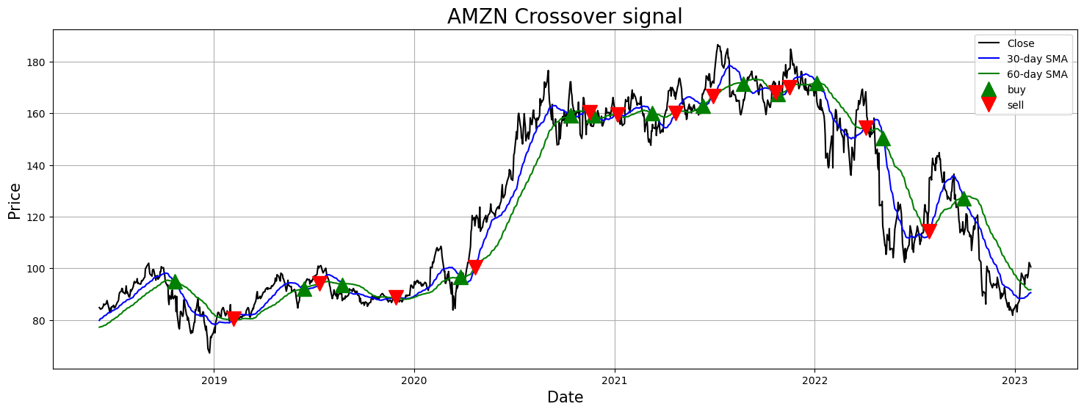
Trading strategy using 30 Day SMA & 60 Day SMA
 | Open | High | Low | Close | Adj Close | Volume | SMA30 | SMA60 | EMA 30 | EMA 60 | Signal | Position | Strategy
Date
2018-06-06 | 85.225502 | 85.724998 | 84.323502 | 84.787498 | 84.787498 | 109464000 | 79.839450 | 77.198375 | 79.760551 | 77.361716 | 0 | 0.0 | Sell
2018-06-07 | 84.928001 | 84.995003 | 83.805496 | 84.464996 | 84.464996 | 75314000 | 80.221334 | 77.282642 | 80.064064 | 77.594611 | 0 | 0.0 | Sell
2018-06-08 | 84.056000 | 84.472000 | 83.650497 | 84.199501 | 84.199501 | 59102000 | 80.498050 | 77.360133 | 80.330866 | 77.811165 | 0 | 0.0 | Sell
2018-06-11 | 84.075500 | 84.711998 | 84.029503 | 84.456001 | 84.456001 | 46710000 | 80.692217 | 77.449133 | 80.597004 | 78.029028 | 0 | 0.0 | Sell
2018-06-12 | 84.650002 | 84.975502 | 84.575996 | 84.937500 | 84.937500 | 45184000 | 80.913250 | 77.555025 | 80.877036 | 78.255535 | 0 | 0.0 | Sell
... | ... | ... | ... | ... | ... | ... | ... | ... | ... | ... | ... | ... | ...
2023-01-24 | 96.930000 | 98.089996 | 96.000000 | 96.320000 | 96.320000 | 66929500 | 89.371000 | 91.975833 | 92.066710 | 95.323983 | 1 | 0.0 | Buy
2023-01-25 | 92.559998 | 97.239998 | 91.519997 | 97.180000 | 97.180000 | 94261600 | 89.640667 | 91.746167 | 92.396600 | 95.384836 | 1 | 0.0 | Buy
2023-01-26 | 98.239998 | 99.489998 | 96.919998 | 99.220001 | 99.220001 | 68523600 | 89.929667 | 91.676333 | 92.836819 | 95.510579 | 1 | 0.0 | Buy
2023-01-27 | 99.529999 | 103.489998 | 99.529999 | 102.239998 | 102.239998 | 87678100 | 90.254667 | 91.673000 | 93.443476 | 95.731216 | 1 | 0.0 | Buy
2023-01-30 | 101.089996 | 101.739998 | 99.010002 | 100.550003 | 100.550003 | 70691900 | 90.553667 | 91.735667 | 93.901962 | 95.889209 | 1 | 0.0 | Buy

Slide 13


Web-scrape Google News Headlines for AMZN Ticker from 01-01- 2018 to 01-31-2023
Analyze stock news headlines using Vader

Slide 14
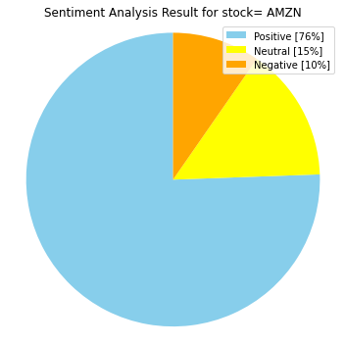
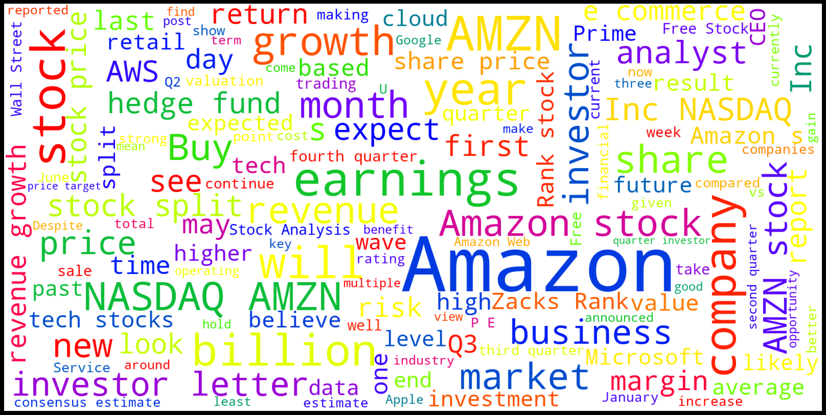
Sentiment Analysis with Vader on Google News Headlines

Slide 15
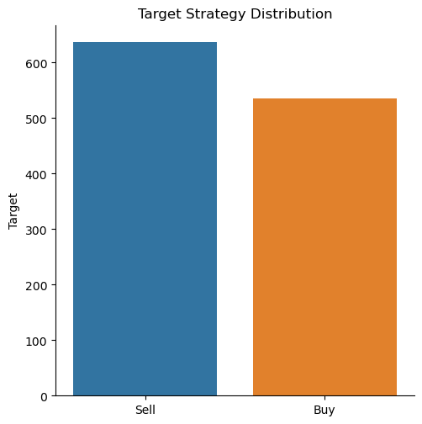
Machine Learning with Classification Algorithms
Balanced Data with equal distribution of Buy and Sell signals
Classification Algorithms
Logistic Regression
Decision Tree
Random Forest
XG Boost
Support Vector Machine

Slide 16
Machine Learning: Train Test Split
X_train
 | Open | High | Low | Close | Adj Close | SMA30 | SMA60 | EMA 30 | EMA 60
Date
2018-06-06 | 85.225502 | 85.724998 | 84.323502 | 84.787498 | 84.787498 | 79.839450 | 77.198375 | 79.760551 | 77.361716
2018-06-07 | 84.928001 | 84.995003 | 83.805496 | 84.464996 | 84.464996 | 80.221334 | 77.282642 | 80.064064 | 77.594611
2018-06-08 | 84.056000 | 84.472000 | 83.650497 | 84.199501 | 84.199501 | 80.498050 | 77.360133 | 80.330866 | 77.811165
2018-06-11 | 84.075500 | 84.711998 | 84.029503 | 84.456001 | 84.456001 | 80.692217 | 77.449133 | 80.597004 | 78.029028
2018-06-12 | 84.650002 | 84.975502 | 84.575996 | 84.937500 | 84.937500 | 80.913250 | 77.555025 | 80.877036 | 78.255535
Shape of X is: (1171, 9)
Shape of y is (1171, 1)
Y_train
Date | Strategy
2018-06-06 | 1
2018-06-07 | 0
2018-06-08 | 1
2018-06-11 | 0
2018-06-12 | 1
Buy 🡪 1
Sell 🡪 0
Train Test Split – 80:20
Shape of X_train is: (936, 9)
Shape of y_train is (936, 1)
Shape of X_test is: (235, 9)
Shape of y_test is (235, 1)

Slide 17
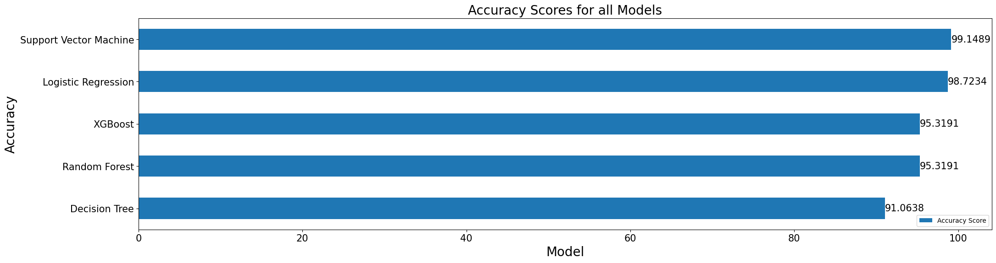
Accuracy Scores Comparison:
Model | Accuracy Score
Decision Tree | 91.063830
Random Forest | 95.319149
XGBoost | 95.319149
Logistic Regression | 98.723404
Support Vector Machine | 99.148936
Support Vector Machine has the Highest Accuracy Score of 99.14%

Slide 18
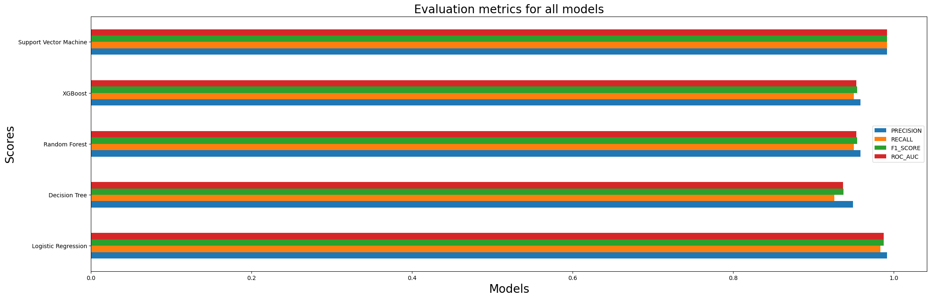
Evaluation Metrics:
 | PRECISION | RECALL | F1_SCORE | ROC_AUC
MODEL
Logistic Regression | 0.991667 | 0.983471 | 0.987552 | 0.98735
Decision Tree | 0.949153 | 0.92562 | 0.937238 | 0.936494
Random Forest | 0.958333 | 0.950413 | 0.954357 | 0.953277
XGBoost | 0.958333 | 0.950413 | 0.954357 | 0.953277
Support Vector Machine | 0.991736 | 0.991736 | 0.991736 | 0.991482

Slide 19
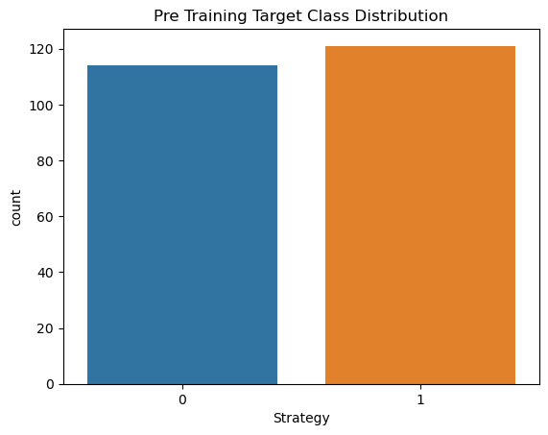
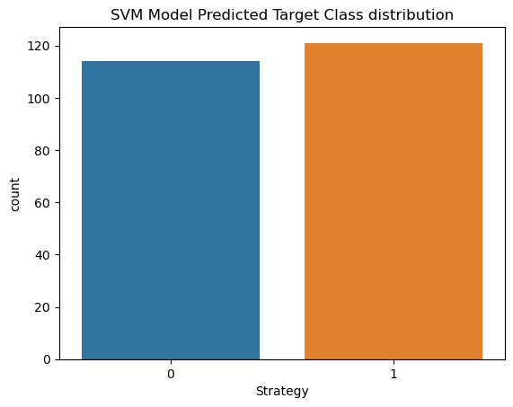
Distribution of Target class before and after training

Slide 20
Trading Strategy using SVM:
 | Date | Strategy | Prediction
0 | 11/30/2020 | 0 | 0
1 | 4/23/2019 | 1 | 1
2 | 2/16/2021 | 1 | 1
3 | 9/13/2022 | 1 | 1
4 | 2/14/2019 | 1 | 1
5 | 6/7/2022 | 0 | 0
6 | 3/11/2021 | 0 | 0
7 | 9/21/2021 | 0 | 0
8 | 8/28/2018 | 1 | 1
9 | 5/21/2019 | 1 | 1
10 | 8/18/2022 | 1 | 1

Slide 21
Questions?

Slide 22
Thank you!

