Slide 1

MSA 8040 Data Management for Analytics Final Project Fall 2021
Shreyashi Mukhopadhyay

Slide 2


Meetings

Slide 3
About Estimize.com
Estimize, launched in 2011 is an open financial estimates platform that aggregates fundamental estimates from independent, buy-side, and sell-side analysts, along with those of private investors and students.
As of 2020, 97,439 users contributed to Estimize stock price estimates.
Coverage on over 2,200 stocks.
Coverage of 80 economic indicators each quarter.
The Estimize consensus has proven more accurate than comparable sell side data sets over 70% of the time and by 15% on average.

Slide 4
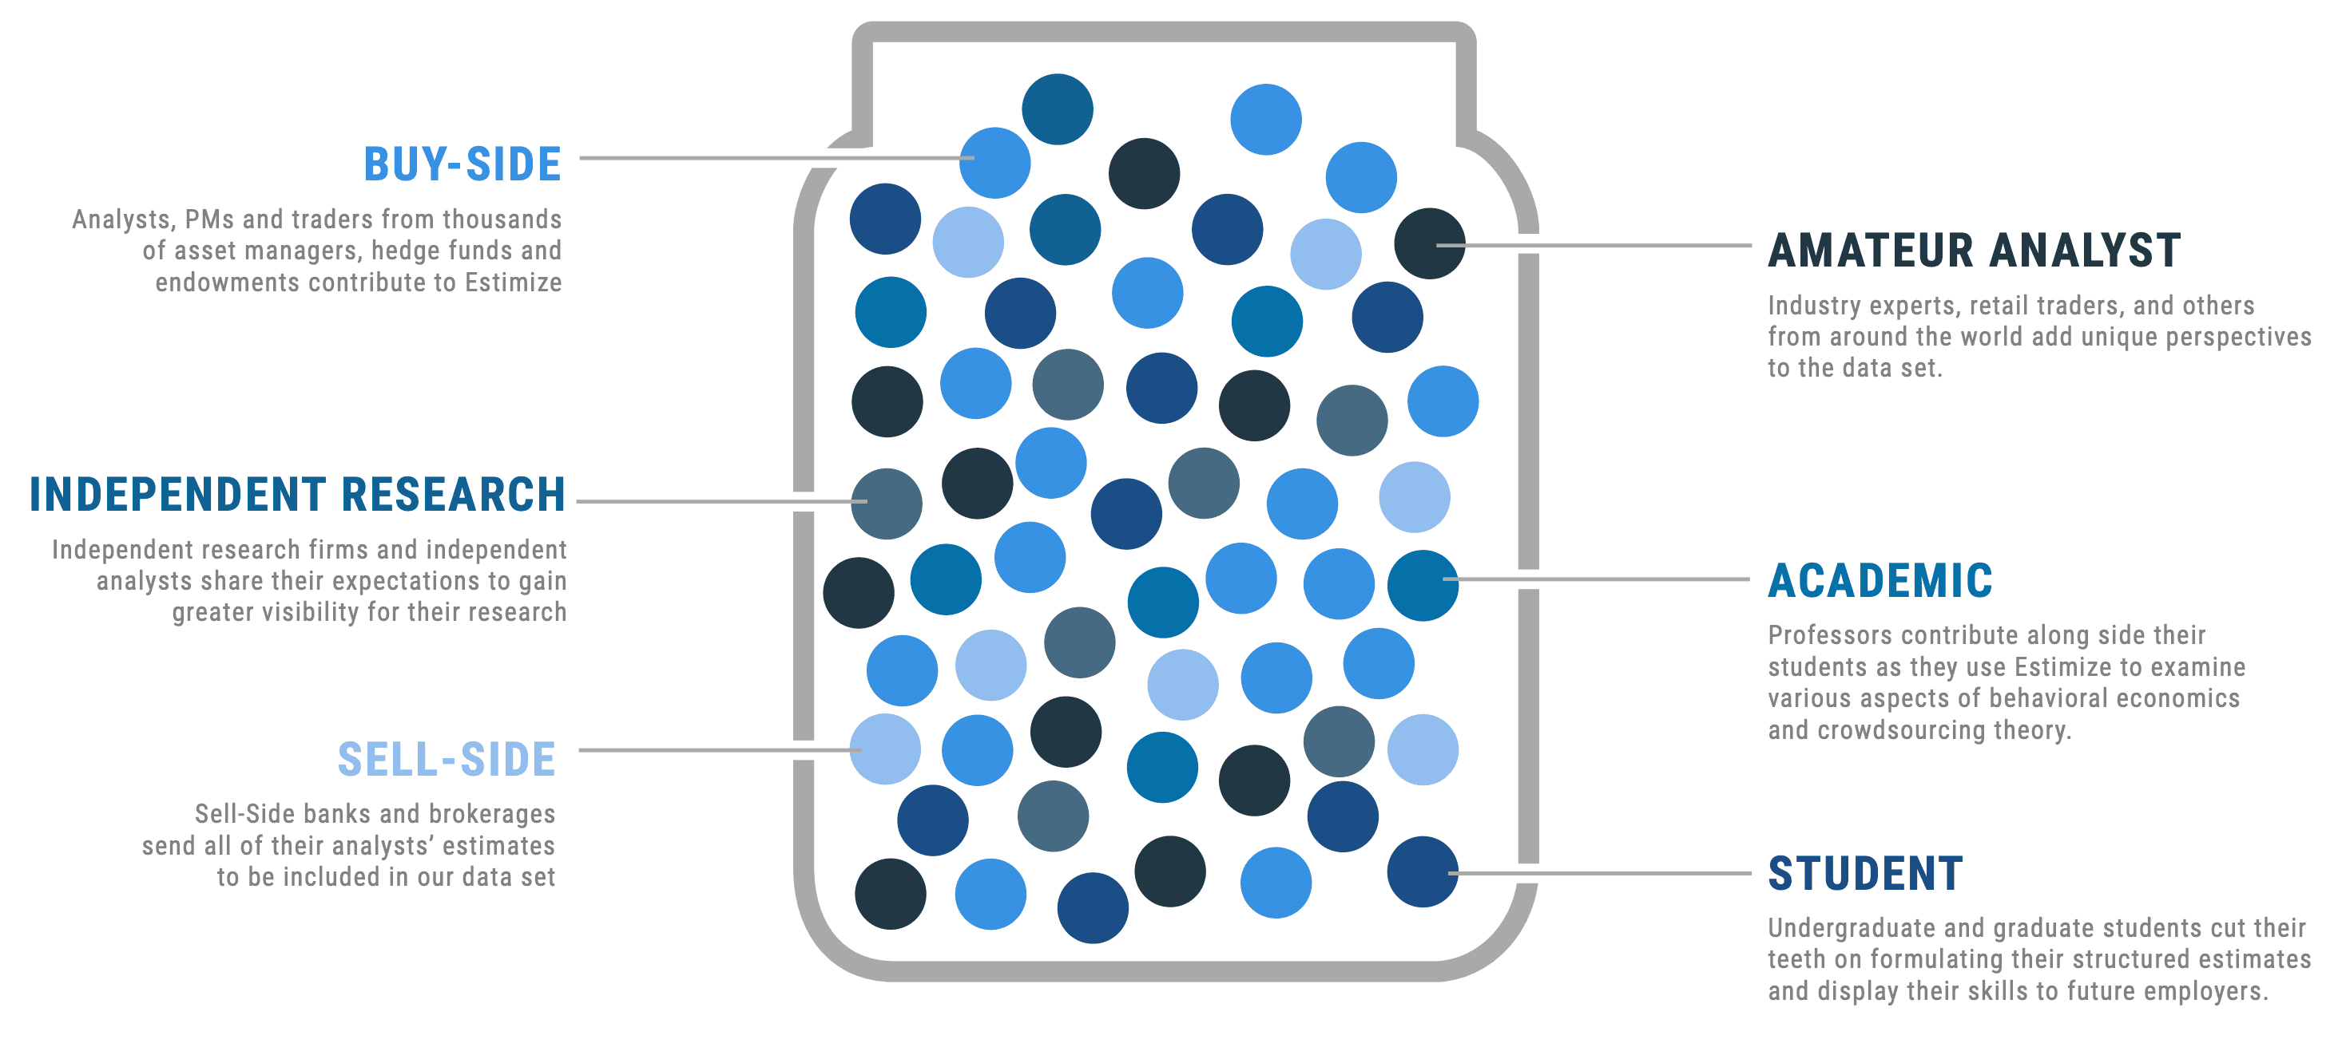
How does Estimize work

Slide 5
Problem Statement:
Scrape
Scrape the data for 50 stock tickers from Estimize.com for at least one year – 4 quarters.
Store
Build datasets to store the scraped EPS, Company and Analyst information.
Build
Build a database using the datasets generated above that supports easy query for extracting the correct information

Slide 6
Solution and steps:
Data on Estimize.com is unstructured data which is not readily downloadable or usable.
Scrape the data from Estimize.com using Selenium.
Store the scraped data into a json or csv format.
Import the stored data in MYSQL workbench and query the data as per further requirements.

Slide 7
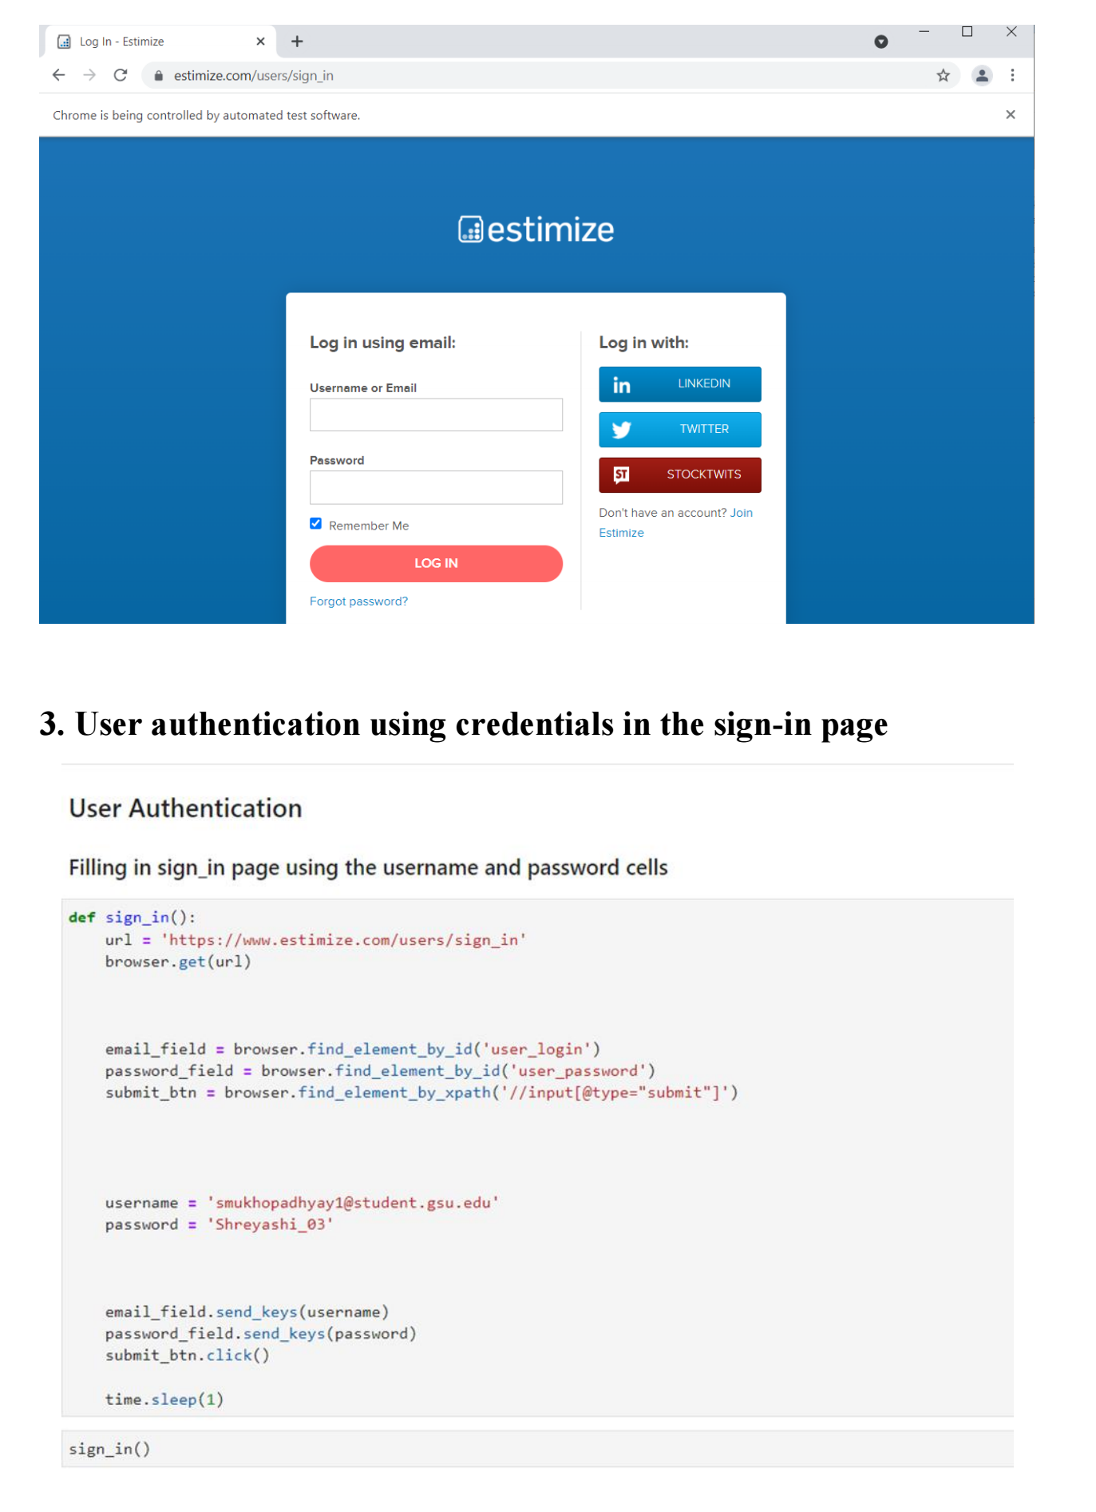
User authentication:

Slide 8
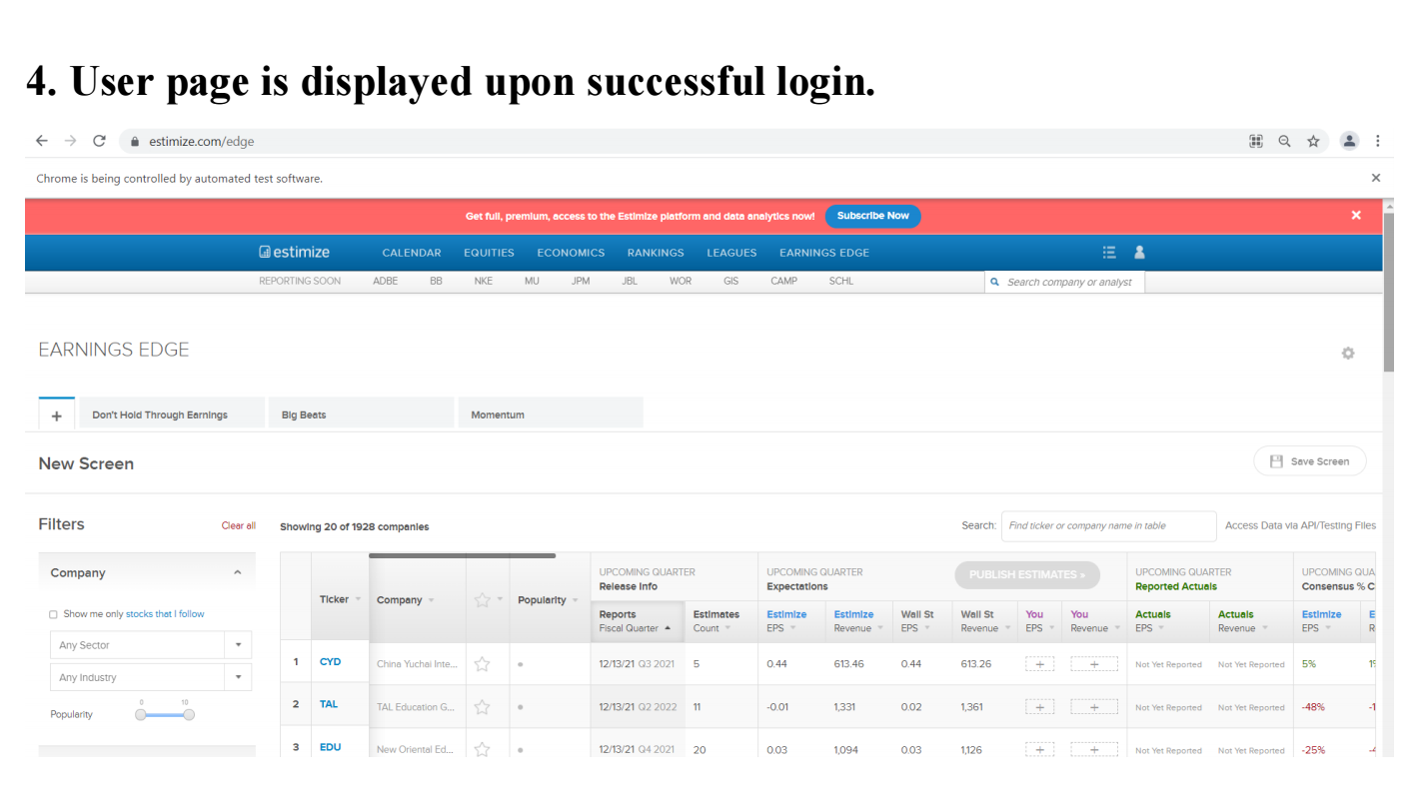
User authentication:

Slide 9
Ticker and Quarter Selection

Slide 10
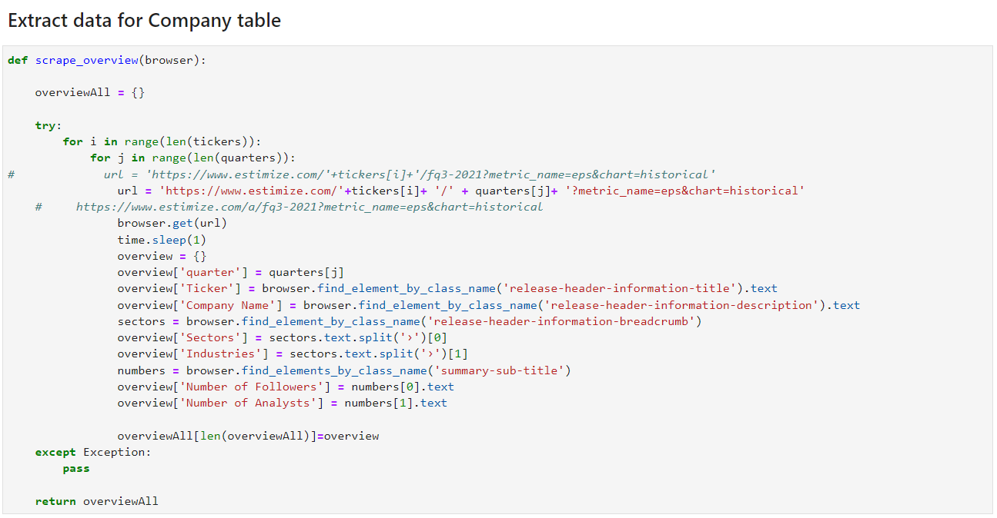
Extract data for the company table

Slide 11
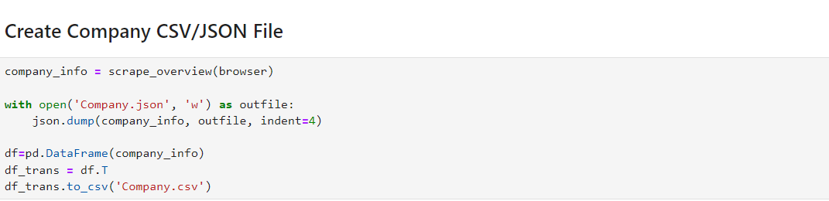
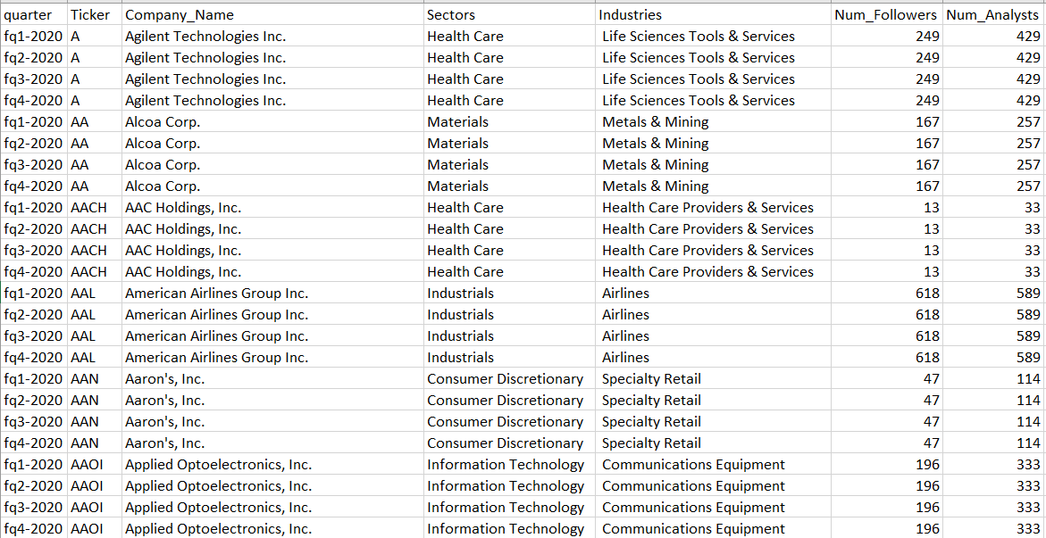
Store the scraped company data into csv format

Slide 12
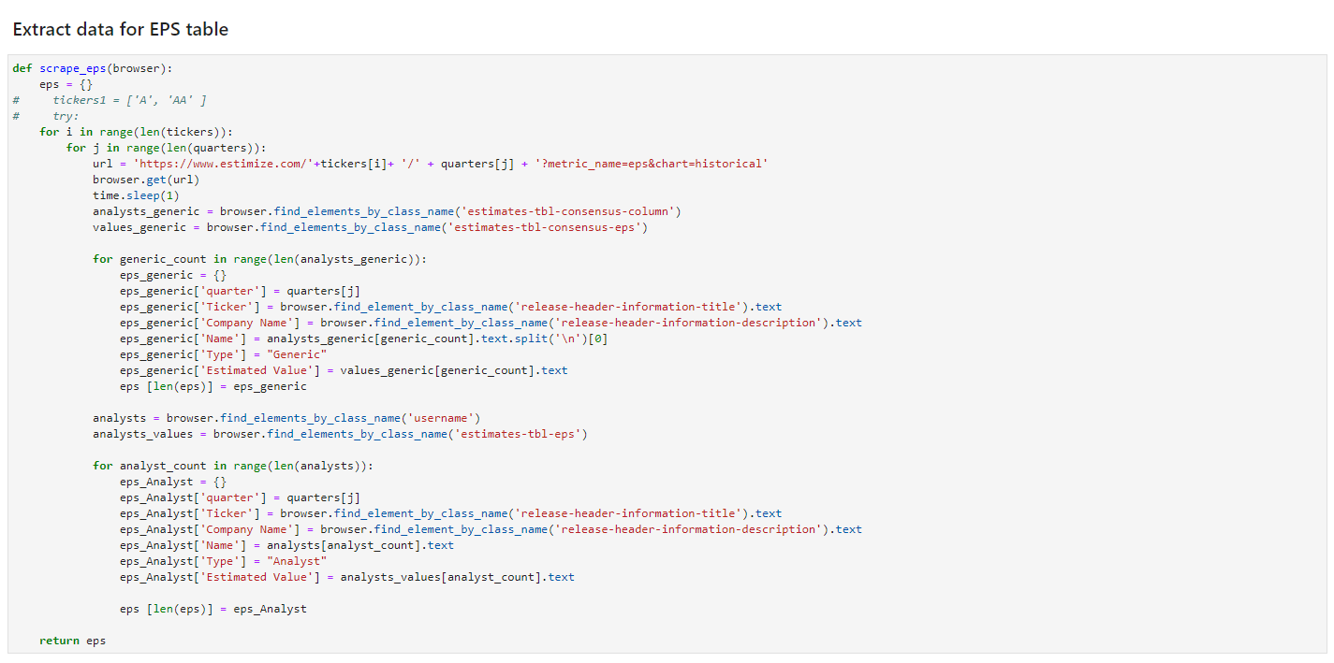
Extract data for the EPS table

Slide 13
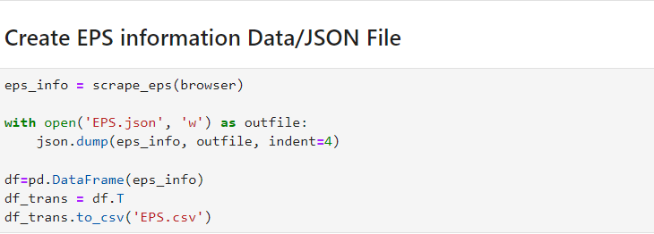
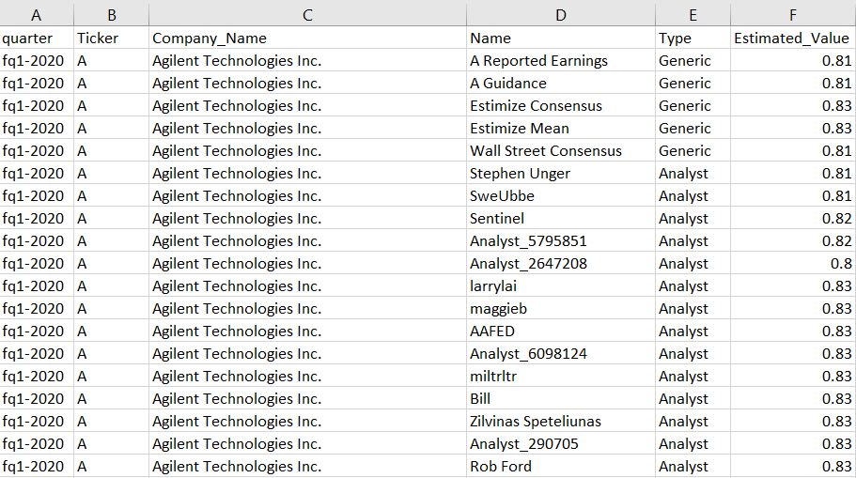
Store the EPS data into csv format

Slide 14
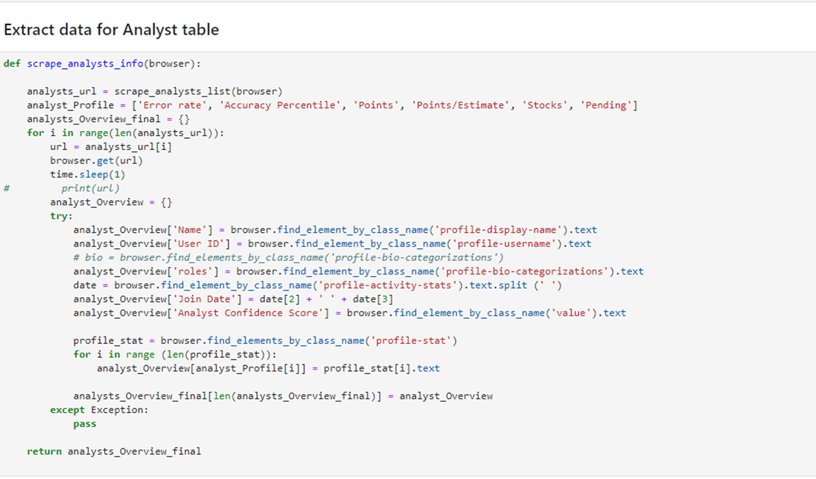
Extract data for the Analyst table

Slide 15
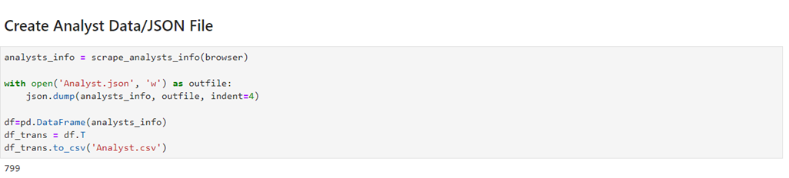
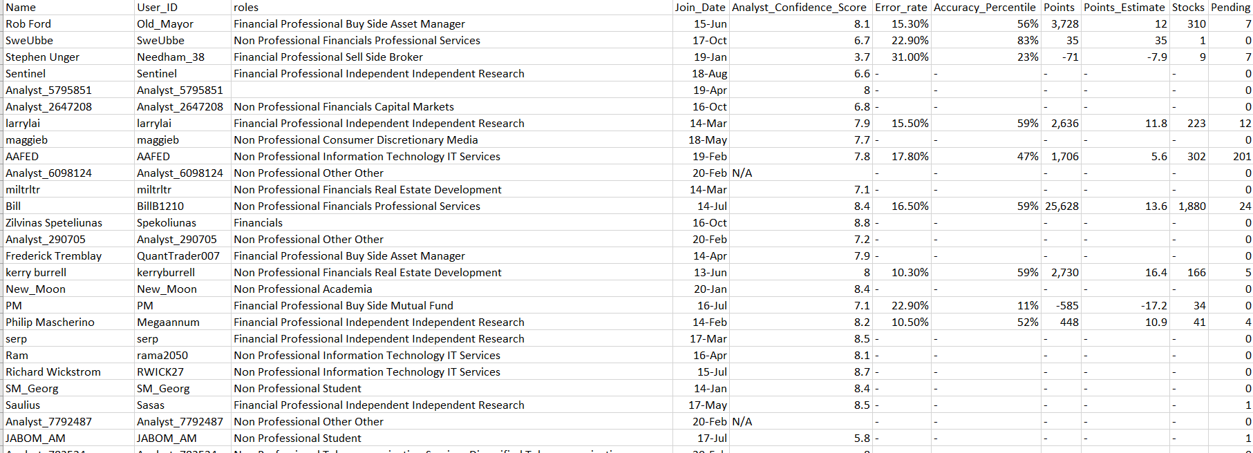
Store the Analyst data into csv format

Slide 16
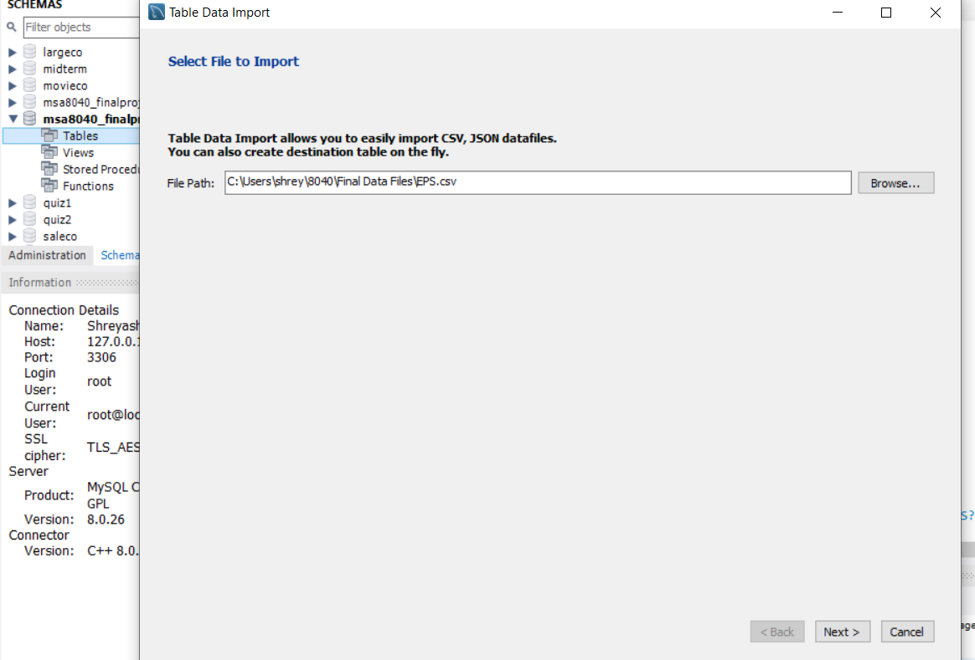
Importing data in MySQL Workbench

Slide 17

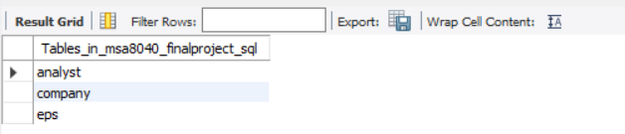
Query the imported tables and check the count of each table

Slide 18
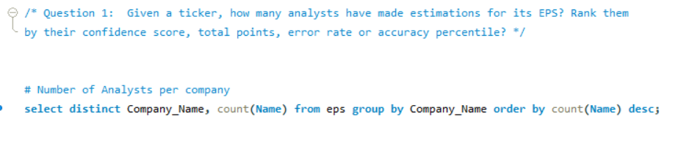
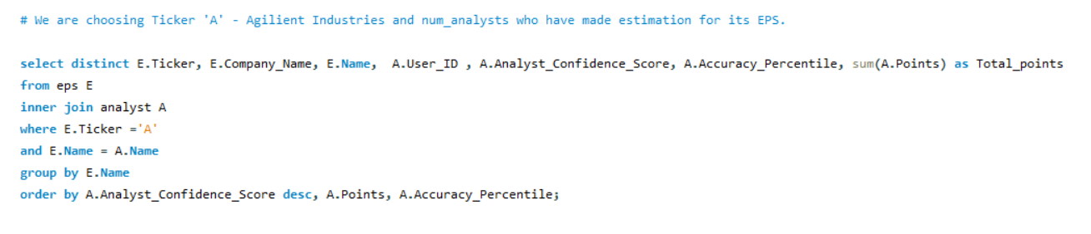
Query the database to extract required information

Slide 19
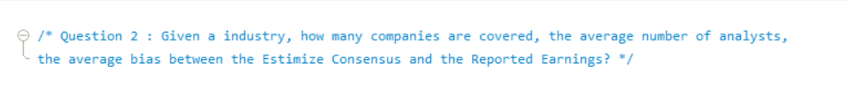
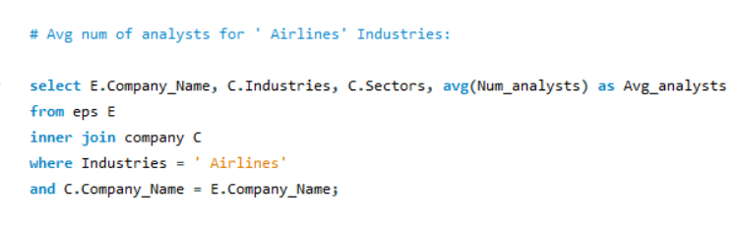
Query the database to extract required information

Slide 20
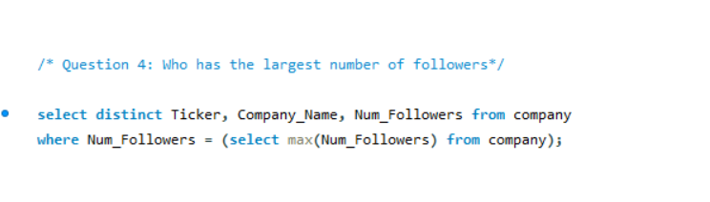
Query the database to extract required information
Who has the largest number of followers?

Slide 21
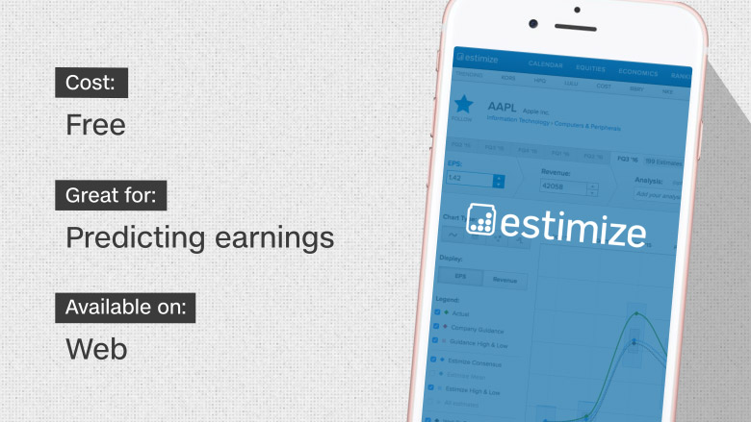
Thank you!

