Slide 1



Callcentre Report PowerBI
View in Power BI
Shreyashi Mukhopadhyay

Slide 2
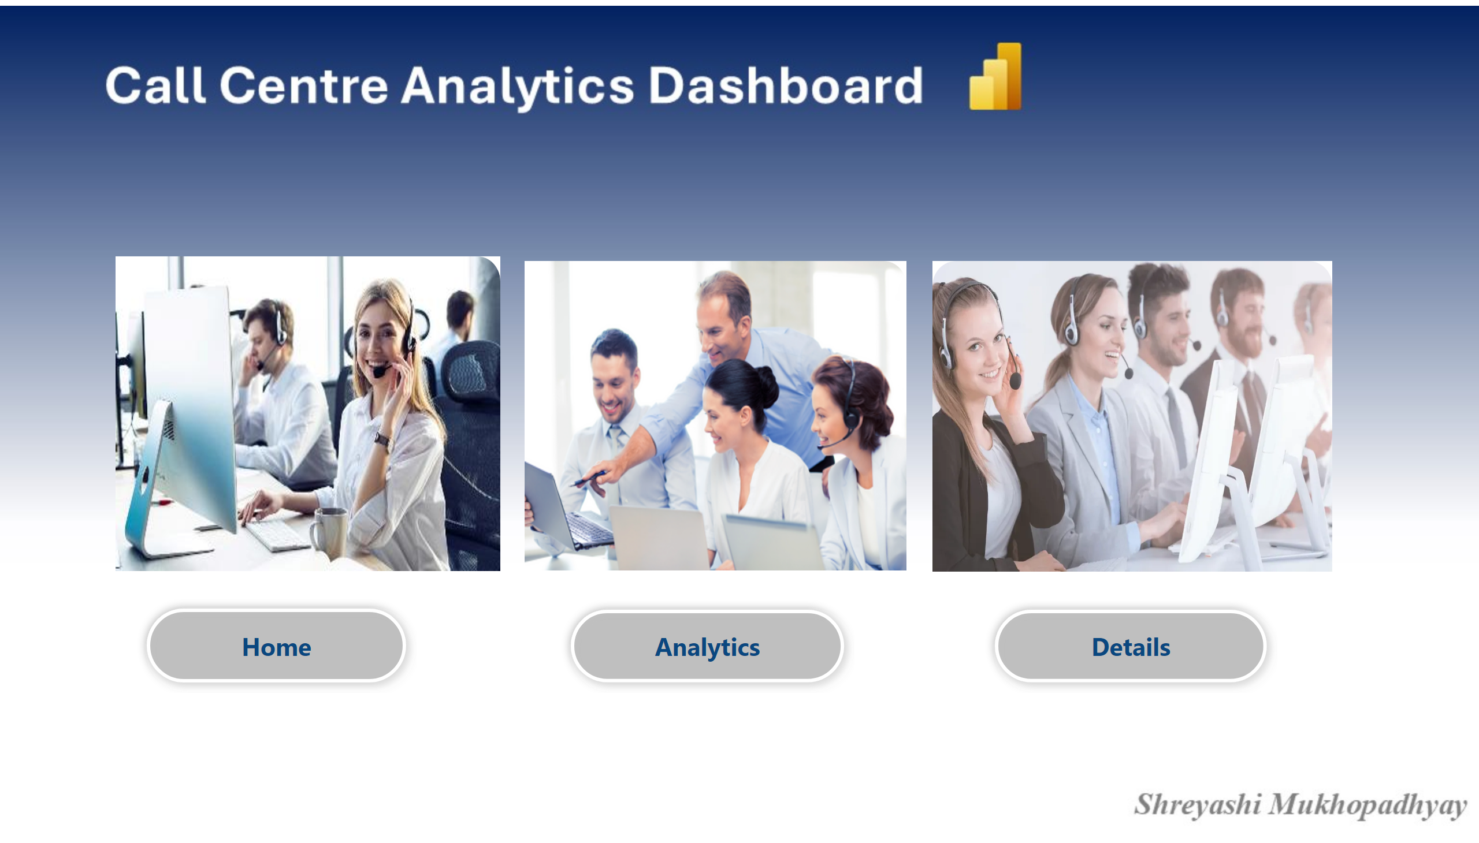
Coverpage
Notes:
actionButton
No alt text provided
actionButton
No alt text provided
actionButton
No alt text provided
Home
No alt text provided
Home
No alt text provided
Home
No alt text provided

Slide 3
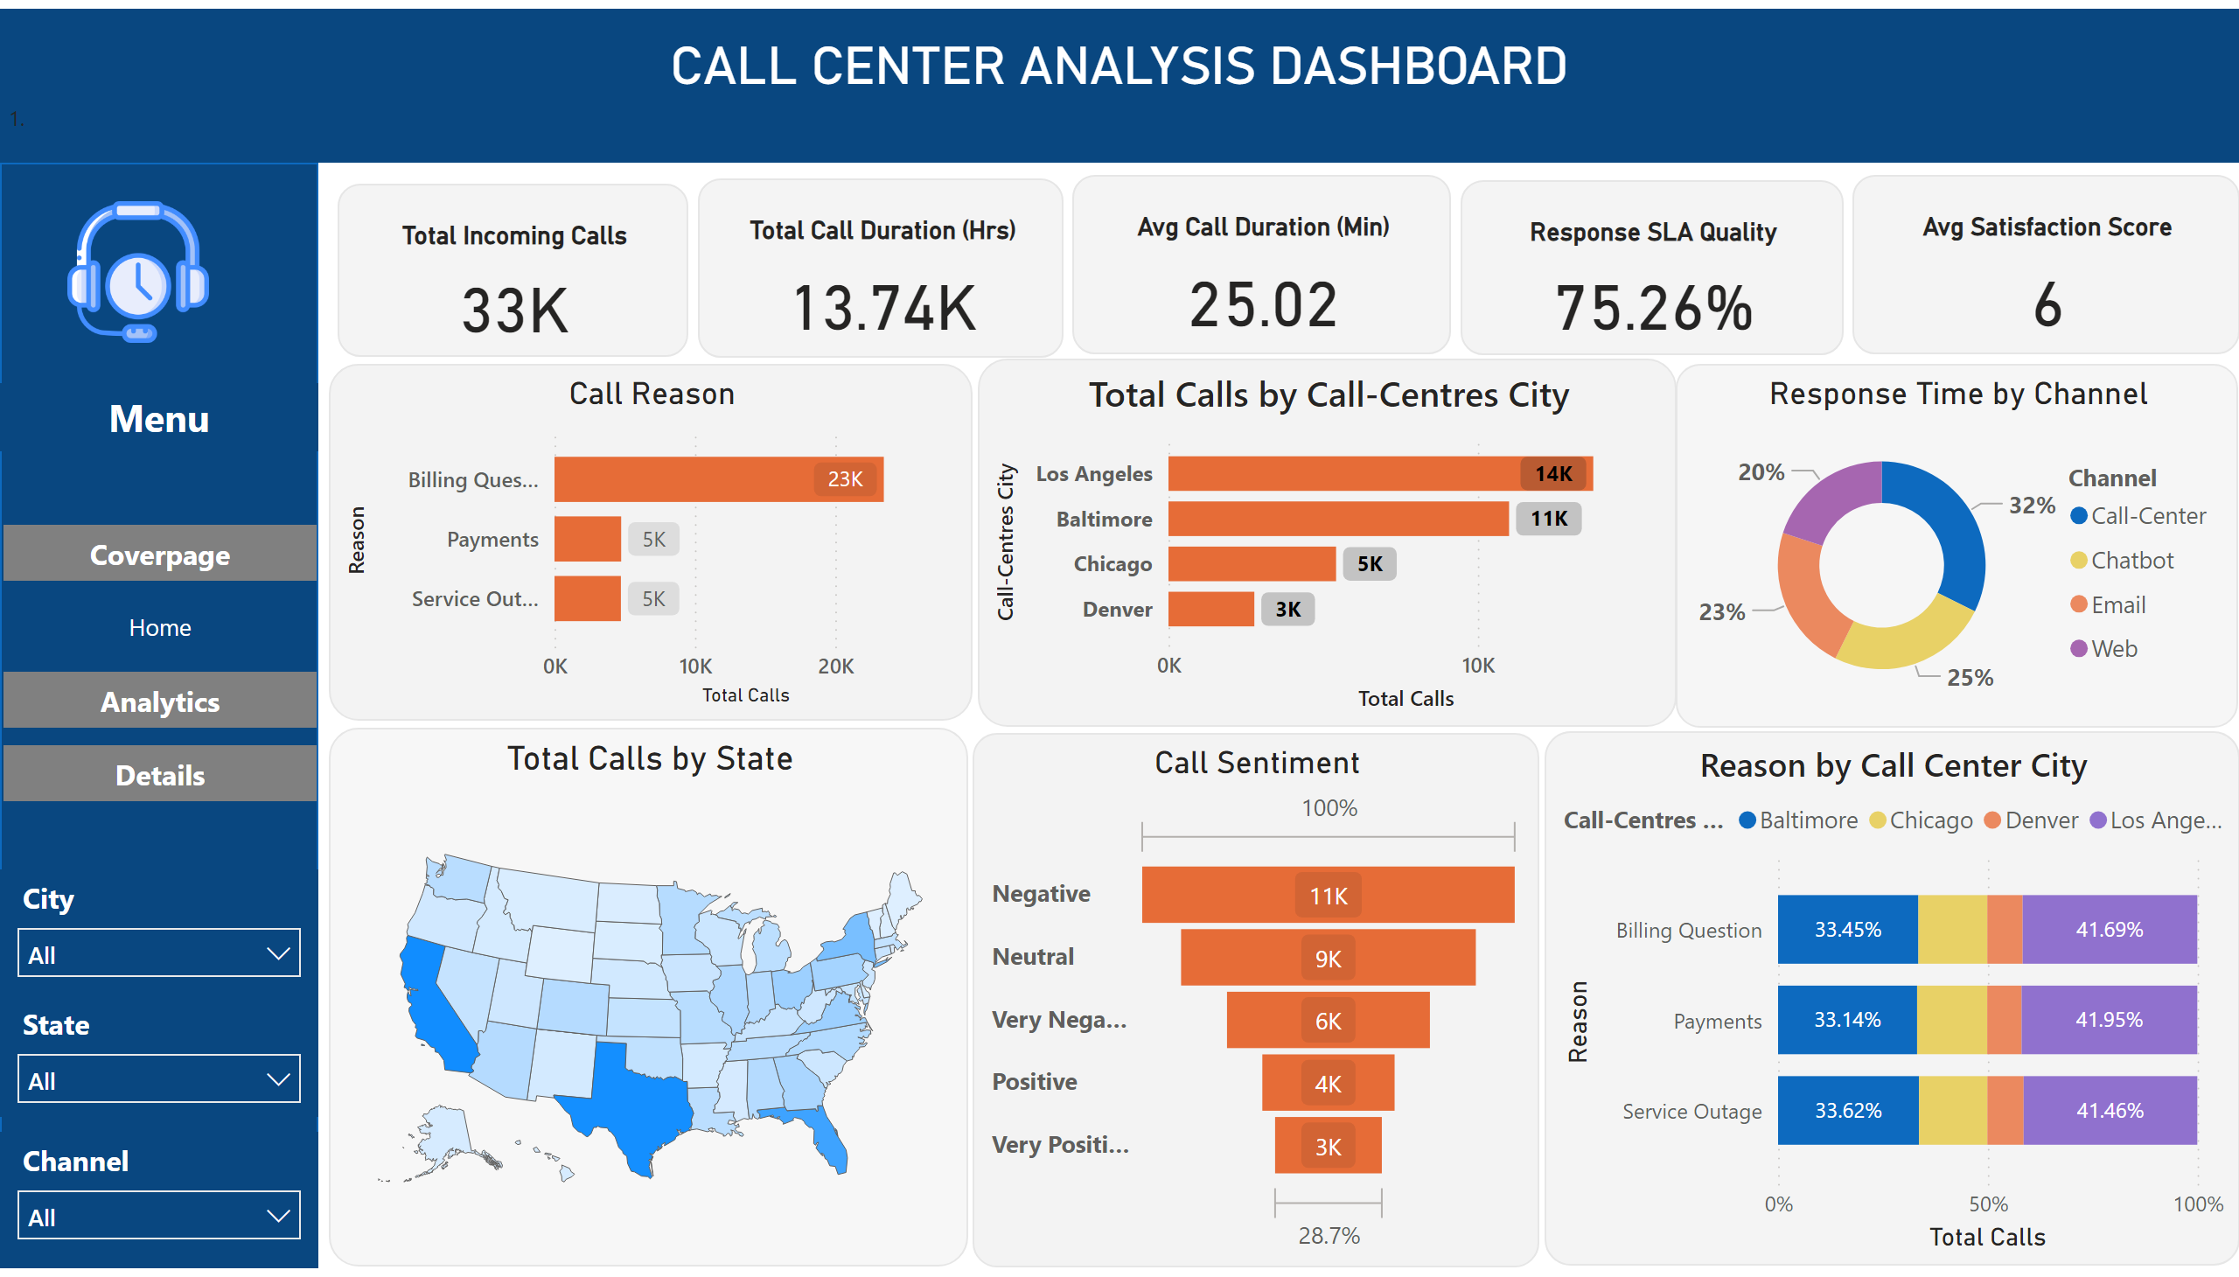
Home
Notes:
CALL CENTER ANALYSIS DASHBOARD
No alt text provided
Total Incoming Calls
No alt text provided
Response SLA Quality
No alt text provided
Avg Satisfaction Score
No alt text provided
Avg Call Duration (Min)
No alt text provided
Total Call Duration (Hrs)
No alt text provided
Call Reason
No alt text provided
Call Sentiment
No alt text provided
shapeMap
No alt text provided
Response Time by Channel
No alt text provided
image
No alt text provided
slicer
No alt text provided
slicer
No alt text provided
slicer
No alt text provided
pageNavigator
No alt text provided
textbox
No alt text provided
shape
No alt text provided
barChart
No alt text provided
Reason by Call Center City
No alt text provided

Slide 4
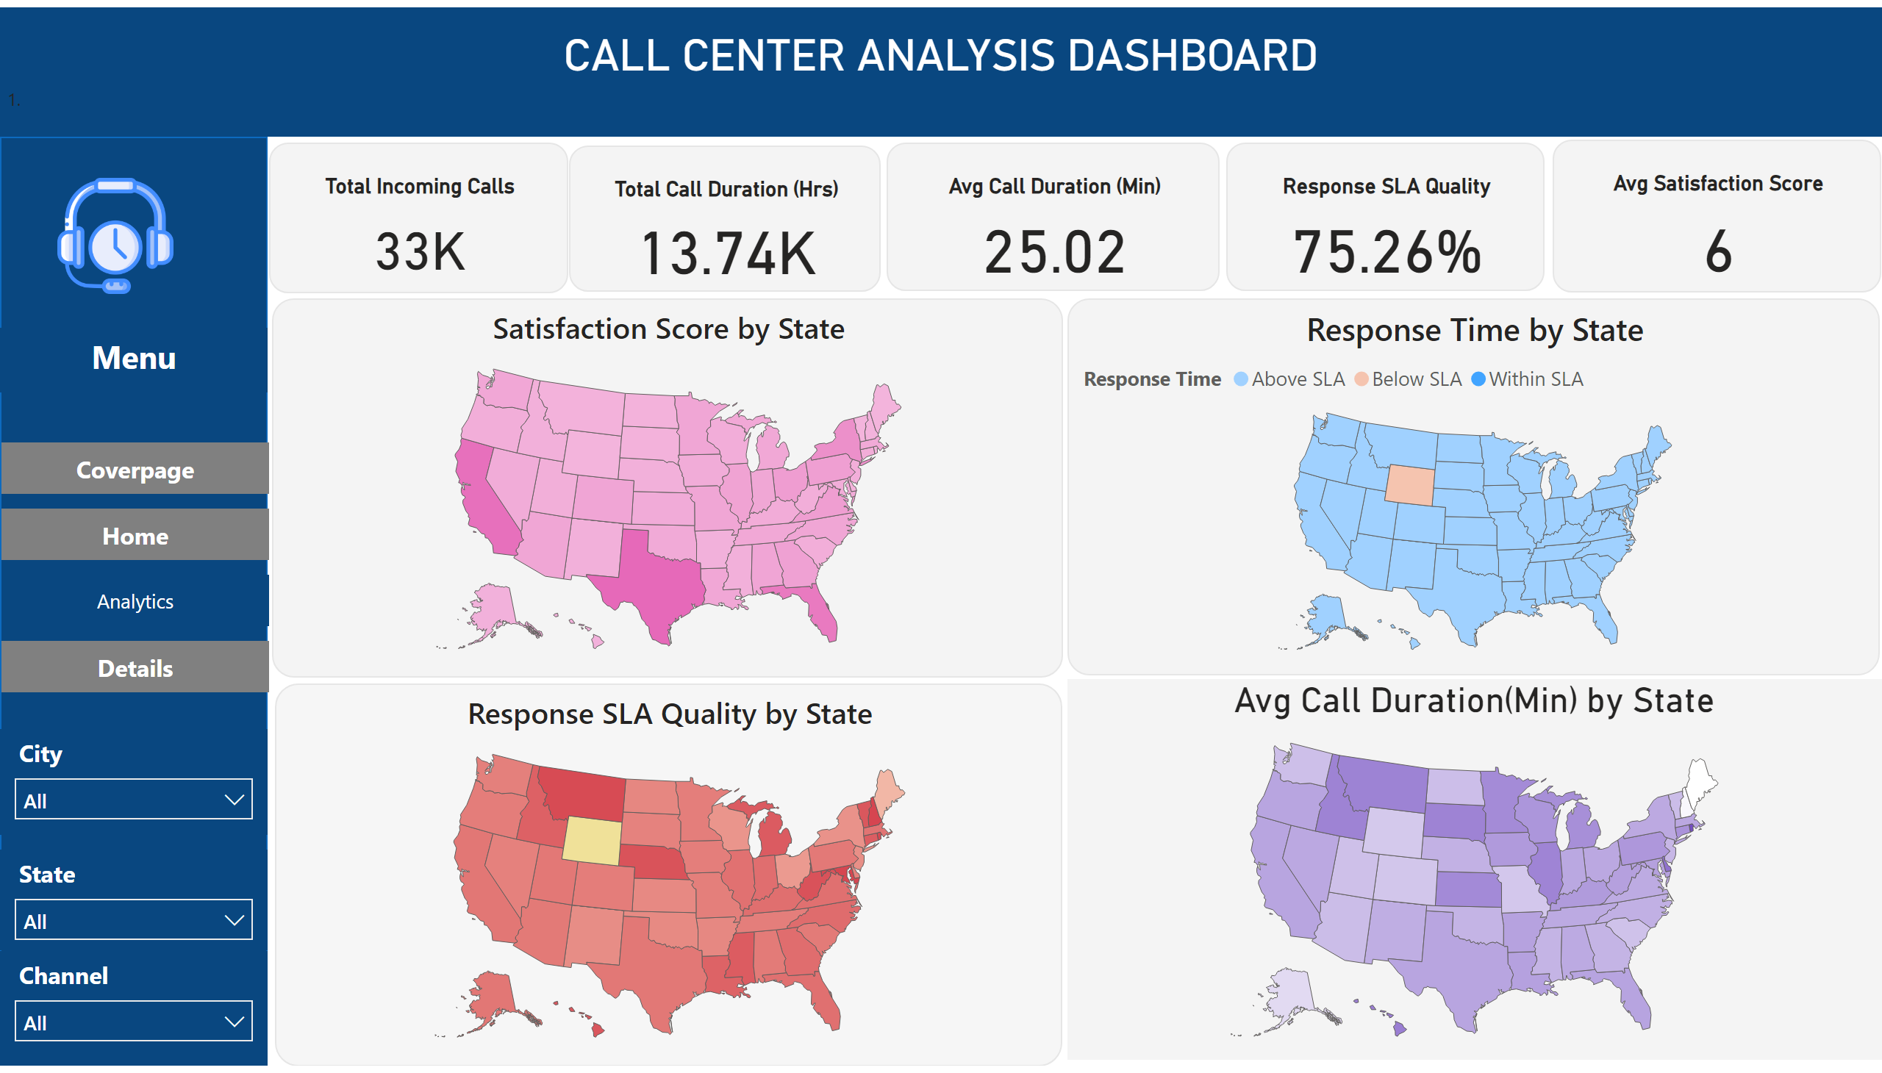
Analytics
Notes:
CALL CENTER ANALYSIS DASHBOARD
No alt text provided
Total Incoming Calls
No alt text provided
image
No alt text provided
slicer
No alt text provided
slicer
No alt text provided
slicer
No alt text provided
pageNavigator
No alt text provided
textbox
No alt text provided
shape
No alt text provided
Total Call Duration (Hrs)
No alt text provided
Avg Call Duration (Min)
No alt text provided
Response SLA Quality
No alt text provided
Avg Satisfaction Score
No alt text provided
Satisfaction Score by State
No alt text provided
shapeMap
No alt text provided
Response Time by State
No alt text provided
shapeMap
No alt text provided

Slide 5
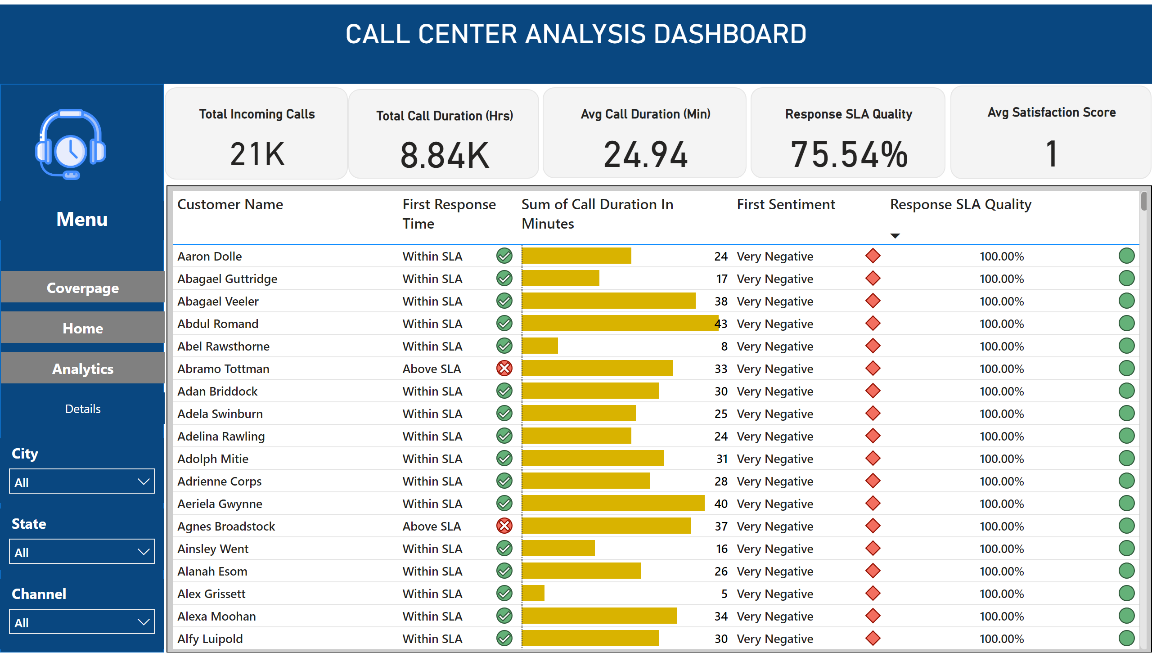
Details
Notes:
CALL CENTER ANALYSIS DASHBOARD
No alt text provided
Total Incoming Calls
No alt text provided
image
No alt text provided
slicer
No alt text provided
slicer
No alt text provided
slicer
No alt text provided
pageNavigator
No alt text provided
textbox
No alt text provided
shape
No alt text provided
Total Call Duration (Hrs)
No alt text provided
Avg Call Duration (Min)
No alt text provided
Response SLA Quality
No alt text provided
Avg Satisfaction Score
No alt text provided
tableEx
No alt text provided

