Slide 1



HR Analytics Report PowerBI
View in Power BI
Shreyashi Mukhopadhyay
Last data refresh:
10/14/2024 8:44:34 PM UTC
Downloaded at:
10/14/2024 9:34:48 PM UTC

Slide 2

Coverpage
Notes:
actionButton
No alt text provided
actionButton
No alt text provided
actionButton
No alt text provided

Slide 3
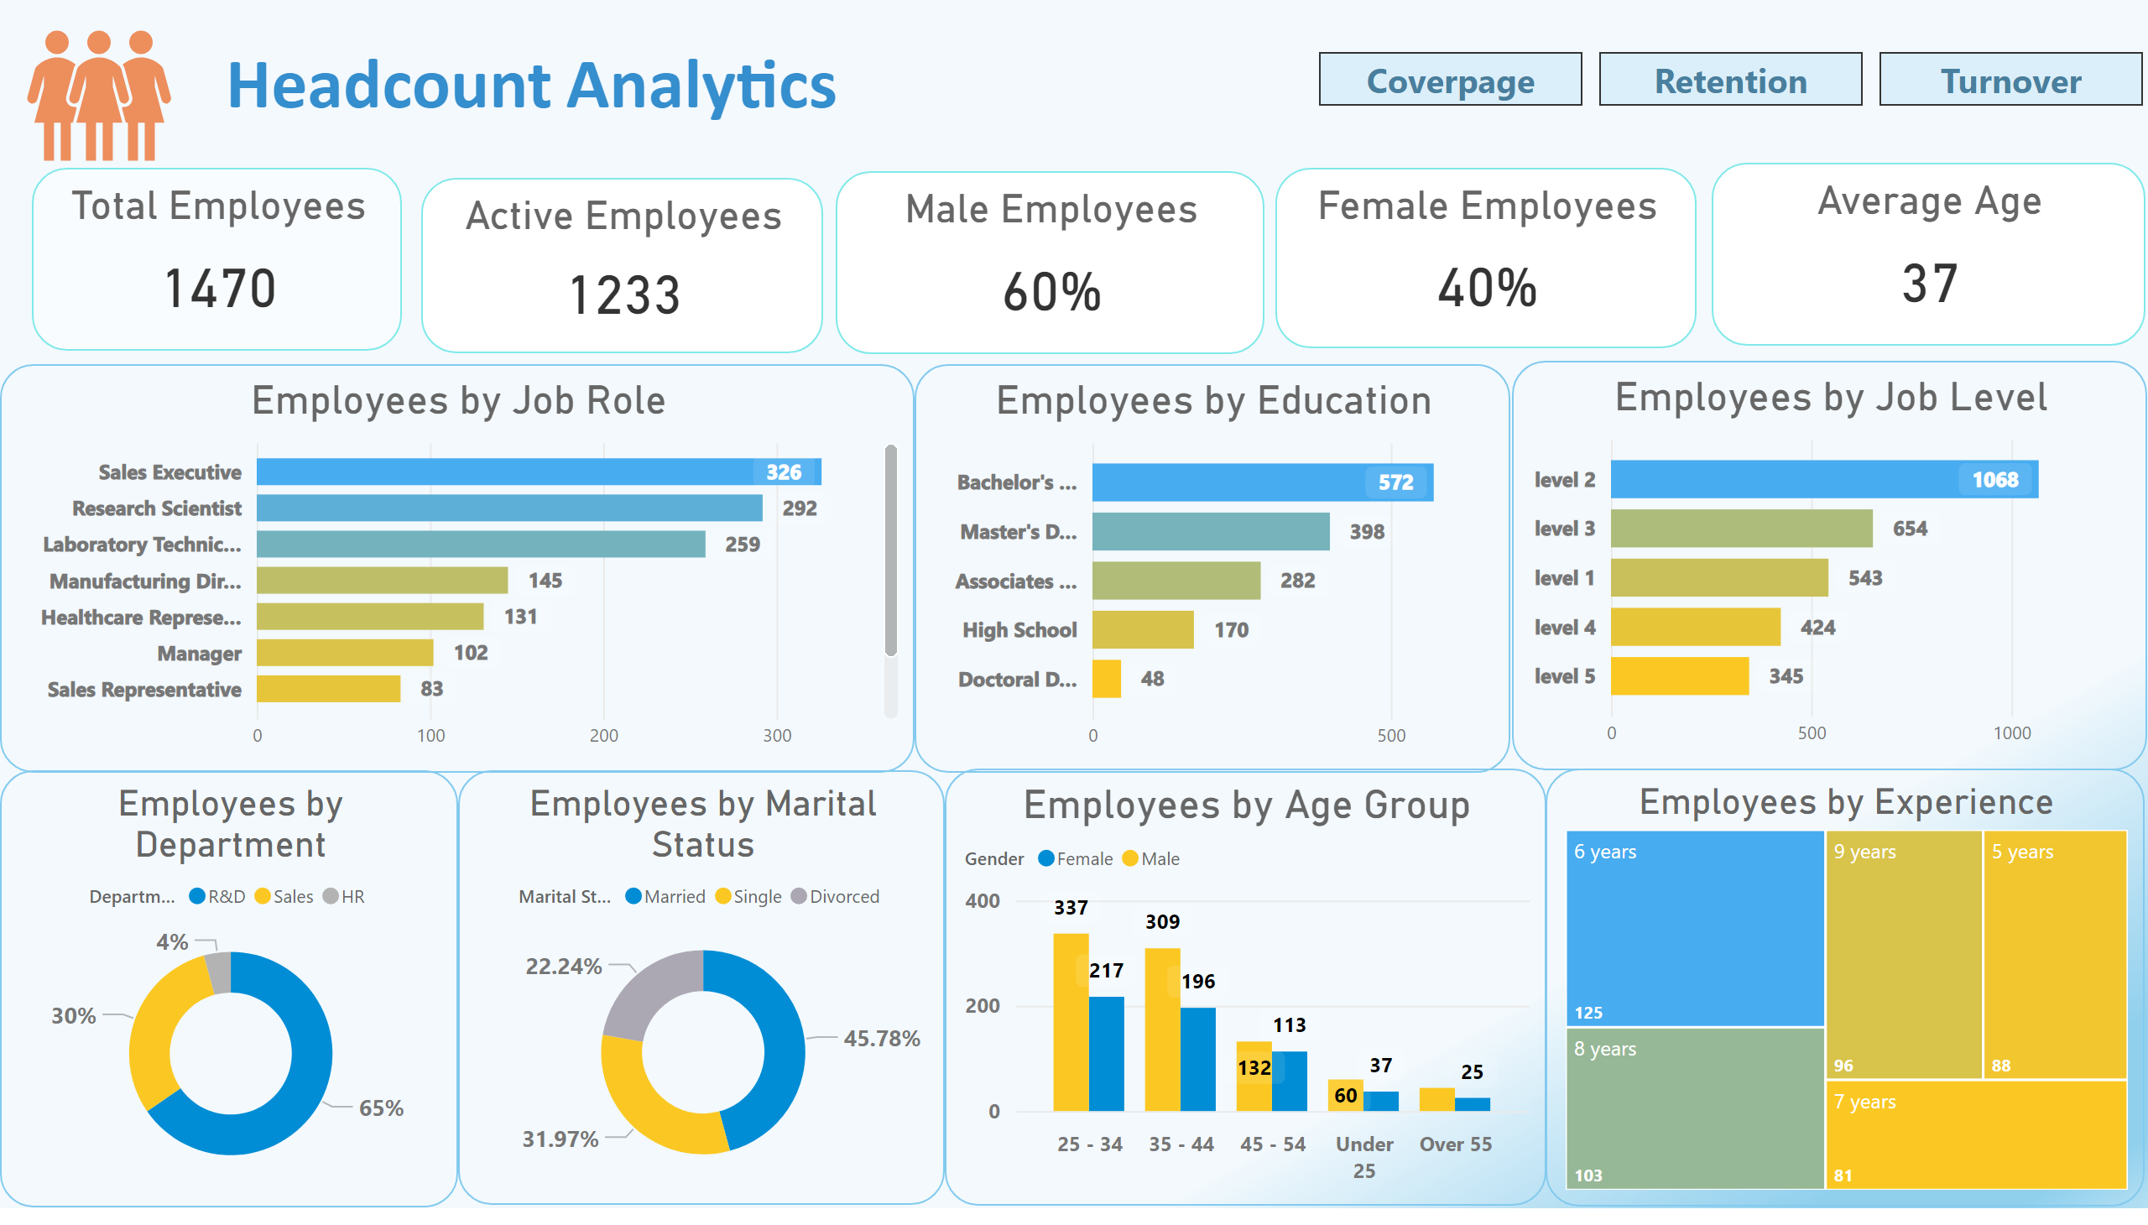
Headcount
Notes:
Total Employees
No alt text provided
Active Employees
No alt text provided
Male Employees
No alt text provided
Female Employees
No alt text provided
Average Age
No alt text provided
Employees by Department
No alt text provided
Employees by Age Group
No alt text provided
Employees by Education
No alt text provided
Employees by Job Level
No alt text provided
Employees by Job Role
No alt text provided
Employees by Marital Status
No alt text provided
Employees by Experience
No alt text provided
pageNavigator
No alt text provided

Slide 4
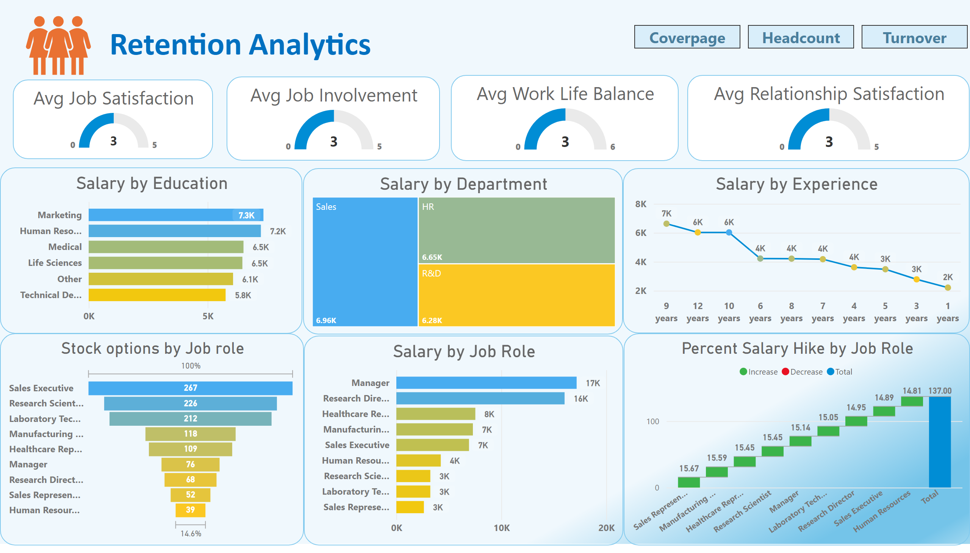
Retention
Notes:
Avg Job Satisfaction
No alt text provided
Avg Job Involvement
No alt text provided
Avg Work Life Balance
No alt text provided
Avg Relationship Satisfaction
No alt text provided
Stock options by Job role
No alt text provided
Salary by Department
No alt text provided
Salary by Education
No alt text provided
Salary by Experience
No alt text provided
pageNavigator
No alt text provided
Percent Salary Hike by Job Role
No alt text provided
Salary by Job Role
No alt text provided

Slide 5
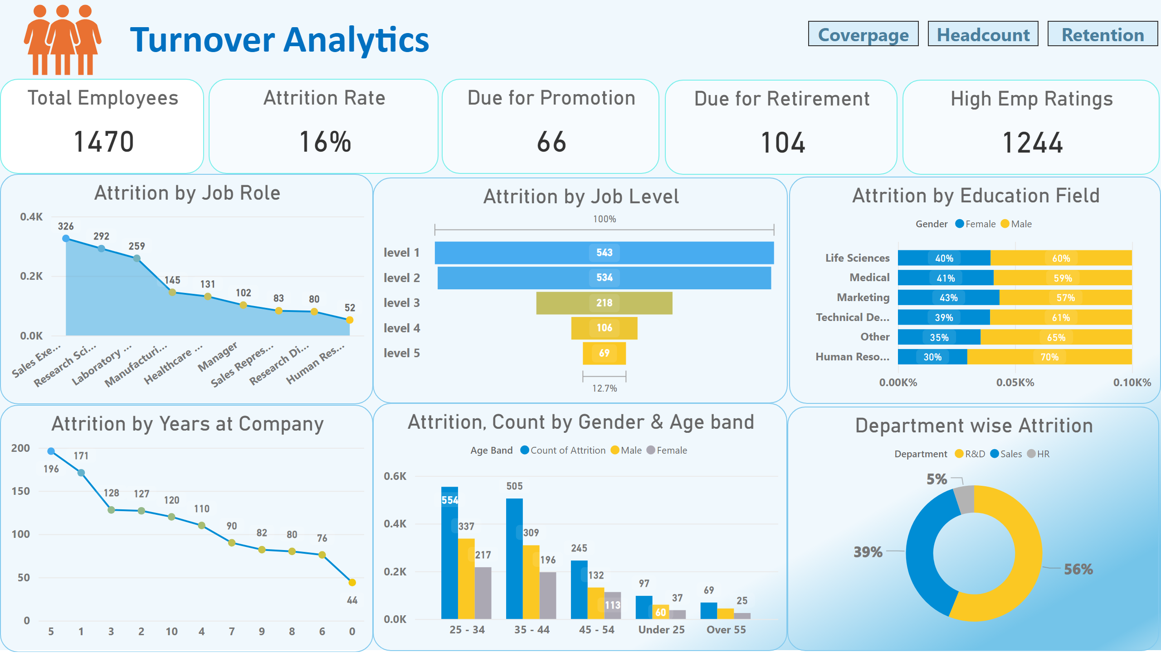
Turnover
Notes:
Attrition Rate
No alt text provided
Total Employees
No alt text provided
Due for Promotion
No alt text provided
Due for Retirement
No alt text provided
High Emp Ratings
No alt text provided
Attrition by Education Field
No alt text provided
Attrition, Count by Gender & Age band
No alt text provided
Department wise Attrition
No alt text provided
Attrition by Job Role
No alt text provided
Attrition by Job Level
No alt text provided
Attrition by Years at Company
No alt text provided
pageNavigator
No alt text provided

