Slide 1
Social Media Analytics – Reddit Sprint Project
Spring - Summer 2022
Shreyashi Mukhopadhyay

Slide 2

Impact of Subreddit r/Wallstreetbets on Stock Transaction Volume and Daily Returns: Rise of the Individual Investor vs Institutional Investors

Slide 3

Introduction:
Stock market trading has always been dominated by Institutional Investors as compared to retail Investors.
Retail investors’ share of total equities trading volume is now approaching 25%, up from 20% in 2020 and 10-15% the preceding decade.
More than half the world has access to social media (59%) which is around 4.70 billion people.
In 2019, Robinhood increased market accessibility by cutting trading commissions to zero, which set off a cascade of copy-cat moves by Charles Schwab, TD Ameritrade, and Fidelity.
Pandemic-induced lockdowns in 2020 saw surplus stimulus money which kicked things into high gear as retail investors began fervent discussions about equities and trading strategies on social media forums like Reddit’s WallStreetBets (WSB).

Slide 4
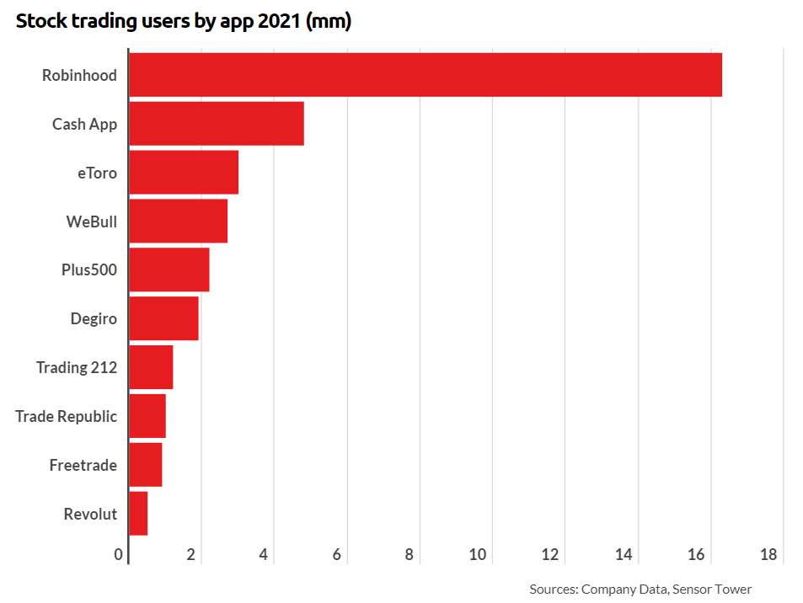
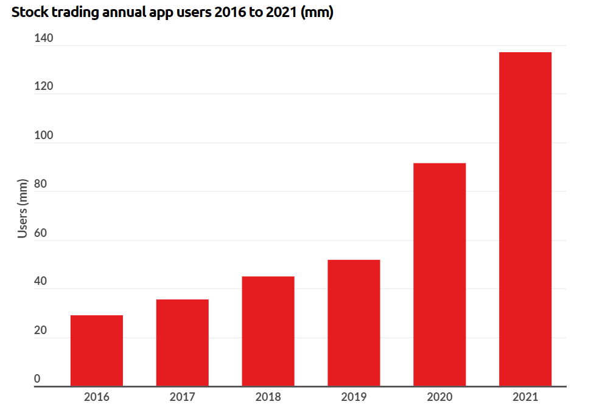
Stock Trading Apps User Statistics https://www.businessofapps.com/data/stock-trading-app-market/

Slide 5
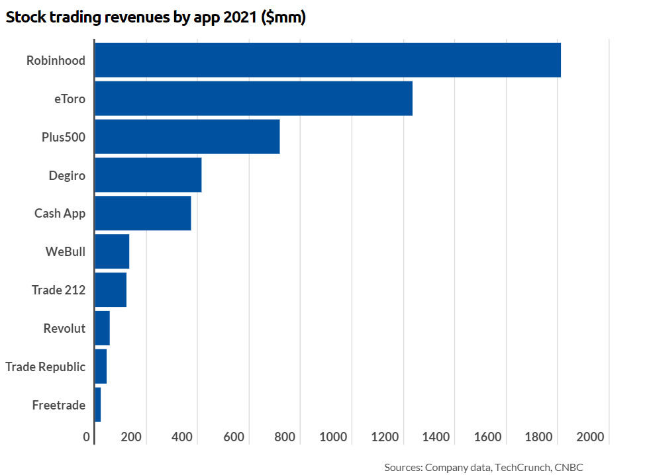
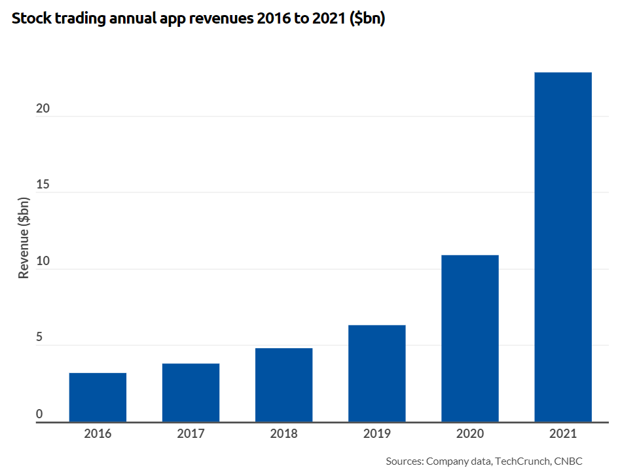
Stock Trading Apps Revenue Statistics https://www.businessofapps.com/data/stock-trading-app-market/

Slide 6
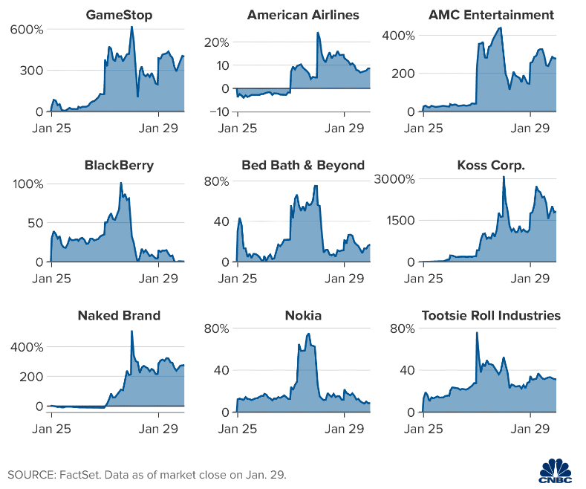
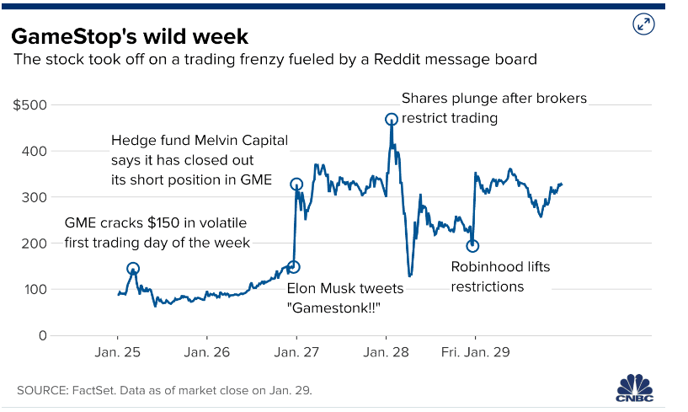
Meme stocks Reddit Rally -- Jan 2021
A band of amateur traders on WallStreetBets aimed to bid up heavily shorted stocks “to the moon,” creating massive short squeezes.

Slide 7
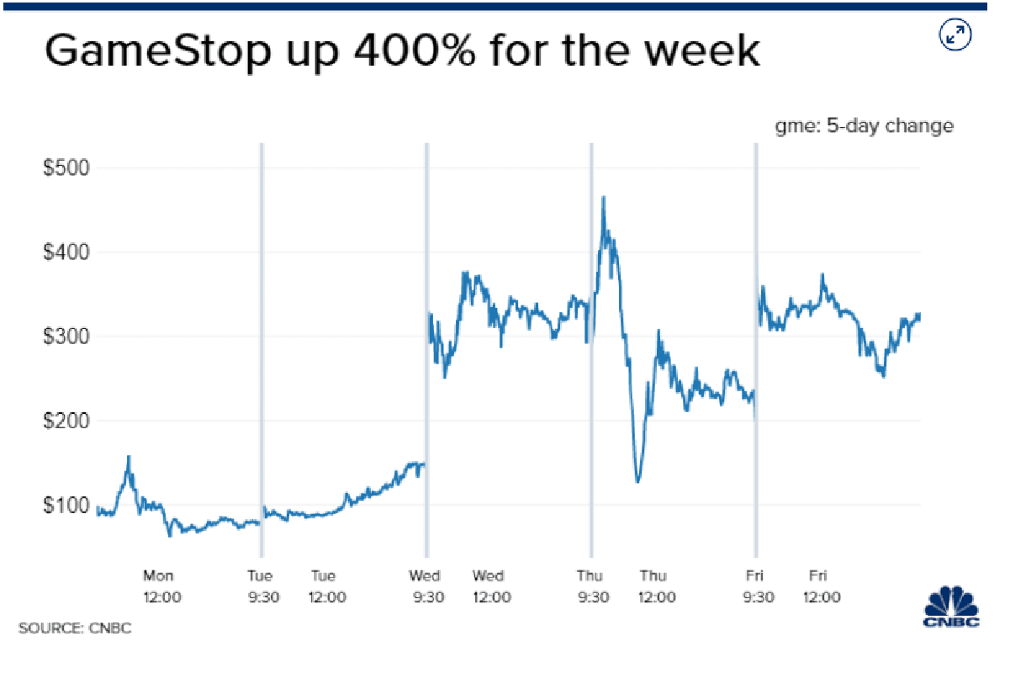
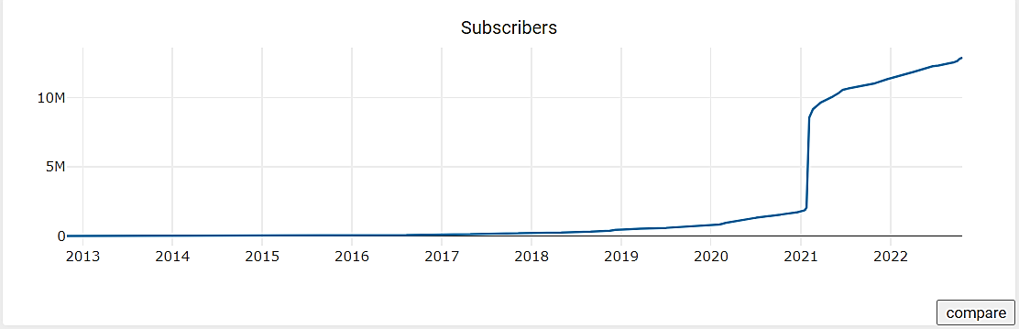
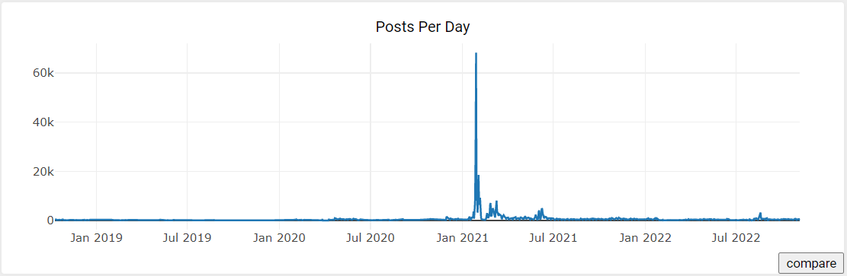
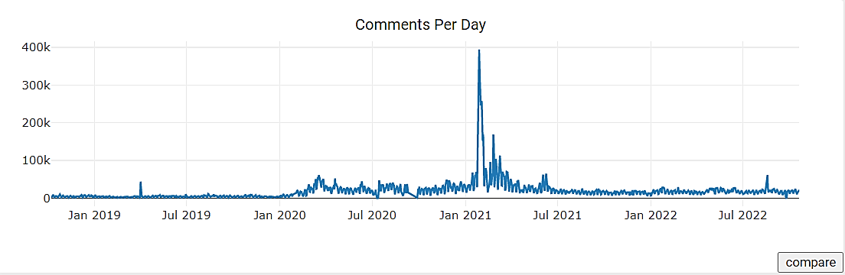
r/WallStreetBets User Statistics : r/WallStreetBets hit 6 million users, after gaining more than 1.5 million users overnight in Jan 2021

Slide 8
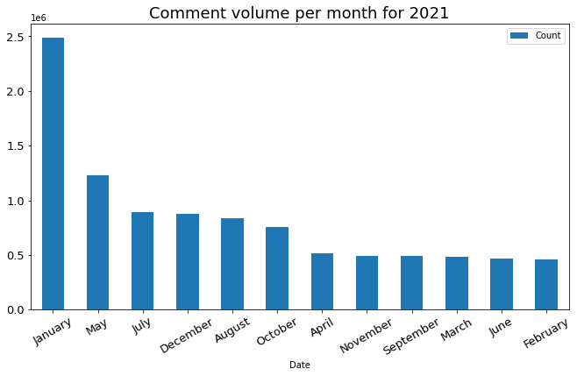
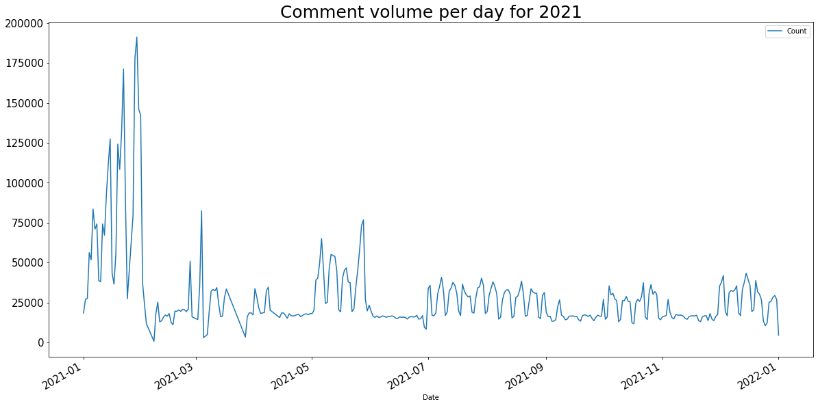
r/WallStreetBets - WSB Comment volume 2021

Slide 9





Objective:
Quantify the relationship between WSB stock comment Volume vs. Stock Transaction Volume.
Quantify the relationship between WSB stock comment Volume vs. Stock Closing Price.
Quantify the relationship between WSB stock Comment Volume vs. Stock Daily Returns.
Quantify the relationship between WSB stock Comment Sentiment score vs. Stock Closing Price.
This Project ultimately culminates into an App with a dashboard displaying all the above relationships along with the stock price movement &other key stock technical and volatility metrics.

Slide 10
Analytics roadmap:
Data collection
Stock Segmentation
Correlation Analysis
Tracking Volatility Metrics
Trade Signal Analysis
Prepare model fitting data
Sentiment Analysis
App Creation

Slide 11
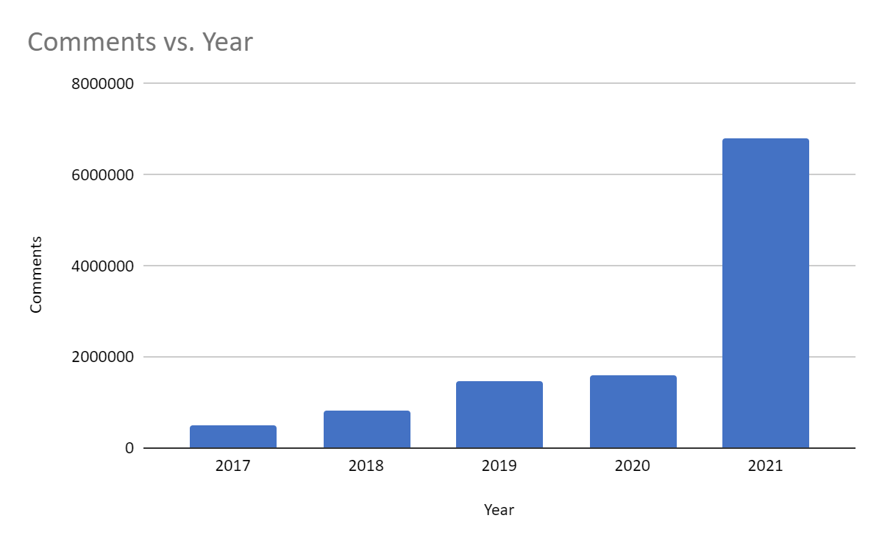
Data collection – r/wallstreetbets Comments
Scrape comments data from r/WallStreetBets using the Pushshift API (PRAW Wrapper)
Store the data month wise from 2017 to 2021.
Create comments data summary.
2021 shows a significant spike in WSB posts compared to previous years suggesting a sudden shift in user activity.

Slide 12
Stock Segmentation
Meme Stocks
Inactive stocks, mostly loss-making companies heavily shorted by Hedge funds
Example: GameStop, AMC, Nokia, Koss
Stocks Popular during
COVID 19 Pandemic
Stocks highly traded during COVID 19 Pandemic
Example: Zoom, Moderna, Palantir, Novavax
Large Cap – Mega Cap Stocks
Stocks with market capitalization value of more than $10B
Example: Tesla, FAANG stocks

Slide 13
Stock selection
Segment 1 | Segment 2 | Segment 3
Meme Stocks -- Jan 2021 | Popular stocks during the Covid 19 Pandemic | Large Cap/Mega Cap stock behavior during 2021
GameStop | Zoom | Tesla
AMC | Uber | Facebook
Bed Bath & Beyond | Moderna | Amazon
Blackberry | Novavax | Apple
Koss | Etsy | Alibaba
Nokia | Tilray | Netflix
American Airlines | Peloton | Alphabet
Beyond Meat | Nio | Nvidia
 | Fiverr | AMD
 | PLUG Power | Microsoft
 | Palantir
 | Wish
 | Clover Health
 | Virgin Galactic
 | Zillow Group

Slide 14
Correlation Analysis: Data pre-processing
Filter and Aggregate the stock comments for each stock from the comments data.
Filtering a stock: General stock
'GME|gme|GameStop|Gamestop|Game Stop|Game stop|GAMESTOP|GAME STOP’
Filtering a stock : FAANG Stocks/ CEO driven stocks
'TSLA|TESLA|tesla|tsla|Elon|Musk|Elon Musk|ELON|MUSK|ELON MUSK’
'META|meta|FACEBOOK|facebook|fb|FB|ZUCKERBERG|MARK ZUCKERBERG|Mark Zuckerberg|zuckerberg’
Extract price data for each stock from Yahoo finance for 2021.
Merge the filtered stock comments data with the stock price data.

Slide 15
Correlations Analysis: Inference
Plot WSB comment volume ~ Stock Transaction volume.
Plot WSB comment volume ~ Stock Closing Price.
Plot WSB comment volume ~ Stock Daily returns.
Plot WSB comment volume ~ Stock Log daily returns.
Plot the correlation heatmap for viewing the overall correlations. (Method: Pearson)
Plot the scatter plot and determine the P-value for significance.
A value of greater than 0.7 is considered a strong correlation. Anything between 0.5 and 0.7 is a moderate correlation, and anything less than 0.4 is considered a weak or no correlation.
https://wsbdaily.substack.com/p/wallstreetbets-impact-on-the-market

Slide 16
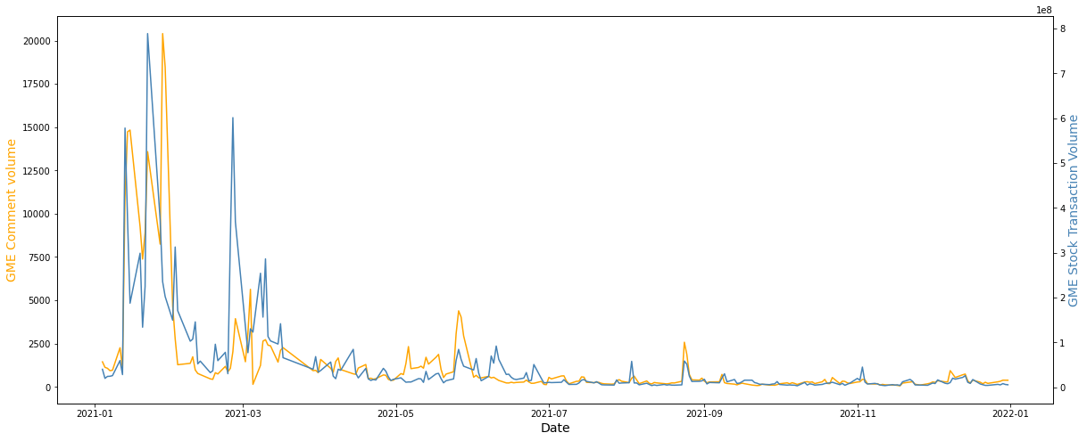
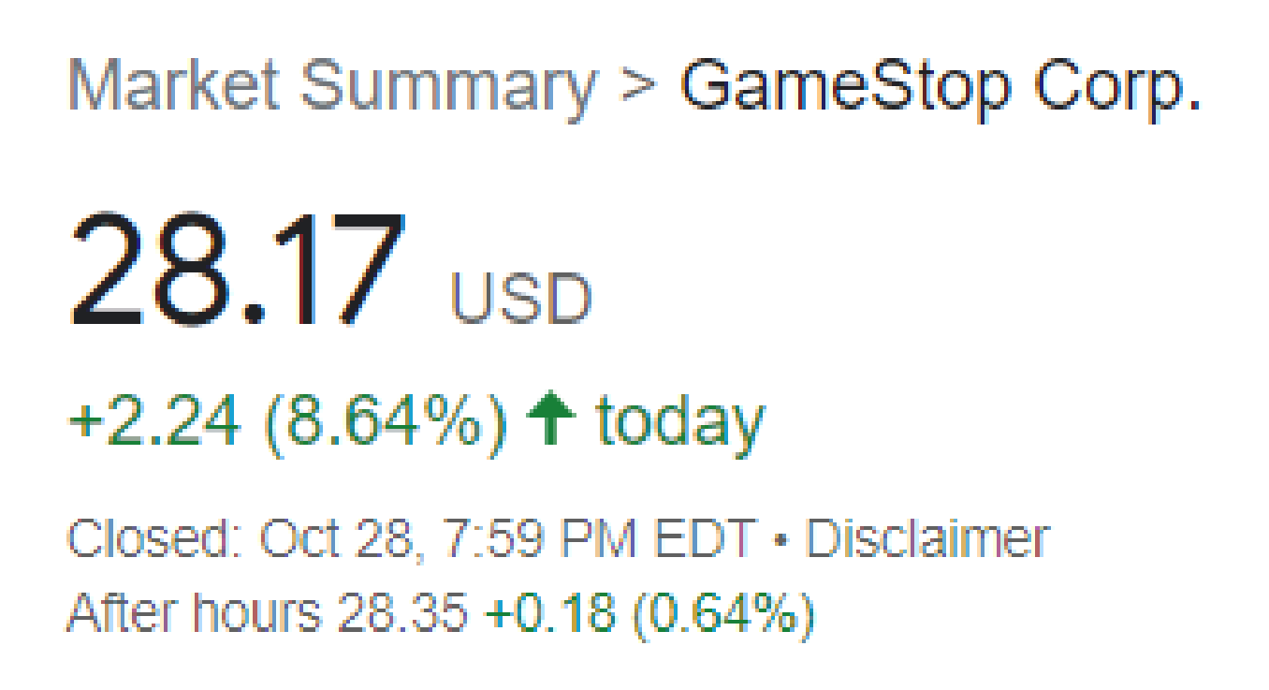

Correlation Analysis: Stock Comment volume ~ Stock Transaction volume

Slide 17
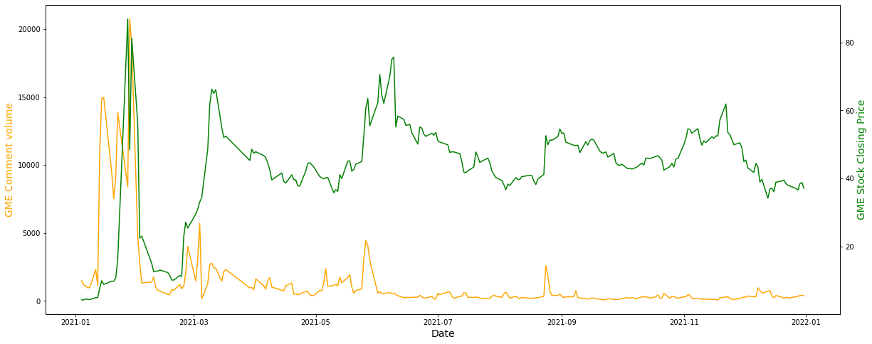
Correlation Analysis: Stock Comment volume ~ Stock Closing Price

Slide 18
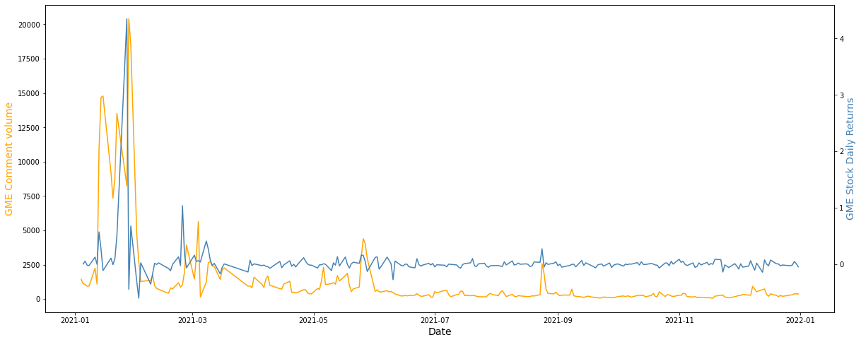
Correlation Analysis: Stock Comment volume ~ Stock Daily Returns

Slide 19
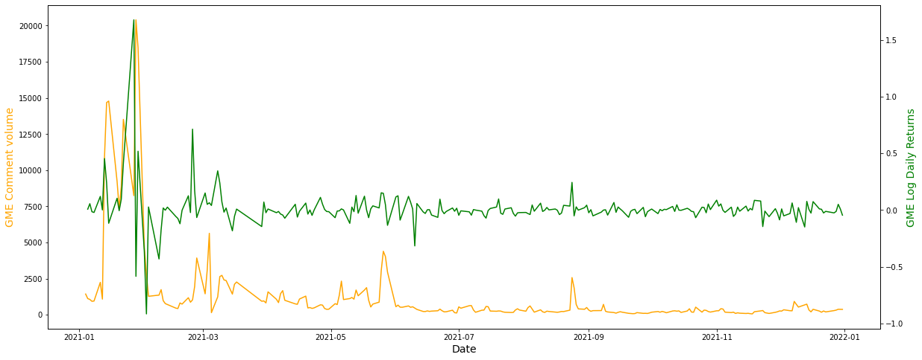
Correlation Analysis: Stock Comment volume ~ Stock Log Daily Returns

Slide 20
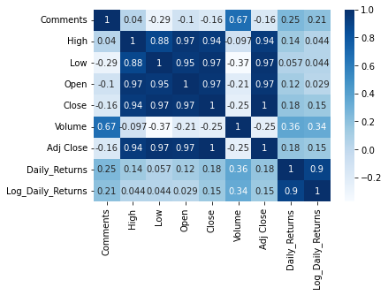
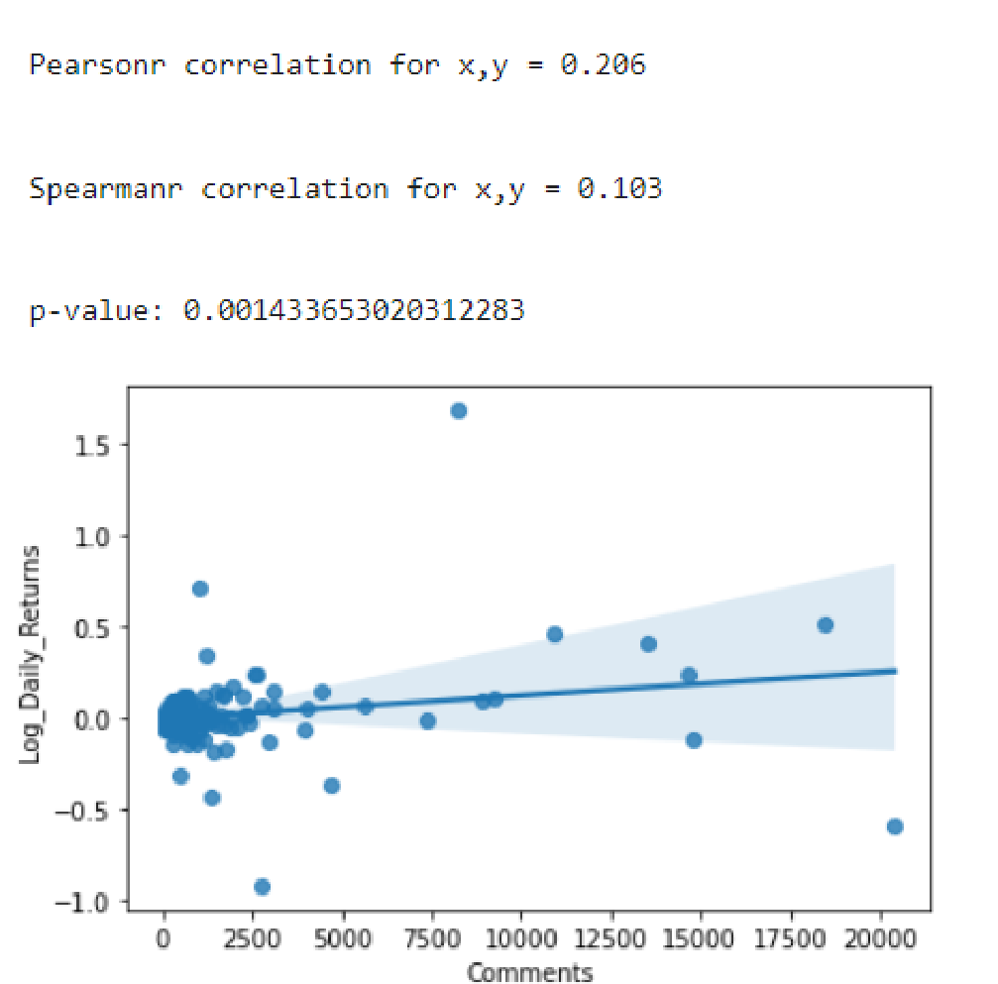
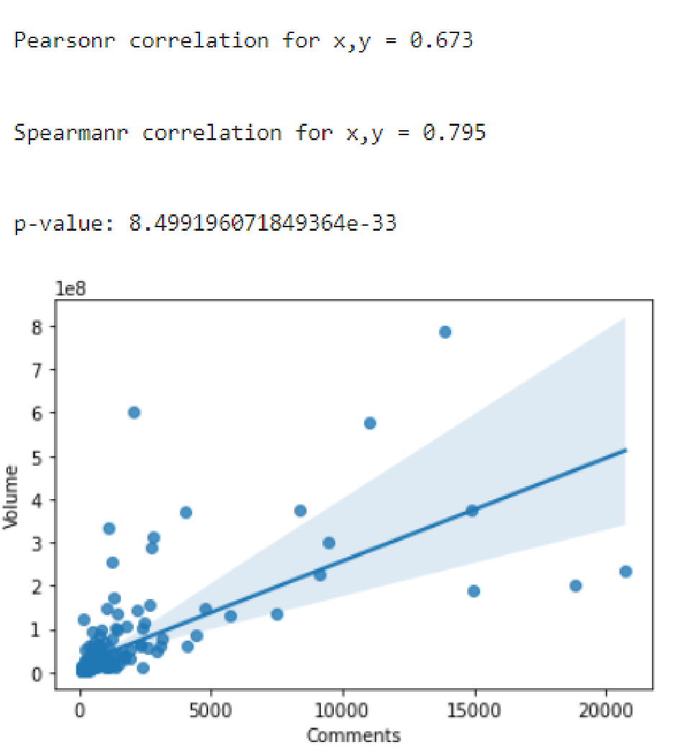
Correlation Analysis: Heatmap & Scatter Plot -- GME

Slide 21
Correlation Results: Stock Comment Volume ~ Stock Transaction Volume
r > 0.70
High Correlation
0.5 < r < 0.70
Medium Correlation
r < 0.40
Weak Correlation
Symbol | Name | Correlation (Pearson) | P-value
NOK | Nokia | 95% | 2.13E-119
WISH | Context Logic Inc | 86% | 4.23E-71
FVRR | Fiverr | 80% | 1.39E-24
ZG | Zillow Group | 79% | 2.66E-47
AMC | AMC | 75% | 3.56E-44
PLUG | Plug Power | 73% | 1.87E-40
BYND | Beyond Meat | 73% | 1.87E-40
NFLX | Netflix | 70% | 2.26E-36
Symbol | Name | Correlation (Pearson) | P-value
SPCE | Virgin Galactic | 68% | 7.34E-34
GME | GameStop | 67% | 8.14E-33
MRNA | Moderna | 67% | 1.15E-30
PTON | Peloton | 67% | 6.90E-31
NVAX | Novavax | 65% | 3.28E-24
NIO | Nio | 65% | 2.21E-30
BABA | Alibaba | 64% | 9.83E-29
ZM | Zoom | 63% | 3.11E-27
NVDA | Nvidia | 63% | 6.42E-28
META | Facebook | 62% | 1.12E-26
ETSY | Etsy | 61% | 2.04E-22
CLOV | Clover Health | 61% | 2.27E-24
TLRY | Tilray | 60% | 8.23E-25
BB | Blackberry | 58% | 1.28E-22
AAL | American Airlines | 53% | 2.06E-18
TSLA | Tesla | 50% | 2.91E-16
AMD | Amd | 50% | 3.18E-16
Symbol | Name | Correlation (Pearson) | P-value
BBBY | Bed Bath & Beyond | 48% | 3.34E-13
UBER | Uber | 48% | 4.49E-15
KOSS | Koss | 45% | 6.67E-05
AMZN | Amazon | 42% | 1.28E-11
AAPL | Apple | 39% | 6.72E-10
PLTR | Palantir | 33% | 2.86E-07
MSFT | Microsoft | 28% | 8.24E-06
GOOGL | Alphabet | 24% | 0.0002295

Slide 22
Correlation Results: Stock Comment Volume ~ Stock Log Daily Returns
r < 0.40
Weak Correlation
Symbol | Name | Log Daily Returns | P-value
PLUG | Plug Power | 31% | 1.05039E-06
SPCE | Virgin Galactic | 26% | 5.52177E-05
TLRY | Tilray | 24% | 0.000191009
CLOV | Clover Health | 22% | 0.000701075
AMC | AMC | 21% | 0.001316033
GME | GameStop | 21% | 0.001402891
PLTR | Palantir | 21% | 0.000957736
NOK | Nokia | 18% | 0.005395559
NFLX | Netflix | 18% | 0.004798792
BB | Blackberry | 17% | 0.010172697
AAL | American Airlines | 17% | 0.010513096
NVDA | Nvidia | 16% | 0.016637547
TSLA | Tesla | 15% | 0.02049406
BYND | Beyond Meat | 15% | 0.009662725
BBBY | Bed Bath & Beyond | 14% | 0.036709972
AMD | Amd | 10% | 0.12648731
Symbol | Name | Log Daily Returns | P-value
NIO | Nio | 8% | 0.202071757
AAPL | Apple | 8% | 0.226664134
BABA | Alibaba | 7% | 0.284249835
MSFT | Microsoft | 7% | 0.29245099
KOSS | Koss | 6% | 0.610959978
ETSY | Etsy | 4% | 0.604158949
WISH | Context Logic Inc | 4% | 0.587577481
GOOGL | Alphabet | 3% | 0.650916557
UBER | Uber | 1% | 0.908489051
MRNA | Moderna | -1% | 0.931789576
NVAX | Novavax | -4% | 0.62346512
AMZN | Amazon | -5% | 0.458567234
META | Facebook | -11% | 0.096567114
ZM | Zoom | -15% | 0.02388591
FVRR | Fiverr | -21% | 0.034849645
PTON | Peloton | -31% | 3.1219E-06
ZG | Zillow Group | -38% | 1.30691E-08

Slide 23
Model fitting data preparation
Evaluate the volatility of each stock using technical and volatility indicators.
Calculate change points/trade signals dates using the volatility of the stock.
Example: For a highly volatile stock use 20 day & 40 day Simple moving averages, whereas for a fairly stable stock we can use a broader SMA window like 50 day and 100 day.
Prepare the data for model fitting by filtering and aggregating the comments between the change points for each stock.
Assign the sentiment +ve, -ve , neutral against each comment by using the best model.
Plot the data and infer the results.

Slide 24
Technical & Volatility Indicators Evaluated
Simple Moving Average
Exponential Moving Average
ATR - Average True Range
Bollinger Bands
Keltner Channels
RSI - Relative Strength Index
MACD - Moving average convergence divergence Indicator
Stochastic Oscillator

Slide 25
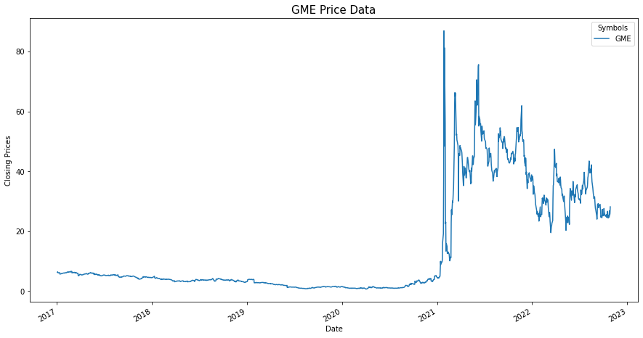
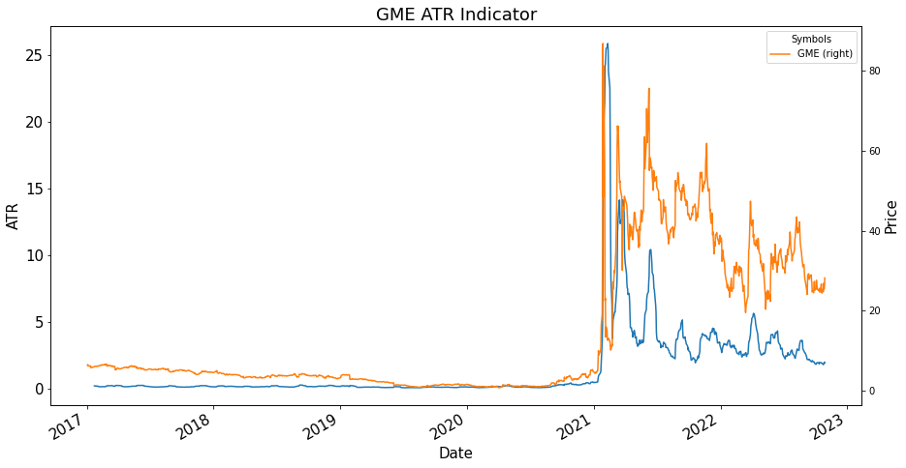
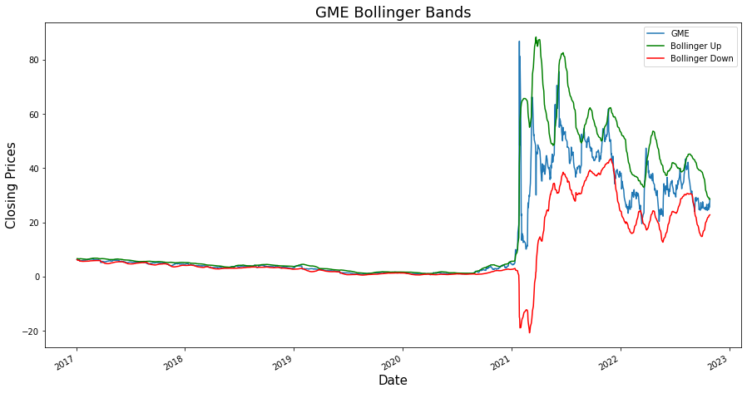
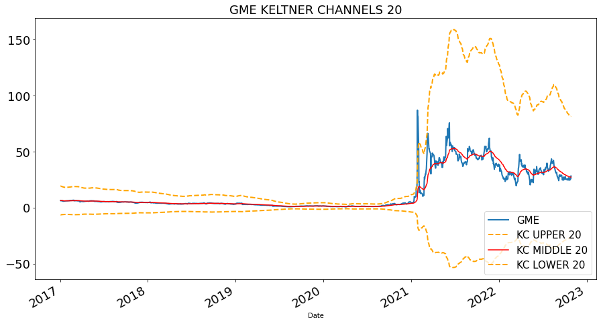
Volatility Indicators evaluated suggest high volatility in 2021 for GME
Higher ATR line 🡪Higher volatility
More the distance of the bands from the center ATR line 🡪 Higher Volatility
More the distance of the Bollinger bands from the center SMA midline 🡪 Higher Volatility

Slide 26
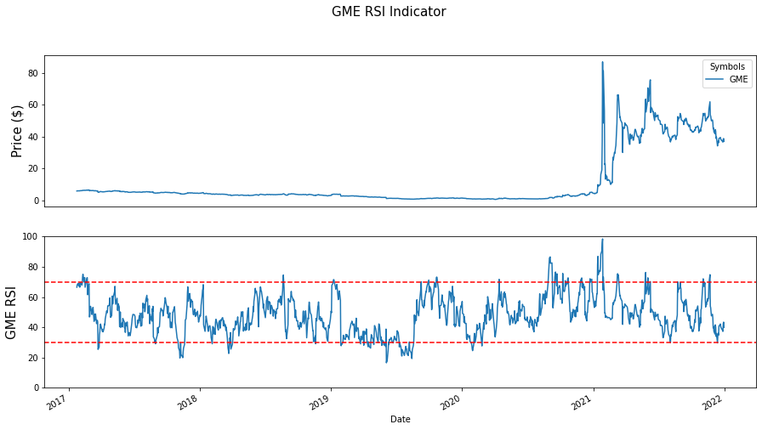
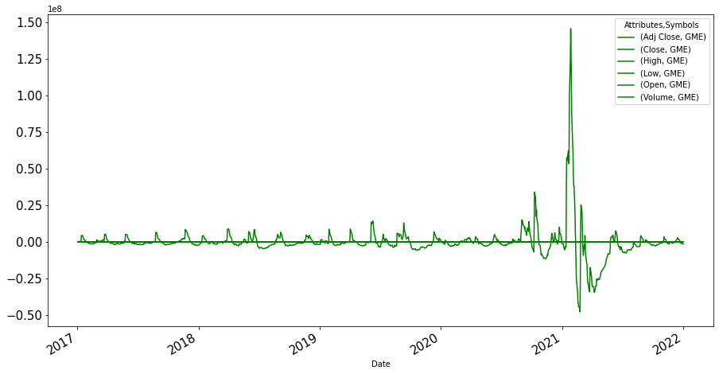
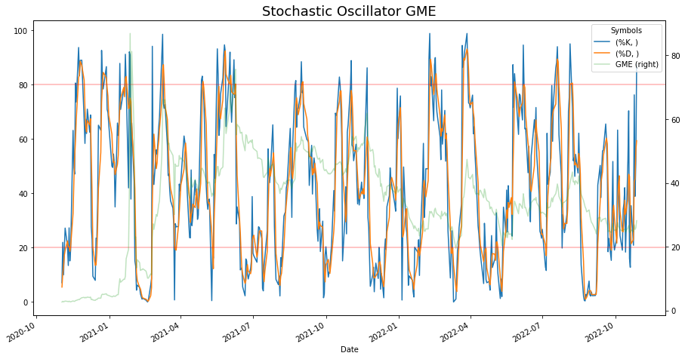
Volatility Indicators evaluated suggest overbought and oversold conditions in 2021 for GME
MACD crossing above the signal line – Buy
MACD crossing below the signal line – Sell
When RSI values are:
above 70, asset is considered overbought (overvalued)
below 30, asset is considered oversold (undervalued)¶
Stochastic Oscillator readings over 80 are considered in the overbought range, and readings under 20 are considered oversold.

Slide 27
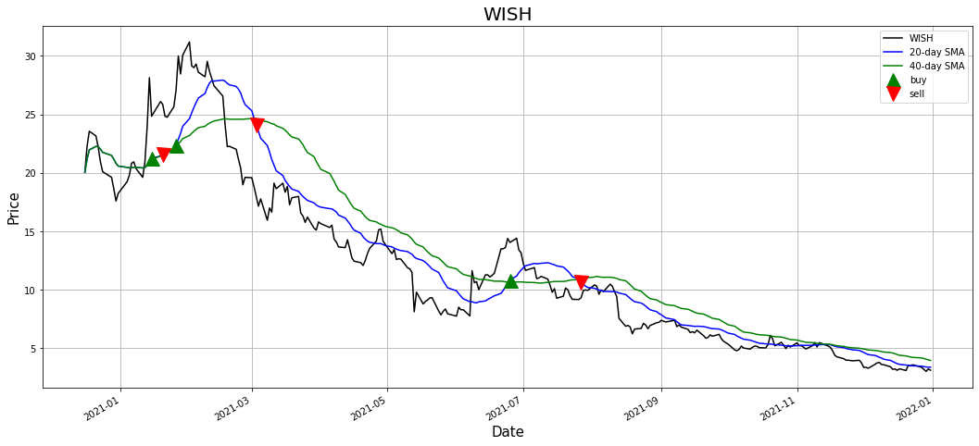
Trade Signal Analysis
Identified time frames with signals to sell or buy stocks.
Data for 5 years from 2017 to 2021
Determined 20 Day and 40 Day Simple Moving Average (SMA)
Buy
20 Day SMA crossing above 40 Day SMA
Sell
20 Day SMA crossing below 40 Day SMA

Slide 28
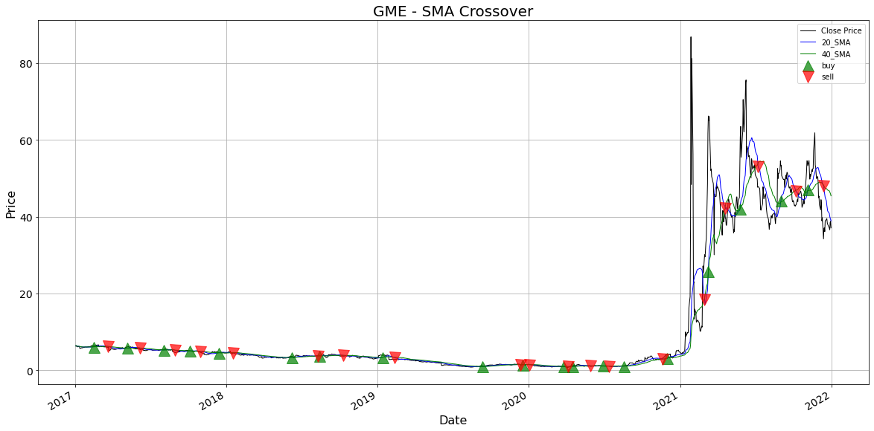
Trade Signal Analysis using 20 day & 40 day SMA for GME
Buy
20 Day SMA crossing above 40 Day SMA
Sell
20 Day SMA crossing below 40 Day SMA
Filter the comments data for each stock from 2017-2021.
Aggregate the filtered comments data from all the years for each stock.
Use the change point dates/ Trade signal dates to filter the aggregated stock data and prepare final data for model fitting.

Slide 29
Model fitting data – Apply sentiment scores to each comment
 | Date | Month | author | author_flair_text | subreddit_id | body | High | Low | Open | Close | Volume | Adj Close | Daily_Returns
29 | 2017-02-21 | February | GorgeWashington | PiggerPig | t5_2th52 | http://segmentnext.com/2017/02/18/russian-nvid... | 6.562500 | 6.437500 | 6.460000 | 6.555000 | 10881200.0 | 5.330748 | 0.011574
30 | 2017-02-24 | February | someroastedbeef | Just do a 360 and walk away. | t5_2th52 | GME hitting 54 is less believable than me beco... | 6.625000 | 6.362500 | 6.387500 | 6.570000 | 7966800.0 | 5.342947 | 0.002288
43 | 2017-02-24 | February | I_Eat_Your_Dogs | Dicks | t5_2th52 | I think you're under estimating how much the v... | 6.625000 | 6.362500 | 6.387500 | 6.570000 | 7966800.0 | 5.342947 | 0.000000
48 | 2017-02-28 | February | mastrann | Dr. Seuss | t5_2th52 | [Nobody](https://www.reddit.com/r/wallstreetbe... | 6.582500 | 5.892500 | 6.582500 | 6.110000 | 31031600.0 | 4.968859 | -0.070015
78 | 2017-03-03 | March | Goosebaby | ye of little bot faith | t5_2th52 | NBC is a media company. They make money shovin... | 6.330000 | 6.252500 | 6.265000 | 6.320000 | 7311600.0 | 5.139637 | 0.034370
... | ... | ... | ... | ... | ... | ... | ... | ... | ... | ... | ... | ... | ...
139121 | 2021-12-10 | December | KOBA-fight-4-Ape | hamburglar | t5_2th52 | Man GME moon or go lower \n\nI don't like this... | 40.575001 | 37.000000 | 39.957500 | 39.752499 | 18107600.0 | 39.752499 | 0.000000

Slide 30
Sentiment Analysis on Comments data using Ensemble technique

Slide 31
Data Preparation
3.6K posts for relevant stocks with 68K sentences.
Sentences with or without stock tickers
For sentences without stock tickers, calculate cosine similarity
Keep sentences with similarity of 80% or more.
Data with 6,355 sentences.

Slide 32
Model Development Process Flow
Data Extraction
Data Preparation
Text Preprocessing
Model Training
Impact Analysis on Stock Transactions
Extract Sentiments for Reddit Comments
Model
Evaluation

Slide 33
Text Preprocessing
Exclude Deleted comments
Word Embeddings using BERT
Remove Stop words and Punctuation marks
Integer representation of Sentiments
Convert to lower case

Slide 34
Word Embeddings: Experiments
Word2Vec
TF-IDF
Count Vectorizer
BERT Encoder

Slide 35
Model Training: Experiments
Vectorization Technique | Classifier Algorithm |  | Precision | Re-call | F1-Score | AUC
CountVectorizer | AdaBoost | 0- Negative | 0.38 | 0.94 | 0.54 | 54%
 |  | 1- Neutral | 0.56 | 0.18 | 0.28
 |  | 2- Positive | 0.18 | 0.02 | 0.04
TF-IDF | AdaBoost | 0- Negative | 0.24 | 0.05 | 0.09 | 46%
 |  | 1- Neutral | 0.46 | 0.75 | 0.57
 |  | 2- Positive | 0.32 | 0.38 | 0.35
W2V | AdaBoost | 0- Negative | 0.52 | 0.63 | 0.57 | 69%
 |  | 1- Neutral | 0.58 | 0.59 | 0.58
 |  | 2- Positive | 0.4 | 0.3 | 0.35
CountVectorizer | SVM | 0- Negative | 0.48 | 0.6 | 0.53 | 62%
 |  | 1- Neutral | 0.52 | 0.49 | 0.5
 |  | 2- Positive | 0.3 | 0.23 | 0.26
TF-IDF | SVM | 0- Negative | 0.28 | 0.09 | 0.13 | 53%
 |  | 1- Neutral | 0.35 | 0.64 | 0.45
 |  | 2- Positive | 0.35 | 0.29 | 0.32
W2V | SVM | 0- Negative | 0.55 | 0.48 | 0.51 | 70%
 |  | 1- Neutral | 0.48 | 0.77 | 0.59
 |  | 2- Positive | 0.38 | 0.18 | 0.24
CountVectorizer | Decision Tree | 0- Negative | 0 | 0 | 0 | 58%
 |  | 1- Neutral | 0.64 | 0.94 | 0.73
 |  | 2- Positive | 0.27 | 0.06 | 0.1
TF-IDF | Decision Tree | 0- Negative | 0 | 0 | 0 | 57%
 |  | 1- Neutral | 0.62 | 0.85 | 0.72
 |  | 2- Positive | 0.38 | 0.23 | 0.28
Vectorization Technique | Classifier Algorithm |  | Precision | Re-call | F1-Score | AUC
BERT | Decision Tree | 0- Negative | 0.55 | 0.45 | 0.5 | 66%
 |  | 1- Neutral | 0.7 | 0.88 | 0.78
 |  | 2- Positive | 0.55 | 0.27 | 0.36
CountVectorizer | Random Forest | 0- Negative | 0.05 | 0.02 | 0.02 | 54%
 |  | 1- Neutral | 0.61 | 0.82 | 0.7
 |  | 2- Positive | 0.32 | 0.17 | 0.22
TF-IDF | Random Forest | 0- Negative | 0.08 | 0.02 | 0.03 | 55%
 |  | 1- Neutral | 0.6 | 0.85 | 0.71
 |  | 2- Positive | 0.33 | 0.14 | 0.19
BERT | Random Forest | 0- Negative | 0.8 | 0.5 | 0.62 | 75%
 |  | 1- Neutral | 0.72 | 0.99 | 0.84
 |  | 2- Positive | 0.95 | 0.34 | 0.5
Tokenizer | LSTM | 0- Negative | 0.79 | 0.2 | 0.32 | 69%
 |  | 1- Neutral | 0.81 | 0.8 | 0.81
 |  | 2- Positive | 0.48 | 0.66 | 0.56
TF-IDF | LSTM | 0- Negative | 0 | 0 | 0 | 59%
 |  | 1- Neutral | 0.66 | 0.8 | 0.72
 |  | 2- Positive | 0.39 | 0.39 | 0.39
Tokenizer | Bi-LSTM | 0- Negative | 0.44 | 0.63 | 0.52 | 68%
 |  | 1- Neutral | 0.8 | 0.78 | 0.79
 |  | 2- Positive | 0.56 | 0.48 | 0.52
TF-IDF | Bi-LSTM | 0- Negative | 0.3 | 0.24 | 0.27 | 58%
 |  | 1- Neutral | 0.66 | 0.8 | 0.72
 |  | 2- Positive | 0.39 | 0.24 | 0.3

Slide 36
Model Training: Champion Models
SVM
AdaBoost Classifier
LSTM
Bi-LSTM

Slide 37
Model Evaluation
Vectorization Technique | Classifier Algorithm |  | Precision | Recall | F1-Score | AUC
BERT | AdaBoost | 0- Negative | 0.68 | 0.4 | 0.5 | 82%
 |  | 1- Neutral | 0.7 | 0.95 | 0.81
 |  | 2- Positive | 0.66 | 0.27 | 0.38
BERT | SVM | 0- Negative | 0.71 | 0.71 | 0.71 | 89%
 |  | 1- Neutral | 0.81 | 0.91 | 0.86
 |  | 2- Positive | 0.78 | 0.56 | 0.65
BERT | LSTM | 0- Negative | 0.74 | 0.77 | 0.75 | 81%
 |  | 1- Neutral | 0.85 | 0.86 | 0.85
 |  | 2- Positive | 0.74 | 0.71 | 0.73
BERT | Bi-LSTM | 0- Negative | 0.75 | 0.76 | 0.76 | 82%
 |  | 1- Neutral | 0.84 | 0.89 | 0.87
 |  | 2- Positive | 0.78 | 0.67 | 0.72

Slide 38
Next Steps
Analyze impact of sentiments extracted on stock transactions
Analyze impact in time frames with buy and sell signals identified

Slide 39
Questions?

Slide 40
Thank you!

