Slide 1

Walmart Recruiting - Store Sales Forecasting
MSA 8200
Mini Project
Spring 2022
Analysis

Slide 2


Shalmali Joshi Shreyashi Mukhopadhyay Nhi Nguyen
Namit Srivastava

Slide 3




Project description
Predicting future sales for a company is one of the most important aspects of strategic planning.
This project aims to analyze how internal and external factors would affect the future Weekly Sales of Walmart, one of the biggest companies in the US.
This project encompasses a complete analysis of data through data exploration, pattern discovery, data visualization and time series analysis in R as the programming language.

Slide 4

Data source
The data has been sourced from Kaggle.com at https://www.kaggle.com/c/walmart-recruiting-store-sales-forecasting/data
The data collected ranges from 2010 to 2012, where 45 Walmart stores across the country were included in this analysis.
These data sets contain information about the Store type, Store size, Date of sale, departments, temperature, unemployment, CPI, Fuel Prices, Holidays, Weekly Sales, Markdown prices.

Slide 5
Data description
Train.csv
- Store: The store number. Range from 1–45. - Type: Three types of stores ‘A’, ‘B’ or ‘C’. - Size: Sets the size of a Store would be calculated by the no. of products available in the particular store ranging from 34,000 to 210,000.
Stores.csv
-Date: The date of the week where this observation was taken.
-Weekly_Sales: The sales recorded during that Week. -Store: The store which observation in recorded 1–45. -Dept: One of 1–99 that shows the department. -IsHoliday: Boolean value representing a holiday week or not.
Features.csv
-Temperature: Temperature of the region during that week. -Fuel_Price: Fuel Price in that region during that week. -MarkDown 1:5 : Represents the Type of markdown and what quantity was available during that week. -CPI: Consumer Price Index during that week. -Unemployment: The unemployment rate during that week in the region of the store.

Slide 6
Data description
After merging the three csv files, Train.csv, Features.csv and Stores.csv, we get a resultant trainmerged.csv with the following data structure:
'data.frame': 421570 obs. of 19 variables:
$ Store : int 1 1 1 1 1 1 1 1 1 1 ...
$ Year : chr "2012" "2012" "2012" "2012" ...
$ Month : chr "01" "01" "01" "01" ...
$ Day : chr "13" "13" "13" "13" ...
$ IsHoliday : num 0 0 0 0 0 0 0 0 0 0 ...
$ Dept : int 1 25 55 92 21 17 19 42 4 44 ...
$ Weekly_Sales: num 16894 6384 10418 158155 7091 ...
$ Type : chr "A" "A" "A" "A" ...
$ Size : int 151315 151315 151315 151315 151315 151315 151315 151315 151315 151315 ...
$ Temperature : num 48.5 48.5 48.5 48.5 48.5 ...
$ Fuel_Price : num 3.26 3.26 3.26 3.26 3.26 ...
$ MarkDown1 : num 5183 5183 5183 5183 5183 ...
$ MarkDown2 : num 8026 8026 8026 8026 8026 ...
$ MarkDown3 : num 42.2 42.2 42.2 42.2 42.2 ...
$ MarkDown4 : num 453 453 453 453 453 ...
$ MarkDown5 : num 3719 3719 3719 3719 3719 ...
$ CPI : num 220 220 220 220 220 ...
$ Unemployment: num 7.35 7.35 7.35 7.35 7.35 ...
$ Week : chr "02" "02" "02" "02" ...

Slide 7
Data Visualization and Exploration
Shreyashi Mukhopadhyay

Slide 8
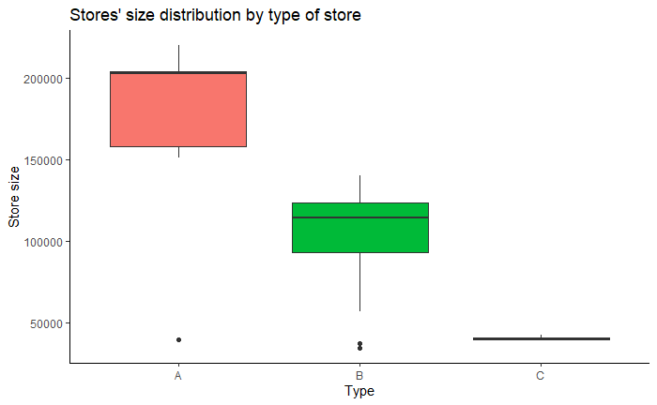
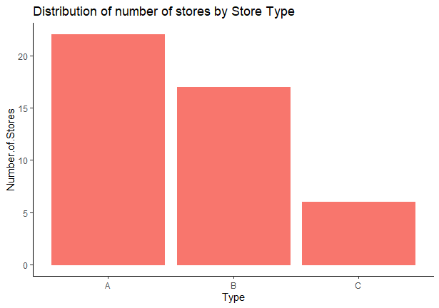
Data Visualization
Distribution of Number of stores by Store Type
Distribution of Store size by Store Type

Slide 9
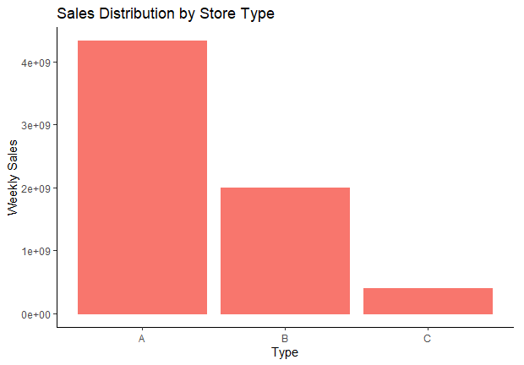
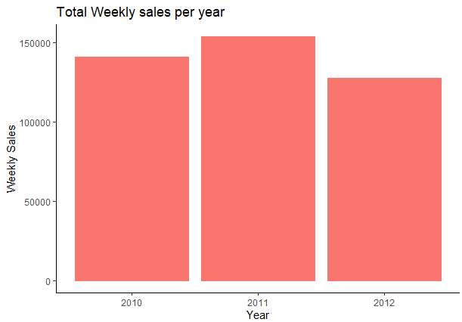
Data Visualization
Distribution of Total weekly sales by by Store Type
Distribution of Total weekly sales by year

Slide 10
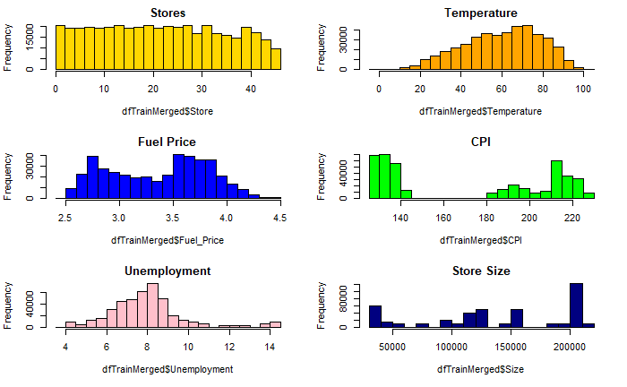
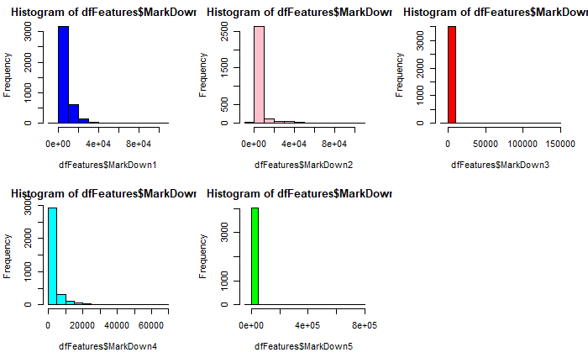
Data Visualization
Distribution of Continuous variables

Slide 11
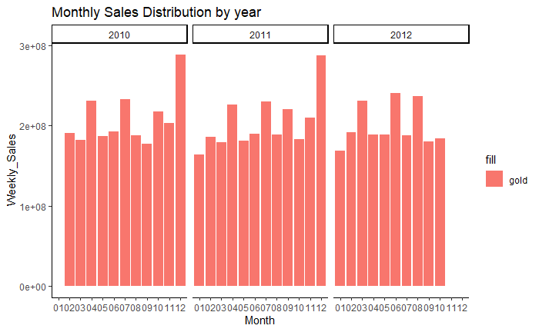
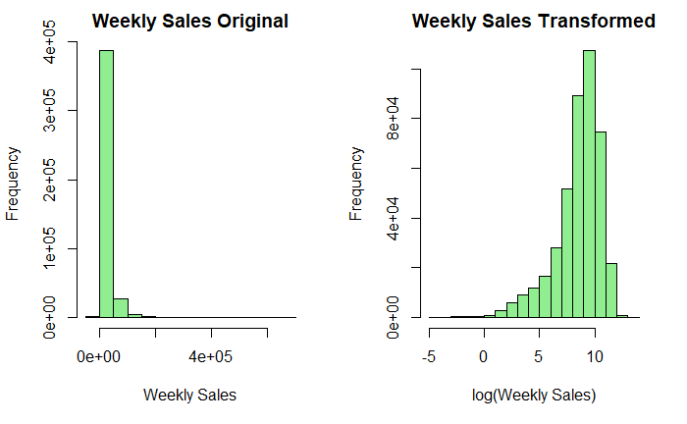
Data Visualization
Distribution of Weekly Sales

Slide 12
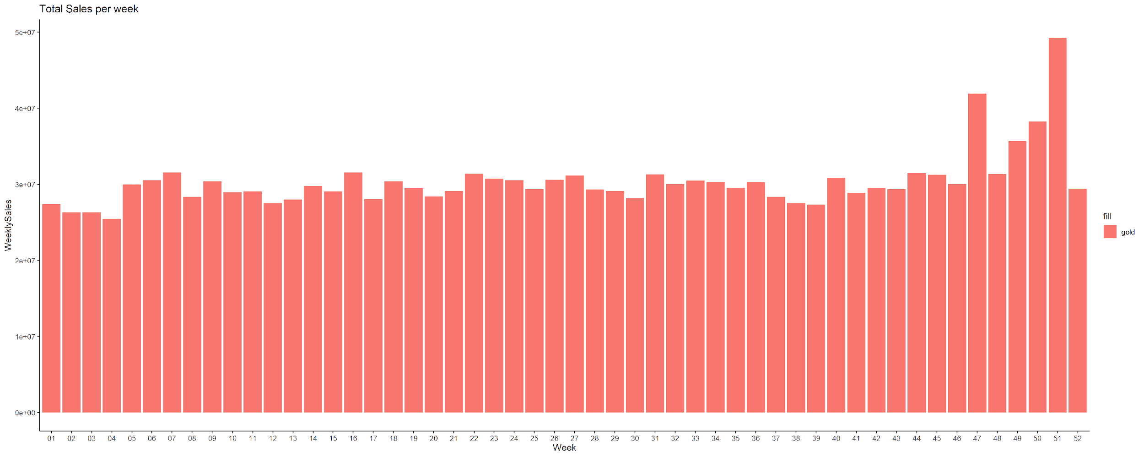
Data Visualization
Distribution of Total Sales per week for 52 weeks

Slide 13
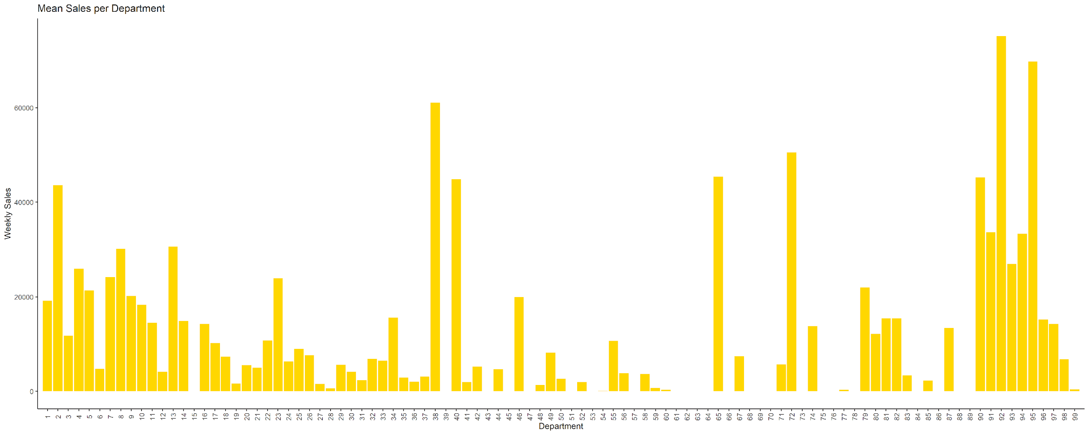
Data Visualization
Distribution of Department wise Mean Sales

Slide 14
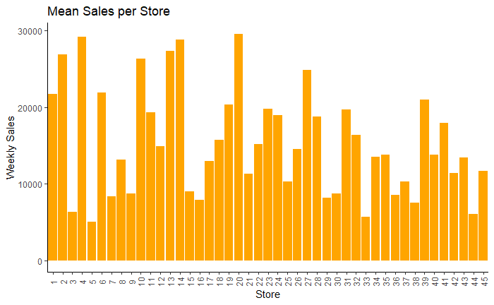
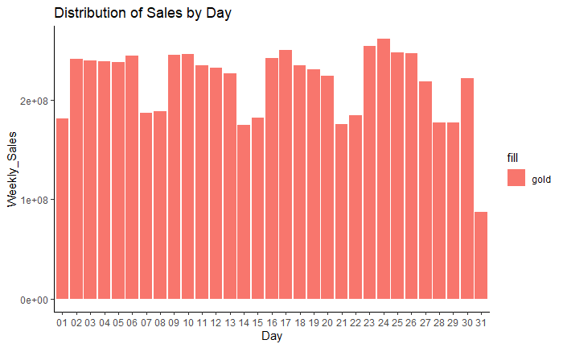
Data Visualization
Distribution of Mean weekly sales per store and Distribution of sales by days of the month

Slide 15
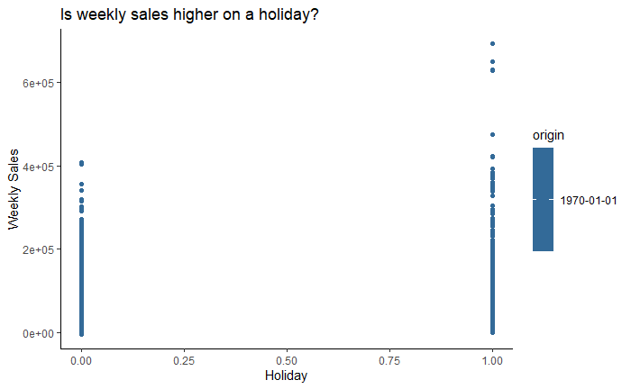
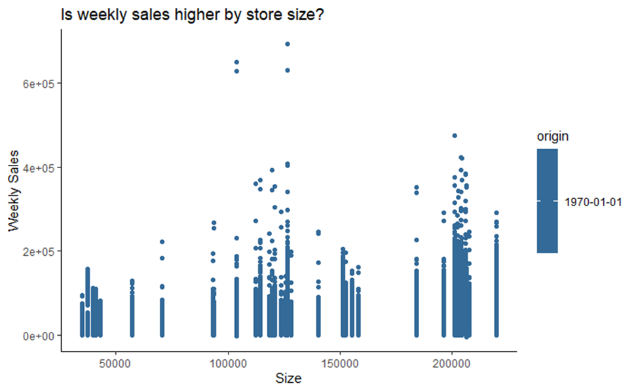
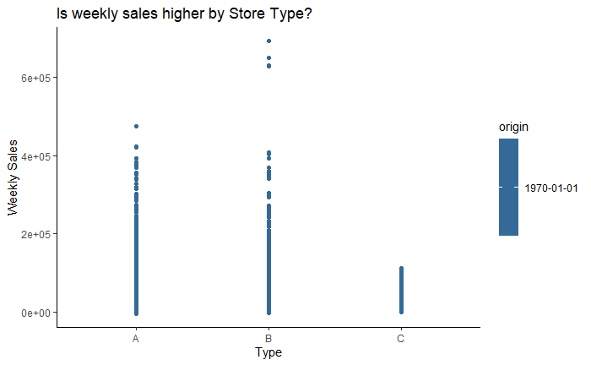
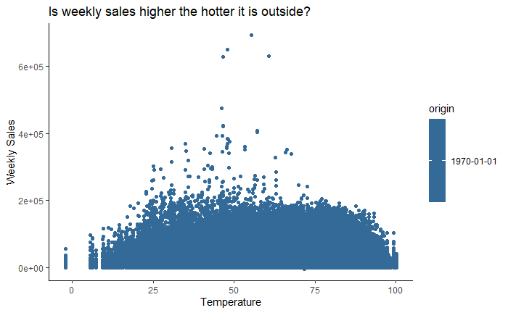
Data Exploration

Slide 16
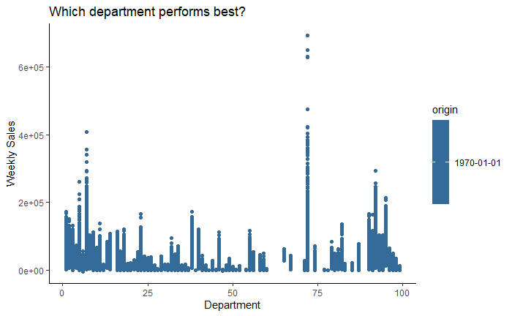
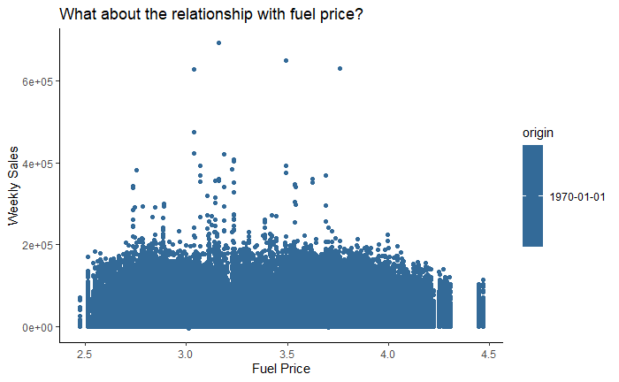
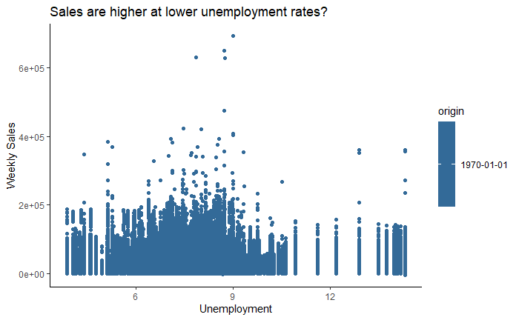
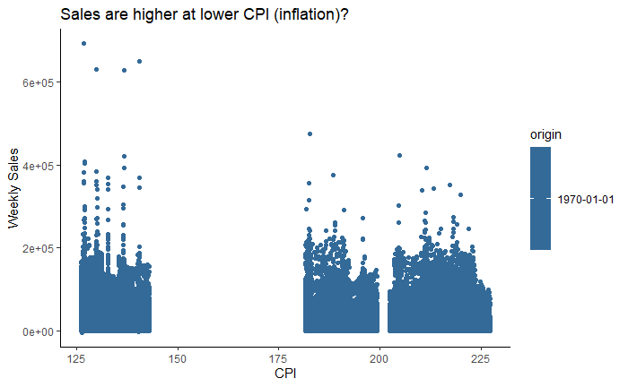
Data Exploration

Slide 17
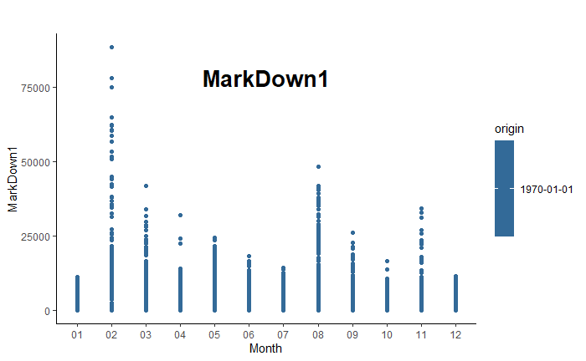
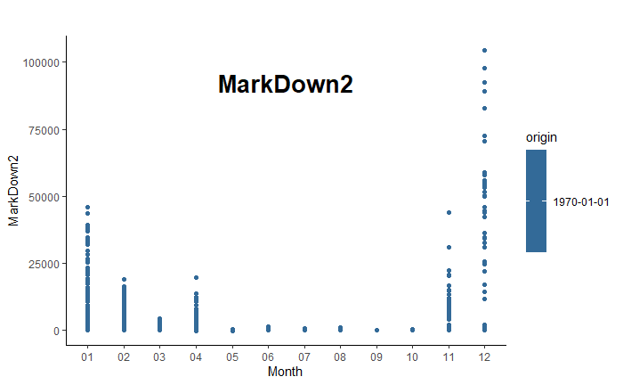
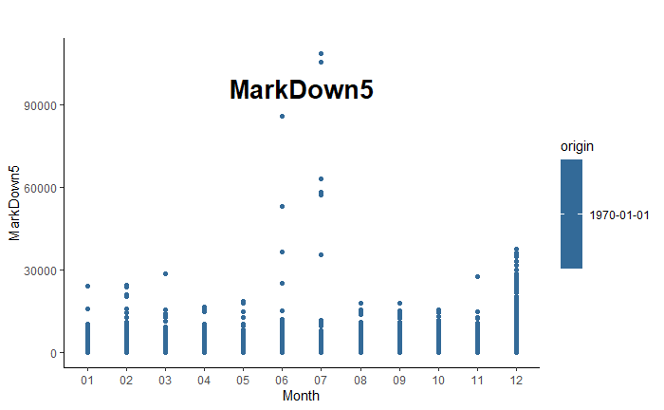
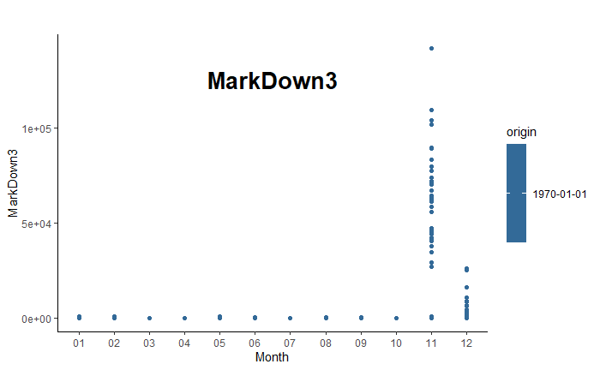
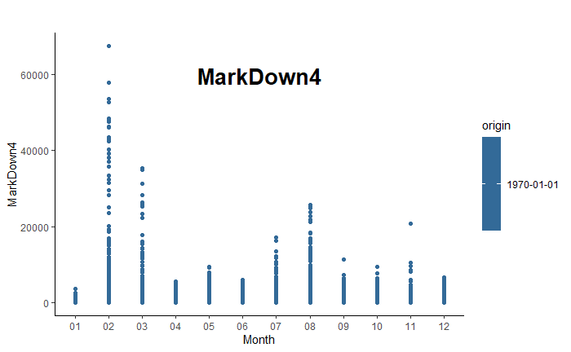
Data Exploration

Slide 18
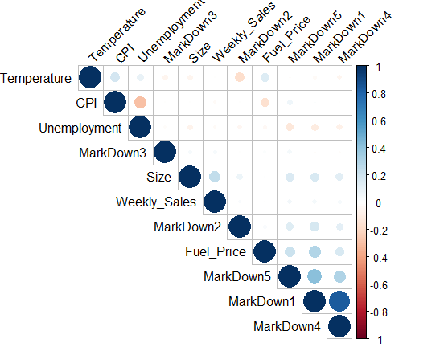
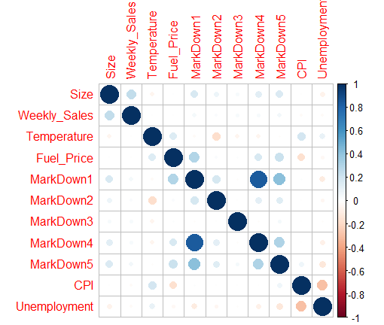
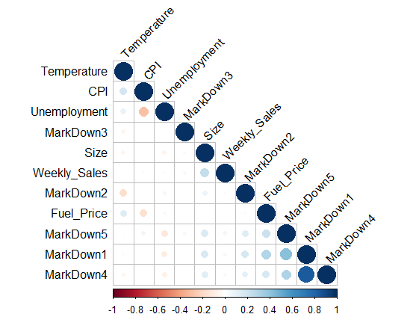
Correlation Plots

Slide 19
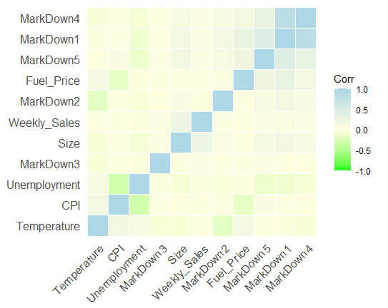
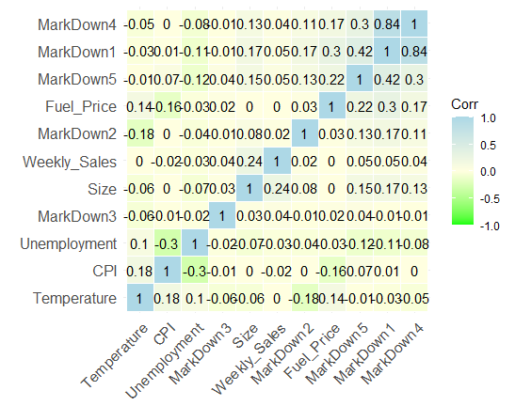
Correlation Heatmap

Slide 20
EDA, Relationship, Pattern discovery
Sarima Modelling and Sales Forecasting
Shalmali Joshi

Slide 21
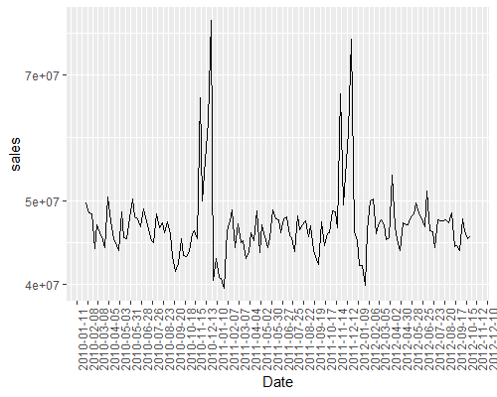
Plotting Weekly Walmart Sales
There is a definite seasonality observed with aggregation of the weekly Walmart sales.
Sales peak maximum in the winter months (November and December) every year. This is the holiday season: festive weeks of Thanksgiving, Christmas and New Year.
b) There are lesser spikes in sales during April-May around Easter or Labor day. It indicates that these are not popular festivals for retail shopping.

Slide 22
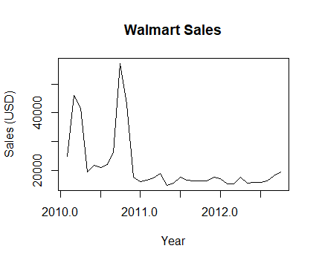
Plotting the time series
Sales are the highest towards Dec 2010 and Jan 2011.
There is a steep drop in sales after that.
The plot shows that the time series is not stationary. Need to decompose the time series to understand this better.

Slide 23
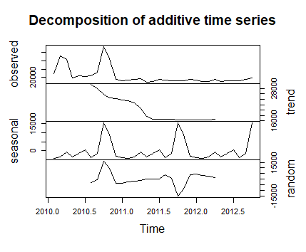
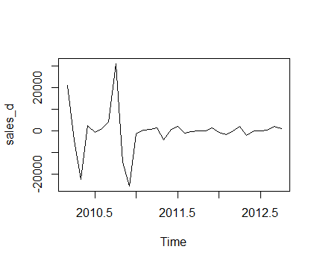
Decomposition and transformation
Now, we have successfully stationarised the time series. With Dickey-Fuller Test, P value is 0.02 indicating we can reject the null hypothesis 'series is non-stationary'. Thus, the time series is stationary after the transformation
There is a definite seasonality observed in the data .The trend in Walmart sales decreased rapidly from mid-year 2010 and seems to be constant from mid-year 2011 onwards.

Slide 24
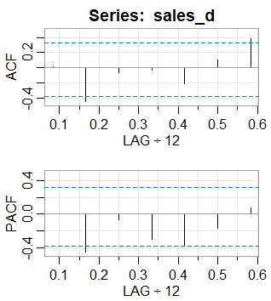
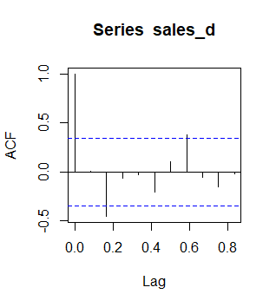
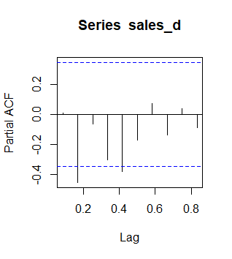
ACF and PACF
ACF shows an AR1 model.
PACF spikes at 2 positions, indicating an MA(2) model
This seems to be a seasonal arima model. The ACF spikes at 2 places, while, the PACF has a spike at lag 1.

Slide 25
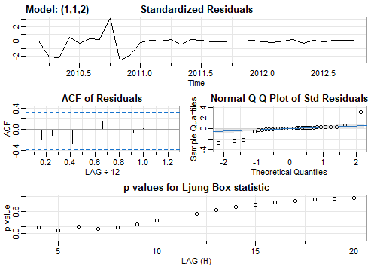
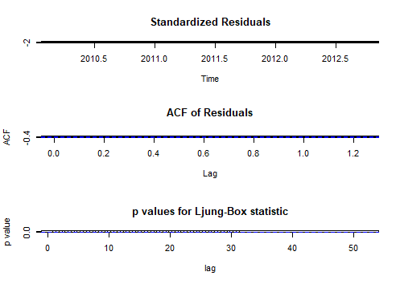
Arima with Seasonal+Sarima (1,1,2)
The Standardized residuals show some pattern until end of 2010 where the sales are highest. They again decrease mid 2011 and then remain constant. Since there is no continuous pattern, it resembles white noise.
Similarly, ACF also resembles the Standardized Residuals in terms of white noise.
QQ plot has few outliers in the beginning but otherwise has a good fit
The P-values are above/equal to the significance level.

Slide 26
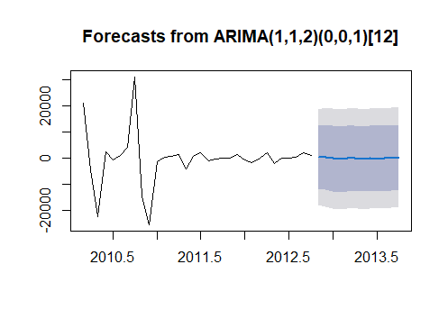
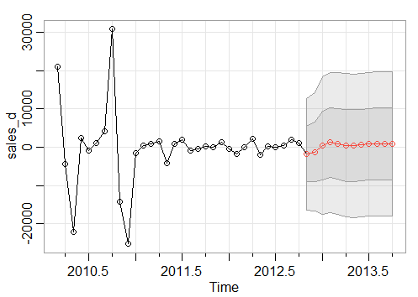
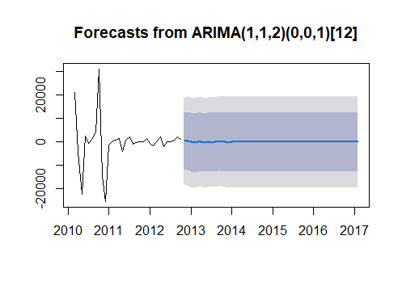
Walmart Sales forecasts on train
The Predicted Walmart Sales indicate that there would be a decline in sales at beginning of 2013 and sales would pick up again Mid-2013.
However, the Sales Forecasting on SARIMA(1,1,2) indicates that the sales revenue would remain constant over the forecasted years 2013 - 2017

Slide 27
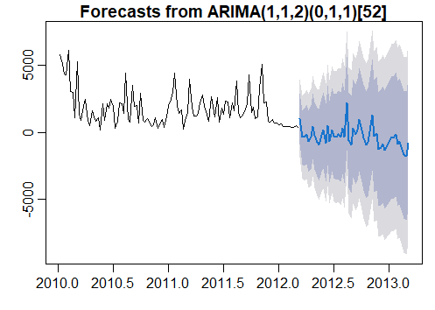
Walmart Sales forecasts on test
Method:
Do a Validation set approach on the Walmart Sales data with an 80-20 % split
Find predictions on the test data of 20 %
The Sales forecasts on the Test dataset actually display both trend and seasonality. This is different from the monthly and yearly Sales forecasts that we had received on the Training dataset.

Slide 28
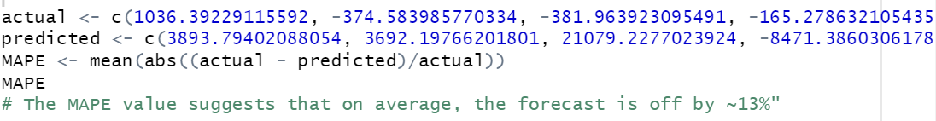
MSPE Calculation
This code snippet gives MSPE calculation that shows a difference of 13 % in training and test Sales forecasts.
We now have the training sales forecasts as well as the test forecasts obtained after fitting the model.
Thus, it is possible for us to calculate the MSPE or one step ahead prediction error.
We conclude the Walmart Weekly Sales Forecast is off by 13 %.

Slide 29
Sarima with additional variables and Linear Regression
Namit Srivastava

Slide 30
Modelling
Original
Train
Features
Stores
Combined
Type C
Type A
Sample
Type B

Slide 31
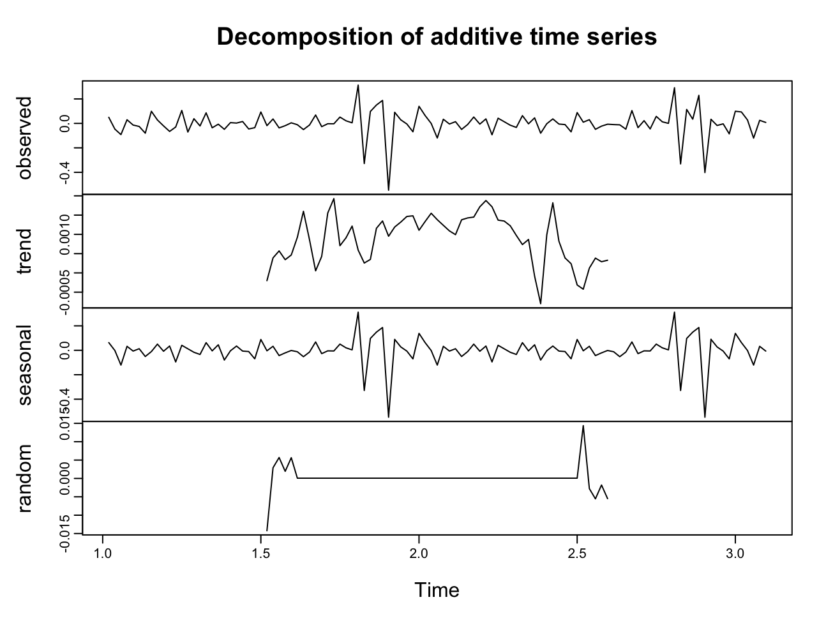
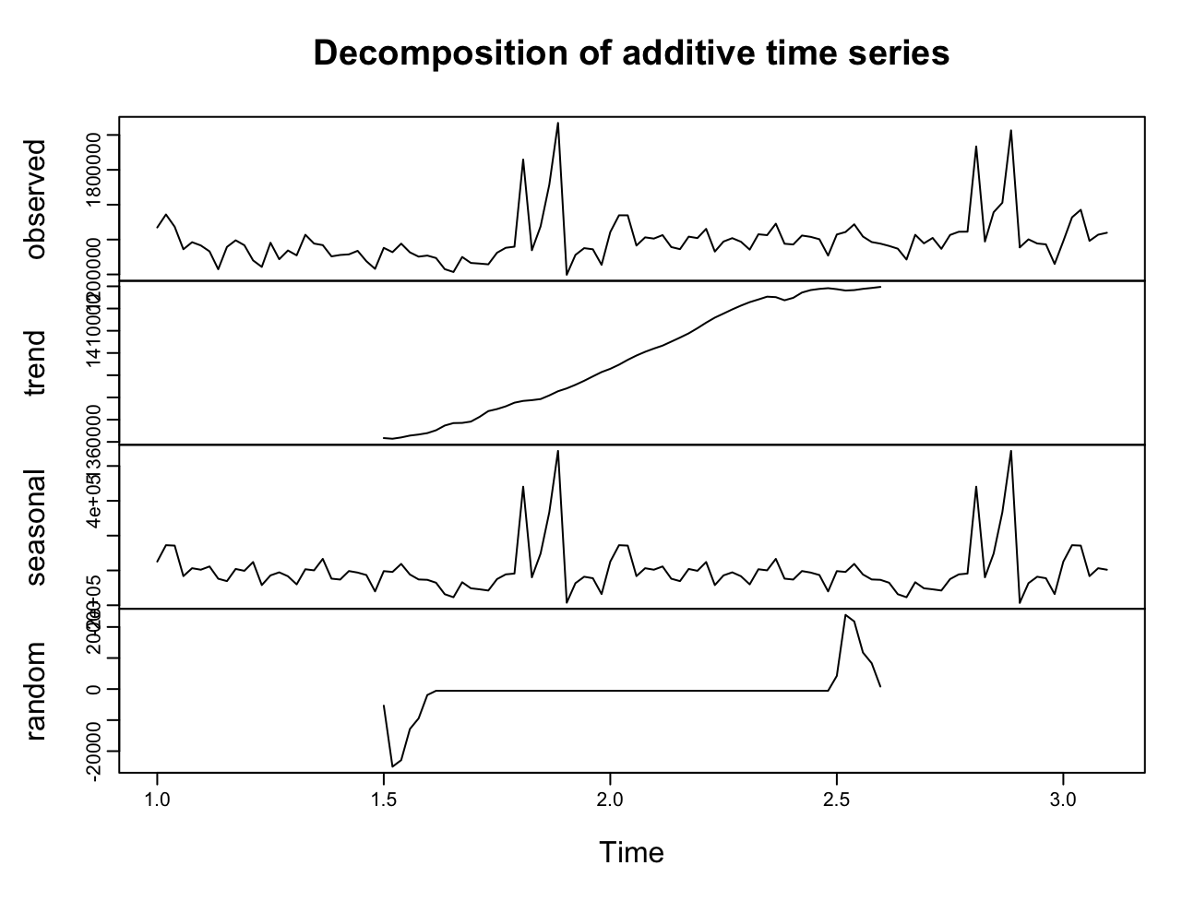
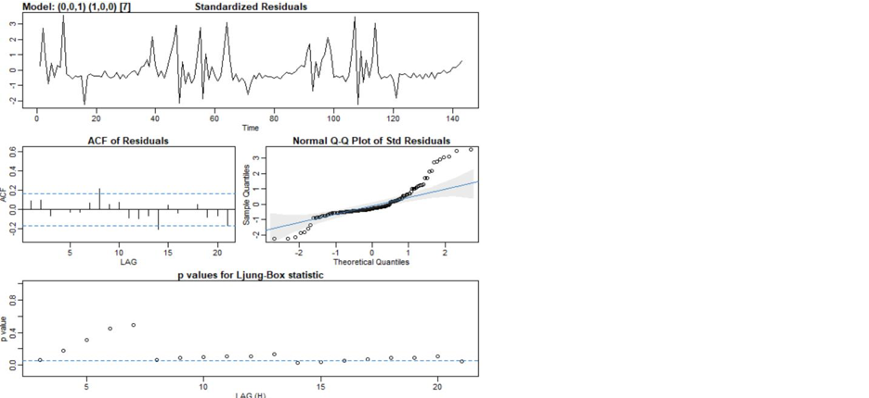
Type A Store Sample
Observe some seasonality and increasing trend
Post log transformation and taking the difference
Post log transformation and taking the difference and applying the Sarima model

Slide 32
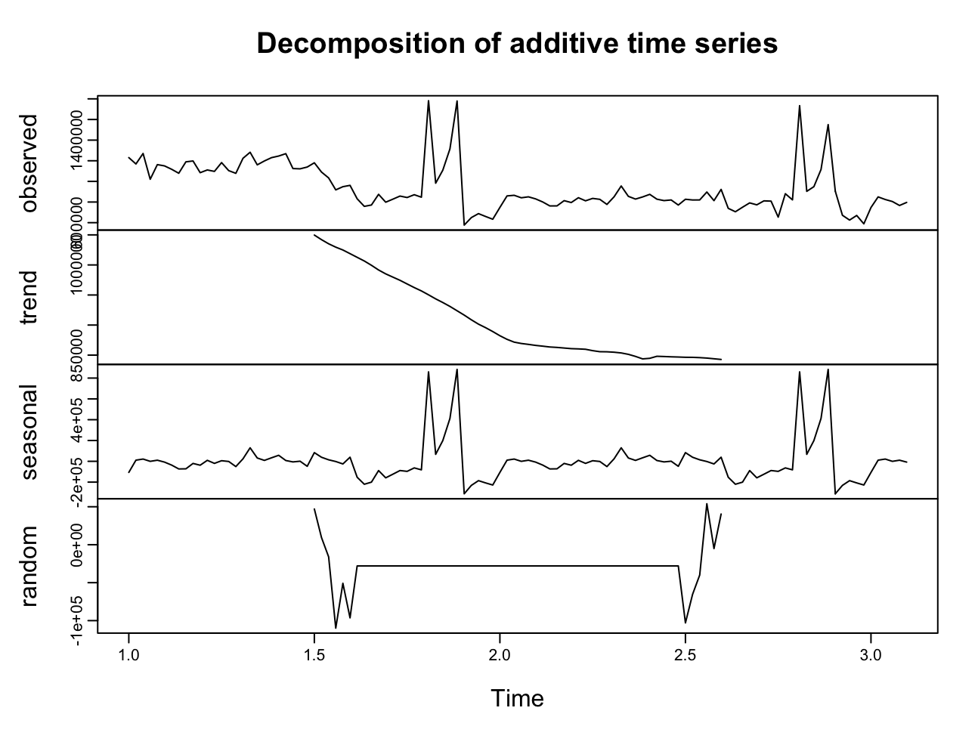
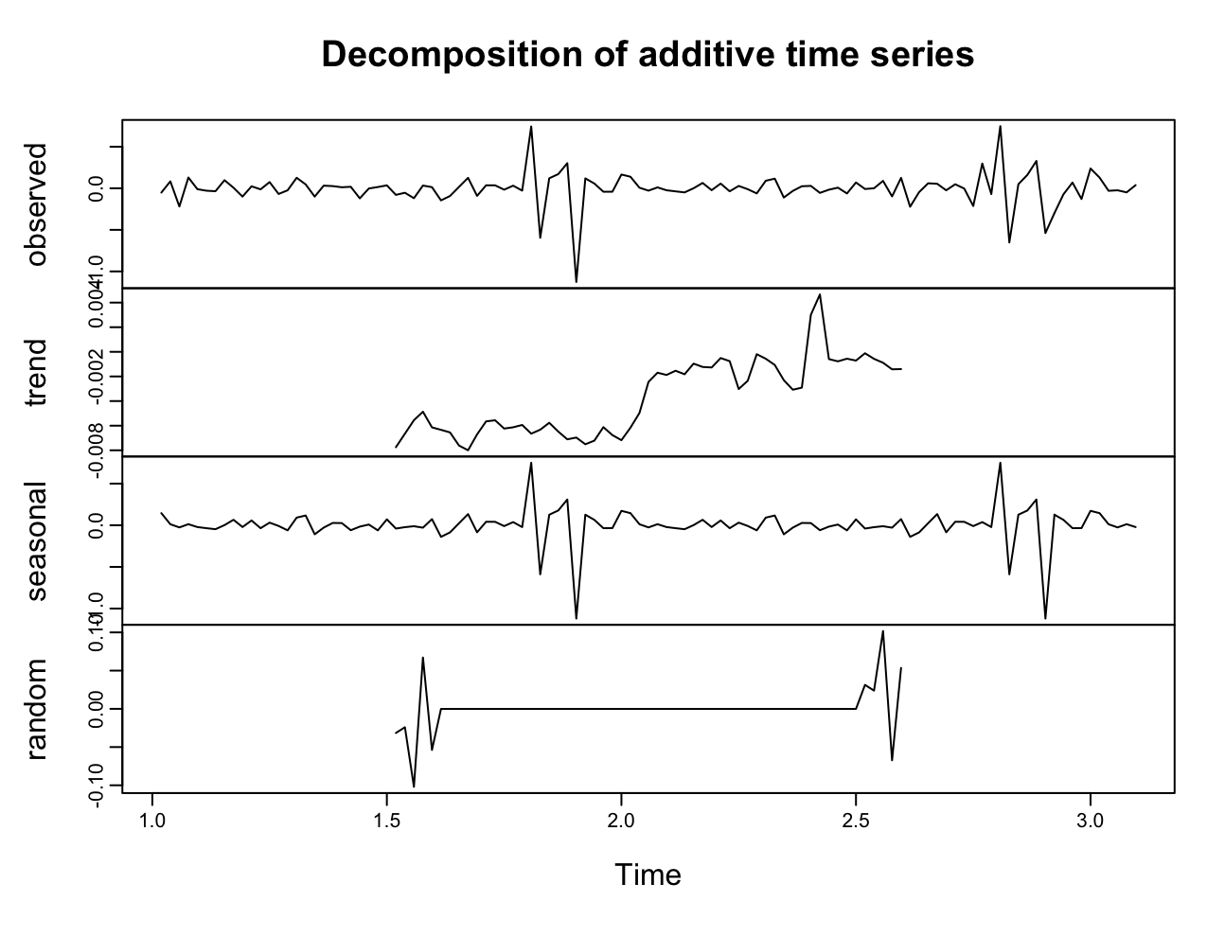
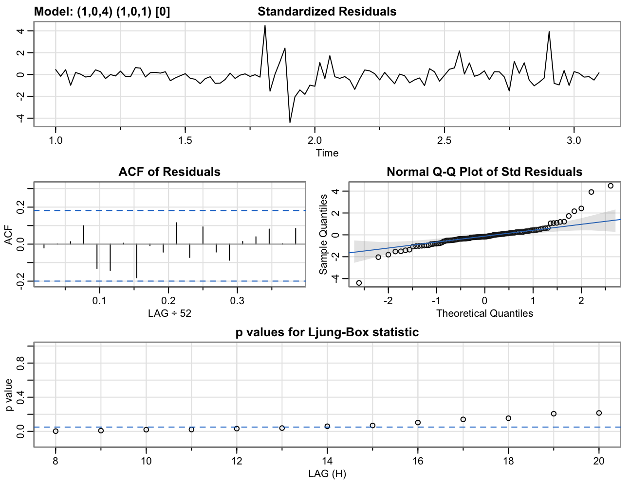
Type B Store Sample
Observe some seasonality and increasing trend
Post log transformation and taking the difference
Post log transformation and taking the difference and applying the Sarima model

Slide 33



Type C Store Sample
Type C
Observe some seasonality and increasing trend
Post log transformation and taking the difference
Post log transformation and taking the difference and applying the Sarima model

Slide 34

Results Summary
A
B
 |  | Sarima Without Features | Sarima With Variables (with Linear regression)
 | Type A | 0.118 | 0.105
 | Type B | 0.56 | 0.45
 | Type C | 0.075 | 0.11
C
Temperature and Unemployment were significant features for the model
Tried Linear regression

Slide 35
PROPHET MODEL
Nhi Nguyen

Slide 36
Overview
Automated Forecasting Procedure which forecasts time series data based on an additive model where non-linear trends are fit with yearly, weekly, and daily seasonality, plus holiday effects.
Suitable for time series has strong seasonality.

Slide 37


Implement
ACF of training data
Prophet model component

Slide 38

Prophet Model for Weekly Sale
MSPE is 2.357449%

Slide 39

Prophet Model for Weekly Sale
Prophet Model with Weekly Seasonality
MSPE is 2.383013%
Increase from initial MSPE

Slide 40

Prophet Model for Weekly Sale
Prophet Model with Holiday
MSPE is 2.357862%
Increase from initial MSPE

Slide 41

Forecast using Prophet Model

Slide 42
Thank You!

