Slide 1



|| JAI SHREE GURUDEV ||
ADICHUNCHANAGIRI INSTITUTE OF TECHNOLOGY
(Affiliated to Visvesvaraya Technological University, Belagavi ,Approved by AICTE and Accredited by NAAC, New Delhi )
Chikkamagaluru-577102.
DEPARTMENT OF ARTIFICIAL INTELLIGENCE AND MACHINE LEARNING ENGINEERING
MINI PROJECT PROPOSAL[BAI586] SEMINAR
ON
“REAL-TIME TRAFFIC PREDICTION USING BIG DATA”
Under the Guidance of:
xyz., B.E., M.Tech.,.
Assistant Professor
Department of AI & ML,
AIT, Chikkamagaluru.
Presented By:
Student name USN
5th Semester, Department of AI & ML.

Slide 2
ABSTRACT
Urban traffic congestion increases travel time, fuel use, and pollution.
By using Manual control, Timer controls and Electronic sensor controls traffic management is monitored.
By machine learning algorithms the system predicts traffic congestion, travel time and incident risks.
This project proposes a real-time traffic prediction, leveraging big data to forecast traffic conditions dynamically.
The project uses weather retrieval protocols, social media feeds and machine learning models.
By providing accurate, real-time traffic forecasts, this system has the potential to reduce congestion, enhance road safety, and improve urban mobility.
01

Slide 3
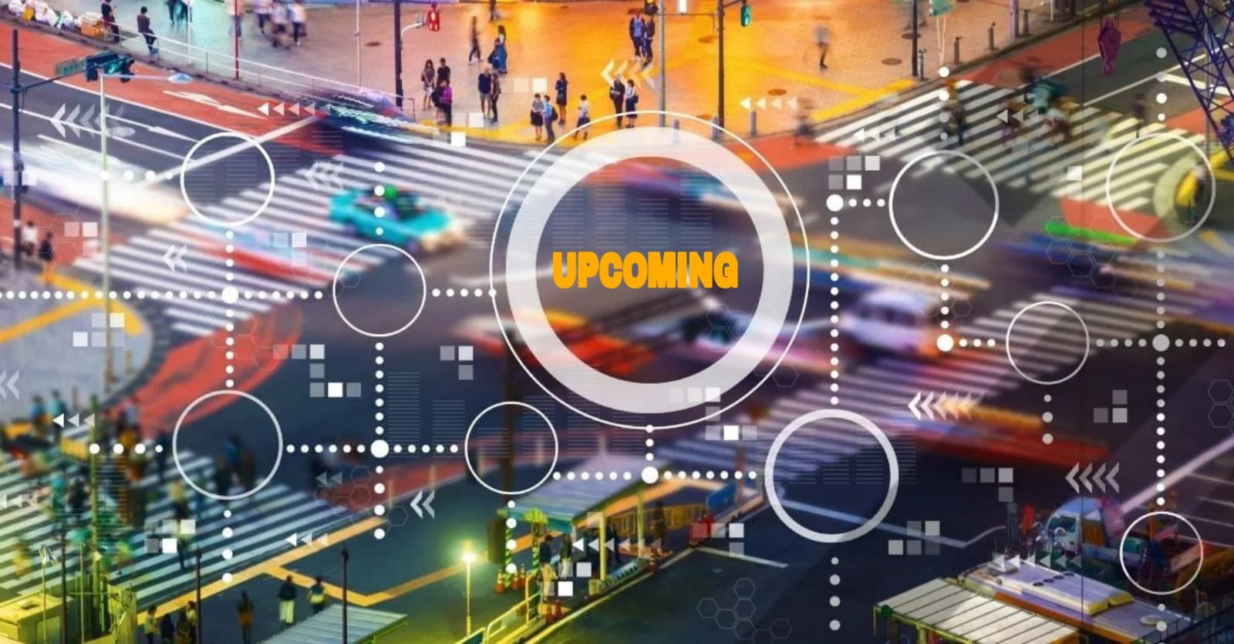
AGENDA
Introduction
Motivation
Problem statement
Dataset
Scope of the project
Objectives
Literature review
System requirements
Architecture diagram
References
02

Slide 4
INTRODUCTION
By rapid urbanization and rising vehicle ownership, leads to wasted time, increased fuel use, pollution, and stress.
Traditional traffic monitoring systems using fixed sensors and manual data entry are often reactive and lack accuracy in forecasting traffic. Big data technologies and machine learning now enable real time data from various sources, allowing for more precise and proactive traffic prediction.
The traffic prediction system employs advanced machine learning models, including LSTM networks and regression models, to analyze and forecast traffic patterns.
The predictions are displayed on user-friendly dashboards integrated with mapping services real time updates.
03

Slide 5
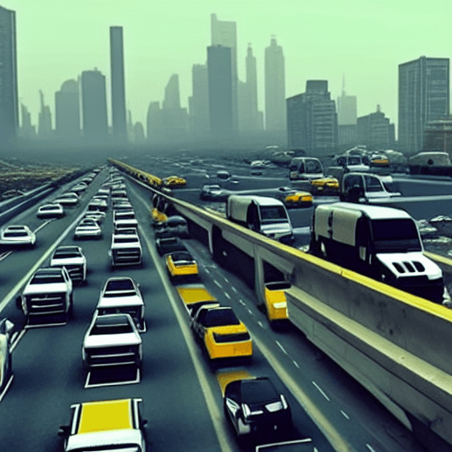
MOTIVATION
Need for Proactive Traffic Management
Technological Advancements in Big Data and Machine Learning
Environmental Concerns
Economic Impacts
Safety and Emergency Response
Real-Time Data and Smart City Vision
Personalized Navigation and User Experience
04

Slide 6
PROBLEM STATEMENT
Input:
o GPS data from smartphones, vehicle navigation systems.
o Historical traffic data from road cameras.
o Social media feeds.
o Weather data from meteorological APIs.
Processing:
o Data processing: Apache Spark, Apache Kafka.
o Model selection: Time series forecasting(LSTM), Logical regression.
o Classification model: SVM, CNN, ANN.
05

Slide 7
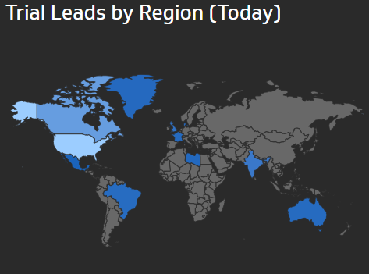
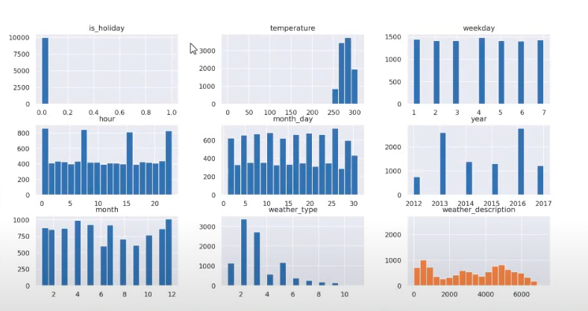
Output:
o Dashboard: Traffic flow visualization using charts and graphs, congestion prediction on maps,
indicates road blocks and weather conditions.
Displays numerical values w.r.t day/month/year.
o User application: drivers, traffic authorities, city planners.
06

Slide 8

DATASET
In this project traffic related data will be sourced from a variety of platforms, including:
  GPS data(Google/MapBox Maps API’s)
  Social media feeds
  Weather data(Open-metro API)
  Historic Junction data
  Analyze the number of vehicles passed through a junction at a
  particular time
  It data will be stored w.r.t date and time on daily basis.
  TRAFFIC WEATHER
07

Slide 9
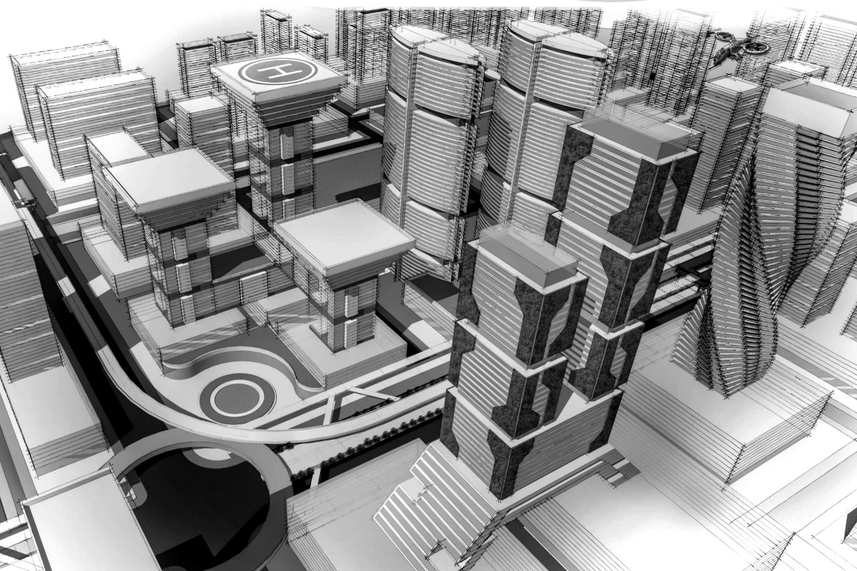
SCOPE OF PROJECT
Smart city planning
Traffic management centers
Public transportation
Ride-sharing services
08

Slide 10
OBJECTIVES
To build an efficient machine learning model that is capable of predicting traffic congestion, travel times in real time.
To collect and integrate real-time data from multiple sources.
To develop an intuitive and interactive dashboard for end users.
To equip city planners and traffic authorities with tools to make decisions that manage and reduce traffic congestion.
To measure the performance, accuracy, and scalability of the real-time traffic prediction system.
To support the development of smarter, transportation systems.
To design the system with flexibility to accommodate future enhancements and scalability to other cities or regions.
09

Slide 11
LITERATURE REVIEW
SL NO | TITLE | AUTHORS | PAPER DETAILS | REMARKS
1 | A Novel Deep Learning Approach of BH & SH on MANET basis Traffic Prediction with Big Data | A. Narasima Venkatesh; Y. M. Mahaboob John; P. Ananthi; Balaji Adusumalli; T. Manikumar; Bhasker Pant | 3rd International Conference on Intelligent Engineering and Management, 2022. | Methods for traffic flow forecasting that consider both spatial and temporal correlations A layered auto encoder model is used to teach traffic flow characteristics since it builds up greedy layer by layer. Deep architecture models for traffic flow prediction used as building blocks.
2 | A Reinforcement Learning-Based Network Traffic Prediction | Laisen Nie; Xiaojie Wang; Qinglin Zhao; Zhigang Shang; Li Feng; Guojun Li | IEEE Transactions on Intelligent Transportation Systems, 2024. | Combines Deep Q-Learning (DQN) and Generative Adversarial Networks (GAN) for network traffic feature extraction. DQN is leveraged to carry out network traffic prediction, in which GAN is involved to represent Q-network.
10

Slide 12
SL NO | TITLE | AUTHORS | PAPER DETAILS | REMARKS
3 | Term Traffic Flow Prediction Algorithm Based on CNN-LSTM Model | Xiang Zhang; Kai Huang; Chengzhi Liu; Xin Xu | 3rd International Conference on Consumer Electronics and Computer Engineering, 2023. | The convolutional neural network is used to capture the local spatial characteristics of traffic flow. The long short-term memory-cycle neural network is used to capture temporal characteristics of traffic flow data. Traffic flow prediction values of the urban areas are obtained by fusing with external factors.
4 | Short-Term Traffic Flow Prediction for Urban Road Sections Based on Time Series Analysis and LSTM_BILSTM Method | Changxi Ma; Guowen Dai; Jibiao Zhou | IEEE Transactions on Intelligent Transportation Systems, 2022. | Performs time series analysis on traffic flow data and perform smoothing and standardization processing to obtain a stable time series as model input data. Combining the advantages of sequential data and long-term dependence of forwarding LSTM and reverse LSTM, the BILSTM is integrated into prediction model.
11

Slide 13
SL NO | TITLE | AUTHORS | PAPER DETAILS | REMARKS
5 | The Impact of Big Data Analytics on Traffic Prediction | Hakima Khelifi; Amani Belouahri | International Conference on Advanced Aspects of Software Engineering, 2022 | Study the impact of big data analytics on traffic prediction in iovs. Big data analytics steps to predict the traffic flow, and based on different deep neural models such as lstm, cnn-lstm, and gru. The models are validated using evaluation metrics, mae, mse, rmse, and r2.
6 | Traffic Flow Prediction Using Deep Learning Models | China-Seh Wu; Satya Pranavi Manthena; Saurabh Kale; Maithili Vinayak Kulkarni | 5th International Conference on Computing and Big Data, 2022. | Present the long short-term memory (LSTM) model, gated recurrent unit (GRU) model, stacked auto encoder (SAE), and an auto-regressive integrated moving average (ARIMA) model, all of which are deep learning methods. Experimental results demonstrate that the gated recurrent unit model is more applicable and performs better.
12

Slide 14
SYSTEM REQUIREMENT
SOFTWARE REQUIREMENTS:
Operating system: windows 10 above.
Software Tools: Python, vs code.
Coding Languages: Python, Java script.
Database: MYSQL.
HARDWARE REQUIREMENTS:
System: Intel Core i5 and above.
Hard Disk: 256GB and above.
Ram:8 GB and above.
13

Slide 15
ARCHITECTURE DIAGRAM
Data set and API’s
Data preprocessing
Real-time prediction
Apache Hadoop
Apache Spark
Apache Kafka
14
Model construction
CNN
SVM
LSTM
ANN
Model evaluation
Accuracy (API’s)
Dashboard with visualization
Fig 9.1: System architecture design of

Slide 16
REFERENCES
[1] A. Narasima Venkatesh, Y. M. Mahaboob John, P. Ananthi, B. Adusumalli, T. Manikumar and B. Pant, "A Novel Deep Learning Approach of BH & SH on MANET basis Traffic Prediction with Big Data," 2022
[2] L. Nie, X. Wang, Q. Zhao, Z. Shang, L. Feng and G. Li, "Digital Twin for Transportation Big Data: A Reinforcement Learning-Based Network Traffic Prediction Approach," 2024.
[3] X. Zhang, K. Huang, C. Liu and X. Xu, "Urban Short - Term Traffic Flow Prediction Algorithm Based on CNN-LSTM Model," 2023
[4] C. Ma, G. Dai and J. Zhou, "Short-Term Traffic Flow Prediction for Urban Road Sections Based on Time Series Analysis and LSTM_BILSTM Method," 2022.
[5] H. Khelifi and A. Belouahri, "The Impact of Big Data Analytics on Traffic Prediction," 2022
[6] C. -S. Wu, S. P. Manthena, S. Kale and M. V. Kulkarni, "Traffic Flow Prediction Using Deep Learning Models," 2022
15

Slide 17
THANK YOU

