Slide 1
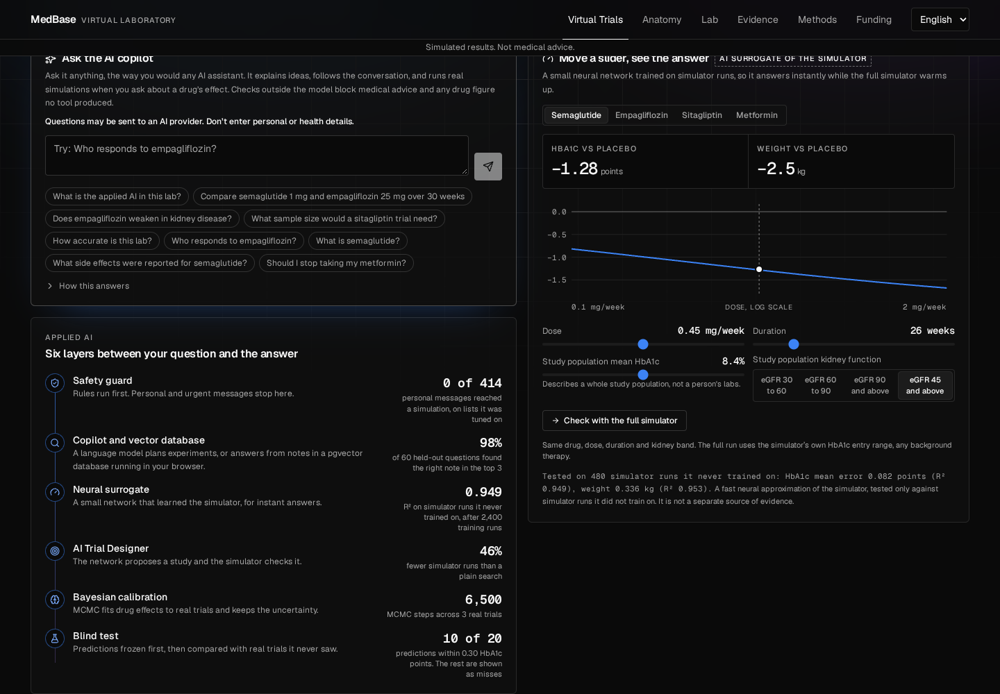
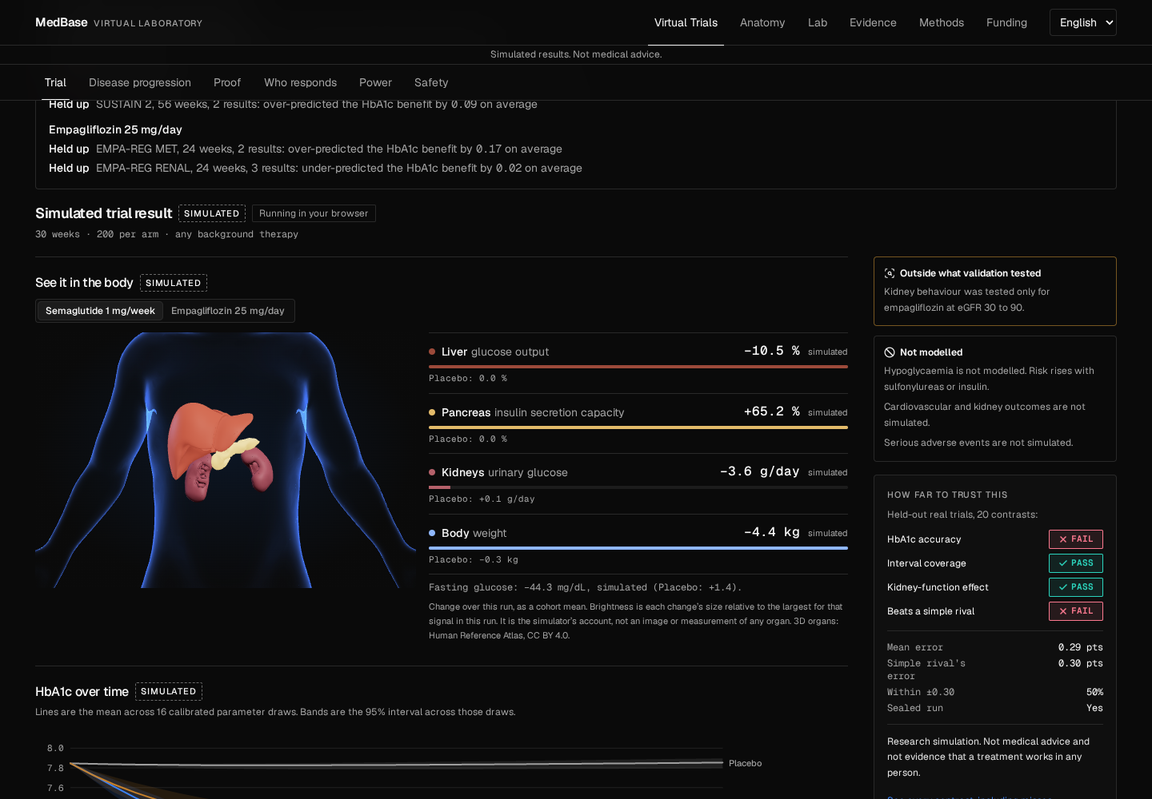
INFINEX 2K26 | APPLIED AI
MedBase Virtual Trials Lab
Rehearse a type 2 diabetes drug trial in your browser, then see how far to trust it.
Try it live
https://zade06079-medbase-virtual-trials-lab.static.hf.space
Simulated results. Not medical advice.
Notes:
Open with the idea: rehearse a trial in a browser, and see how far to trust the answer. The link on this slide is the live site.

Slide 2
Students can't rehearse a trial, and much health AI can't show where it went wrong
The rehearsal gap
The trust gap
Drug trials cost years and enormous sums. Students and early researchers have no accessible way to explore how a study would behave before it exists, and most open diabetes simulators cover type 1 only.
Many health AI tools produce confident answers with no way to check them. A learner cannot tell a sourced figure from a plausible one, or see where the tool has been wrong before.
Our answer: virtual patients from real survey data, AI that plans and explains, and a simulator that computes every efficacy number.
Notes:
Two gaps. No accessible way to explore a study before it exists. And confident health AI answers with no way to check them.

Slide 3
Our solution: ask in plain English, run a trial, and see how far to trust it
Conversational AI copilot
Virtual trials
AI Trial Designer
Explains ideas, follows up on "why?", and runs real simulations when you ask about a drug's effect.
Four real drugs and hypothetical molecules, on virtual patients built from real health survey labs.
Set a goal. A neural network proposes a study, and the simulator checks it step by step.
Instant neural sliders
Vector database in the browser
Public blind test
Move dose or duration and get an answer in milliseconds, then race it against the full simulator.
PostgreSQL with pgvector finds the right notes by meaning, with no server and no account.
Every frozen prediction beside the real result, shown beside each simulated answer, misses included.
Notes:
This is the product in one slide. Then show it live if you can.

Slide 4
Models propose and explain. The simulator computes.
Bayesian calibration
MCMC learns drug effects from three real trials and carries the uncertainty into every prediction.
R-hat 1.026
44 walkers, 6500 steps, 56 autocorrelation times
Neural surrogate
Trained on 2400 simulator runs. Instant sliders, runs in the browser. It learned the simulator, not reality.
R² 0.949
HbA1c error 0.082 points on 480 simulator runs it never saw
AI Trial Designer
The surrogate proposes a dose; the simulator checks it, refines it, then sizes the study.
46% fewer
simulator runs than plain search, across 36 goals
Live copilot
A language model on NVIDIA NIM plans tool calls, explains results, and answers ordinary questions from a pgvector database running in the browser.
98%
of 60 held-out questions found the right note in the top 3. Right tool on 10 of 10 experiments
Number and advice guard
A digit figure no tool produced sends the reply back, then falls to computed text. Dose guidance and personal questions are refused.
44 of 44
project-written attack prompts refused before any model is called
Notes:
Walk the layers left to right. The point: each model does what it is good at, and each has a measured result. The neural surrogate learned the simulator, not reality.

Slide 5
Technology stack
AI models
Science
In the browser
Hosting and safety
NVIDIA Nemotron 3.5 on NIM: language model
nemotron-3-embed-1b: embeddings
Neural surrogate: a small MLP
Bayesian MCMC with emcee
Python, NumPy, SciPy
scikit-learn, statsmodels
NHANES survey data
Published trial results
React 19, TypeScript, Vite, Tailwind
Pyodide: the Python simulator
PostgreSQL and pgvector 0.8.7, through PGlite
three.js: 3D body views
Hugging Face Spaces: static site
Vercel: proxy that holds the AI key
Rule-based guard before any model
Content Security Policy, key scans
Notes:
Point out that the simulator and the database both run on the visitor's own device.

Slide 6
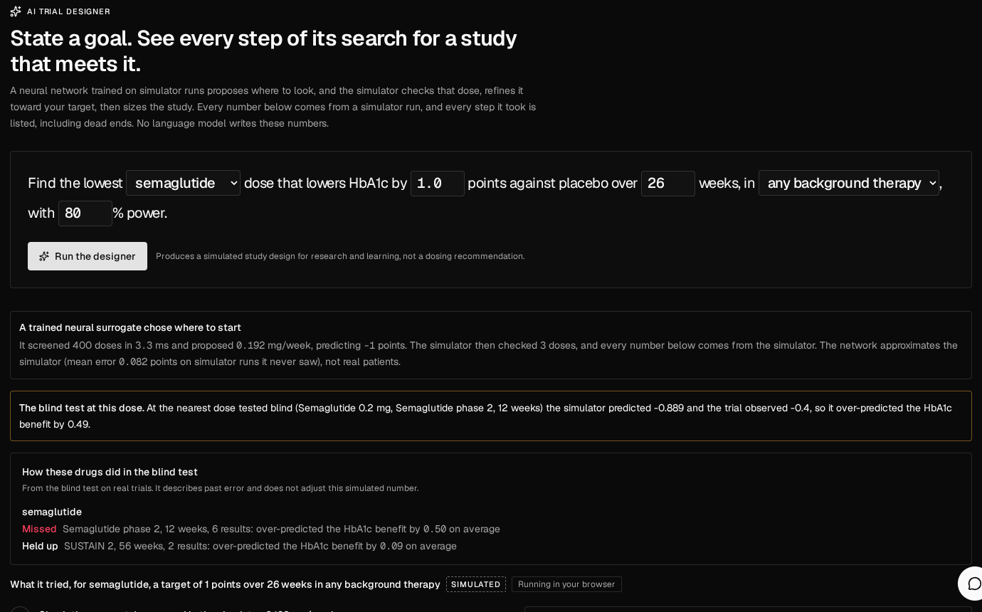
A neural network chooses where to look, so the simulator runs less
46%
fewer simulator runs: 3.28 on average against 6.03 for plain bisection
36 of 36
goals reached the same verdict on whether a design exists
3%
median dose difference from plain search; largest 8.7%
Notes:
The surrogate screens 400 doses in milliseconds and proposes a start. The simulator checks it and has the last word. The benchmark compares guided against plain search on the same goals.

Slide 7
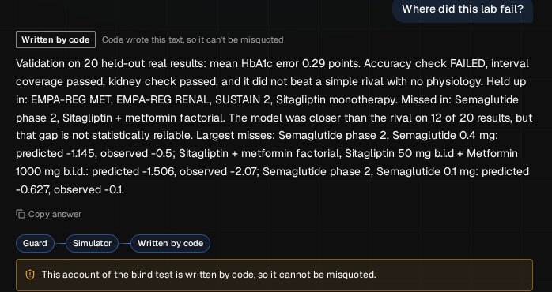
Testing the copilot found errors a number check can't see, so we changed the design
1
No tool run, no answer
A reply with no tool behind it is rejected. An early draft invented parameter names.
2
One chance to fix a figure
The guard names the unsourced number and sends the draft back. A second failure loses that line, or the whole draft.
3
Its failures and designs are written by code
A paraphrase got the lab's results backwards, and a design must not read as a dose. The model chooses the tool; code writes the text.
Latest run on 10 project-written questions: 7 answered by the model, 3 written by code, 0 replaced by computed text. Known limit: the guard checks that a figure has a source, not the sentence around it.
Notes:
Be candid. The first version got only 3 of 10 answers past its own guard, and reading replies by hand found errors no number check could catch. A clinical review also found ways past the guard, now permanent tests. So replies must follow a tool run, code appends every warning, and failures and designs are written by code.

Slide 8
We attacked our own safety guard, and it failed before it held
Test | Personal reaching a simulation | Urgent missing the emergency reply | Research questions refused
First attack, after reading the rules | 171 got a trial number (201 of 246 wrong class)
First blind run | 0 of 188 | 17 of 28 | 15 of 72
Second blind run, terse messages | 6 of 226 | 28 of 58; 4 with no 112 | 42 of 84
Shipped guard, same lists (tuned, not held out) | 0 of 414 | 1 of 86 | 18 of 156
Default is no: only a question with a research frame reaches a simulation or a model, in any language
Urgent messages are checked first, and every simulation or safety answer ends with 112 and the Tele-MANAS helpline, 14416
For a supervised research demo, not an unattended public service. Lists written by one author, hard on purpose
Notes:
Say this plainly. The first attack got a trial number out of the guard 171 times. A blind test then found emergencies getting an ordinary reply, including self-harm messages. So the default flipped to no, emergencies are checked first, and every simulation or safety answer says where help is. The last row was tuned on these same lists, so it is not a held-out result, and this is for a supervised demo.

Slide 9
Blind test on 20 real results: two passed, two failed
Check | Pass mark | Result
Accuracy | error ≤ 0.25, 70% within 0.30 | error 0.29, 50% within | FAIL
95% interval | ≥ 85% of results inside | 85%; only 50% inside the 80% interval | PASS
Kidney effect, never fitted | each stratum within 0.30 | within, on 3 results | PASS
Beat a rival with no physiology | whole 95% interval below 0 | gap -0.01; -0.091 to 0.034 | FAIL
Predictions were frozen and pushed publicly before any result was opened, and results were opened once. The seal is mechanical: these are famous trials, so the authors knew the literature in general.
Notes:
Predictions were frozen and pushed to a public commit before the real results were opened, once. Say the failures out loud. Accuracy failed and the model did not beat a simple rival. It held up on empagliflozin, SUSTAIN 2 and sitagliptin alone, and missed the 12-week semaglutide trial and the metformin arms.

Slide 10
So the misses stay on screen, beside every simulated result
A learner sees a number and its record together.
Semaglutide: the 12-week trial missed; the 56-week trial held up
Empagliflozin: held up in both trial groups, including kidney strata
The record describes past error and never adjusts the number
Added after the blind run; it changes no prediction
Notes:
This is the real-world idea. Every result shows where that drug held up in the blind test and where it missed. It describes past error and does not adjust the number. It was added after the blind run and changes no prediction.

Slide 11
Innovation and real-world impact
What is new
Who it helps
A real simulator and a real vector database run inside the browser, at no server cost
The language model plans and explains, and code checks its figures against what actually ran
Predictions were frozen before real results were opened, and the failures stay public
We attacked our own safety guard and published what got through
Students and early researchers can rehearse a study design for free, with no account, on an ordinary laptop
Learners see how far to trust an AI answer, because its track record sits beside it
The AI designer used 46% fewer simulator runs than a plain search, reaching the same verdict
Next: pilot it with a class, and add Indian patient data
Notes:
Be plain that nobody outside the project has used it yet. The next step is a pilot with a class.

Slide 12
It scales like a static site, and it knows what it is not
Built to spread
What it is not
The real simulator runs in the visitor's browser through Pyodide, with no server to pay for
A small proxy keeps the AI key off the public site
If the AI is down, an offline planner still answers from computed results
Not clinically validated, and not advice for any person
No cardiovascular outcomes, hypoglycaemia or serious adverse events simulated
Virtual patients come from a US survey, not an Indian cohort
Live demo https://zade06079-medbase-virtual-trials-lab.static.hf.space
Code and validation report https://github.com/shreynachaegari-glitch/medbase-virtual-trials-lab
Built on MedBase by Team Aegis.
Notes:
Close on scale and limits, then the links. It is a way to think about a study, not a forecast, and never advice for a person.

