Slide 1
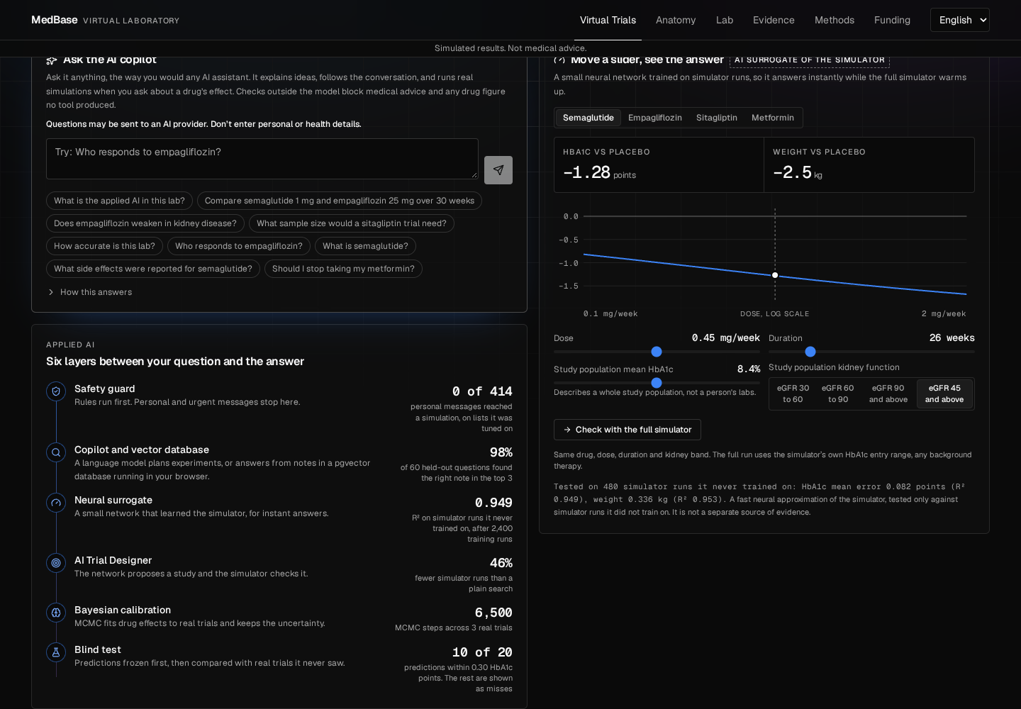
INFINEX 2K26 | APPLIED AI
MedBase Virtual Trials Lab
Run a simulated type 2 diabetes drug trial in your browser, on virtual patients built from real health survey data, and see how far to trust the answer.
Try it live
https://zade06079-medbase-virtual-trials-lab.static.hf.space
Simulated results. Not medical advice.
Notes:
Open with the idea, then show the live site if you can.

Slide 2
The problem: trials can't be rehearsed, and health AI can't be checked
The rehearsal gap
The trust gap
Drug trials cost years and enormous sums. Students and early researchers have no accessible way to explore how a study would behave before it exists, and most open diabetes simulators cover type 1 only.
Many health AI tools give confident answers with no way to check them. A learner can't tell a sourced figure from a plausible one, or see where the tool has been wrong before.
Our answer: virtual patients from real survey data, AI that plans and explains, and a simulator that computes every efficacy number.
Notes:
Two gaps: no easy way to try a study before it exists, and confident answers with no way to check them.

Slide 3
The solution: ask in plain English, and a real simulator answers
1
2
3
4
5
Your question
Safety guard
AI copilot
Simulator
Checked answer
Plain English, such as "How much does semaglutide lower HbA1c?"
Personal and urgent messages stop here, before any AI
Plans the experiment, or finds notes by meaning
Computes every efficacy number on your own device
Code checks the figures, and the track record sits beside them
Models propose and explain. The simulator computes.
Notes:
Walk the path of one question from left to right.

Slide 4
Key features
Conversational AI copilot
Virtual trials
AI Trial Designer
Explains ideas, follows up on "why?", and runs real simulations when you ask about a drug's effect.
Four real drugs and hypothetical molecules, on virtual patients built from real survey labs.
Set a goal. A neural network proposes a study, and the simulator checks it step by step.
Instant neural sliders
Vector database in the browser
Public blind test
Move dose or duration and get an answer in milliseconds, then race it against the full simulator.
PostgreSQL with pgvector finds the right notes by meaning, with no server and no account.
Every frozen prediction beside the real result, including the ones it got wrong.
Notes:
Show these live if you can.

Slide 5
Technology stack
AI models
Science
In the browser
Hosting and safety
NVIDIA Nemotron 3.5 on NIM: language model
nemotron-3-embed-1b: embeddings
Neural surrogate: a small MLP
Bayesian MCMC with emcee
Python, NumPy, SciPy
scikit-learn, statsmodels
NHANES survey data
Published trial results
React 19, TypeScript, Vite, Tailwind
Pyodide: the Python simulator
PostgreSQL and pgvector 0.8.7, through PGlite
three.js: 3D body views
Hugging Face Spaces: static site
Vercel: proxy that holds the AI key
Rule-based guard before any model
Content Security Policy, key scans
Notes:
The simulator and the database both run on the visitor's own device.

Slide 6
Innovation: applied AI you can check
What is new
R² 0.949
A real simulator and a real vector database run inside the browser, at no server cost
The language model plans and explains, while code checks its figures against what actually ran
Predictions were frozen before real results were opened: 10 of 20 landed within 0.30 HbA1c points, and every miss stays public
We attacked our own safety guard and published what got through
neural surrogate, on 480 simulator runs it never trained on
98%
of 60 held-out questions found the right note in the top 3
4 ms
median vector database query, under Node
Notes:
Each point is something most projects don't do. Be plain that the blind test was mixed.

Slide 7
Real-world impact
Who it helps
46%
Students and early researchers can rehearse a study design for free, with no account, on an ordinary laptop
Learners see how far to trust an AI answer, because its track record sits beside it
It costs almost nothing to run, because each visitor's browser does the simulating
Next: pilot it with a class, and add Indian patient data
fewer simulator runs than a plain search, across 36 study goals
0
servers to run for the simulator, and no account needed
Notes:
Be plain that nobody outside the project has used it yet. The next step is a pilot with a class.

Slide 8
What it is not, and where to try it
What it is not
Not clinically validated, and not advice for any person
In its blind test it missed its accuracy mark and did not clearly beat a simple rival
No cardiovascular outcomes, hypoglycaemia or serious adverse events simulated
Virtual patients come from a US survey, not an Indian cohort
Live demo https://zade06079-medbase-virtual-trials-lab.static.hf.space
Code and validation report https://github.com/shreynachaegari-glitch/medbase-virtual-trials-lab
Built on MedBase by Team Aegis.
Notes:
Close on the limits, then the links. It is a way to think about a study, not a forecast, and never advice for a person.

