Slide 1

INFINEX 2K26 | APPLIED AI
MedBase
Virtual Trials Lab
Rehearse a type 2 diabetes drug trial in your browser, on virtual patients built from real health data, and know how far to trust the result.
Live demo https://zade06079-medbase-virtual-trials-lab.static.hf.space
Team Aegis
Notes:
MedBase lets anyone rehearse a type 2 diabetes drug trial in the browser, on virtual patients built from real health survey data, and see how far to trust the answer.

Slide 2
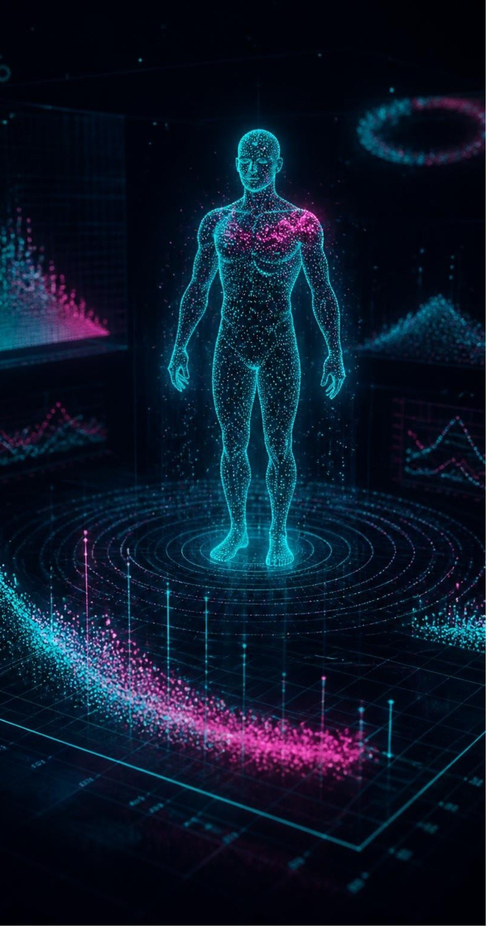
THE PROBLEM
Trials can't be rehearsed, and health AI can't be checked
REHEARSAL GAP
TRUST GAP
Trials cost years and enormous sums. Students and early researchers have no accessible way to try a study first, and most open diabetes simulators cover type 1 only.
Health AI gives confident answers with no way to check them, or to see where it has been wrong before.
MedBase closes both: real patient data, AI that plans and explains, and a simulator that computes every efficacy number.
Notes:
Two gaps: nobody can try a study before it exists, and health AI gives confident answers with no way to check them.

Slide 3
THE SOLUTION
Ask in plain English, and a real simulator answers
STEP 01
STEP 02
STEP 03
STEP 04
STEP 05
Your question
Safety guard
AI copilot
Simulator
Checked answer
Ask about a drug, a trial or an idea, in plain English.
Personal and urgent messages stop here, before any AI.
NVIDIA Nemotron plans the experiment, or finds notes by meaning.
Computes every efficacy number, right on your device.
Code checks the figures, and the track record sits beside them.
Models propose and explain. The simulator computes.
Notes:
Follow one question through the pipeline. The architecture rule is the key: models propose and explain, and the simulator computes.

Slide 4
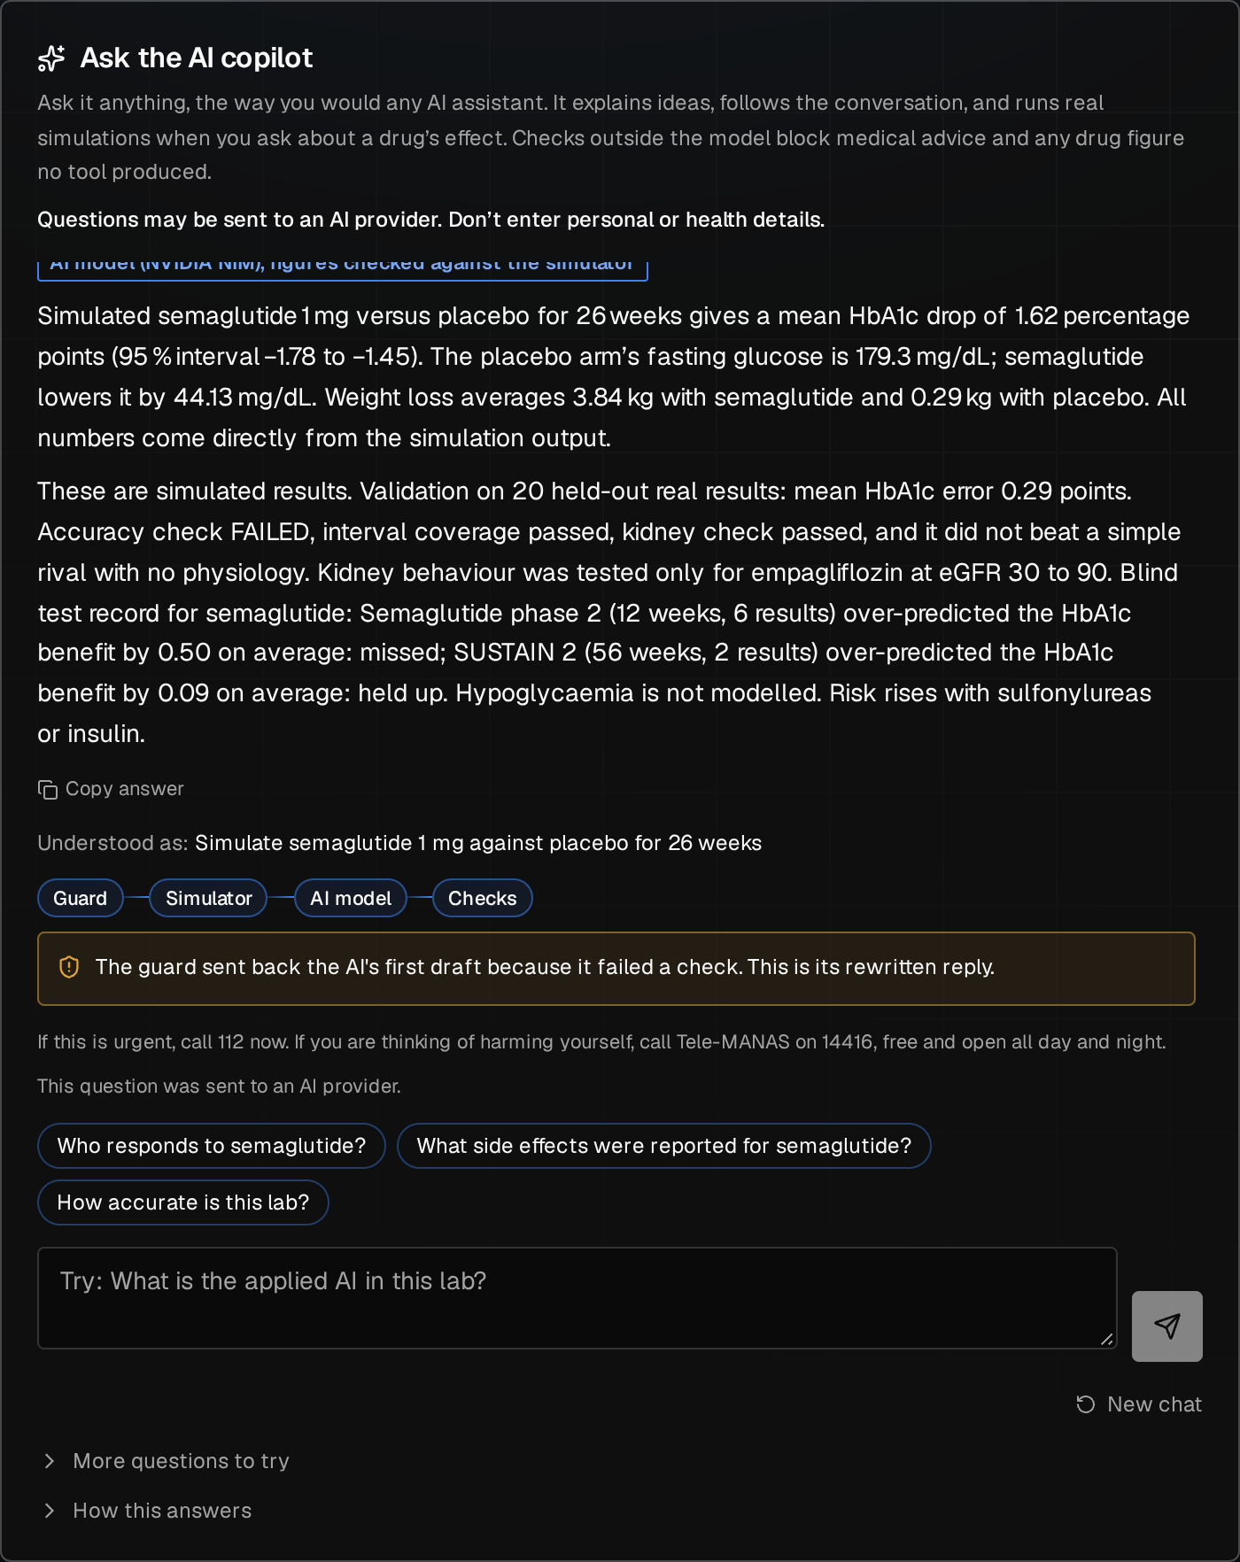
KEY FEATURES
Six ways to explore a trial
AI copilot
Virtual trials
Explains ideas, follows up on "why?", and runs real simulations
Four real drugs and hypothetical molecules
AI Trial Designer
Instant neural sliders
A neural network proposes a study, and the simulator checks it
Change dose or duration and see the answer in milliseconds
Vector database
Public blind test
PostgreSQL with pgvector, in the browser, with no server or account
Every frozen prediction beside the real result
Notes:
The picture is the real copilot on the live site, running a real simulation.

Slide 5

TECHNOLOGY STACK
A full AI stack, with the simulator and database in the browser
AI
SCIENCE
NVIDIA Nemotron 3.5 on NIM, nemotron-3-embed-1b embeddings, a neural surrogate, Bayesian MCMC with emcee
Python, NumPy, SciPy, scikit-learn, statsmodels, NHANES survey data, published trial results
BROWSER
SAFETY AND HOSTING
React 19, TypeScript, Vite, Pyodide, PGlite with pgvector 0.8.7, three.js
Rule-based guard, Vercel key proxy, Hugging Face Spaces, Content Security Policy
Notes:
The simulator and the vector database run on the visitor's device. The language model and embeddings run on NVIDIA NIM, through a small proxy that holds the key.

Slide 6
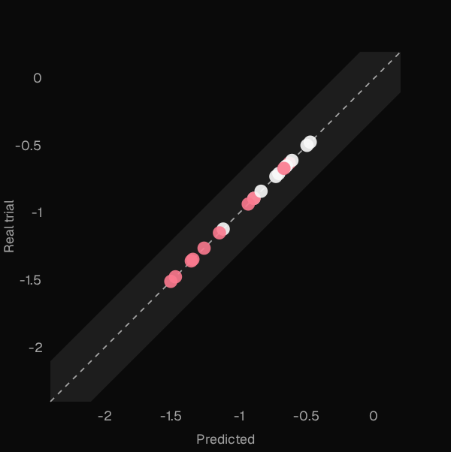
INNOVATION
Applied AI you can check
R² 0.949
98%
Under 11 ms
Neural surrogate
Retrieval
Vector database
on 480 simulator runs it never saw
right note in the top 3, on 60 held-out questions
query measured in the live browser
FROZEN BEFORE THE ANSWERS WERE KNOWN
20 predictions were published before real trial results were opened. 10 landed within 0.30 HbA1c points, the lab passed 2 of 4 pre-registered checks, and every miss stays public. We also attacked our own safety guard and published what got through.
Each dot is a real prediction against the real trial result.
Notes:
We froze 20 predictions before opening the real trial results. 10 landed within 0.30 points, and the lab passed 2 of its 4 pre-registered checks: it missed its accuracy mark and did not clearly beat a simple baseline. We publish that, because it is what makes the rest believable. The surrogate's R-squared measures it against the simulator, not reality.

Slide 7
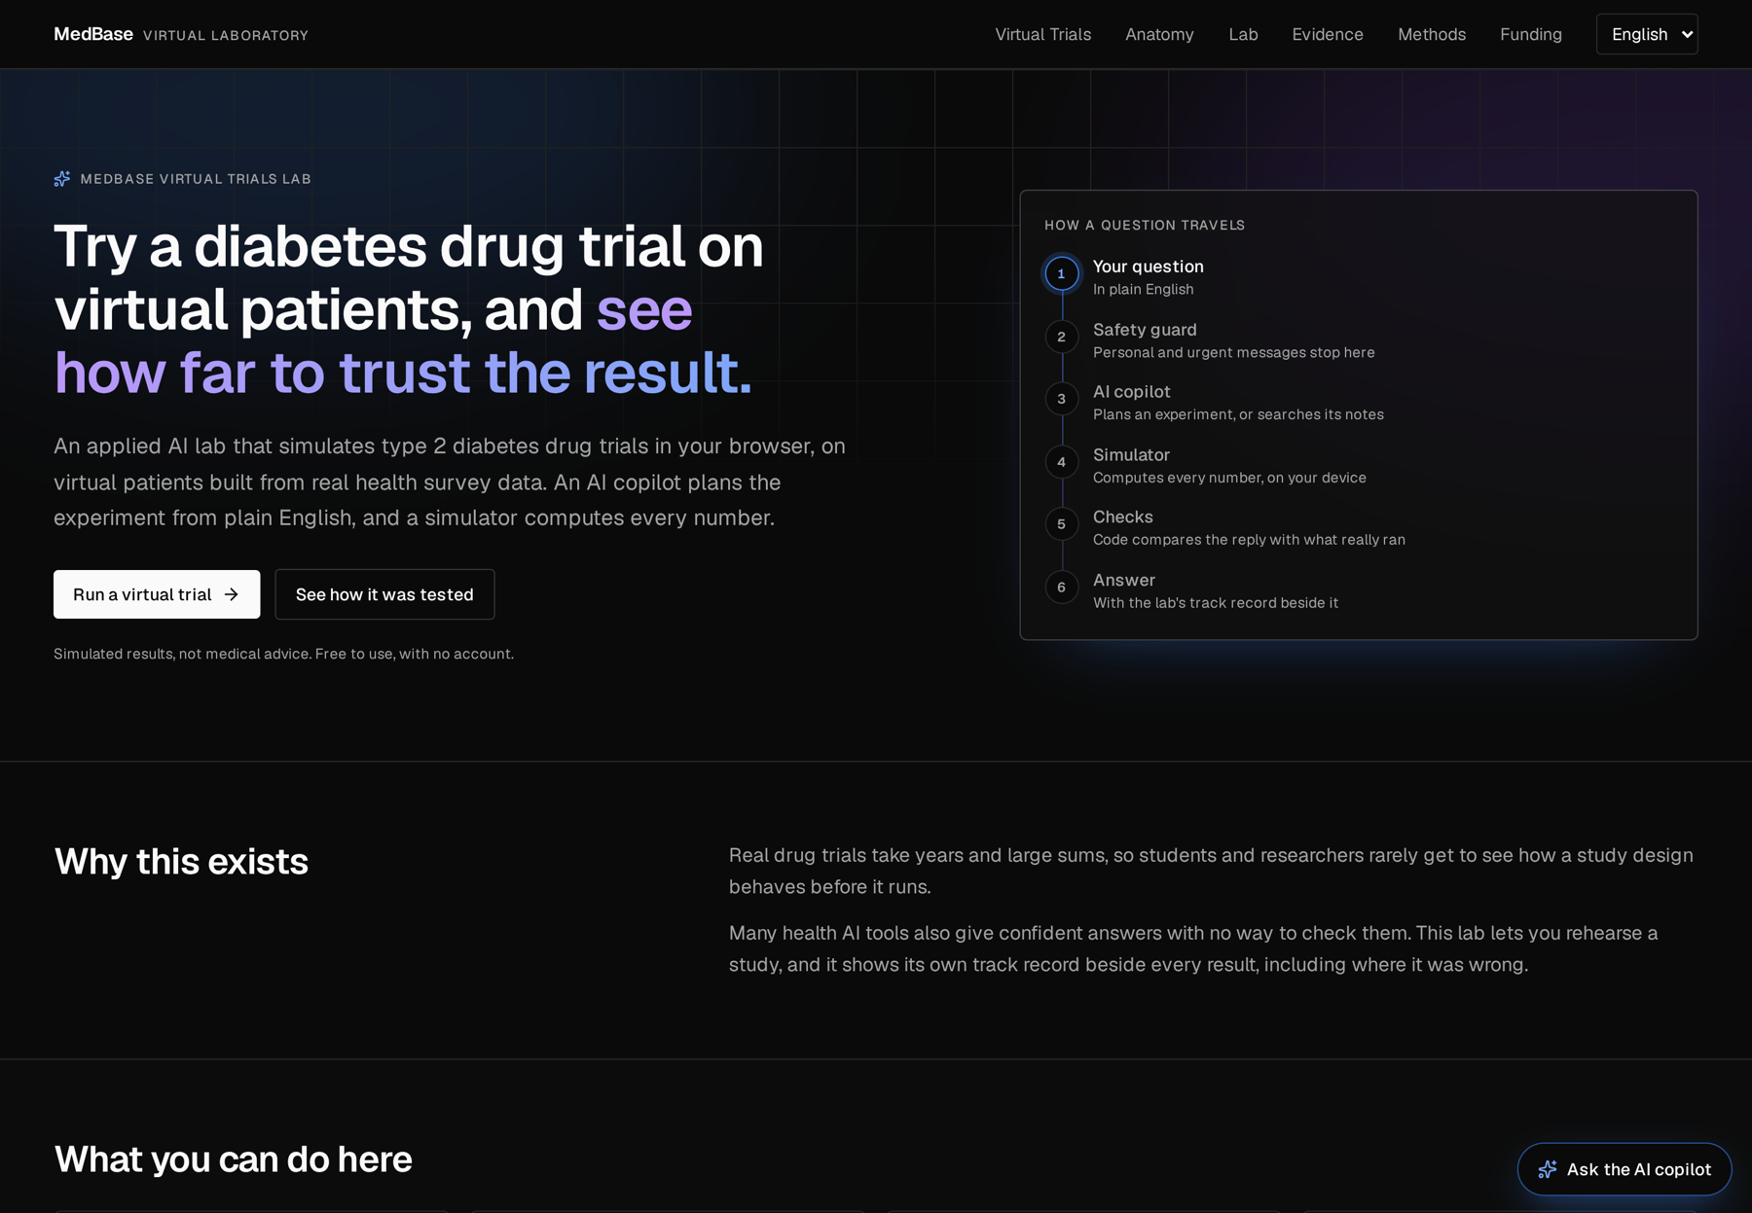
REAL-WORLD IMPACT
Trial rehearsal for anyone with a laptop
46%
0
fewer simulator runs than a plain search, across 36 study goals
servers to run for the simulator, and no account needed
Students and early researchers rehearse a study design free, on an ordinary laptop
Learners see an AI answer's track record right beside it
Almost no running cost, because each browser does the simulating
Next: a pilot with a class, and Indian patient data
Notes:
If asked: nobody outside the project has used it yet. The next step is a pilot with a class.

Slide 8
TRY IT TODAY
Rehearse a trial. See how far to trust it.
Live demo https://zade06079-medbase-virtual-trials-lab.static.hf.space
Code and validation report https://github.com/shreynachaegari-glitch/medbase-virtual-trials-lab
No install. No account. Just ask.
Built on MedBase by Team Aegis
Notes:
Close on the idea, then invite them to try it. If asked: it is a simulator for learning, it has not been clinically validated, it gives no advice for any person, and its patients come from a US survey.

