Slide 1


Slide 2


IMDb
MOVIES
ANALYSIS
Drive Link:
https://drive.google.com/file/d/1IAVanXlwS34PDMmqaZoby2vpN0M3rp6y/view?usp=sharing
PREPARED BY SHREYASH PATEL
PROEJCT OBJECTIVE
The primary objective of this project is to analyze movie data sourced from IMDb to uncover patterns and insights related to movie ratings, genres, popularity, and audience preferences.

Slide 3
PROEJCT OBJECTIVE
The primary objective of this project is to analyze movie data sourced from IMDb to uncover patterns and insights related to movie ratings, genres, popularity, and audience preferences.

Slide 4
02
03
AGENDA
DATA CLEANING & PREPROCESSING
Clean and transform raw data by handling missing values, converting formats, and preparing features for analysis.
Exploratory Data Analysis (EDA)
Analyze patterns, relationships and distribution of variables to uncover key trends.
01
DATA COLLECTION
Scrape movie data from IMDb including rating, genre, description, votes, and other metadata.

Slide 5
AGENDA
01
02
03
Data Collection
Scrape movie data from IMDb including rating, genre, description, votes, and other metadata.
DATA CLEANING & PREPROCESSING
Clean and transform raw data by handling missing values, converting formats, and preparing features for analysis.
Exploratory Data Analysis (EDA)
Analyze patterns, relationships and distribution of variables to uncover key trends.

Slide 6
AGENDA
01
02
03
Data Collection
Scrape movie data from IMDb including rating, genre, description, votes, and other metadata.
Data Cleaning & Preprocessing
Clean and transform raw data by handling missing values, converting formats, and preparing features for analysis.
Exploratory Data Analysis (EDA)
Analyze patterns, relationships and distribution of variables to uncover key trends.

Slide 7
AGENDA
01
02
03
Data Collection
Scrape movie data from IMDb including rating, genre, description, votes, and other metadata.
Data Cleaning & Preprocessing
Clean and transform raw data by handling missing values, converting formats, and preparing features for analysis.
Exploratory Data Analysis (EDA)
Analyze patterns, relationships and distribution of variables to uncover key trends.

Slide 8
AGENDA
04
05
03
Genre Trend Analysis
Understand how audience preferences for movie genres have evolved over time.
Rating Prediction
Build machine learning model to predict IMDb ratings using movie features.
Recommendation System
Develop content-based recommendation system to suggest similar movies.

Slide 9
AGENDA
04
05
03
Genre Trend Analysis
Understand how audience preferences for movie genres have evolved over time.
Rating Prediction
Build machine learning model to predict IMDb ratings using movie features.
Recommendation System
Develop content-based recommendation system to suggest similar movies.

Slide 10
AGENDA
04
05
06
Genre Trend Analysis
Understand how audience preferences for movie genres have evolved over time.
Rating Prediction
Build machine learning model to predict IMDb ratings using movie features.
Recommendation System
Develop content-based recommendation system to suggest similar movies.

Slide 11

A
B
C
D
FEATURE SELECTION
Before Scraping we defined key features required for analysis, and these features were selected based on their analytical importance.
Movie Information
Rating & Popularity
Content Attributes
Financial Features
DATA SOURCE
Data is collected from different IMDb listing pages to prevent biasness while training the model.
Top Rated (8-10)
Most Popular (votes)
Mid Rated (5-8)
Low Rated (1-5)
Old Movies (1980-2000)
TOOLS SELECTION
As the dataset is large enough, tool preference is a important factor based on the website you’re scraping.
Beautiful Soup or Selenium?
Or Hybrid (Selenium + Beautiful Soup) ?
SCRAPING STRATEGY
The scraping process is divided into two main stages:
Collecting Movie Links
Scraping Movie Details from the links.
( Avoid blocking from IMDb servers )

Slide 12
A
B
C
D
MOVIES SCRAPING
The scraping task is designed to systematically extract movies from IMDb across multiple categories while ensuring scalability, efficiency, and data quality.
FEATURE SELECTION
Before Scraping we defined key features required for analysis, and these features were selected based on their analytical importance.
Movie Information
Rating & Popularity
Content Attributes
Financial Features
DATA SOURCE
Data is collected from different IMDb listing pages to prevent biasness while training the model.
Top Rated (8-10)
Most Popular (votes)
Mid Rated (5-8)
Low Rated (1-5)
Old Movies (1980-2000)
TOOLS SELECTION
As the dataset is large enough, tool preference is a important factor based on the website you’re scraping.
Beautiful Soup or Selenium?
Or Hybrid (Selenium + Beautiful Soup) ?
SCRAPING STRATEGY
The scraping process is divided into two main stages:
Collecting Movie Links
Scraping Movie Details from the links.
( Avoid blocking from IMDb servers )
~5500 movies scraped

Slide 13
A
B
C
D
FEATURE SELECTION
Before Scraping we defined key features required for analysis, and these features were selected based on their analytical importance.
Movie Information
Rating & Popularity
Content Attributes
Financial Features
DATA SOURCE
Data is collected from different IMDb listing pages to prevent biasness while training the model.
Top Rated (8-10)
Most Popular (votes)
Mid Rated (5-8)
Low Rated (1-5)
Old Movies (1980-2000)
TOOLS SELECTION
As the dataset is large enough, tool preference is a important factor based on the website you’re scraping.
Beautiful Soup or Selenium?
Or Hybrid (Selenium + Beautiful Soup) ?
SCRAPING STRATEGY
The scraping process is divided into two main stages:
Collecting Movie Links
Scraping Movie Details from the links.
( Avoid blocking from IMDb servers )

Slide 14



DATASET SCHEMA
Movie URL
IMDb page link/unique identifier
Movie Title
Name of the Movie
Release Date
Official release date of the movie
Duration
Total runtime of movie in minutes
Countries
Countries where movie produced
Languages
Languages used in the movie
Content Rating
Age certification (e.g. PG-13, R)
Watchlist Count
No. of users who added movie to their watchlist
Genres
Categories assigned to the movie
Description
Short summary of the movie plot
Keywords
Important tags/themes related to the movie content
Director & Casts
Name of the director and lead actor/ actresses in the movie
Rating
IMDb user rating
Votes
No. of user votes received on IMDb
Metascore
Critic rating score from external sources
User & Critic Reviews
Total no. of user-written and critic reviews
Gross
Total Box Office Collection
Budget
Estimated production cost of movie
Opening Weekend
Revenue generated during the opening weekend
ROI
Return on investment of a movie
Basic Movie Information

Slide 15
DATASET SCHEMA
Countries
Countries where movie produced
Languages
Languages used in the movie
Content Rating
Age certification (e.g. PG-13, R)
Watchlist Count
No. of users who added movie to their watchlist
Movie URL
IMDb page link/unique identifier
Movie Title
Name of the Movie
Release Date
Official release date of the movie
Duration
Total runtime of movie in minutes
Genres
Categories assigned to the movie
Description
Short summary of the movie plot
Keywords
Important tags/themes related to the movie content
Director & Casts
Name of the director and lead actor/ actresses in the movie
Rating
IMDb user rating
Votes
No. of user votes received on IMDb
Metascore
Critic rating score from external sources
User & Critic Reviews
Total no. of user-written and critic reviews
Gross
Total Box Office Collection
Budget
Estimated production cost of movie
Opening Weekend
Revenue generated during the opening weekend
ROI
Return on investment of a movie
Extra Movie Information

Slide 16
DATASET SCHEMA
Genres
Categories assigned to the movie
Description
Short summary of the movie plot
Keywords
Important tags/themes related to the movie content
Director & Casts
Name of the director and lead actor/ actresses in the movie
Movie URL
IMDb page link/unique identifier
Movie Title
Name of the Movie
Release Date
Official release date of the movie
Duration
Total runtime of movie in minutes
Countries
Countries where movie produced
Languages
Languages used in the movie
Content Rating
Age certification (e.g. PG-13, R)
Watchlist Count
No. of users who added movie to their watchlist
Rating
IMDb user rating
Votes
No. of user votes received on IMDb
Metascore
Critic rating score from external sources
User & Critic Reviews
Total no. of user-written and critic reviews
Gross
Total Box Office Collection
Budget
Estimated production cost of movie
Opening Weekend
Revenue generated during the opening weekend
ROI
Return on investment of a movie
Content Attributes

Slide 17
DATASET SCHEMA
Rating
IMDb user rating
Votes
No. of user votes received on IMDb
Metascore
Critic rating score from external sources
User & Critic Reviews
Total no. of user-written and critic reviews
Movie URL
IMDb page link/unique identifier
Movie Title
Name of the Movie
Release Date
Official release date of the movie
Duration
Total runtime of movie in minutes
Countries
Countries where movie produced
Languages
Languages used in the movie
Content Rating
Age certification (e.g. PG-13, R)
Watchlist Count
No. of users who added movie to their watchlist
Genres
Categories assigned to the movie
Description
Short summary of the movie plot
Keywords
Important tags/themes related to the movie content
Director & Casts
Name of the director and lead actor/ actresses in the movie
Gross
Total Box Office Collection
Budget
Estimated production cost of movie
Opening Weekend
Revenue generated during the opening weekend
ROI
Return on investment of a movie
Rating & Popularity

Slide 18
DATASET SCHEMA
Gross
Total Box Office Collection
Budget
Estimated production cost of movie
Opening Weekend
Revenue generated during the opening weekend
ROI
Return on investment of a movie
Movie URL
IMDb page link/unique identifier
Movie Title
Name of the Movie
Release Date
Official release date of the movie
Duration
Total runtime of movie in minutes
Countries
Countries where movie produced
Languages
Languages used in the movie
Content Rating
Age certification (e.g. PG-13, R)
Watchlist Count
No. of users who added movie to their watchlist
Genres
Categories assigned to the movie
Description
Short summary of the movie plot
Keywords
Important tags/themes related to the movie content
Director & Casts
Name of the director and lead actor/ actresses in the movie
Rating
IMDb user rating
Votes
No. of user votes received on IMDb
Metascore
Critic rating score from external sources
User & Critic Reviews
Total no. of user-written and critic reviews
Financial Features

Slide 19
Text
Cleaning &
Standardization
Handling
Missing
Values
Thousands (K) & Millions (M)
Conversion
Handling
Duplicate
Values
Datatype
Conversion
Currency
Conversion
Data Cleaning &
Preprocessing

Slide 20
Thousands (K) & Millions (M)
Conversion
Currency
Conversion
Handling
Duplicate
Values
Data Cleaning &
Preprocessing
Datatype
Conversion
Text
Cleaning &
Standardization
Handling
Missing
Values

Slide 21
Text
Cleaning &
Standardization
Handling
Missing
Values
Thousands (K) & Millions (M)
Conversion
Handling
Duplicate
Values
Datatype
Conversion
Currency
Conversion
Data Cleaning &
Preprocessing

Slide 22

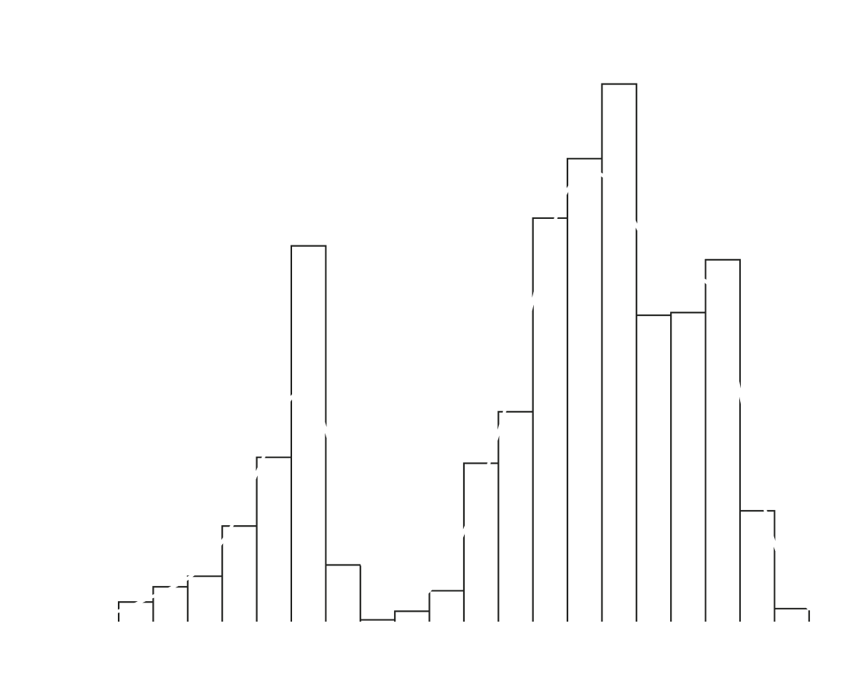
MOVIES PER YEAR
Univariate Analysis
Univariate analysis focuses on examining each variable independently to understand its distribution, central tendency, and variability. The objective is to:
Identify overall distribution of all key features
Detect skewness, and outliers.
Understand frequency pattern in categorical data.
VOTES DISTRIBUTION
INTRODUCTION
RATING DISTRIBUTION
Distribution of IMDb Ratings
Ratings are mostly concentrated between 6 & 8
The distribution appears slightly left-skewed.
Most movies receive moderately high ratings, indicating bias towards well-rated movies.
Extremely low-rated movies are rare.

Slide 23

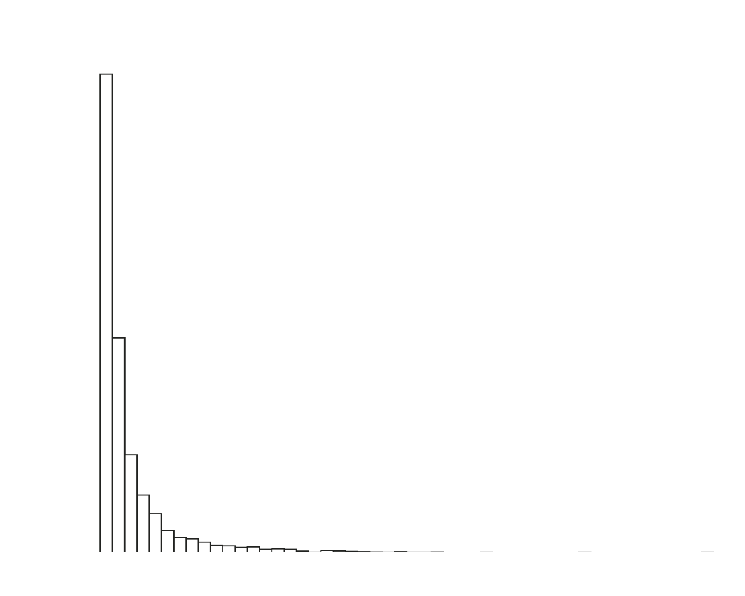
Univariate Analysis
Univariate analysis focuses on examining each variable independently to understand its distribution, central tendency, and variability. The objective is to:
Identify overall distribution of all key features
Detect skewness, and outliers.
Understand frequency pattern in categorical data.
MOVIES PER YEAR
Distribution of IMDb Ratings
Ratings are mostly concentrated between 6 & 8
The distribution appears slightly left-skewed.
Most movies receive moderately high ratings, indicating bias towards well-rated movies.
Extremely low-rated movies are rare.
VOTES DISTRIBUTION
INTRODUCTION
RATING DISTRIBUTION
Distribution of Votes
The distribution is highly right-skewed.
A large number of movies have low vote counts
A small number of movies have extremely high votes.
Popularity is unevenly distributed across movies.
Few blockbuster movies dominate in terms of audience engagement.

Slide 24


Distribution of IMDb Ratings
Ratings are mostly concentrated between 6 & 8
The distribution appears slightly left-skewed.
Most movies receive moderately high ratings, indicating bias towards well-rated movies.
Extremely low-rated movies are rare.
MOVIES PER YEAR
Distribution of Votes
The distribution is highly right-skewed.
A large number of movies have low vote counts
A small number of movies have extremely high votes.
Popularity is unevenly distributed across movies.
Few blockbuster movies dominate in terms of audience engagement.
VOTES DISTRIBUTION
INTRODUCTION
RATING DISTRIBUTION
Movies Production Trend
A general increasing trend in the number of movies over the year.
Indicates that movies production has grown significantly over time.
Noticeable dip during the early 1990s, while significant growth after 2000s.
Sharp decline in the most recent years shows missing data ( less 2025-26 movies).

Slide 25

Distribution of Votes
The distribution is highly right-skewed.
A large number of movies have low vote counts
A small number of movies have extremely high votes.
Popularity is unevenly distributed across movies.
Few blockbuster movies dominate in terms of audience engagement.
MOVIES PER YEAR
Movies Production Trend
A general increasing trend in the number of movies over the year.
Indicates that movies production has grown significantly over time.
Noticeable dip during the early 1990s, while significant growth after 2000s.
Sharp decline in the most recent years shows missing data ( less 2025-26 movies).
VOTES DISTRIBUTION
INTRODUCTION
RATING DISTRIBUTION

Slide 26

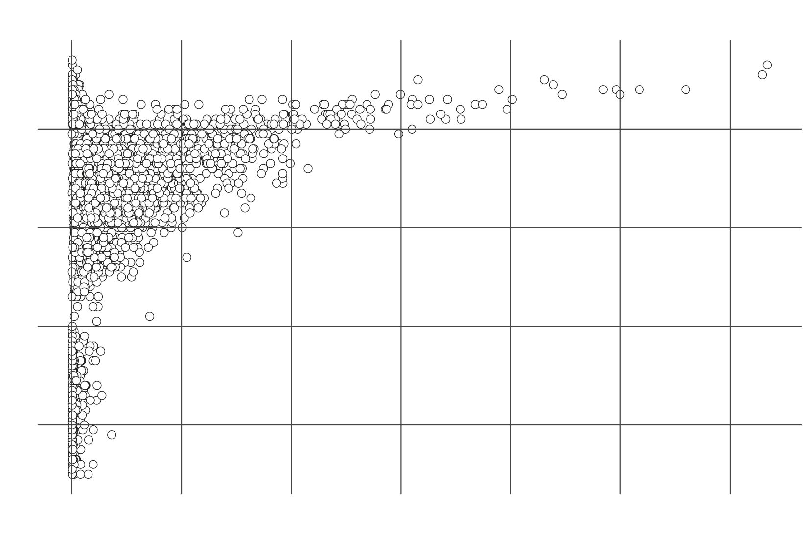
CORRELATION HEATMAP
Bivariate Analysis
Bivariate analysis examines the relationship between two variables to identify patterns, correlations, and dependencies. The objective is to:
Understand how one variable influence another
Detect positive, negative or no correlation
Support feature selection for model building.
BUDGET VS GROSS
BIVARIATE ANALYSIS
RATING VS VOTES
Ratings vs Votes
Slight upward trend between votes and ratings, which tells there is a weak positive correlation between ratings and votes.
Most movies are clustered in the lower vote range.
Popular movies tend to have better ratings, as high-vote movies generally have ratings above 7.
However, high ratings also present in low-votes movies, indicating less popular movies can also have high ratings.

Slide 27

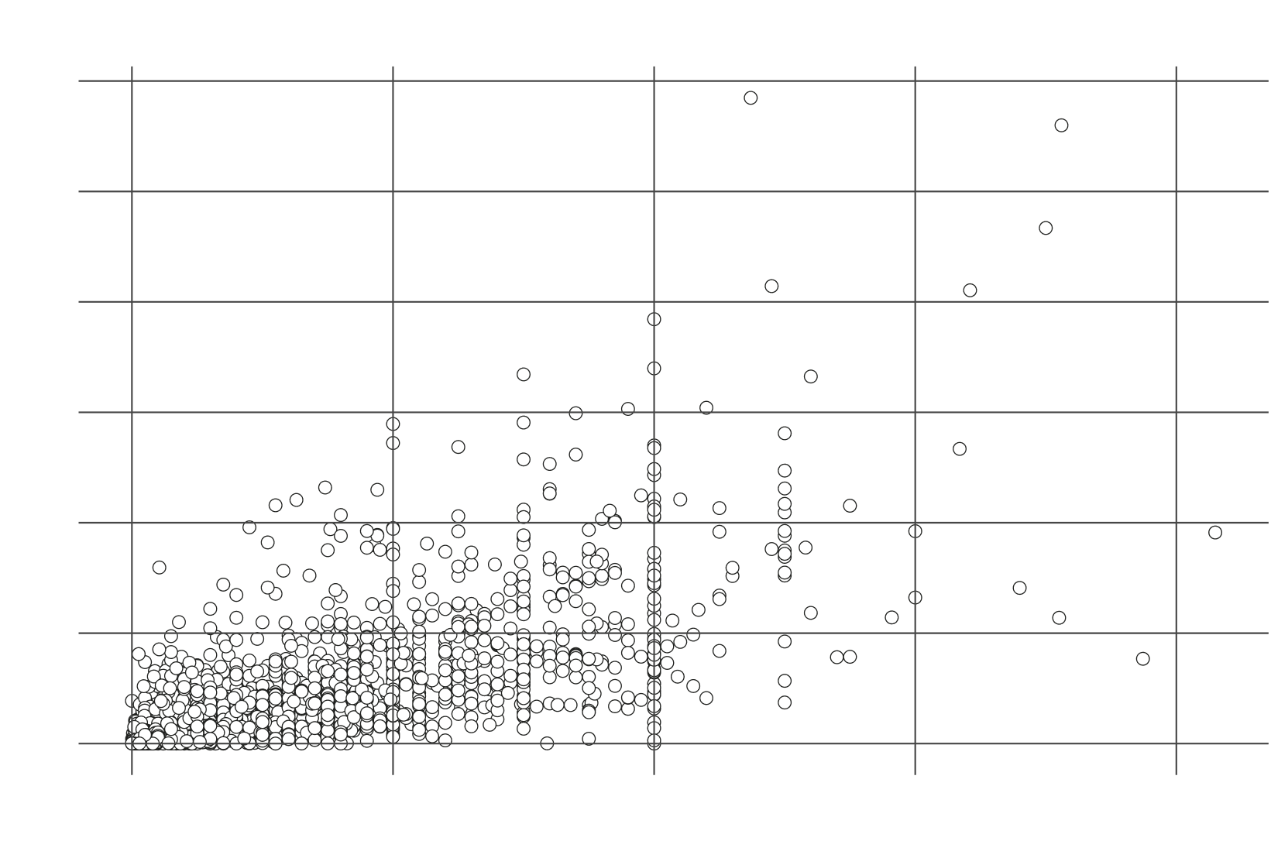
Bivariate Analysis
Bivariate analysis examines the relationship between two variables to identify patterns, correlations, and dependencies. The objective is to:
Understand how one variable influence another
Detect positive, negative or no correlation
Support feature selection for model building.
CORRELATION HEATMAP
Ratings vs Votes
Slight upward trend between votes and ratings, which tells there is a weak positive correlation between ratings and votes.
Most movies are clustered in the lower vote range.
BUDGET VS GROSS
BIVARIATE ANALYSIS
Popular movies tend to have better ratings, as high-vote movies generally have ratings above 7.
However, high ratings also present in low-votes movies, indicating less popular movies can also have high ratings.
RATING VS VOTES
Budget vs Gross
There is a positive relation between budget and gross.
Higher budget movies tends to generate higher revenue.
Significant spread indicates high budget does not always guarantee success.
Presence of outliers indicates there are some blockbuster or underperforming movies with very high budget.

Slide 28

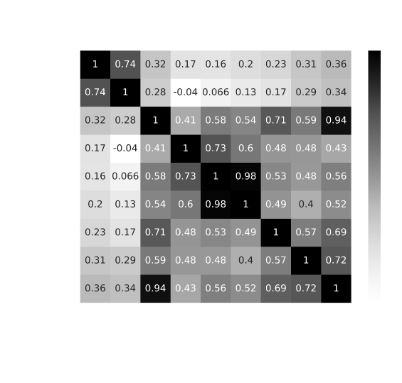
Ratings vs Votes
Slight upward trend between votes and ratings, which tells there is a weak positive correlation between ratings and votes.
Most movies are clustered in the lower vote range.
Popular movies tend to have better ratings, as high-vote movies generally have ratings above 7.
However, high ratings also present in low-votes movies, indicating less popular movies can also have high ratings.
CORRELATION HEATMAP
Budget vs Gross
There is a positive relation between budget and gross.
Higher budget movies tends to generate higher revenue.
Significant spread indicates high budget does not always guarantee success.
BUDGET VS GROSS
BIVARIATE ANALYSIS
RATING VS VOTES
Presence of outliers indicates there are some blockbuster or underperforming movies with very high budget.
Correlation Heatmap
Strong positive correlation between:
Gross & Profit
Watchlist & Votes
Moderate positive correlation between:
Votes & Reviews
Rating & Metascore
Votes & Gross
Ratings have weak correlation with financial metrics except metascore, indicating critically successful movies not always financially successful.

Slide 29

Budget vs Gross
There is a positive relation between budget and gross.
Higher budget movies tends to generate higher revenue.
Significant spread indicates high budget does not always guarantee success.
Presence of outliers indicates there are some blockbuster or underperforming movies with very high budget.
CORRELATION HEATMAP
Correlation Heatmap
Strong positive correlation between:
Gross & Profit
Watchlist & Votes
Moderate positive correlation between:
Votes & Reviews
Rating & Metascore
Votes & Gross
BUDGET VS GROSS
BIVARIATE ANALYSIS
RATING VS VOTES
Ratings have weak correlation with financial metrics except metascore, indicating critically successful movies not always financially successful.

Slide 30


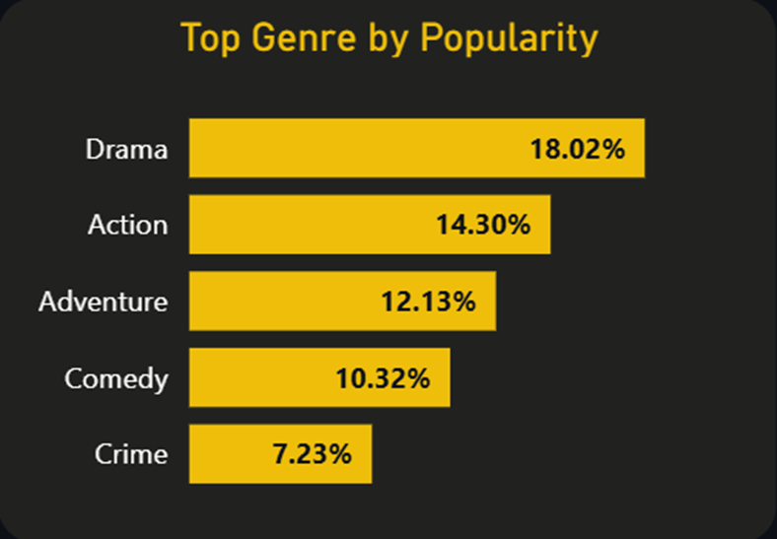
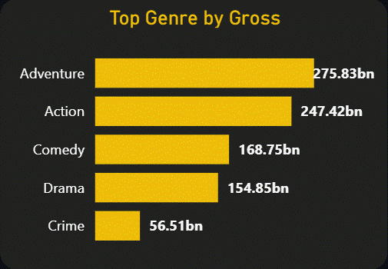
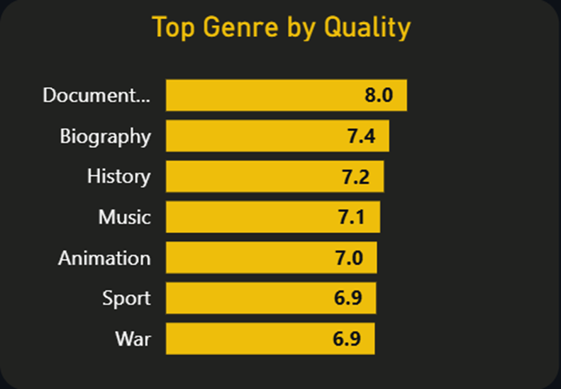


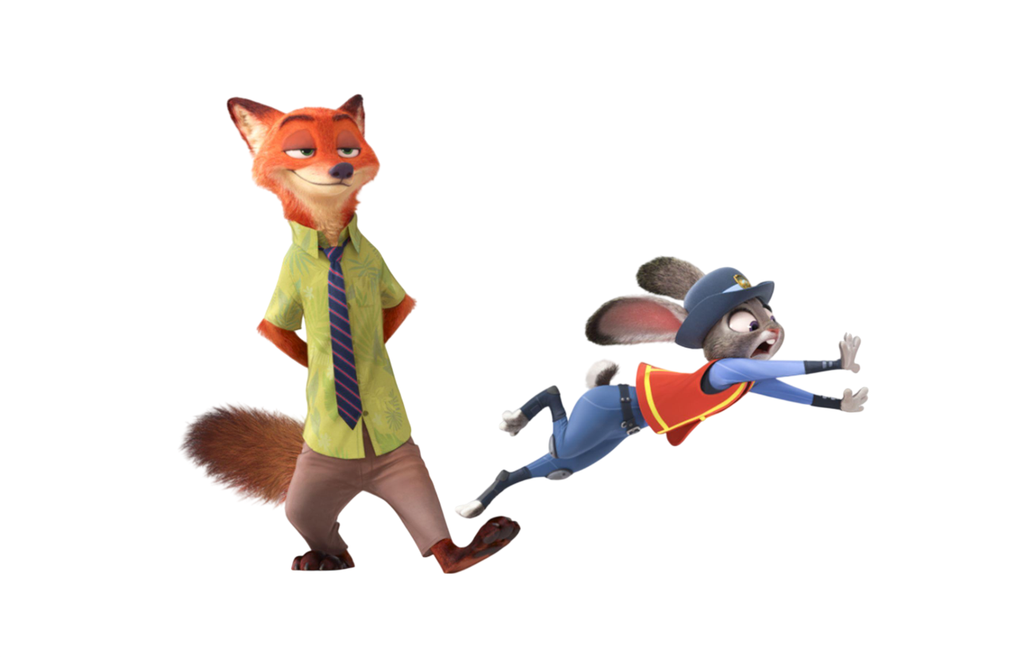



GENRE TREND ANALYSIS
Top Genres
5631
Total Movies
The objective of this analysis is to analyze how audience preferences for genres evolved over time and to identify:
Most popular genres
Highest quality genres
Most profitable genres
Forecast future trend using Power BI
Drama is the most popular genre, contributing highest share (~18% of votes) followed by Action & Adventure, which indicates strong audience preference for storytelling-driven and high-engagement content.
Documentary ranks highest in average rating (~8.0) followed by Biography and History, which indicates that documentary and biopic films have less audience but they love it (higher avg. ratings).
Adventure and Action dominate in terms of total gross revenue, which indicates high-budget and large-scale genres drive box office success.
2bn
Total Votes
6.23
Avg.Rating
Drama
Top Genre

Slide 31
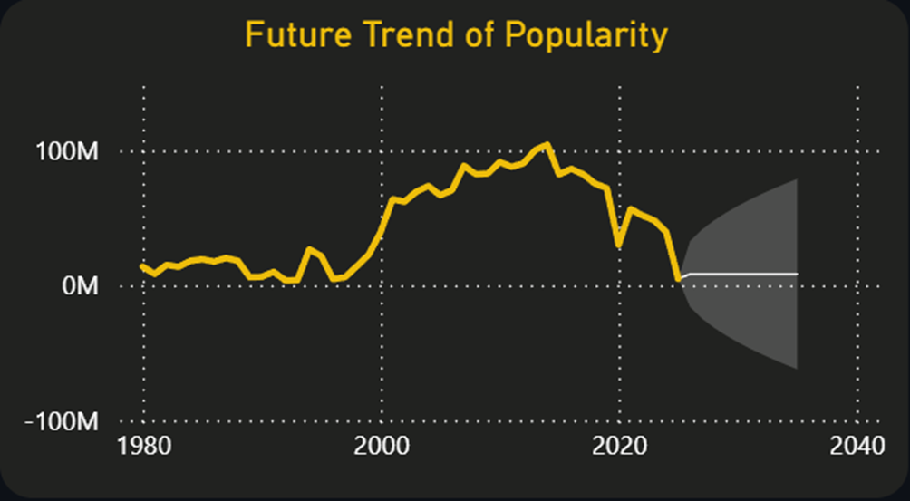
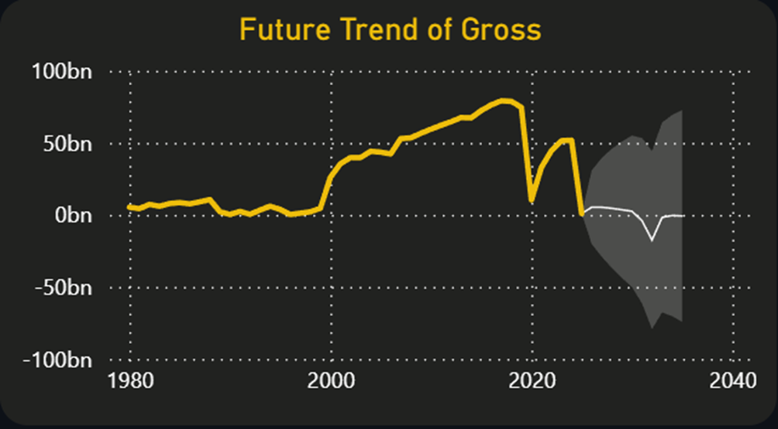

GENRE TREND ANALYSIS
Top Genres
Future Trends
5631
Total Movies
The objective of this analysis is to analyze how audience preferences for genres evolved over time and to identify:
Most popular genres
Highest quality genres
Most profitable genres
Forecast future trend using Power BI
Audience interest shows a steady rise from early 2000s, peaking around the late 2010s.
A noticeable decline after 2020, possibly due to external factors (e.g, industry shifts, streaming impact due to corona as mostly audience started watching shows over movies).
This analysis indicates that genre popularity is dynamic and influenced by changing viewing patterns.
2bn
Total Votes
Drama is the most popular genre, contributing highest share (~18% of votes) followed by Action & Adventure, which indicates strong audience preference for storytelling-driven and high-engagement content.
Documentary ranks highest in average rating (~8.0) followed by Biography and History, which indicates that documentary and biopic films have less audience but they love it (higher avg. ratings).
Adventure and Action dominate in terms of total gross revenue, which indicates high-budget and large-scale genres drive box office success.
6.23
Avg.Rating
Drama
Top Genre

Slide 32
Top Genres
Future Trends
Drama is the most popular genre, contributing highest share (~18% of votes) followed by Action & Adventure, which indicates strong audience preference for storytelling-driven and high-engagement content.
Documentary ranks highest in average rating (~8.0) followed by Biography and History, which indicates that documentary and biopic films have less audience but they love it (higher avg. ratings).
Adventure and Action dominate in terms of total gross revenue, which indicates high-budget and large-scale genres drive box office success.
Audience interest shows a steady rise from early 2000s, peaking around the late 2010s.
A noticeable decline after 2020, possibly due to external factors (e.g, industry shifts, streaming impact due to corona as mostly audience started watching shows over movies).
This analysis indicates that genre popularity is dynamic and influenced by changing viewing patterns.

Slide 33


Rating Prediction
The primary goal is to develop a model that can accurately predict IMDb ratings and generalize well to new data.
FEATURE
FEATURE
MODEL
ENGINEERING
SELECTION
SELECTION
Dropped rows with null values in budget & gross columns.
Log transformation to reduce skewness.
Categorical encoding using multi-label binarization.
Redundant & non-informative columns were removed.
Only model-relevant numerical and encoded features were retained.
Features like metascore, log value of votes, genre encoded, etc.
Linear Regression was used as a baseline model.
Random Forest was used to capture non-linear relationships.
GridSearchCV was applied to optimize Random Forest.

Slide 34
Rating Prediction
MODEL
FEATURE
NEW DATA
EVALUATION
IMPORTANCE
TEST
Linear Regression Score:
Train: 0.917
Test: 0.921
Random Forest Score:
Train: 0.98
Test: 0.921
Director Score & Star Score has appeared to be the most important features
Votes, Watchlist Count and Metascore also give decent contribution.
Duration has less impact.
Both models tested on the new 2025-26 movies dataset.
Both models give very less score (~0.3 – 0.4)
As movie rating depends on many external factors both models has been overfitted.

Slide 35

Recommendation System
The objective is to build content-based movie recommendation system that suggest similar movies based on
Genre & Keywords
Description (plot)
Director & Casts
Engagement Metrics (rating, votes, watchlist, reviews)
Country & Language
Approach
Text Vectorization
TF-IDF converts text into numerical form while giving higher importance to unique words and reducing the effect of common words, improving similarity detection between movies
Encoding & Scaling
Multilabel encoding allows us to represent multiple categories without losing information, used to encode genres, countries & language. Standard Scaler is used to encode the numerical columns like ratings, votes, etc.

Slide 36
Recommendation System
The objective is to build content-based movie recommendation system that suggest similar movies based on
Genre & Keywords
Description (plot)
Director & Casts
Engagement Metrics (rating, votes, watchlist, reviews)
Country & Language
Approach
Text Vectorization
TF-IDF converts text into numerical form while giving higher importance to unique words and reducing the effect of common words, improving similarity detection between movies
Encoding & Scaling
Multilabel encoding allows us to represent multiple categories without losing information, used to encode genres, countries & language. Standard Scaler is used to encode the numerical columns like ratings, votes, etc.

Slide 37

Recommendation System
Feature Combination & Weighting
Combined all features into a single matrix using hstack, and without weighting numeric features (like vote, rating, metascore) dominate the model, so it ensures TF-IDF metrics will get prioritized.
Similarity Calculation
Cosine similarity measure the angle between feature vectors, making it ideal for high-dimensional sparse data like TF-IDF, and focuses on similarity rather than magnitude.

Slide 38









Recommendation
Spider-Man
Spider-Man
Genres Action · Adventure · Sci-Fi
Director Sam Raimi
Stars Tobey Maguire · Kristen Dunst · Willem Dafoe
Release Date May 3, 2002
7.4/10 (964k)

